Slide 1


An - Najah National University
“ Integrated Design of Nablus Municipality”
Supervisor : Dr. Monther dwaikat.
Prepared By:
Farah Ahmad
Farah Maqbool
Enas Barham
Nama’ Sawalmeh

Slide 2
outlines
Introduction
Site location
Architectural Design
Structural Design
Environmental Design
Electrical Design
Mechanical Design
Safety Design
Quantity Surveying and Cost Estimation

Slide 3
introduction
Our project present an integrated design of a municipality to meet the local needs and cover all city requirements
The current building of Nablus municipality is not sufficient for requirements.
Thus , we decided to design a new building to satisfied the current requirements.

Slide 4
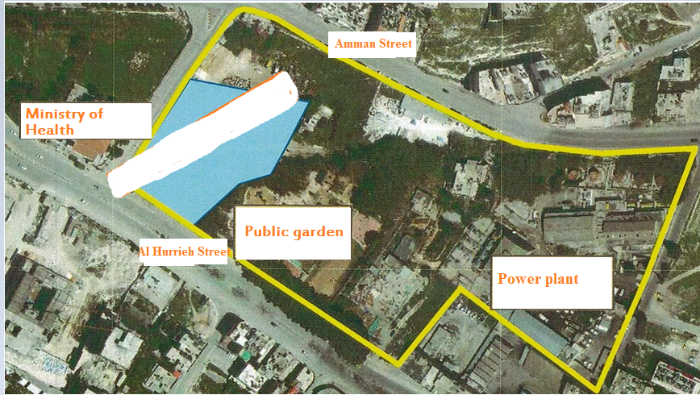
Site location
New Municipality Building

Slide 5
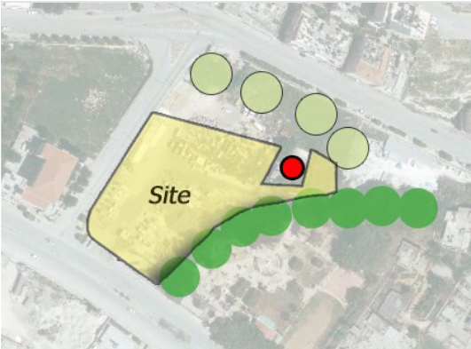
Site location

Slide 6
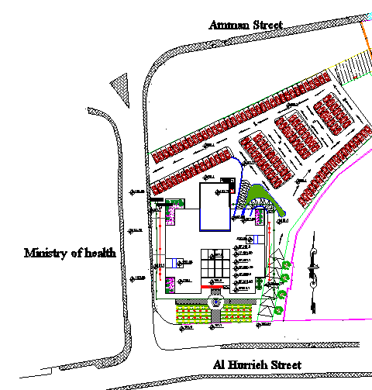
Architectural Design
6

Slide 7
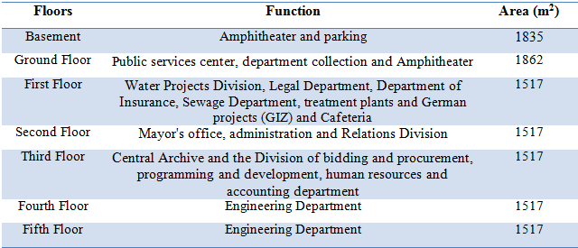

Slide 8
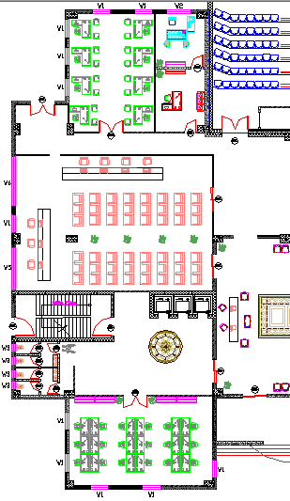
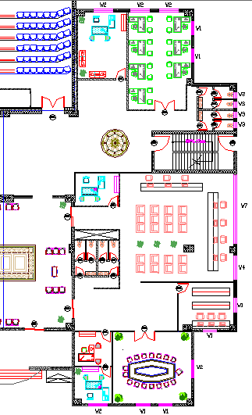

Slide 9
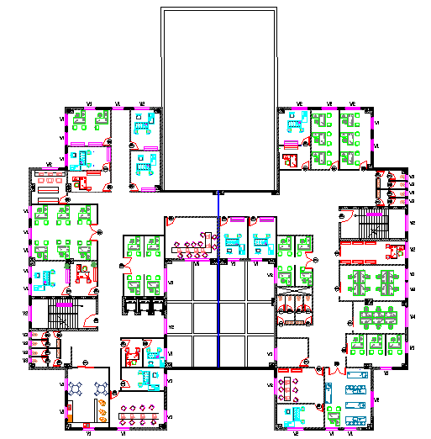
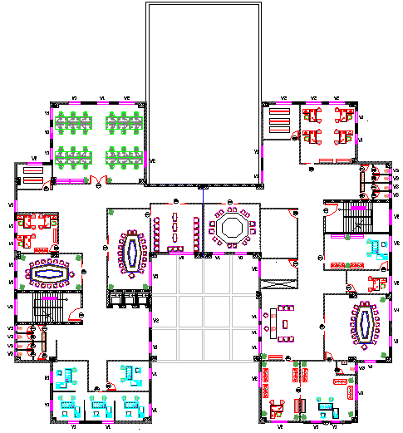
First and second floor

Slide 10
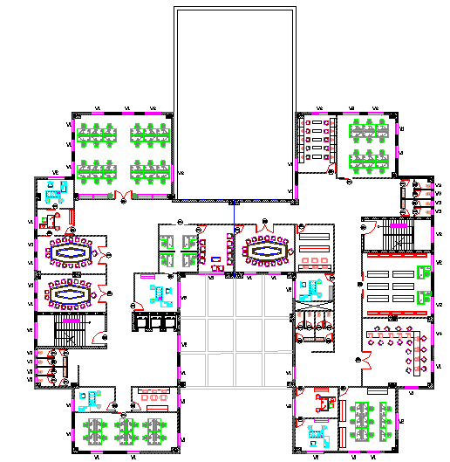
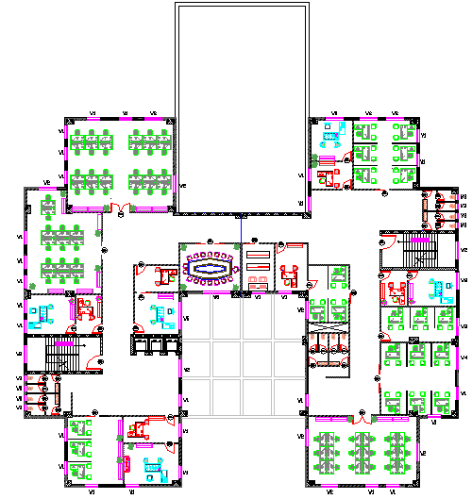
Third and fourth floor

Slide 11
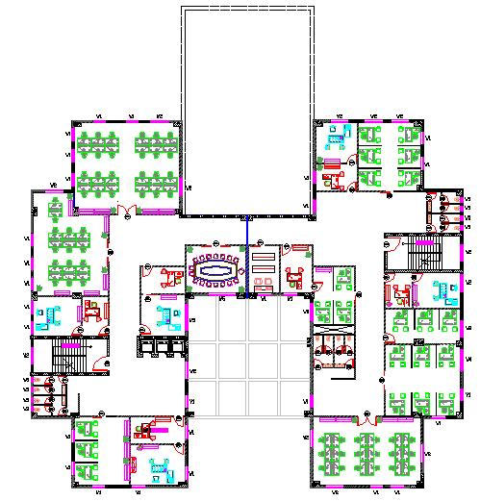
fifth floor

Slide 12
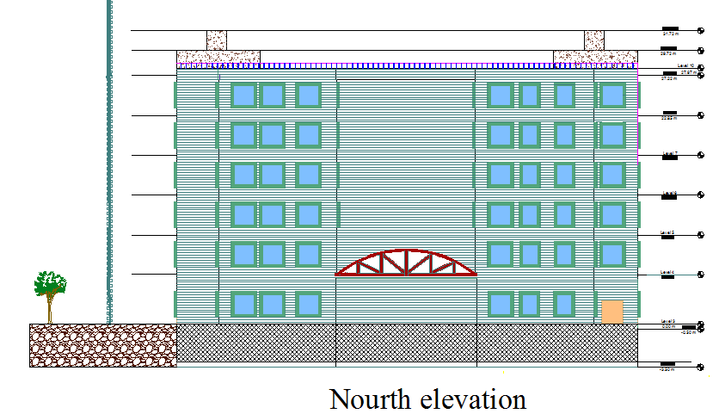
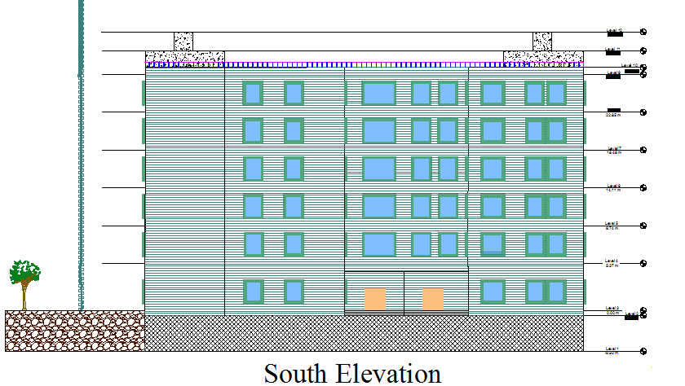

Slide 13
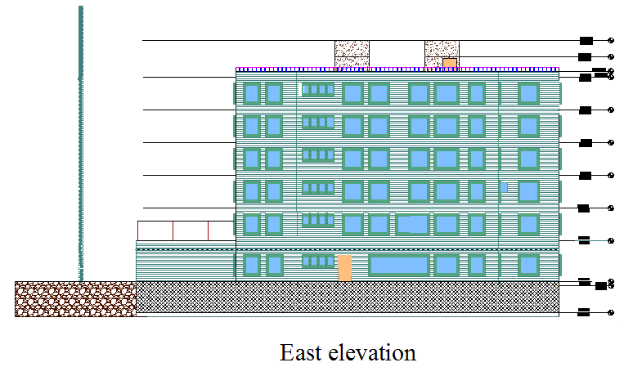
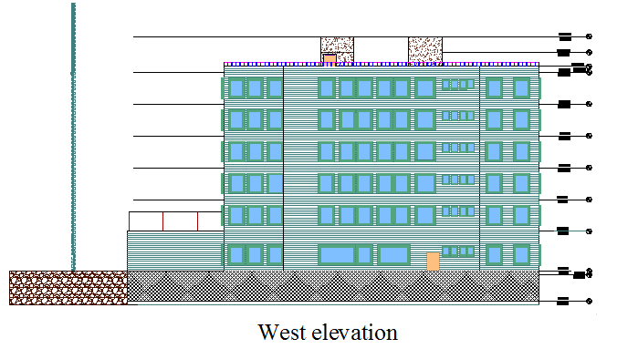

Slide 14
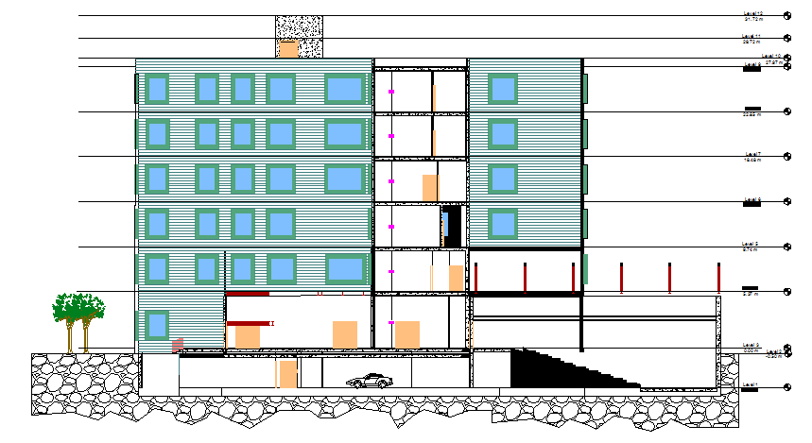
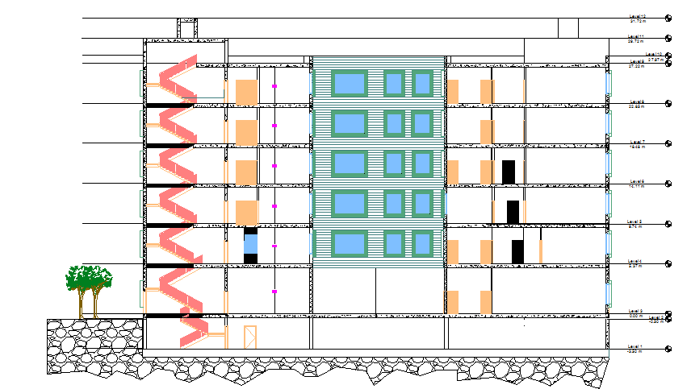

Slide 15
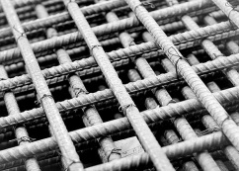
Structural Design

Slide 16
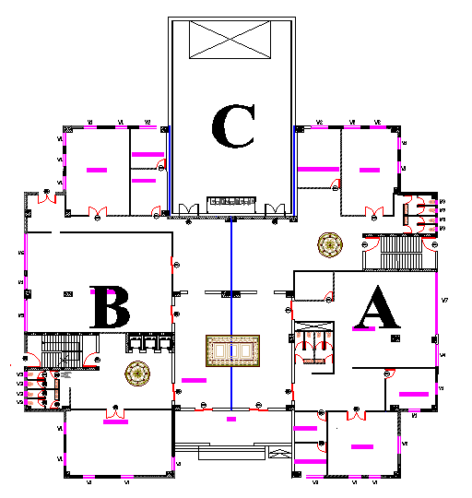
Building Structural Blocks:

Slide 17
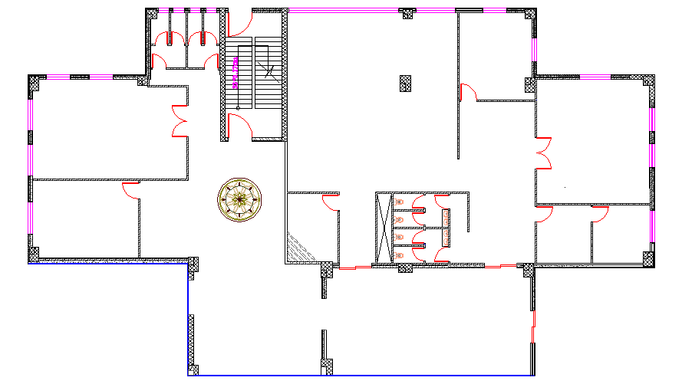
Block A

Slide 18
Structural Design (Blocks A)
Design Data :
Concrete f /_{c}= 24MPa for beams, slabs columns and footings.
Bearing capacity of soil = 200 kN/m².
Slabs system used :- One way ribbed slab.
Load :
Super imposed dead load = 4kN/m2
Live load = 3kN/m2
ACI 318

Slide 19
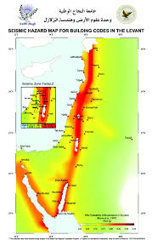
Seismic Design Data :
UBC 97
soil type S_{D}
Location → Nablus
zone =2B → Z=0.2
C_{V} = 0.4 , C_{a}=0.28
I= 1.25 (essential building)

Slide 20
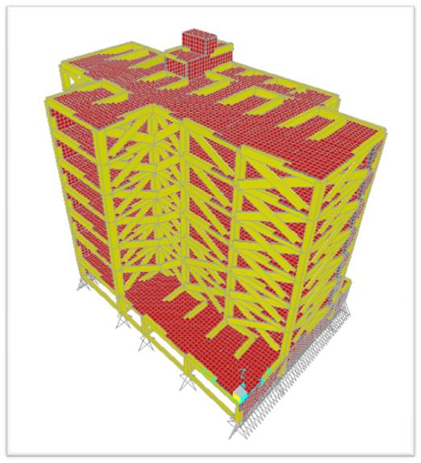
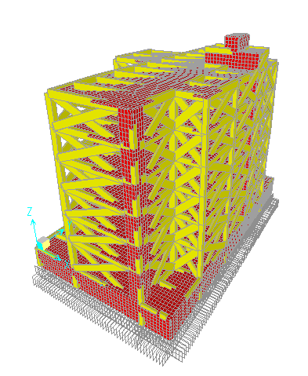
Sap Model (Block A)

Slide 21
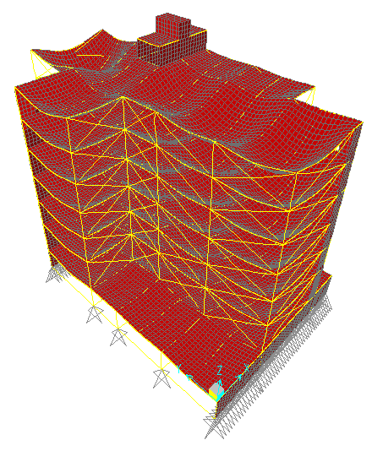
Model Checks
T SAP | T manual | %error
0.54 | 0.600 | 10 %
Mass participation ratio | Sum X = 97% | Sum y = 97%
Vmanual | Vx SAP | Vy SAP
13940 | 13930 | 13910
1
2

Slide 22
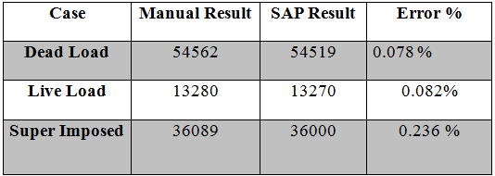
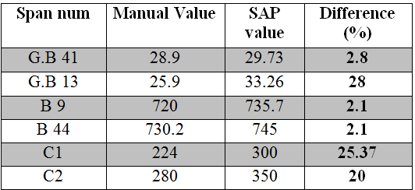
3
4

Slide 23
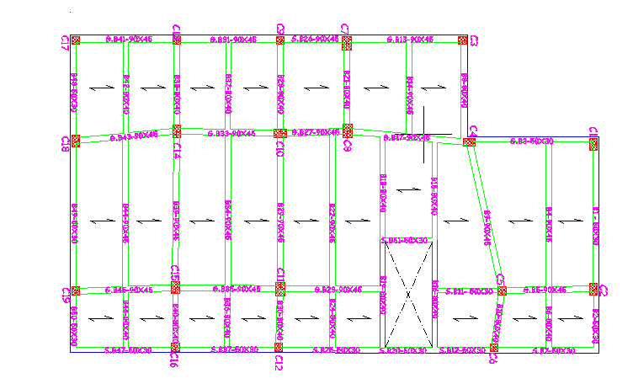
Basement Beams Plan

Slide 24
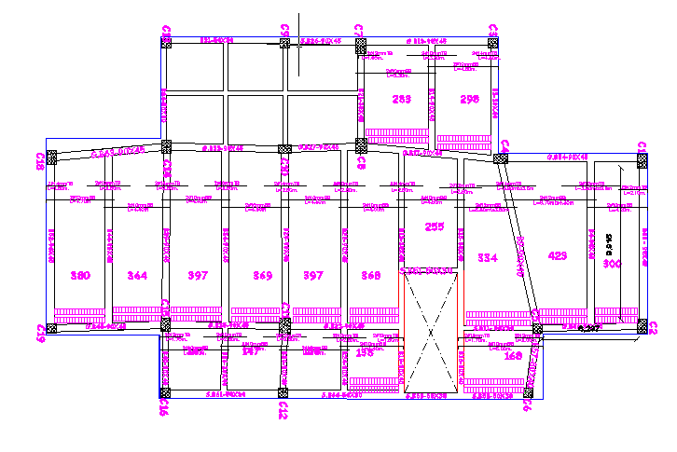

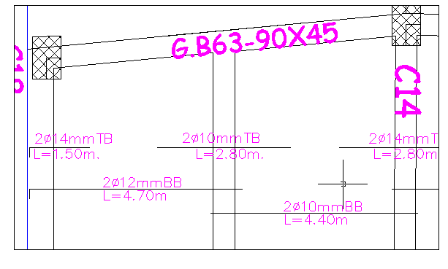
Slabs Reinforcement:
24

Slide 25
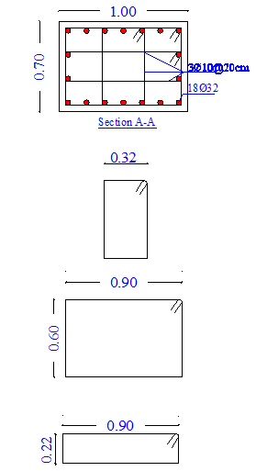
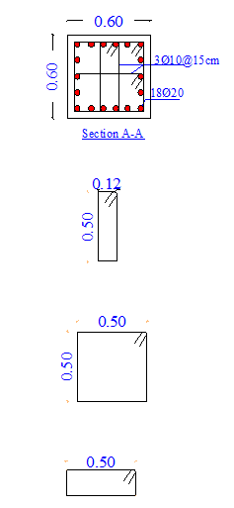
Column Design
Columns 8-11
Columns 3-5-15

Slide 26
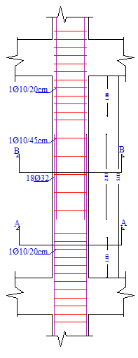
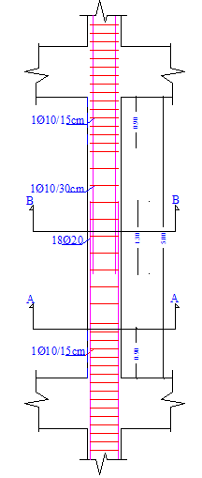
Longitudinal Column Sections :

Slide 27
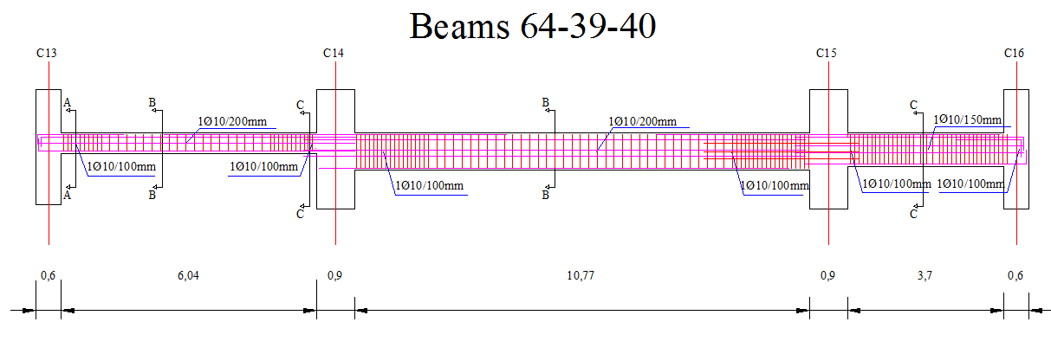
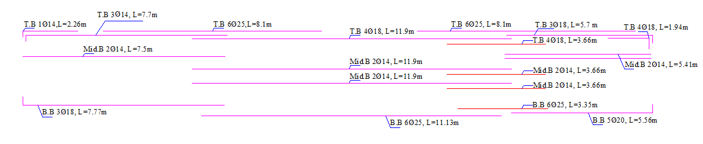
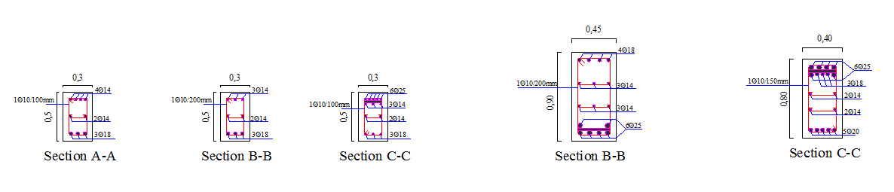
Beam Reinforcement :

Slide 28
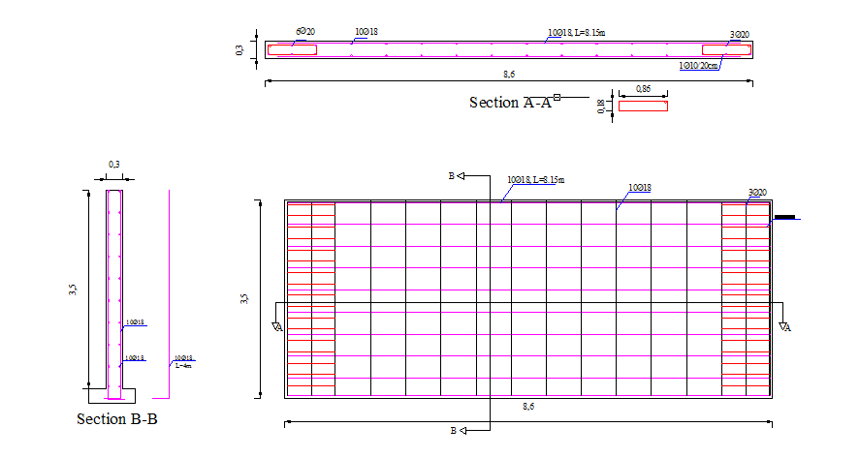
Shear Wall Reinforcement

Slide 29
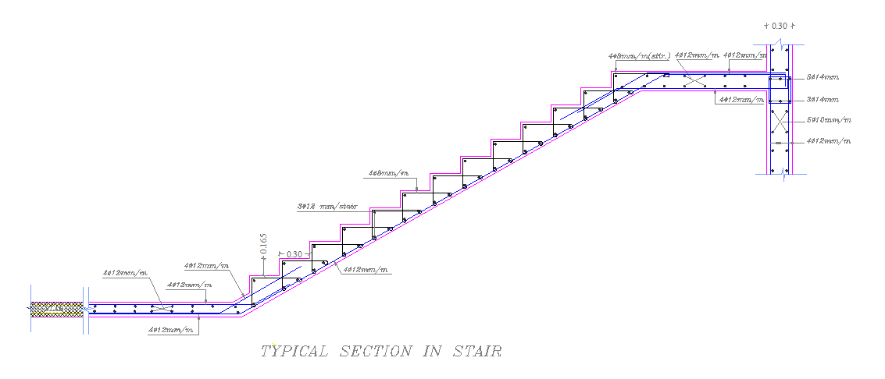
Stair Case Reinforcement

Slide 30
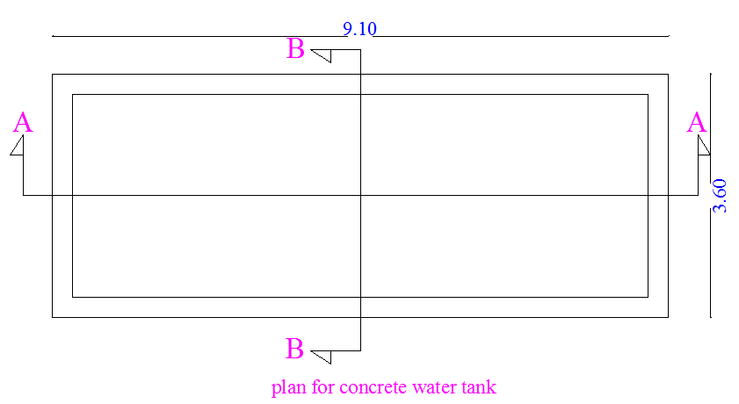
Concrete water tank (Block E)

Slide 31
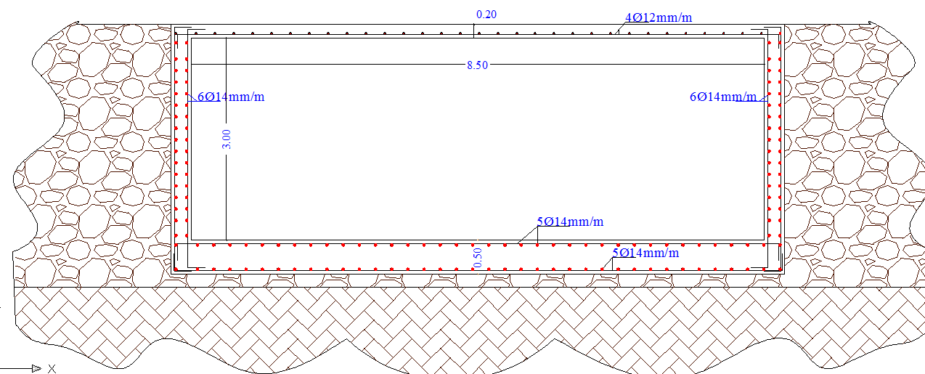
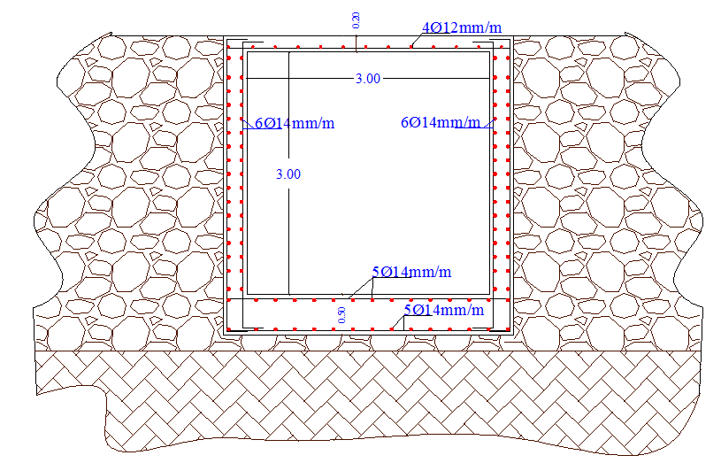
Reinforcement Details :
Section A-A
Section B-B

Slide 32
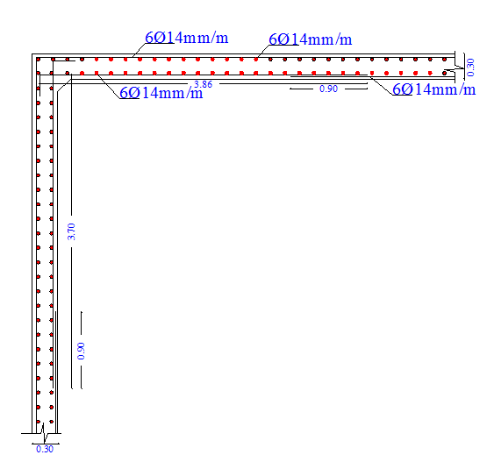
Reinforcement Details :
Section in the wall of the tank

Slide 33
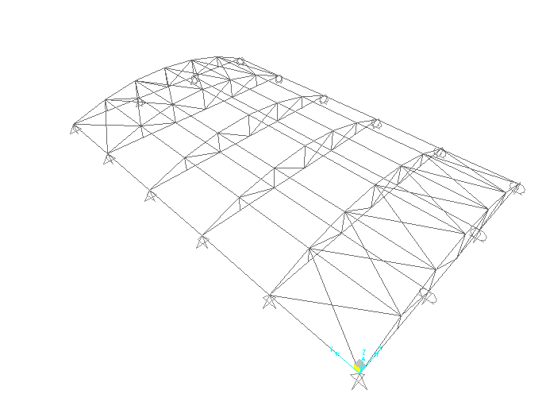
Steel Structure block C.
Truss System With Purlins is Used

Slide 34
Materials and Loads Used in Steel Block
Materials for Steel Structure:
•A36 steel is used for all members and plates.
•With (Fy = 250 MPa) (Fu = 400 MPa)
•E60XX Welding Material is Used, FEXX= 413 MPa
:
Loads for Steel Structure
Type of load | load(kN/m2)
Dead load | 0.22kN/m2
live load | .5kN/m2
Wind load | .5kN/m2
Snow load | 1.5kN/m2

Slide 35
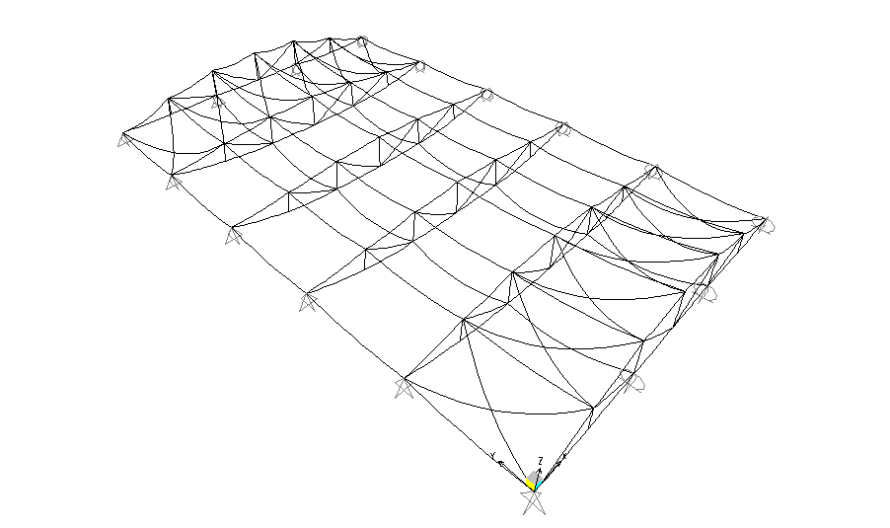
:
Model Validation
Compatibility and Deflection Check:

Slide 36
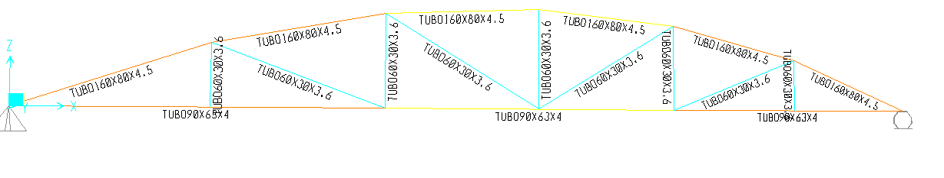
Equilibrium Check:
load | Manual Total Load | SAP Total Load | The Percentage Of Difference
For live load | 31.50kN | 30.59 kN | 2.89 % < 5%
For Dead load | 13.84kN | 13.46 kN | 2.74% < 5%
For Snow load | 94.51kN | 91.77 kN | 2.89% < 5%
For Wind load | 31.50kN | 30.59 kN | 2.89 % < 5%
Design Stage

Slide 37
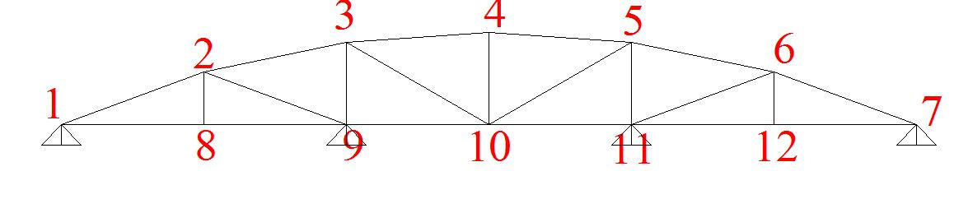
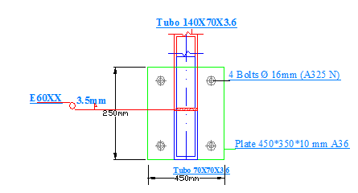
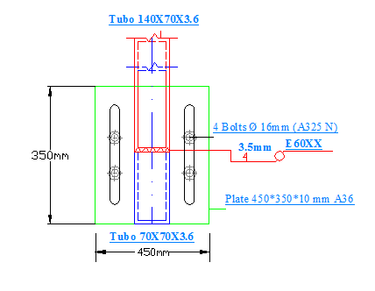
Design connection
Connection#1(Top view)
Connection#7(Top view)

Slide 38
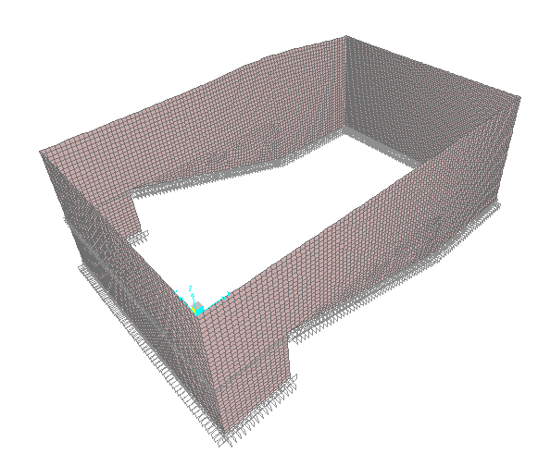
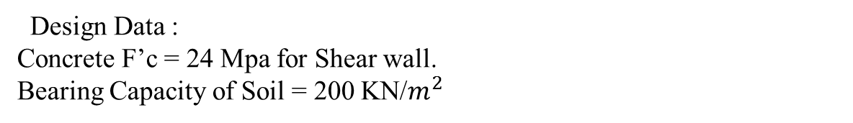

Block C
Design Data :
Concrete F’c = 24 Mpa for Shear wall.
Bearing Capacity of Soil = 200 KN/$m^{2}$
Load :
Live Load =5 KN/$m^{2}$

Slide 39
Block C
T =0.45) is within the acceptable range which means that our structure is Ok.
Case | Manual Result | SAP Result | Error %
Dead Load | 3968 | 4177 | 1%
Live Load | 367 | 367 | 0%
snow load | 1092 | 1092 | 0%
wind load | 366 | 366 | 0%
 | Manual Result (KN.m) | SAP Result (KN.m) | Error %
Shear wall | 47 | 48 | 0.2%

Slide 40



Shear wall Reinforcement

Slide 41


Mat Foundation Reinforcement
N

Slide 42



Mat Foundation and wall footing Reinforcement
E

Slide 43

Retaining wall:
1) Ф = 30˚, γs =18 kN/m² 2) q _{allowable} = 200 kN/m²
3) F.S over turning = 2 4) F.S sliding = 1.5
5) Ɲ = 0.5 6) Fc = 25 Mpa
7) Fy = 420 Mpa

Slide 44

Retaining wall reinforcement
:

Slide 45
Environmental design:
Heating and cooling calculations:
U value for materials :
Part | U value (W/m².K)
External wall | 0.56
floor | 0.48
Ceiling | 0.51
Ceiling –theater | 0.46
Internal wall | 1.36
Window | 2.70

Slide 46


Heating and Cooling Load
36.48kw/m²
Framework of the windows has been architecturally modified and projected by 0.3 meters from the interface, so there is no need to have horizontal shading.
Acceptable range of heating and
cooling loads = (30-80) KW/m²

Slide 47




Natural Day light analysis
Acceptable range of :
DF = (3-6)% and up to 500 lux for illuminance
Activity | Floor | Orientation | Value
 |  |  | D.F | Lux
Open offices | Ground | North | 6.12% | 500
Legal department | first | West | 3.86% | 347
Meeting room | second | South | 3.46% | 399
Mayor | Third | East | 3.34% | 311

Slide 48

Acoustical analysis:
Noise level:

Slide 49


1. Open office:
Reverberation time RT60 for open offices.
Acceptable range for open offices = (0.4-0.8) sec .

Slide 50



STC and IIC values:
IIc = 72dB.
STC=45db
STC=56db

Slide 51
Background noise calculation.
Layers | STC (dB)
Masonry wall 40 cm with (23.13m²) | 66
Window (soundproof window over a dual pane window type) | 50
TLc | 56
Noise =60dB
The acceptable noise level in offices shall be less than 25 dB.

Slide 52


2. Theater:
Reverberation time RT60 :
Acceptable range for theaters= (0.8-1.5) sec .

Slide 53


STC and IIC values:
IIC= 82dB.
STC=56db

Slide 54
Background noise calculation.
Layers | STC (dB)
shear wall with a 40 mm thickness | 65
Plaster | +3dB
Stone | +5dB
TLc | 73
Noise =60dB
The acceptable noise level in theaters shall be less than 30-35 dB.

Slide 55

Loudspeakers :
We use four distributed loudspeakers with angle=60 degrees.
Two with low frequency in front (A TL-1601a low frequency),and two with high frequency in the rare, (LT 6400 mid/high loudspeaker).

Slide 56

Electrical Design

Slide 57

Socket Arrangement

Slide 58

Lighting Distribution

Slide 59



Artificial Lighting
 | Value
Eavg. | 551
Uo | 0.806

Slide 60


 | Value
Eavg. | 590
Uo | 0.73

Slide 61




 | Value
Eavg. | 408
Uo | 0.735

Slide 62

Mechanical Design

Slide 63
Mechanical design consists of :
Water Supplying System.
Drainage System.
Munhall System.
HVAC System.

Slide 64



Water supplying for ground floor:

Slide 65


Drainage System for ground floor:

Slide 66

Munhall system for ground floor:

Slide 67

Munhall system for basement:

Slide 68

Hvac System
Air Handling unit system

Slide 69

Hvac System
Integration of lighting and hvac

Slide 70





Public safety

Slide 71

Emergency exits:

Slide 72

Quantity surveying

Slide 73

Quantity surveying calculation
Quantity | Unit | Work
5500 | m³ | Earth work
10000 | m³ | Concrete work
598 | Ton | Steel work
5260 | m² | Stone
129000 | No. | Block
31360 | m² | Plaster
9060 | No. | Tile
543500 | Kg | Sand
10000 | No. | False ceiling
4700 | m² | Insulation
666 | No. | Windows
946 | No. | Doors

Slide 74
Quantity surveying calculation
Quantity | Unit | Work
530 | No. | Sprinklers
282 | No. | Smoke detectors
28 | No. | Hose station
325 | No. | Fire extinguisher
1170 | m | Ducts
1095 | No. | Mechanical work
555 | No. | Electrical work
The total cost of our project is 9950000 NIS

Slide 75


