Slide 1
Early detection of Breast cancer using microwave imaging
Prepared By:
Isra’a Ramadan
Wala’ Rawajbeh
Haneen Shtayeh
Supervised by:
Dr. Yousef Dama

Slide 2
Out-lines:
Objectives.
FDTD Theory in 2d.
Formulation for FDTD in 2d.
Formulation for FDTD In 2d with PML.
Simulation and results.
Conclusion.

Slide 3
Objectives:
The object is to detect breast cancer using microwave imaging. This includes:
Antenna design and analysis.
Analyzation using EDTD in two directions.

Slide 4
FDTD Theory in 2D:
In contrast to X-ray and ultrasound modalities, The system uses a pulsed confocal technique to enhance the detection of tumors while suppressing the effects of tissue heterogeneity and absorption.
The confocal microwave breast cancer detection technology considered here is based upon two fundamental properties

Slide 5
Formulation of 2-D FDTD:
Multidimensional simulations require that we think in terms of a multidimensional grid and thus we require multidimensional arrays to store the fields.

Slide 6
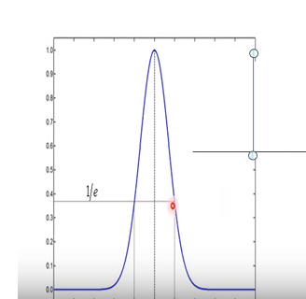
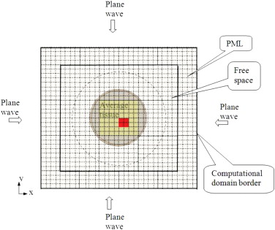
Continued:
A 6-cm-diameter metal cylindrical scattered in free space is modeled.

Slide 7
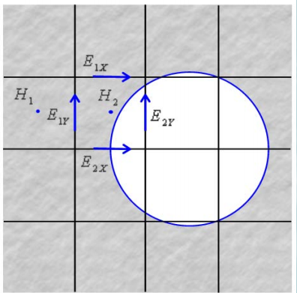
FDTD Parameters:
The grid resolution

Slide 8

Continued:
To ensure stability we using the Courant stability condition, which sets the relation between the time step and cell size for three-dimensional FDTD as follows:

Slide 9
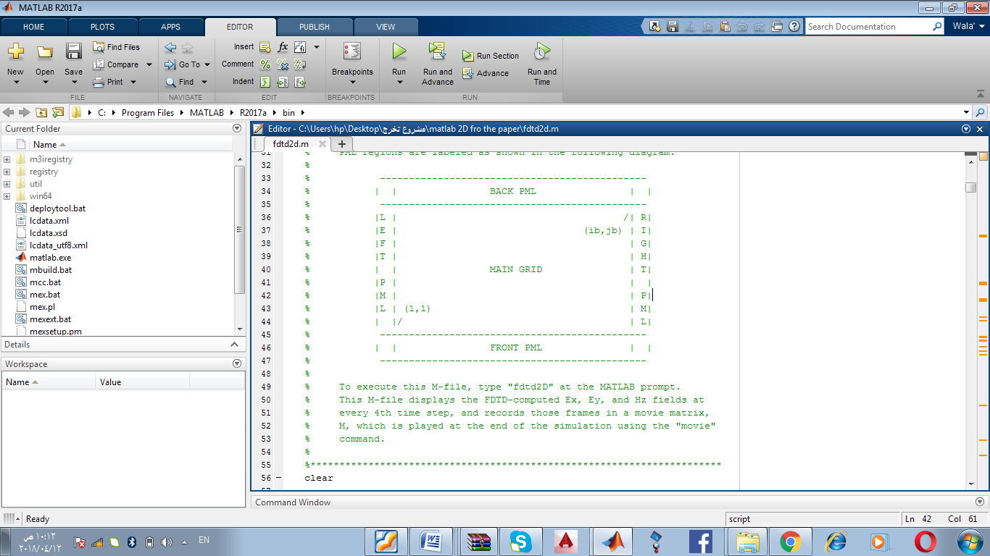
Formulation of FDTD in 2D with PML:
The computational domain is truncated using the perfectly matched layer (PML) absorbing boundary conditions..

Slide 10
Simulations and results:
Section 1:
This section displays the designed antenna (printed micro-strip slotted antenna) using:
  HFSS Program.
  Printed circuit board machine.

Slide 11
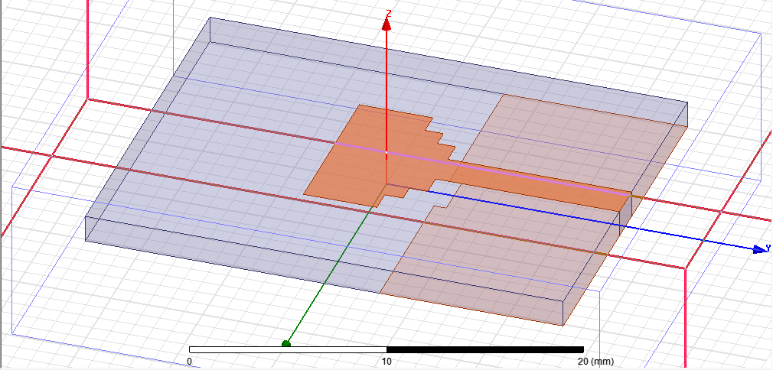
Designed antenna using HFSS program:
This antenna designed to work at 10 GHz frequency

Slide 12
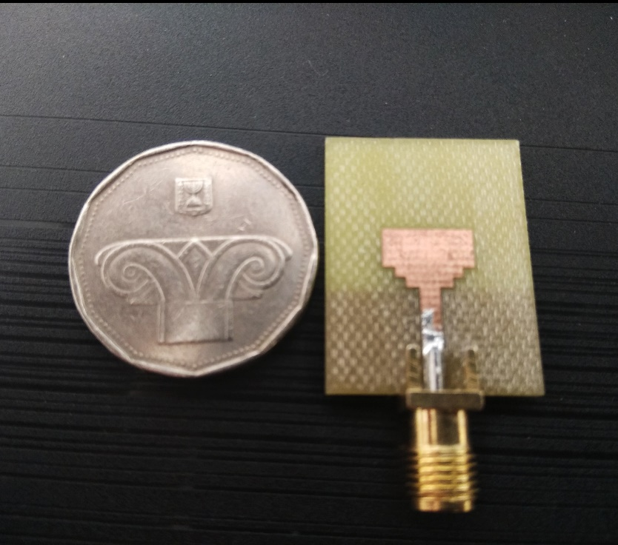
Printed antenna using PCB machine:
Working at a frequency of 10 GHz

Slide 13
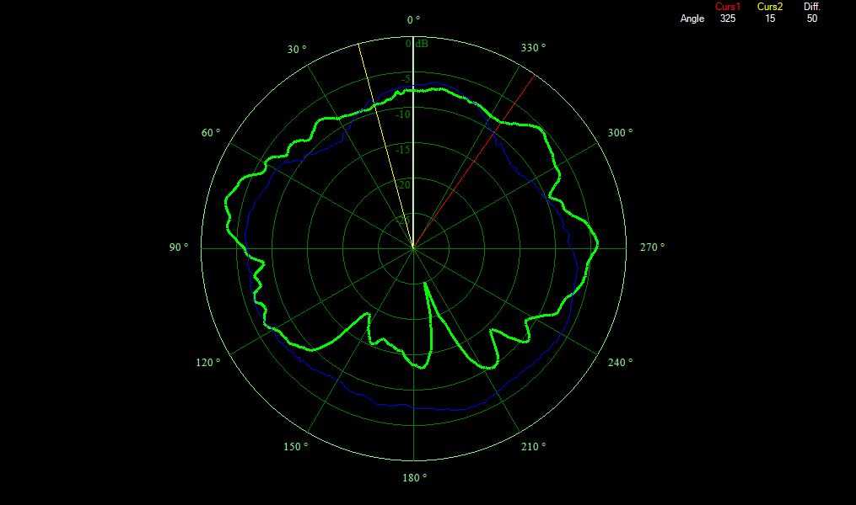
Continued:

Slide 14
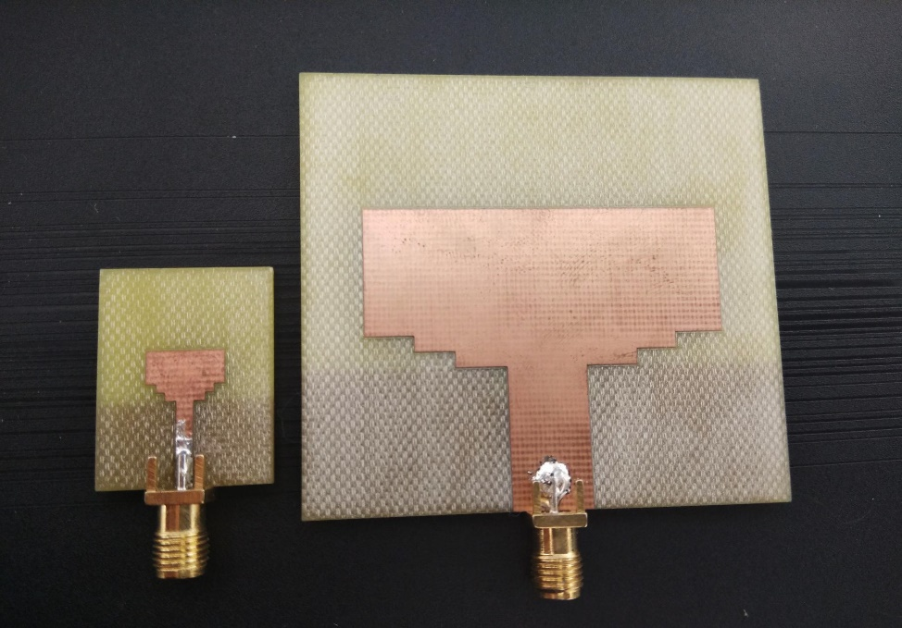
Printed antenna using PCB machine:
Working at a frequency of 2 GHz

Slide 15
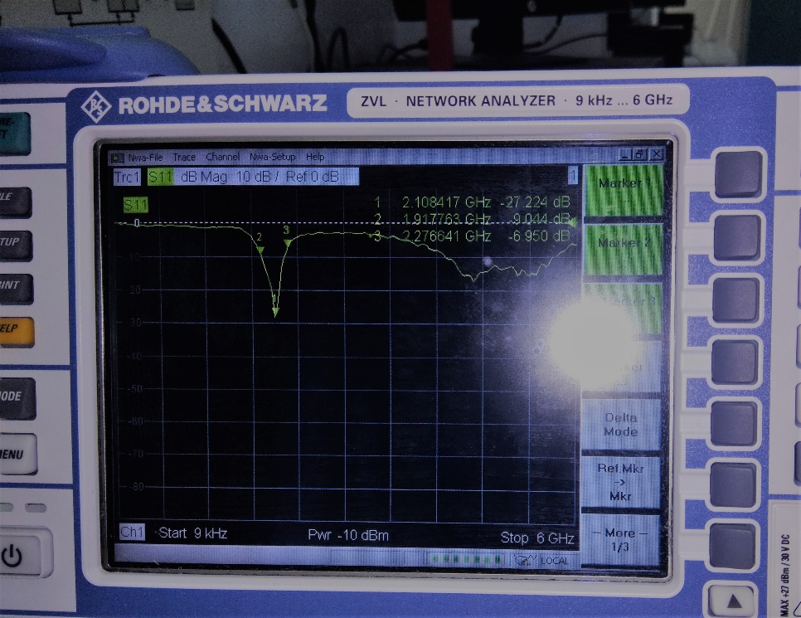
Continued:

Slide 16
Simulations and results:
Section 2:
This section displays the result of FDTD in 2d coding using matlab program.
A code uses a Gaussian pulse as excitation signal and displays a movie of propagation of the signal.

Slide 17
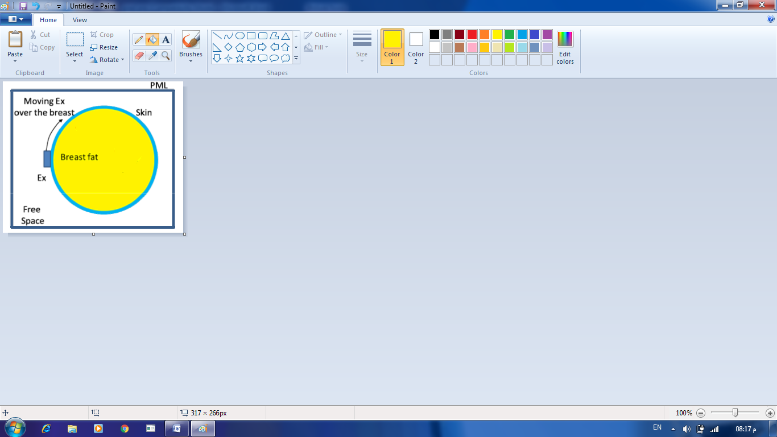
Case1: Breast cancer detection without a tumor:
The results are as Shown below:
This figure represent the electric and magnetic field moving over the breast without tumor.

Slide 18
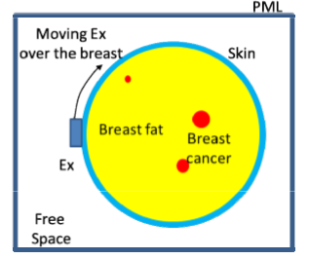
Case 2: Breast cancer detection with a tumor:
    The results are as Shown below:
This figure represent the electric and magnetic field moving over the breast with tumor.

Slide 19
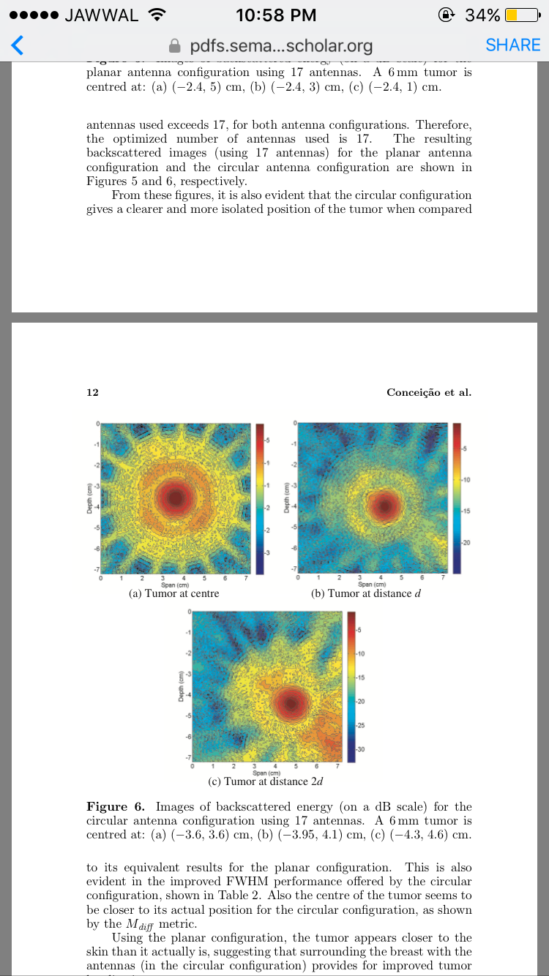
Tumor with different position:
a-Tumor at the center
b- Tumor at distance d
c- Tumor at distance 2d
From the above figures we can see the tumor in two dimension at different position first at the center then at distance d then at desistance 2d.

Slide 20
behavior of electromagnetic waves in 2D space can be considered as 3D:
Fields propagate through, and scatter from the tissue in a three–dimensional (3D) fashion. However, in order to reduce the computational complexity and to speed up the image reconstruction process.

Slide 21
CONCLUSION:
We tried to use (USRP) to connect the antennas and the matlab.
Therefore, we can say that future work may include the implementation of this step if the required equipment is available.

