Slide 1
Structural Design of University College of Technology and Applied Sciences Building in Nablus
An-Najah National University
Faculty of Engineering
Civil Engineering Department
Prepared by: Ahmad Sawalmeh & Ahmad Fuqaha
Supervisor: Eng. Ibrahim Arman
Date: 22-12-2016

Slide 2
Outline:
General Description.
Preliminary Design.
Three-Dimensional Modeling & Analysis.
Masonry Block Analysis Study.

Slide 3
General
Description
Main Assumptions.
Types of Loads.

Slide 4
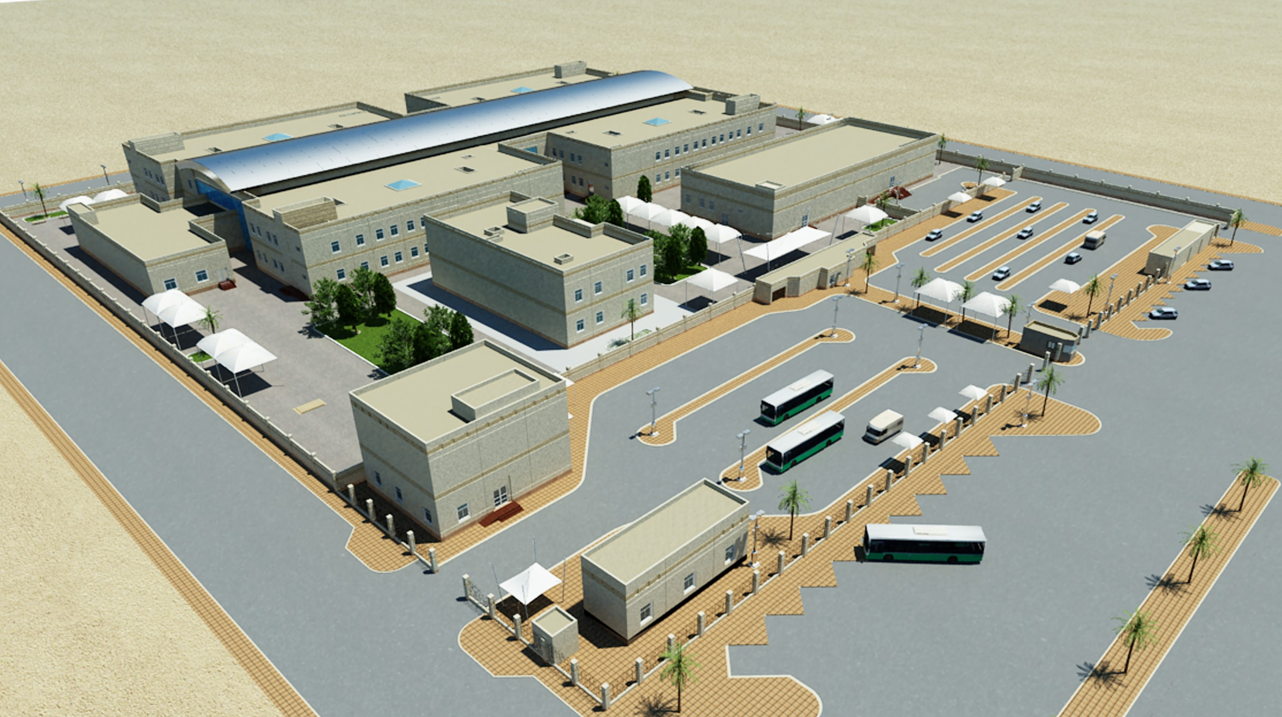
General Description

Slide 5
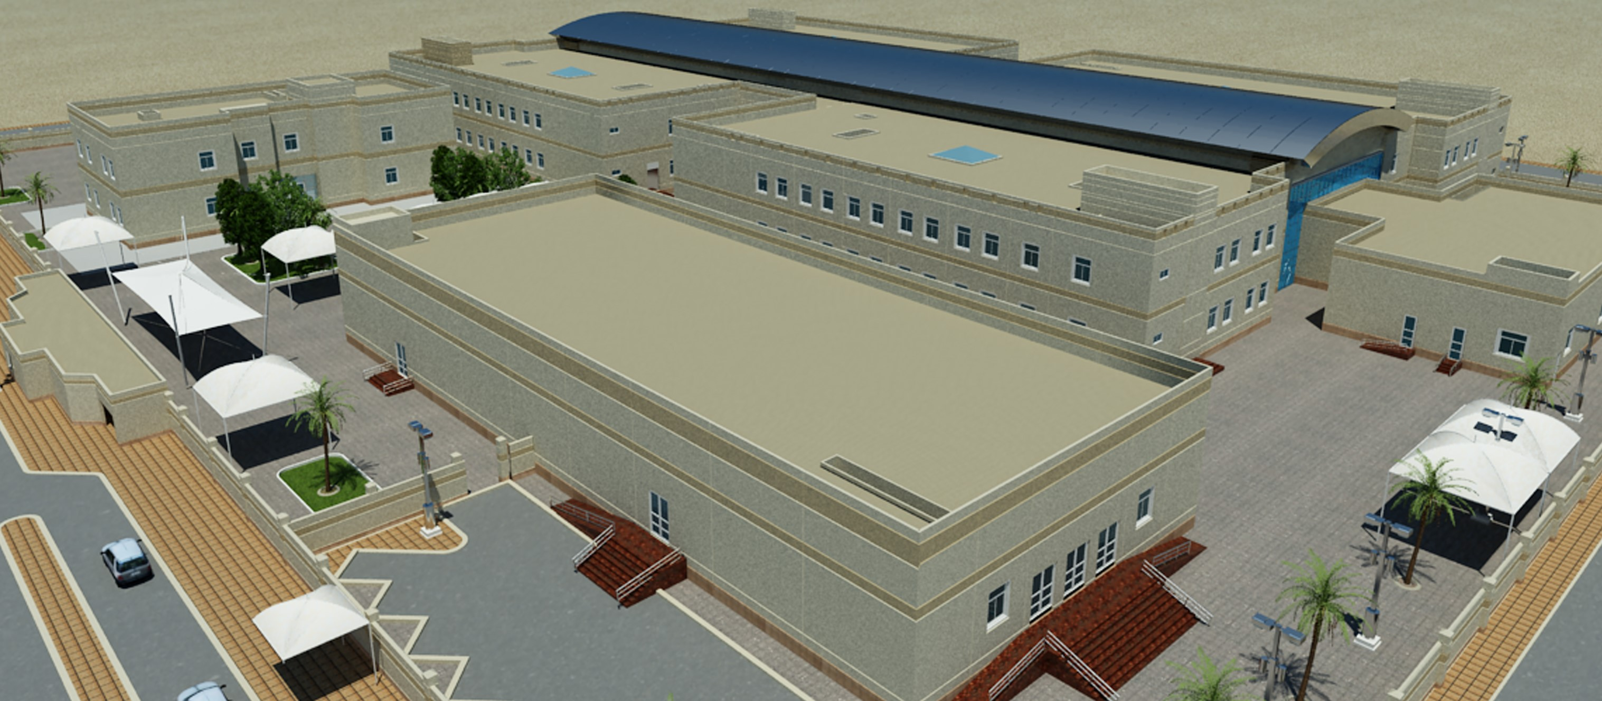
General Description

Slide 6
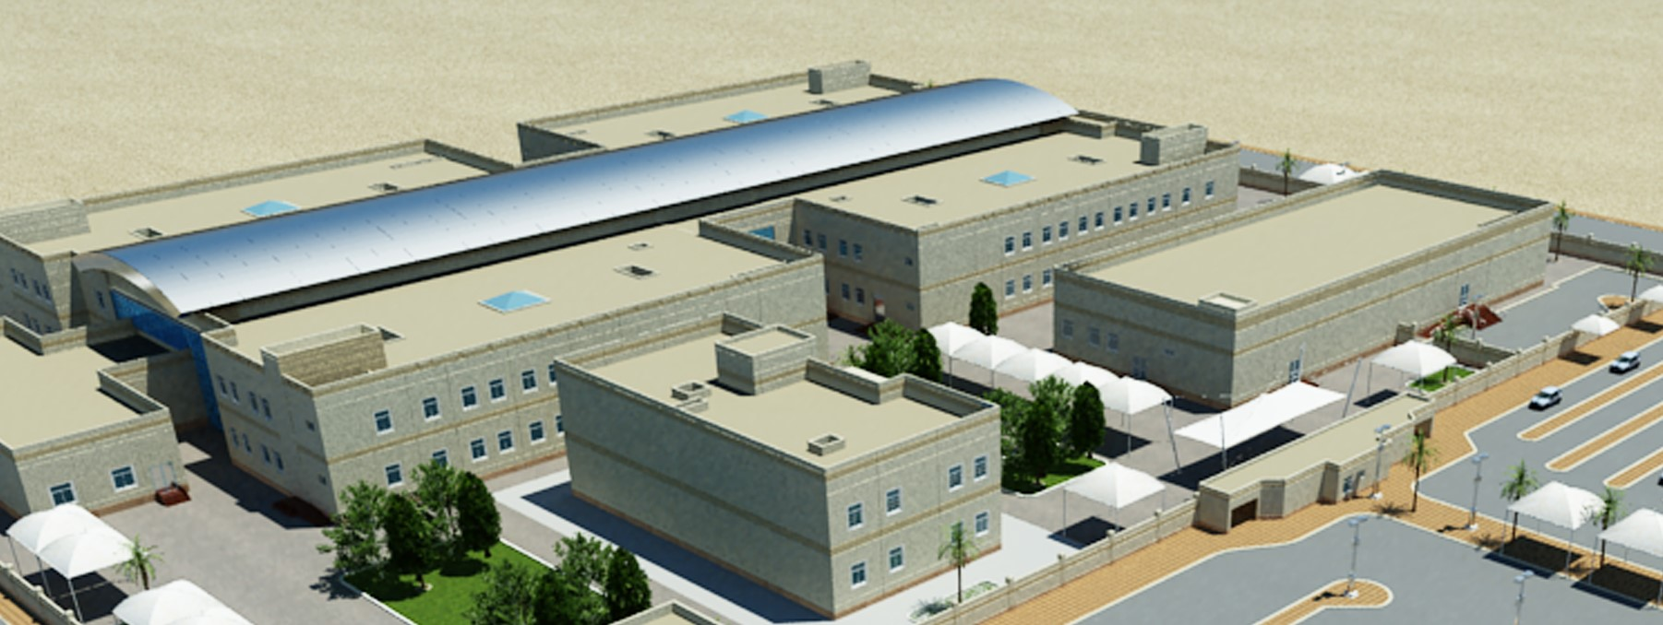
General Description

Slide 7
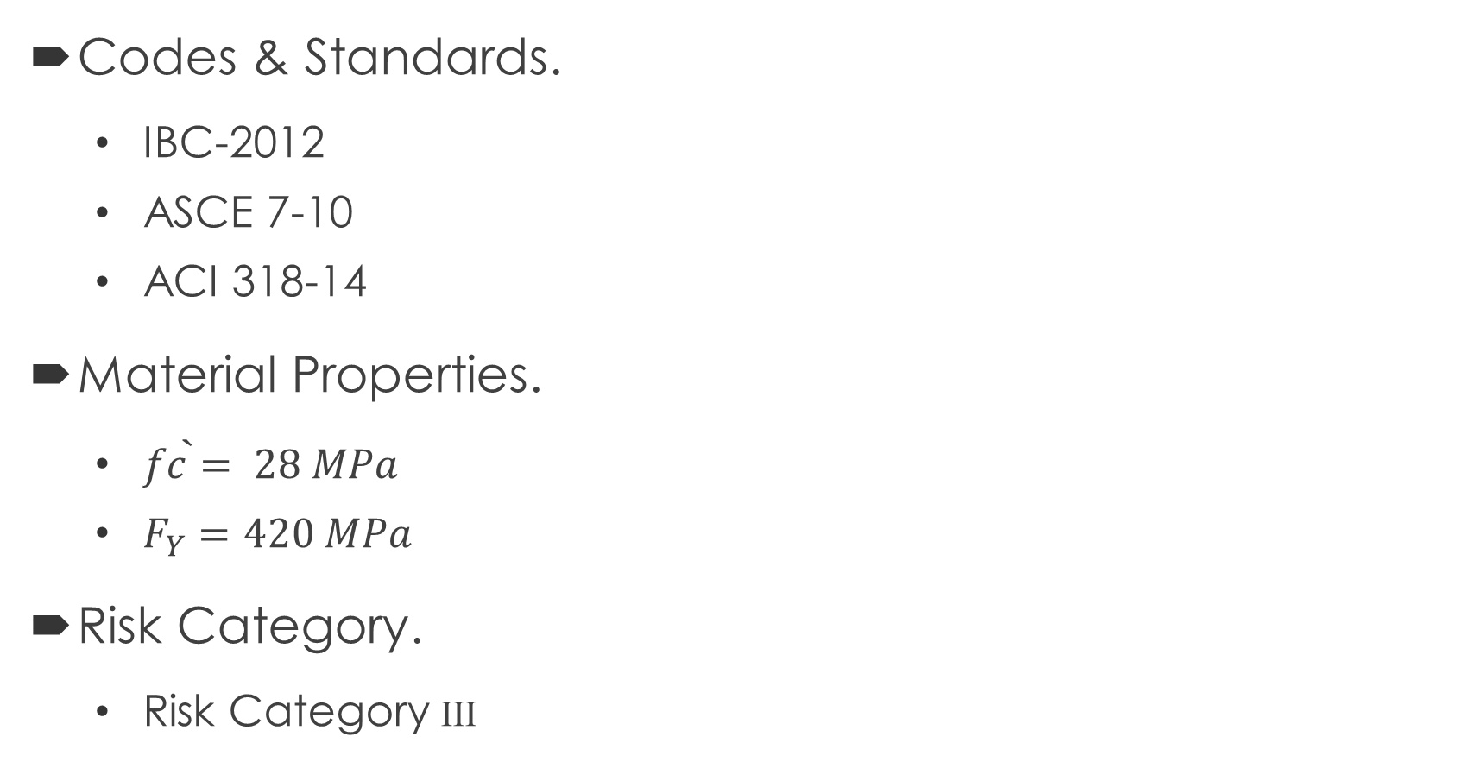
Main Assumptions
Codes & Standards.
IBC-2012
ASCE 7-10
ACI 318-14
Material Properties.
$\grave{fc=} 28 MPa$
$F_{Y}=420 MPa$
Risk Category.
Risk Category III

Slide 8
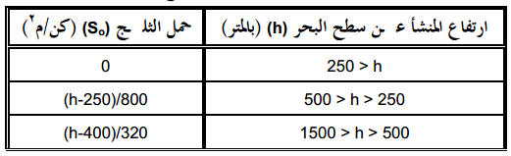
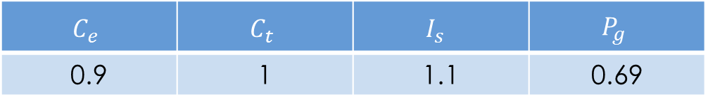

Types of Loads
Gravity Loads (KN/$m^{2}$)
$P_{f}=0.7 C_{e}C_{t} I_{s }P_{g}$ (ASCE 7-10) (1)
Superimposed | Live | Snow
3.25 | 4.80 | 1.00
$$C_{e}$$ | $$C_{t}$$ | $$I_{s }$$ | $$P_{g}$$
0.9 | 1 | 1.1 | 0.69

Slide 9
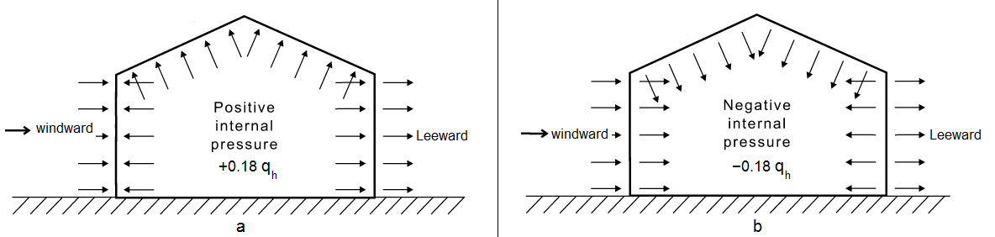
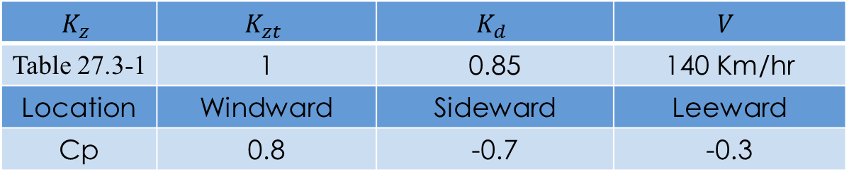

Lateral Loads (according to ASCE 7-10)
Wind Load : $P=q G C_{p}−q_{i}\left(GC_{pi}\right)$ (2)
$q=0.613K_{z}K_{zt}K_{d}V^{2}$ (3)
$$K_{z}$$ | $$K_{zt}$$ | $$K_{d}$$ | $$V$$
Table 27.3-1 | 1 | 0.85 | 140 Km/hr
Location | Windward | Sideward | Leeward
Cp | 0.8 | -0.7 | -0.3

Slide 10
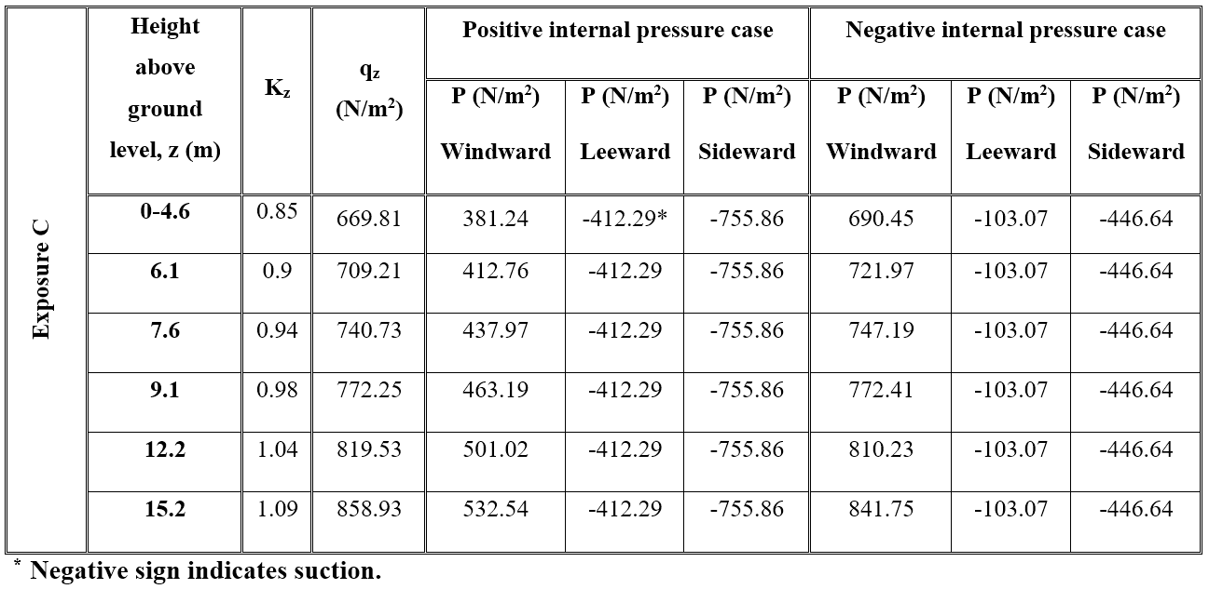

Slide 11
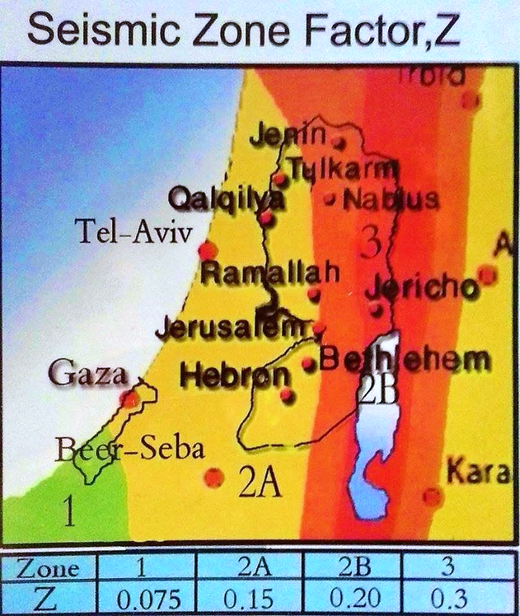
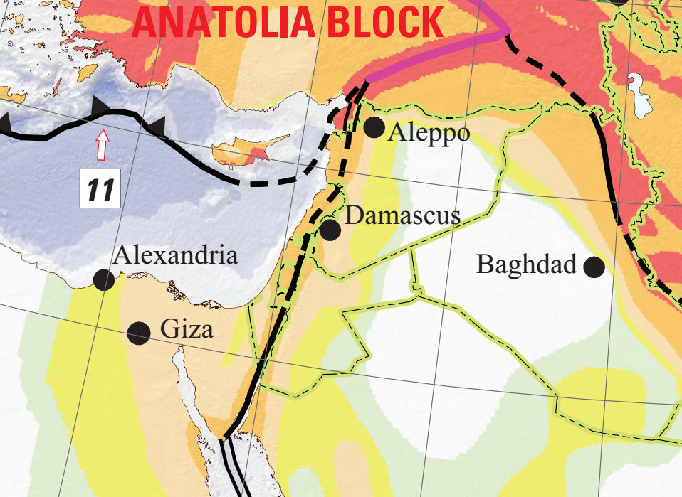

Earthquake Load.
Spectral Response Acceleration.

Slide 12
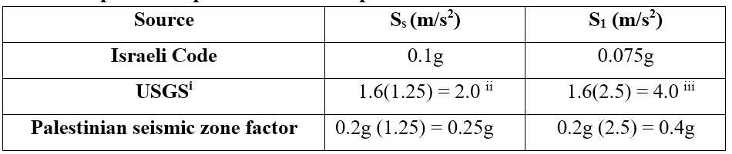
Design Response Acceleration Parameters
Site Class : C
Importance Factor : 1.25
Seismic Design Category : D

Slide 13
Preliminary Design
Slab
Beams
Columns

Slide 14
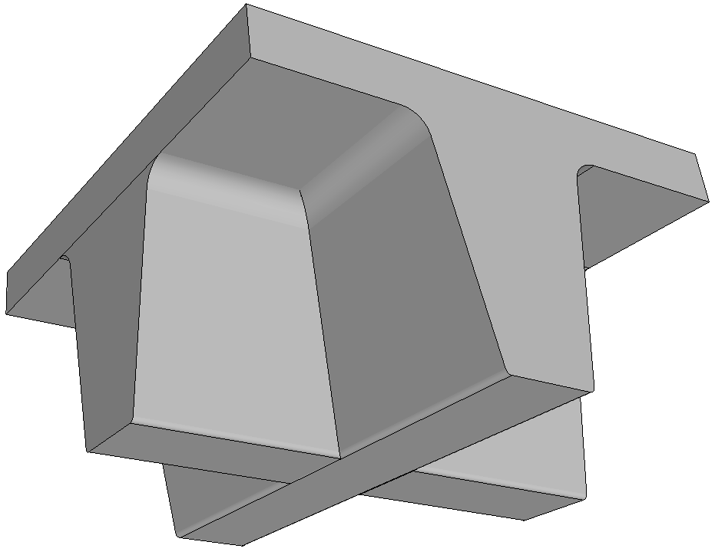
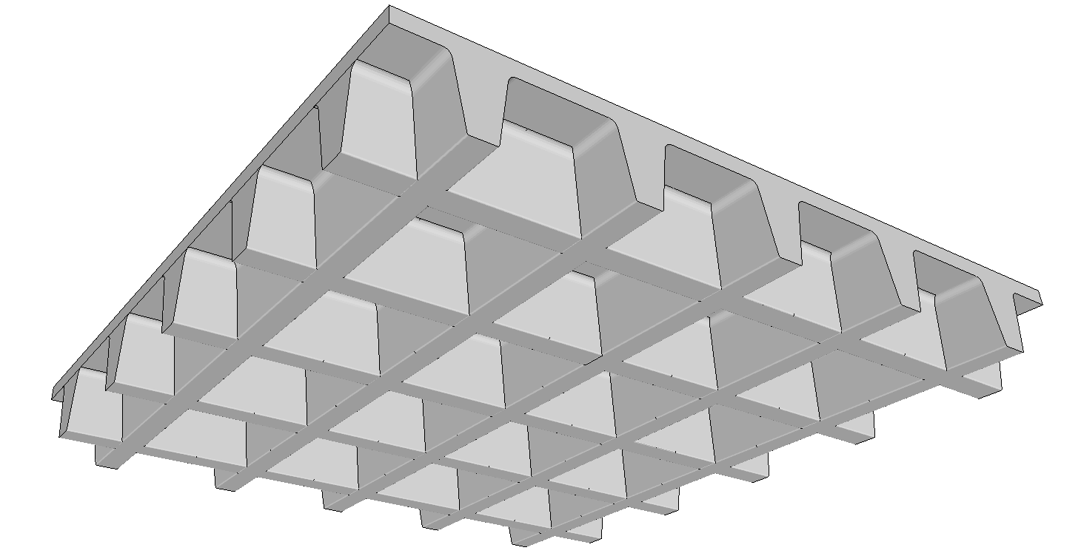
Preliminary Design of Slab
Structural System:
Two-way Waffle.

Slide 15
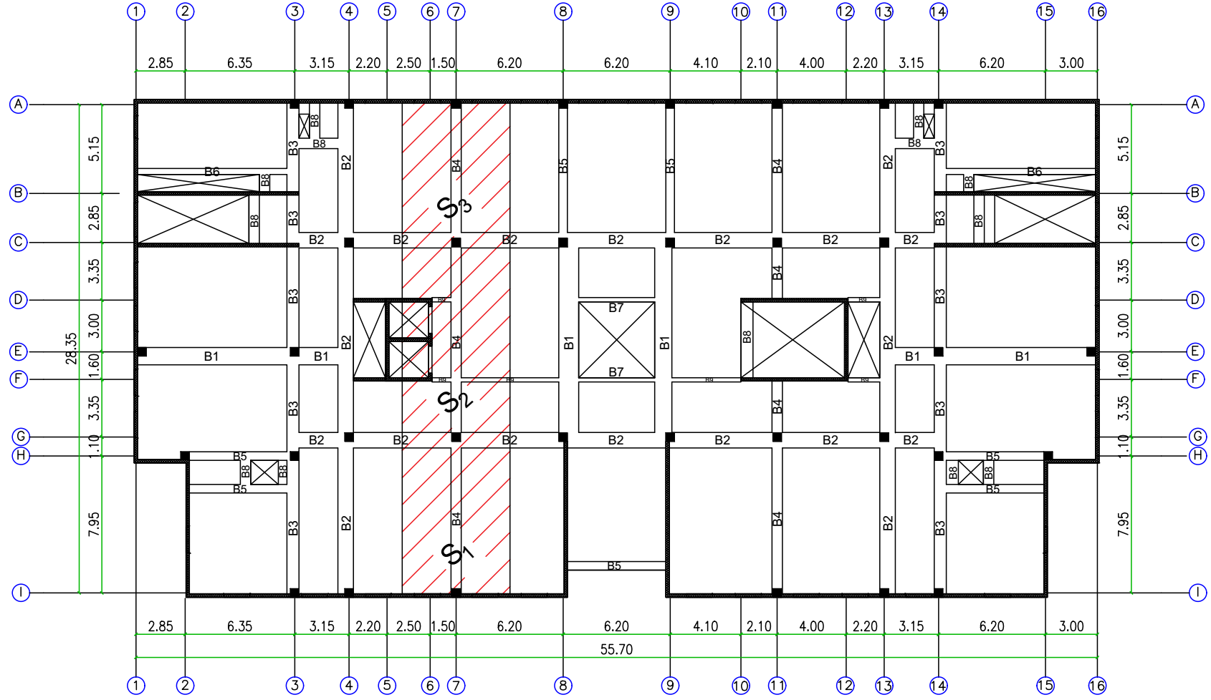
Designed Frame

Slide 16
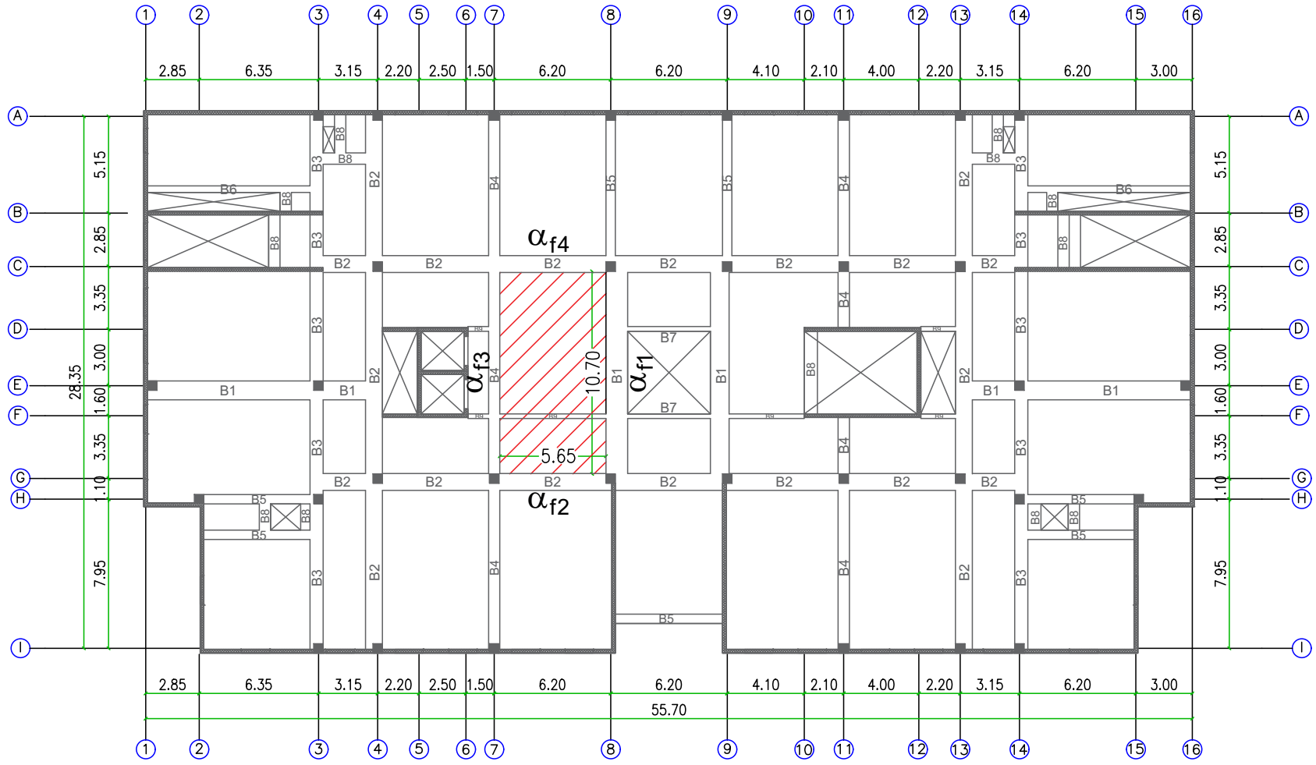
Critical Panel

Slide 17
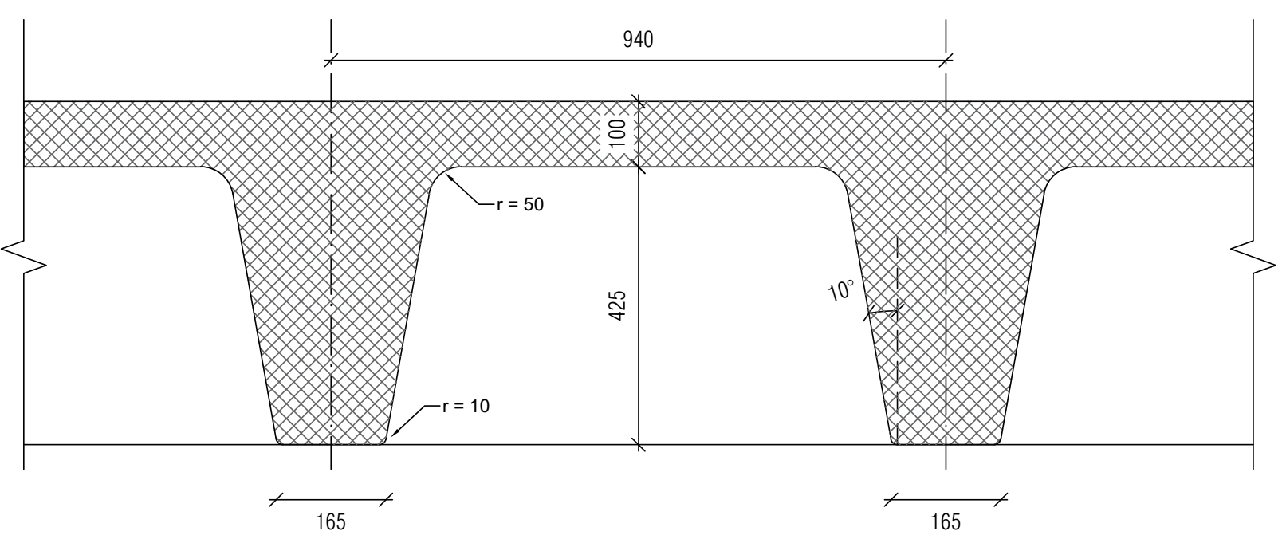
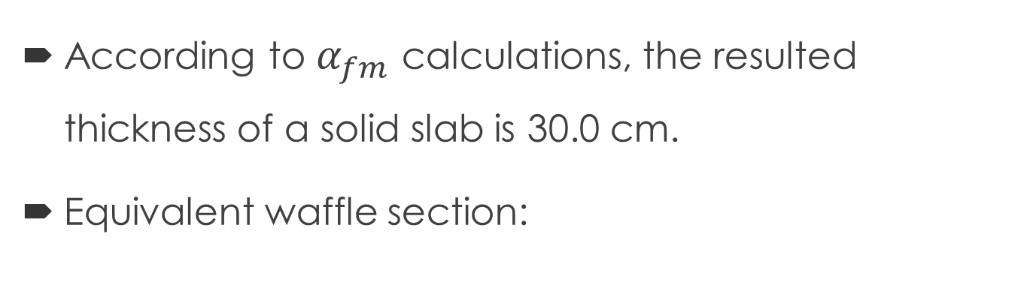
Resulted Thickness
According to $α_{fm}$ calculations, the resulted thickness of a solid slab is 30.0 cm.
Equivalent waffle section:

Slide 18
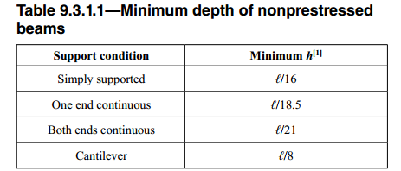
Preliminary Design of Beams
Minimum Depth (According to ACI 318-14):
For beam B4 (e.g.) = 0.55 m
Dimensions of the beams:
 | B1 | B2 | B3 | B4 | B5 | B6 | B7 | B8 | B9
Width (mm) | 1000 | 900 | 700 | 600 | 500 | 300 | 250 | 600 | 250
Depth (mm) | 725 | 725 | 725 | 725 | 725 | 725 | 725 | 525 | 525

Slide 19
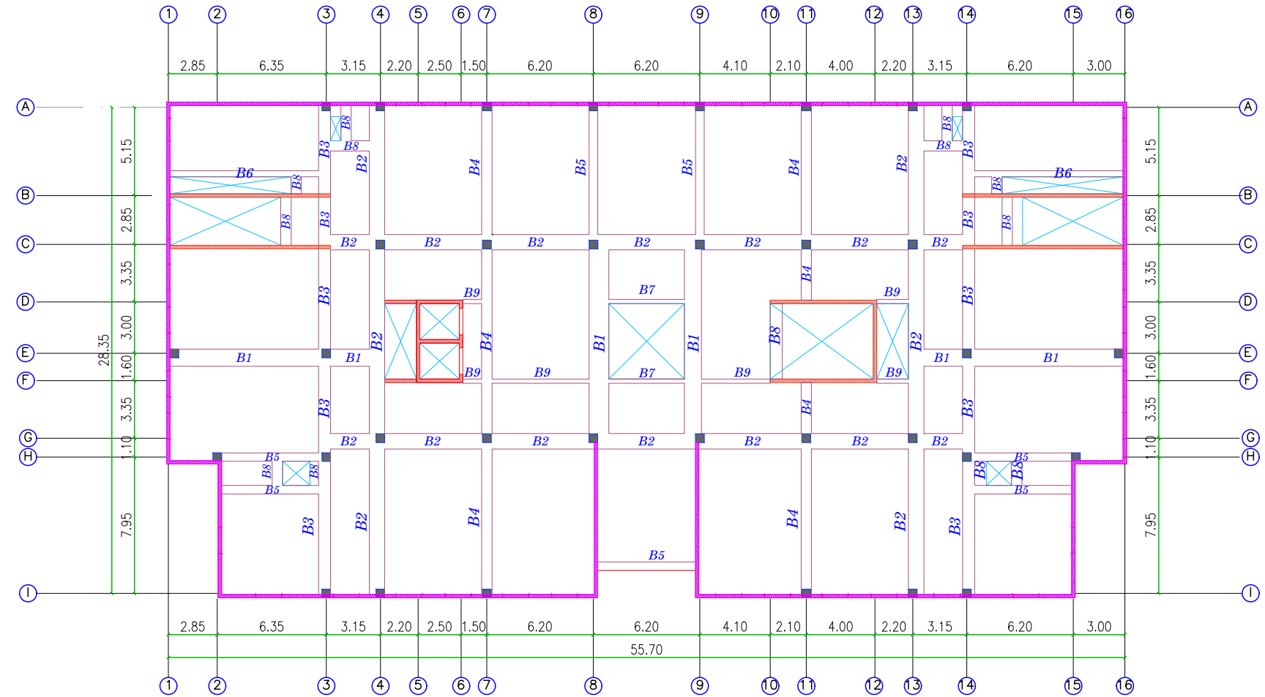
Beams Layout

Slide 20
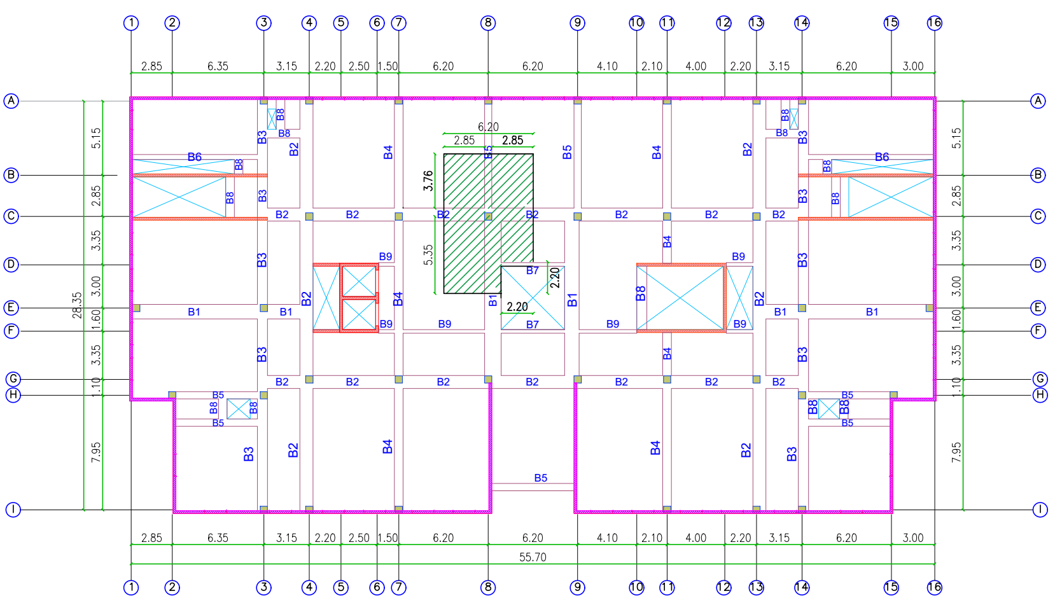
Preliminary Design of Columns

Slide 21

Preliminary Design of Columns
Critical Column C8:
Ultimate load = 3781.4 KN.
$Pu= ∅ λ \left(0.85 f^{′}c \left(Ag−As\right)+Fy As\right)$ (4)
Assuming ρ = 1%
Dimensions = 500 × 500 (mm)

Slide 22
3-D Modeling & Analysis
Section & loads Assignment & related definitions
Checks:
Compatibility.
Equilibrium.
Type of System & Irregularity Checks.

Slide 23
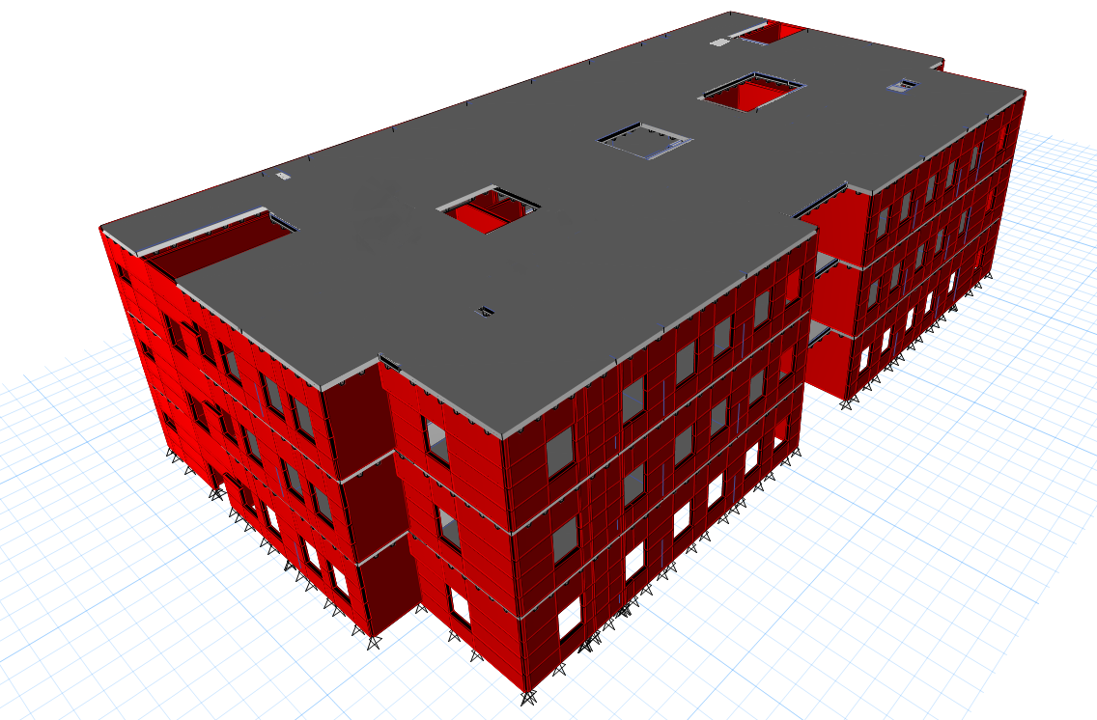
3-D Modeling

Slide 24
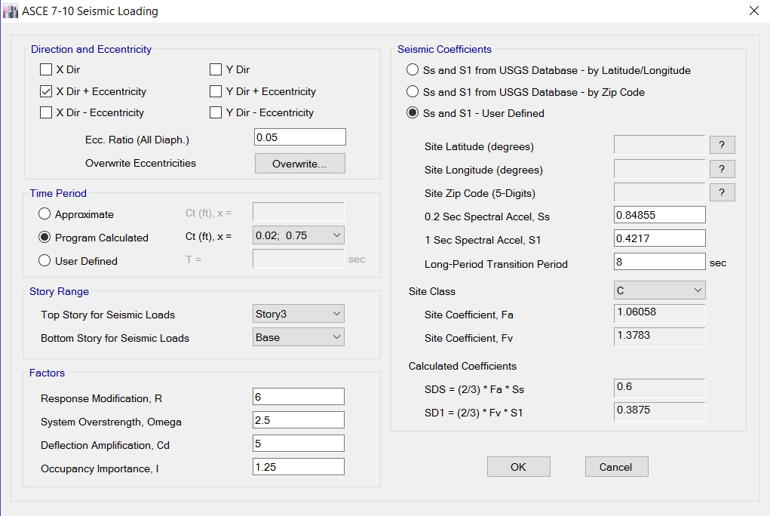
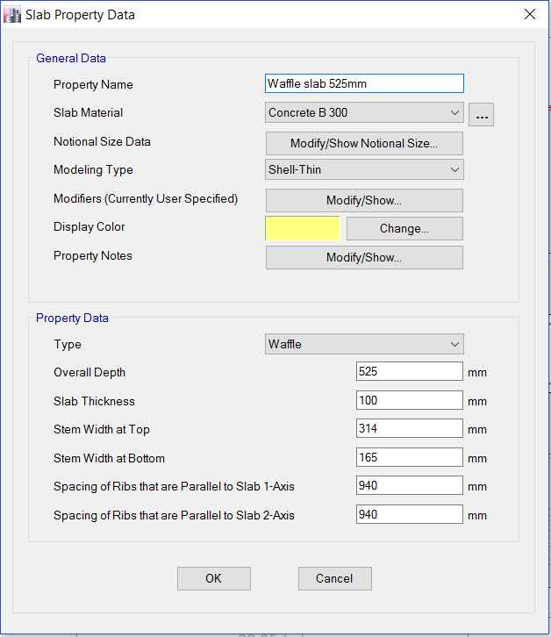
Sections & Load definitions

Slide 25
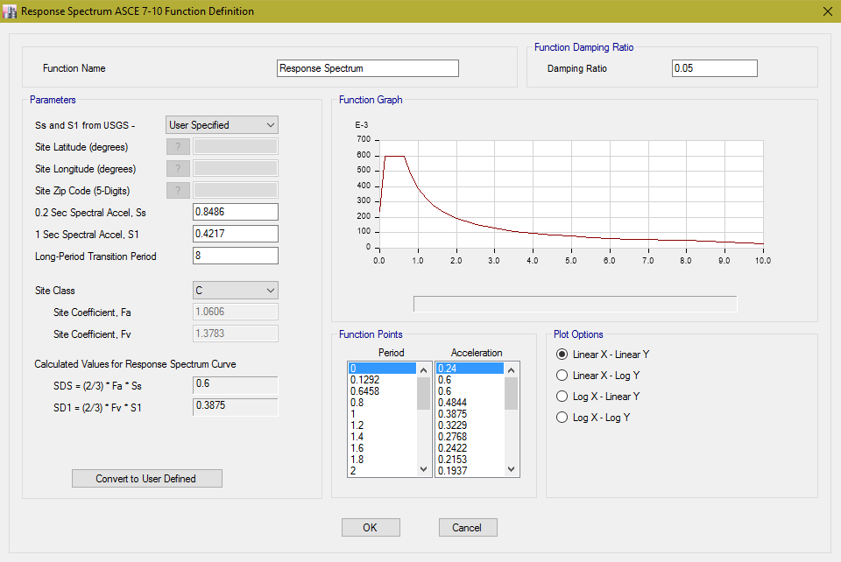
Response Spectrum Function

Slide 26
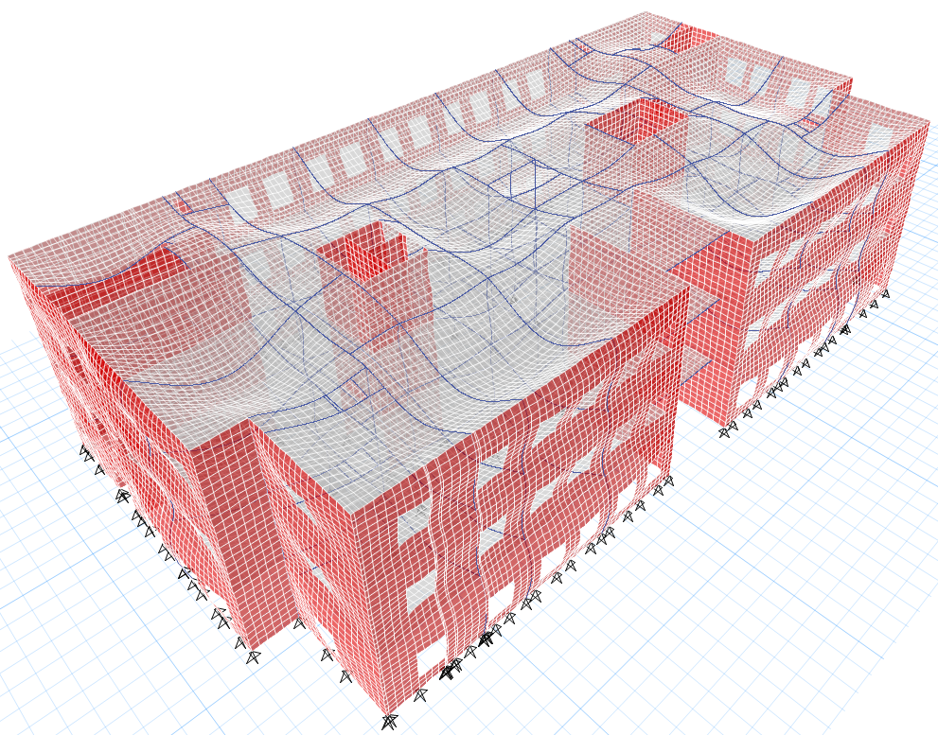
Checks:
Compatibility

Slide 27
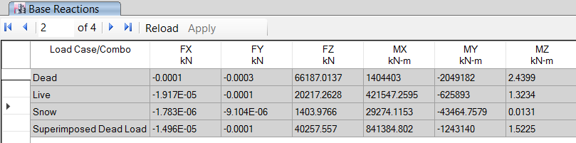
Equilibrium
Gravity loads
 | Dead (KN) | Live (KN) | Snow (KN) | Superdead (KN)
Hand calculations | 66229.1 | 20246.4 | 1406 | 40327.62
Difference % | 0.06 % | 0.14 % | 0.14 % | 0.17 %

Slide 28
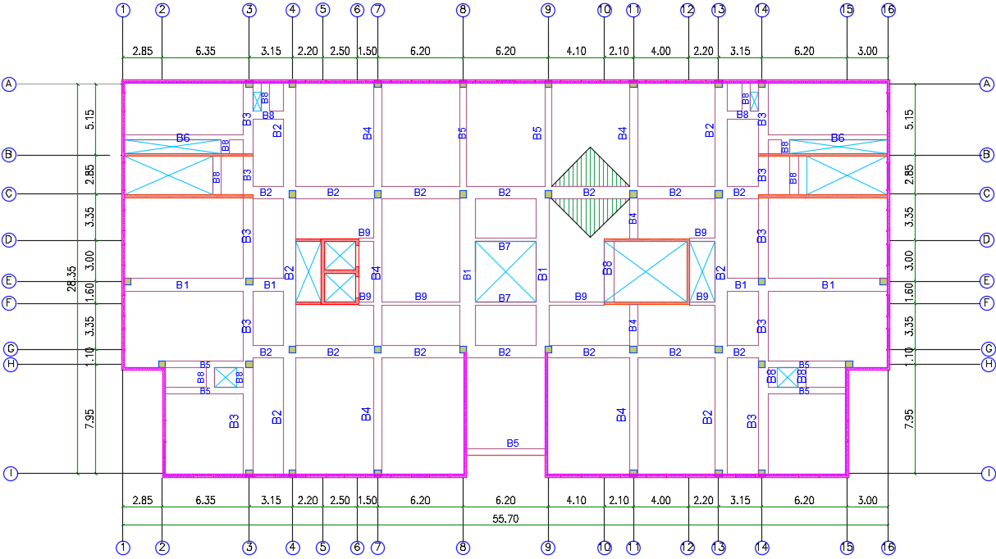
Internal Forces
Beams ( B2)
Hand ML= 71.34 KN.m
Etabs ML = 68.36 KN.m
Difference = 4.1 %

Slide 29
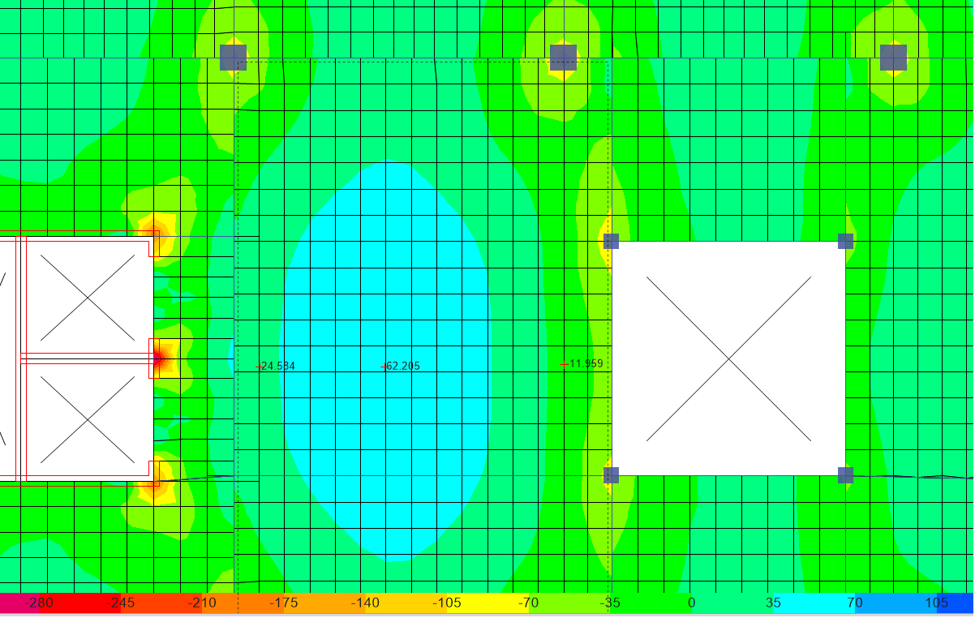
Internal Forces
Critical Panel
Hand Mu = 80.68 KN.m
Etabs Mu = 80.48 KN.m
Difference = 0.2 %

Slide 30
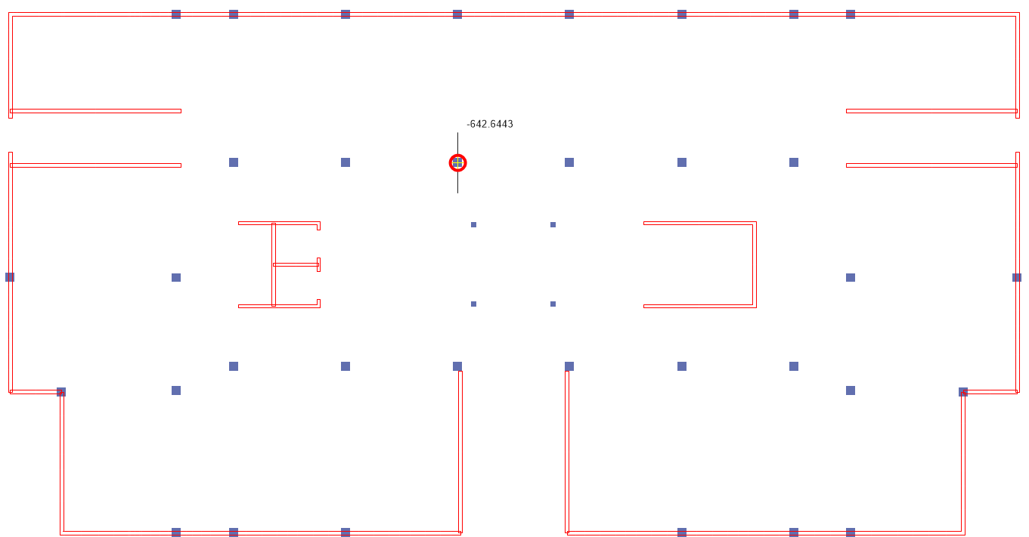
Internal Forces
Critical Column
Hand PL = 652.61 KN
Etabs PL = 642.64 KN
Difference = 1.5 %

Slide 31
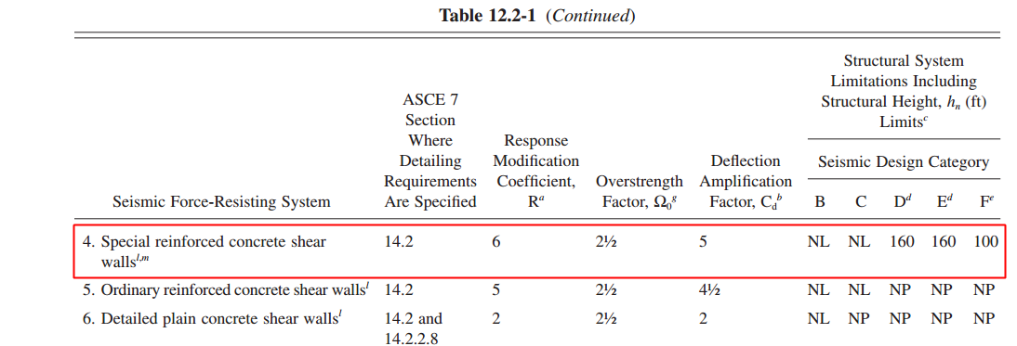
Base Shear
SDS = 0.6 , S_{D1} = 0.3875.
SDC = D
Seismic Force-Resisting System:

Slide 32
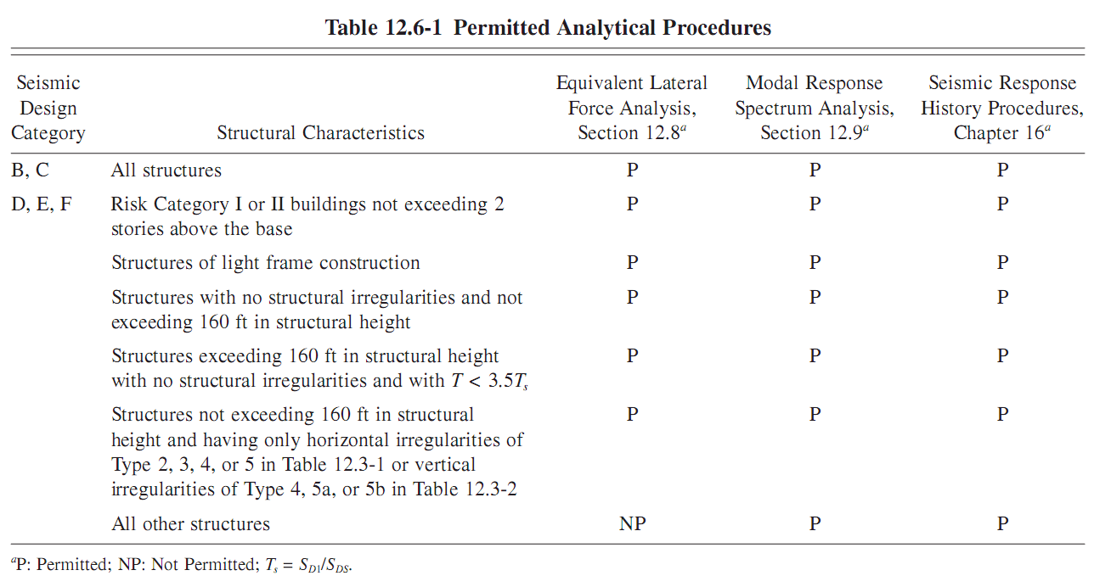
Effective Seismic Weight ( D+SD+0.25L) = 111618 KN
Importance Factor = 1.25
Analysis procedure selection:

Slide 33
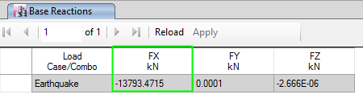
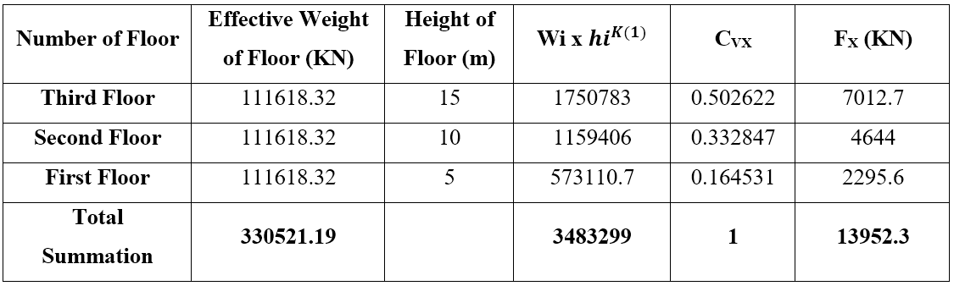
Total base shear = 13952 KN
Difference Percentage = 1.14 %

Slide 34

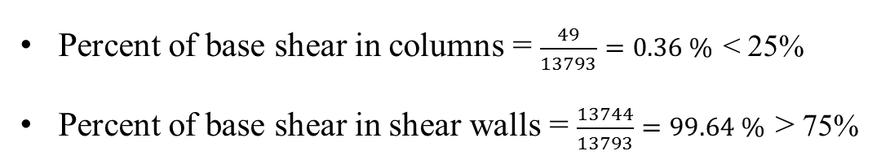
Check Type of the Structural System
Percent of base shear in columns = $\frac{49}{13793}=0.36 \%$ < 25%
Percent of base shear in shear walls = $\frac{13744}{13793}=99.64 \%$ > 75%

Slide 35
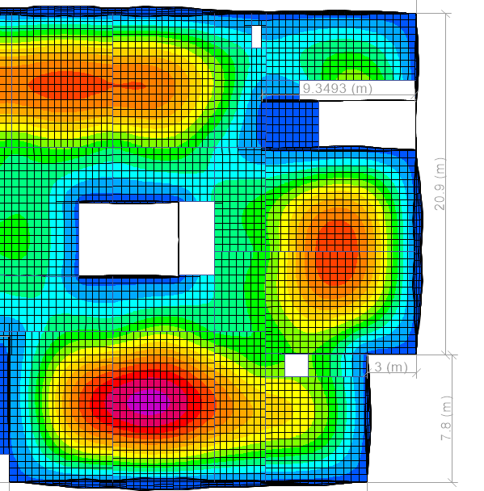
Deflection
Long term Deflection : $ΔLT = ΔL + λ∞ ΔD + λt ΔLS$ (5)

Slide 36
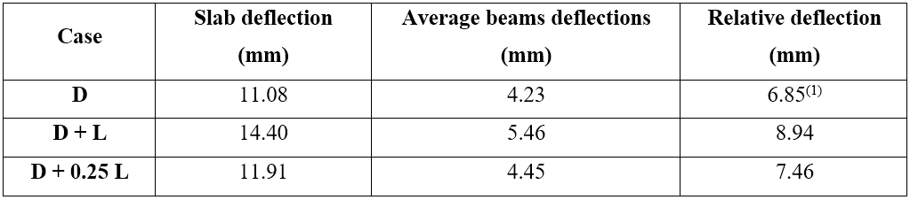
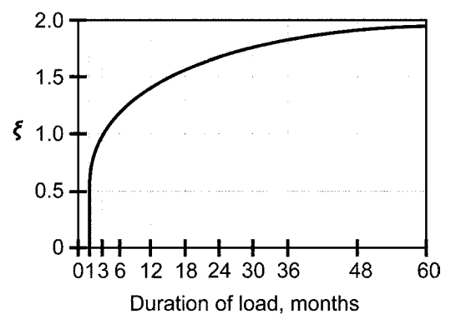
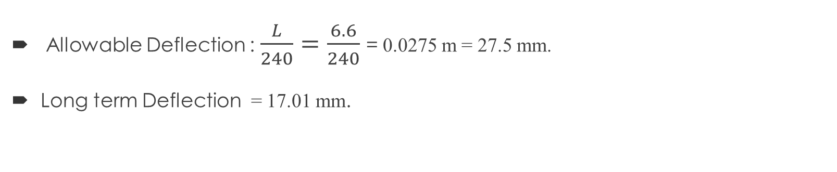
Deflection
Allowable Deflection : $\frac{L}{240}=\frac{6.6}{240}$ = 0.0275 m = 27.5 mm.
Long term Deflection = 17.01 mm.

Slide 37
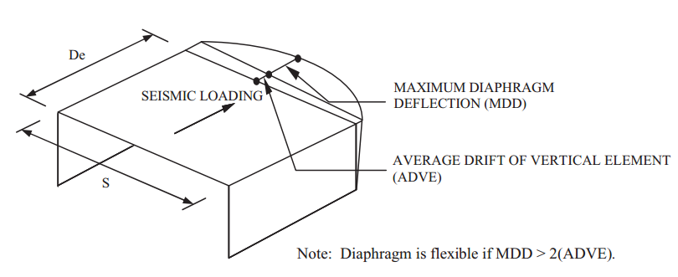
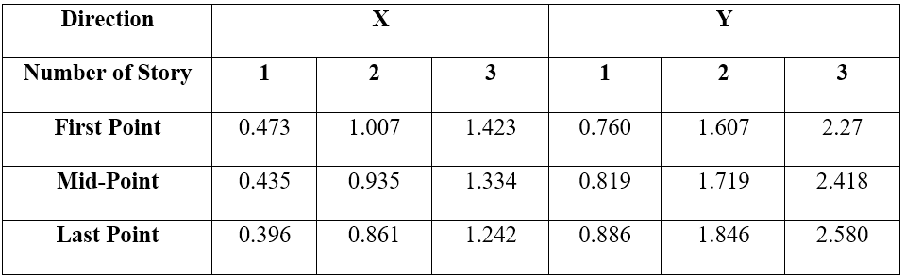
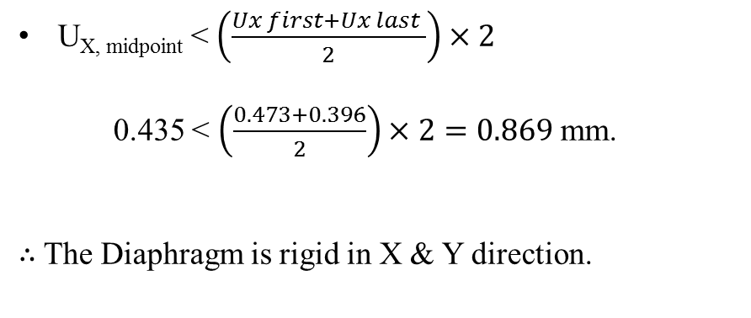
Type of Diaphragm
U_{X, midpoint} < $\left(\frac{Ux first+Ux last }{2}\right)×2$
0.435 < $\left(\frac{0.473+0.396}{2}\right)×2=0.869$mm.
$∴$The Diaphragm is rigid in X & Y direction.

Slide 38
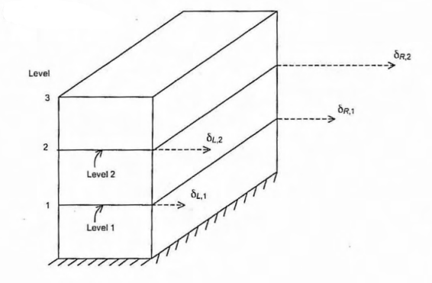
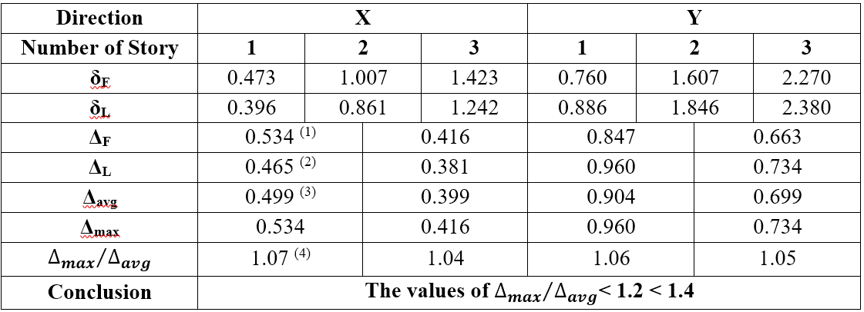
Irregularities
Horizontal Irregularities:
Type 1 – Torsional Irregularity.

Slide 39
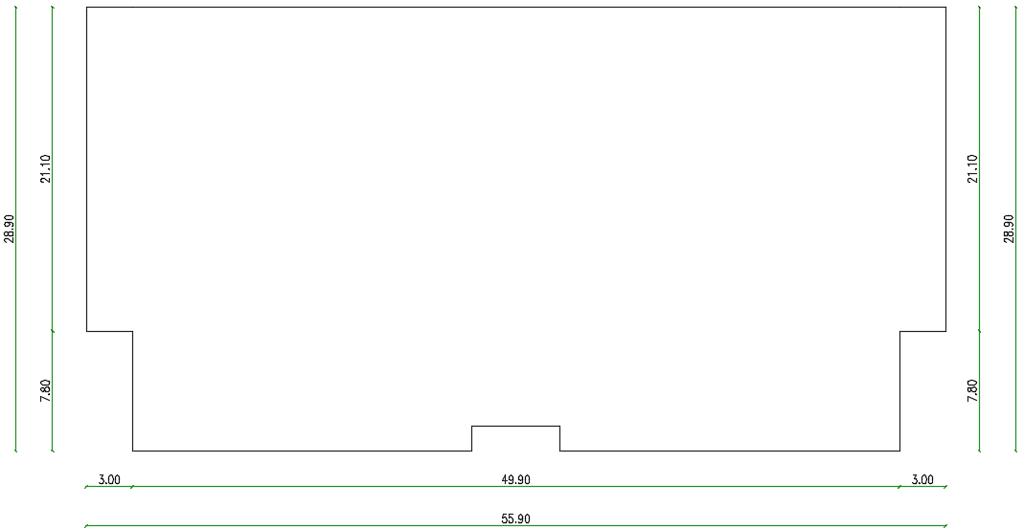

Irregularities
Horizontal Irregularities:
Type 2 – Reentrant
Corner irregularity.
In X-direction:
The projection beyond the re-entrant corner is $\frac{3}{55.7}=5.4 \%<15 \% →Ok.$
In Y-direction:
The projection beyond the re-entrant corner is $\frac{7.8}{28.7}=27.2 \%>15 \%$
Irrigularity exists.

Slide 40
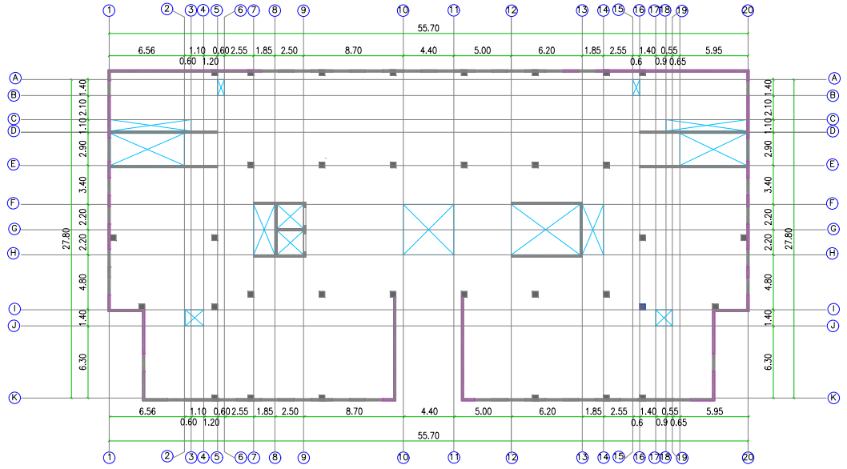

Irregularities
Horizontal Irregularities:
Type 3 – Diaphragm
discontinuity.
The percentage of opening area in the diaphragm = $\frac{140.7}{1406}=10 \%<50 \%.$

Slide 41

Irregularities
Horizontal Irregularities:
Type 4 – out of plan
offsets.
Does not exist.

Slide 42

Irregularities
Horizontal Irregularities:
Type 5 – Non-parallel System.
Does not exist.

Slide 43


Irregularities
Vertical Irregularities:
Type 1 – Stiffness Soft Story.
When 70% of $\frac{δ_{1e}}{h_{1}}$excess $\frac{δ_{2e}−δ_{1e} }{h_{2}}$
Does not exist.

Slide 44
Irregularities
Vertical Irregularities:
Type 2 – Mass & weight vertical irregularity.
is considered to exist when the effective mass of any story is more than 150 percent of the effective mass of an adjacent story.
Does not exist.

Slide 45

Irregularities
Vertical Irregularities:
Type 3 – Vertical Geometry.
is considered to exist where the horizontal dimension of the seismic-force-resisting system in any story is more than 130 percent of that in the adjacent story.
Does not exist.

Slide 46

Irregularities
Vertical Irregularities:
Type 4 – In plan Discontinuity in Vertical.
vertical irregularity exists when there is an in-plane offset of the lateral-forceresisting elements greater than the length of those elements
Does not exist.

Slide 47
Design of Structural Members
Structural system:
Intermediate Beams.
Special Columns.
Special Shear walls.

Slide 48



Design of Structural Members
Beams
Flexure Check:
$ρ=0.00208\overset{⇒}{ } 1245 {mm}^{2}$
${As}_{min}\left\{\begin{aligned}max of\left\{\begin{aligned}\frac{0.25 \sqrt{f′c}}{fy} bw d \overset{⇒}{ } 1885 {mm}^{2} \\ \frac{1.4 }{fy} bw d \overset{⇒}{ }1995 {mm}^{2}\end{aligned}\right. \\ \frac{4}{3} {As}_{calculated } \overset{⇒}{ }1660 {mm}^{2}\end{aligned}\right.$
Difference % = 1.44%

Slide 49


Design of Structural Members
Beams
Shear Check:
$ØVc=396 KN$
$\frac{Av}{S}$ $=353 {mm}^{2}/m$
${\frac{Av}{S}}_{min}$ $\max{of \left\{\begin{aligned}0.062\sqrt{f′c}\frac{bw}{Fy}=703 {mm}^{2}/m \\ 0.35 \frac{bw}{Fy}=750 {mm}^{2}/m \end{aligned}\right.}$
Difference % = 0.00%

Slide 50



Design of Structural Members
Beams
Torsion Check:
$ØT_{th}=43.3 KN$
$\frac{At}{S}$ $=169 {mm}^{2}/m$
Difference % = 1.18%
$A_{L}$ $=448 {mm}^{2}$.
${A_{L}}_{min}=2341 {mm}^{2}$
Difference % = 1.66%

Slide 51

Design of Structural Members
Column
Slenderness (P-$∆$ effect):
For column not braced against side sway :$if \frac{K L_{u}}{r} ≤22 \overset{→}{ }$ not slender.
For column braced against side sway : if $\frac{K L_{u}}{r} ≤34+12 \left(\frac{M1}{M2}\right) \overset{→}{ }$ not slender.
Check if braced or not:
If stiffness of Lateral Force Resisting System > 12 stiffness of columns$→$braced.
$\frac{K L_{u}}{r}=$ $28.5$ $≤34+12$ $\left(\frac{M1}{M2}\right)$= $48$ (About global Y-axis)

Slide 52


Slide 53


Design of Structural Members
Column
Axial & Bending Moment Strength Check:
$ØP_{n}=\text{Ø }\text{0.8 }\text{(}\text{0.85 }\text{f}\text{′}\text{c}\text{ (}\text{Ag} \text{– }\text{Ast}\text{) + }\text{F}\text{y} A_{st}=1363 KN$
$M_{1}$ = 26.7 KN.m, $M_{2}$ = 32.2 KN.m
$e_{allowable}$ = 15 + 0.03 x h = 30 mm.
$Ø{M_{n}}_{allowable}$ = $P_{u }×e=$41 KN.m
${A_{s}}_{min}$ $=2500 {mm}^{2}$
500 mm
500 mm

Slide 54
Detailing of Structural Members
General Seismic Requirements
Intermediate beams.
Longitudinal Reinforcement:
Have at least two continuous bars at both top and bottom faces. Continuous bottom bars shall have area not less than one-fourth the maximum area of bottom bars along the span.
Positive moment strength at joint face is not to be less than 1/3 of the negative moment strength provided at the face of the joint.
The negative or positive moment at any section along the member is not to be less than 1/5 the maximum moment strength provided at the face of either joint.

Slide 55


Detailing of Structural Members Reinforcement
General Seismic Requirements
Intermediate beams (continued).
Transverse Reinforcement:
Check for Beam-Column design is needed or not:
If $Pu >0.1A_{g}{\grave{f}}_{c } \overset{⇒}{ }$ Design for axial load is needed.

Slide 56

Detailing of Structural Members Reinforcement
General Seismic Requirements
Intermediate beams (continued).
Shear Strength Reinforcement:
Shear capacity ($ØVn$) shall be at least the minimum of:
The sum of the shear associated with development of nominal moment strength (Mn) of the beam at each restrained end of the clear span and the shear calculated for factored gravity loads (ultimate gravity load).
The maximum shear obtained from design load combinations that include
earthquake loading E, with E taken as twice (2E).

Slide 57


Slide 58

Detailing Sample:

Slide 59

Detailing of Structural Members Reinforcement
General Seismic Requirements
2. Special columns.
Longitudinal Reinforcement:
Area of longitudinal reinforcement, A_{st}, shall be at least 0.01Ag and shall not exceed 0.06Ag.
Lap splices are permitted only within the center half of the member length, and shall be designed as tension lap splices and enclosed within transverse reinforcement.
Transverse Reinforcement.

Slide 60

Detailing Sample:

Slide 61


Detailing of Structural Members Reinforcement
3. Special shear walls.
Wall components:
Vertical segments.
Horizontal segments.

Slide 62

Detailing of Structural Members Reinforcement
General Requirements
3. Special shear walls.
$ρ_{l}$ and $ρ_{t}$ are at least 0.0025.
Reinforcement spacing each way in structural walls shall not exceed 450 mm.
At least two layers of reinforcement shall be used in a wall if Vu larger than 0.17Acv λ $\sqrt{f′c}$ or$\frac{h_{w}}{l_{w}}$ ≥ 2.0
Special requirements for walls piers.
Transverse reinforcement shall be in the form of hoops.
Vertical spacing of transverse reinforcement shall not exceed 150 mm.

Slide 63



Detailing Sample:

Slide 64

Detailing of Structural Members Reinforcement
Foundations
Type of footing : Mat & Wall footings.

Slide 65

Detailing of Structural Members Reinforcement
Detailing:

Slide 66


Detailing of Structural Members Reinforcement
Tie Beams
Analysis & design considerations:
Gravity loads: Dead load (own weight).
Seismic effects: according to IBC 2012, the design shall be for an axial load =
The lesser of $\left\{\begin{aligned}\frac{Max Pu S_{DS}}{10} \\ 0.25 Min Pu\end{aligned}\right.$
Due to differential settlement effect.

Slide 67



Detailing of Structural Members Reinforcement

Slide 68


Hollow Block Masonry Wall Study

Slide 69



Creating Parts :

Slide 70

Material Definition
Viscosity parameter | K | f_{bo}/f_{co} | Eccentricity ϵ | Dilation angle ψ (degree) | Poisson’s ratio | Young’s modulus (MPa) | Mass density (Kg/mm3)
0 | 0.67 | 1.16 | 0.1 | 36 | 0.2 | 19,264 | 2.4E-6

Slide 71
Assembly:

Slide 72

Meshing Instances:

Slide 73

Results

Slide 74




Curve Fitting

Slide 75


Resulted Mechanical Properties:
Young Modulus = Slope = 14630 MPa
Poisons’ Ratio = Slope = 0.218

Slide 76
Thank You

