Slide 1
Air Quality In City center Tulkarim , Jenin & Nablus
By
Montaser Mohammad Thafer 11525909
Hamza Faris Habash 11344733
Anas Bashar Mosleh 11344981
Sondos Rasheed Shebli 11420217
Under supervision of: Dr. Abd Alhaleem Khader

Slide 2

How can the climate factors it selves
have its own effect on the air pollution

Slide 3
introduction
Wind , temperature and humidity are one of the most effective natural factors on the quality of the air
Specially Because they are the factors that control the density, speed, and components of air.

Slide 4
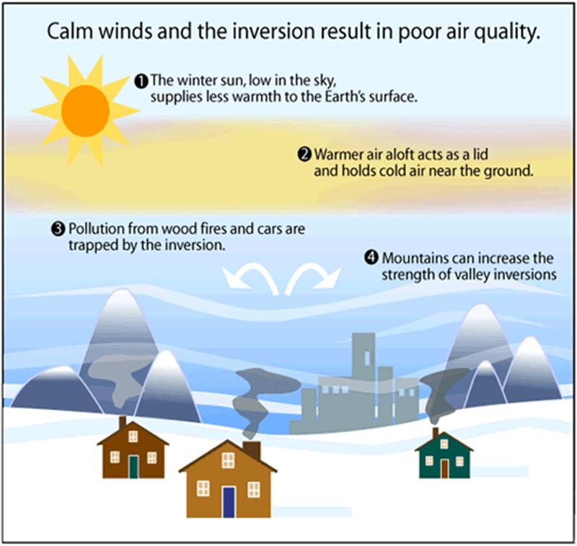
1-introduction:
wind

Slide 5
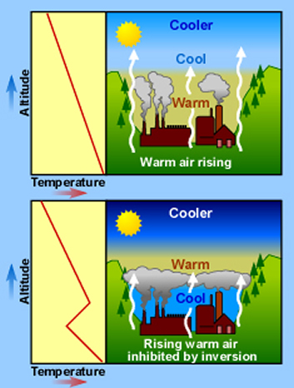
tempreture

Slide 6
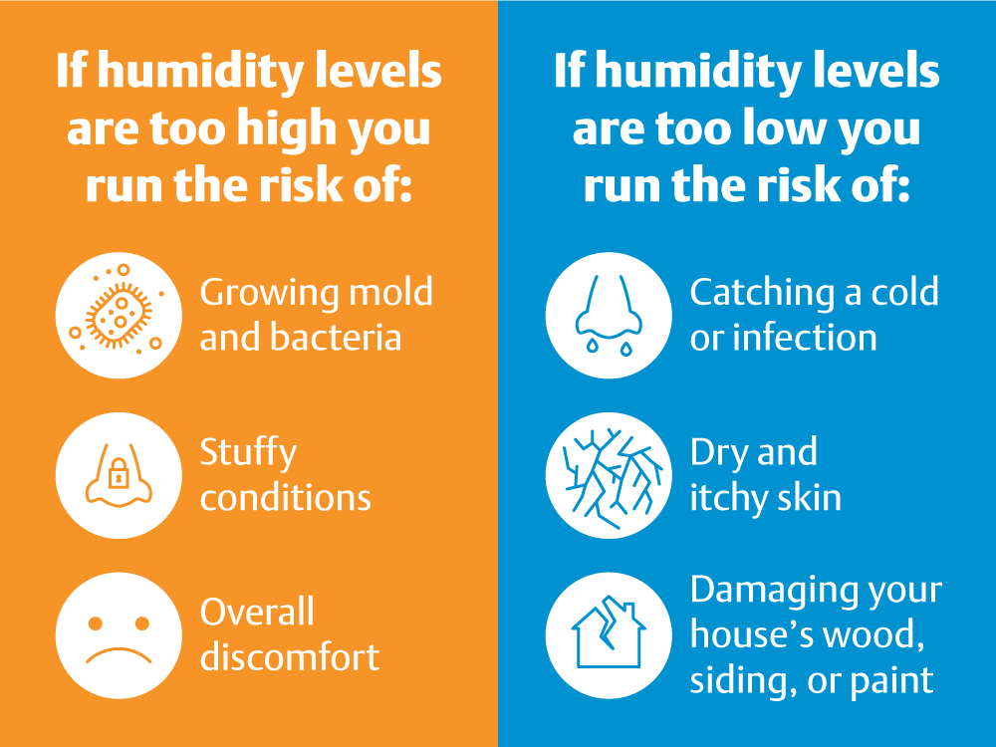
humidity

Slide 7
2-methodology
AirU sensors based on a Plan tower PMS3003 laser particle counted
Pm2.5/1/10-humidity-tempreture-location(z.x.y)
To measure pm 2.5 mg/l with time for every location according to the WHO
After that a data collection on excel have took a place to compare the result and discover the effect of the natural sources on the pm 205

Slide 8
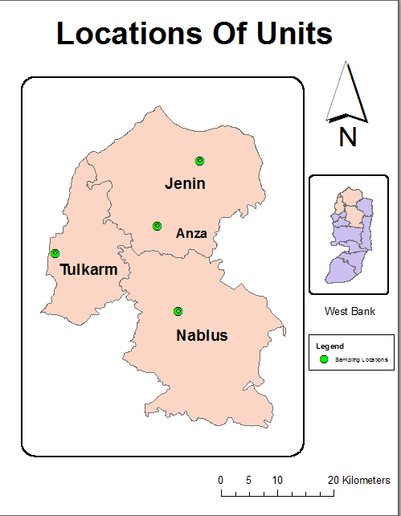
locations
Nablus :
Location =32.220955,35.260716
Tulkarm:
Location=32.313877,35.027816
jenin
Location = L :35.3016 W:32.4627
Anza
Location= L:35.2208w:32.3584

Slide 9
Data for one day
Time (GMT) | MAC | Uptime (s) | Altitude (m) | Latitude (DD.dd) | Longitude (DD.dd) | PM1 (ug/m3) | PM2.5 (ug/m3) | PM10 (ug/m3) | Temperature (C) | Humidity | RED (x/4096) | OX (x/4096) | Time Source ([N]TP/[G]PS)
0:00:29 | 3C71BF49DF7C | 66685 | 154.3 | 32.3142 | 35.028 | 22.94 | 31.27 | 32.34 | 36.61 | 38.57 | 286 | 142 | G
0:01:29 | 3C71BF49DF7C | 66745 | 155.7 | 32.3143 | 35.0279 | 21.83 | 28.63 | 29.66 | 36.59 | 38.48 | 286 | 142 | G
0:02:30 | 3C71BF49DF7C | 66806 | 156.7 | 32.3143 | 35.0279 | 25.61 | 34.56 | 35.59 | 36.56 | 38.48 | 290 | 142 | G
0:03:30 | 3C71BF49DF7C | 66866 | 160.3 | 32.3143 | 35.0279 | 22.89 | 30 | 30.44 | 36.51 | 38.6 | 287 | 142 | G
0:04:30 | 3C71BF49DF7C | 66926 | 173.7 | 32.3143 | 35.028 | 27.03 | 36.21 | 37.54 | 36.44 | 38.5 | 286 | 142 | G
0:05:30 | 3C71BF49DF7C | 66986 | 174.9 | 32.3142 | 35.028 | 29.39 | 39.35 | 40.2 | 36.33 | 38.6 | 289 | 142 | G
0:06:30 | 3C71BF49DF7C | 67046 | 171.1 | 32.3142 | 35.028 | 30.23 | 40.2 | 40.94 | 36.17 | 38.91 | 315 | 478 | G
0:07:30 | 3C71BF49DF7C | 67107 | 181.8 | 32.3141 | 35.0281 | 30 | 39.52 | 41.32 | 36.05 | 39 | 289 | 142 | G
0:08:31 | 3C71BF49DF7C | 67167 | 189.2 | 32.3143 | 35.028 | 26.73 | 37.29 | 38.21 | 35.98 | 39.12 | 290 | 142 | G
0:09:31 | 3C71BF49DF7C | 67227 | 161.9 | 32.3143 | 35.028 | 27.11 | 36.44 | 37.79 | 35.98 | 39.12 | 317 | 142 | G
0:10:31 | 3C71BF49DF7C | 67287 | 146 | 32.3142 | 35.028 | 23.61 | 32.3 | 33.7 | 36.01 | 39.1 | 291 | 142 | G
0:11:31 | 3C71BF49DF7C | 67347 | 143.4 | 32.3142 | 35.028 | 21.61 | 29.03 | 29.77 | 36.08 | 39 | 290 | 142 | G
0:12:31 | 3C71BF49DF7C | 67407 | 138.4 | 32.3143 | 35.028 | 21.65 | 28.54 | 30.32 | 36.17 | 38.91 | 382 | 474 | G
0:13:32 | 3C71BF49DF7C | 67468 | 134.6 | 32.3143 | 35.028 | 19.29 | 26.86 | 28.13 | 36.22 | 38.91 | 290 | 142 | G
0:14:32 | 3C71BF49DF7C | 67528 | 137.3 | 32.3142 | 35.028 | 19.23 | 27.51 | 28.29 | 36.25 | 38.81 | 288 | 142 | G
0:15:32 | 3C71BF49DF7C | 67588 | 162.5 | 32.3141 | 35.0281 | 24.9 | 34.74 | 36.22 | 36.25 | 38.81 | 329 | 142 | G
0:16:32 | 3C71BF49DF7C | 67648 | 180.3 | 32.3141 | 35.0281 | 27.47 | 37.27 | 38.2 | 36.18 | 38.81 | 289 | 142 | G
0:17:32 | 3C71BF49DF7C | 67708 | 177 | 32.3141 | 35.0281 | 29 | 38.14 | 39.68 | 36.08 | 39 | 291 | 142 | G
0:18:32 | 3C71BF49DF7C | 67769 | 168.1 | 32.3141 | 35.0281 | 27.39 | 35.61 | 36.99 | 35.99 | 39.2 | 299 | 142 | G

Slide 10
3-Result and discussion
Wind Speed
DATE | Wind Speed | ANZA | TULKARIM | NABLUS | JENIN
04-أكتوبر | 16.4 | 26.80808 | 29.02676 | 30.39874 | 51.89241
05-أكتوبر | 19.6 | 41.00286 | 30.64419 | 36.4156 | 44.8636
06-أكتوبر | 21.6 | 21.23024 | 22.44161 | 23.95147 | 25.25279
07-أكتوبر | 18.7 | 12.10827 | 18.47175 | 19.63688 | 26.2597
08-أكتوبر | 18.4 | 17.95673 | 25.77562 | 30.02213 | 41.27358
09-أكتوبر | 18.7 | 32.98893 | 26.87752 | 41.10172 | 45.33664
10-أكتوبر | 18.4 | 23.61348 | 26.82844 | 32.8522 | 32.05547
11-أكتوبر | 17.2 | 26.41789 | 28.18529 | 27.70001 | 31.13493
12-أكتوبر | 22 | 26.42476 | 25.40677 | 34.69595 | 41.10173
13-أكتوبر | 18.5 | 25.79302 | 33.92476 | 32.76126 | 36.33426
14-أكتوبر | 17.1 | 19.81869 | 35.13869 | 25.47422 | 33.99756
15-أكتوبر | 25.4 | 21.08364 | 22.66969 | 25.63372 | 35.99861
16-أكتوبر | 14.8 | 39.01324 | 38.78328 | 35.69894 | 56.78358
17-أكتوبر | 18.7 | 46.47858 | 46.39434 | 43.04546 | 53.18594
18-أكتوبر | 20.2 | 29.93719 | 33.00432 | 28.18334 | 39.93269
19-أكتوبر | 21.6 | 36.32485 | 36.88995 | 44.04595 | 46.50383
20-أكتوبر | 20.5 | 23.12469 | 25.60843 | 28.19284 | 29.49617
21-أكتوبر | 17.2 | 31.675 | 35.97334 | 40.03386 | 58.41469
22-أكتوبر | 21.4 | 29.70173 | 35.44467 | 34.48199 | 34.78845
23-أكتوبر | 33.2 | 15.49992 | 21.12278 | 21.66738 | 27.27542
24-أكتوبر | 18.9 | 19.74899 | 24.1184 | 31.61587 | 42.89984
25-أكتوبر | 16.1 | 33.3486 | 35.31239 | 35.38566 | 41.70369
26-أكتوبر | 24.9 | 23.53063 | 26.63386 | 36.84652 | 41.30898
27-أكتوبر | 17.7 | 24.49456 | 32.254 | 34.94429 | 43.54162

Slide 11
The relation between the Wind Speed and pm2
there is a positive slope which mean there is
a direct relationship between the Wind Speed and pollution (PM 2.5) as the Wind Speed
the Concentration of pollutants will decrease . This appears in the readings for all study areas.

Slide 12
Figure 1 : relation between Wind Speed and concentration of PM2.5 for Jenin city
Figure 2 : relation between Wind Speed and concentration of PM2.5 for Nablis city

Slide 13
Figure 3 : relation between Wind Speed and concentration of PM2.5 for tulkarim city
Figure 4 : relation between Wind Speed and concentration of PM2.5 for Anza vallige

Slide 14
Relative humidity
DATE | Relative Humidity | ANZA | TULKARIM | NABLUS | JENIN
04-أكتوبر | 53.67 | 26.80808468 | 29.02676443 | 30.39873684 | 51.89240947
05-أكتوبر | 52.16 | 41.00286132 | 30.64418816 | 36.41559541 | 44.86360474
06-أكتوبر | 49.32 | 21.23024414 | 22.44160976 | 23.95146792 | 25.25278552
07-أكتوبر | 61.96 | 12.10827424 | 18.47175488 | 19.63688341 | 26.25970182
08-أكتوبر | 52.51 | 17.95672614 | 25.77561978 | 30.02212831 | 41.27358128
09-أكتوبر | 52.67 | 32.98892674 | 26.87751916 | 41.10172161 | 45.33664344
10-أكتوبر | 58.79 | 23.61348408 | 26.82844011 | 32.85220299 | 32.05547261
11-أكتوبر | 56.79 | 26.41789253 | 28.18528552 | 27.70000957 | 31.13492883
12-أكتوبر | 71.43 | 26.42475707 | 25.40677352 | 34.69594619 | 41.10173161
13-أكتوبر | 55.75 | 25.79301617 | 33.92476257 | 32.76125853 | 36.33426184
14-أكتوبر | 43.71 | 19.81868697 | 35.1386899 | 25.47421658 | 33.99756437
15-أكتوبر | 44.96 | 21.08363724 | 22.66969295 | 25.63372328 | 35.99860724
16-أكتوبر | 57.32 | 39.01324363 | 38.78327957 | 35.69893516 | 56.7835769
17-أكتوبر | 72.5 | 46.47858262 | 46.39434495 | 43.04545934 | 53.1859352
18-أكتوبر | 68.64 | 29.937185 | 33.00432103 | 28.18333669 | 39.93269022
19-أكتوبر | 71.54 | 36.32484583 | 36.88995471 | 44.04595056 | 46.50383009
20-أكتوبر | 68.31 | 23.12468509 | 25.60842706 | 28.19284385 | 29.49617258
21-أكتوبر | 69.19 | 31.675 | 35.9733449 | 40.03386411 | 58.4146936
22-أكتوبر | 48.29 | 29.70173396 | 35.44466574 | 34.48199324 | 34.78844816
23-أكتوبر | 57.82 | 15.4999193 | 21.12277856 | 21.66738324 | 27.27541783
24-أكتوبر | 61.35 | 19.74898983 | 24.11840084 | 31.61587479 | 42.89983703
25-أكتوبر | 56.11 | 33.34860376 | 35.31238916 | 35.38565808 | 41.70369081
26-أكتوبر | 61.61 | 23.53063415 | 26.63385794 | 36.846516 | 41.30897704
27-أكتوبر | 69.03 | 24.49456084 | 32.25400418 | 34.94428621 | 43.54161617

Slide 15
The relation between the humidity and pm2
there is a positive slope which mean there is
a direct relationship between the relative humidity and pollution (PM 2.5) as the humidity
the Concentration of pollutants will increase . This appears in the readings for all study areas.

Slide 16
Figure 1 : relation between relative humidity and concentration of PM2.5 for Jenin city
Figure 2 : relation between relative humidity and concentration of PM2.5 for Nablus city

Slide 17
Figure 3 : relation between relative humidity and concentration of PM2.5 for Tulkarim city
Figure 4 : relation between relative humidity and concentration of PM2.5 for Anza village

Slide 18
tempreture
For Temperature these results was found for the four places
DATE | Temp | ANZA | TULKARIM | NABLUS | JENIN
04-أكتوبر | 23.5 | 26.80808468 | 29.02676443 | 30.39873684 | 51.89240947
05-أكتوبر | 23.5 | 41.00286132 | 30.64418816 | 36.41559541 | 44.86360474
06-أكتوبر | 23.5 | 21.23024414 | 22.44160976 | 23.95146792 | 25.25278552
07-أكتوبر | 23.2 | 12.10827424 | 18.47175488 | 19.63688341 | 26.25970182
08-أكتوبر | 24.5 | 17.95672614 | 25.77561978 | 30.02212831 | 41.27358128
09-أكتوبر | 24.2 | 32.98892674 | 26.87751916 | 41.10172161 | 45.33664344
10-أكتوبر | 24.1 | 23.61348408 | 26.82844011 | 32.85220299 | 32.05547261
11-أكتوبر | 24 | 26.41789253 | 28.18528552 | 27.70000957 | 31.13492883
12-أكتوبر | 22.7 | 26.42475707 | 25.40677352 | 34.69594619 | 41.10173161
13-أكتوبر | 25.4 | 25.79301617 | 33.92476257 | 32.76125853 | 36.33426184
14-أكتوبر | 27.4 | 19.81868697 | 35.1386899 | 25.47421658 | 33.99756437
15-أكتوبر | 27.1 | 21.08363724 | 22.66969295 | 25.63372328 | 35.99860724
16-أكتوبر | 25.5 | 39.01324363 | 38.78327957 | 35.69893516 | 56.7835769
17-أكتوبر | 23.6 | 46.47858262 | 46.39434495 | 43.04545934 | 53.1859352
18-أكتوبر | 22.5 | 29.937185 | 33.00432103 | 28.18333669 | 39.93269022
19-أكتوبر | 21.5 | 36.32484583 | 36.88995471 | 44.04595056 | 46.50383009
20-أكتوبر | 21.4 | 23.12468509 | 25.60842706 | 28.19284385 | 29.49617258
21-أكتوبر | 21.5 | 31.675 | 35.9733449 | 40.03386411 | 58.4146936
22-أكتوبر | 22.8 | 29.70173396 | 35.44466574 | 34.48199324 | 34.78844816
23-أكتوبر | 21.1 | 15.4999193 | 21.12277856 | 21.66738324 | 27.27541783
24-أكتوبر | 20.6 | 19.74898983 | 24.11840084 | 31.61587479 | 42.89983703
25-أكتوبر | 20.8 | 33.34860376 | 35.31238916 | 35.38565808 | 41.70369081
26-أكتوبر | 20.2 | 23.53063415 | 26.63385794 | 36.846516 | 41.30897704
27-أكتوبر | 20.6 | 24.49456084 | 32.25400418 | 34.94428621 | 43.54161617
AVG |  | 27.0052 | 29.8721 | 32.2827 | 40.0557
MIN |  | 12.1083 | 18.4718 | 19.6369 | 25.2528
MAX |  | 46.4786 | 46.3943 | 44.046 | 58.4147

Slide 19
As shown in figures there no clear relations between temperature and concentration of PM2.5
Figure 1 : relation between temperature and concentration of PM2.5 for Jenin city
Figure 2 : relation between temperature and concentration of PM2.5 for Nablus city

Slide 20
Figure 3 : relation between temperature and concentration of PM2.5 for Tulkarim city
Figure 4 : relation between temperature and concentration of PM2.5 for Anza village

Slide 21
precipitation
DATE | Precipitation | ANZA | TULKARIM | NABLUS | JENIN
04-أكتوبر | 0 | 26.80808468 | 29.02676443 | 30.39873684 | 51.89240947
05-أكتوبر | 0 | 41.00286132 | 30.64418816 | 36.41559541 | 44.86360474
06-أكتوبر | 1.2 | 21.23024414 | 22.44160976 | 23.95146792 | 25.25278552
07-أكتوبر | 0 | 12.10827424 | 18.47175488 | 19.63688341 | 26.25970182
08-أكتوبر | 0 | 17.95672614 | 25.77561978 | 30.02212831 | 41.27358128
09-أكتوبر | 0 | 32.98892674 | 26.87751916 | 41.10172161 | 45.33664344
10-أكتوبر | 0 | 23.61348408 | 26.82844011 | 32.85220299 | 32.05547261
11-أكتوبر | 0 | 26.41789253 | 28.18528552 | 27.70000957 | 31.13492883
12-أكتوبر | 0 | 26.42475707 | 25.40677352 | 34.69594619 | 41.10173161
13-أكتوبر | 0 | 25.79301617 | 33.92476257 | 32.76125853 | 36.33426184
14-أكتوبر | 0 | 19.81868697 | 35.1386899 | 25.47421658 | 33.99756437
15-أكتوبر | 0 | 21.08363724 | 22.66969295 | 25.63372328 | 35.99860724
16-أكتوبر | 3.8 | 39.01324363 | 38.78327957 | 35.69893516 | 56.7835769
17-أكتوبر | 0 | 46.47858262 | 46.39434495 | 43.04545934 | 53.1859352
18-أكتوبر | 0 | 29.937185 | 33.00432103 | 28.18333669 | 39.93269022
19-أكتوبر | 0 | 36.32484583 | 36.88995471 | 44.04595056 | 46.50383009
20-أكتوبر | 0 | 23.12468509 | 25.60842706 | 28.19284385 | 29.49617258
21-أكتوبر | 0 | 31.675 | 35.9733449 | 40.03386411 | 58.4146936
22-أكتوبر | 0 | 29.70173396 | 35.44466574 | 34.48199324 | 34.78844816
23-أكتوبر | 4.1 | 15.4999193 | 21.12277856 | 21.66738324 | 27.27541783
24-أكتوبر | 0 | 19.74898983 | 24.11840084 | 31.61587479 | 42.89983703
25-أكتوبر | 0 | 33.34860376 | 35.31238916 | 35.38565808 | 41.70369081
26-أكتوبر | 1 | 23.53063415 | 26.63385794 | 36.846516 | 41.30897704
27-أكتوبر | 11.1 | 24.49456084 | 32.25400418 | 34.94428621 | 43.54161617
معدل الايام الماطره | 4.24 | 24.75372041 | 28.247106 | 30.62171771 | 38.83247469
معدل الايام الغير ماطره |  | 27.36850687 | 28.70092608 | 31.41756011 | 41.55976966
AVG | 4.24 | 27.005191 | 29.8721 | 32.28275 | 40.0557
MIN | 1 | 12.108274 | 18.4718 | 19.63688 | 25.2528
MAX | 11.1 | 46.478583 | 46.3943 | 44.04595 | 58.4147

Slide 22
RESULT OF AVERAGE HOURLY

Slide 23
elevation
Thereis no relationship between the height of the area and the concentration of the pollutant

Slide 24
4-conclusions and recommendations
the highest pollution rate in Jenin city, where the value of PM 2.5 ranged between approximately 25 mg\l as minimum to a maximum of 58 mg\l which have been affected there by those natural sourses
Then Nablus city followed, in terms of pollution value. Values ranged between 18 mg\l as a minimum and 44 mg\l as a maximum ,
Then the city of Tulkarem and the village of Anza followed with close values ranging from 12 as a minimum to 45 as a maximum

Slide 25
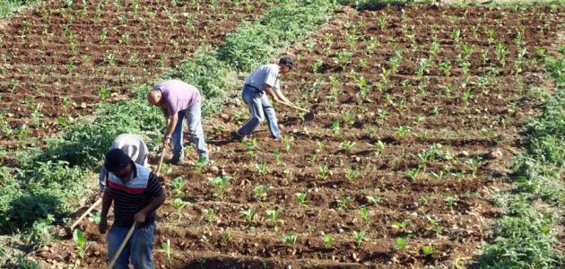
Wind and heat can be used to increase
agricultural products to get the benefit from them in Palestine.
There are a lot of unexploited lands, which will lead to a more healthy and fresh air
and this will contribute to self-sufficiency in terms of food and employment of labor and others.

