Slide 1

An-Najah National University
Engineering college
Building Engineering Department
Health Center
Prepared by:
Sobhi Ibrahim
Islam Ammar
Mohammad Odeh
Supervisor: Eng. Abdelhakim W. Al jawhari

Slide 2
Overview
1-
Introduction
Architectural Design
2-
3
Structural Design
3-
4-
Environmental Design
5-
Mechanical Design And Safety system
6-
Electrical Design
Quantity Surveying and Cost Estimation
7-

Slide 3

1
Introduction
There is an urgent need to improve the medical and health services provided to people and to make it as efficient and as near as possible to people’s living areas. Given the difficulties in the treatment especially in peak hours and the need to submit the treatment urgently, there is a need to establish health clinics or centers or even hospitals, with fair and correct distribution to cover almost all areas. A health center will help to solve this especially if it is designed to cover different medical services and if equipped by all required in addition to the human resource.

Slide 4
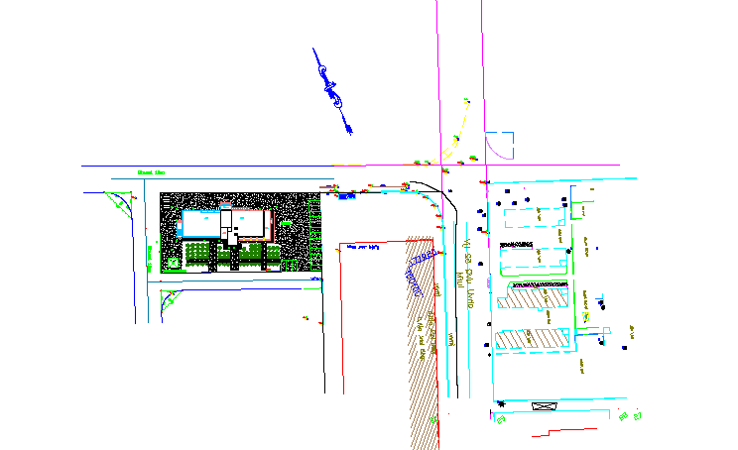
Site Location
area of site = 4350 m²
Area of building =2000 m²

Slide 5
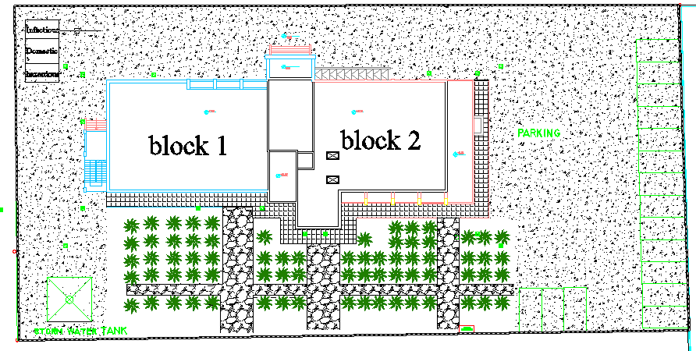
2
Architectural Design

Slide 6
2
Architectural Design
Rating health clinics, according to the Palestinian Ministry of Health :-
The first level: to submit various health services for the agglomeration with a population of less than 2000 people
The second Level: to submit various health services for the agglomeration with a population from 2001-6000 people
The third Level: Level: to submit various health services for the agglomeration with a population from 6001-12000 people
The fourth level: Level: to submit various health services for the agglomeration with a population more than 12000 people

Slide 7
2
Architectural Design
General description of the project
Reception area
Medical service (PHC)
laboratory
X-ray department
Support service
Medical service(MCH)
General management
Medical management
Environmental
Notes:
multipurpose hall it consists of several different elements and services cater to the public and the players, referees, supervisors and senior visitors and journalists.

Slide 8
Recommendation Spaces :
Spaces | Area(m² )
Reception area | 60
Medical service (PHC) | 179
Laboratory | 44
X-ray department | 64
Support service | 44
Medial service(MCH) | 86
General management | 147
Medical management | 112
Environmental | 106

Slide 9
834m2 | Space total area
333m2 | Circulation and walls and stair 40%
83m2 | Contingency 10%
1250-1500 m2 | TOTAL AREA

Slide 10
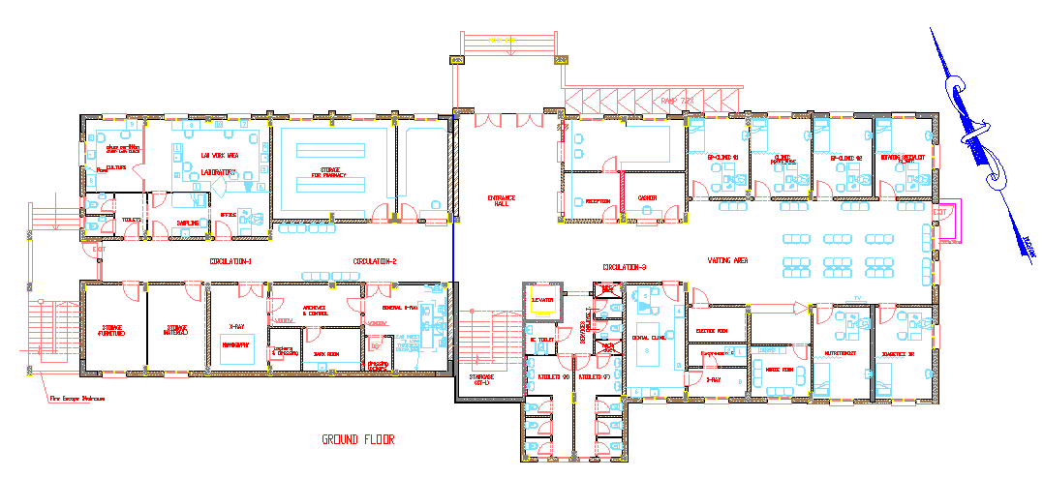
Ground Floor

Slide 11
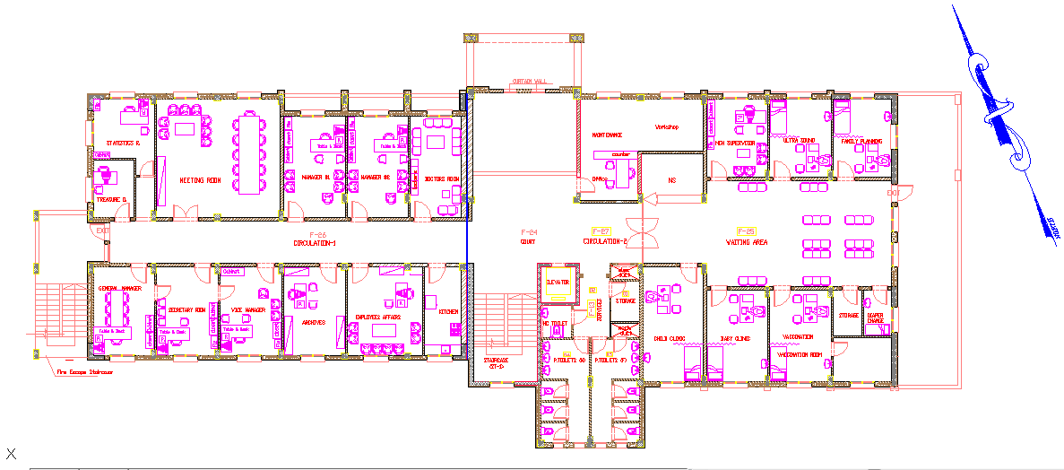
First Floor

Slide 12
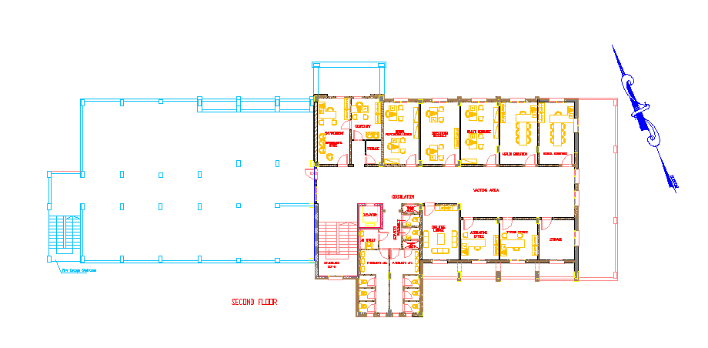
Second Floor

Slide 13
North ELE.

Slide 14
South ELE.

Slide 15
West ELE.

Slide 16
East ELE.

Slide 19
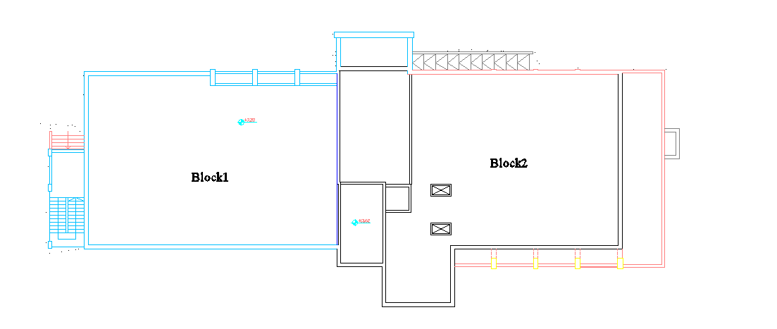
3
Structural Design

Slide 20
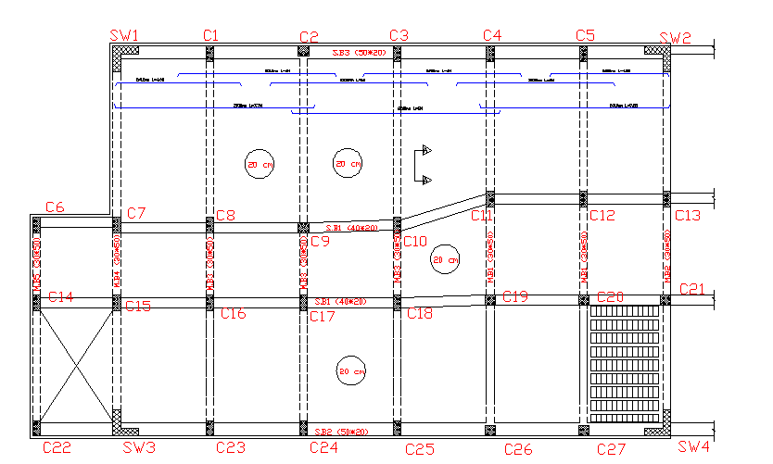
3
Structural Design

Slide 21
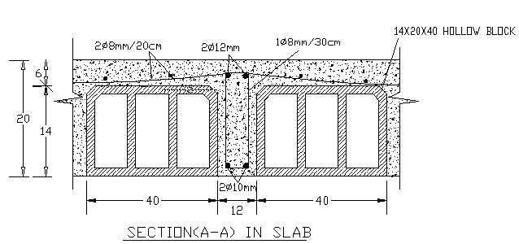
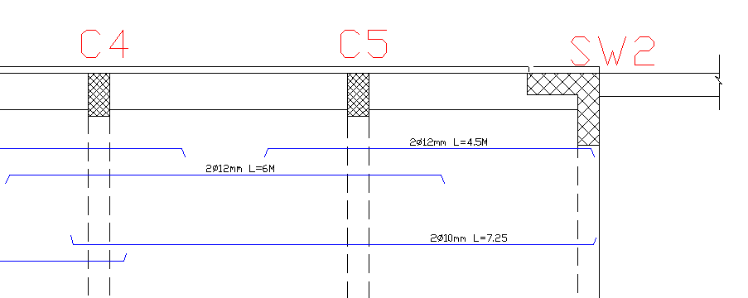
3
Structural Design
One way ribbed slab with drop beams
Slab thickness =20cm
Loads Used:-
Dead load (superimposed) = 3.5 KN/𝑚2
Live load = 4 KN/𝑚2

Slide 22
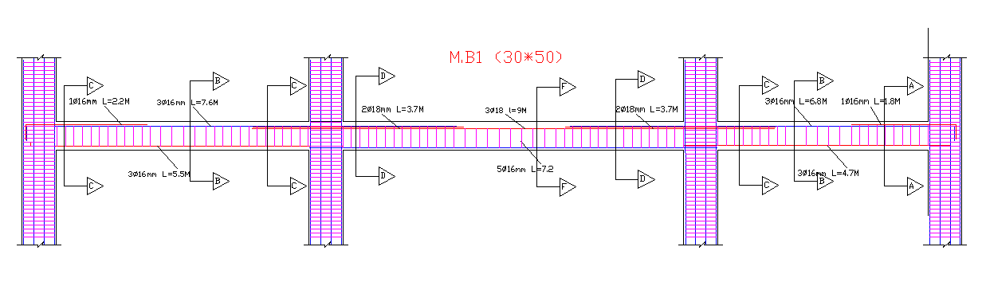
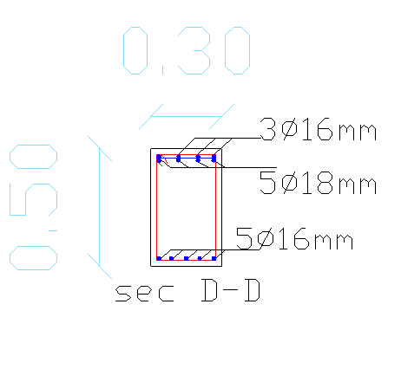
Main beam dimension (30*50)cm
Secondary beam dimension (50*20)cm

Slide 23
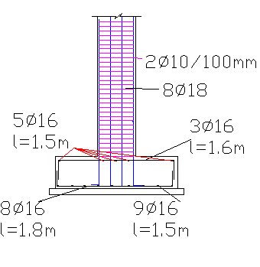
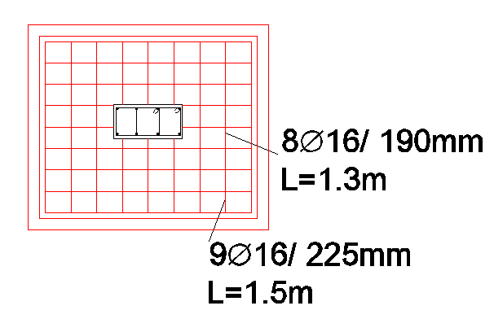
Column dimension(30*60) (40*40)cm
Footing design
Single footing

Slide 24
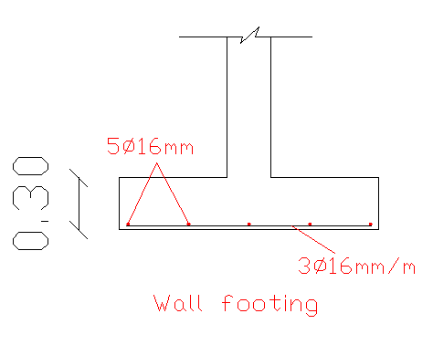
Shear Wall and Footing Reinforcement:

Slide 25
3
3D Structural
block2
block1

Slide 26
Deformed Shape For Block 2

Slide 27
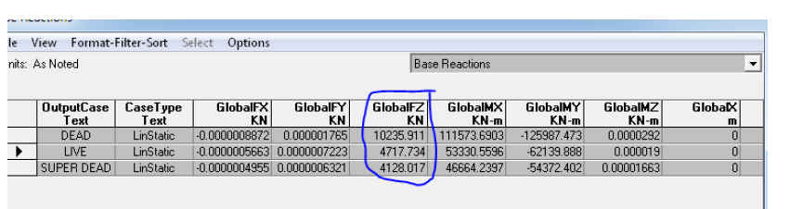
Equilibrium Check:
A ) Live load = are of floor *No. of floor *L.L
area of floors = 1240 m2
Live Load=4KN*1240=4960KN
B) Dead load
Slab (O.W)= (1240*.149*25)=4619KN
Beam weight=2340KN
(Columns +shear wall )weight = 3866KN
Total D.L=4619+2340+3866=10805KN
C) Super imposed= (3.5*1240)
= 4340KN

Slide 28
D.L % error = (manual calculation – sap calculation / manual calculation)
= (10805 – 10235 / 10805)
= 5 % …. Ok
L.L % error = (manual calculation – sap calculation / manual calculation)
= (4960– 4717 / 4960)
= 4.1 % …. Ok
S.I.D % error= (manual calculation – sap calculation / manual calculation)
= (4340 – 4128 / 4340)
= 4.8 % …. Ok

Slide 29
Internal Forces Checks:
Slab: We take the average moment from SAP and compare it with manual value.
Average moment (M) =4+4.5/2+14.5=18.75KN.M
Manual moment M = wu*L^2 / 8=14.9*3.3^2/8
=20KM.M
Moment % error = (manual calculation – sap calculation / manual calculation)
= (20 – 18.75) / 20 = 6.2% OK

Slide 30
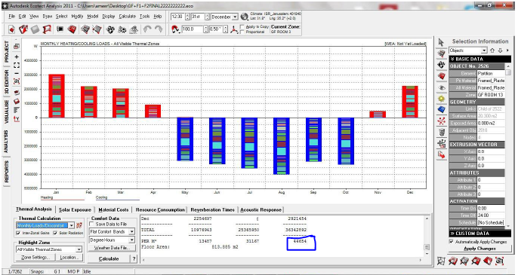
4
Environmental Design
Heating and Cooling Load
44KW/m2

Slide 31
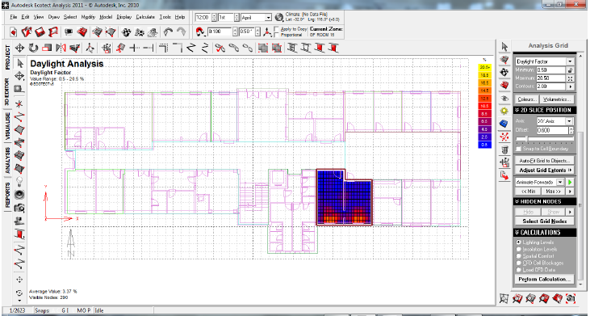
Daylight Factor
3.37%

Slide 32
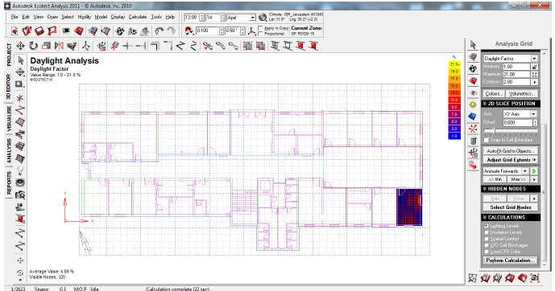
4.9%

Slide 33
Acoustical Design:-
RT₆₀ = 1.18 second.
%Alcons = 10 is acceptable
The range of the Reverberation time 0.6< RT₆₀ < 1.4

Slide 34
STC calculations :-
Room to adjacent room STC=52dB
Room to corridor STC=42.2 dB
Room to outside STC=41.1dB
ICC = 50dB

Slide 35
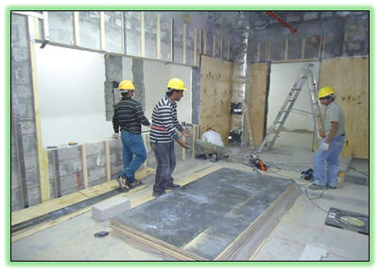
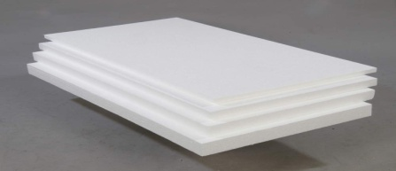
Insulations Material
Materials like Foam, rubber and polystyrene, Fiberglass
.
Polystyrene layers
Lead sheet

Slide 36
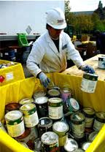
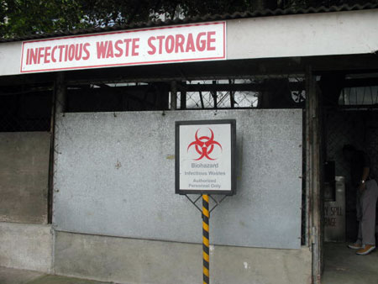
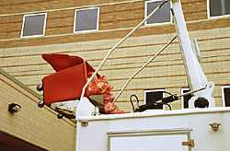
Medical waste management :-
Proper disposal of waste :-
All infectious waste and sharps containers :Incineration
All Domestic waste : Landfill
All hazardous waste : Chemical treatment before disposal

Slide 37
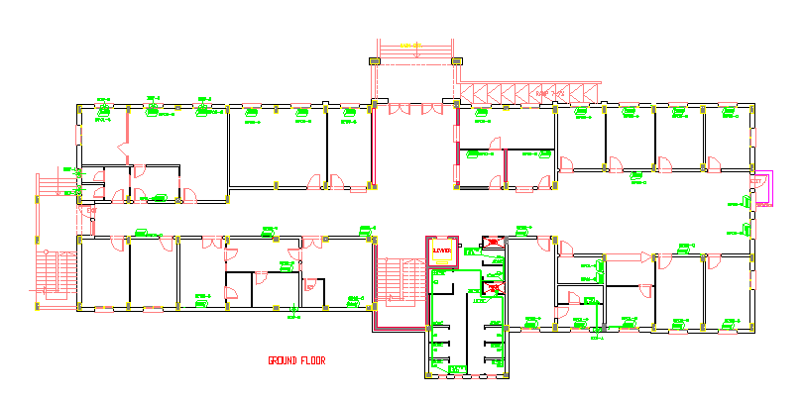
5
Mechanical Design And Safety system :-
Heating and cooling systems:-
Split unit

Slide 38
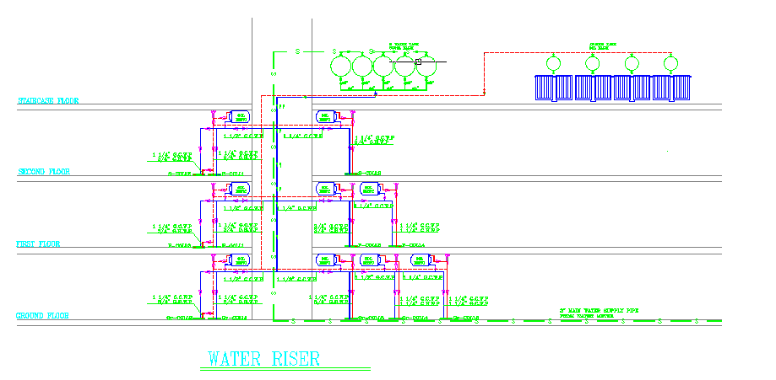
Water Supply System :-

Slide 39
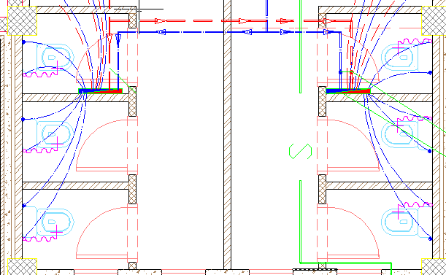

Slide 40
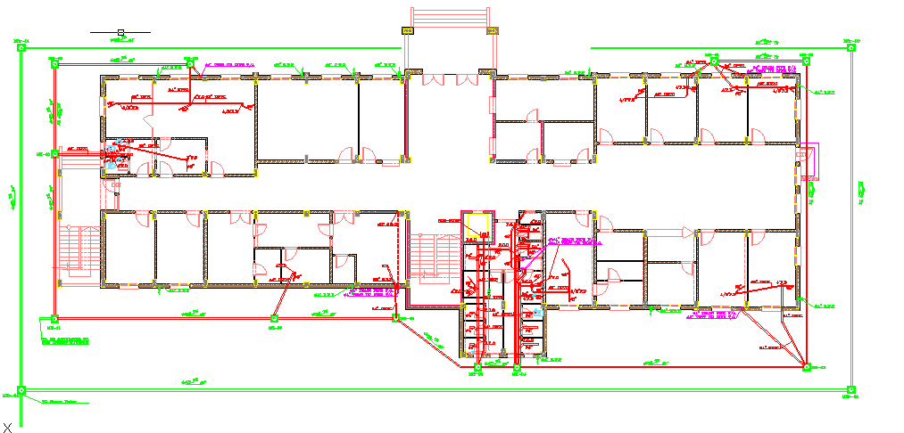
Drainage System:-

Slide 41
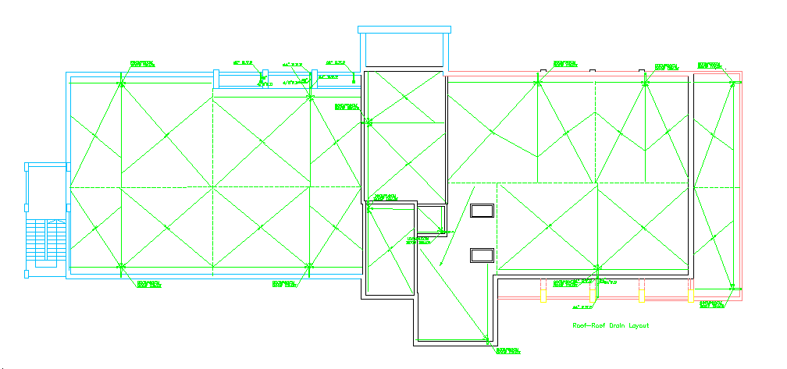
Rain water Drainage :-

Slide 42
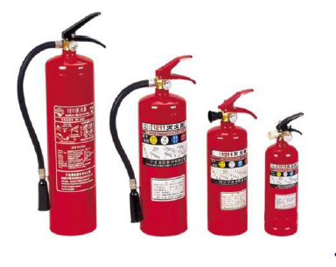
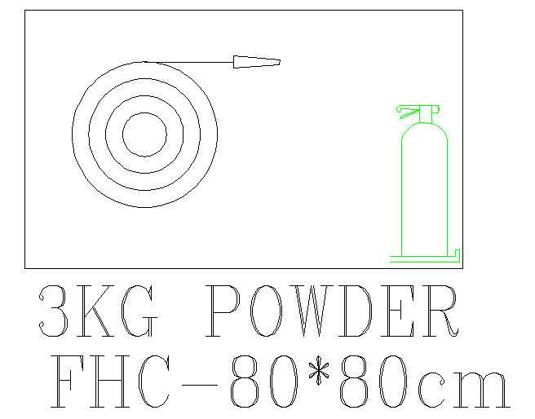
Safety system:-
Smoke Detectors
Fire extinguishers
Fire House Cabinet

Slide 44
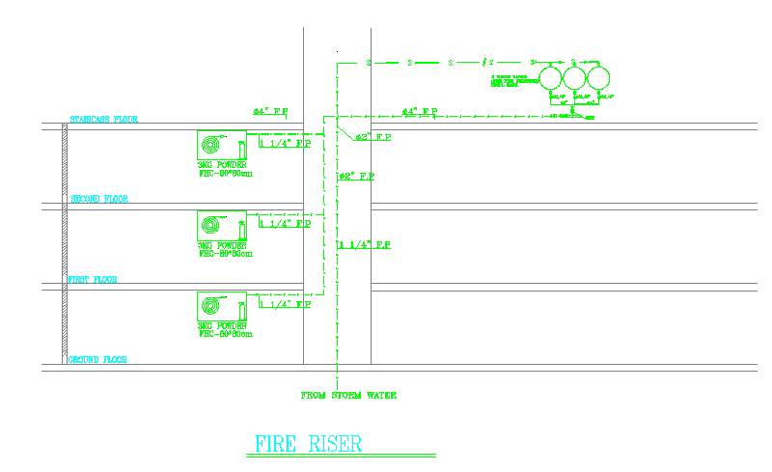

Slide 45
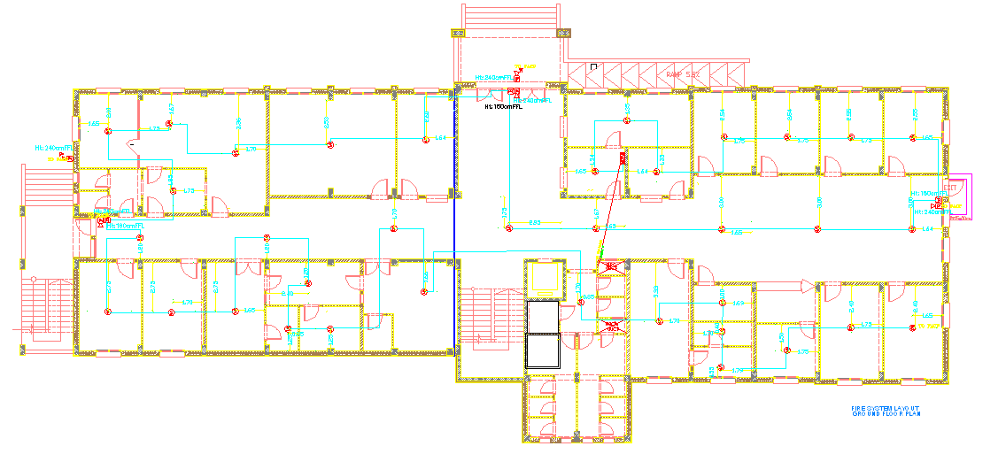
Fire system alarm layout :-

Slide 46
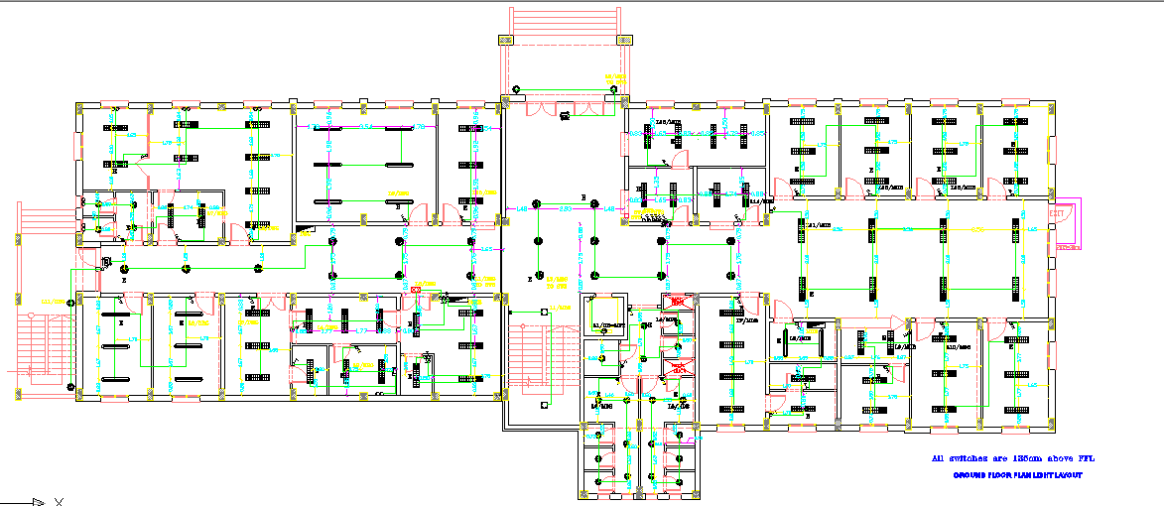
6
Electrical Design

Slide 47
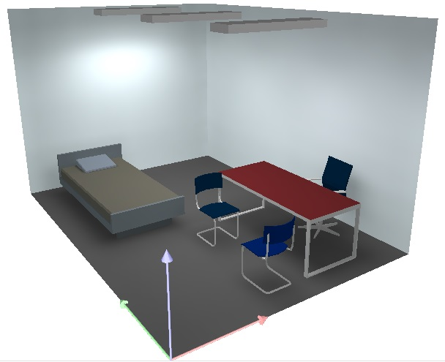


3 luminaries are need for offices
The uniformity > 50% it's ok

Slide 48
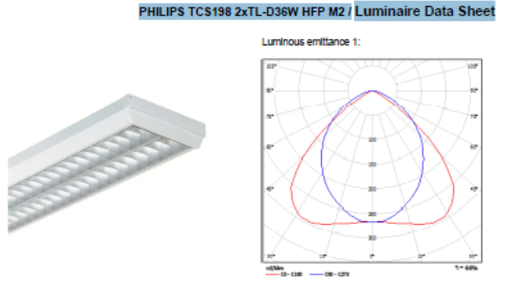
In Office room used Philips lamp

Slide 49
7
Quantity Surveying and Cost Estimation
The total price for the health center is 3.808422 million shekel.
The price for m² for the concrete structure 1904.22NIS/m²

Slide 50
Thank You

