Slide 1


CIA: CleanItALL
Abdalsalam Jodalah
Shehab Al-dein Kharaz
-
Dr.Anas Toma

Slide 2


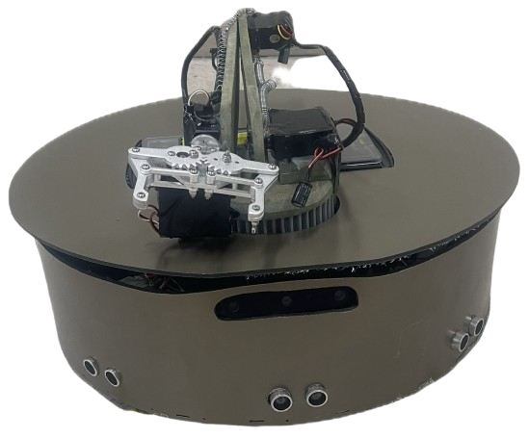
About CIA
Different Cleaning Modes.
Object Detection and Objects Removal using the AI model.
- Movements pattern.

Slide 3


Agenda
Introduction | 3
CIA Stages | 4
Idea & Design | 5
Body & Movement | 6
Cleaning | 7
Arm & Camera | 8
Mobile App | 9
Constrains | 10
Future work | 11
Demonstration | 13

Slide 4
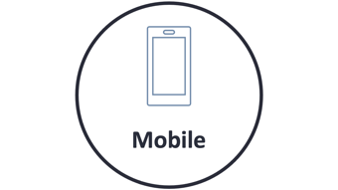
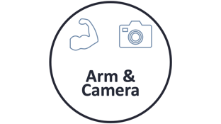



CIA Stages

Slide 5

Idea & Design

Slide 6
Idea & Design

Slide 7

Idea
  Motivation and initial concept.
  Integrating cleaning with object Removing.
  The problems that the CIA aims to solve:
    Automated cleaning.
    Handling different debris types.
    Mopping floors.
Idea & Design

Slide 8

Body & Movement

Slide 9
Body & Movement

Slide 10
Body
Materials Used:
  Wood for the base.
  Aluminum (Alcabond) for the height and top part.
Dimension:
  Radius: 40 cm.
  Arm length: 50 cm when it is extended.
Body & Movement

Slide 11
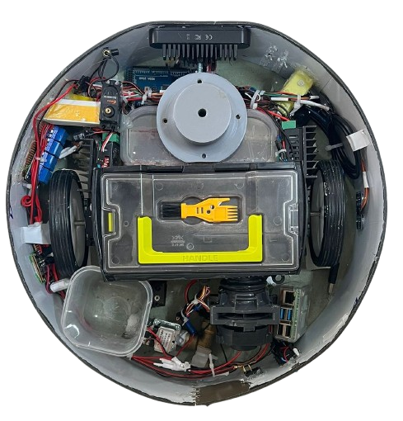
Body & Movement
Movement System:
Stepper motors are used for precise control and movement.
Navigation System:
  Ultrasonic sensors, IR sensors, and Camera were implemented to avoid obstacles and detect stairs.

Slide 12

Cleaning

Slide 13
Cleaning

Slide 14
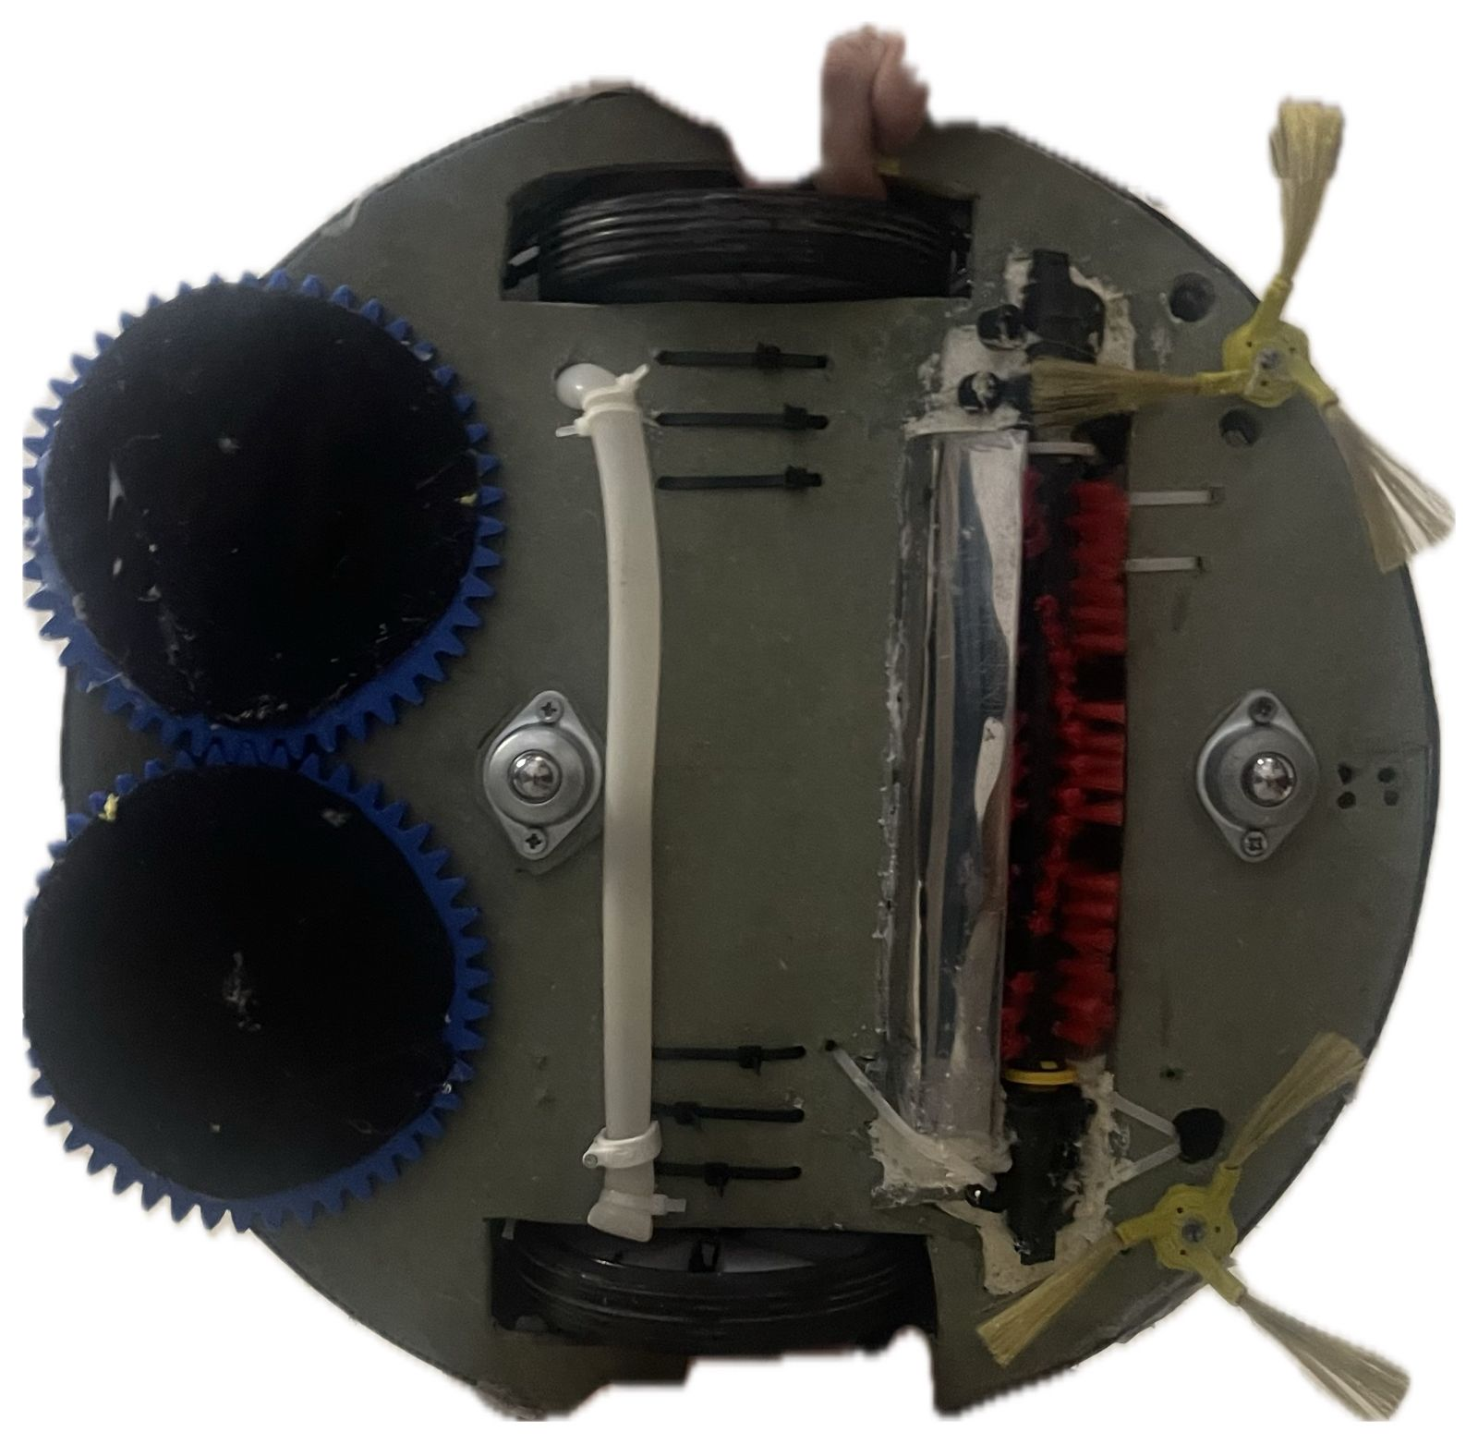
Cleaning
- Front brushes.
- Main brush.
- Vacuum Motor and dustpan.
- Water Valve.
- Side Brushes & Mops.

Slide 15


Arm & Camera

Slide 16
Arm & Camera

Slide 17
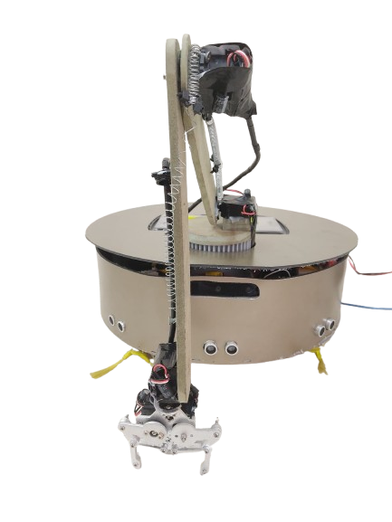
Arm & Camera
Arm
  Consist of 5 Servos -> 5 DOF.
  Pick up Objects using a Metal griper.
  Main body: Wood and spring for support.
Camera
  OAK-d Full HD Camera.
  Using AI Model and OpenCV for object detection
Robotic Arm:
- Consist of 5 Servos.
Discuss how the arm picks up objects and places them in a dedicated area on the robot. The arm has 3 degrees of freedom (DOF) for flexibility.
Object Recognition with OAK-D Camera:Explain how the OAK-D camera uses object recognition technology to detect and locate trash. Mention its 100% accuracy during testing.
Integration:Highlight how the robotic arm works in sync with the camera, collecting trash that the camera detects.

Slide 18

Mobile

Slide 19
Mobile

Slide 20
Mobile
Mainly, 3 pages:
  Home page.
  Manual control.
  Settings.
Connection Done via WebSocket between mobile and Server.
The server is hosted locally in Raspberry.

Slide 21
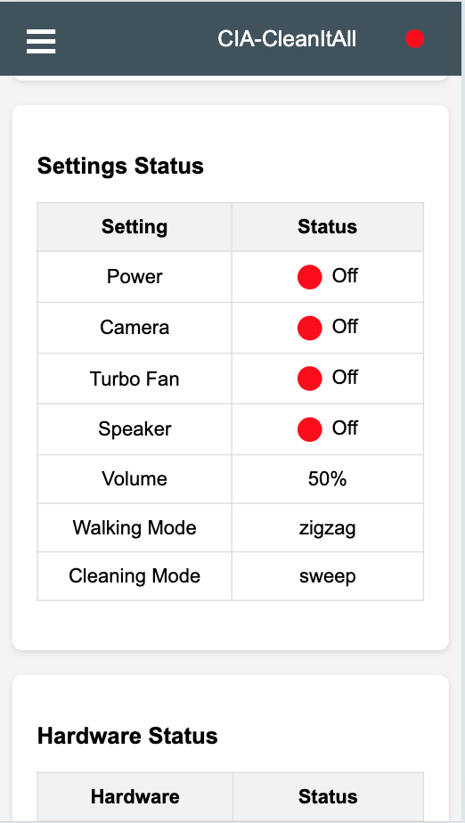
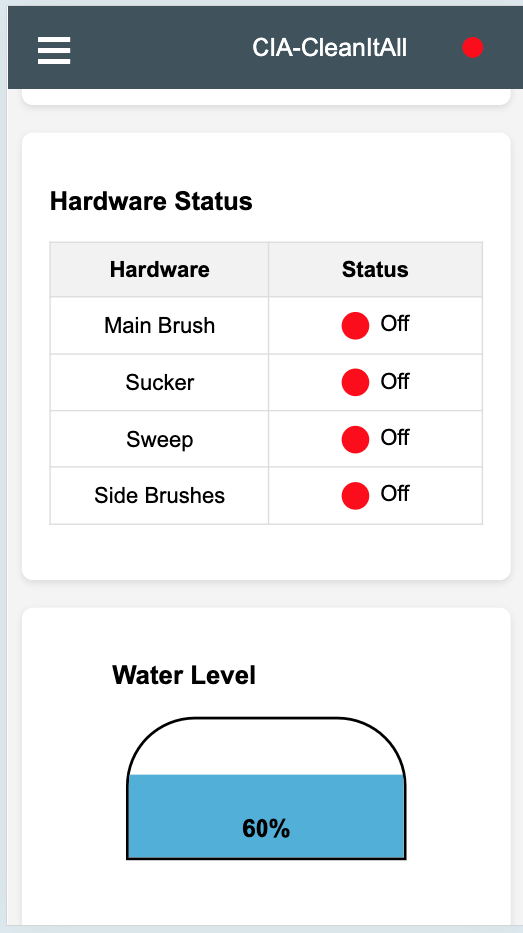
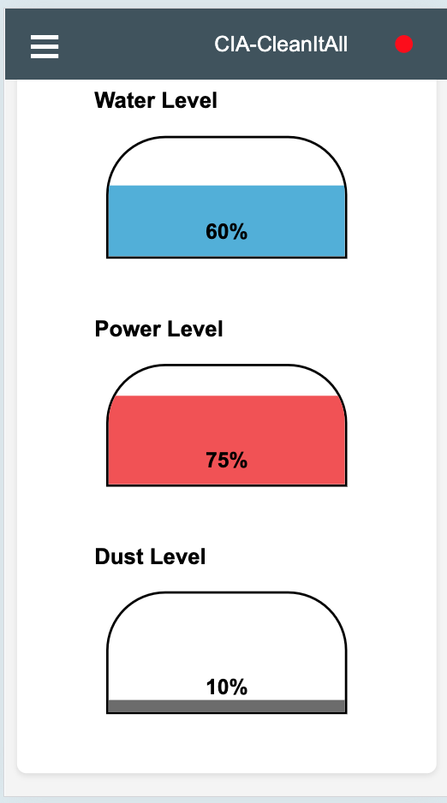
  Home page

Slide 22
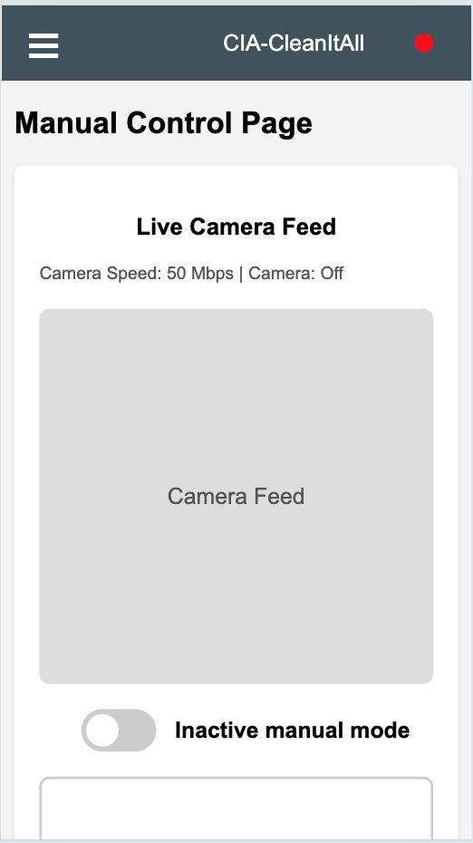
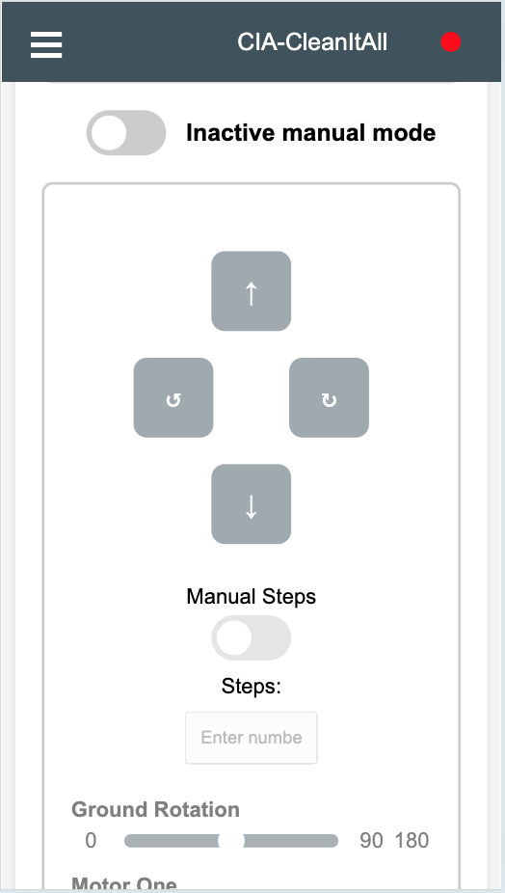
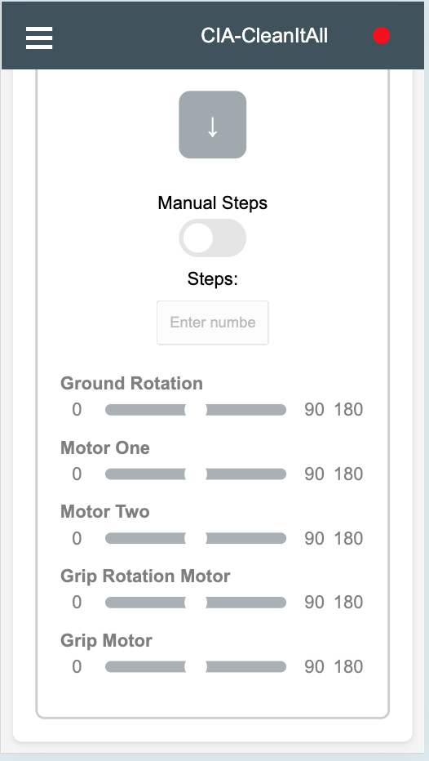
  Manual Control

Slide 23
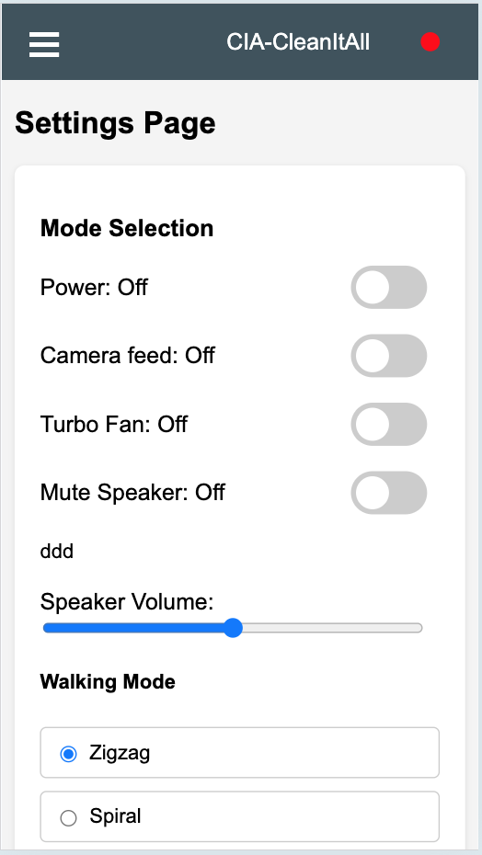
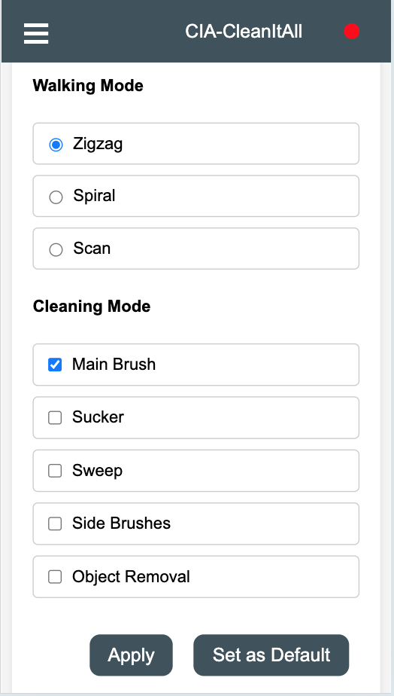
  Settings

Slide 24
Constraints
  Time, Time, Time …. N, where N → ∞
  Size.
  A lot of things related to size(power).
  Some ICs like LIDAR(Light Detection and Ranging).

Slide 25
Future work
Several objects (trach) types detection for Camera.
Integrate other Movement modes.
Scan the map to the mobile and add the user interactive map.
Add the functionality to let the arm remove non-trash objects.
Automated power charging and water fill in.

Slide 26
Demonstration
1- Test antiFall.
2- test 2

