Slide 1

Ease
Pal

Slide 2

Group
Members:

Slide 3




OutLine:

Slide 4


Problems:
01
When you want to get done with a governmental document, you will need to take many days off of your work to be able to get things done. which costs a lot of time and energy.
02
Searching for centers that work with and help people with special can be hard and you may not find a center that match your requirements.
03
Searching for schools and universities to find a suitable one may be hard for some parents and students
Donating to orphanages and sponsoring orphans can be hard and risky if you don’t have a secure link that can make you sure that this donation is gonna reach the righ hands.
04

Slide 5
Our Solutions:
01
Now, using PalEase you can apply for the governmental document you would like to have, and just wait for the worker to tell you it is ready, so you now go to the governmental office just once, which saves you time and energy.
02
All the centers now are in one place, you can check for them and apply for what suits you.
03
Schools and Universities are all in one place, with advanced filtering so you can decide which school or university you would like to apply or move into.
Orphanages information and donation links are available in the app, you can donate your money with you heart at ease.
04

Slide 6
Mobile
App

Slide 7

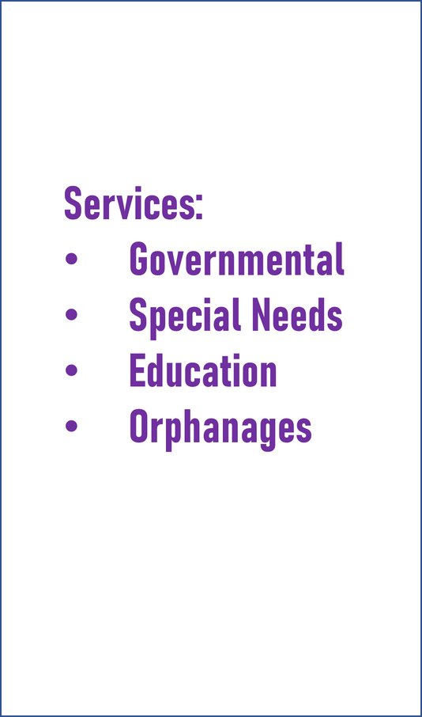



Application
Features:

Slide 8

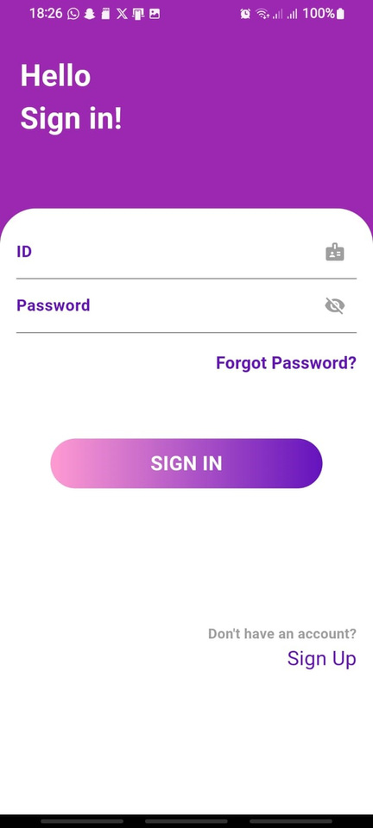
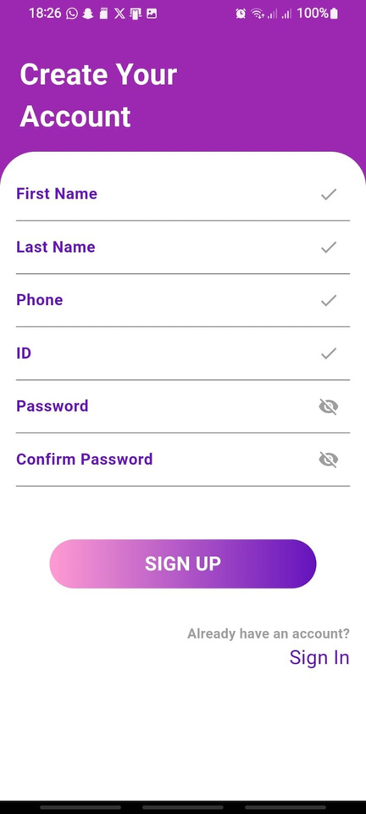
Sign in
&
Sign Up

Slide 9
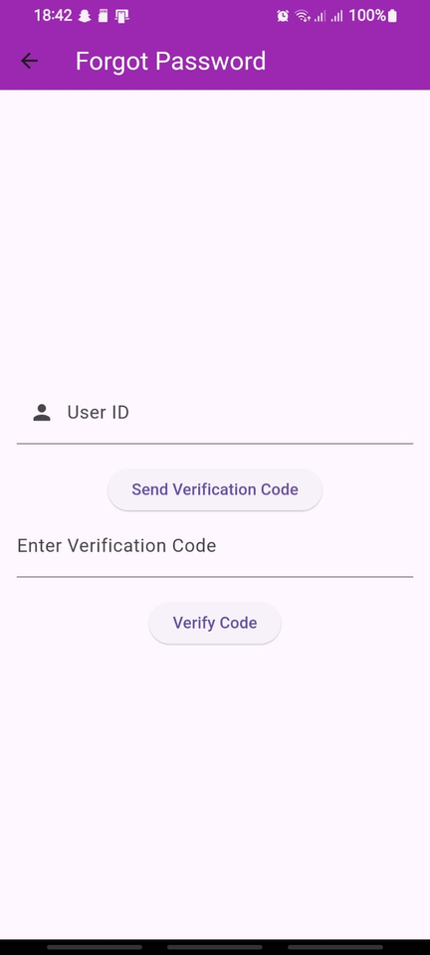
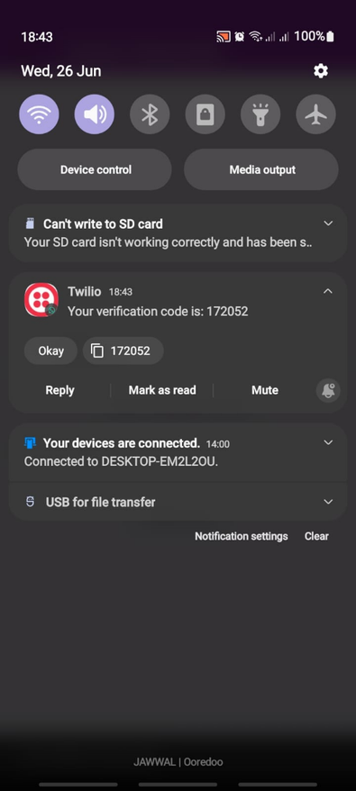
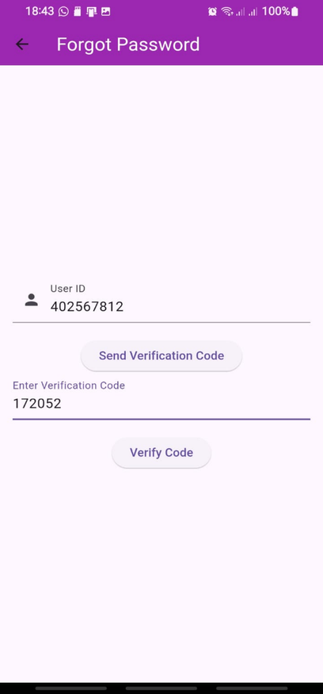
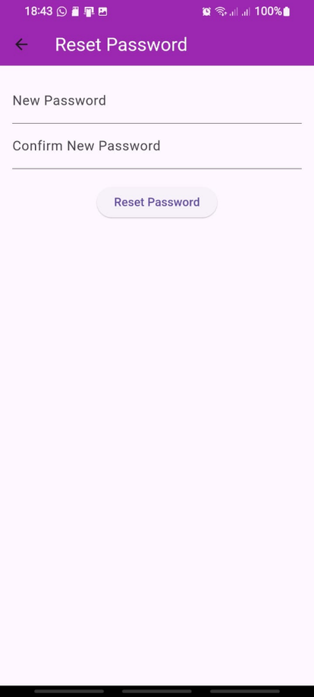
Reset
Password

Slide 10
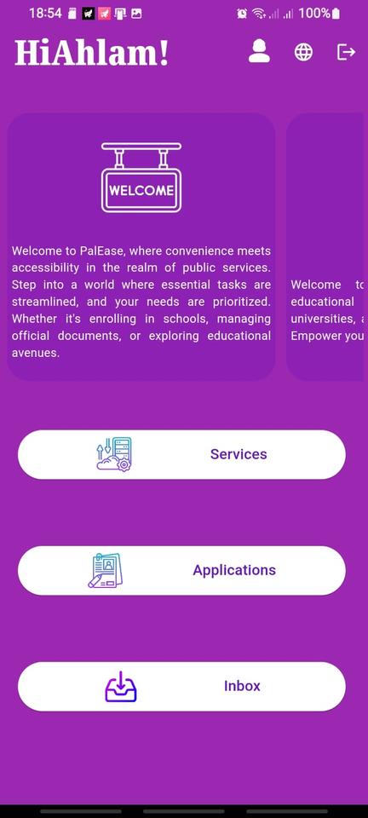
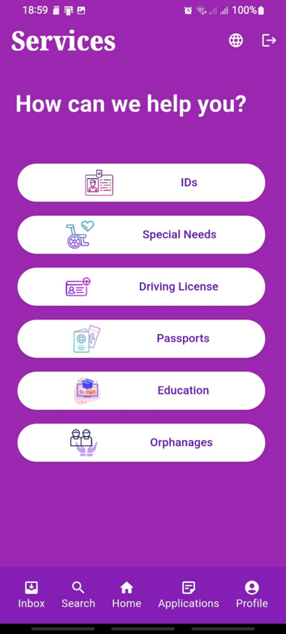
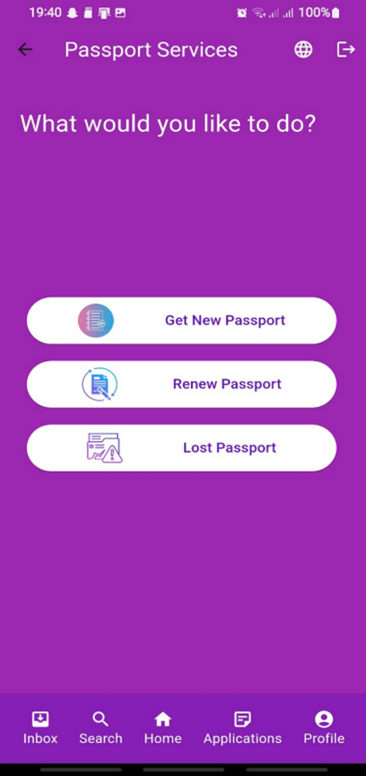
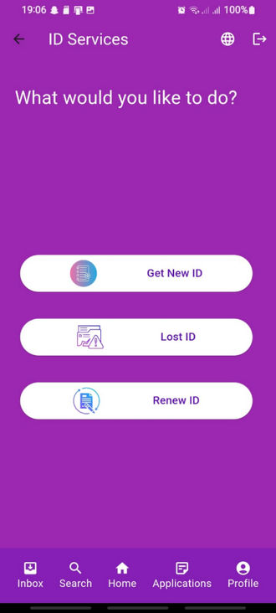
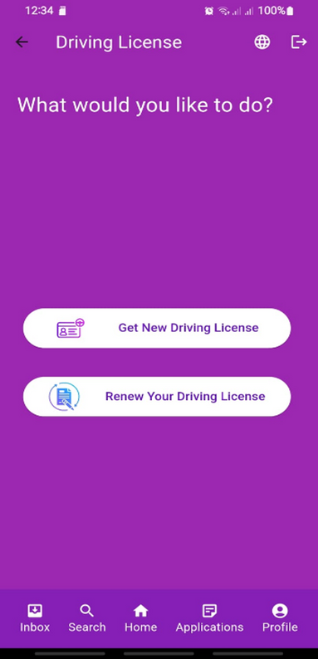
Our Services

Slide 11
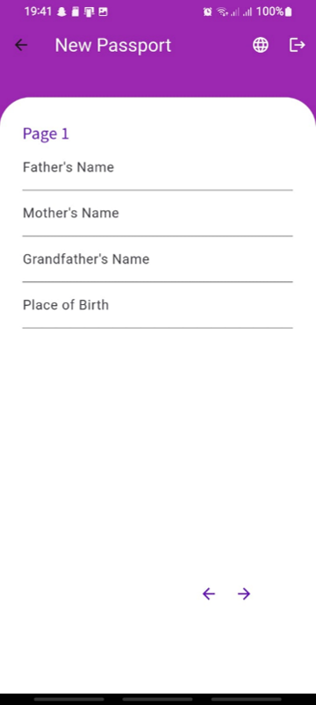
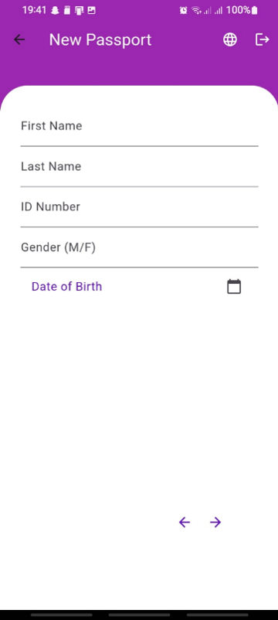
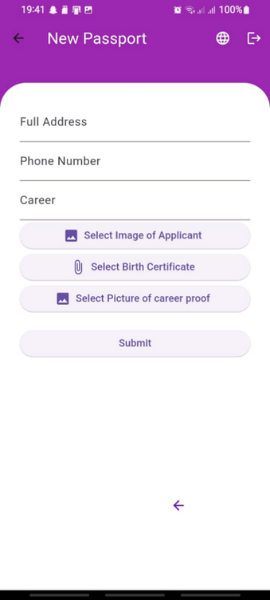
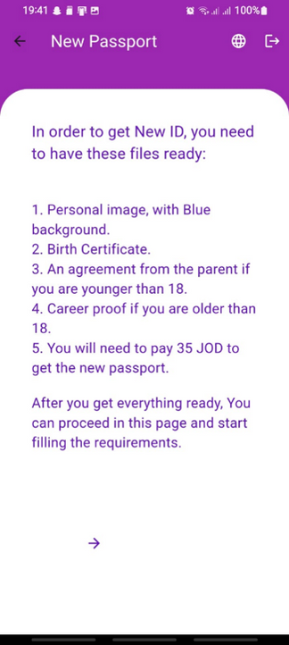
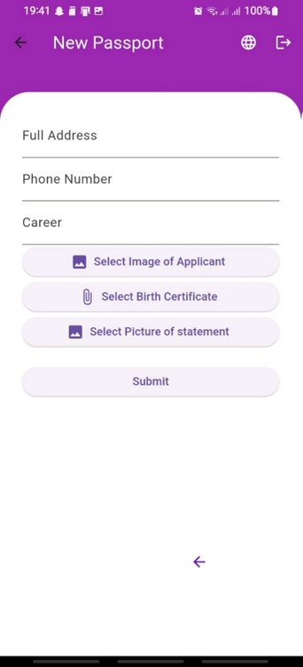
Govermental Forms

Slide 12
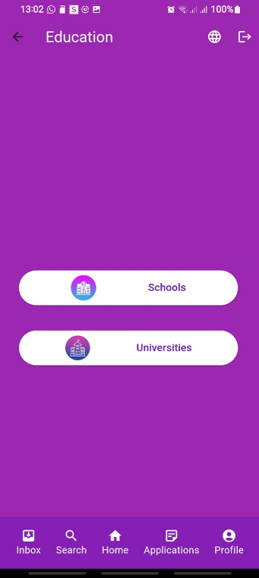
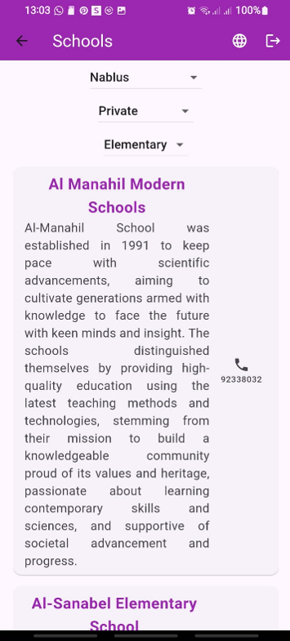
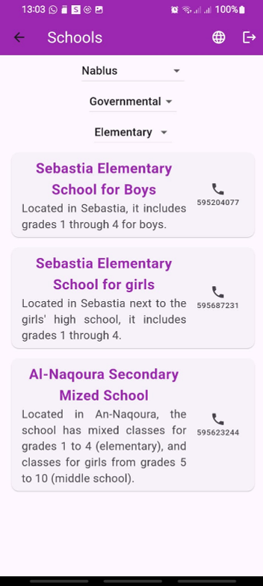
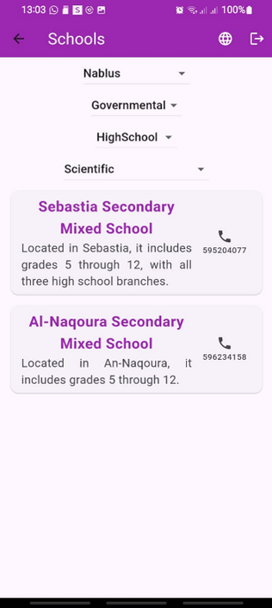
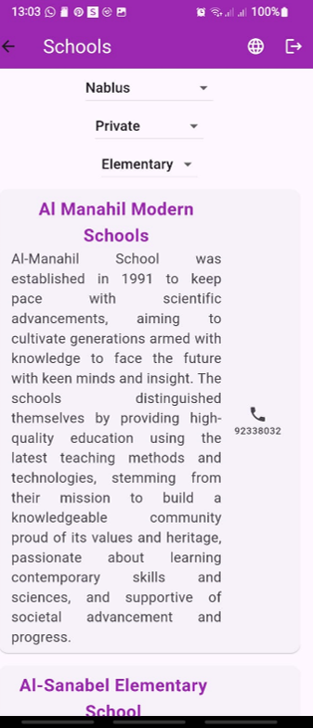
Education: Schools

Slide 13
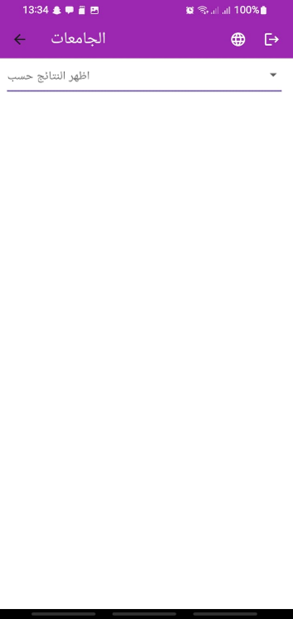
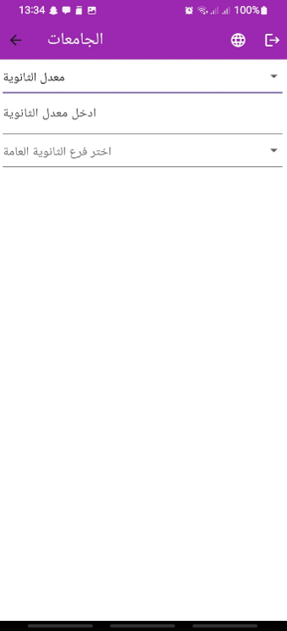
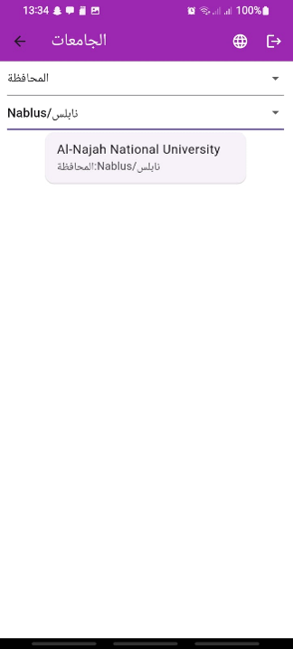
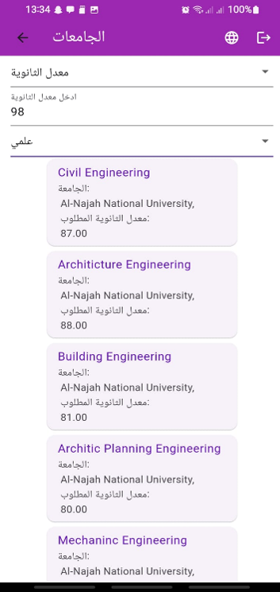
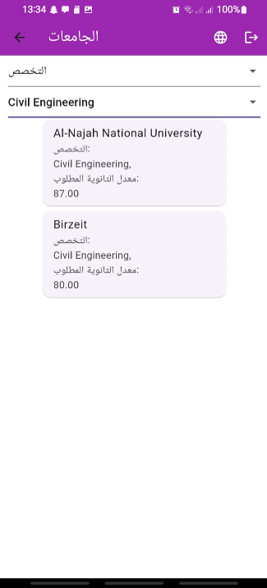
Education: Universities

Slide 14
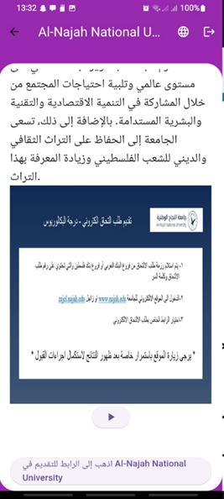
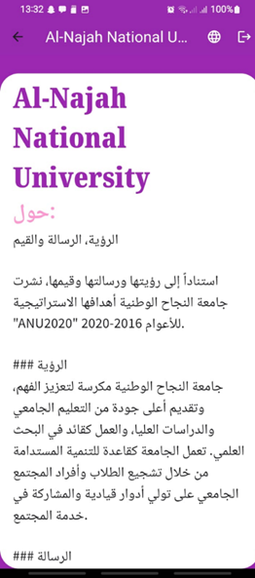
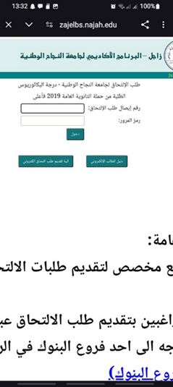
University Info

Slide 15
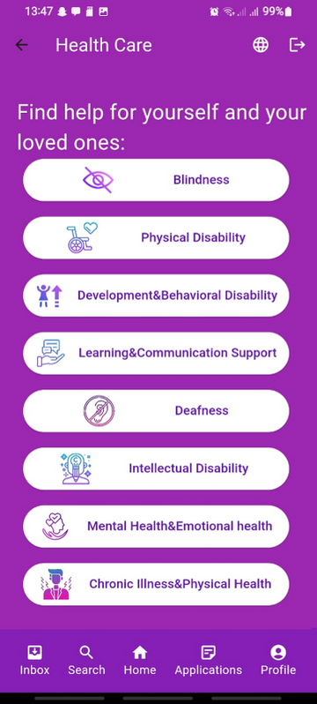
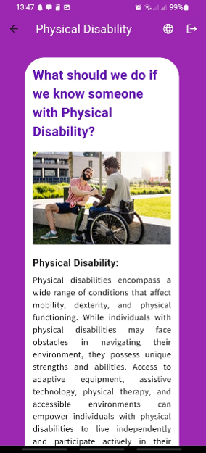
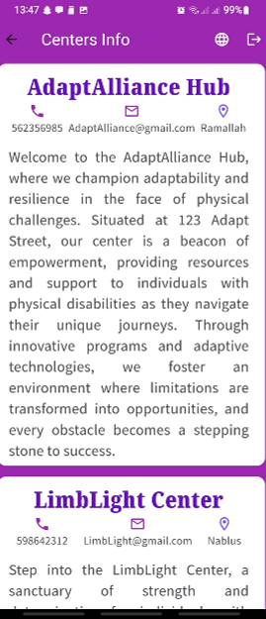
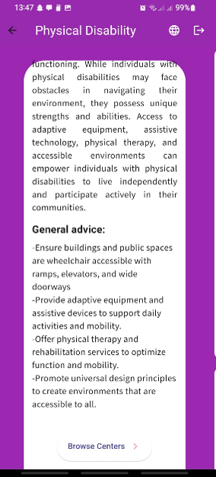
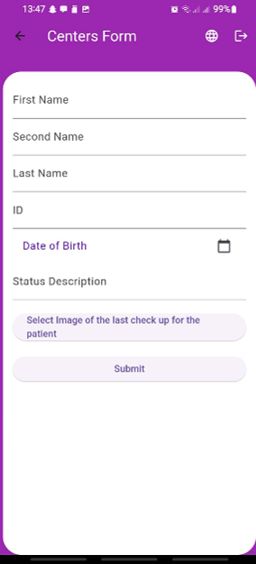
Special Needs

Slide 16
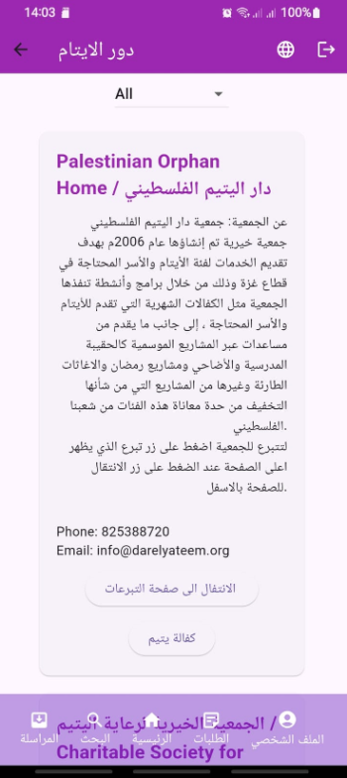
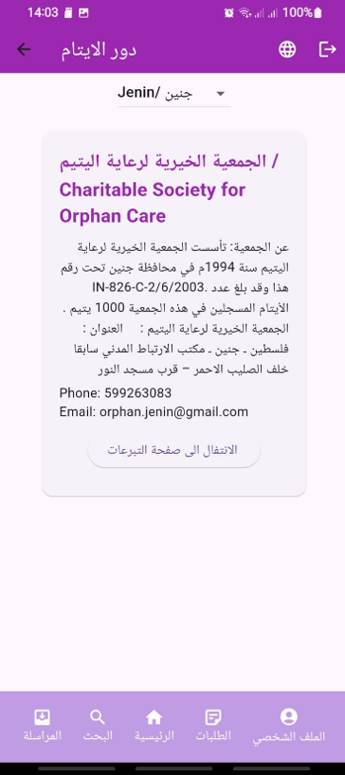
Orphanages

Slide 17
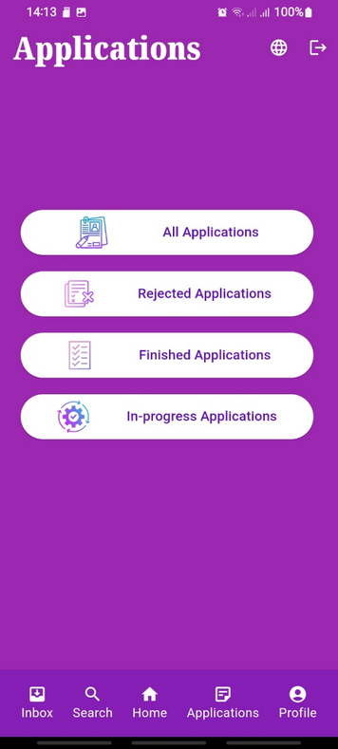
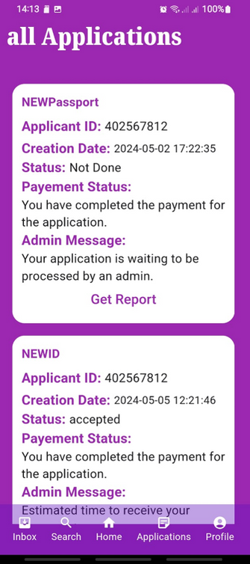
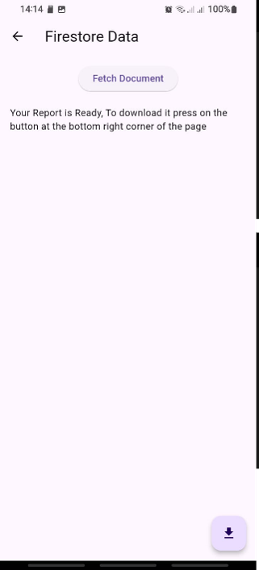
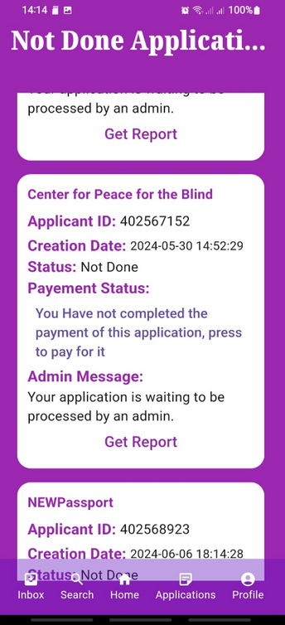
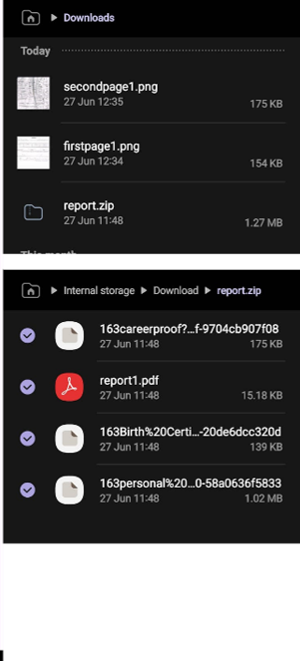
Applications

Slide 18
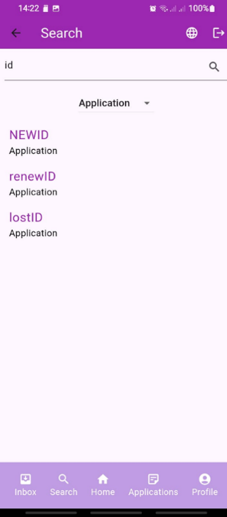
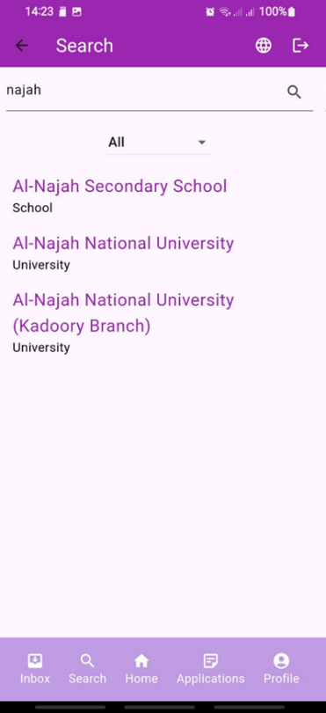
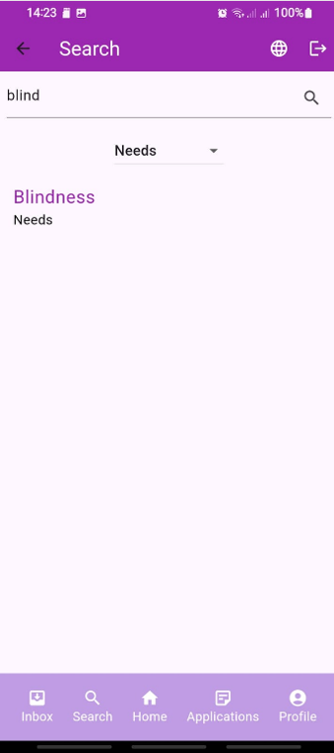
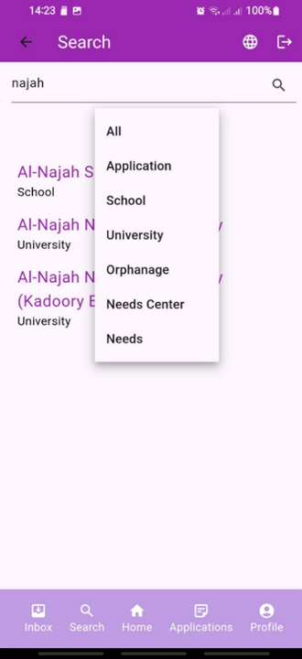
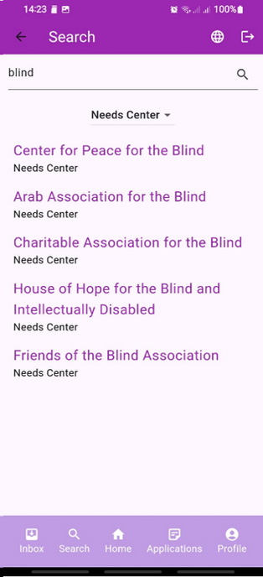
Search Page

Slide 19
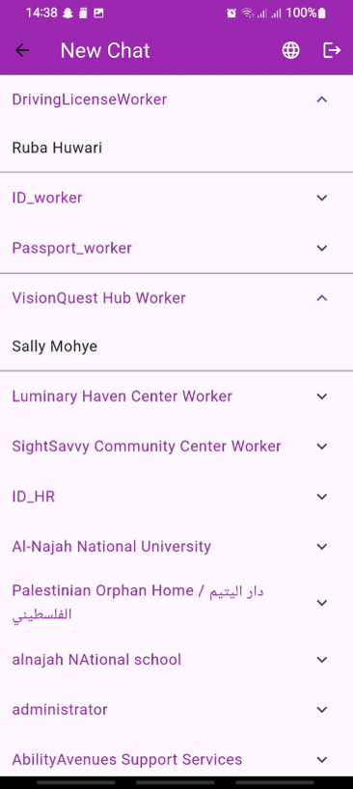
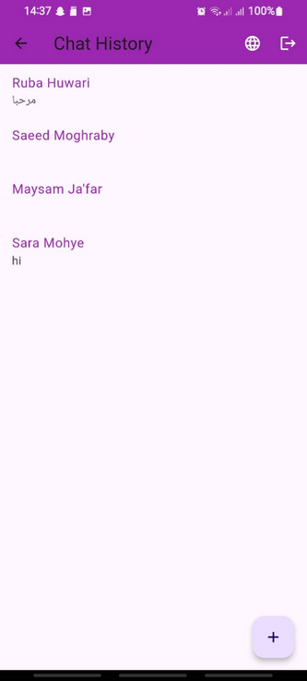
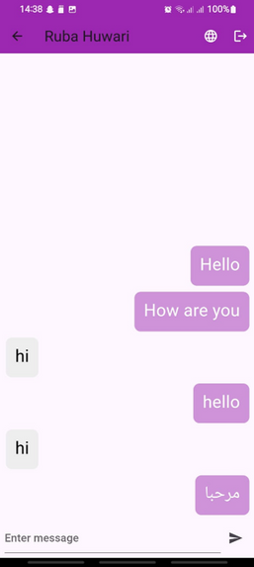
Chat Page

Slide 20




Payment:

Slide 21

Profile
Page

Slide 22

Website

Slide 23

Sign In

Slide 24

Forgot Password

Slide 25

Reset Password

Slide 26

Sign Up
Page

Slide 27

Worker
Sign Up

Slide 28

Governmental worker- Dashboard

Slide 29

Governmental worker- Applications

Slide 30

Governmental worker- Applications

Slide 31

Governmental worker- Applications

Slide 32

Governmental worker- Applications

Slide 33

Applications
Processing- processed Application

Slide 34

Applications
Processing

Slide 35

Applications
Processing-
Rejection

Slide 36

Applications
Processing-
Acceptance

Slide 37

Notification

Slide 38

Notify
Page

Slide 39

Notification

Slide 40

Chat
Page

Slide 41

Chat
Page

Slide 42

Chat
Page

Slide 43

School
Worker

Slide 44

University Worker

Slide 45

University Worker

Slide 46

University Worker

Slide 47

Special-Needs Center
Worker

Slide 48

Special-Needs Center
Worker

Slide 49

Special-Needs Center
Worker

Slide 50

Special-Needs Center
Worker

Slide 51

Orphanages
Worker

Slide 52

Administrator

Slide 53

Administrator

Slide 54



Future Work
In the Future Many more services can be added to the application, as Court services, Bank services, Clinics and hospital and much more services that can serve the Palestinians.
01
02

Slide 55
Thank You

