Slide 1


Mechanic Workshop
Deyaa Bani jaber
Supervisor: Dr. Manar Qamhieh
Omar Zaqout

Slide 2

TABLE OF CONTENT
  Why?
  Main Idea
  Technology and Strategy
  System Rloes
  Future work

Slide 3





Why?
Traditional car workshops suffer from poor organization and slow diagnostics.
We developed a smart system using AI to manage workshops efficiently and analyze faults quickly.
The goal is to enhance the experience for all users with real-time updates and an easy interface.
Calle Cualquiera 123, Cualquier Lugar

Slide 4
MAIN IDEA
To build an intelligent and user-friendly application for managing car repair workshops, integrating AI for faster diagnostics and using real-time communication to improve efficiency for all users.

Slide 5






IDES & Frontend Technology
VS Code
Android Studio
Flutter

Slide 6




Backend & Intelligent Processing
Node.js
MongoDB
Python
Colab

Slide 7



Cloud Services & Deployment Infrastructure
Cloudinary
Firebase
Render

Slide 8





SYSTEM RLOES
Admin
Owner
Employee
Client

Slide 9

FEATURES

Slide 10
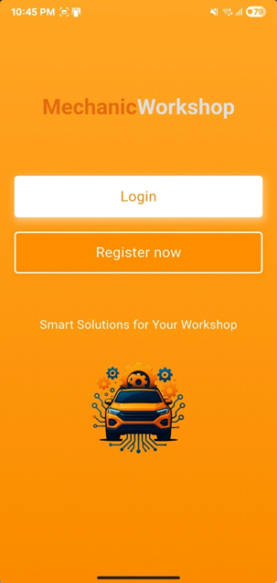

Welcome screen

Slide 11
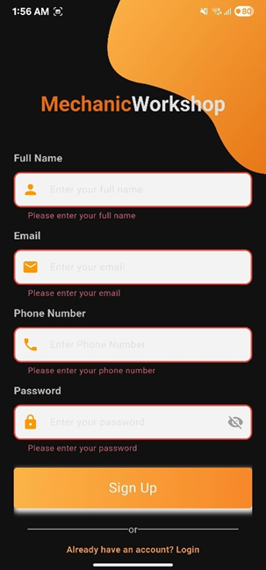
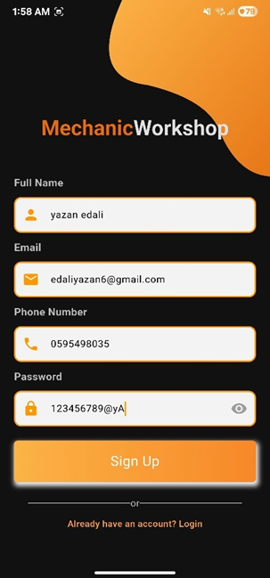
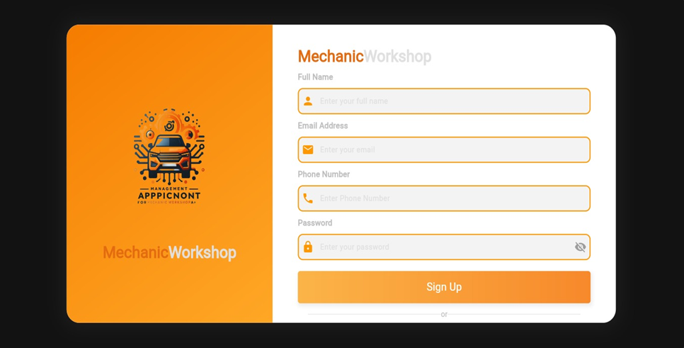
Authentication Screens
Sign-up screens

Slide 12
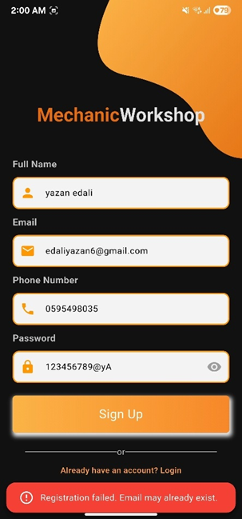
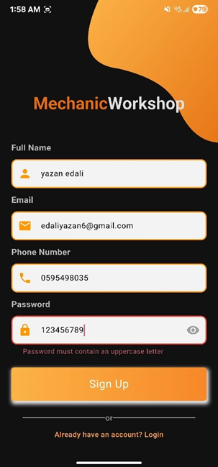
Authentication Screens
Sign-up screens

Slide 13
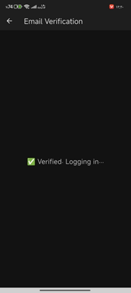
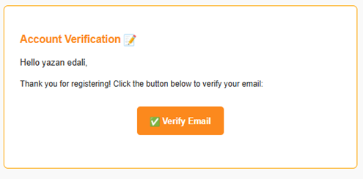
Authentication Screens
Veirification

Slide 14
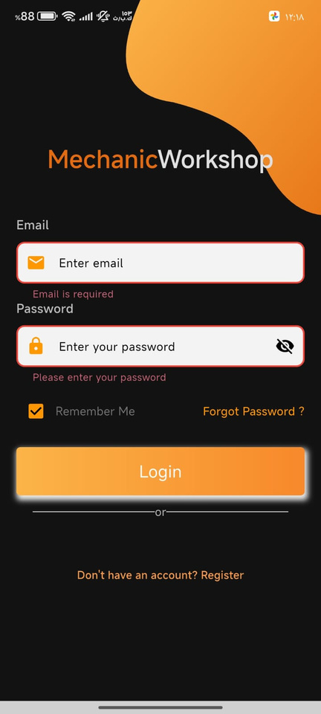
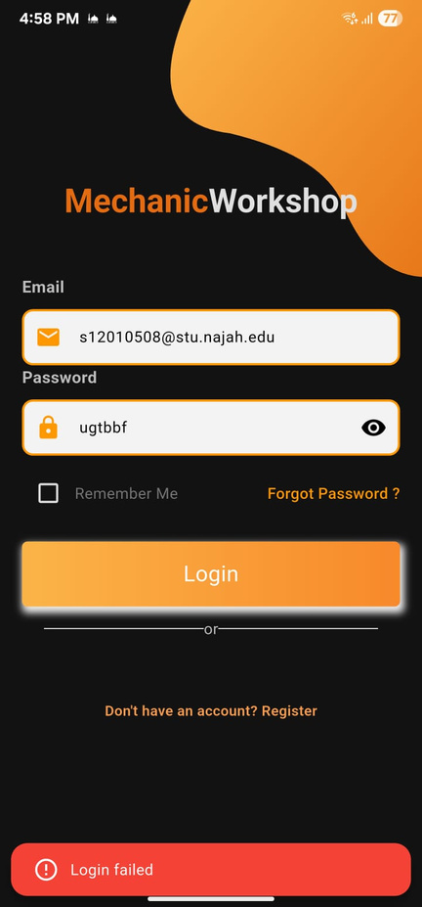
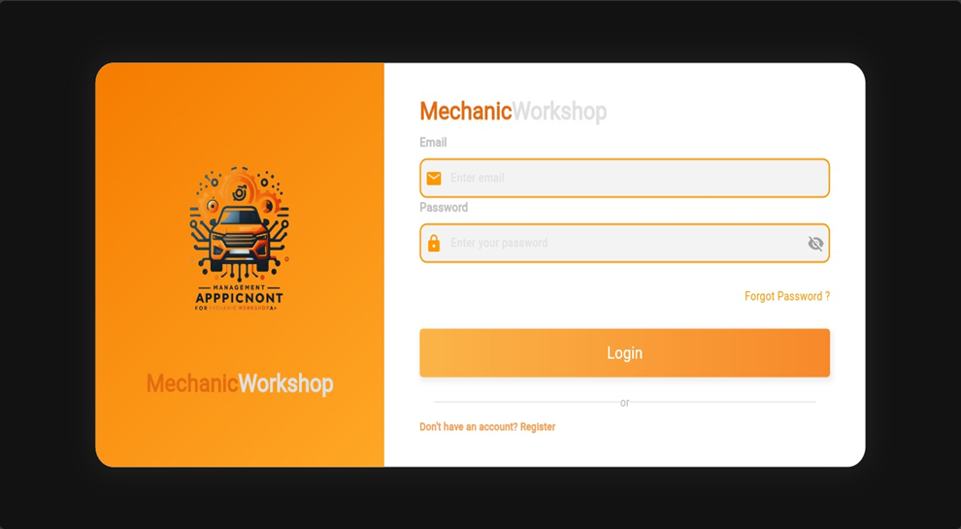
Authentication Screens
Login Screen

Slide 15
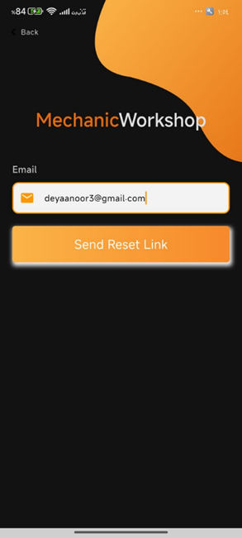
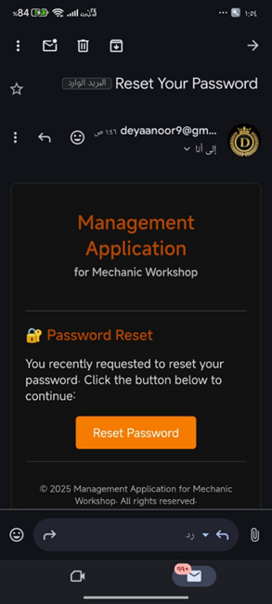
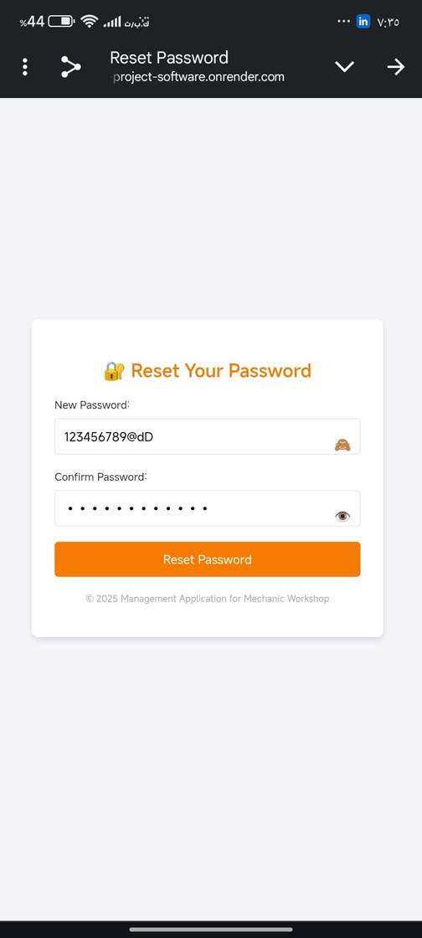
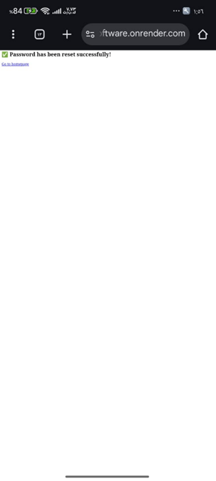
Authentication Screens
Forgot Password Screen

Slide 16

Admin

Slide 17
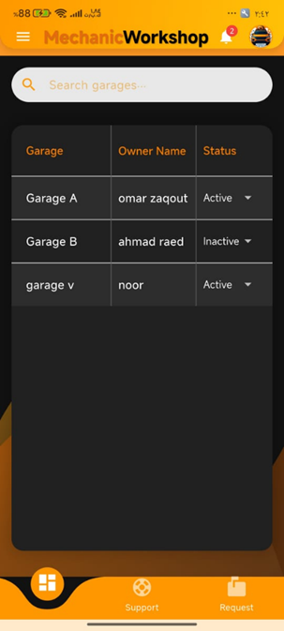
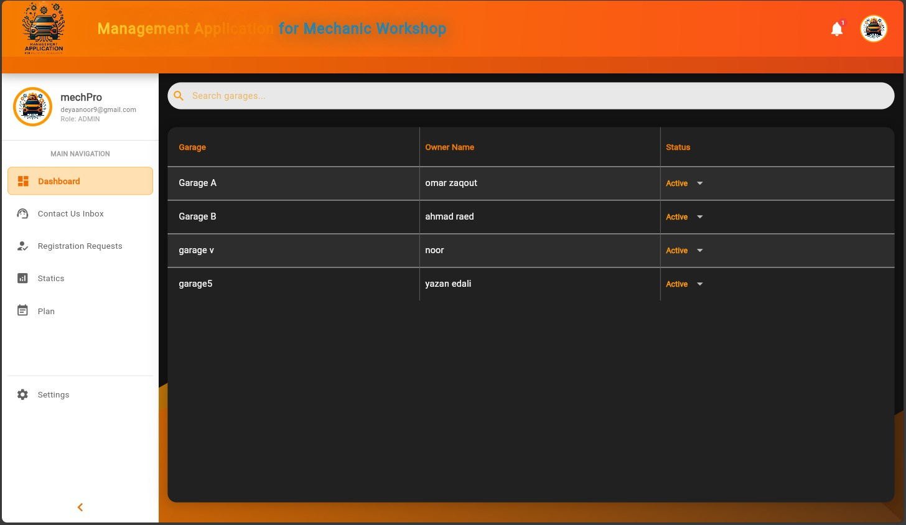
Dashboard Page

Slide 18
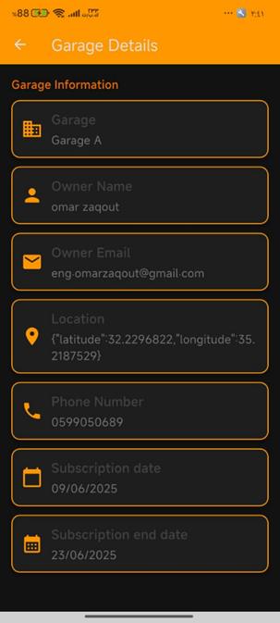
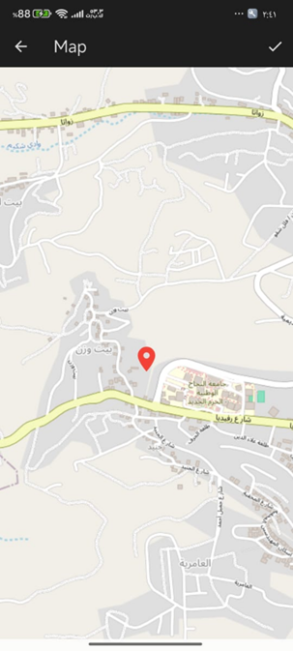
Dashboard Page

Slide 19
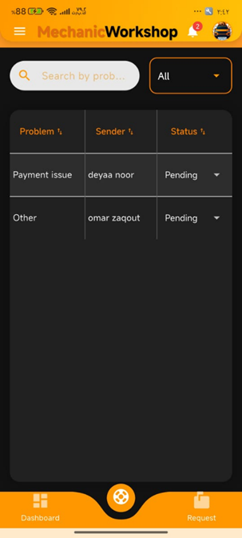
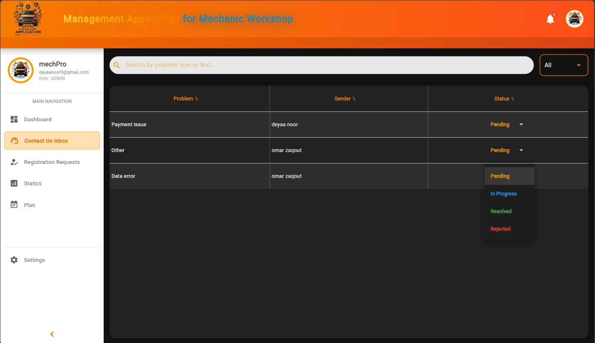
Support Page

Slide 20
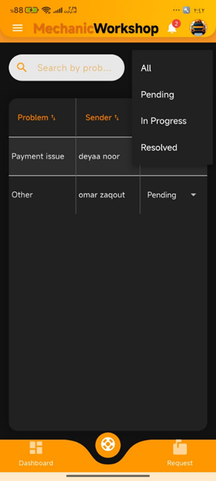
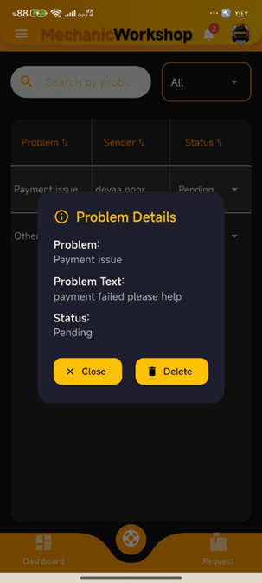
Support Page

Slide 21
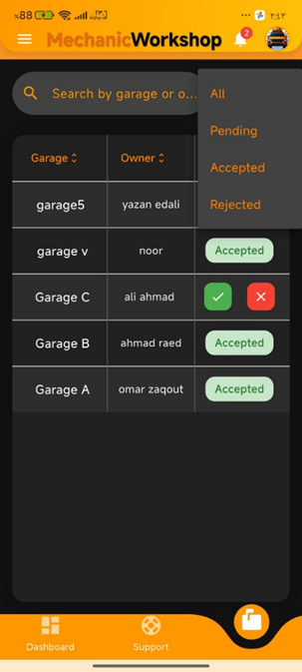
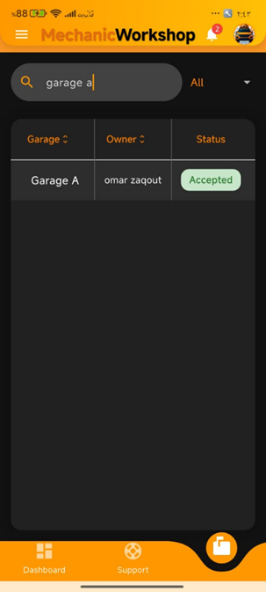
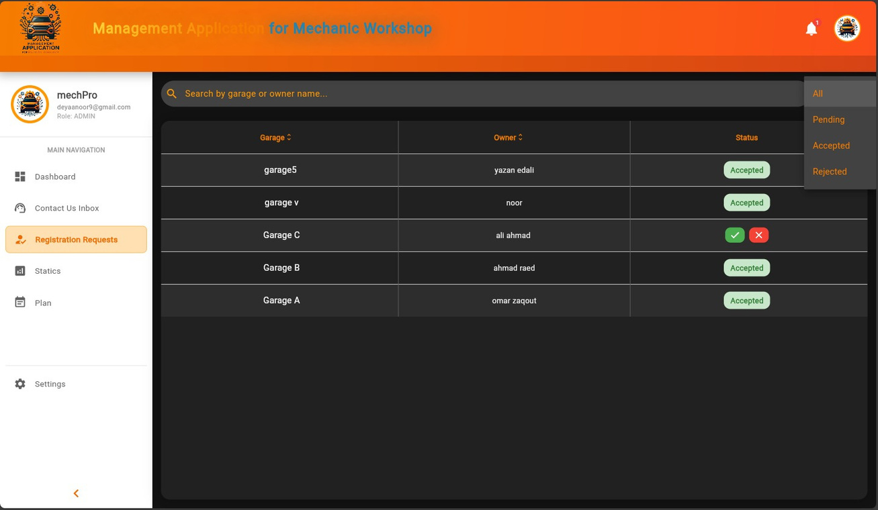
Request Page

Slide 22
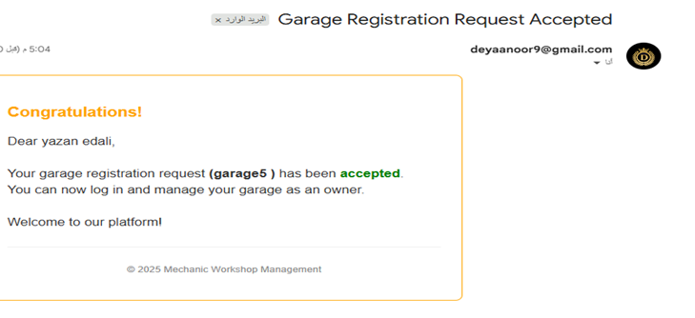
Request Page

Slide 23
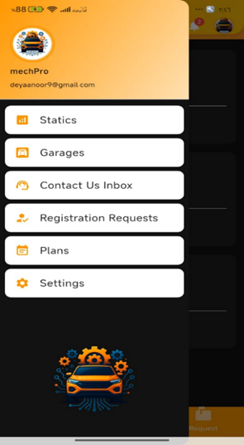
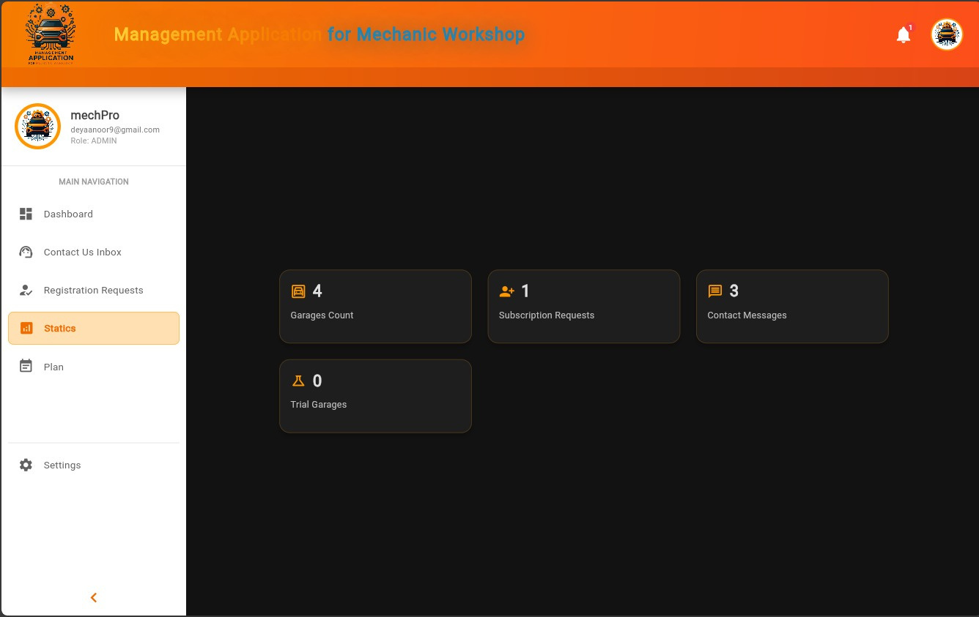
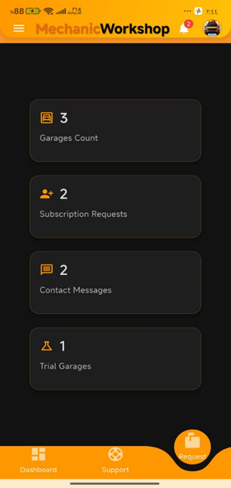
Statistics Page

Slide 24
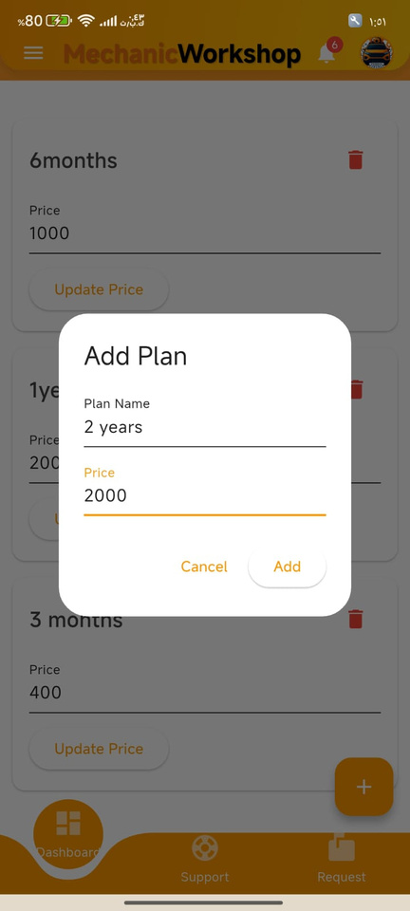
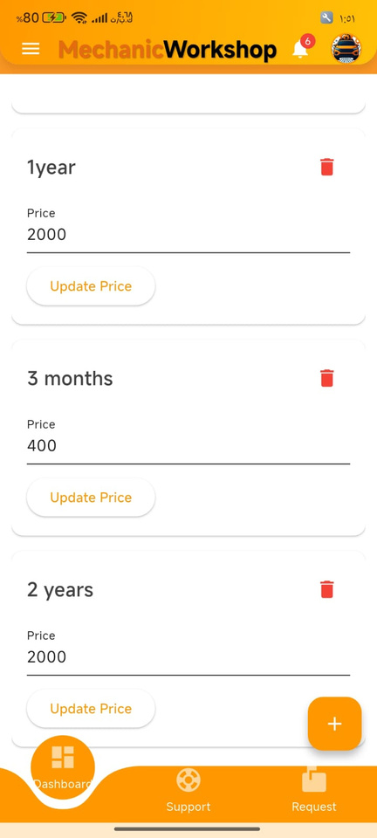
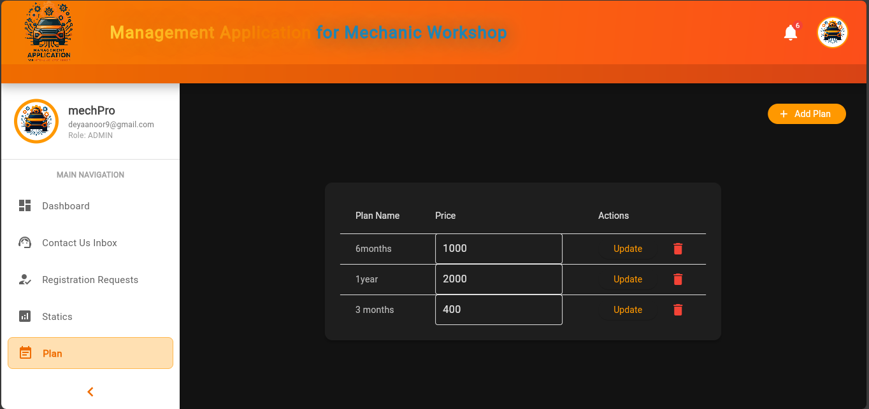
Plans Page

Slide 25
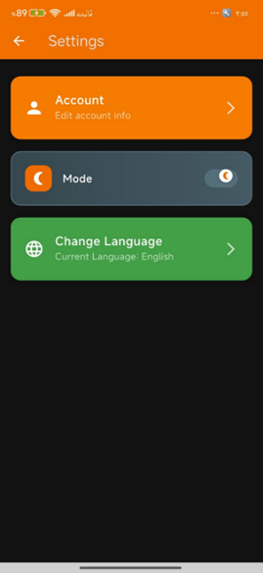
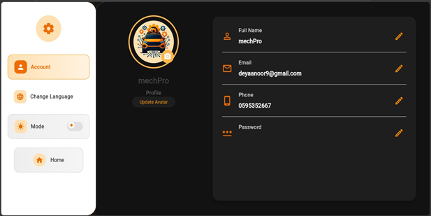
Settings Page

Slide 26
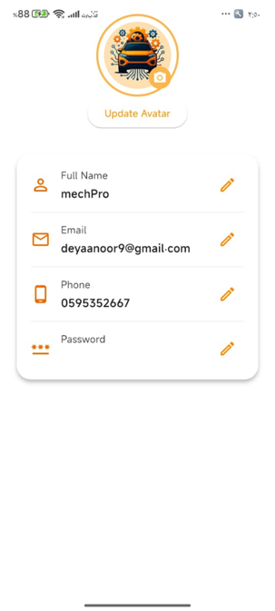
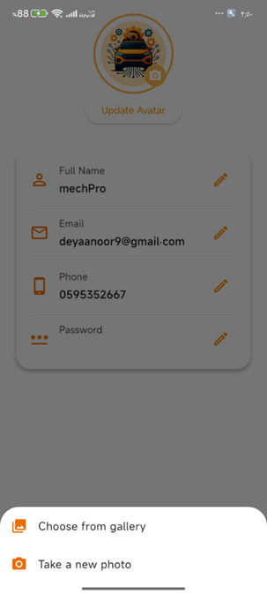
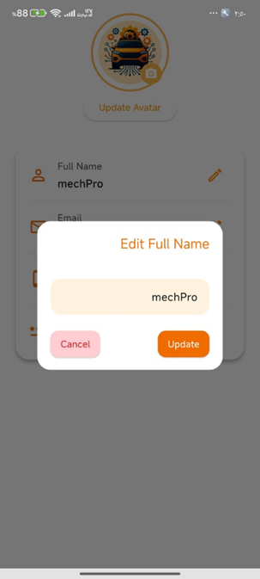
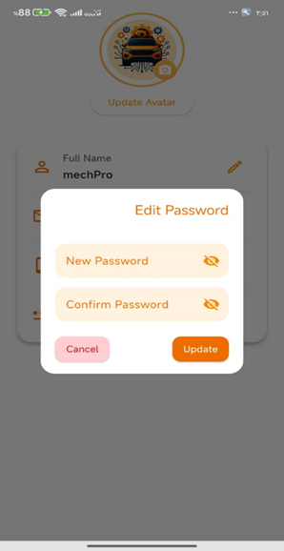
Account Page

Slide 27
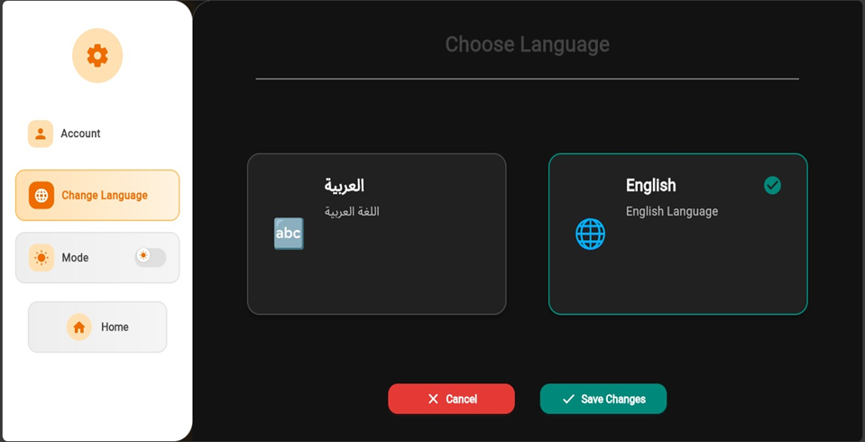
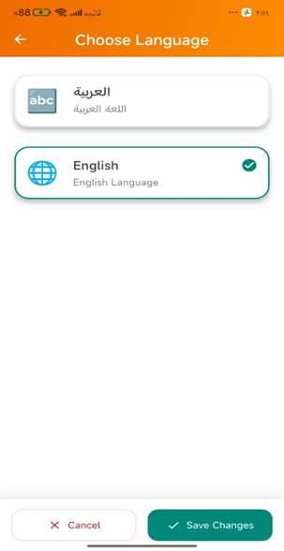
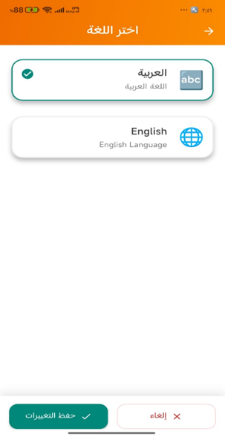
Change Language

Slide 28
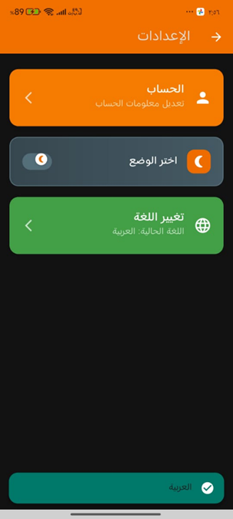
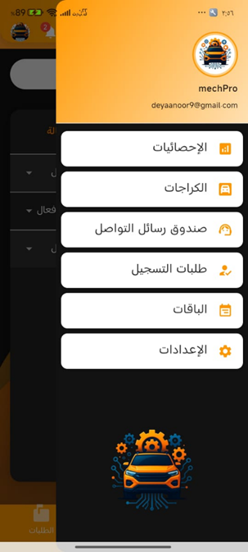
Change Language

Slide 29
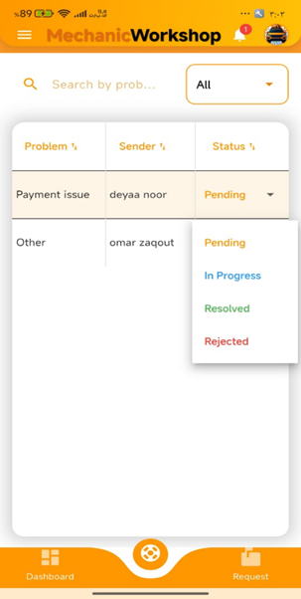
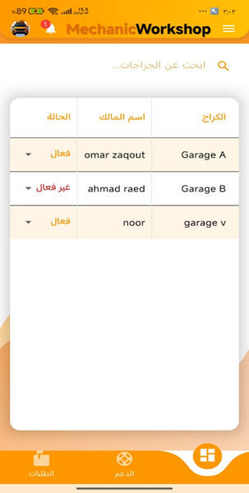
Change Language

Slide 30
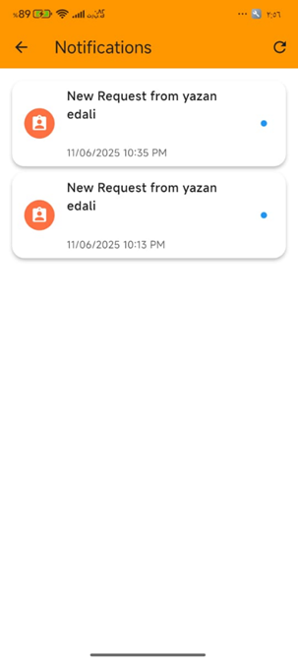
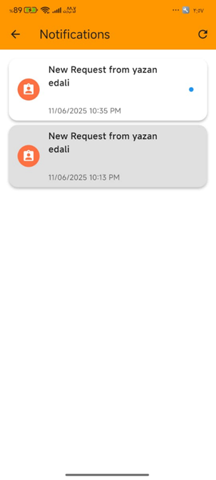
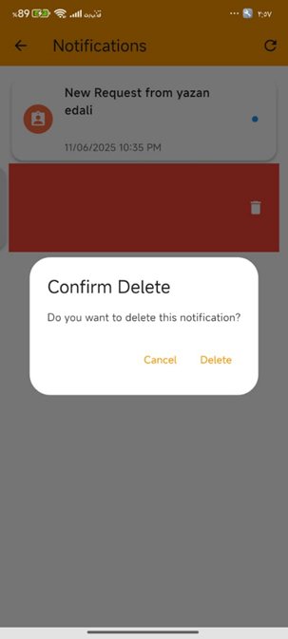
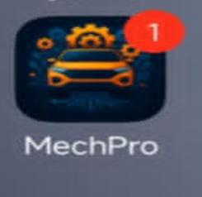
Notifications Page

Slide 31

Notifications Page

Slide 32


Apply Request Page

Slide 33


Apply Request Page

Slide 34



Apply Request Page

Slide 35



Apply Request Page

Slide 36
Owner

Slide 37


Home Page

Slide 38


Home Page

Slide 39


Reports Page

Slide 40



Reports Page details

Slide 41


Reports Page

Slide 42



Add Report Page

Slide 43



Add Report Page

Slide 44



Update Report Page

Slide 45



Instant News Page

Slide 46




Employees Page

Slide 47




Clients Page

Slide 48



Requests Page

Slide 49



Requests Page details

Slide 50


Slide 51



Subscription Page

Slide 52


Subscription Page

Slide 53


Subscription Page

Slide 54



Contact Us Page

Slide 55


Contact Us Page

Slide 56


Settings Page

Slide 57


Notifications Page

Slide 58


Notifications Page

Slide 59
Employee

Slide 60


News Page

Slide 61


Contact us

Slide 62


Reports Page

Slide 63


Garage Page

Slide 64



Settings Page

Slide 65


Settings Page

Slide 66

Garage not Active

Slide 67
Client

Slide 68


Garage Page

Slide 69


Garage Page
Service History

Slide 70



Garage Page
Requests

Slide 71


Garage Page

Slide 72


Emergency Request Page

Slide 73


Emergency Request Page

Slide 74



Icon IQ Page

Slide 75


Icon IQ Page

Slide 76



Icon IQ Page

Slide 77



Auto Check Page

Slide 78

Contact Us Page

Slide 79
Settings Page

Slide 80
Settings Page

Slide 81




Future work
  After the repair is completed, customers can rate the technician’s performance based on quality, professionalism and speed.
  Customers can book car repair appointments by selecting available time slots provided by the garage.

Slide 82

THANK YOU

