Slide 1
Mr. Pen
An automated approach to smart typing
Supervisor:
Dr. Anas Toma
Students:
Amr J. Eshtiwi
Ahmed A. Al-Qerem

Slide 2
Table of Content
Main Idea
01
02
Feature
Hardware Component
03
04
Construction
Machine
Strategy
05
06
Future Work

Slide 3
Main Idea
01

Slide 4
System that can draw completely without hands.
Multiple Modes for that system:
Drawing mode.
Tic-Tac-Toe mode.
Writing mode

Slide 5
Feature
02

Slide 6
AI algorithm
To solve the Tic-Tac-Toe game.
Drawing machine
That can draw remotely with the movement of the user head.
Voice Recognition
Full controlling with user voice.

Slide 7
Hardware Component
03

Slide 8
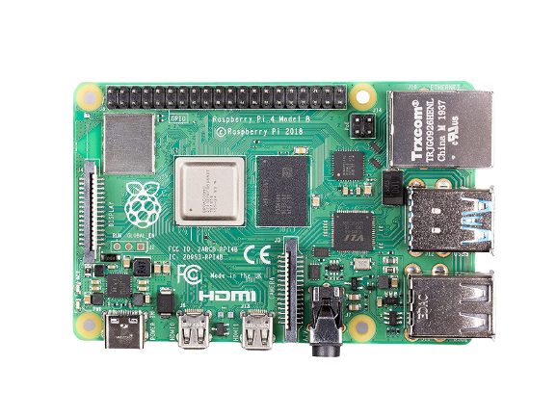
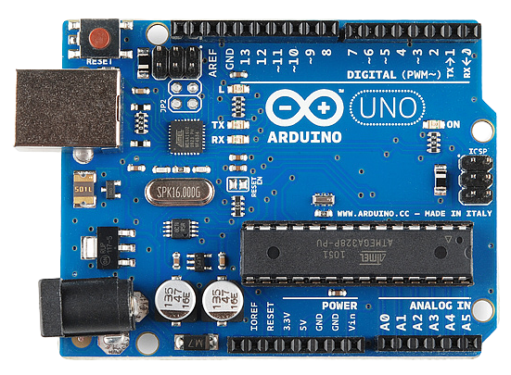
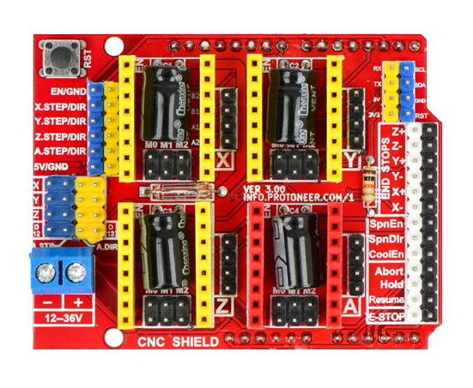
Raspberry Pi 4
Arduino
CNC Shield

Slide 9
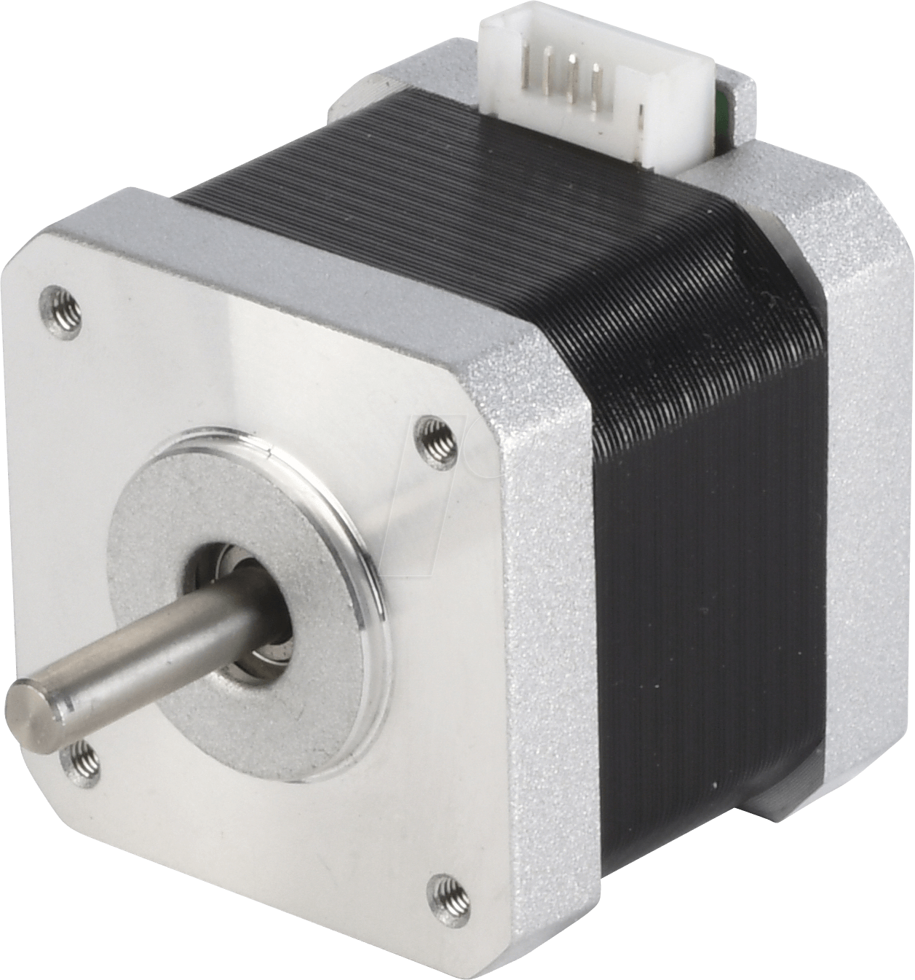
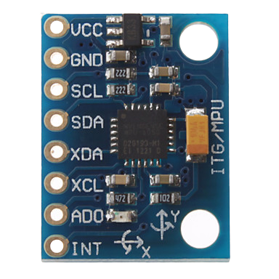
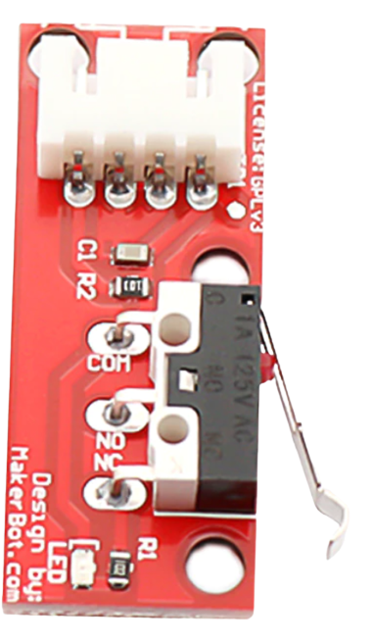
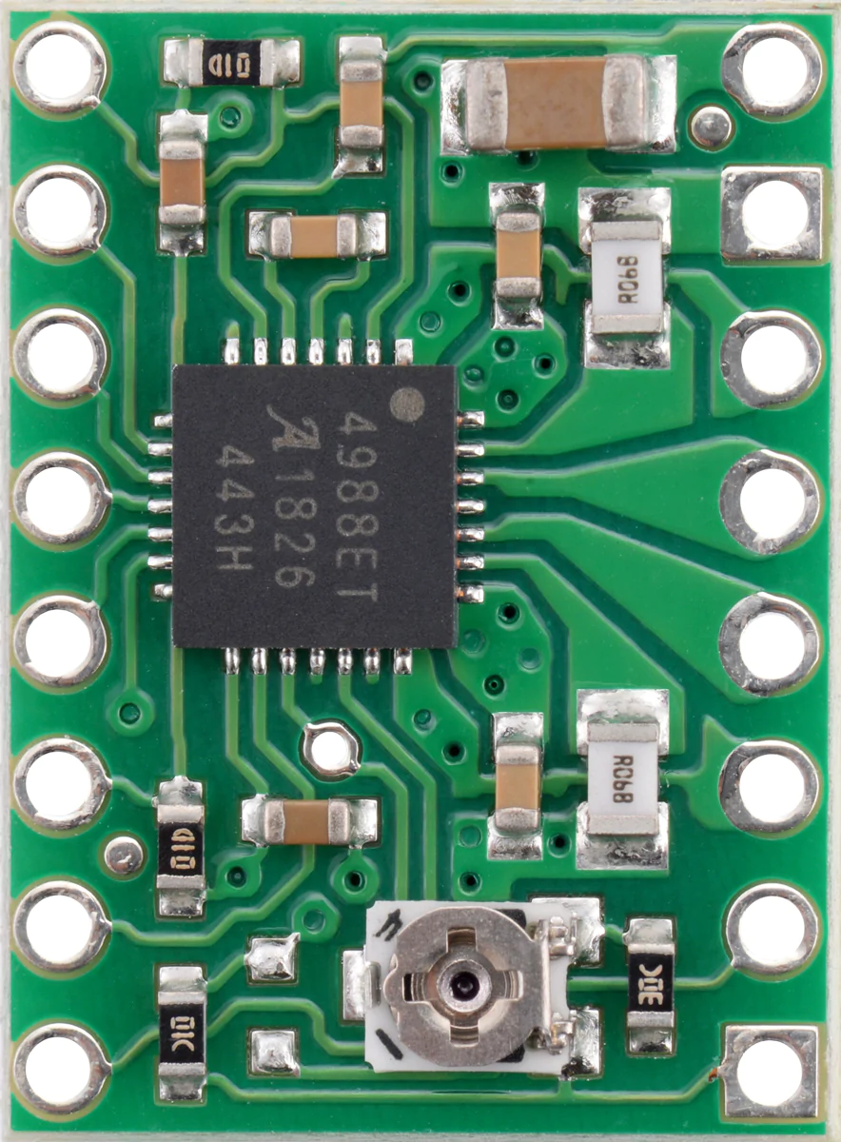
NEMO 17 Stepper
A4988 Driver
MPU6050
Control limit switch

Slide 10
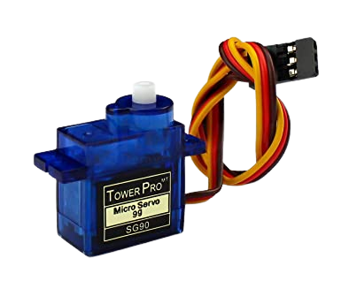
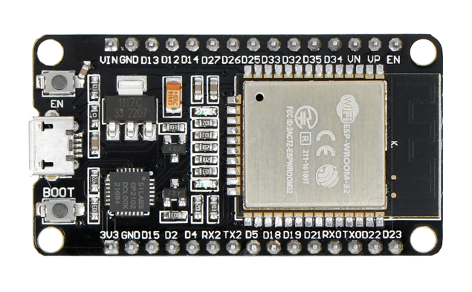
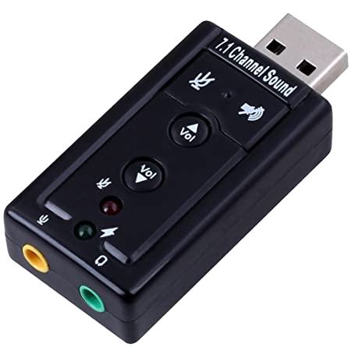
Servo motor
ESP 32
Sound Card

Slide 11
Construction
04

Slide 12
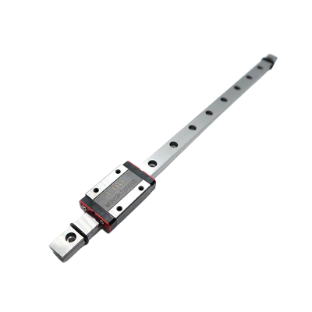
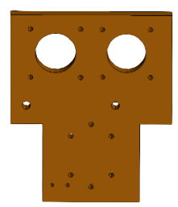
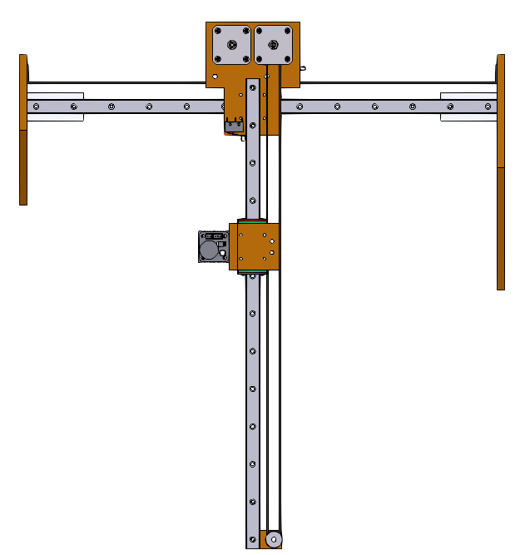
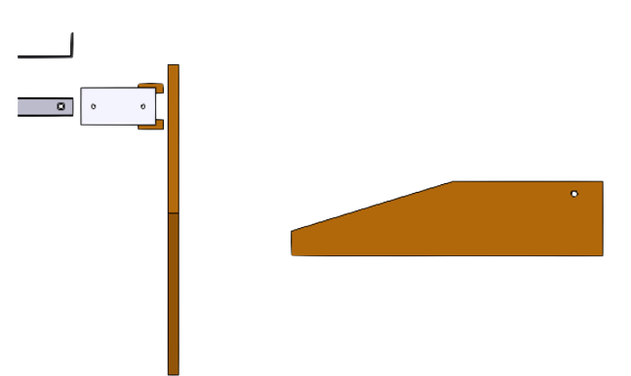
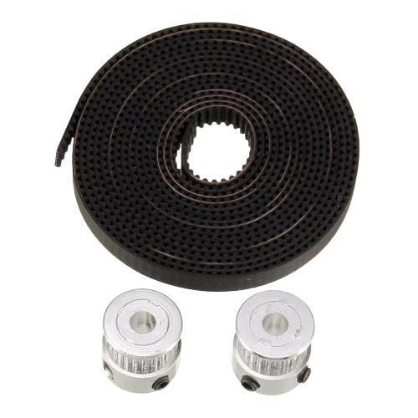
Mechanical Parts

Slide 13
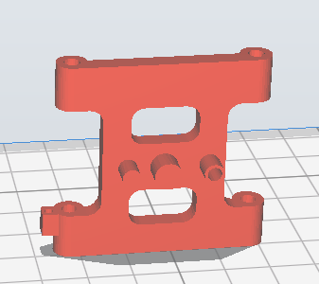
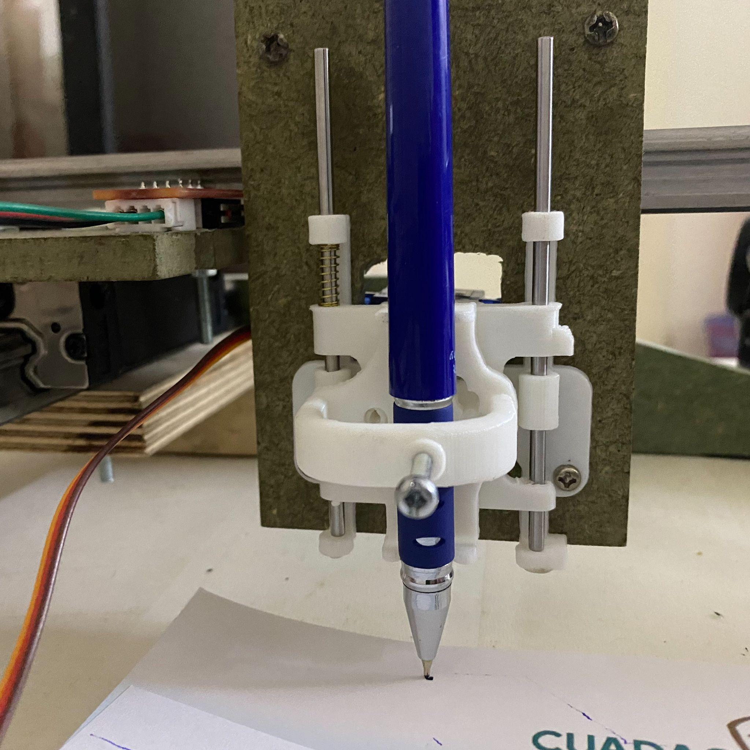
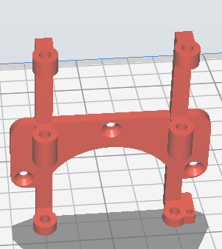
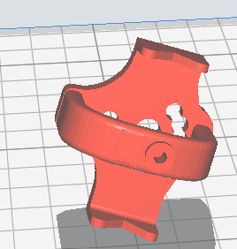
Pen Holder

Slide 14
Machine
Strategy
05

Slide 15
Steps Flow
Recognize voice
Machine Movement
Detect which mode should the system Enter
1
Moving the Machine
3
Do the algorithm for each Mode.
2
Processing

Slide 16
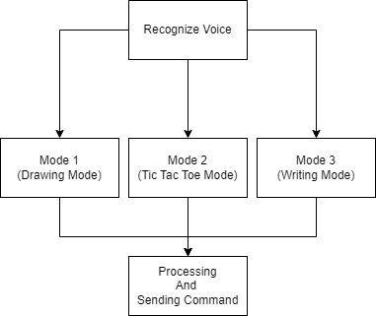
Steps Flow
Sending to executing part With Bluetooth
communication

Slide 17
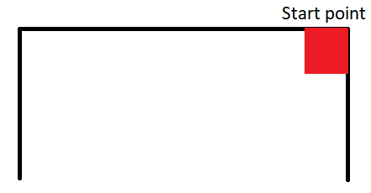
Start point

Slide 18
Processing mode one
Kalman Filter
WITH

Slide 19
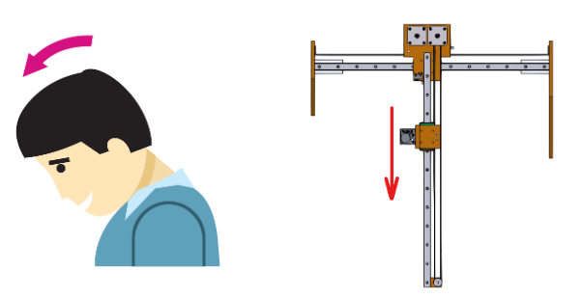
Processing mode one
Eight possibilities of movement
1
Forward movement

Slide 20
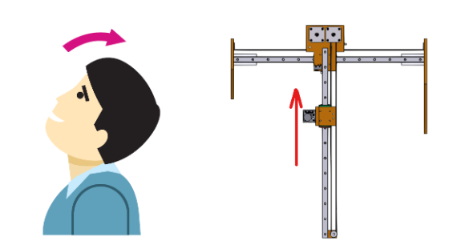
Processing mode one
Eight possibilities of movement
2
Backward movement

Slide 21
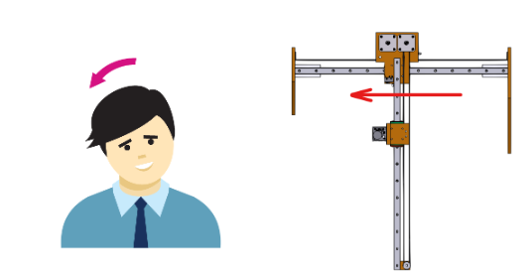
Processing mode one
Eight possibilities of movement
3
Left movement

Slide 22
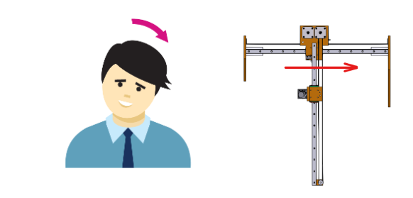
Processing mode one
Eight possibilities of movement
4
Right movement

Slide 23
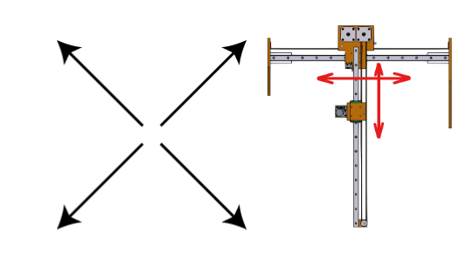
Processing mode one
Eight possibilities of movement
5
Four common directions

Slide 24
Processing mode one
UP —-----------------
Down —-----------------
Disconnect —---------------- choosing Mode

Slide 25
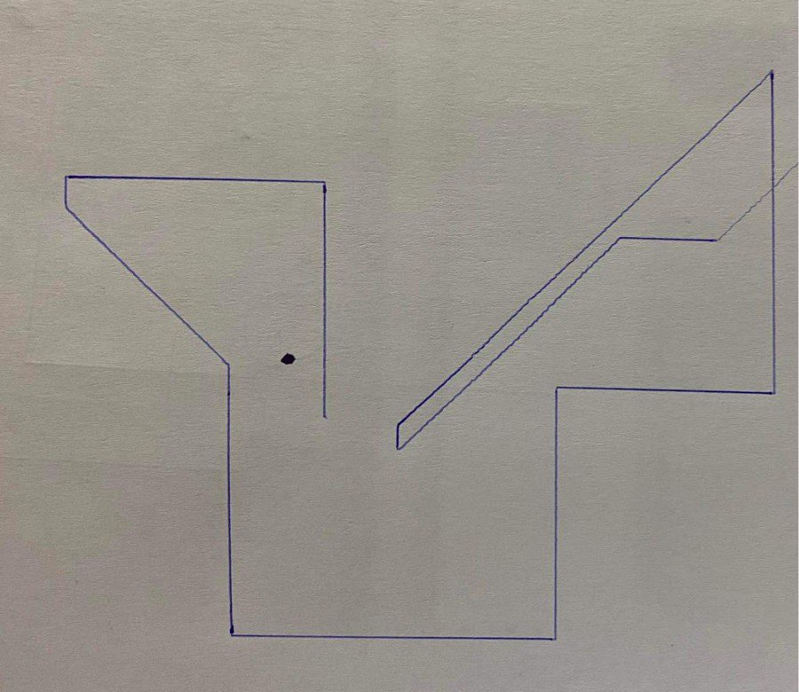
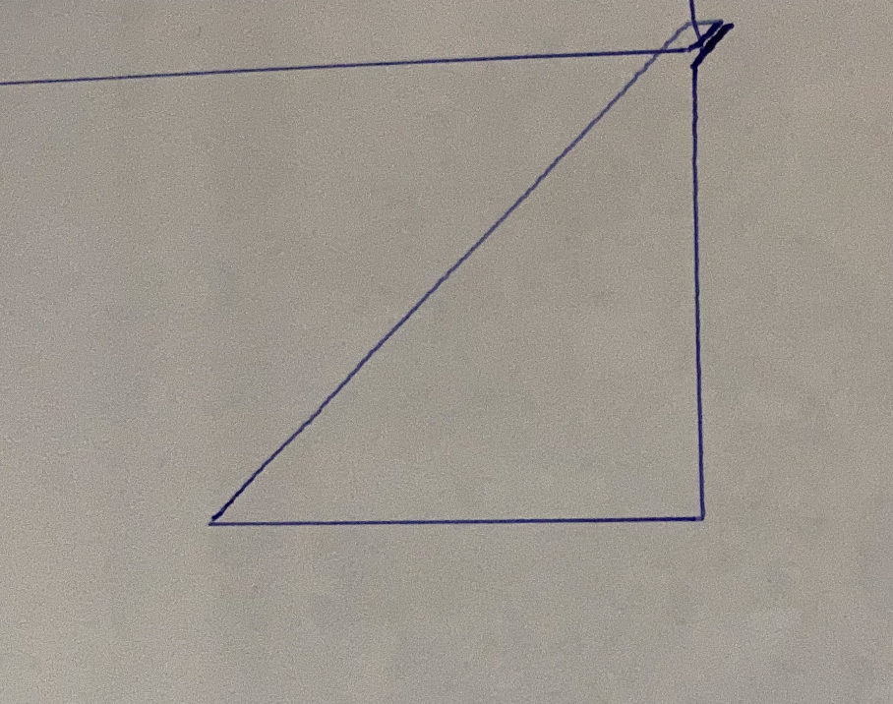
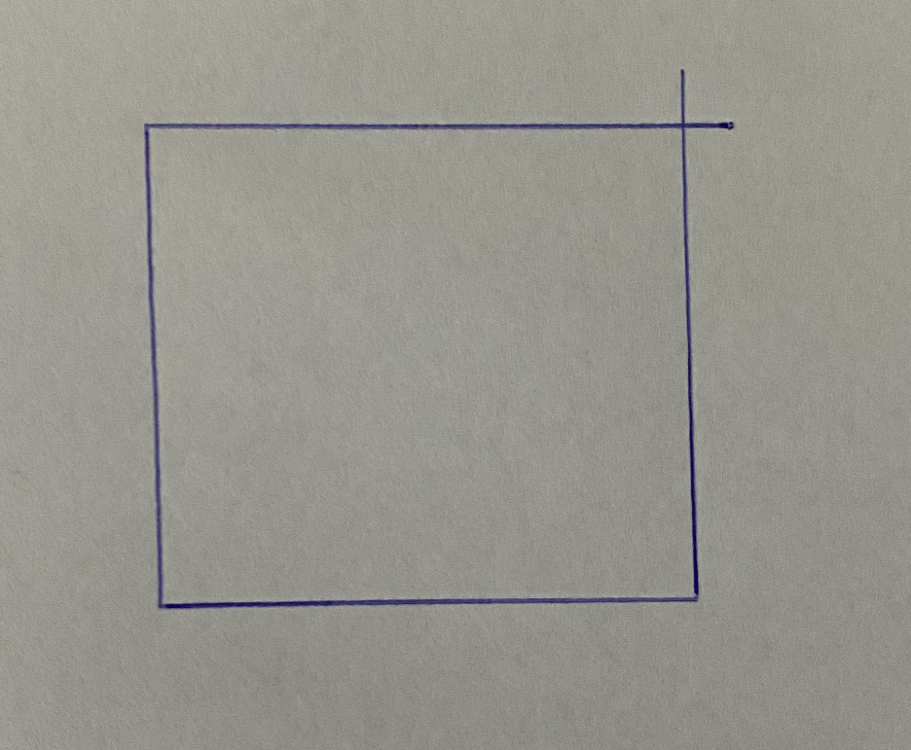
mode one Example

Slide 26
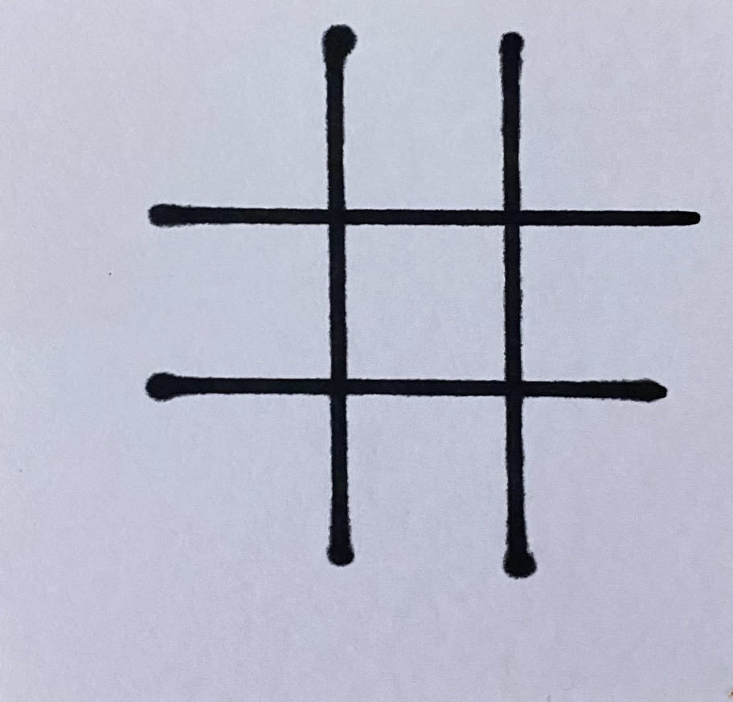
Processing mode two
Start with …

Slide 27
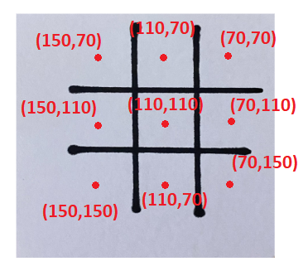
Processing mode two
By Calculate the Absolute point for each blink ….

Slide 28
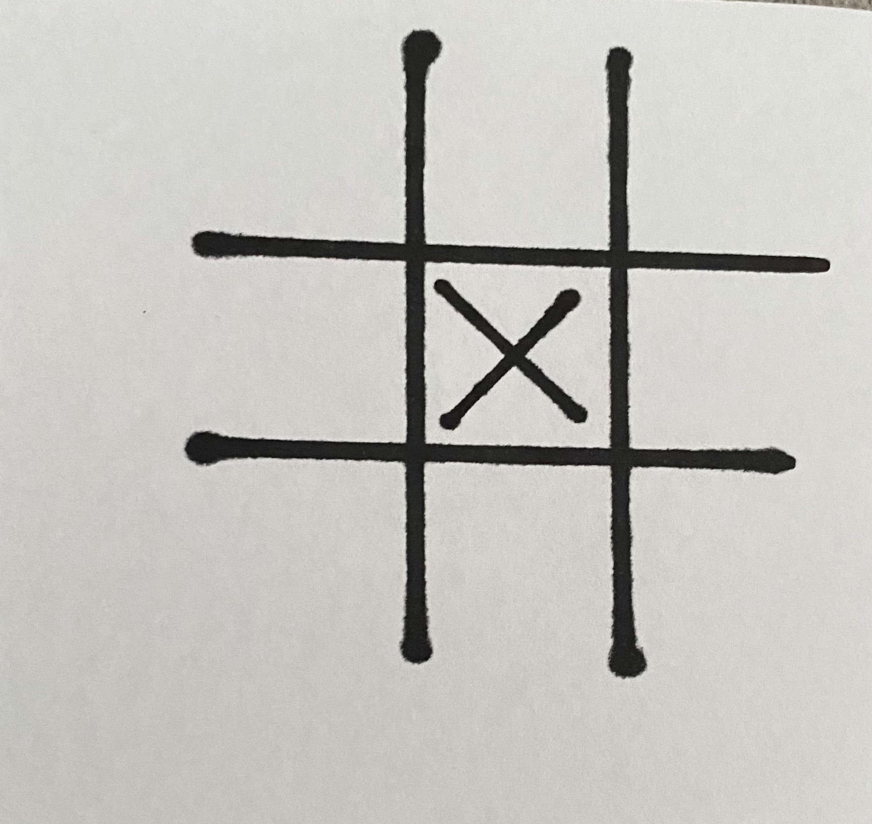
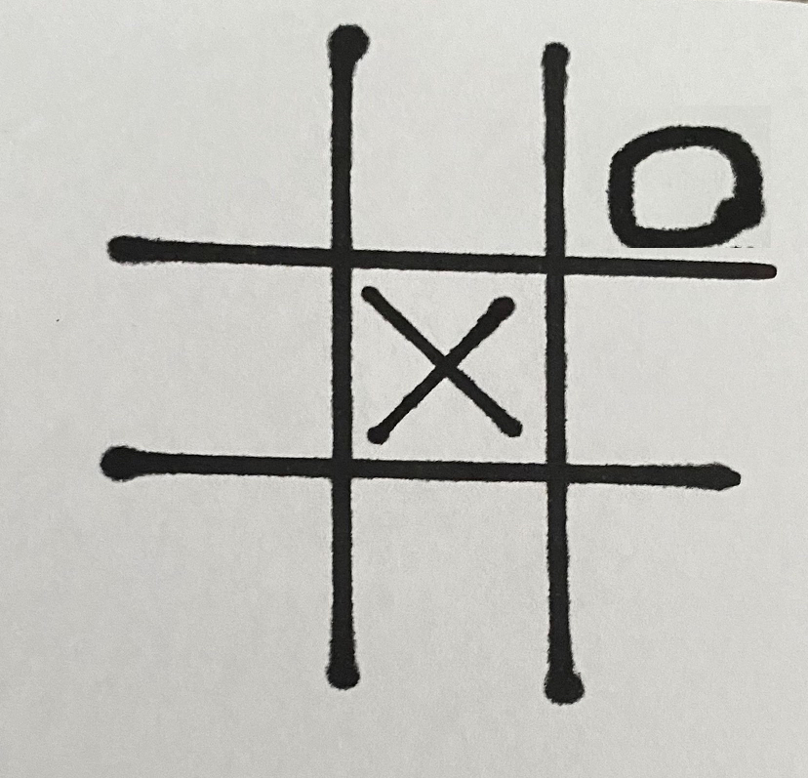
Processing mode two
By voice
By Machine
(Alpha Beta algorithm)

Slide 29
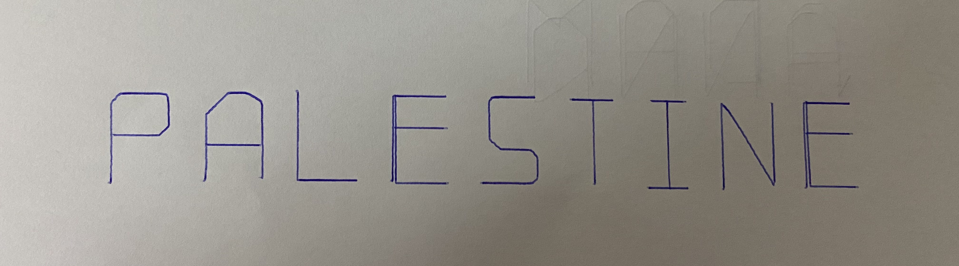
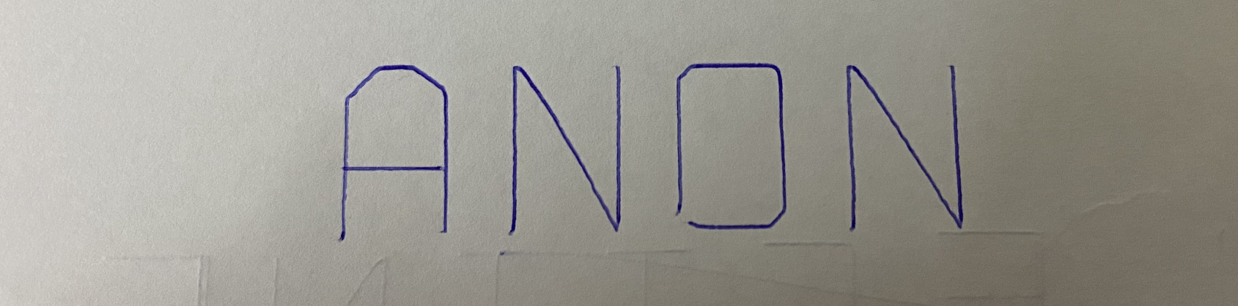
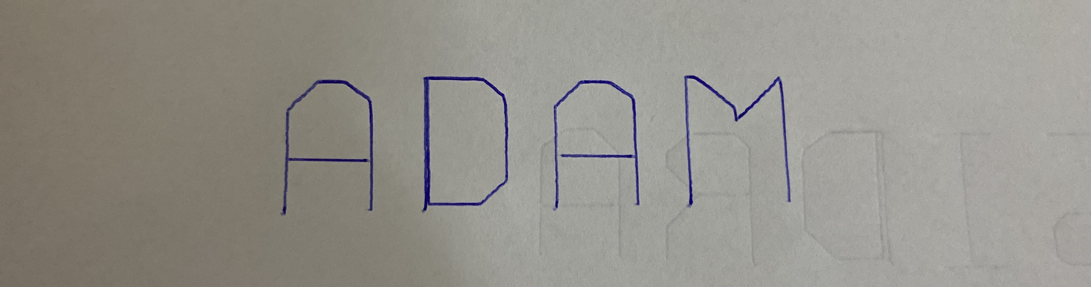
Processing mode three
By TextToGcode library from python

Slide 30
Future Work
BCI boards
3D printing

Slide 31
Thanks!
Do you have any questions?

