Slide 1

An-Najah National University
Faculity of Engineering
جامعة النجاح الوطنية
كلية الهندسة وتكنولوجيا المعلومات
Comparative Study of Analytical and Finite Element Methods for Designing Gear Drives: Bending and Pitting Stress Analysis
Prepared by:
Izzat Zohud
Karam Irshaid
Arafat Othman
Supervised by:
Dr. Iyad Assaf
Mechanical Engineering Department
2024

Slide 2
Table of Contents
Introduction
Theory
Research Approach
Finite Elements Analysis (FEA)
Results and Discussion
Conclusions

Slide 3
Introduction
Gears are a mechanical system used for transmitting motion and power.
  Gear Classification
Spur Gear
Helical Gear
Bevel Gear
Worm Gear
Failure >> due to excessive stress exceeding the material's strength.
Failure Modes
    Wear Failure >> due to contact
Breakage (Bending Failure) >> due to overloading

Slide 4
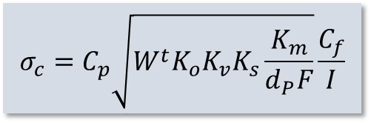
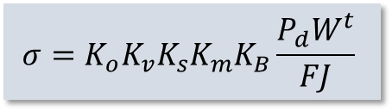

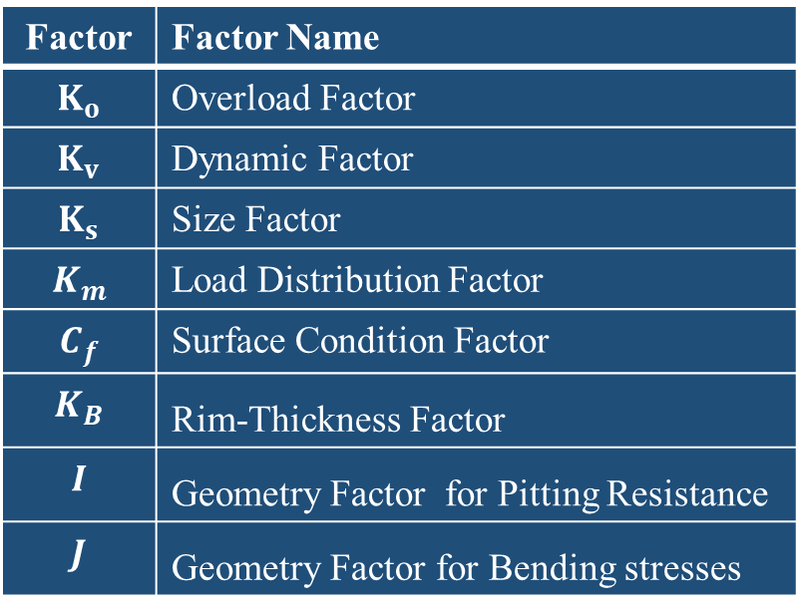
Theory
American Gear Manufacturing Association AGMA provide a methods with consideration of Design Factors.
Factor | Factor Name
$$K_{o}$$ | Overload Factor
$$K_{v}$$ | Dynamic Factor
$$K_{s}$$ | Size Factor
$$K_{m}$$ | Load Distribution Factor
$$C_{f}$$ | Surface Condition Factor
$$K_{B}$$ | Rim-Thickness Factor
$$I$$ | Geometry Factor for Pitting Resistance
$$J$$ | Geometry Factor for Bending stresses
    Spur and Helical Gear Stressing (AGMA)
$$σ_{c}=C_{p}\sqrt{{W^{t}K}_{o}K_{v}K_{s}\frac{K_{m}}{d_{P}F}}\frac{C_{f}}{I}$$
Pitting Stress (contact stress)
Bending Stress
$$σ=K_{o}K_{v}K_{s}K_{m}K_{B}\frac{P_{d}W^{t}}{FJ}$$
$$C_{p}$$ | Elastic Coefficient

Slide 5
Research Approach
Material Selection
Gears Parameter
Analytical Analysis
Modeling in SolidWorks
Comparison
Finite Element Analysis (FEA)
Conclusion

Slide 6
Material Selection
The primary analysis will be:
On the gears made of through hardened AISI 4140 steel, water quenched and tempered at 650 °C (1200 °F), grade 1 material, and the targeted core and case hardness of 230 Brinell for pinion.
Then, for different material:
Material | Young’s modulus (MPSI) | Poisson's ratio | Elastic Coefficient | Yield strength (KPSI) | Ultimate Strength (KPSI)
AISI 4140 Steel | 30 | 0.292 | 2285 | 95 | 110
Cast Stainless Steel | 27.5 | 0.26 | 2169.4 | 85.5 | 348
ASTM A536 Ductile Cast Iron | 24.5 | 0.31 | 2077.51 | 50 | 720
ASTM B148 Alloy 954 –Bronze | 17.5 | 0.316 | 1759.5 | 45 | 949.99
ASTM A48 Gray Cast Iron Class-40 | 14.5 | 0.211 | 1554.51 | 14.2 | 200

Slide 7
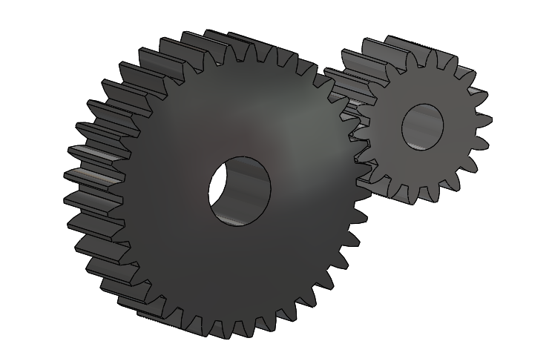
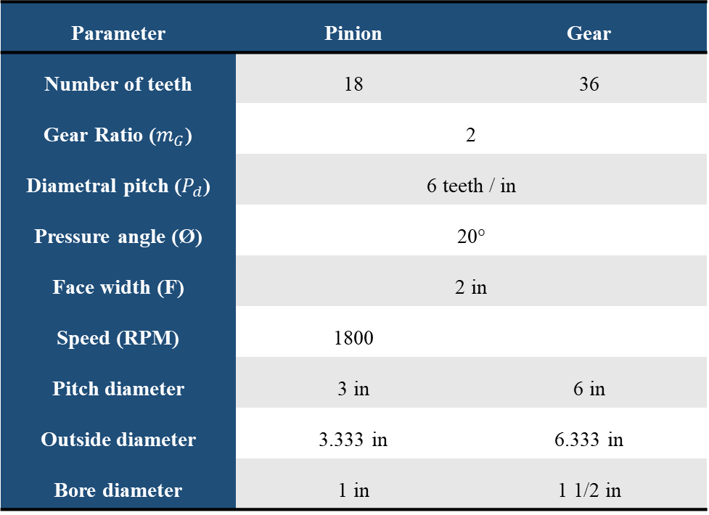
Gears Parameter & Modeling
Design parameter-spur gear
Parameter | Pinion | Gear
Number of teeth | 18 | 36
Gear Ratio ($m_{G}$) | 2
Diametral pitch ($P_{d}$) | 6 teeth / in
Pressure angle (Ø) | 20°
Face width (F) | 2 in
Speed (RPM) | 1800
Pitch diameter | 3 in | 6 in
Outside diameter | 3.333 in | 6.333 in
Bore diameter | 1 in | 1 1/2 in

Slide 8
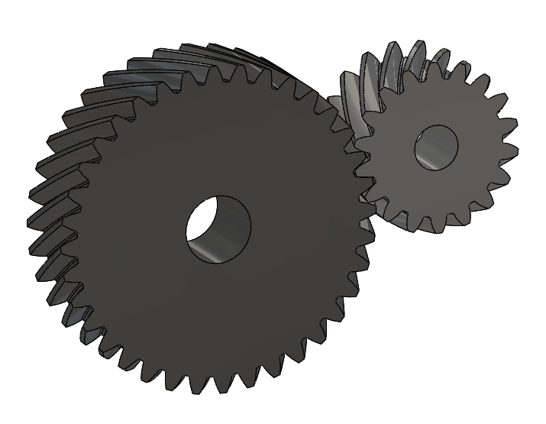
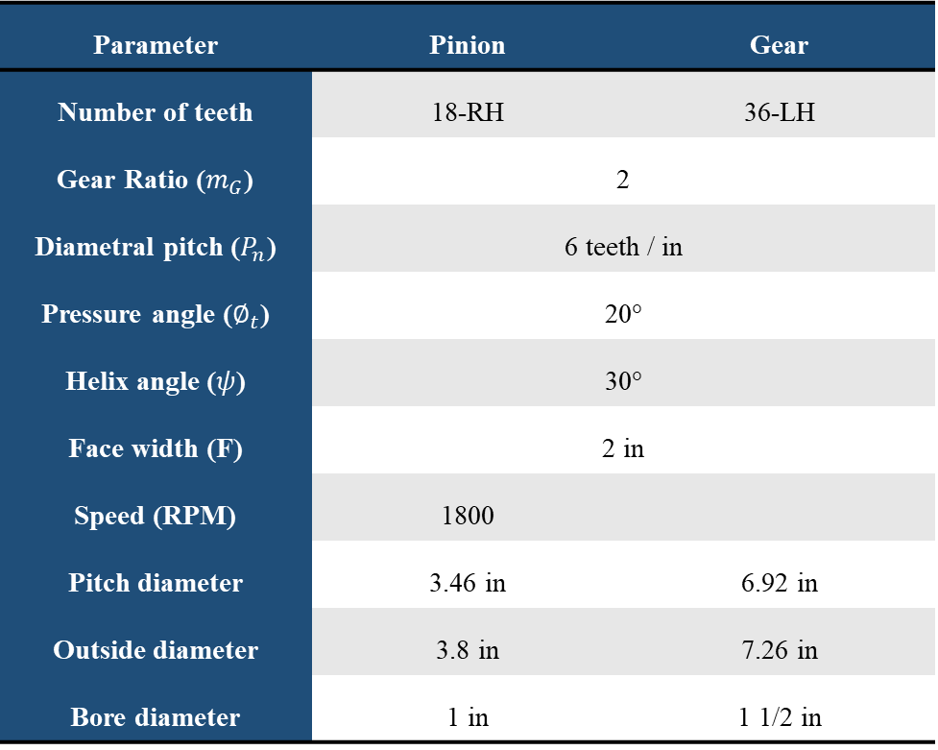
Gears Parameter & Modeling
Design parameter-helical gear
Parameter | Pinion | Gear
Number of teeth | 18-RH | 36-LH
Gear Ratio ($m_{G}$) | 2
Diametral pitch ($P_{n}$) | 6 teeth / in
Pressure angle ($∅_{t}$) | 20°
Helix angle ($ψ$) | 30°
Face width (F) | 2 in
Speed (RPM) | 1800
Pitch diameter | 3.46 in | 6.92 in
Outside diameter | 3.8 in | 7.26 in
Bore diameter | 1 in | 1 1/2 in

Slide 9
Study Parameters
Changing material (Young’s modulus, Poisson's ratio)
Torque (Ib.in) >> (50, 100, 150, 200)
Face Width (in) >> (1, 2, 3, 4)
Gear Ratio >> (1:1, 2:1, 3:1, 4:1)
The effect of changing these variables on Bending and pitting stresses according to AGMA standard and FEA
For both Spur and Helical Gears

Slide 10
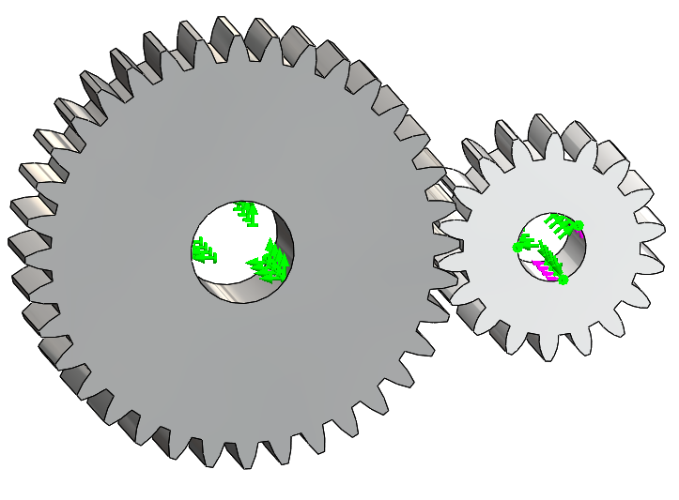
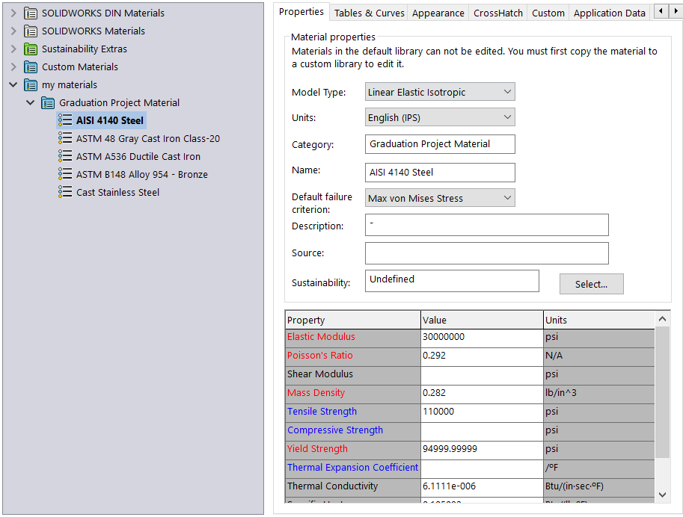
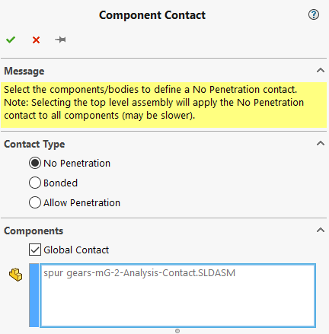
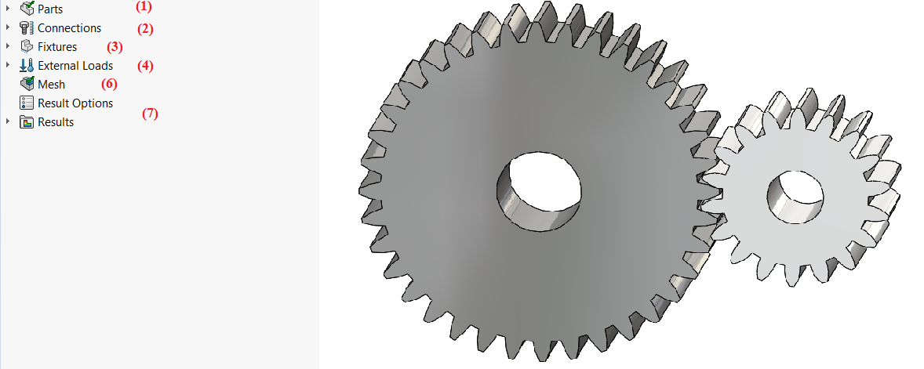
Finite Element Analysis
SolidWorks simulation
Material Definition
Contact Definition
Fixture Definition
Static Study
Fixed Support
Hinge
T = 140.12 Ib.in

Slide 11
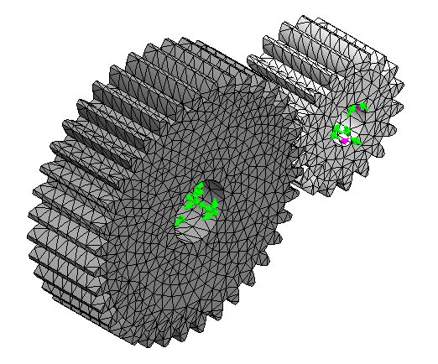
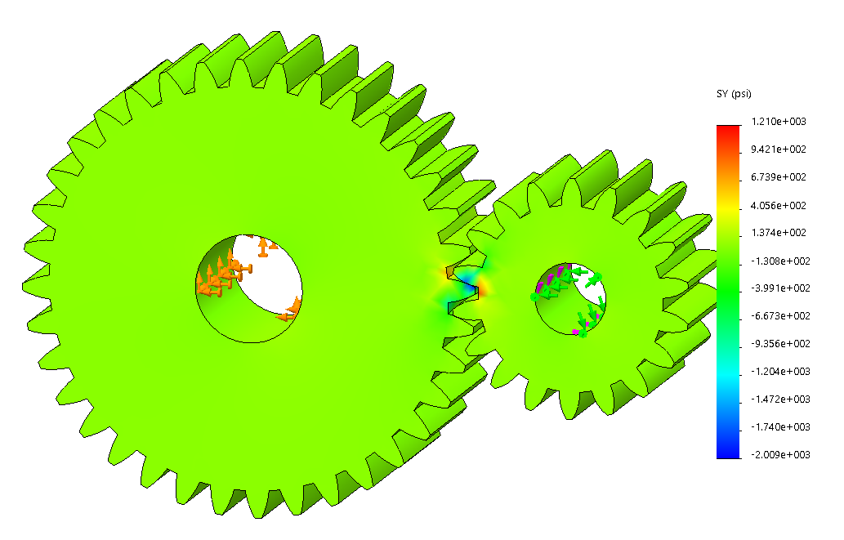
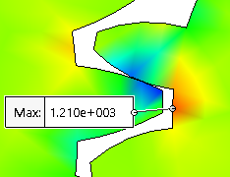
Finite Element Analysis
SolidWorks simulation
Mesh Generation
Visualization & results

Slide 12
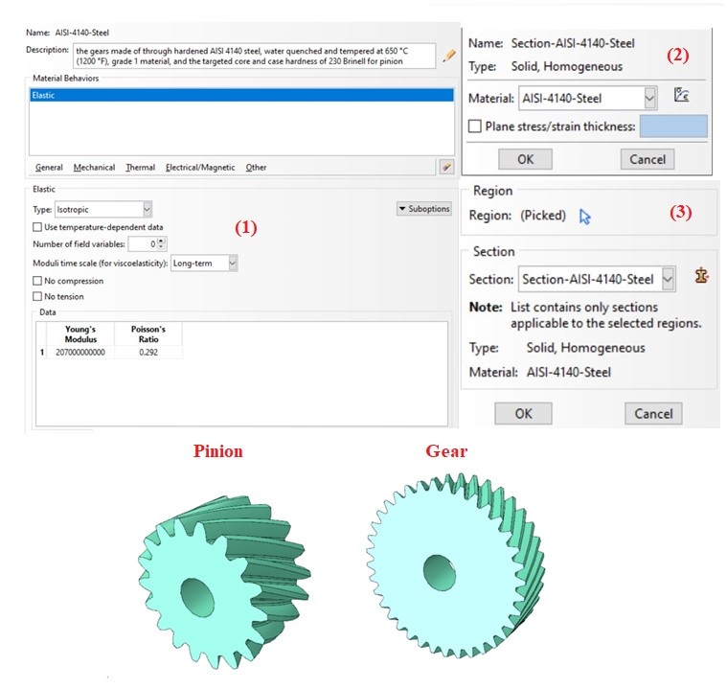
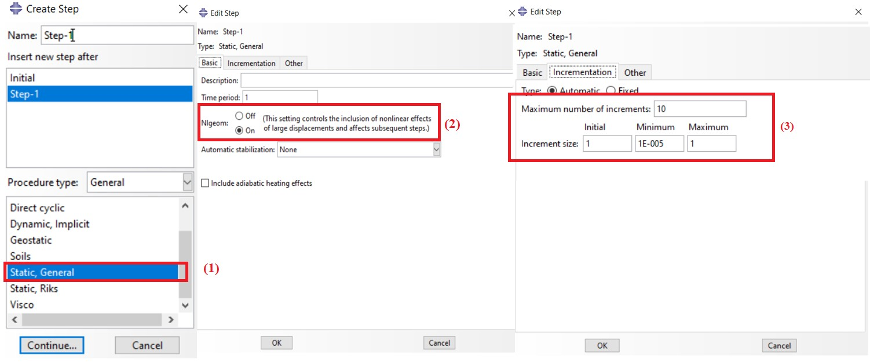
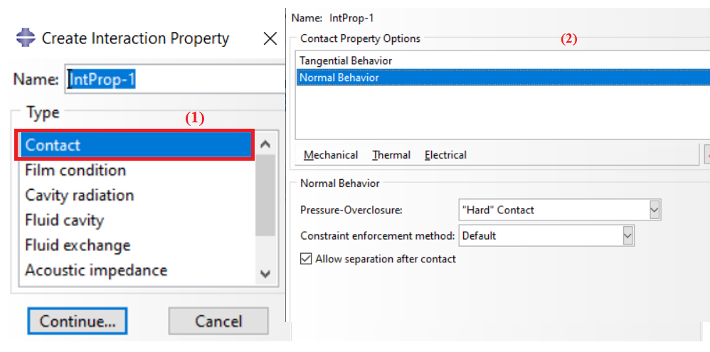
Finite Element Analysis
ABAQUS CAE
Property Module
Step Module
Interaction Module
>> Create
Interaction property

Slide 13
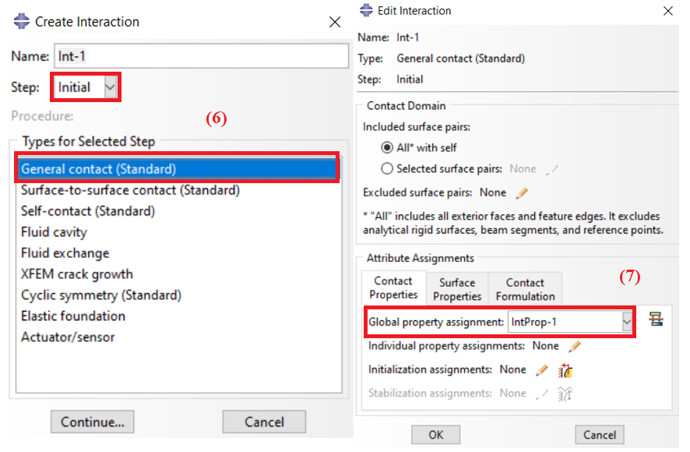
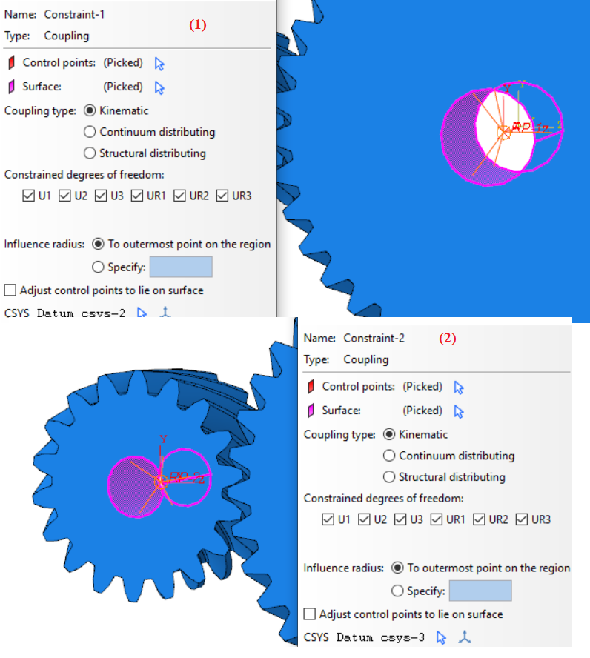
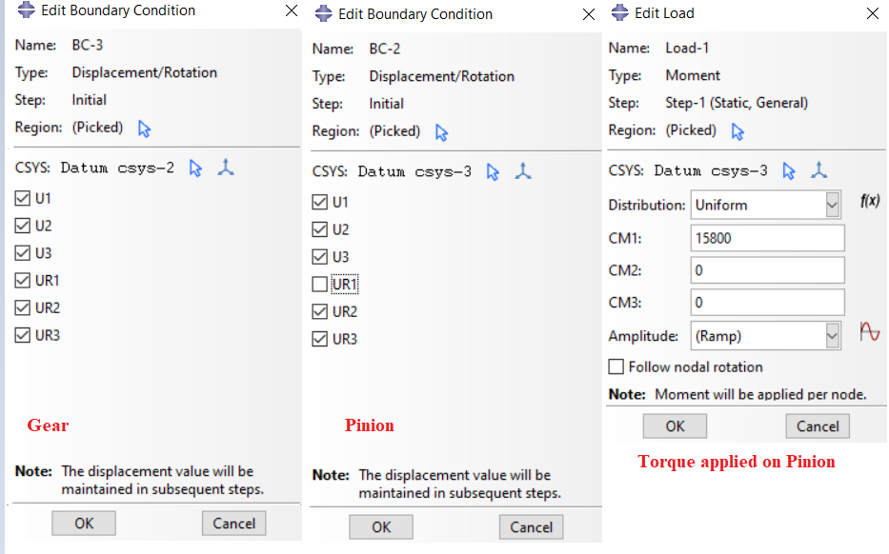
Finite Element Analysis
ABAQUS CAE
Interaction Module
>> Constraints
Load Module
(5)
(3)
(4)
(6)
Boundary conditions
Torque Load

Slide 14
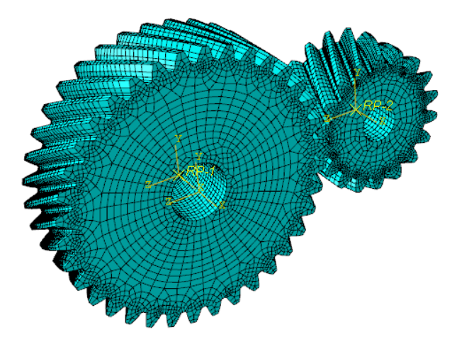
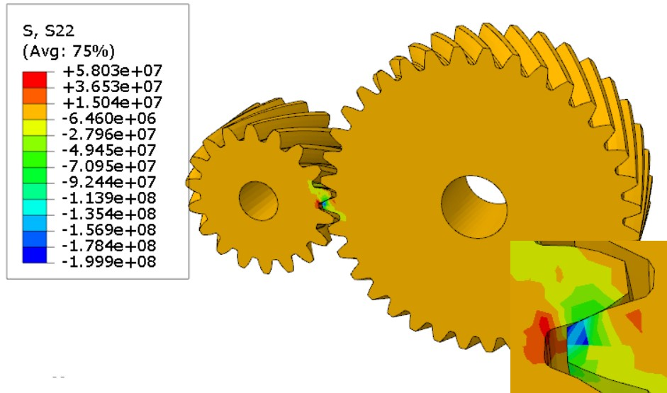
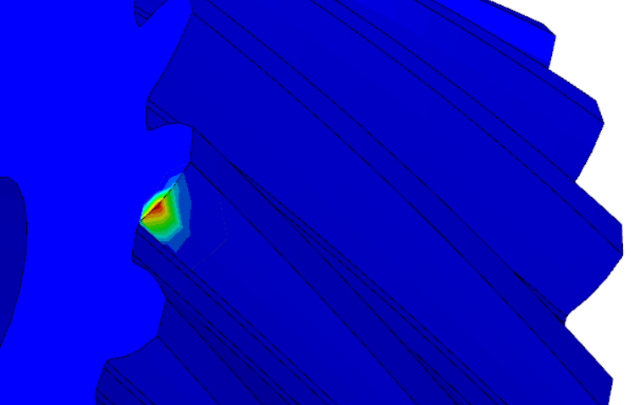
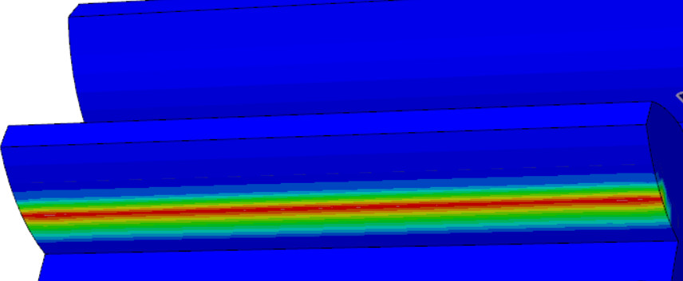
Finite Element Analysis
ABAQUS CAE
Comparison
Mesh Module
Visualization Module
Helical Gear
Spur Gear

Slide 15
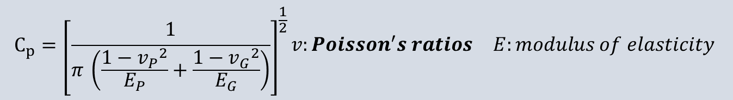
Results & Discussion
Effect of young’s modulus and Poisson's ratio on contact stress
Material | CP | FEA-Contact –Spur (KPSI) | AGMA-Contact-Spur (KPSI) | FEA-Contact –Helical (KPSI) | AGMA-Contact –Helical (KPSI)
AISI 4140 Steel | 2285 | 39.3 | 39 | 29 | 26
Cast Stainless Steel | 2169.4 | 35.96 | 36.97 | 26.85 | 24.77
ASTM A536 Ductile Cast Iron | 2077.51 | 31.75 | 35.39 | 20.27 | 23.74
ASTM B148 Alloy 954 –Bronze | 1759.5 | 22.83 | 29.9 | 14.6 | 20.11
ASTM A48 Gray Cast Iron Class-40 | 1554.51 | 18.67 | 26.84 | 11.63 | 17.76
$$\begin{aligned}&C_{p}={\left[\frac{1}{π \left(\frac{1−{v_{P}}^{2}}{E_{P}}+\frac{1−{v_{G}}^{2}}{E_{G}}\right)}\right]}^{\frac{1}{2}}\begin{matrix}v:Poisson^{′}s ratios & E:modulus of elasticity\end{matrix} \#\end{aligned}$$

Slide 16
Results & Discussion
As the elastic coefficient increases the contact stress increase for both spur and helical gear.
Generally, AGMA standard agreed well with FEA.

Slide 17
Results & Discussion
Effect of young’s modulus and Poisson's ratio on bending stress
Materialz | CP | FEA-Bending–Spur (KPSI) | AGMA-Bending-Spur (KPSI) | FEA-Bending –Helical (KPSI) | AGMA-Bending –Helical (KPSI)
AISI 4140 Steel | 2285 | 1.21 | 1.47 | 0.928 | 0.907
Cast Stainless Steel | 2169.4 | 1.185 | 1.47 | 0.91 | 0.907
ASTM A536 Ductile Cast Iron | 2077.51 | 1.23 | 1.47 | 0.879 | 0.907
ASTM B148 Alloy 954 –Bronze | 1759.5 | 1.23 | 1.47 | 0.768 | 0.907
ASTM A48 Gray Cast Iron Class-40 | 1554.51 | 1.155 | 1.47 | 0.742 | 0.907

Slide 18
Results & Discussion
The AGMA standard and FEM are almost behave at the same level.
There are no effect of changing elastic coefficient on bending stress.

Slide 19
Results & Discussion
Effect of Torque on bending stress
Torque (Ib.in) |  | 50 | 100 | 150 | 200
FEA-Bending (KPSI) | Spur gear | 0.432 | 0.864 | 1.297 | 1.73
AGMA-Bending (KPSI) |  | 0.535 | 1.07 | 1.6 | 2.14
FEA-Bending (KPSI) | Helical gear | 0.363 | 0.725 | 1.08 | 1.39
AGMA-Bending (KPSI) |  | 0.355 | 0.708 | 1.06 | 1.41

Slide 20
Results & Discussion
Effect of Torque on pitting stress
Torque (Ib.in) |  | 50 | 100 | 150 | 200
FEA-Contact (KPSI) | Spur gear | 23.916 | 31.82 | 40.65 | 49.31
AGMA-Contact (KPSI) |  | 23.47 | 33.2 | 40.67 | 46.97
FEA-Contact (KPSI) | Helical gear | 16.83 | 22.52 | 29.5 | 33.75
AGMA-Contact (KPSI) |  | 15.62 | 22.06 | 27.02 | 31.2

Slide 21
Results & Discussion
Effect of Face width on bending stress
Face Width (in) |  | 1 | 2 | 3 | 4
FEA-Bending (KPSI) | Spur gear | 2.57 | 1.21 | 1.02 | 0.752
AGMA-Bending (KPSI) |  | 2.8 | 1.47 | 1.01 | 0.808
FEA-Bending (KPSI) | Helical gear | 1.66 | 0.928 | 0.83 | 0.654
AGMA-Bending (KPSI) |  | 1.9 | 0.907 | 0.678 | 0.524

Slide 22
Results & Discussion
Effect of Face width on pitting stress
Face Width (in) |  | 1 | 2 | 3 | 4
FEA-Contact (KPSI) | Spur gear | 42 | 39.3 | 32.32 | 31.3
AGMA-Contact (KPSI) |  | 53.68 | 39 | 32.56 | 28.85
FEA-Contact (KPSI) | Helical gear | 37.12 | 29 | 22.86 | 20.42
AGMA-Contact (KPSI) |  | 36.24 | 26.12 | 21.58 | 18.975

Slide 23
Results & Discussion
Effect of Gear Ratio on bending stress
Face Width (in) |  | 1 | 2 | 3 | 4
FEA-Bending (KPSI) | Spur gear | 1.6 | 1.21 | 1.04 | 1.01
AGMA-Bending (KPSI) |  | 1.8 | 1.47 | 1.39 | 1.34
FEA-Bending (KPSI) | Helical gear | 1.01 | 0.928 | 0.954 | 0.87
AGMA-Bending (KPSI) |  | 0.999 | 0.907 | 0.888 | 0.84

Slide 24
Results & Discussion
Effect of Gear Ratio on pitting stress
Face Width (in) |  | 1 | 2 | 3 | 4
FEA-Contact (KPSI) | Spur gear | 46.6 | 42.28 | 32.25 | 29.11
AGMA-Contact (KPSI) |  | 45.02 | 39 | 36.76 | 35.3
FEA-Contact (KPSI) | Helical gear | 42 | 29 | 25.56 | 16.61
AGMA-Contact (KPSI) |  | 37.38 | 26 | 20.78 | 17.88

Slide 25
Conclusion
The results showed good agreement between FEA and AGMA standards for both gear types.
Increases in Elastic Coefficient led to increased pitting stress but did not affect bending stress.
Increases in torque resulted in higher bending and pitting stresses.
Increases in face width or gear ratio reduced both bending and pitting stresses.

Slide 26
Conclusion
Spur gears exhibited higher stress values than helical gears under similar conditions.
The study highlighted FEA's capability to handle complex geometries and validated the reliability of the AGMA standard.
This study would be a good approach for designers for optimal gear design.

Slide 27
THANK YOU

