Slide 1
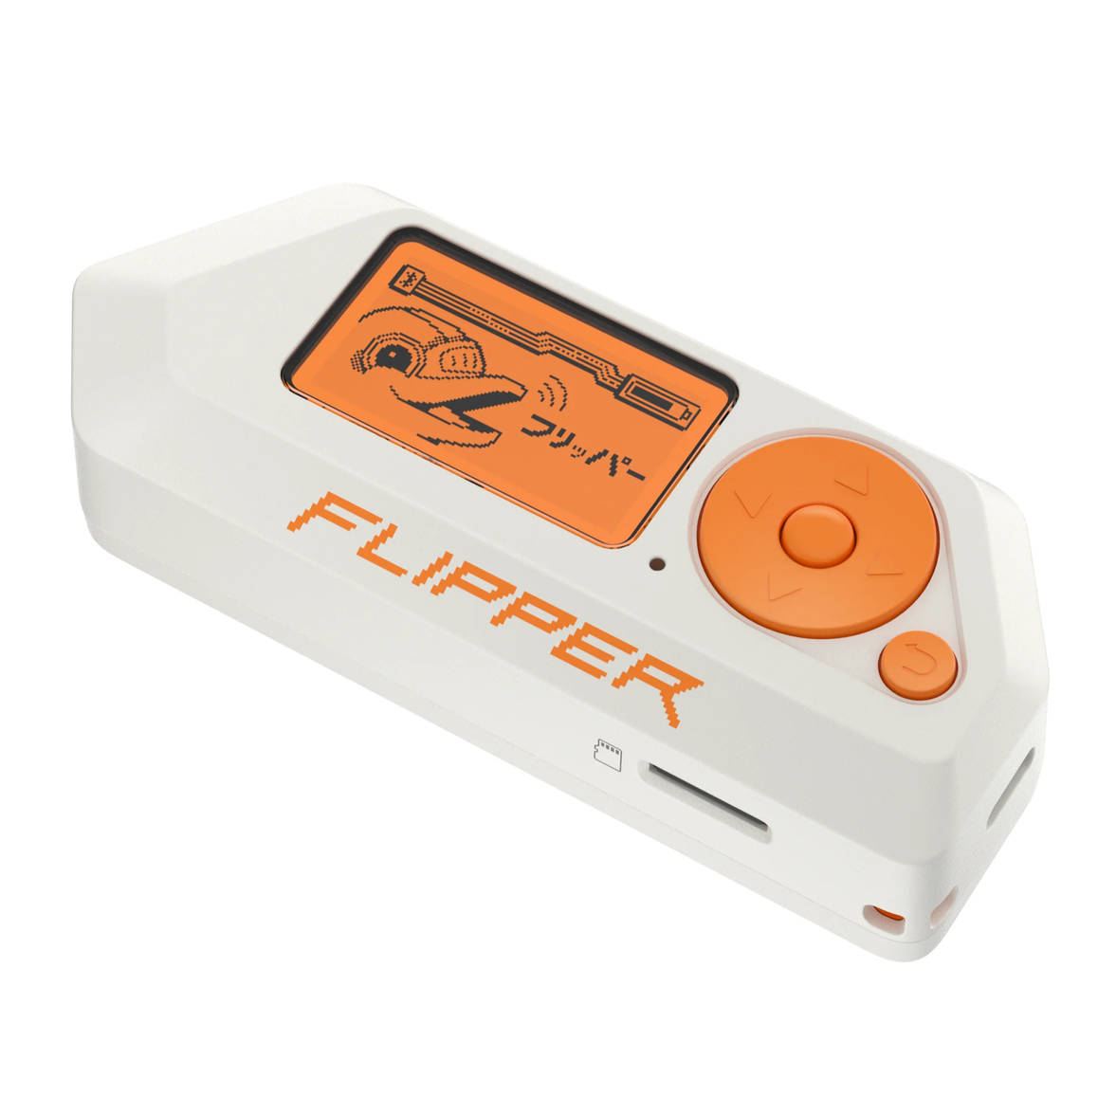
Flipper Core
Salah Aldin Tanbour
Mhammad Ahmad

Slide 2
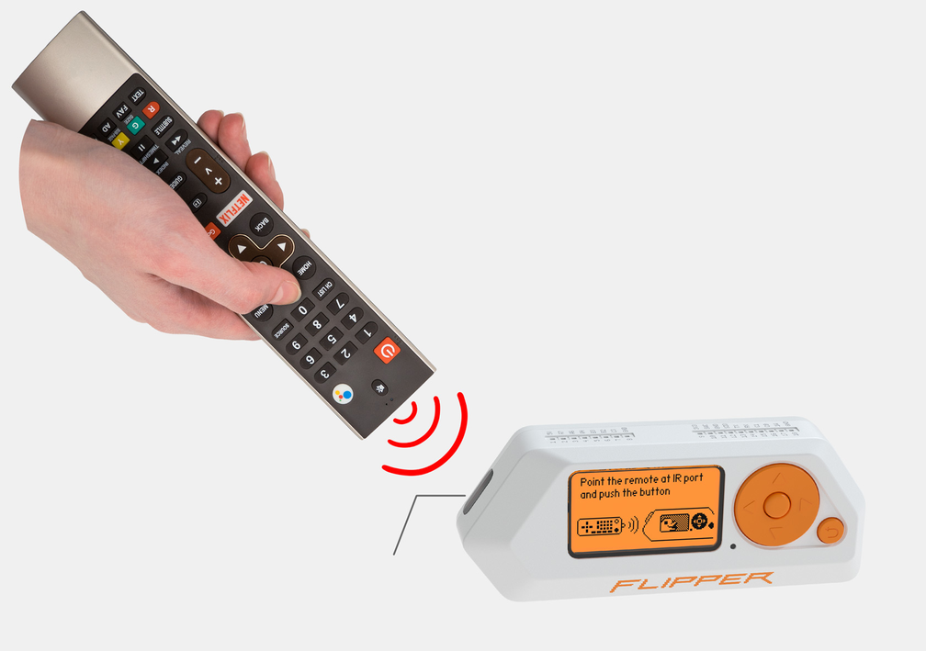
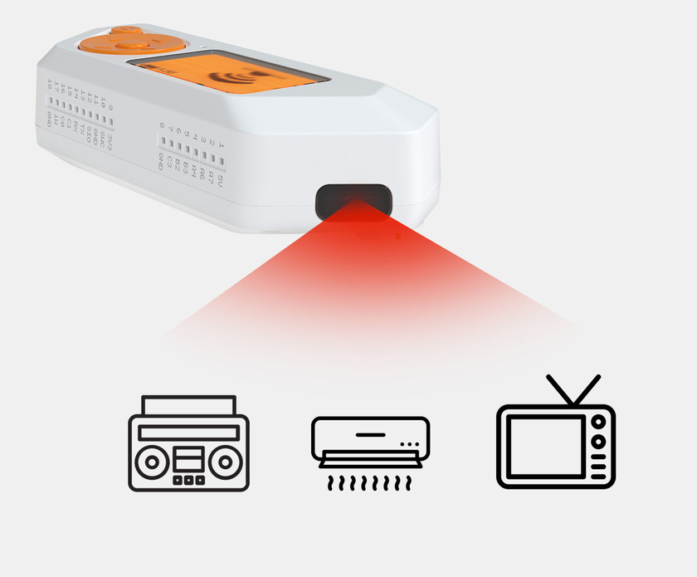
Infrared Signals

Slide 3
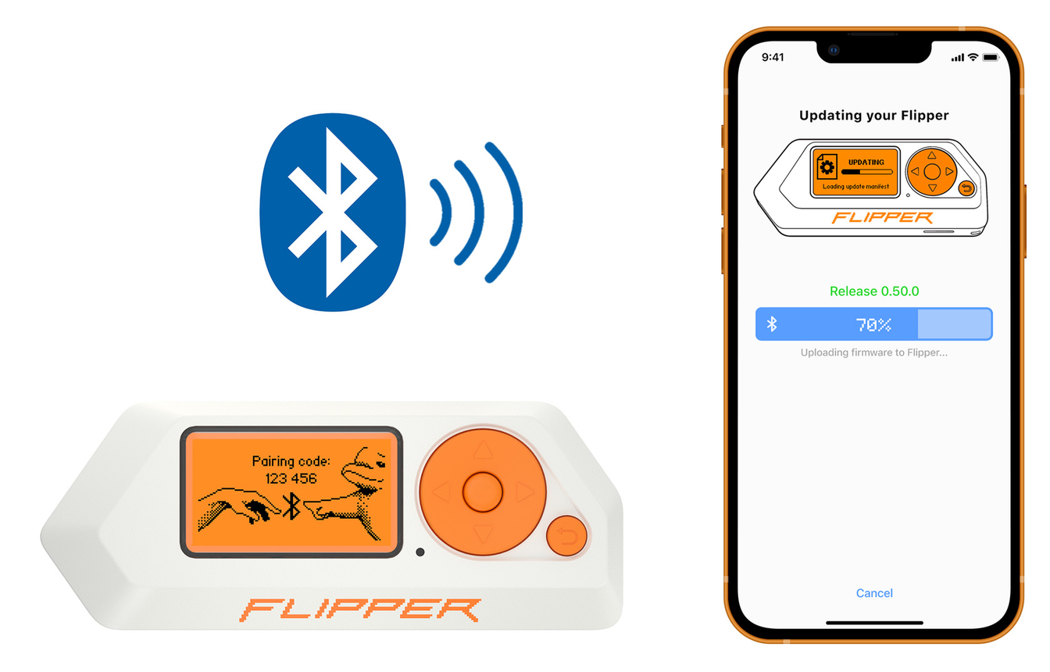
Bluetooth

Slide 4
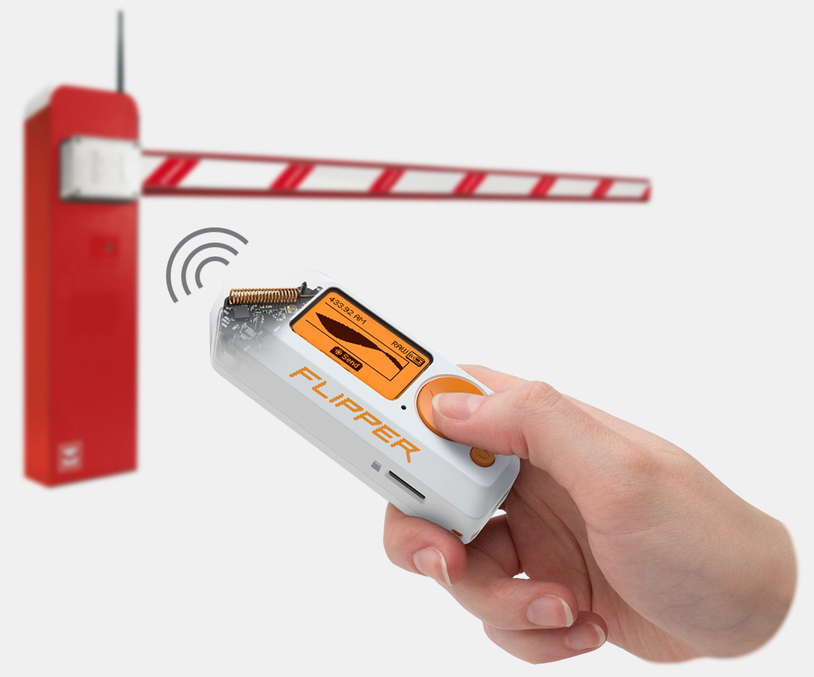
Sub-Ghz Signals

Slide 5
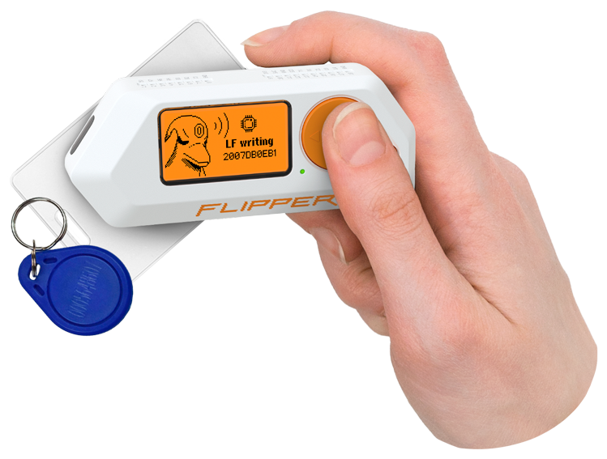
RFID Tags

Slide 6
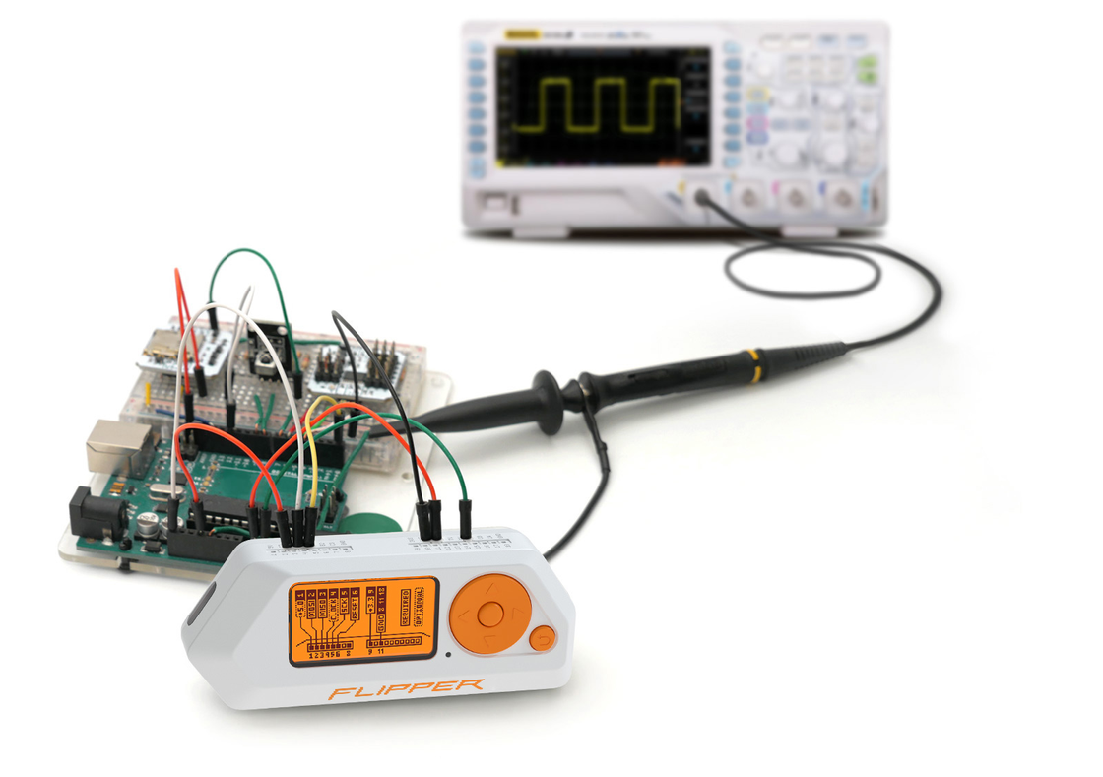
GPIO pins

Slide 7
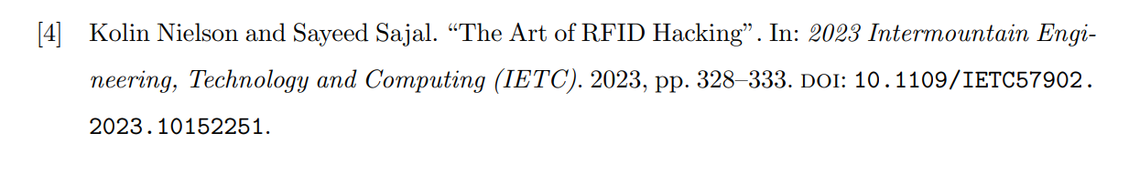
Used in Research & Security Testing

Slide 8
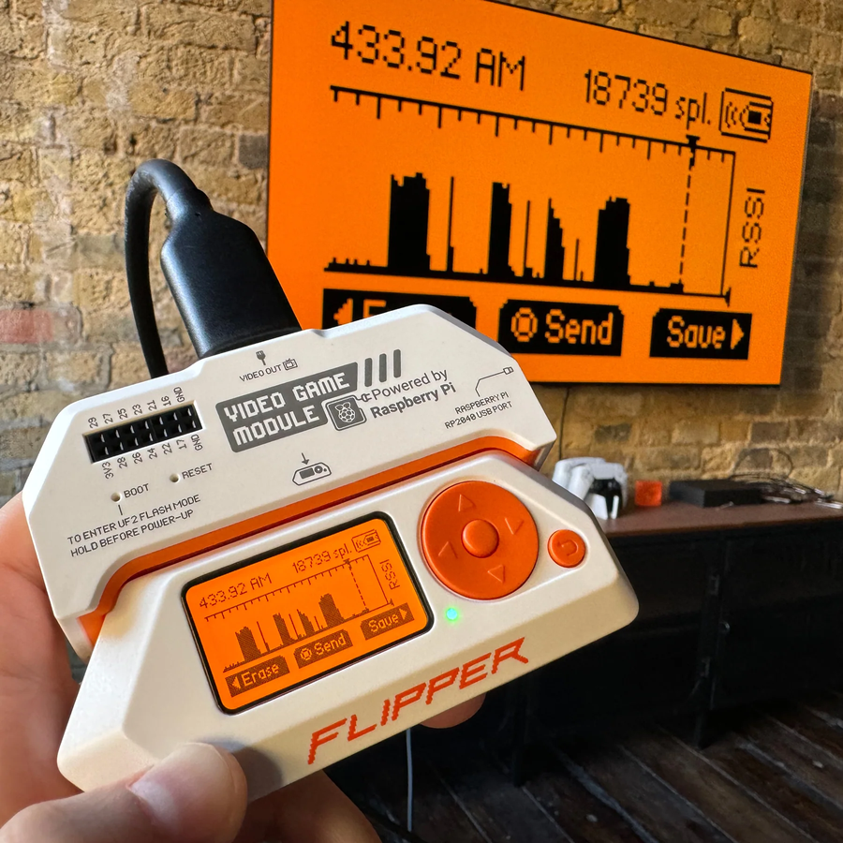
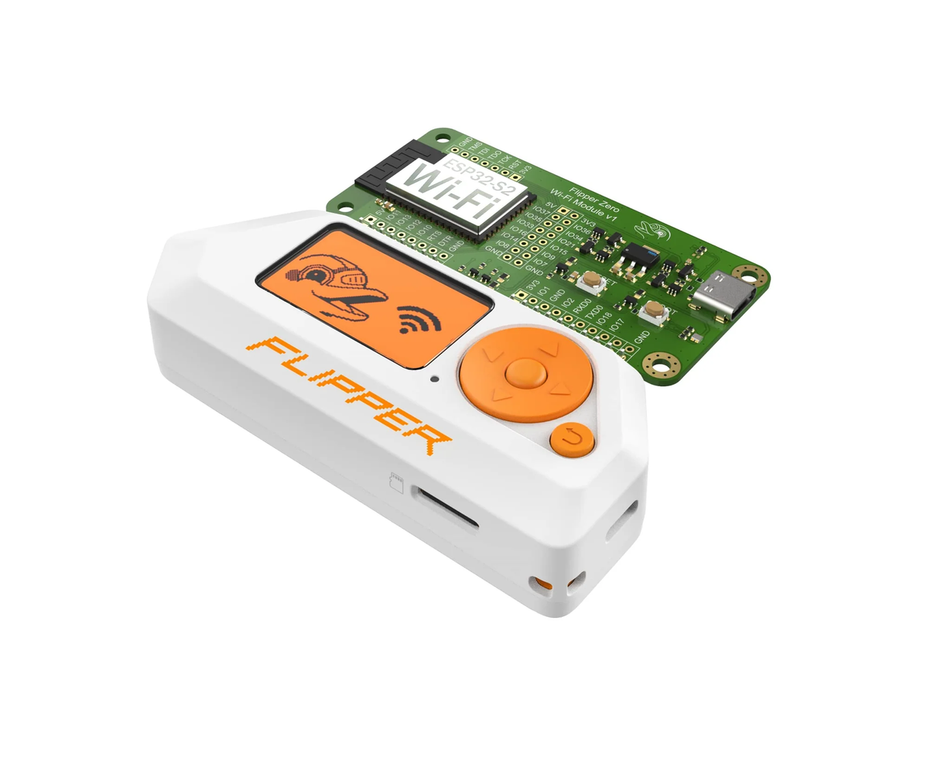
Extended with Modules

Slide 9
What is Flipper Core?

Slide 10
Proof of concept
Implements Core Functionalities
Functional Prototype
Notes:
We wanted a small, hand-held device that you can take anywhere and it just works.
Flipper zero is popular and useful as we've seen

Slide 11
Motivation

Slide 12
Unique Hardware Project
Flipper Zero is Trendy
Great Learning Opportunity
Notes:
We wanted a small, hand-held device that you can take anywhere and it just works.
Flipper zero is popular and useful as we've seen

Slide 13
What does Flipper Core cover?

Slide 14
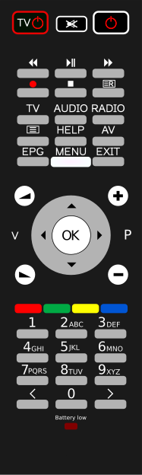
Scan
Store
Infrared
Emulate
Delete

Slide 15

Scan
Store
Sub-Ghz
Emulate
Delete
433Mhz

Slide 16
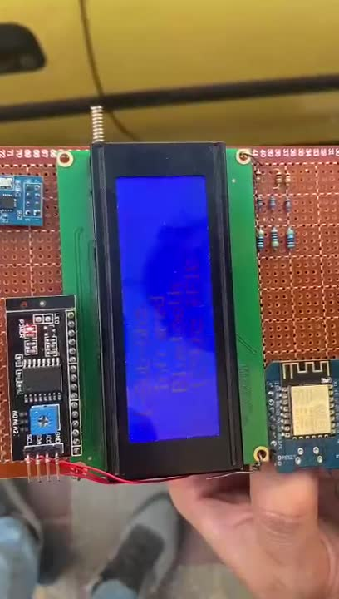
Demo...
Open a Car

Slide 17
Bluetooth
Mouse
Keyboard

Slide 18
GPIO
Temperature
Ultrasonic
On/Off

Slide 19
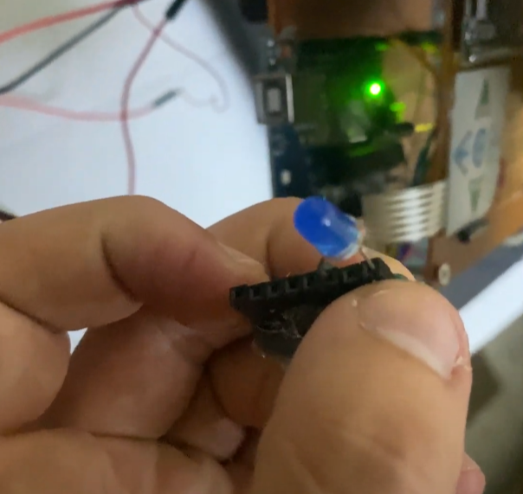
GPIO
On/Off Mode

Slide 20
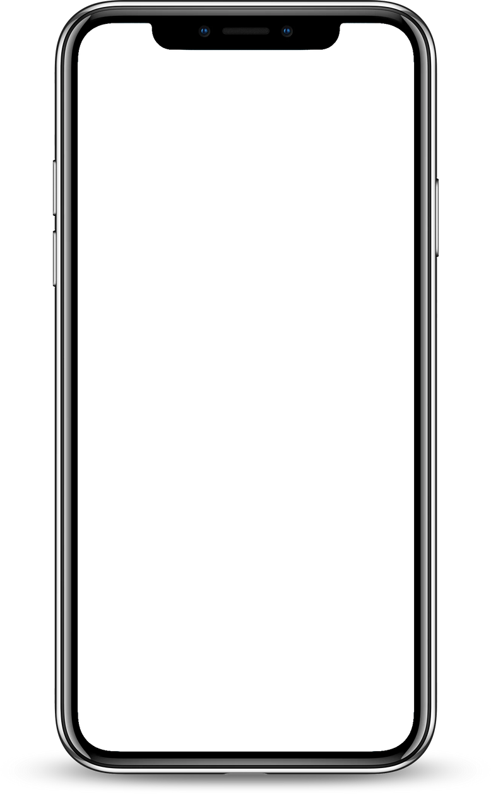
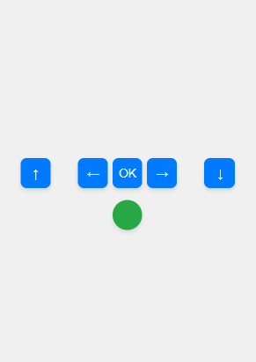
Web page

Slide 21
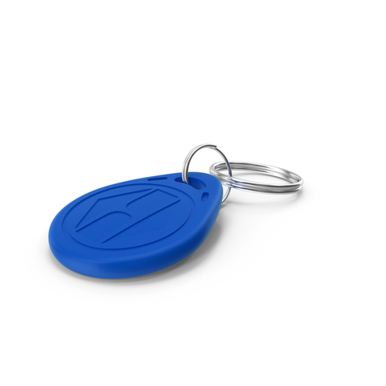
Scan
Store
RFID
Emulate
Delete

Slide 22
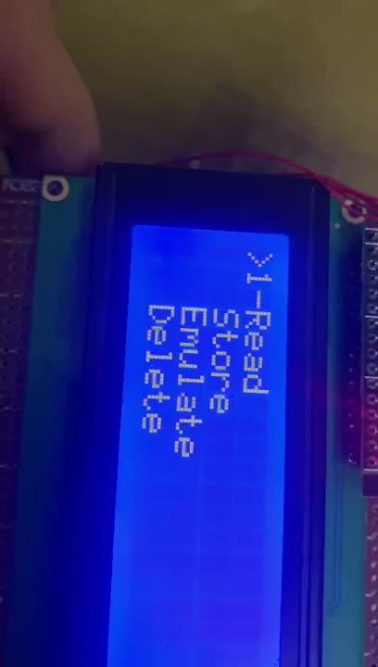
Demo...
Emulate Tag

Slide 23
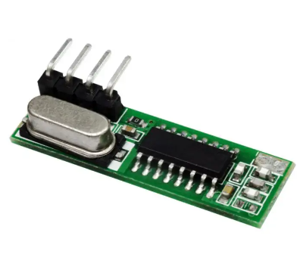
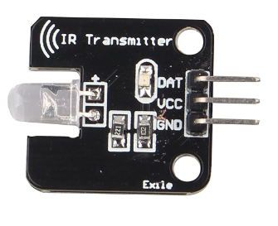
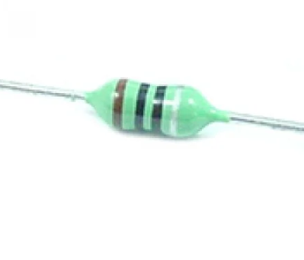
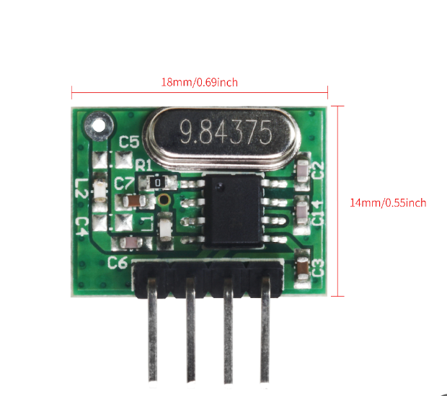
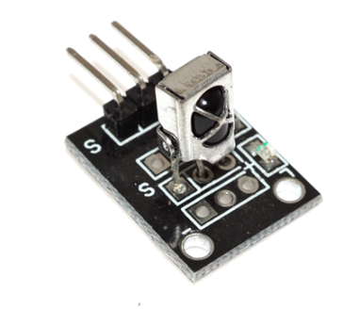
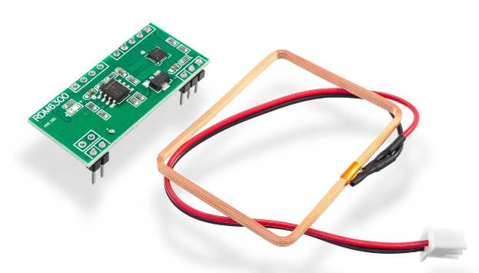
RX477
1uH Inductor
IR Transmitter
WL-102
IR Receiver
RDM6300

Slide 24
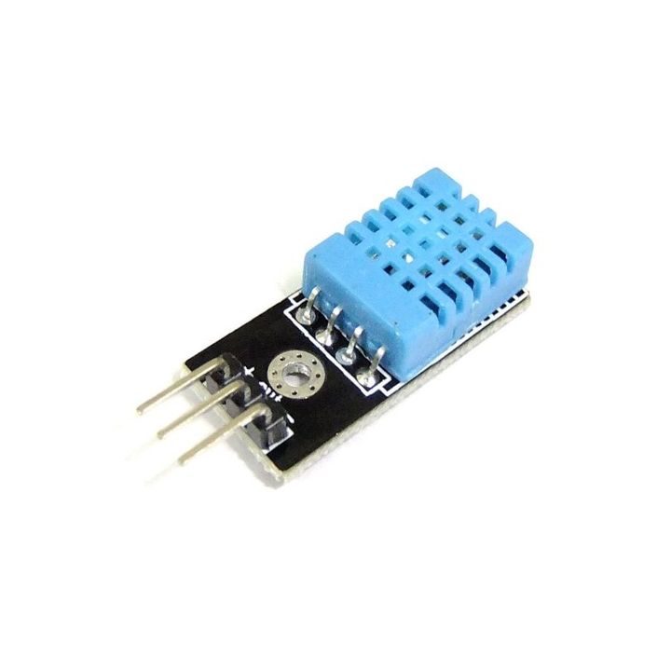
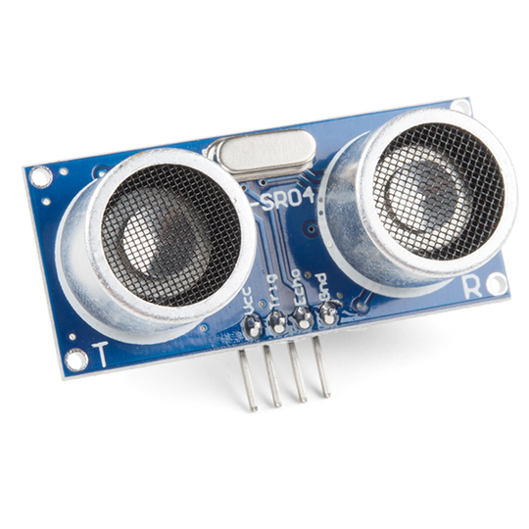
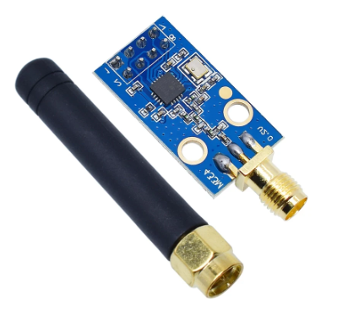
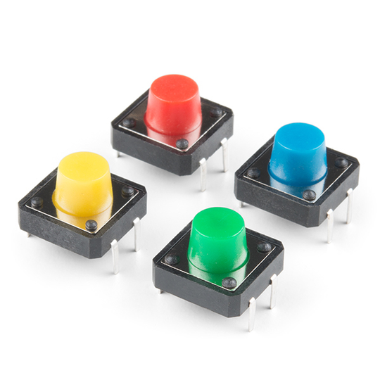
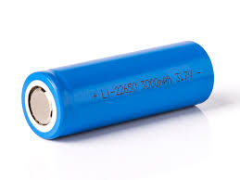
Ultrasonic
Temperatre Sensor
CC1101
Push buttons
2x 3.7V Battery

Slide 25
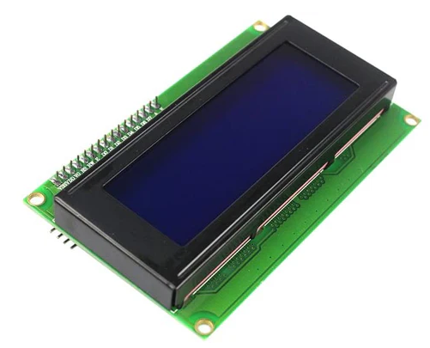
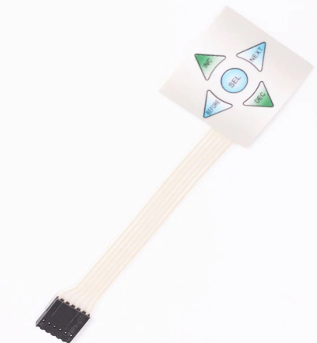
4x20 LCD
5x1 Keypad

Slide 26
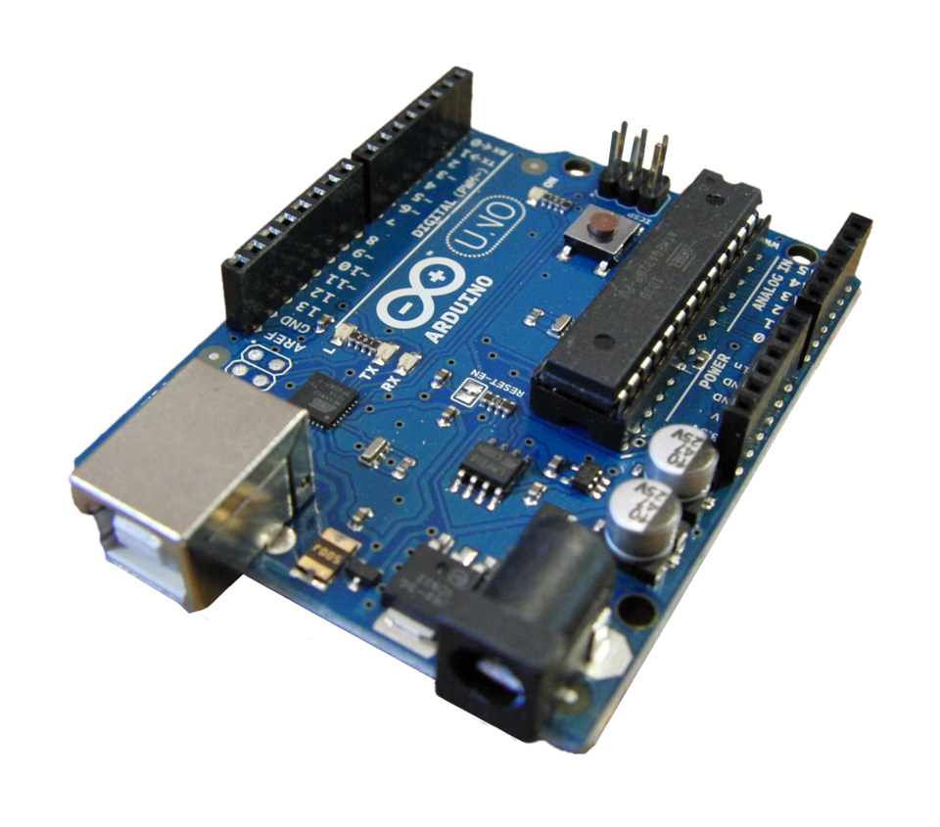
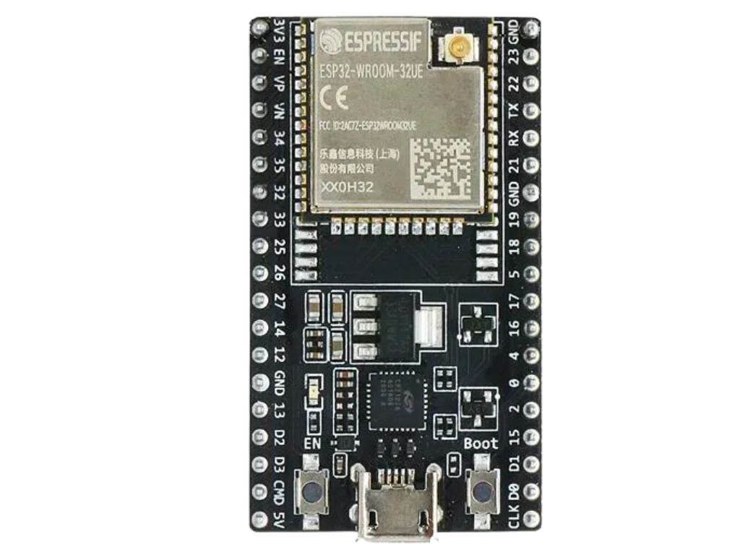
UART
ESP32
Arduino Uno

Slide 27
Challenges
Extensible LCD Code for many menus sub-menus
Software Design Patterns: Composite
Limited Experience in the domain
No previous similar projects & limited resources

Slide 28
Future Work
Online library of custom scripts & Plug-in Modules (same as Ultrasonic)
Shared Signals Repository
Better Product Design (eg. PCB)

Slide 29
Thanks For You Attendence

