Slide 1
SNAKE HUNT

Slide 2
Snake Hunt
Supervised by:
Dr.Raed Al-Qadi

Slide 3

OUR TEAM
Maryam Sholi
Yara Haydariah

Slide 4
OUTLINE
1
3
2
4
Introduction
Design and Implementation
Constraints
Future Work

Slide 5
01
Introduction

Slide 6

Project Opjective
The goal of this project is to create a snake game that blatantly fits the following requirements, as the game progresses, the difficulty must grow since a snake`s size must increase after consuming a unit of food(They will be spawned randomly after each snake eating in different areas around the playing area).

Slide 7
Constraints
02

Slide 8


Data transfer
components on glove
bigger screen

Slide 9
Design and Implementation
03

Slide 10
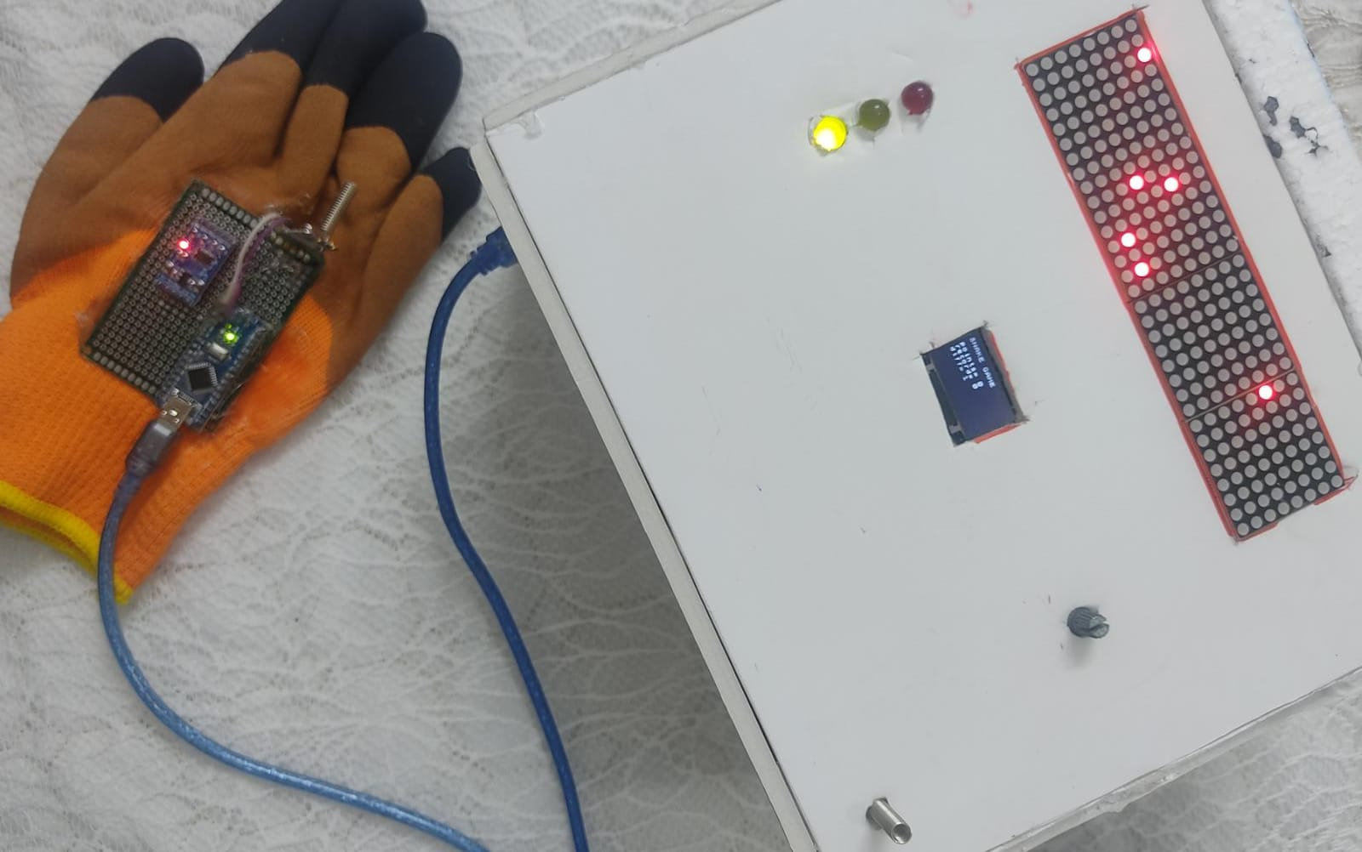

Slide 11
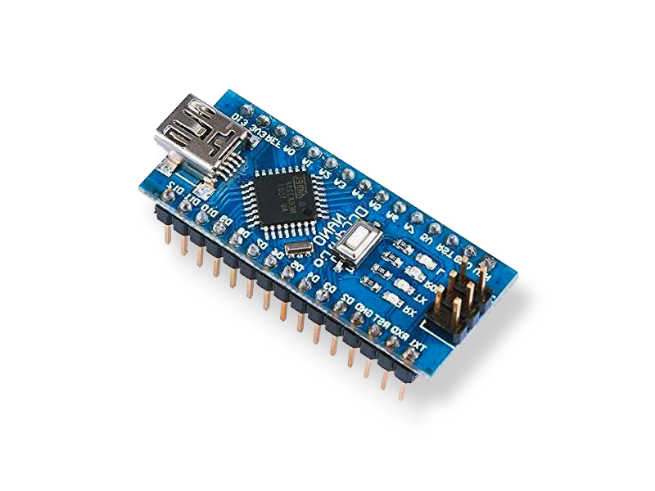
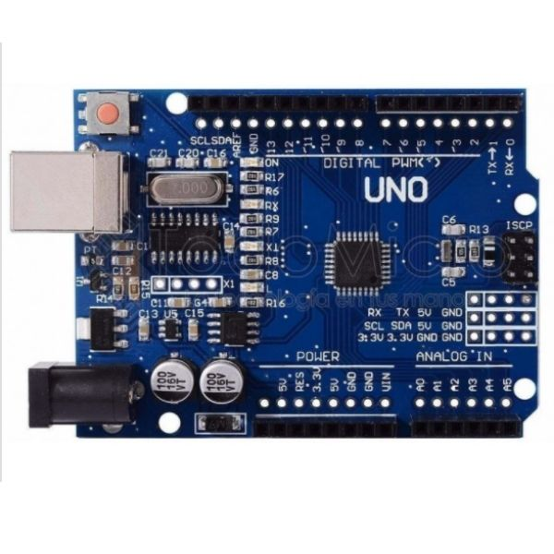
Hardware Components
Arduino Uno
Arduino Nano

Slide 12
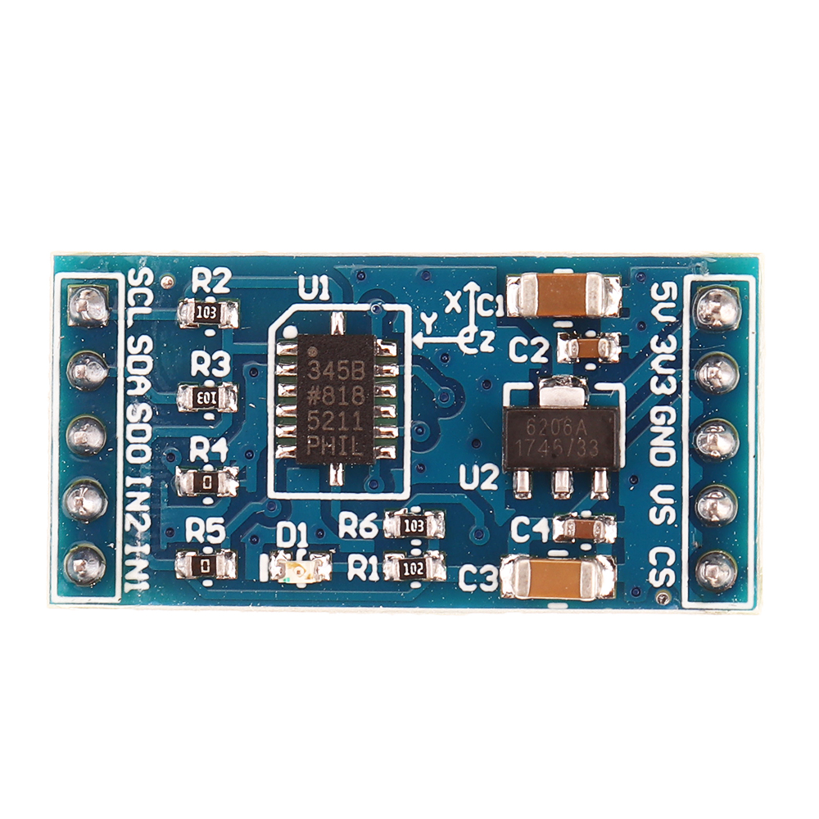
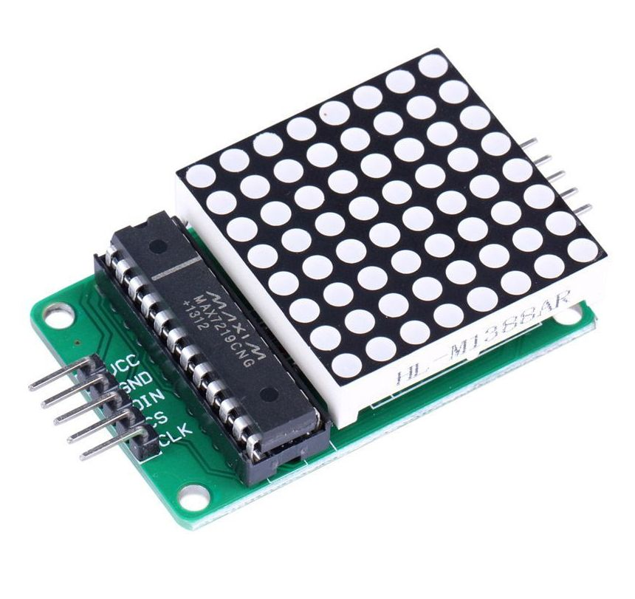
Hardware Components
ADXL345 accelerometer
max7219 led matrix

Slide 13
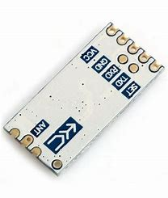
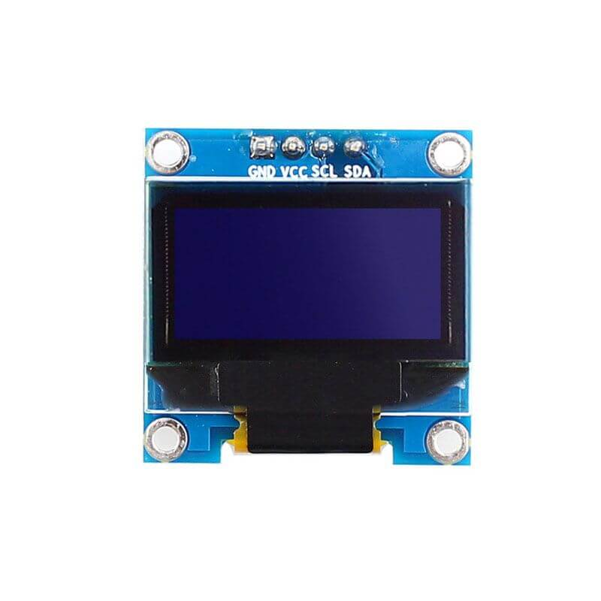
Hardware Components
HC-12
OLED Display

Slide 14
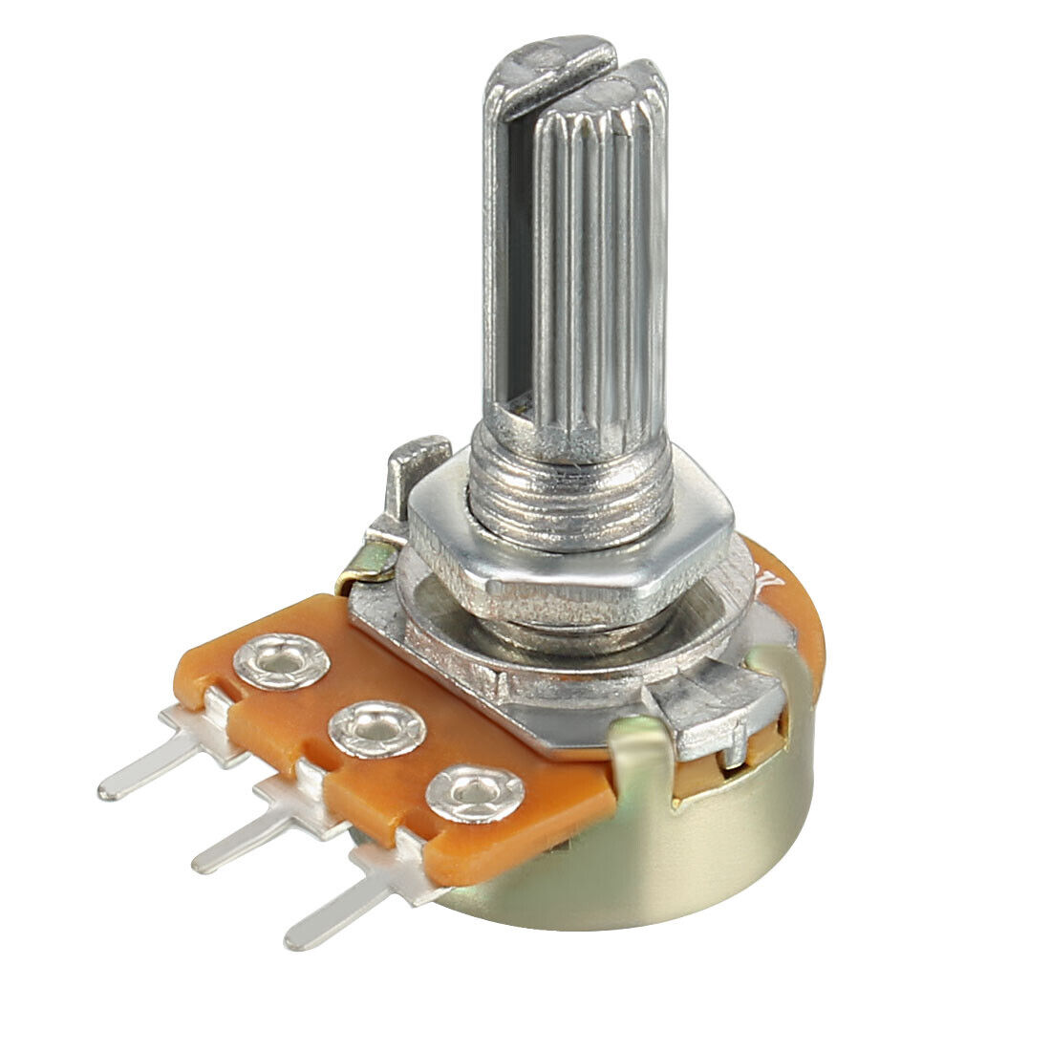
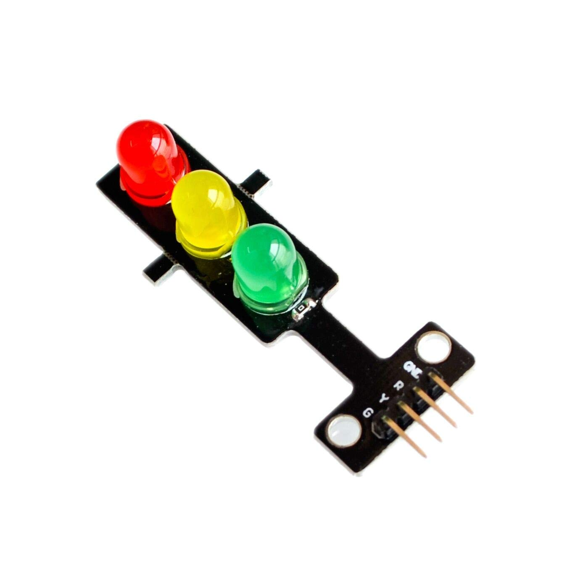
Hardware Components
Potentiometer
Traffic Light

Slide 15
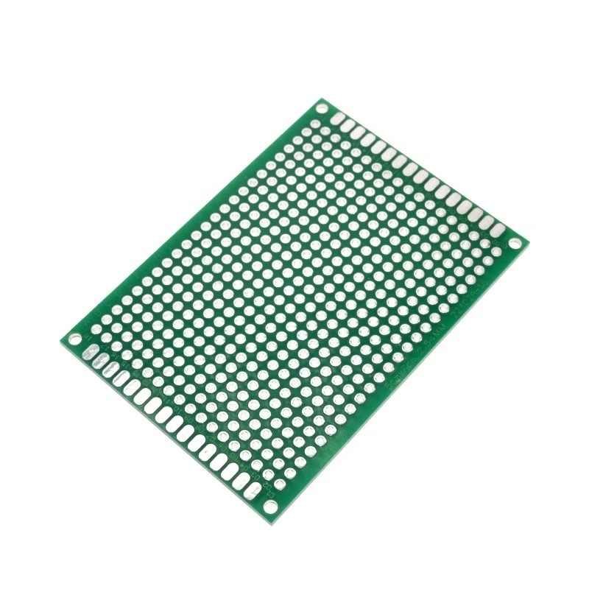
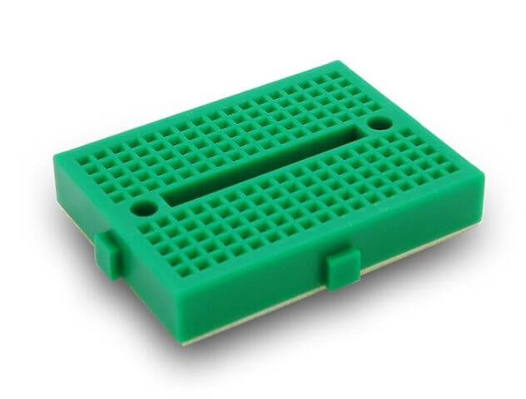
Hardware Components
printed circuit
board (pcb)
Mini Green Breadboard

Slide 16
04
Future Work

Slide 17

We will use the RGB led matrix
show fruits of different colors to indicate different values
adding another arm
so that another player can play and confront so that increased the challenge motive
Adding a snake by the game itself
that acts as a competitor to the player and plays against him

Slide 18
Thank you

