Slide 1
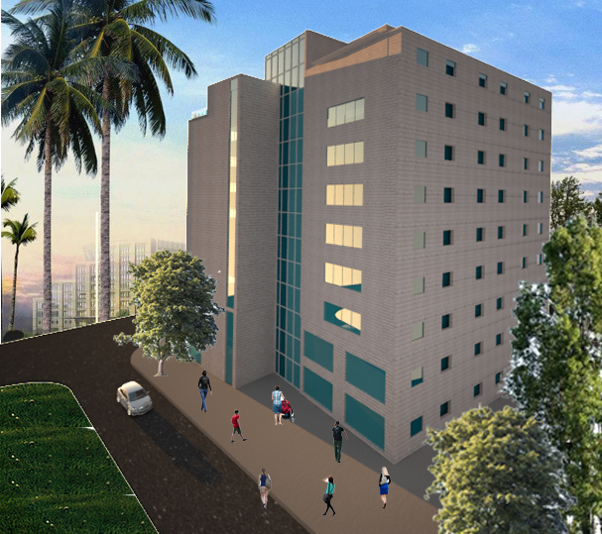

An-Najah National University
Faculty of Engineering
Civil Engineering Department
Graduation Project II
Structural Analysis and Seismic Design of Palestine Mall in Ramallah City
Prepared by :
Ahmad Kittaneh
Muhammad Jarrar
Muhammad Zakarneh
Supervisor :
Munther Diab

Slide 2
Outline
Background Information.
Preliminary Design.
Project Modeling.
Model Checks.
Design.

Slide 3
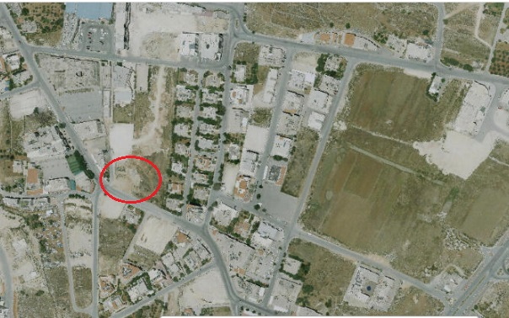
Location: The project addresses is the analysis and design of Palestine mall (12536.54 m²) located in Ramallah.

Slide 4


Slide 5
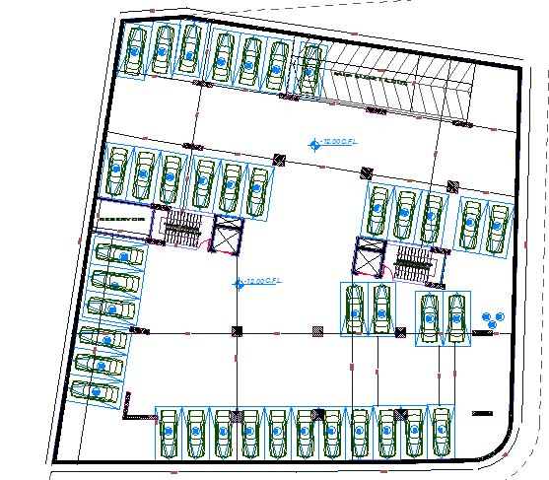
Basement Floor

Slide 6
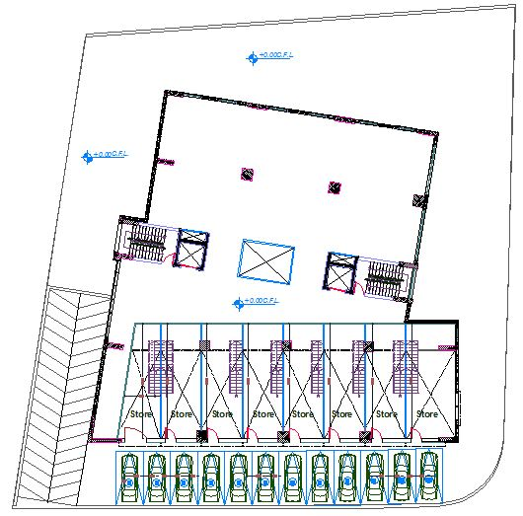
Ground Floor

Slide 7
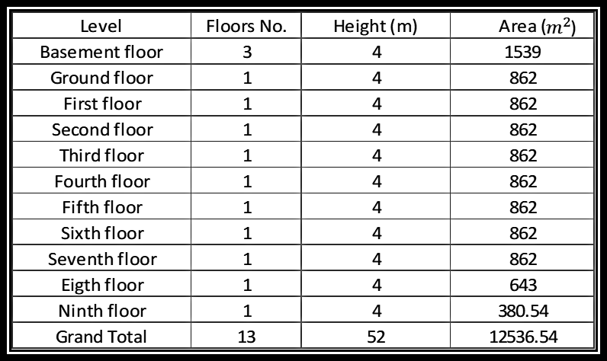
Floors, areas and heights

Slide 8
Codes and Standards
American Concrete Institute (ACI 318- 2014).
American Society for Civil Engineering – Minimum Design Loads for Buildings and Other Structures (ASCE 7-2010).
International Building Code (IBC- 2015).

Slide 9
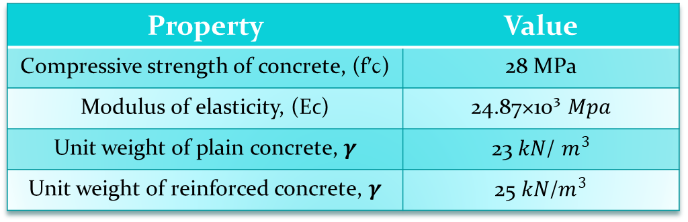
Materials
Structural Materials:
Concrete:
Property | Value
Compressive strength of concrete, (fʹϲ) | 28 MPa
Modulus of elasticity, (Eϲ) | 24.87×10³ 𝑀𝑝𝑎
Unit weight of plain concrete, 𝜸 | 23 𝑘𝑁/ $m^{3}$
Unit weight of reinforced concrete, 𝜸 | 25 𝑘𝑁/$m^{3}$
Reinforced Steel:
Property | Value
Steel Grade | Grade 60
Yield strength (Fy) | 420 𝑀𝑝𝑎
Ultimate strength (Fu) | 620 𝑀𝑝𝑎

Slide 10
Non Structural Elements:
Material | Unit weight, 𝜸 in KN\m³
Plaster | 23
Tiles | 25
Sand | 16
Masonry stone | 27
Block | 12
Concrete mortar | 23

Slide 11
Loads:
Loads
Gravity
Lateral
Dead
Live
Seismic
Soil

Slide 12
  Gravity Load:
I. Dead Load:
  Slab superimposed dead load= 4.6 KN/m².
  Superimposed dead load of external walls = 21 KN/m.
II. Live Load:
  The maximum value of the live load which was obtained from table 4-1 in ASCE7-10 is 4.8 KN/m², But we used a live load value of 5 KN/m²

Slide 13
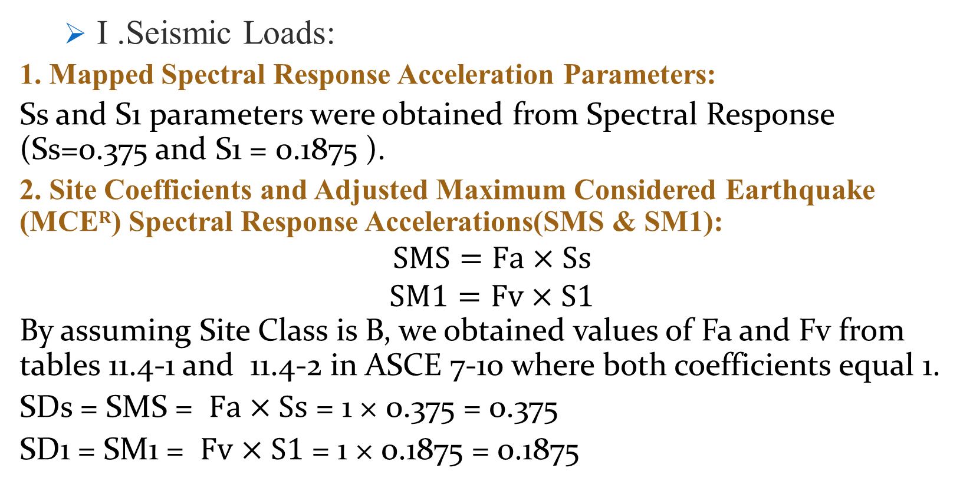
  Lateral load:
  I .Seismic Loads:
1. Mapped Spectral Response Acceleration Parameters:
Ss and S1 parameters were obtained from Spectral Response (Ss=0.375 and S1 = 0.1875 ).
2. Site Coefficients and Adjusted Maximum Considered Earthquake (MCEᴿ) Spectral Response Accelerations(SMS & SM1):
$$SMS=Fa×Ss$$
$$SM1=Fv×S1$$
By assuming Site Class is B, we obtained values of Fa and Fv from tables 11.4-1 and 11.4-2 in ASCE 7-10 where both coefficients equal 1.
SDs = SMS = $Fa×Ss$ = 1 × 0.375 = 0.375
SD1 = SM1 = $Fv×S1$ = 1 × 0.1875 = 0.1875

Slide 14
3.Importance Factor (Ie) and Risk Category:
The risk Category was decided to be Ш from table 1.5-1 in ASCE7-10, so the Importance Factor is equal 1.25 according to table 1.5-2 in ASCE7-10.
4. Seismic Design Category:
According to the tables 11.6-1 and 11.6-2 in ASCE7-10, Since the value of SDs= 0.375, and the Risk Category is Ш. So, it’s found that the seismic design category is C.

Slide 15
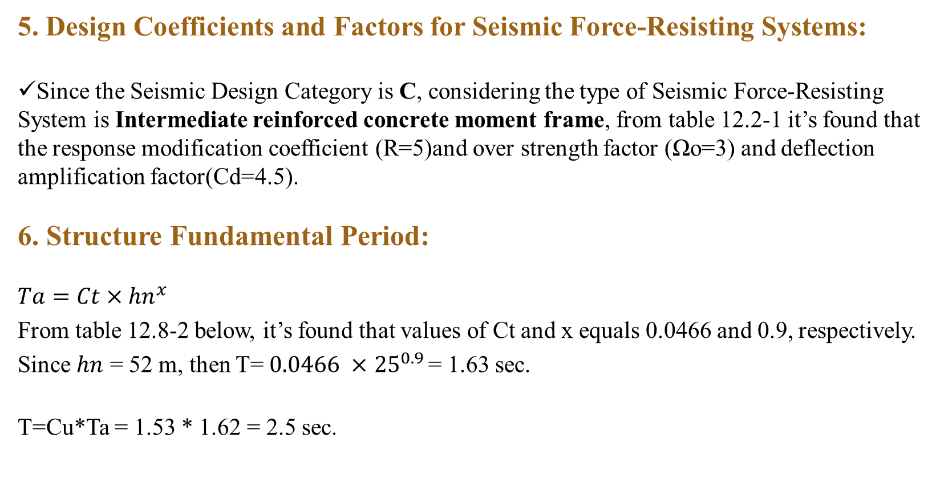
5. Design Coefficients and Factors for Seismic Force-Resisting Systems:
Since the Seismic Design Category is C, considering the type of Seismic Force-Resisting System is Intermediate reinforced concrete moment frame, from table 12.2-1 it’s found that the response modification coefficient (R=5)and over strength factor (Ωo=3) and deflection amplification factor(Cd=4.5).
6. Structure Fundamental Period:
$$Ta=Ct×{hn}^{x}$$
From table 12.8-2 below, it’s found that values of Ct and x equals 0.0466 and 0.9, respectively.
Since $hn$ = 52 m, then T= $0.0466 ×$ ${25}^{0.9 }$= 1.63 sec.
T=Cu*Ta = 1.53 * 1.62 = 2.5 sec.

Slide 16
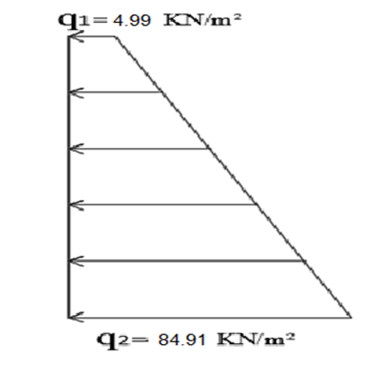
  II. Soil Load:
Ɣ = 20 kN/m³
Ø = 30˚
Ko =1-sin (Ø) =1-sin (30) =0.33
the value of the surcharge live load (w) = 15 KN/m²
The figure below shows the total earth pressure on the basement shear wall including seismic earth pressure .

Slide 17
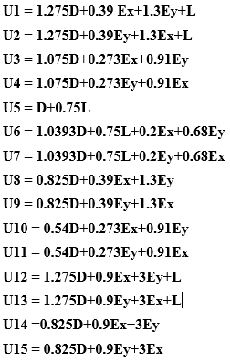
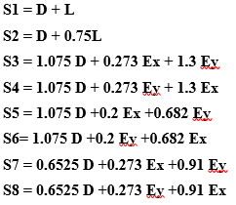
Load Combinations
Ultimate Load Combinations Service Load Combinations

Slide 18

Preliminary Design

Slide 19
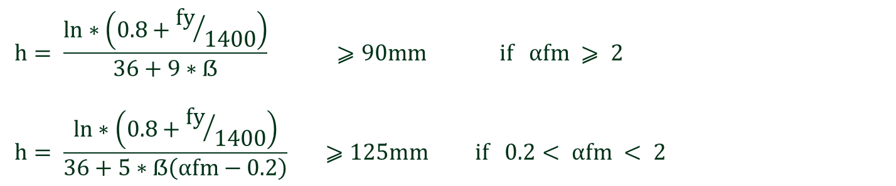
The structural system used is two way solid slab
Slab thickness
$$h= \frac{ln∗\left(0.8+{fy}/{1400}\right)}{36+9∗ẞ} ⩾90mm if αfm ⩾ 2$$
$$h= \frac{ln∗\left(0.8+{fy}/{1400}\right)}{36+5∗ẞ\left(αfm−0.2\right)} ⩾125mm if 0.2< αfm < 2$$
Slab thickness =220 mm

Slide 20
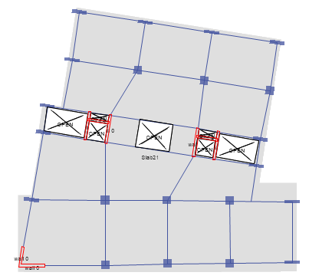
Slab

Slide 21
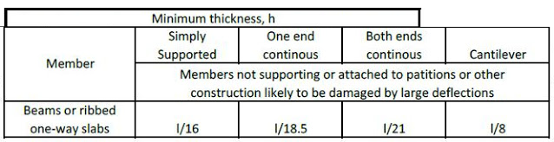
Beams
Beam | Dimensions (mm)
B1 | 500*800
B2 | 500*1500
B3 | 300*220

Slide 22
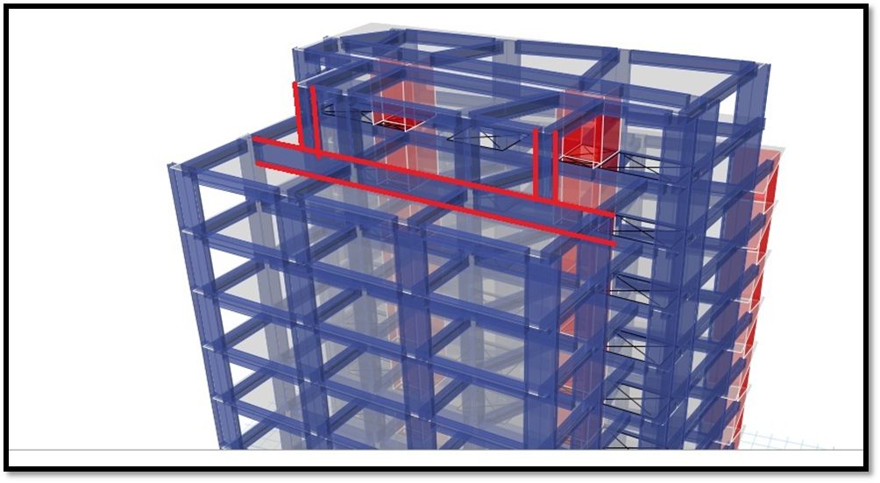
Beam II

Slide 23
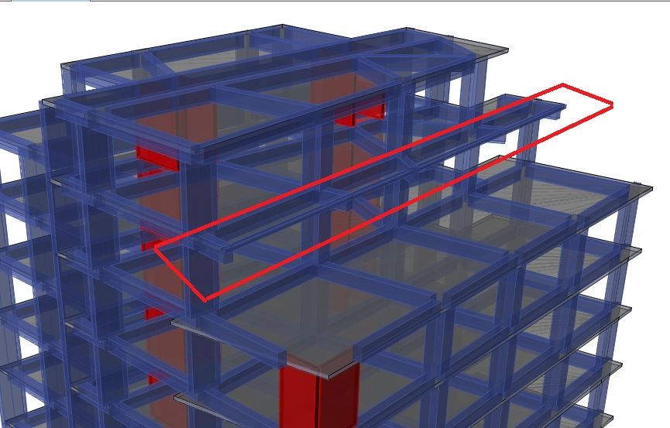
Beam III

Slide 24
Columns
Columns dimensions are shown in the table:
Group No. | Dimensions (mm)
G1 | 1100*1100
G2 | 400*1800
G3 | 1000*1000
G4 | 900*900

Slide 25
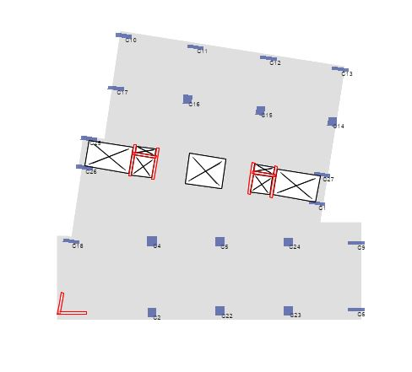
The following figure shows the distribution of columns in the seventh floor:

Slide 26
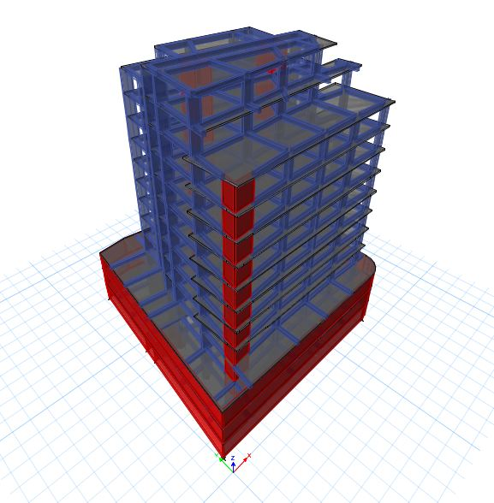
3-D Modeling
Structural Modeling using ETABS.

Slide 27
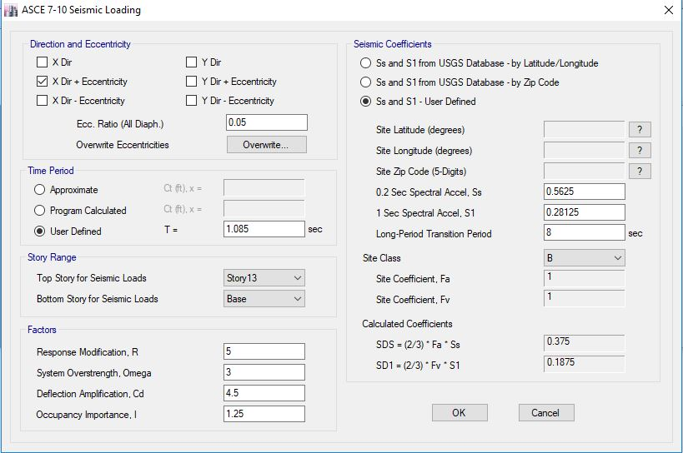
Seismic loading data according to Equivalent Static Method .
X-direction:

Slide 28
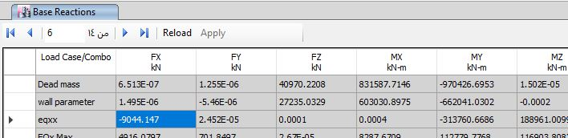
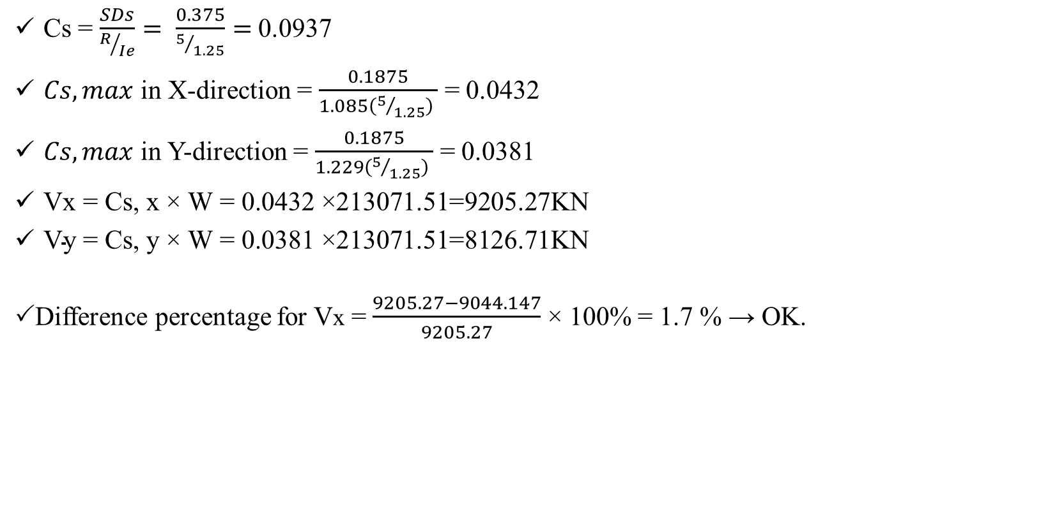
Check Base Shear Equilibrium
Cs = $\frac{SDs}{R/{Ie}}= \frac{0.375}{5/{1.25}}=$0.0937
$Cs,max$ in X-direction = $\frac{0.1875}{1.085\left(5/{1.25}\right) }$ = 0.0432
$Cs,max$ in Y-direction = $\frac{0.1875}{1.229\left(5/{1.25}\right) }$ = 0.0381
$\text{Vx}\text{ = }\text{Cs}\text{, }\text{x}\text{ ×} \text{W}\text{ = }\text{0.}\text{0432 }\text{×}\text{213071.51}\text{=}\text{9205.27}\text{KN}$
$\text{V}\text{y}\text{ = }\text{Cs}\text{, }\text{y}\text{ ×} \text{W}\text{ = }\text{0.}\text{0381 }\text{×}\text{213071.51}\text{=}\text{8126.71}\text{KN}$
Difference percentage for Vx = $\frac{9205.27−9044.147}{9205.27}$ × 100% = 1.7 % → OK.

Slide 29
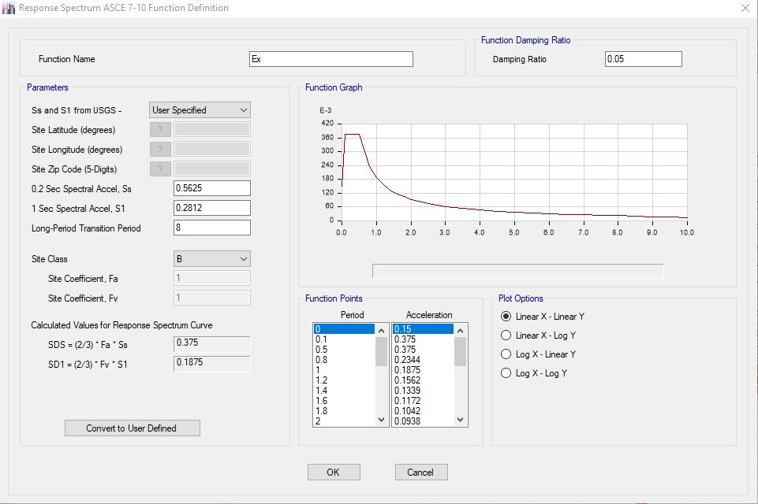
Response Spectrum Function
X-direction

Slide 30
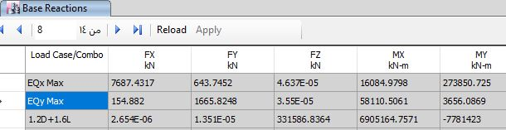
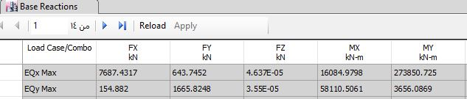

Checking for Dynamic Response Spectrum Analysis
X-Direction:
The scale factor = (𝑔 𝐼)/𝑅 = (9810 × 1.25)/5 = 2043.05
$To reach 0.85 of ELF−x⇒ \frac{0.85∗9044}{ 1849.55}×2043.05=10193.4 kN$
After multiplying with the scale factor

Slide 31
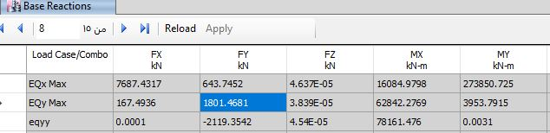

Y-direction:
The scale factor = (𝑔 𝐼)/𝑅 = (9810 × 1.25)/5 = 2043.05
$To reach 0.85 of ELF−y⇒ \frac{0.85∗2119.35}{ 1665.824}×2043.05=26522 kN$
After multiplying with the scale factor

Slide 32
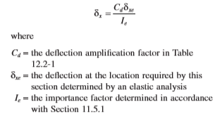
Drift Check:
Drift limitations under earthquakes are imposed on inelastic displacements. The story drift, Δ, is defined as the relative displacements between adjacent story displacements, δ. The story displacement, δx, at level x is calculated as follows:

Slide 33
Drift in X-directions:
Story | ᶋxe from etabs | Cd | Height | ᶋx(m) | Allowable (m)
1 | 0.0003 | 4.5 | 4 | 0.00108 | 0.06
2 | 0.00024 | 4.5 | 4 | 0.000864 | 0.06
3 | 0.00244 | 4.5 | 4 | 0.0088 | 0.06
4 | 0.00724 | 4.5 | 4 | 0.0261 | 0.06
5 | 0.0119 | 4.5 | 4 | 0.043 | 0.06
6 | 0.0136 | 4.5 | 4 | 0.0489 | 0.06
7 | 0.0164 | 4.5 | 4 | 0.058 | 0.06
8 | 0.01435 | 4.5 | 4 | 0.051 | 0.06
9 | 0.01377 | 4.5 | 4 | 0.0495 | 0.06
10 | 0.0125 | 4.5 | 4 | 0.045 | 0.06
11 | 0.01189 | 4.5 | 4 | 0.042 | 0.06
12 | 0.0018 | 4.5 | 4 | 0.00648 | 0.06
13 | 0.006 | 4.5 | 4 | 0.0216 | 0.06

Slide 34
Drift Y-direction
All values of drift are less than 0.015h_{x,} so it is OK.
Story | ᶋxe from etabs | Cd | Height | ᶋx(m) | Allowable (m)
1 | 0.0003 | 4.5 | 4 | 0.00108 | 0.06
2 | 0.0002 | 4.5 | 4 | 0.00072 | 0.06
3 | 0.00069 | 4.5 | 4 | 0.00248 | 0.06
4 | 0.00235 | 4.5 | 4 | 0.00846 | 0.06
5 | 0.0044 | 4.5 | 4 | 0.0144 | 0.06
6 | 0.00487 | 4.5 | 4 | 0.0175 | 0.06
7 | 0.00498 | 4.5 | 4 | 0.0179 | 0.06
8 | 0.00482 | 4.5 | 4 | 0.0173 | 0.06
9 | 0.00444 | 4.5 | 4 | 0.0159 | 0.06
10 | 0.00394 | 4.5 | 4 | 0.0141 | 0.06
11 | 0.00345 | 4.5 | 4 | 0.0125 | 0.06
12 | 0.00278 | 4.5 | 4 | 0.00972 | 0.06
13 | 0 | 4.5 | 4 | 0 | 0.06

Slide 35
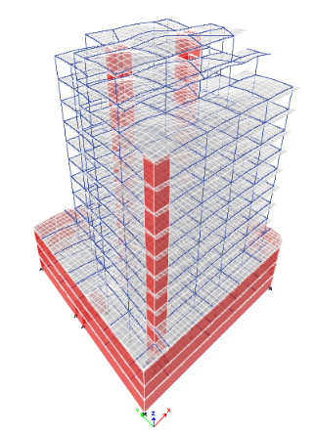
Model Checks
Compatibility Check:
To ensure that the model will behave as one static unit.

Slide 36
Equilibrium Checks:
To ensure that the model is satisfied Newton’s Law for statics and equilibrium objects.
Load Type | Hand Cal. (KN) | ETABS Results(KN) | Difference %
Dead | 149604.37 | 144143.48 | 3.6
SD | 54908.08 | 54572.48 | 0.6
Live | 59387.5 | 58385.83 | 1.67

Slide 37
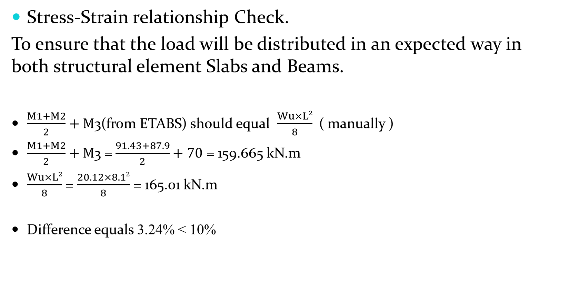
Stress-Strain relationship Check.
To ensure that the load will be distributed in an expected way in both structural element Slabs and Beams.
$\frac{M1+M2}{2}+M$3(from ETABS) should equal $\frac{Wu×L²}{8}$( manually )
$\frac{M1+M2}{2}+M$3 =$\frac{91.43+87.9}{2}+70$ = 159.665 kN.m
$\frac{Wu×L²}{8}$ = $\frac{20.12×8.1²}{8}$ = 165.01 kN.m
Difference equals 3.24% < 10%

Slide 38
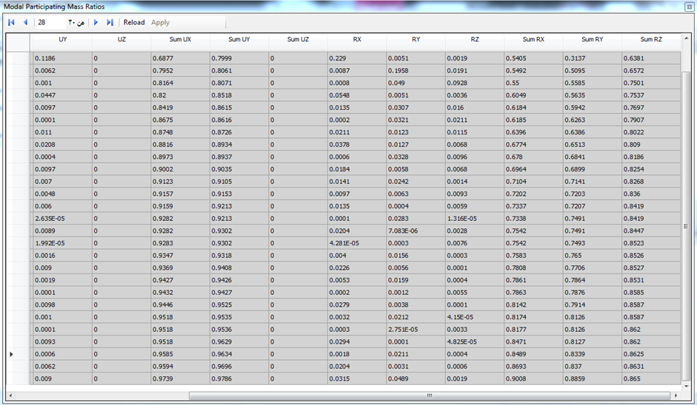
Mass participation ratio check.

Slide 39
Design
After building the 3D model using ETABS and make the checks, then we can make the design process and preparing the detailing sheets for all members.

Slide 40
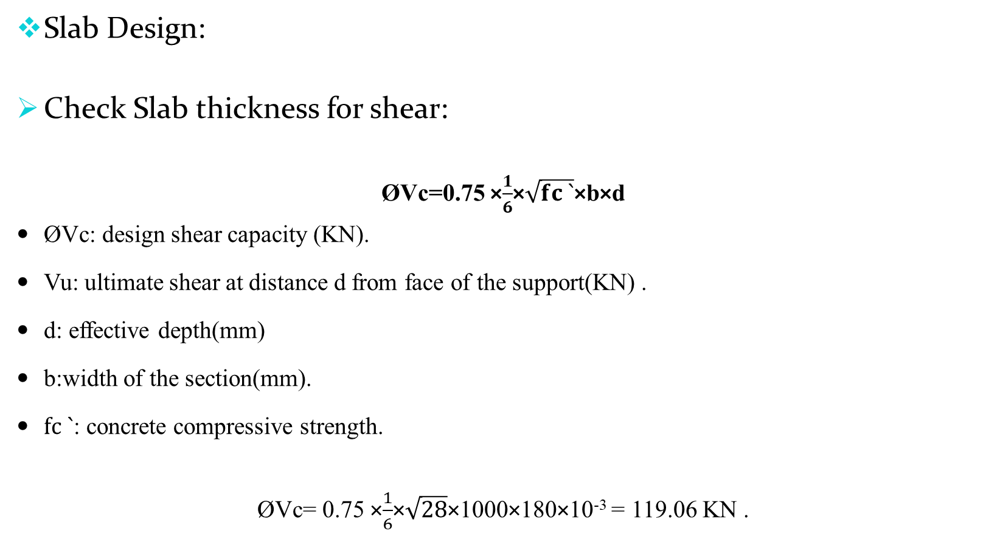
Slab Design:
Check Slab thickness for shear:
ØVc=0.75 ×$\frac{1}{6}$×$\sqrt{fc `}$×b×d
ØVc: design shear capacity (KN).
Vu: ultimate shear at distance d from face of the support(KN) .
d: effective depth(mm)
b:width of the section(mm).
$fc `$: concrete compressive strength.
ØVc= 0.75 ×$\frac{1}{6}$×$\sqrt{28}$×1000×180×10⁻³ = 119.06 KN .

Slide 41
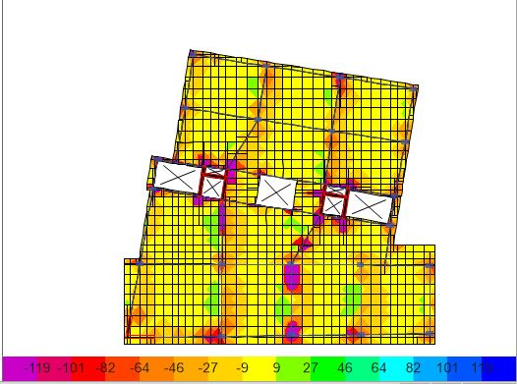
Shear Values:
Maximum value of V13

Slide 42
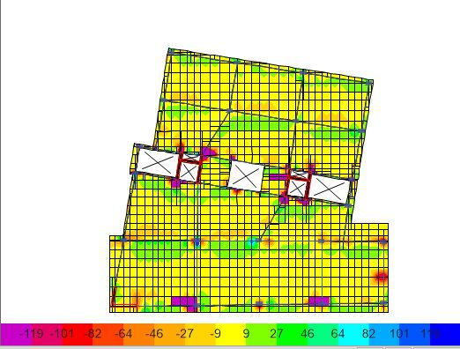
Maximum Value of V23
The maximum shear value of the slab equals 61.11 kN
ØVc = 119.06 kN > Vu=61.11 kN ➔ The slab thickness is adequate to resist shear.

Slide 43
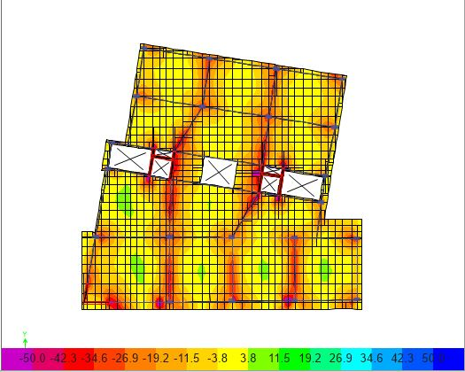
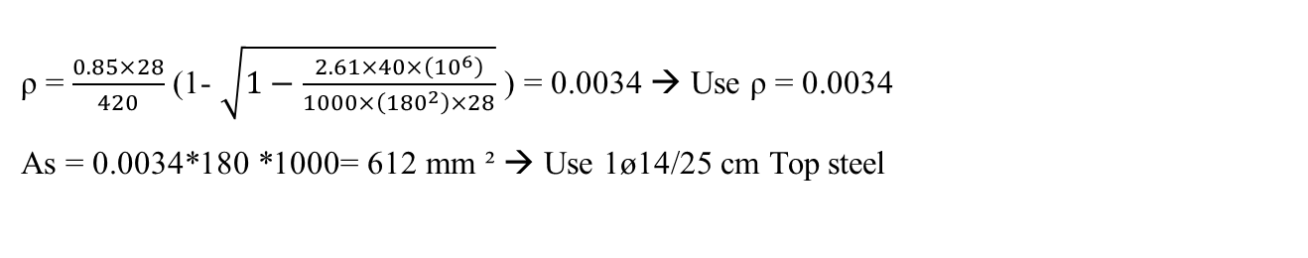
Design for Flexure:
Maximum negative value
ρ = $\frac{0.85×28}{420}$ (1- $\sqrt{1−\frac{2.61×40×\left({10}^{6}\right)}{1000×\left({180}^{2}\right)×28}}$ ) = 0.0034 → Use ρ = 0.0034
As = 0.0034*180 *1000= 612 mm ² → Use 1ø14/25 cm Top steel

Slide 44
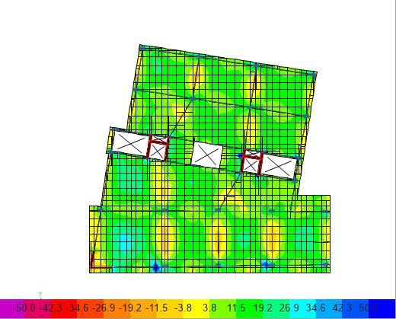
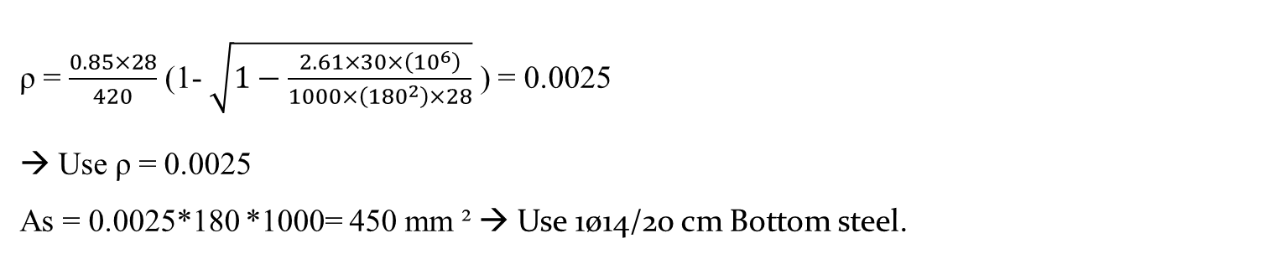
Maximum positive value
ρ = $\frac{0.85×28}{420}$ (1- $\sqrt{1−\frac{2.61×30×\left({10}^{6}\right)}{1000×\left({180}^{2}\right)×28}}$ ) = 0.0025
→ Use ρ = 0.0025
As = 0.0025*180 *1000= 450 mm ² → Use 1ø14/20 cm Bottom steel.

Slide 45
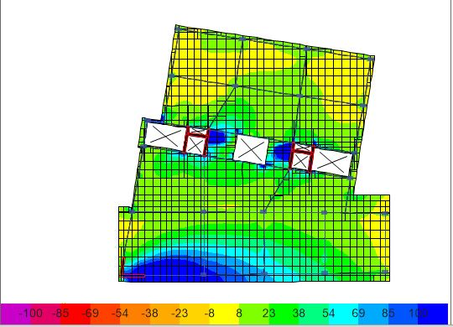
The slab should be designed also for axial tension force:
F11 = 217kN.
Tu = 0.9*As*Fy
As (top + bottom)= 217*1000/(0.9*420) = 574 mm/1m
As top = As bottom = 287mm2
Total Top steel in slab = 612+287 =899 mm = (5Ø16 mm/1m) = 1 Ø16 mm/20cm.
Total Bottom steel in slab =450+287= 737mm = (4Ø16 mm/1m) = 1 Ø16mm/25cm.

Slide 46
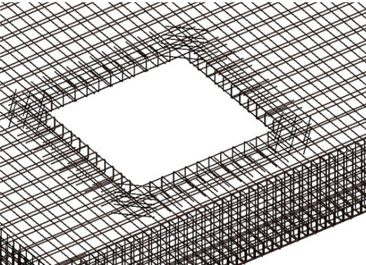

Openings:
Minimum area of steel was added in the corners of the openings due to the concentrated load over it
As_{min} =0.0018$×1000×220$ = 396 mm².
396/154 = 2.57 → use 3 Ø14 / 1 m.

Slide 47
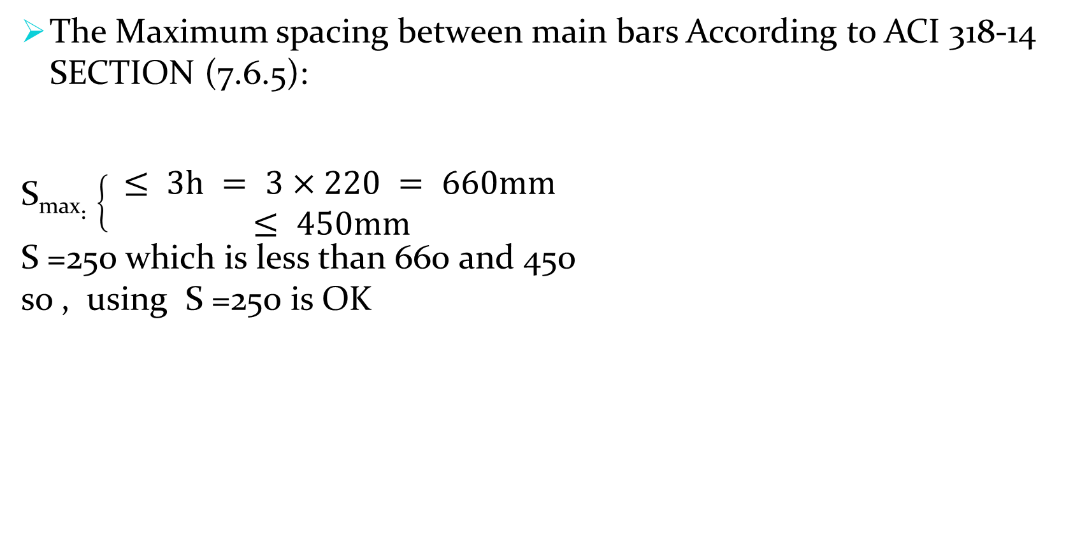
The Maximum spacing between main bars According to ACI 318‐14 SECTION (7.6.5):
S_{max}$:\left\{\begin{aligned} ≤ 3h = 3×220 = 660mm \\ ≤ 450mm\end{aligned}\right.$
S =250 which is less than 660 and 450
so , using S =250 is OK

Slide 48
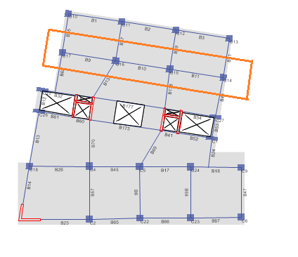
Beam Design.
Design for Flexure:
The value of moment in span 1 of the beam shown in Figure is taken as sample calculation.

Slide 49
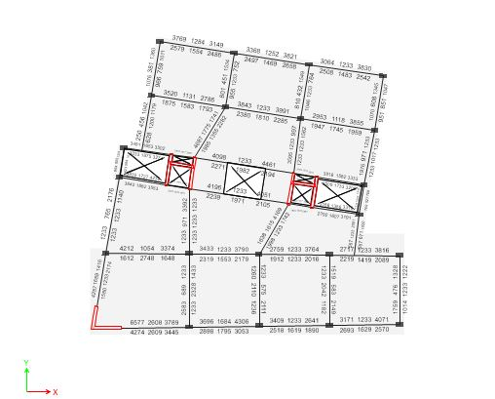
Results from ETABS
Longitudinal Reinforcement:

Slide 50
Longitudinal Reinforcement for Beam 7 :
Span number | location | As (mm²) | As required ( mm²) | bars
1 | Negative – Left | 3639 | 3639 | 8Ø25
 | Positive | 2069 | 2069 | 5Ø25
 | Negative -Right | 3239 | 3239 | 7Ø25
2 | Negative – Left | 3972 | 3972 | 9Ø25
 | Positive | 2487 | 2487 | 5Ø25
 | Negative -Right | 3909 | 3909 | 8Ø25
3 | Negative – Left | 3535 | 3535 | 8Ø25
 | Positive | 2208 | 2208 | 5Ø25
 | Negative -Right | 3829 | 3829 | 4Ø25

Slide 51
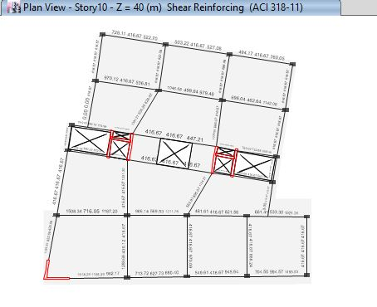
Shear Reinforcement:

Slide 52
Shear reinforcement for Beam :
Span number | location | (Av/s)etabs | (Av/s)min | (Av/s)used | S (mm) | Stirrups
1 | Near Support | 1.12 | 0.42 | 1.12 | 120 | 1 φ 10 /120 mm
 | Middle | 0.54 | 0.42 | 0.54 | 250 | 1 φ 10 /250 mm
 | Near Support | 0.71 | 0.42 | 0.71 | 220 | 1 φ 10 /220 mm
2 | Near Support | 1.2 | 0.42 | 1.2 | 100 | 1 φ 10 /100 mm
 | Middle | 0.54 | 0.42 | 0.54 | 250 | 1 φ 10 /250 mm
 | Near Support | 1.1 | 0.42 | 1.1 | 100 | 1 φ 10 /100 mm
3 | Near Support | 0.9 | 0.42 | 0.9 | 150 | 1 φ 10 /150 mm
 | Middle | 0.6 | 0.42 | 0.6 | 250 | 1 φ 10 /250 mm
 | Near Support | 1.21 | 0.42 | 1.21 | 100 | 1 φ 10 /100 mm

Slide 53
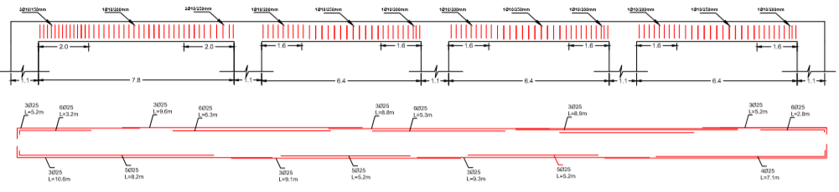
Cross Section for Beam:

Slide 54
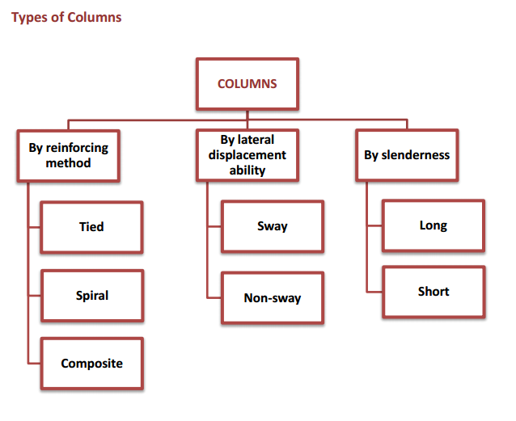
Column Design:
According to ACI Code, a structural element with a ratio of height-to-least lateral dimension not exceeding three used primarily to support compressive loads is defined as column.

Slide 55
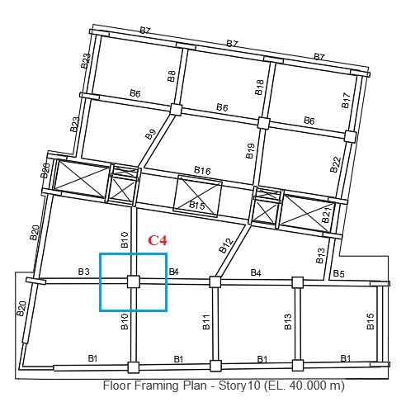
Column Layout:

Slide 56
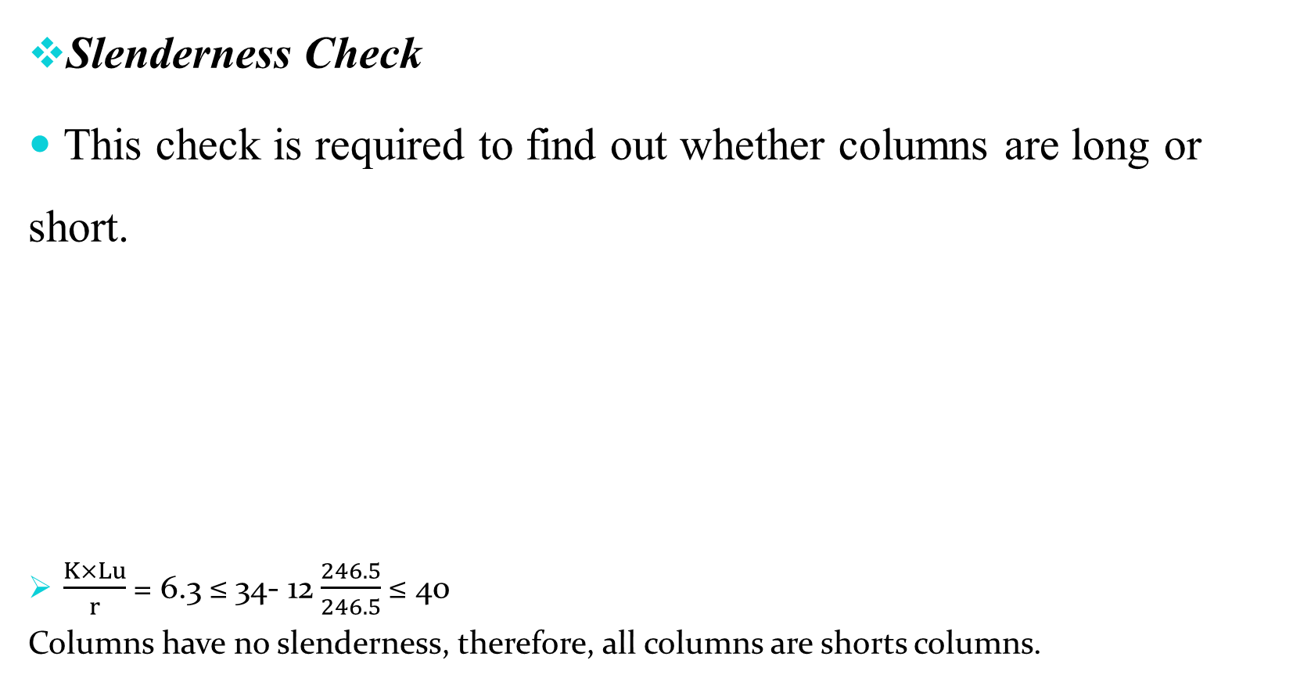
Slenderness Check
This check is required to find out whether columns are long or short.
$\frac{K×Lu}{r}$ = 6.3 ≤ 34- 12$\frac{246.5}{246.5}$ ≤ 40
Columns have no slenderness, therefore, all columns are shorts columns.

Slide 57
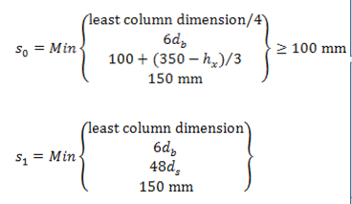


Seismic Requirements for Columns of Intermediate moment Frames:

Slide 58
Longitudinal Reinforcement
As =21681 mm2 use 44Ø25 mm
S max= 150 mm
S min = 50 mm or 1.5 db which is larger 50 or (1.5×25=37.5)
S min = 50 mm.
→ Use 1Ø25/10 cm.

Slide 59


Used stirrups Ø10 mm

Slide 60

Staircase Design:

Slide 61
1) Dimensions of stairs:
- Riser: 0.166m. - Going: 0.30 m. - Landing length: 3.2 m.
- Step width: 1.5 m.
-Span length= 5.2 m.
- Slab thickness → 0.18 m, d= 0.15m.
2) Loads on stairs:
- Live load: 5 KN/m - Super imposed dead load: 4.4 KN/m.
- Dead load: 0.1 x 25 = 2.5 KN/m.

Slide 62

3) Design of stairs:
Ultimate loads on slab equal (1.2D + 1.6L) = (1.2x (4.4+2.5) + 1.6 x(5)) = 16.28 KN/m2.
$M_{U}= \frac{W L^{2} }{8}= \frac{16.28 ×5.17²}{8}=54.4$ kN.m.
-Longitudinal reinforcement ratio (ρ) from equation:
$$ρ=\frac{0.85 ×28}{420} \left(1−\sqrt{1−\frac{2.61×54.4 ×{10}^{6}}{28×1000×{150}^{2}} }\right)=0.0068$$
So, the longitudinal area of steel As = 0.0068 x 1000 x 150 = 1020 mm².
As, Shrinkage = 0.0018 x 180 x 1000 = 320 mm²
Use 6$Ø$16/m.
Use 4$Ø$10/m in the other direction.
Vu = Wu x L = 16.28 x 1.5=24.42KN.
$ØVc=Ø \frac{1}{6} \sqrt{f^{′}c} bw d$
$$ØVc=\frac{0.75× \frac{1}{6} ×\sqrt{28 }× 1000×150}{1000}=99.21KN˃24.42KN ⇒OK.$$

Slide 63

4) Landing design:
- Landing length: 3.2 m.
Ultimate loads on slab equal (1.2D + 1.6L) = (1.2x (4.4+0.18 x 25) + 1.6 (5)) = 18.68 KN/m².
$M_{U}= \frac{W L^{2} }{8}= \frac{18.68 ×{3.2}^{2}}{8}=23.9$ kN.m.
- Longitudinal reinforcement ratio (ρ) from equation:
$$ρ=\frac{0.85 ×28}{420} \left(1−\sqrt{1−\frac{2.61×23.9 ×{10}^{6}}{28×1000×{150}^{2}} }\right)=0.0029$$
So, the longitudinal area of steel As = 0.0029 x 1000 x 150 = 431 mm2.
As, Shrinkage = 0.0018 x 180 x 1000 = 324 mm2
Use 1Ø12 /200mm in each direction for top and bottom .
Vu = (Wu x L)/2 =(18.68 x 3.2)/2=29.88 kN.
$ØVc=Ø \frac{1}{6} \sqrt{f^{′}c} bw d$
$$ØVc=\frac{0.75× \frac{1}{6} ×\sqrt{28 }× 1000×150}{1000}=99.21 KN˃29.4KN ⇒OK.$$

Slide 64

Shear wall Design:

Slide 65

Shear Wall 5
Length=38.4 m which divided into five spans ( 5.8 m ,11 m ,7.5 m,7.5 m and 6.5 m)
width=0.3 m .
height= 4 m for each floor
Vertical rebar area(p_{l}) =28739 mm²
Horizontal rebar area(p_{t}) =750 mm²

Slide 66

Longitudinal reinforcement:
NO. of vertical bars:
Span 1 =$\frac{5800}{300}$ = 19.3 bars
Span 2 =$\frac{11000}{300}$ = 36.7 bars
Span 3 =$\frac{7500}{300}$ =25 bars
Span 4 =$\frac{7500}{300}$ =25 bars
Span 5 =$\frac{6500}{300}$ =21 bars
So use 37 bars Ø25 /30 cm along each face of the shear wall.

Slide 67

Transverse reinforcement:
No. of transverse bars =$\frac{4000}{300}$ =13.3 bars.
So use 14 bars Ø 18/30 cm along each vertical face of the shear wall.

Slide 68

Design of footings

Slide 69
Mat foundation was used for the building.
The area of the building = 1539 m²
The total area of foundation is > 0.6 of basement area .
P service =265480 kN.
Allowable bearing capacity of soil = 350 kN/m²
Area of footing=total service load /allowable bearing capacity = 265480*1.1/350= 834.4 m²
The total area of mat foundation =1616.14 m²

Slide 70
Soil Property Definition (Modules of subgrade Reactions (Ks) :
Safety Factor (S_{f}) = 2 for Granular soil
Allowable Bering Capacity = 350
Modules of subgrade Reactions (Ks) = 40 (Sf) (q _{all}) = 40*2*350 = 28000

Slide 71

Deflection Check:

Slide 72

Design of Mat foundation:
By drawing a contour line of moment m₁₁ and m₂₂ between (-1353,0) ,which corresponding to minimum area of steel of section b=1000mm and h=1500mm.

Slide 73

Minimum steel =0.0018×1000×1500 =2700 mm²
So use 4Ø32 / 1 meter top in both direction.

Slide 74

By drawing a contour line of moment M₁₁ and M₂₂ between (0,1353) kN.m , which corresponding to minimum area of steel of section b=1000m and h=1500mm

Slide 75

Maximum positive moment M22

Slide 76

the maximum moment in the bottom face of mat foundation is more than 1353 kN.m, so the maximum value of moment in both direction is less than 2000 kN.m by reading the value of moment with blue color far away the center of column and shear wall.
$ρ$ =$\frac{0.85×28}{420}×\left(1−\sqrt{1−\frac{2.61×\left(2000\right)×{10}^{6}}{1000×{1420}^{2}×28}} \right)$ = 0.00268
So , As =0.00268$×1000×1420$ = 3806 mm²
So , use 5Ø32 / 1 meter bottom in both direction in dark blue area which equal to 1.5m from each face of column and shear wall.

Slide 77


