Slide 1
Contractor’s response towards managing the project time
Prepared by:
Osama Assi
Mohammed abdulfattah
Under supervision of: Eng. Hussein abuzant

Slide 2
Outline
Introduction.
Objectives.
State of Problem.
Methodology.
Questionnaire and Analysis.
Case Study.
The Manual.
Conclusion and Recommendation.

Slide 3
Introduction
What is project delay ?
Effects of project delay on the contractor.

Slide 4
Objectives
The main objective of our project is to identify the major causes of delay in construction projects, its effects on contractor and how to minimize it as much as possible.

Slide 5
State of problem
Determine the problems that can be caused by the delay.
Since the contractor shall execute the project within the time and cost in the contract.
In case of delay, the contractor shall pay the liquidated damages which affects his profit, also it will harm the contractor’s reputation.

Slide 6
Methodology
Determine the most significant causes of delay that affect on the contractor by questionnaire survey.
Questionnaire analysis by using SPSS software.
Case study ( project scheduling by using primavera).
Suggest several actions that helps the contractor to avoid the liquidated damages.

Slide 7
Questionnaire and Data analysis
The sample consist of 30 individuals in the construction sector in Palestine.
The study aimed at identifying the causes of delay that could affect the benefit of the contractor.
The reliability of the questionnaire for the total degree was 83.3% which is acceptable.

Slide 8
The data collected were analyzed using (SPSS software), The researchers used the following scales to represent the estimation level of sample responses.
Standard deviation | percentage | Estimation level
4.20 and more | 84% and more | Very high
3.40 ----- 4.19 | 68----83.8 % | High
2.60 ----- 3.39 | 52 ----- 67.8 % | Moderate
1.80 ----- 2.59 | 36-----51.8 % | Low
Less than 1.80 | 35.9% and less | Very low

Slide 9
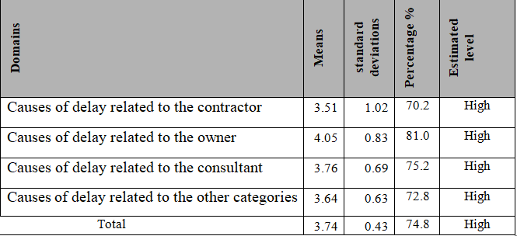
The highest mean was given to the domain( causes of delay related to the owner ).

Slide 10
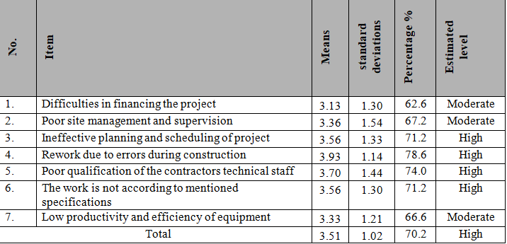
Standard deviations and estimated level of causes of delay related to the contractor.

Slide 11
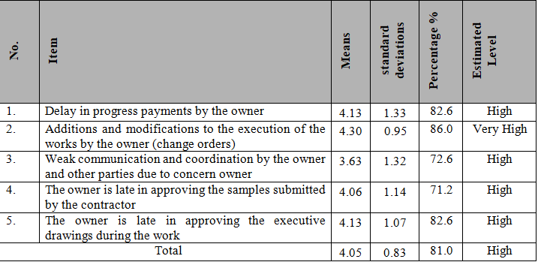
Standard deviations and estimated level of causes of delay related to the owner.

Slide 12
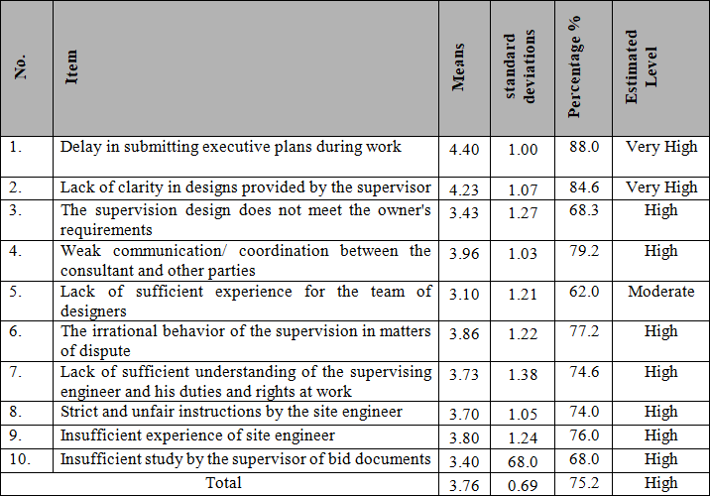
Standard deviations and estimated level of causes of delay related to the designer and consultant.

Slide 13
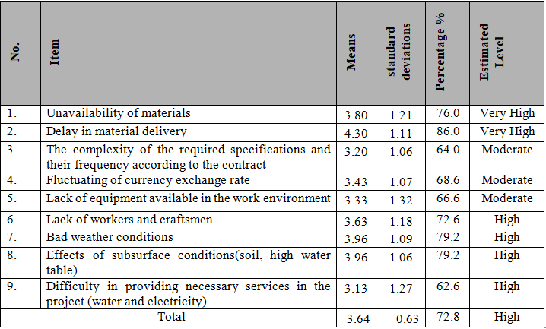
Standard deviations and estimated level of causes of delay related to the other categories.

Slide 14
Case study
Rehabilitate and upgrade the ground floor of engineering association- Nablus branch.
The project consists of only one story which is the ground floor.
The contract time was 70 working days and the cost was 73,415 JD.
This project was funded by engineering association-Nablus.

Slide 15
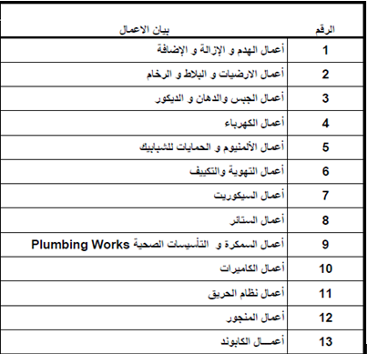
The project consists of many activities as listed in the following table:

Slide 16
Project challenges
The main challenge was the duration and cost of the project were doubled after execution the project.
The most two significant causes of delay in this case study is change orders and the non-regularity in the presence of site engineer.
The causes of delay were due to the contractor, designer and the owner.

Slide 17
Causes of delay related to the contractor:
Bad estimation of cost in planning phase.
There was no updating for the schedule during project execution (lack of contractor management).
The cost was unsuitable since the time of the project was very tight, so the bid price was illogical compared with the work that has to be done.

Slide 18
Causes of delay related to the designer:
Lack of clarity in plans, there was many conflicts between drawings and bill of quantities BOQ.
Delay in the modification of the drawings.
Poor quality of drawings which submitted by the consultant.
Poor communication between designer and contractor.

Slide 19
Causes of delay related to the owner:
Additions and modifications to the execution of the works by the owner (change orders).
Weak communication and coordination by the owner and other parties.
The late of owner in approving the samples submitted by the contractor.
The late of owner in approving the executive drawings during the work.

Slide 20
The causes of delay were clarified previously. As noted, the project’s causes of delays fit the outputs of the questionnaire.

Slide 21
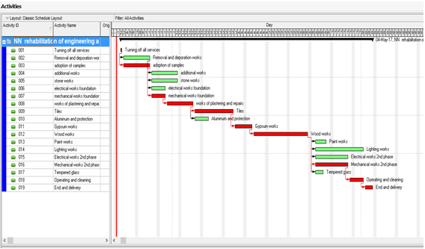
Tracking of the project

Slide 22
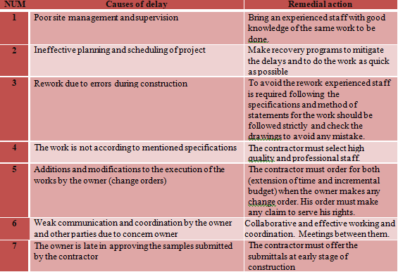
The manual

Slide 23
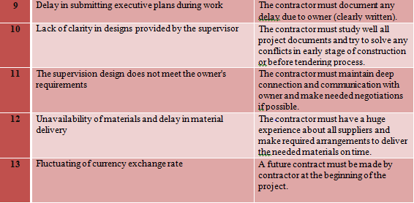

Slide 24
Conclusion
Questionnaire and interviews are the tools which could be used to identify the most significant causes of delay.
There are a lot of causes that make the project to be hand-over on scheduled time.
The delay of contractor is the most cause of his losses either the money or his reputation.

Slide 25
There must be a good coordination between all key players (owner, designer, and contractor) to accelerate the project execution.
During the bidding process, the contractor must study well the contract time and analyze if its enough or not. In addition, the contractor must recognize if there is any conflict between the drawings and the specifications in BOQ(bill of quantities).

Slide 26
Recommendations
Seminars and workshops could be held by the PCU for all contractors in order to enrich their managing of all causes of delay.
The contractor must be aware for the importance of project time. So, the contractor will avoid the liquidated damages.
In case the delay occurs the contractor must order for both ( extension time and incremental budget ).
It’s worth for all contractors to study well the attached manual to be familiar with all causes of delays and their remedial actions.

Slide 27
Thank You

