Slide 1
Supervisor :
Dr.Luay Dwaikat
An-Najah National university
Faculty of engineering
Building engineering departmenet
Graduation project ||
Toward zero energy building
Prepared By :
Jafar Abu Zahra
Qaysar halabi
Mohannad zohair

Slide 2
Outline
Introduction.
Site analysis.
Architectural design.
Structural design.
Environmental design.
Electro-mechanical design
Safety and fire system.
Quantity survey
Life cycle cost

Slide 3
Introduction
What is zero energy building?

Slide 4
Why we chose this project?
Source: United Nation Report on the global AIDS epidemic, 2010

Slide 5
Site Analysis
Project location :
Roujeeb village ,Nablus- Palestine
Total area of 1950 m²

Slide 6
Architectural Design
Our building contains three stories and basement.
every story contains two apartments with an area 220 m² each .

Slide 7
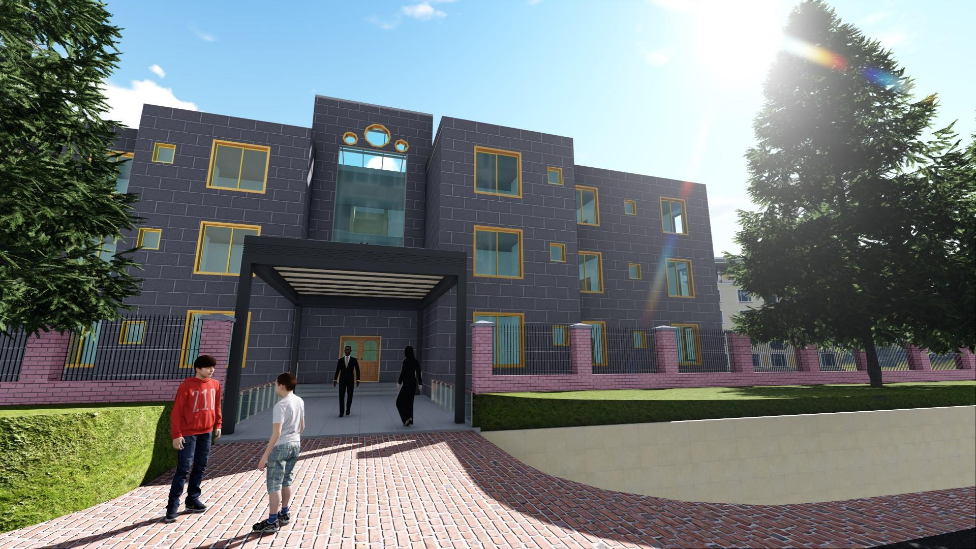
Architectural Design
3D-view

Slide 8
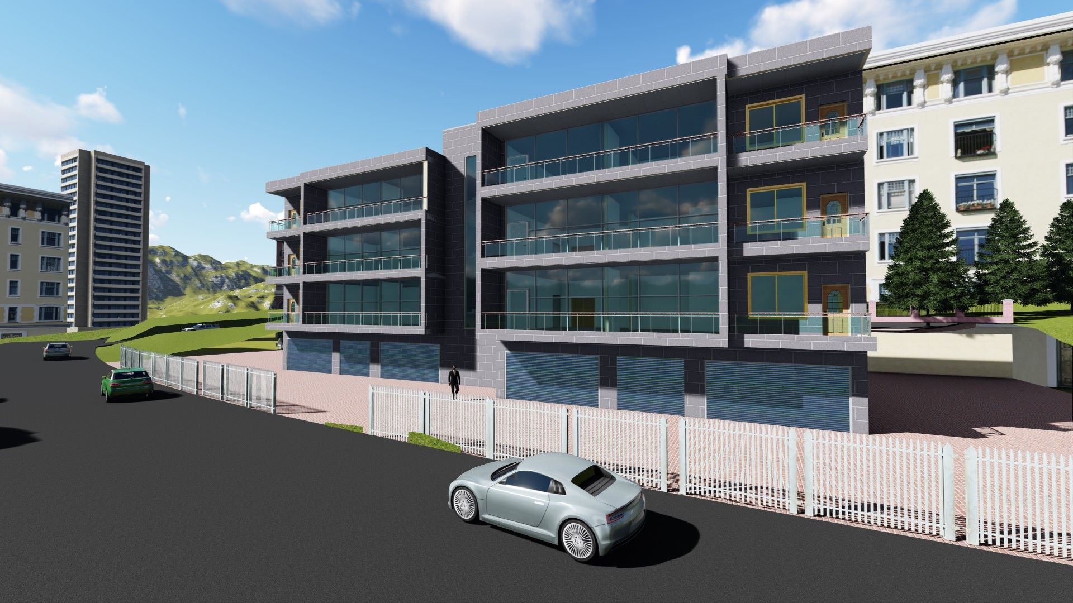
Architectural Design
3D-view

Slide 9
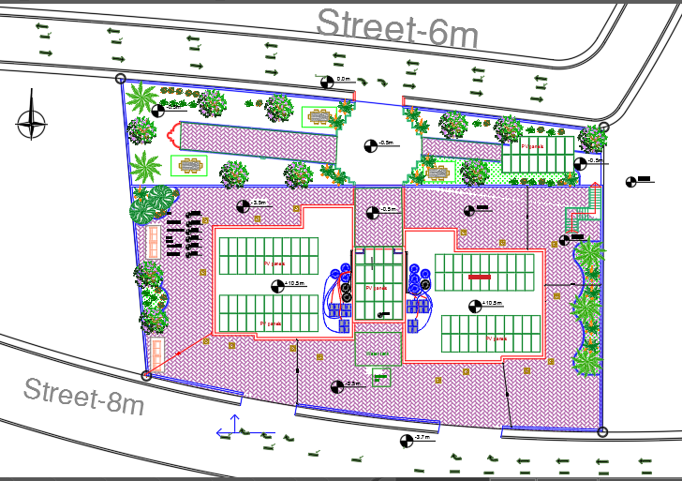
Architectural Design
Site plan

Slide 10
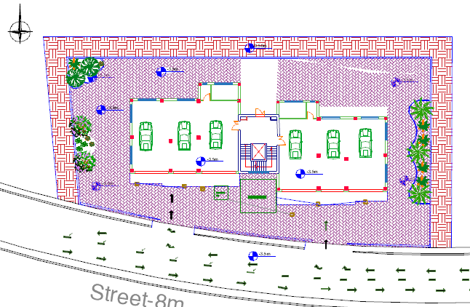
Architectural Design
basement plan

Slide 11
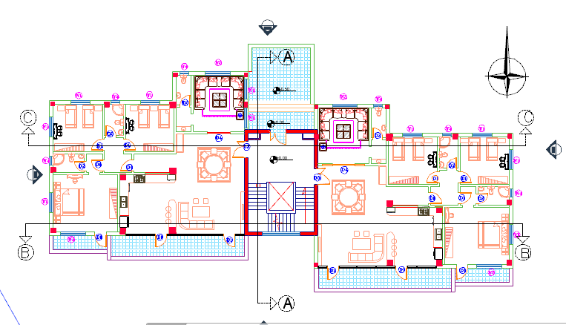
Architectural Design
ground floor plan

Slide 12
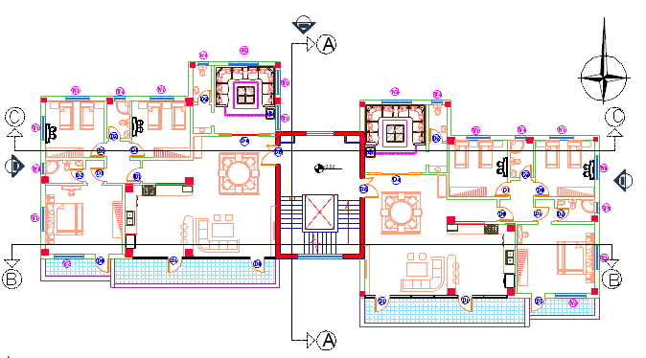
Architectural Design
First floor plan

Slide 13
Architectural Design
second floor plan

Slide 14
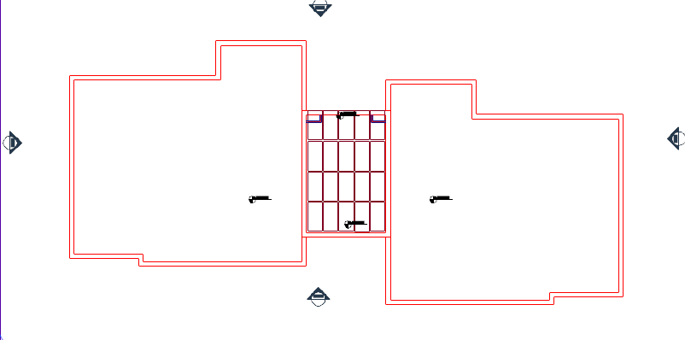
Architectural Design
Roof plan

Slide 15
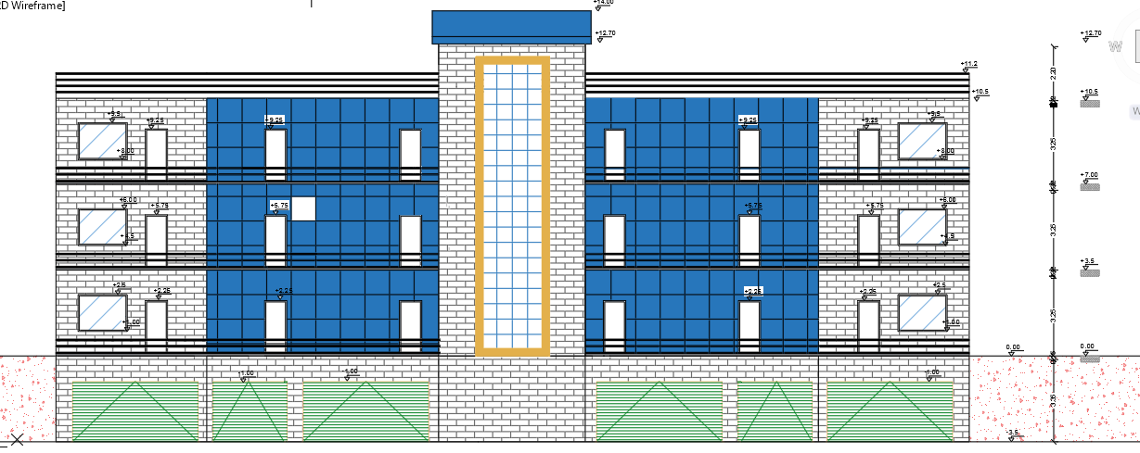
Architectural Design
Southern elevation

Slide 16
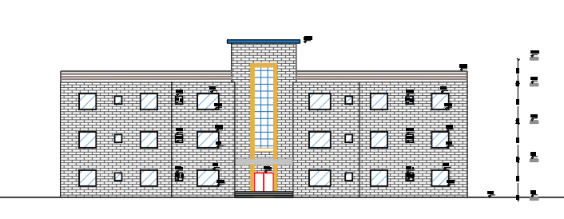
Architectural Design
northern elevation

Slide 17
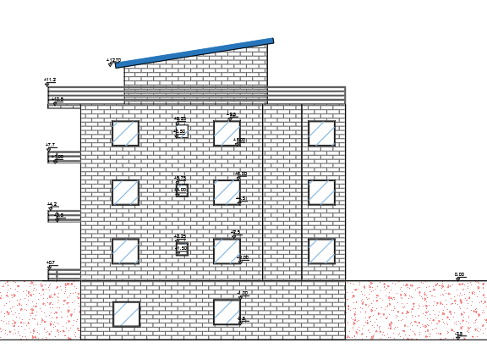
Architectural Design
eastern elevation

Slide 18
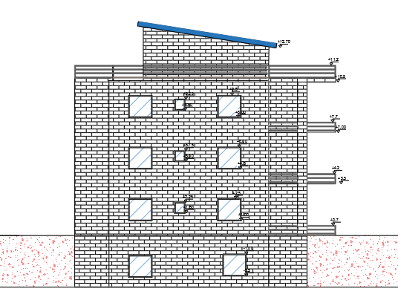
Architectural Design
western elevation

Slide 19
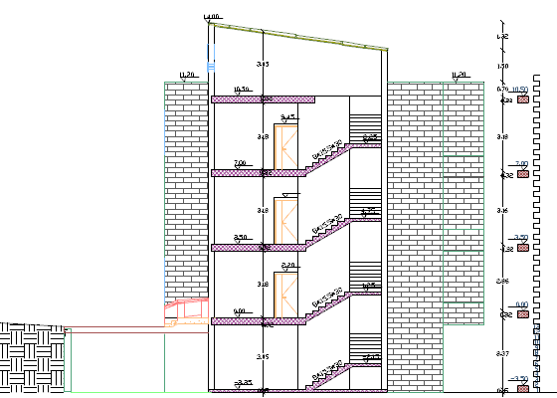
Architectural Design
Section A-A

Slide 20
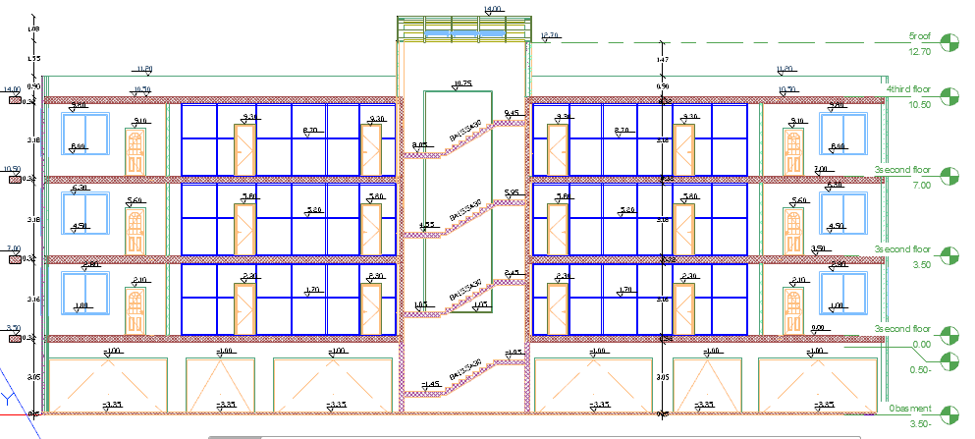
Architectural Design
Section B-B

Slide 21
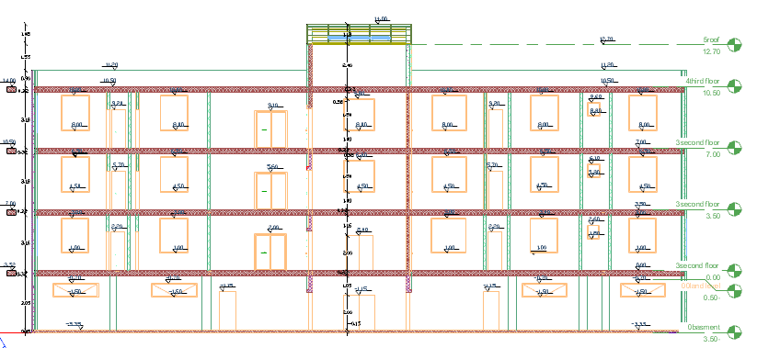
Architectural Design
Section C-C

Slide 22
Structural Design

Slide 23
Structural Design
Codes and Standards:
ACI -318-11 for reinforced concrete structural design.
UBC -97 for earthquake design.
ASCE 7 2010 for load combinations

Slide 24
Structural Design
Design data:
Concrete strength for slabs and beams, f’c =24 MPa.
Concrete strength for columns and shear walls, f’c =28 MPa.
Steel yield strength f=420 MPa.
Bearing capacity for soil = 350 KN/m²

Slide 25
Structural Design
Loads:
Load Type | Ribbed slab
Live | 3 (KN/m²)
S.I.D | 5 (KN/m²)

Slide 26
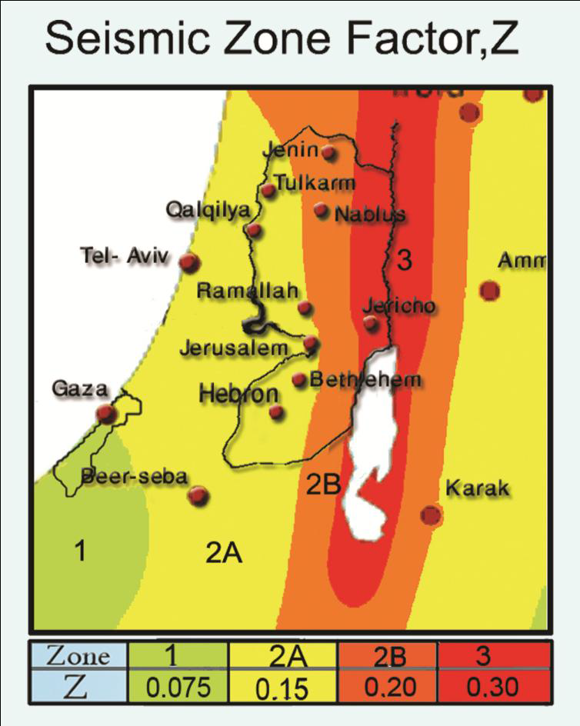
Structural Design
Lateral loads:
The city of structure is Nablus.
The seismic zone factor. Z=0.2.
The soil profile is type Sc.
The acceleration seismic coefficient Ca=0.24
The velocity seismic coefficient Cv=0.32.
The Seismic importance factor is 1.
The structural design type is building frame, R=5.5

Slide 27
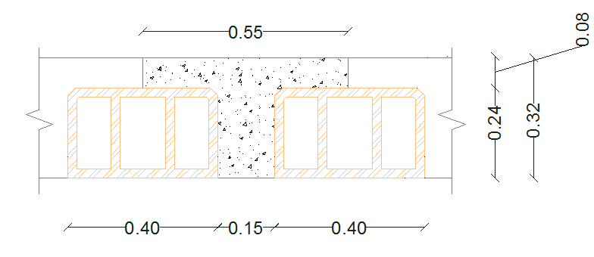
Slabs
Ribbed slab with 32 cm thickness.
25

Slide 28
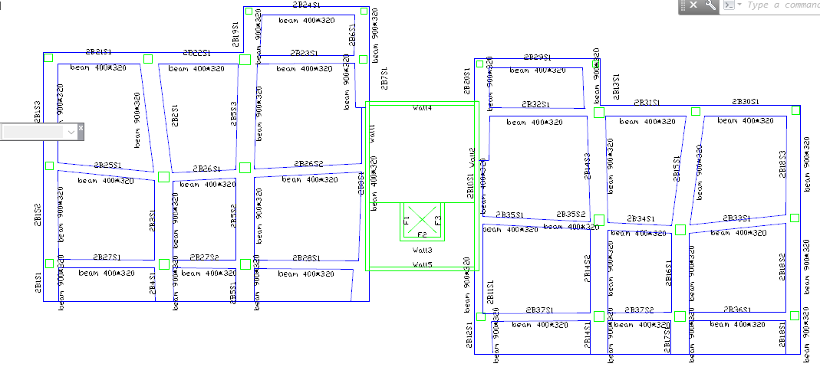
Beams
26

Slide 29
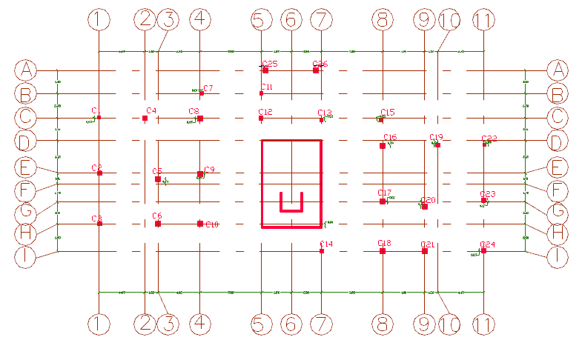
Columns layout
27

Slide 30
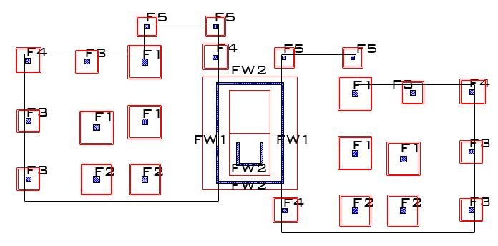
Footings layout
28

Slide 31
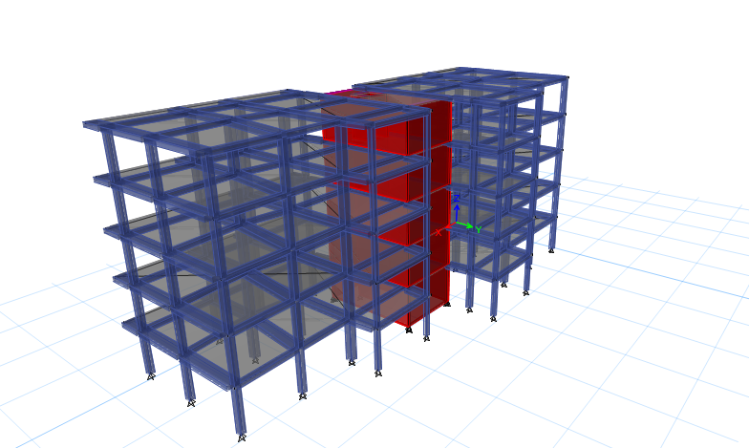
Modeling
29

Slide 32
Verification of model
Compatibility check
Equilibrium check
Internal force check
Deflection check
Drift check
Period check
Model participating mass ratio check

Slide 33
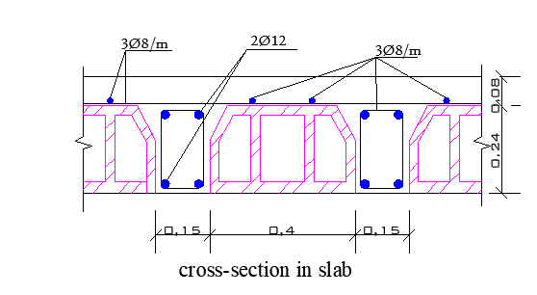
Slab Reinforcement
31

Slide 34
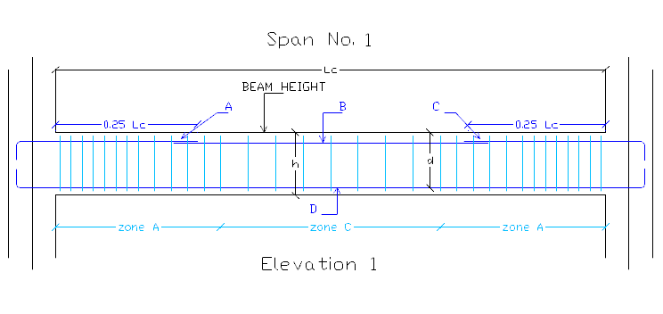
Beam Reinforcement
32

Slide 35
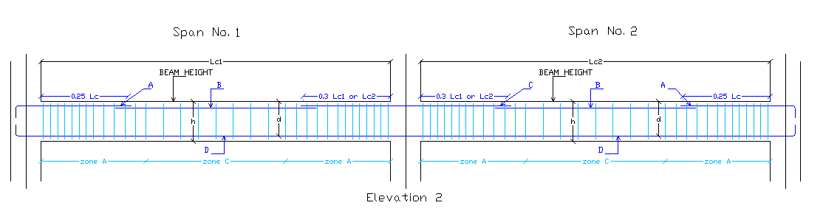
Beam Reinforcement
33

Slide 36
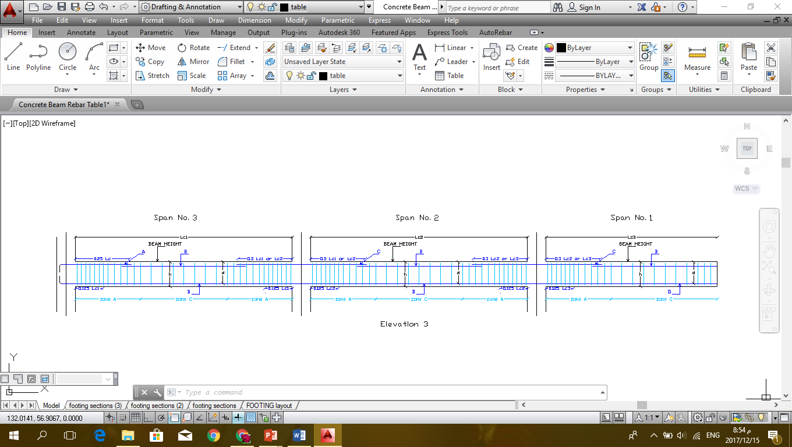
Beam Reinforcement
34

Slide 37
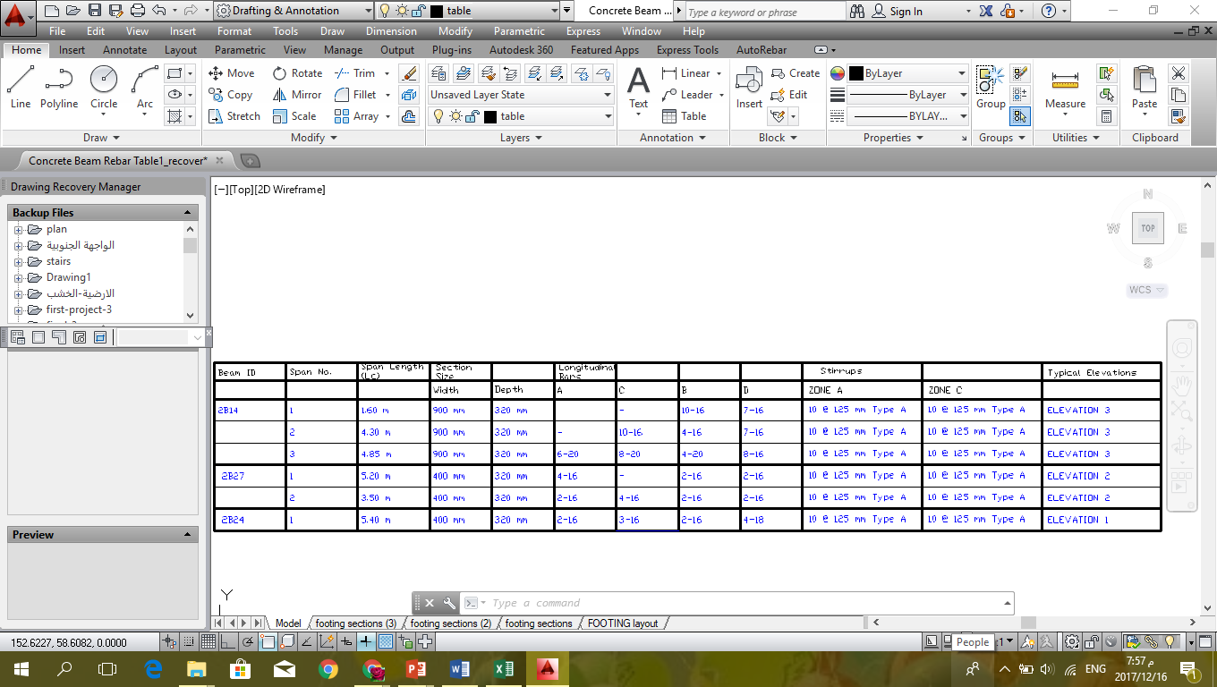
Beam Reinforcement
35

Slide 38
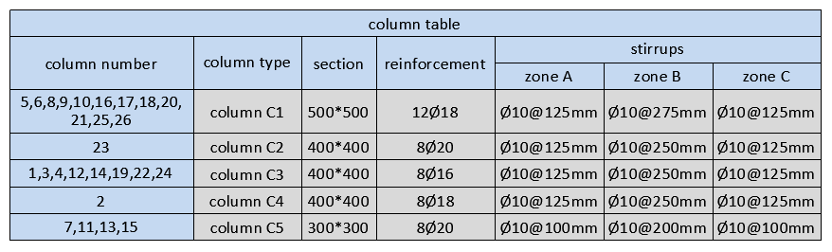
Columns Reinforcement

Slide 39
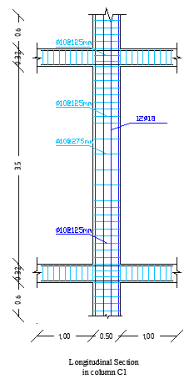
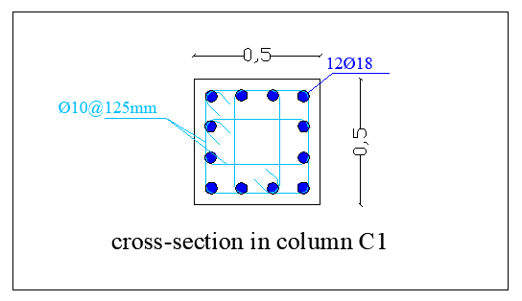
Columns Reinforcement
37

Slide 40
Footing Reinforcement TABLE
38

Slide 41
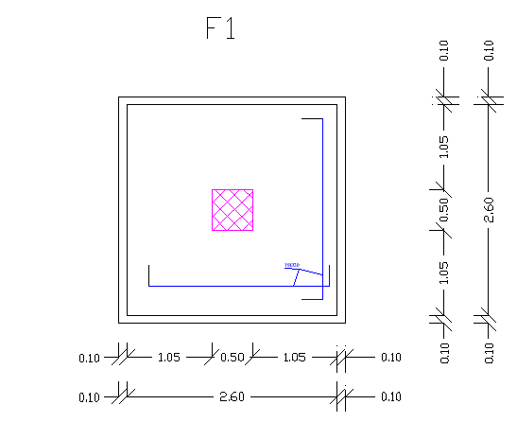
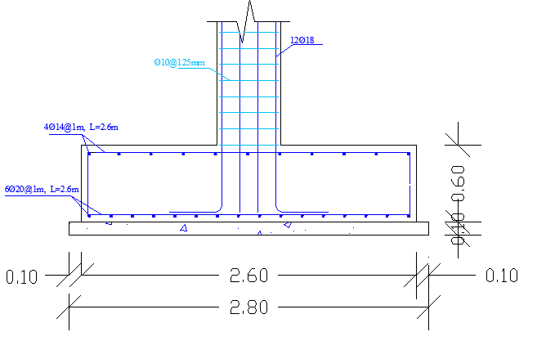
Footing Reinforcement
39

Slide 42
Environmental Design

Slide 43
Passive Design
Building Orientation
Thermal Insulation
Solar window.
Shading system.
Solar Hot Water.

Slide 44
Passive Techniques
Solar window

Slide 45
Effect of shading
1)21th July at10:00 (Summer solstice)

Slide 46
2) 21th Jan at 11:00 (Winter solstice):

Slide 47
Materials used
Comparison between materials:

Slide 48
The results

Slide 49
The results

Slide 50
Thermal comfort
Comfort curve:

Slide 51
LIGHTING DESIGN

Slide 52
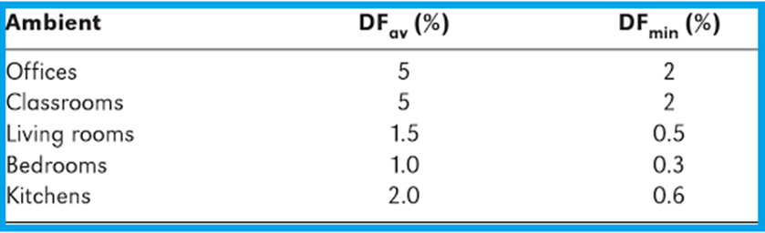
LIGHTING DESIGN
DAY LIGHT FACTOR STANDARDS

Slide 53
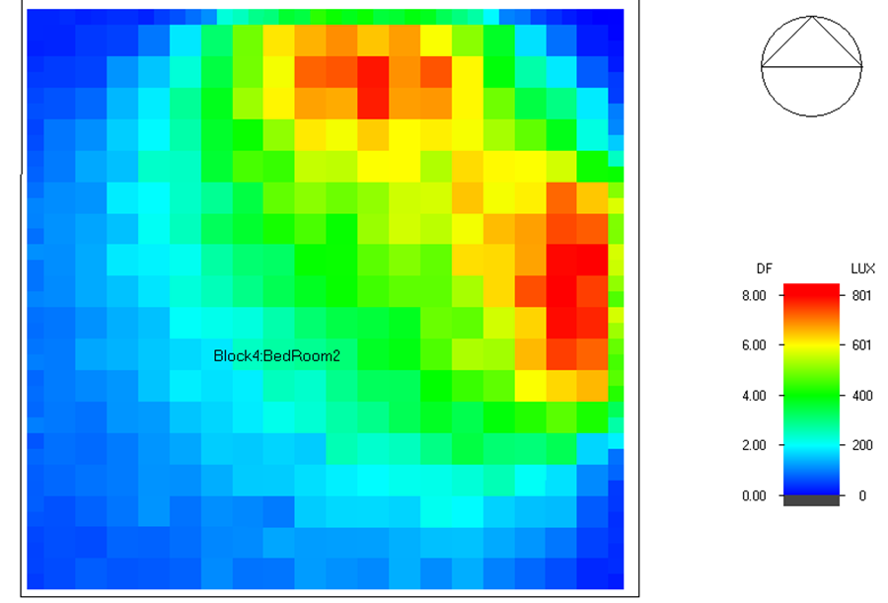
LIGHTING DESIGN
DAY LIGHT FACTOR from DESIGN BUILDER
→→for bed room DF%=3.05 Acceptable

Slide 54
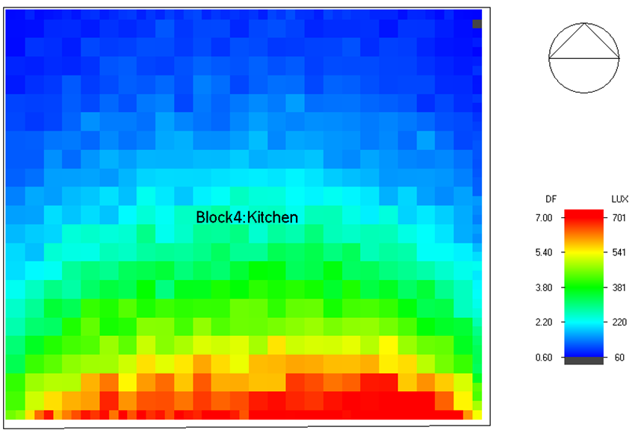
LIGHTING DESIGN
→→for kitchen DF%=2.77 Acceptable

Slide 55
Lighting design
Artificial lighting design using dialux evo
illuminance recommendations
type of room | recommended illuminance value
 | LUX
bed room | 200-250
guest room | 200-300
living room | 200-250
dining room | 200-250
kitchen | 300-500
parking | 100-150
corridor | 100-150
bathroom | 100-150

Slide 56
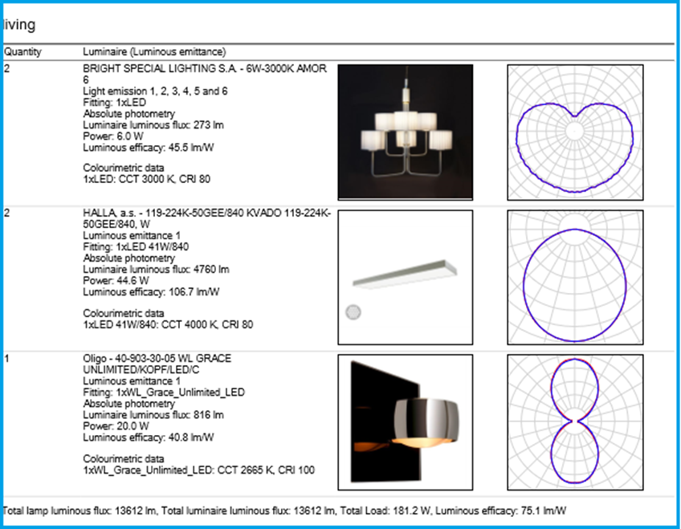
Lighting design
Artificial lighting design using dialux evo
→ living room design

Slide 57
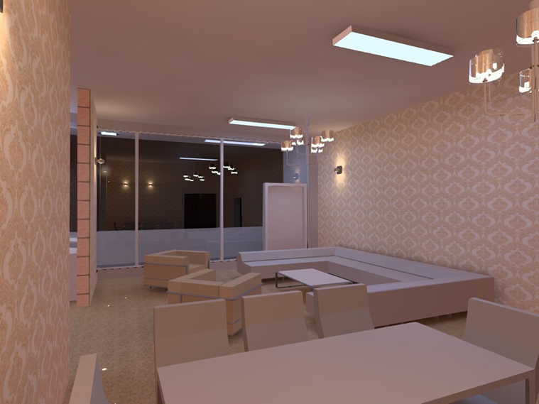
Lighting design

Slide 58
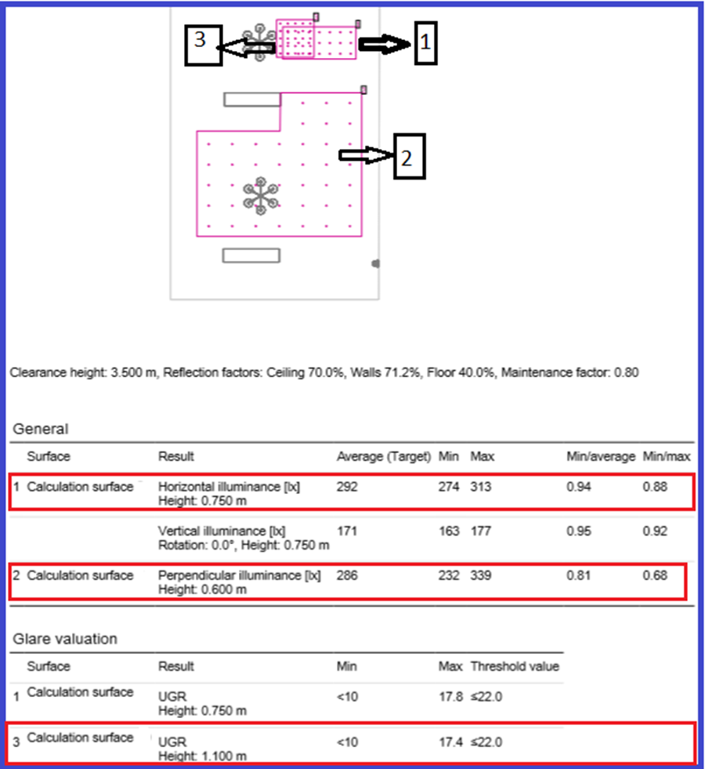
Results of calculation surface in living rooms

Slide 59
Acoustical DESIGN

Slide 60
Acoustical design
We used Ecotect program to check Reverberation time RT60.
although there is no speakers in residential buildings; we check RT60 for spaces and all values are acceptable.

Slide 61
Sound transmition class STC we used INSUL Program to check design as we see all values are acceptable
type of element | Designed STC value
External wall | 57 dB
Windows double glazing | 34 dB
External wall with glazing | 44 dB
Partition | 51 dB
Ceiling | 58 dB

Slide 62
Mechanical Design

Slide 63
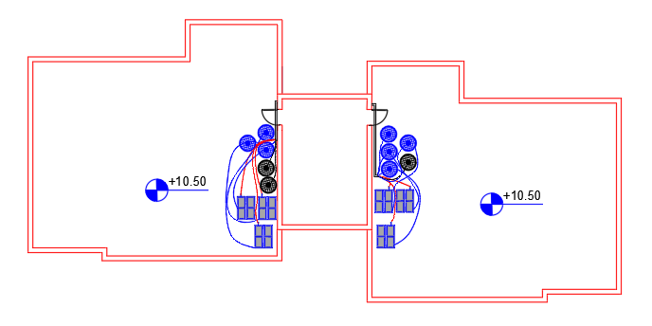
Mechanical Design
1) Water supply system:

Slide 64
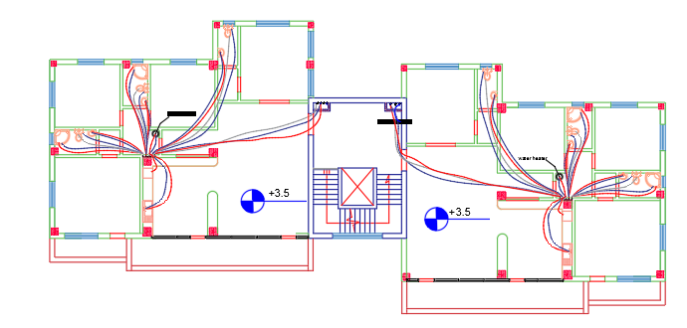
Mechanical Design
1) Water supply system:

Slide 65
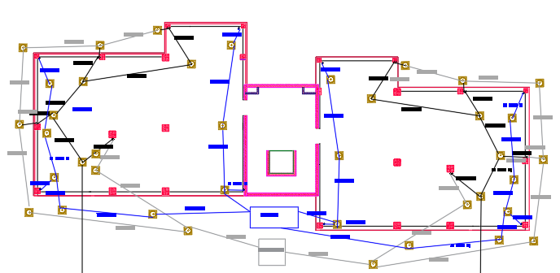
Mechanical Design
2) Drainage System

Slide 66
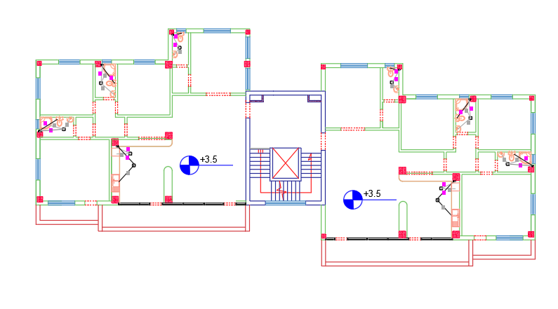
Mechanical Design
2) Drainage System

Slide 67
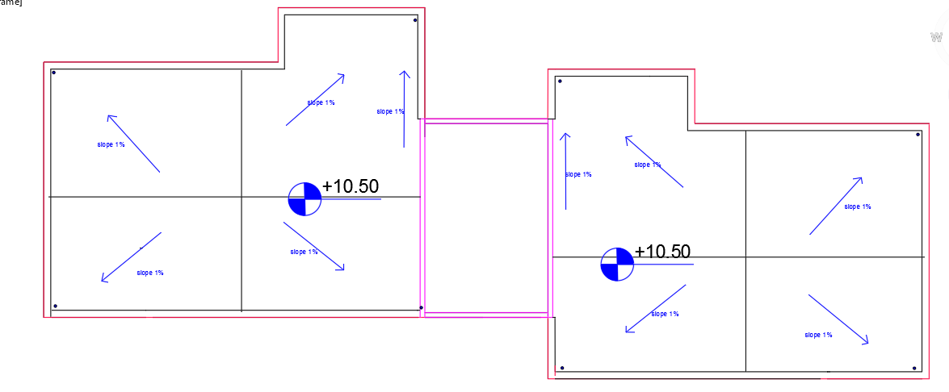
Mechanical Design
3) Rainwater design

Slide 68
Mechanical Design
4) HVAC design

Slide 69
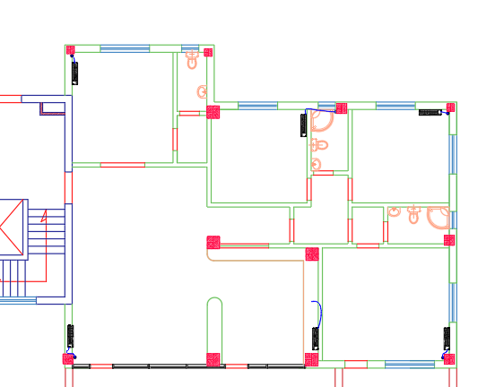
Mechanical Design
4) HVAC design

Slide 70
Electrical Design

Slide 71
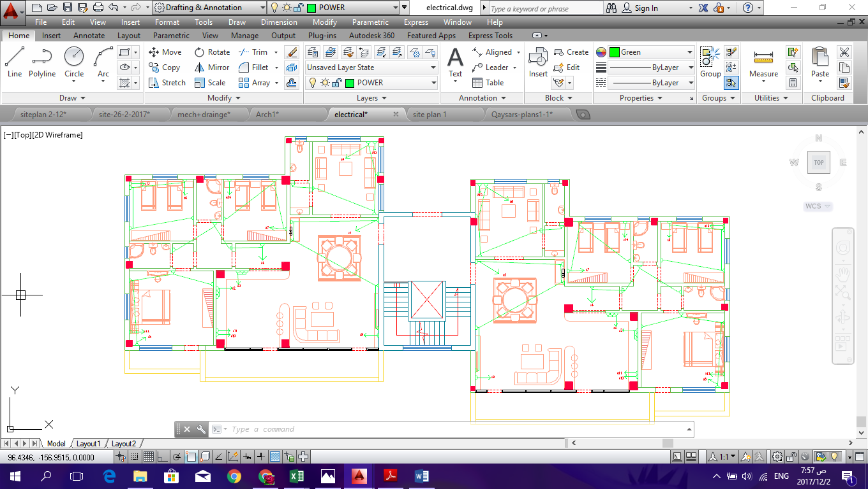
Sockets distribution

Slide 72
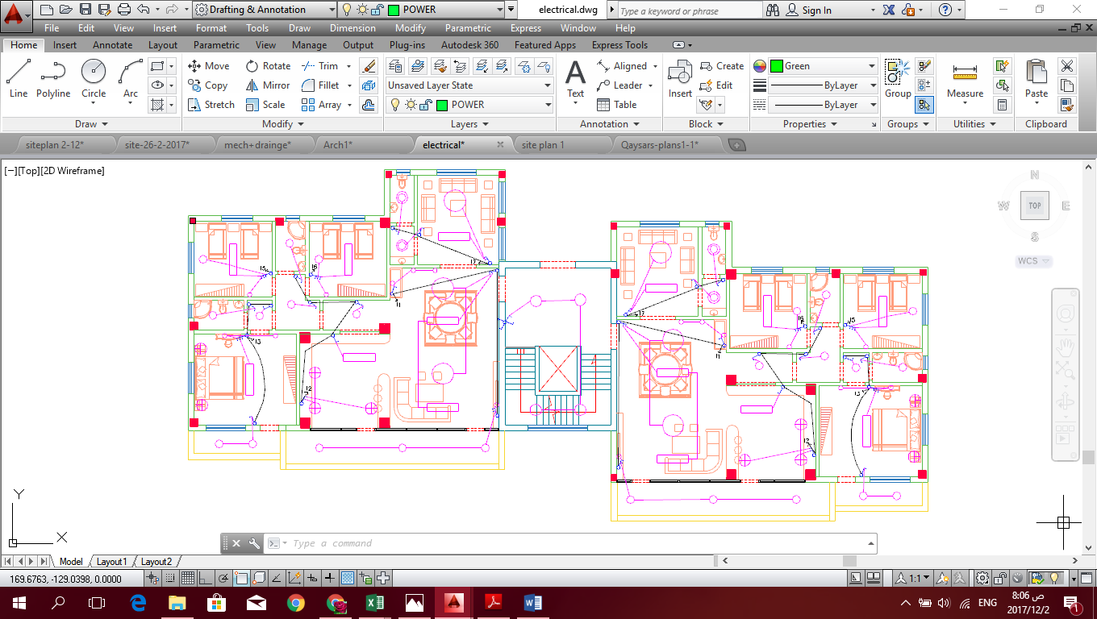
Switches distribution

Slide 73
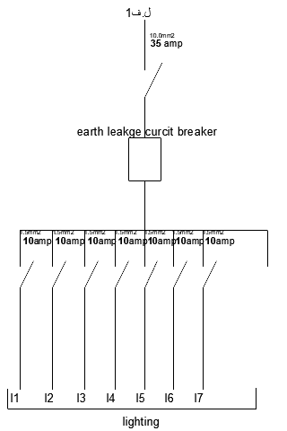
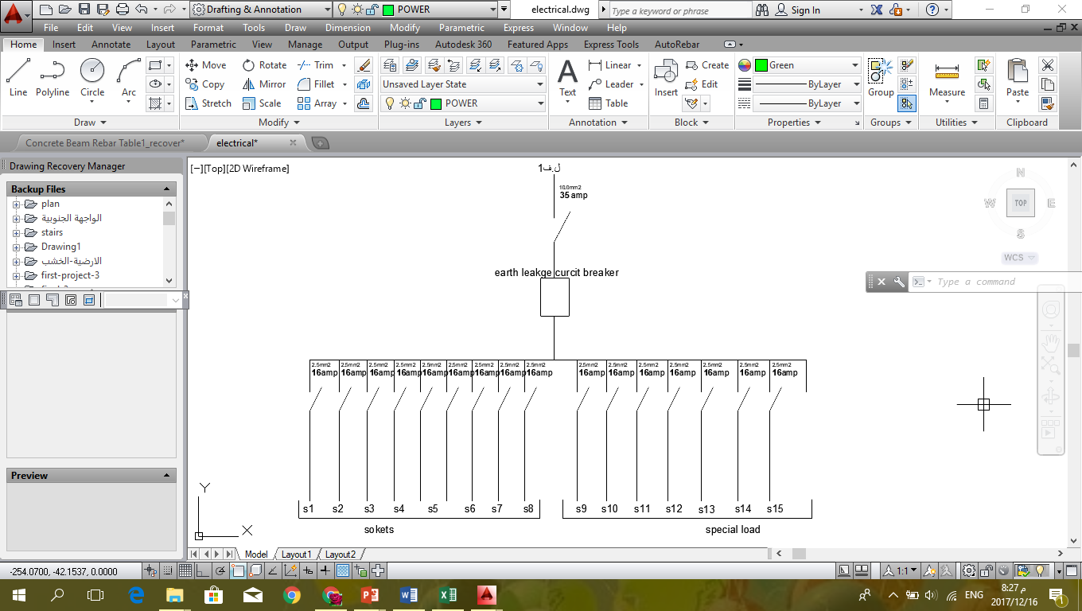
Circuit breaker distribution

Slide 74
Energy Generation Techniques

Slide 75
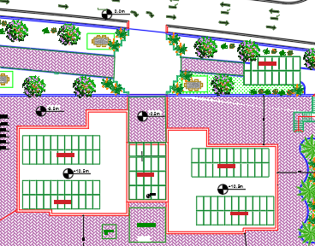
Energy generation techniques
On grid photovoltaic system:

Slide 76
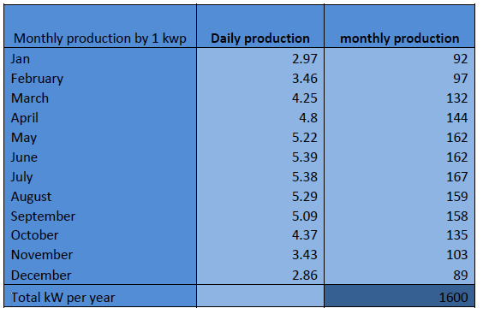
Photovoltaic System

Slide 77
Calculations:
Total energy consumption (annually) = 67818KWh
1KWP produce almost 1600 KWh (annually)
#of KWP needed = 67818/1600 = 42.38 KWP
We need 43 KWP
We need 129 plates
The capacity for each plate (320-330 watt)
This thing requires about (380-430 m2)
The unit price for one KWP=1200 $
Total price=43*1200= 51600$

Slide 78
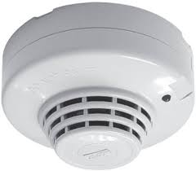
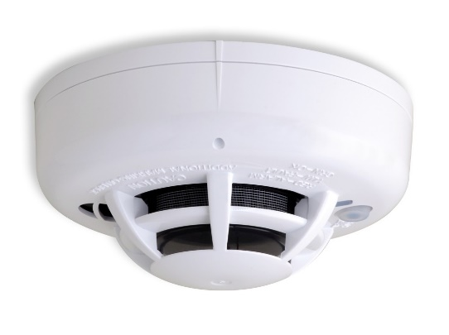
Fire and Alarm System

Slide 79

Fire and Alarm System
Detectors.

Slide 80

Fire and Alarm System
Firefighting.

Slide 81
Quantity Survey
 | Total Cost (NIS) | Unit cost (NIS/m²)
Excavation works | 72000 | 55.81
Civil works | 722184 | 559.83
Architectural works | 1172145 | 908.64
Mechanical works | 118005 | 91.48
Electrical works | 98500 | 76.36
PV-system | 180600 | 140.00
Total Cost | 2363434 | 1832.12

Slide 82
Life cycle cost
Comparison between traditional building and zero energy building after 25 years at discount rate of 5%.
building type. | Annual energy consumption (KWh/year) | Annual energy recurring cost (NIS) | Energy cost after 25 years (NIS)
Traditional building | 127000 | 76200 | 1074420
Zero-energy building | 67818 | 40691 | 574575

Slide 83
Life cycle cost
Comparison in cost between the buildings with photovoltaic system and without photovoltaic system) after 25 years.
Energy cost after 25 years for the Building without PV-system is 574575 NIS.
The total cost for PV-system to cover the energy needs of the building is 185760 NIS.
Total cost saving in 25 years is 388815 NIS.

Slide 84


