Slide 1
Experimental validation of dust impact on-grid connected PV system performance in Palestine: A case study, Nablus.
Supervisor Name: Dr. Adel Juaidi
Group Members:
Hatem Haj Muhammad
Faris Kawa’

Slide 2
Presentation Content:
Project Description
Main factors that affect the performance of the PV module
Procedure
Results and analysis
Conclusion and recommendation

Slide 3
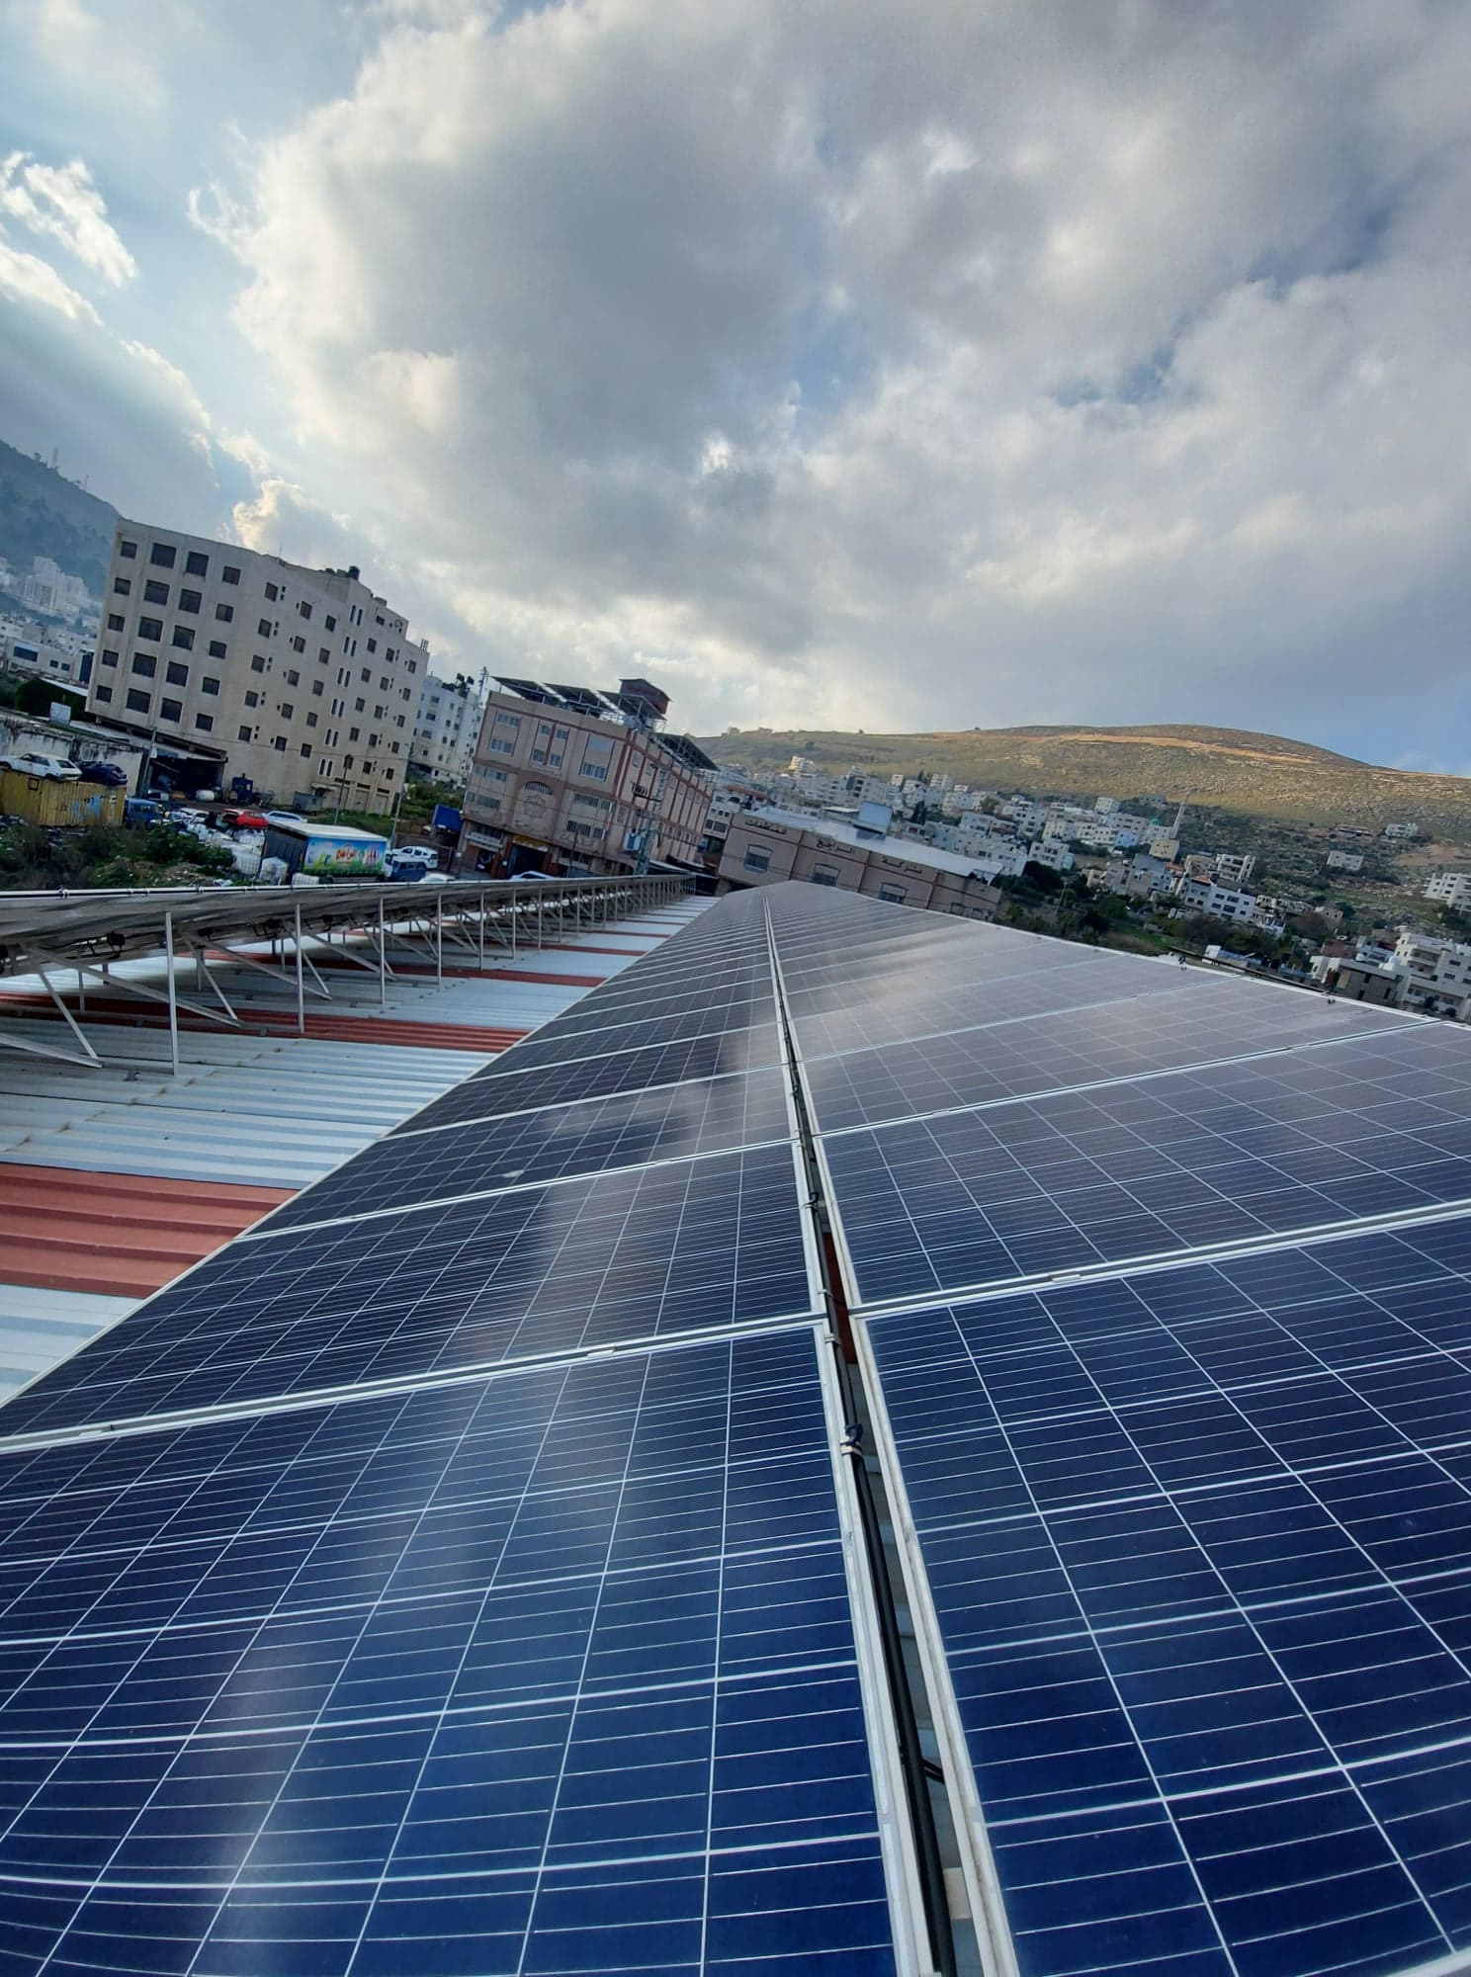
Project Description
The main objective of this project is to compare the effect of dust on the PV panel’s efficiency when cleaned on different time spans

Slide 4
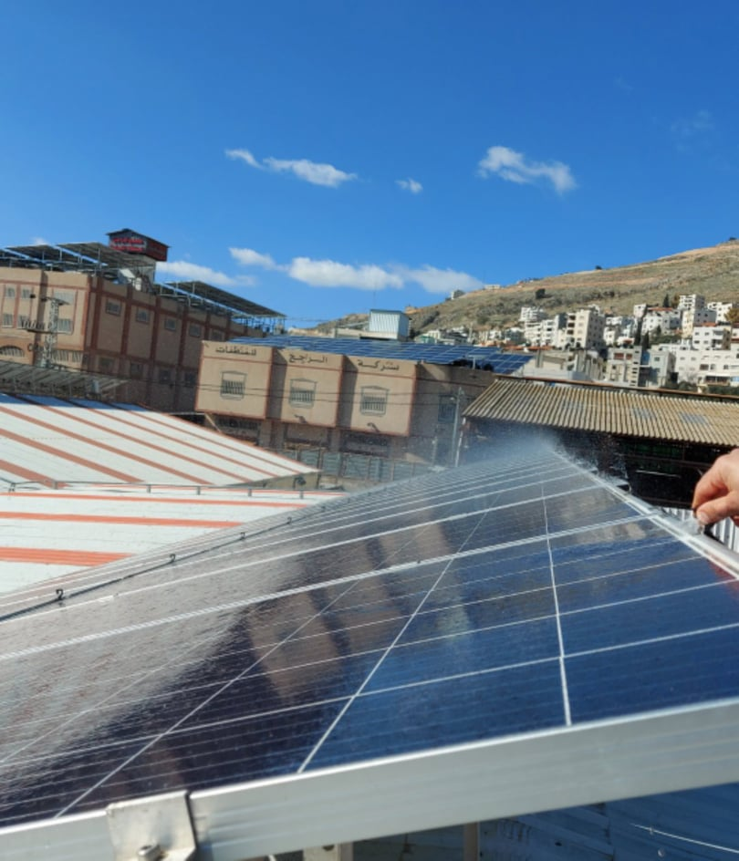
What are the benefits of cleaning the panels at the right time ?
Assists in lowering cleaning costs.
Aids in obtaining the highest possible power production.

Slide 5
Main factors that affect the performance of the PV module
There are several Parameters that may influence the output of the PV module.
1-Solar irradiance/radiation
2-Wind speed
3-Temperature
4-Humidity
5-Dust presence
6- Shading effect

Slide 6
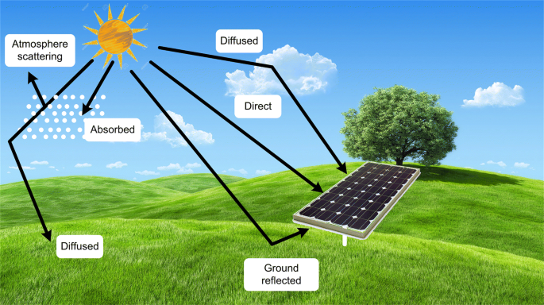
Main factors that affect the performance of the PV module
1- Solar irradiance/radiation
The amount of energy from the solar source per unit area is known as irradiance (KWh/m^2), as the solar irradiance increases, the electrical power output from the PV panel increases too.

Slide 7
Main factors that affect the performance of the PV module
2- Wind speed
A PV module’s performance can be affected by wind velocity in both, a helpful and undesirable manner. The effect of wind velocity is primarily a function of wind speed and direction and also the deposition of dust.
a- Wind speed and direction impact
b- Dust deposition impact

Slide 8
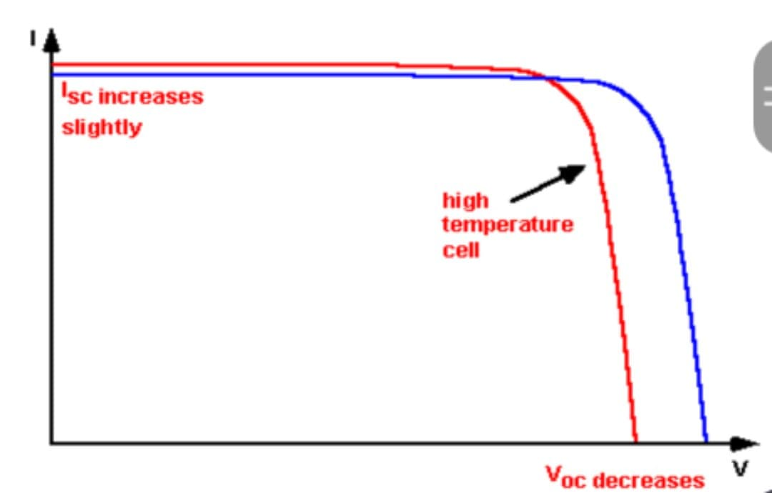
Main factors that affect the performance of the PV module
3- Effect of temperature
Temperature is a factor that can highly affect the behavior of a PV system, as it influences the system’s efficiency and energy output. NOCT=(45-48)
The increase in the temperature of the module occurs because of:
Excessive solar radiation
High ambient temperatures
Wind speed and direction
Mechanical characteristics of PV module

Slide 9
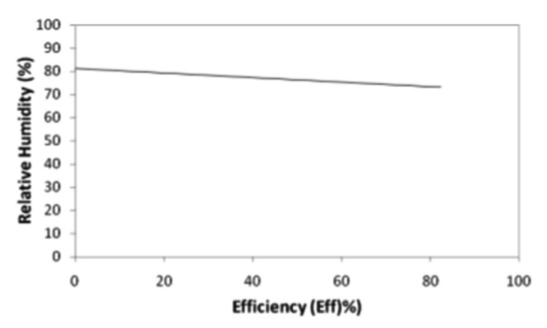
Main factors that affect the performance of the PV module
4- Relative humidity
Humid conditions are observed to cause dust to stick on the modules glass covers which causes degradation in PV power output.

Slide 10
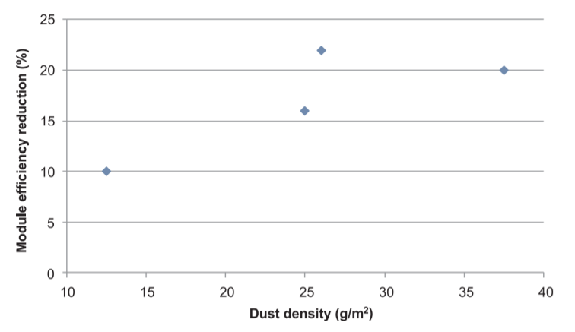
Main factors that affect the performance of the PV module
5- Effect of dust
Dust has two potential effects on the power output of the PV panels.
1- Suspended dust particles in the atmosphere that are larger than the wavelength of the incoming solar beam can diffuse the sunlight.
2- Creation of a dense layer of dust on the surface of the PV panel.

Slide 11
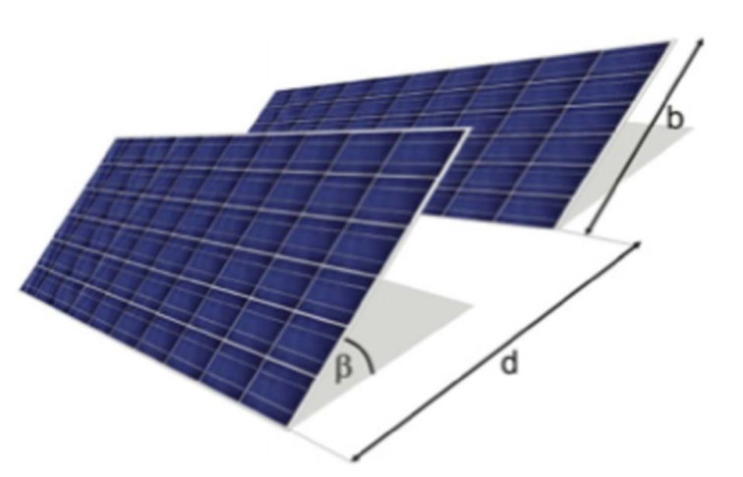
Main factors that affect the performance of the PV module
6- Shading effect
The production power of the PV module is significantly influenced by partial or full shading depending on the location of the module. The shading scenario influences the current flow in the shaded cells. The cells may be shaded by trees, buildings, and dust accumulation. Another form of partial shading is called self-shading induced by the previous row of PV modules

Slide 12
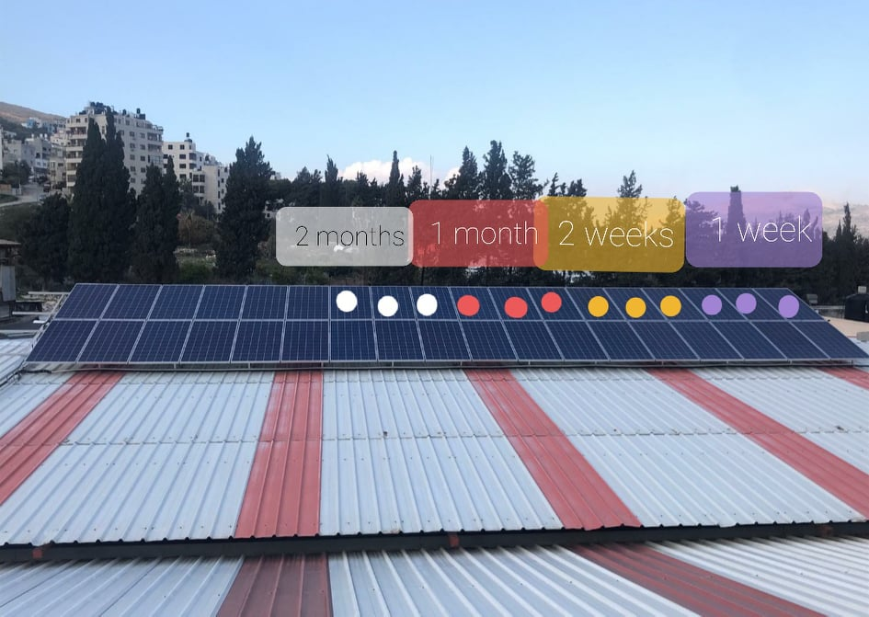
Procedure
The practical method of this experiment is as follows, each time period had three solar cells and the average of the electrical production was calculated for them to get the most possible accurate answer.

Slide 13
Litereture Review
Similar operational study
A similar experiment was done in Ma’an district, Jordan by a group at Al-Hussein Bin Talal University. The study found that based on a one cleaning process per month, the worst scenario will cause a power degradation of 2.99% with an average of 2.22% for the whole period of the study and based on the results a monthly cleaning process can be sufficient to maintain a healthy power plant status.

Slide 14
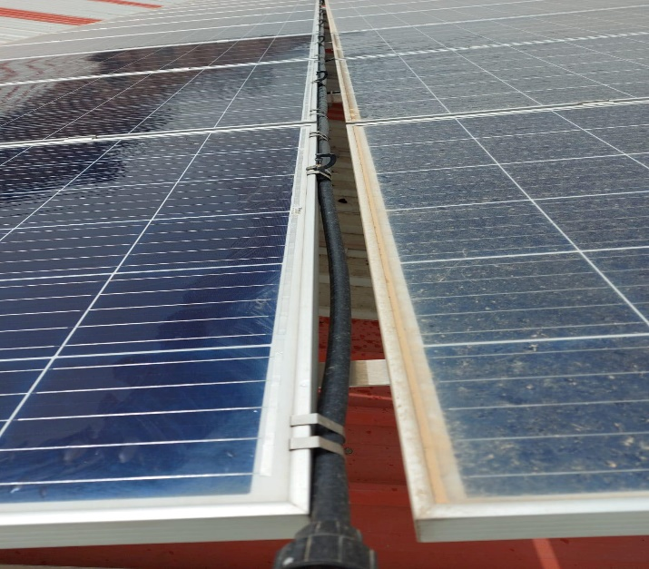
Results and Analysis
The results of power generation for the uncleaning and cleaning PV panels by timetabling (weekly, two weeks, monthly, two months)
- The cleaning schedule was based on the recommendations given by First Solar operation manual. Which states a drop of 2% in power efficiency requires a cleaning act for the whole plant.

Slide 15
Results and Analysis
The results of power generation for the uncleaning and cleaning PV panels by timetabling (weekly, two weeks, monthly, two months)
- The cleaning schedule was based on the recommendations
given by First Solar operation manual. Which states a drop
of 2% in power efficiency requires a cleaning act for the whole plant.

Slide 16
Results and Analysis
- The output power difference between the two weeks uncleaned and
Automated cleaned panels with percentage difference.

Slide 17
Results and Analysis
- The output power difference between the monthly uncleaned and
Automated cleaned panels with percentage difference.

Slide 18
Results and Analysis
- The output power difference between the two months uncleaned and
Automated cleaned panels with percentage difference.

Slide 19
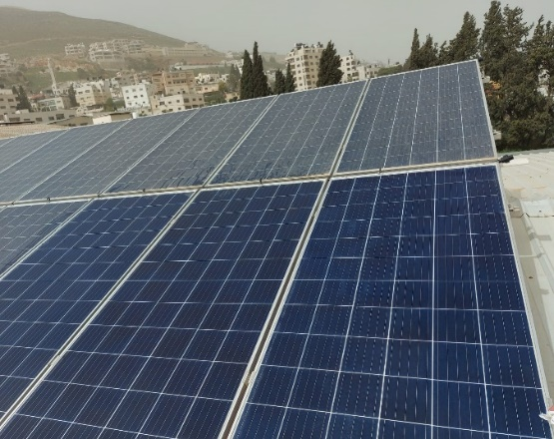
Conclusion and Recommendation
The performance of PV technology is facing a serious challenge caused by dust formation.
will assist in lowering cleaning costs by choosing the most appropriate period for cleaning
the observations in the results sections led to the following recommendation:
A monthly cleaning operation in Winter season is appropriate and every two weeks cleaning in March and April, while in May it’s recommended to clean the plant after less than two weeks. This recommendation is necessarily to keep the PV panels at the highest possible performance.

Slide 20
Thanks for Listening

