Slide 1
Transportation Management Plan for The Eastern Entrance of Tulkarm City
Prepared By:
Fuad Ziyad Ahmed Tanni
Mohammed Zaher Asad Jallad
Abd Al-Rahman Zuher Adel Khuder
Under supervision of:
Dr. Khaled Al-Sahili

Slide 2
Introduction
Background / Existing Problems
Objectives of the study

Slide 3
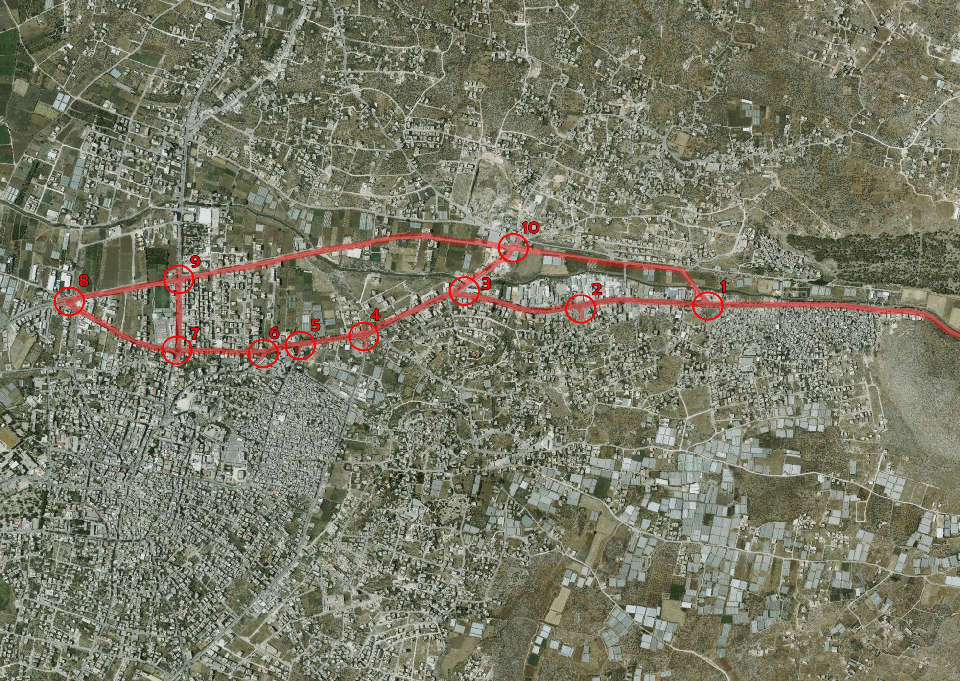
Study Area

Slide 4
Data Collection
Pavement conditions
The general pavement conditions, based on field observations, are good, but there are some locations that need maintenance.
Geometric conditions
Inventory study for Study Area Streets
Traffic Conditions
Traffic accidents
Traffic volume counts on links
Traffic volume counts on Intersections
Public transportation

Slide 5


Slide 6
Evaluation of Existing Condition
LOS at Intersections
Intersection | LOS | ICU LOS
Iktaba-Nablus | A | B
Al-Salam | A | B
Hasouna | - | G
Tulkarm-Nablus | C | C
Tulkarm Refugee | A | B
Zanoubia School | C | A
Ahmed Yassin | - | D
Al-Alimi | - | D
Al-Younis | F | G
Iktaba | - | B

Slide 7
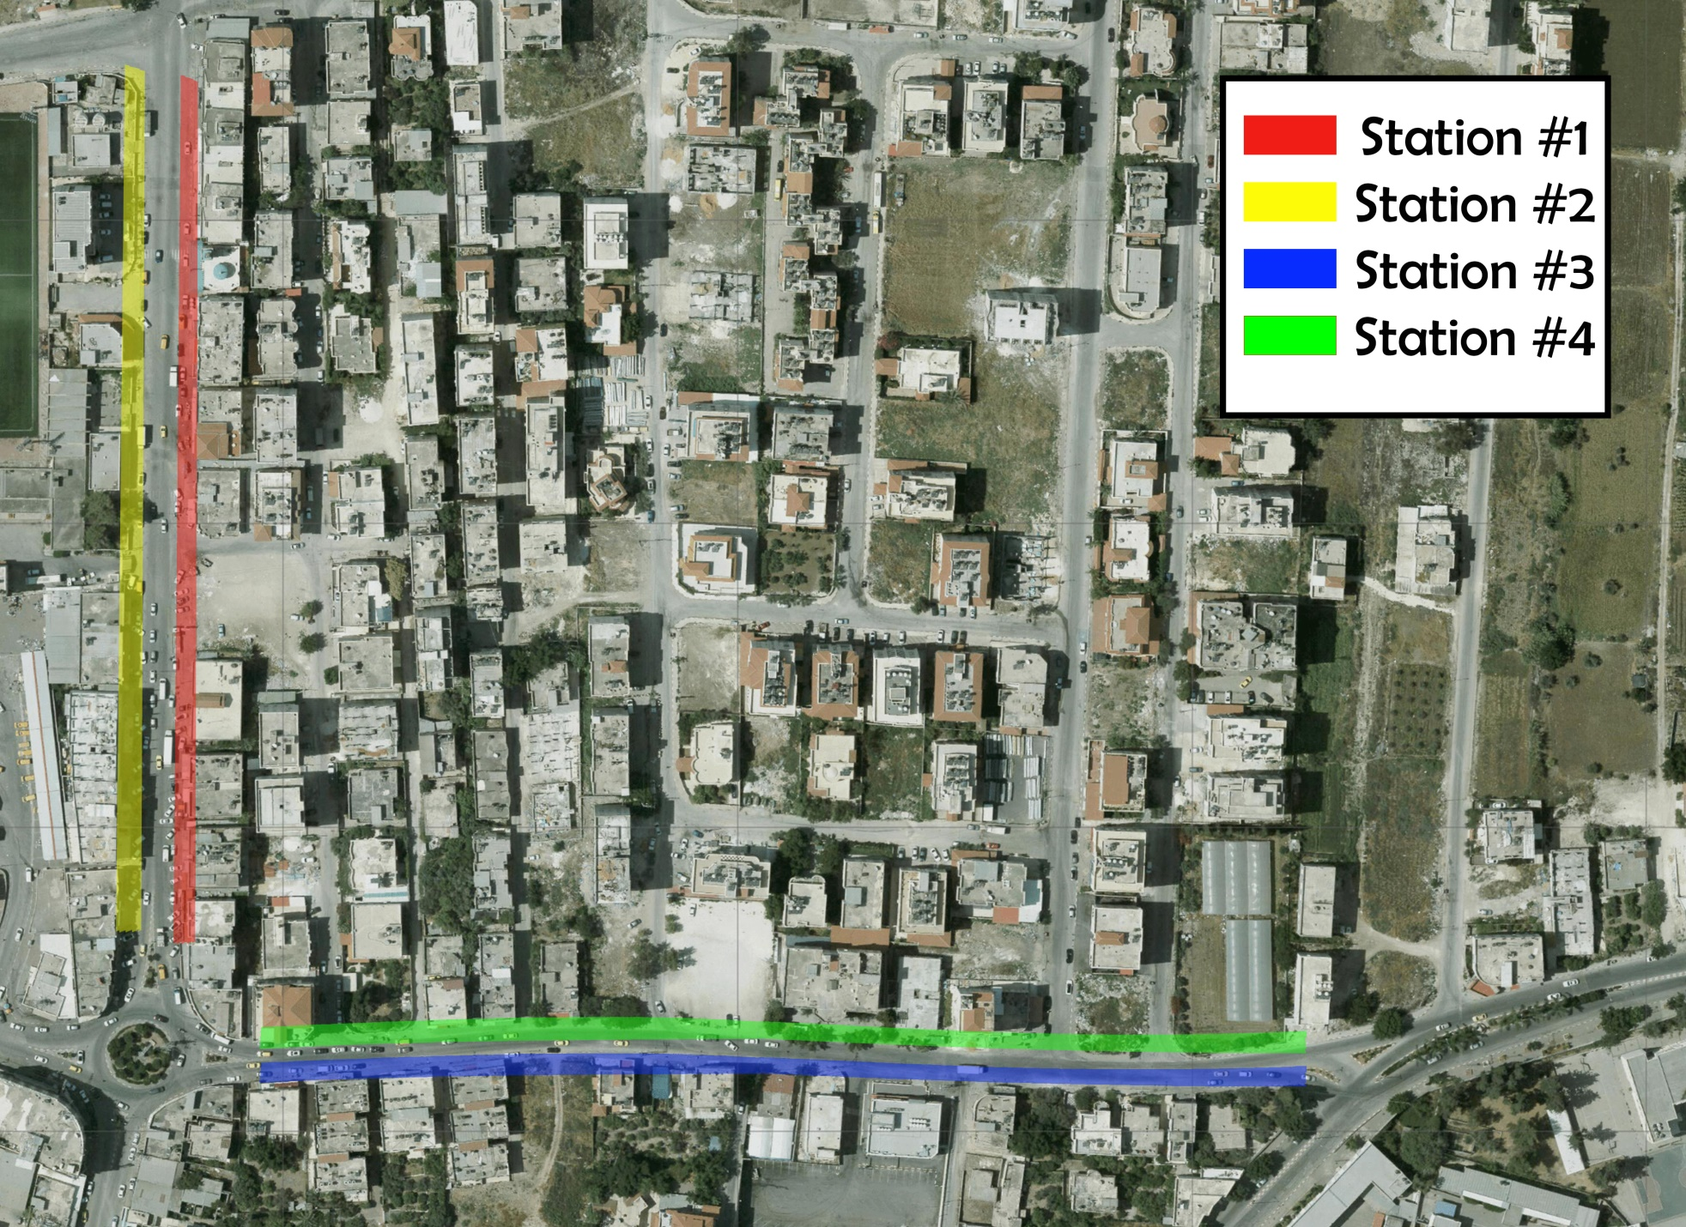
Pedestrian LOS
Pedestrian Sidewalks

Slide 8
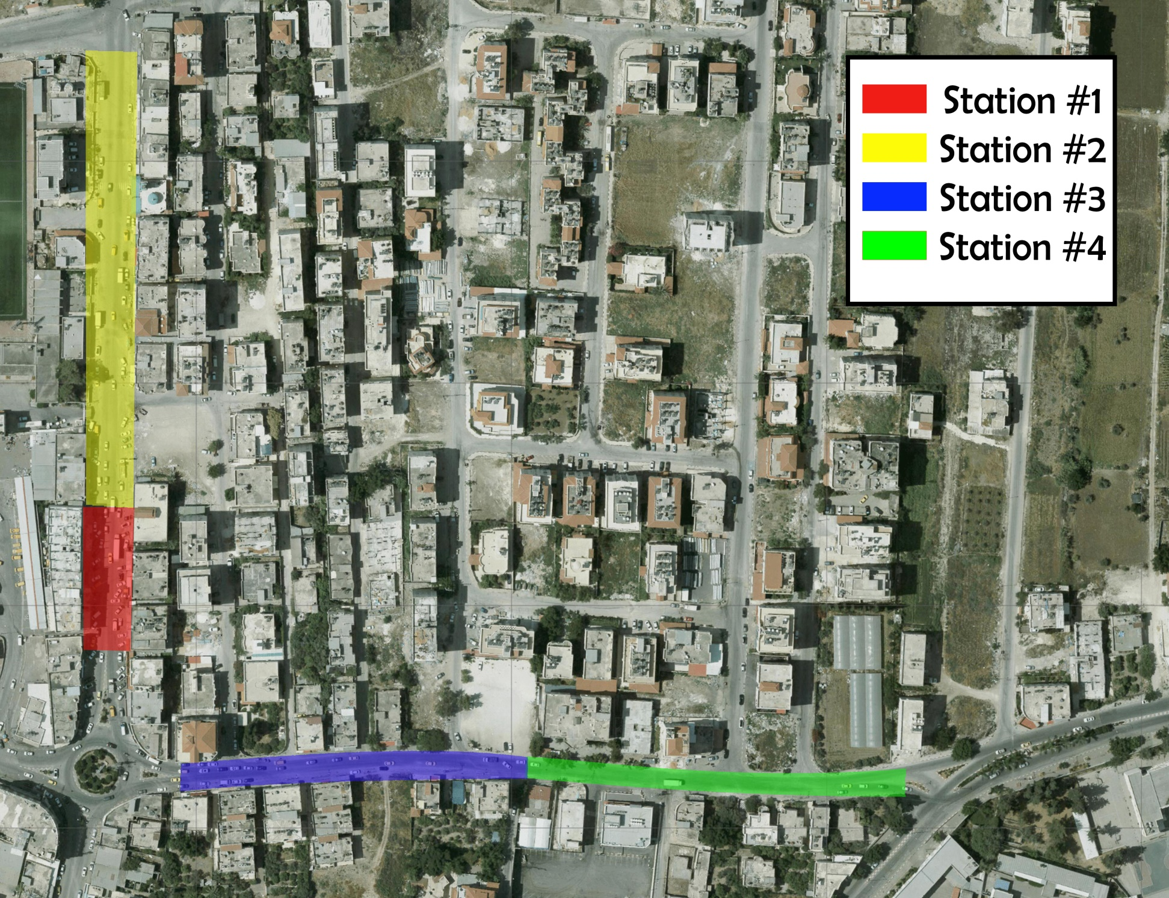
Pedestrian Crossings

Slide 9
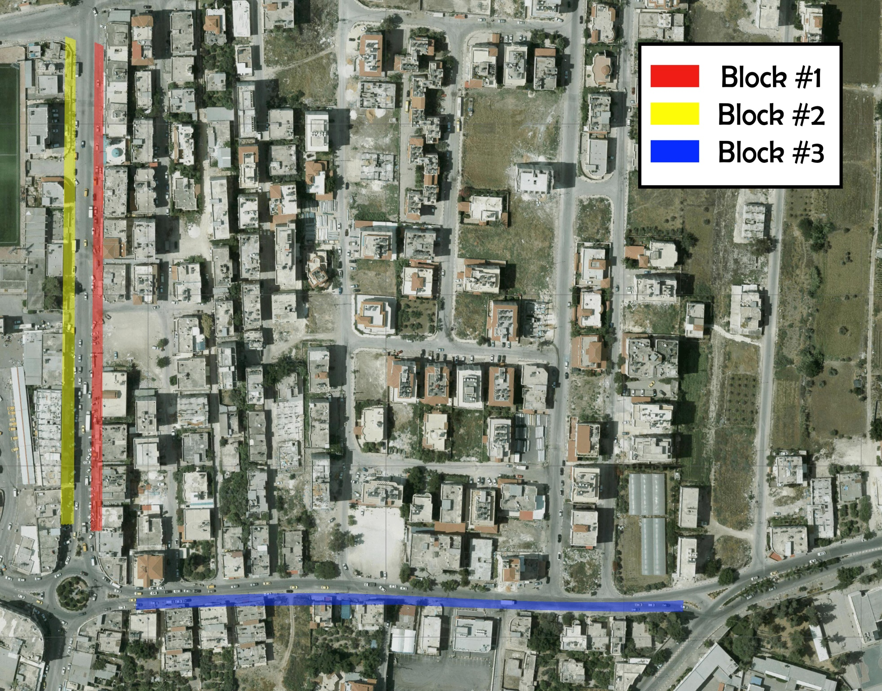
Parking

Slide 10
Traffic Signal Warrants
Intersection | Warrant Satisfied?
Iktaba-Nablus | Not Warranted
Al-Salam | Not Warranted
Hasouna | Warranted
Tulkarm-Nablus | Warranted
Tulkarm refugee | Not Warranted
Zanoubia school | Warranted
Ahmed Yassin | Warranted
Al-Alimi | Not Warranted
Al-Younis | Warranted
Iktaba | Not Warranted

Slide 11
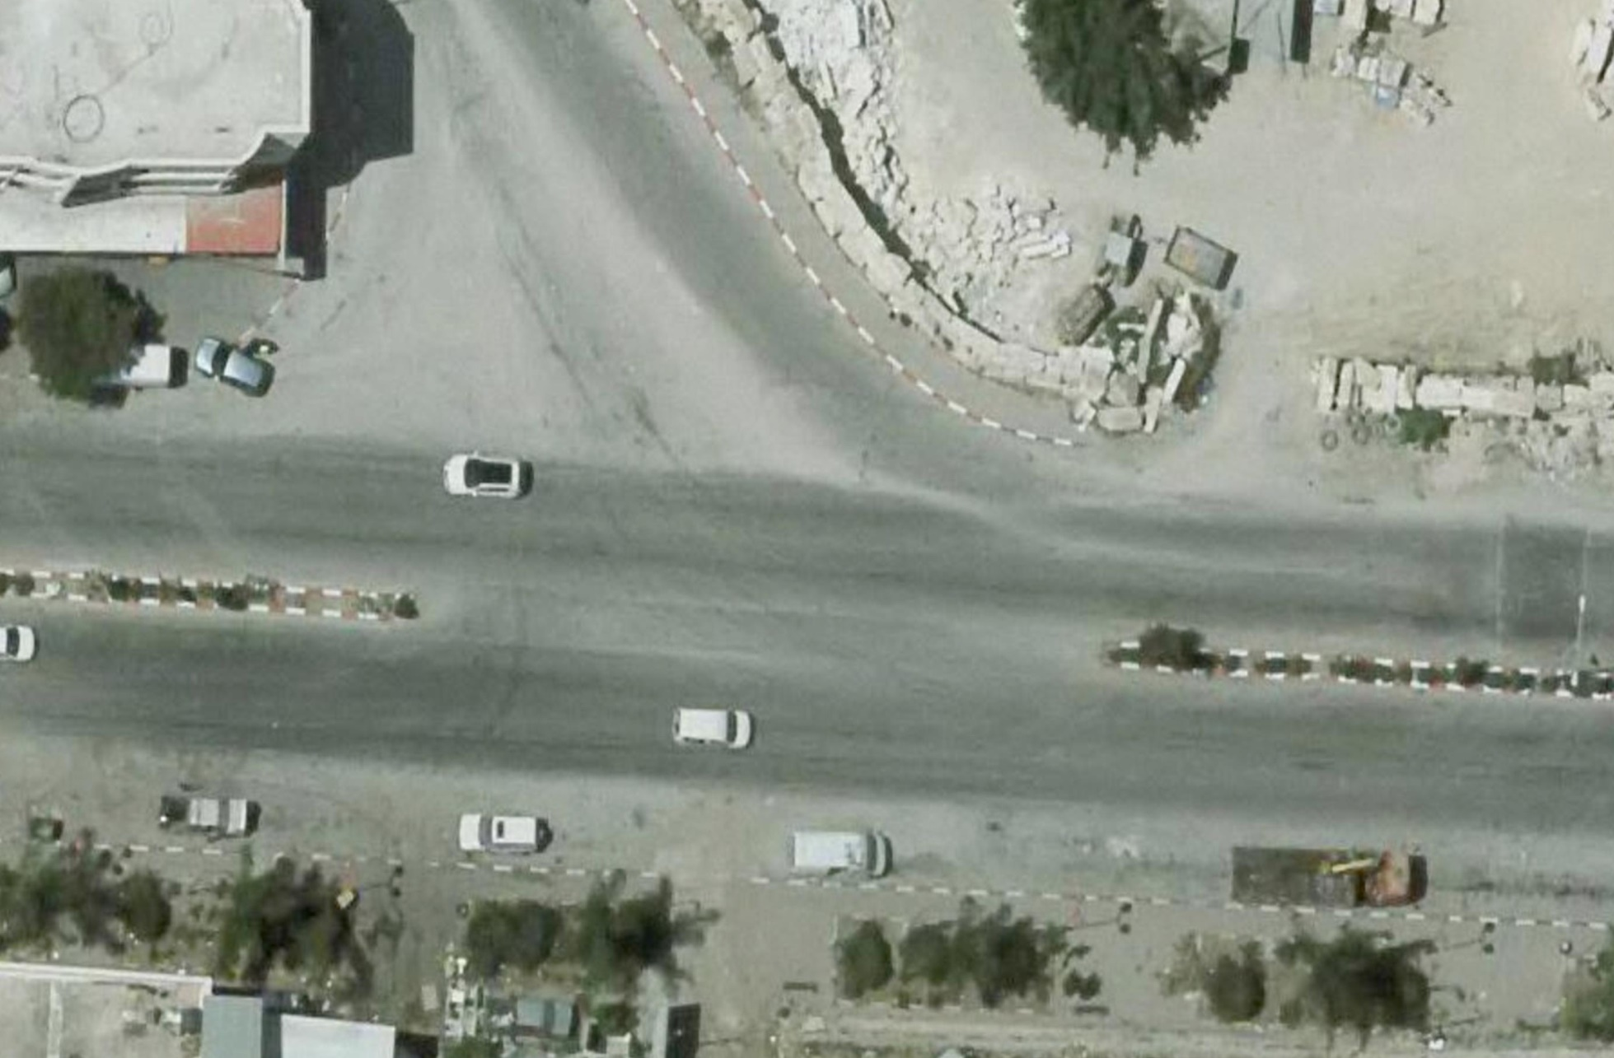
Design of Intersections
Iktaba-Nablus Intersection

Slide 12
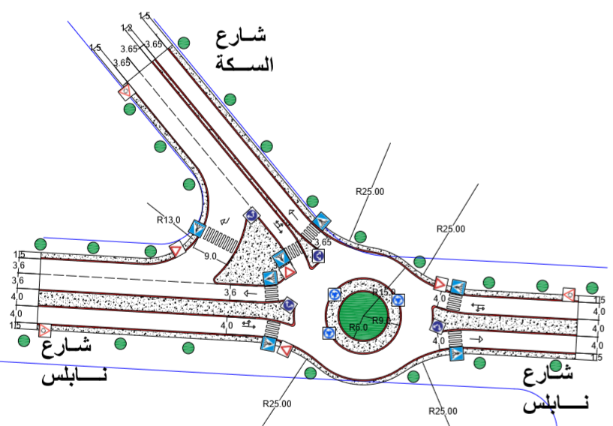
Suggestion

Slide 13
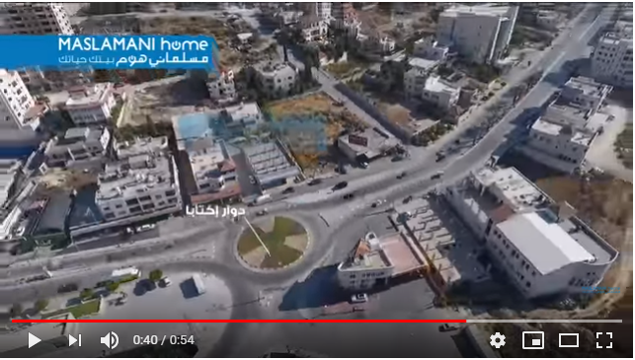
Hasouna Intersection

Slide 14
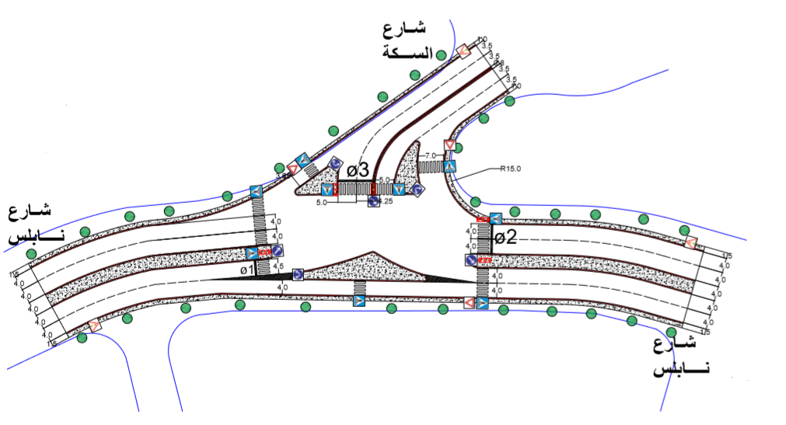
Suggestion

Slide 15
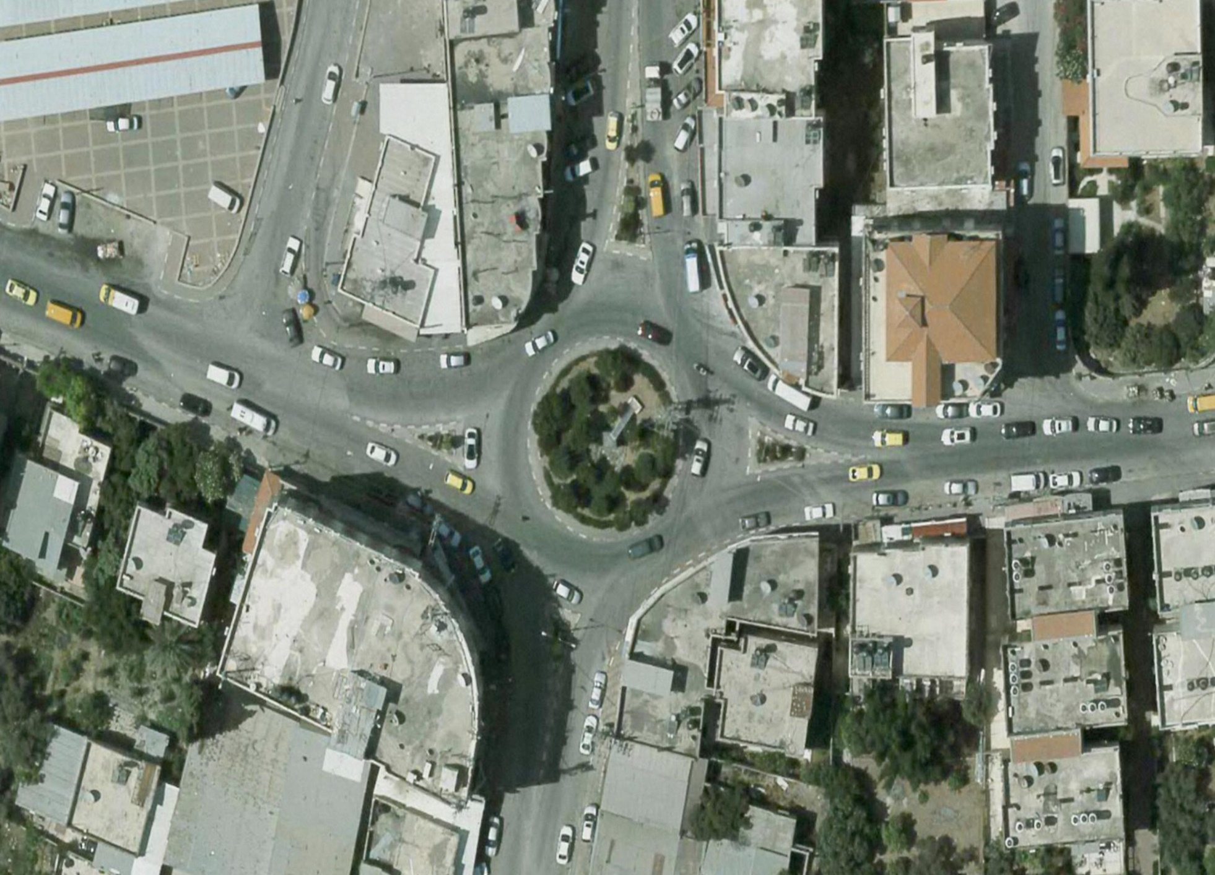
Ahmed Yassin Intersection

Slide 16
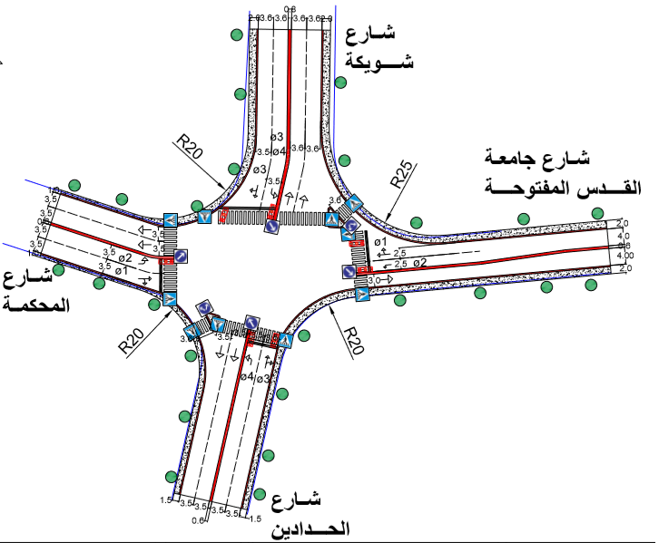
Suggestion

Slide 17
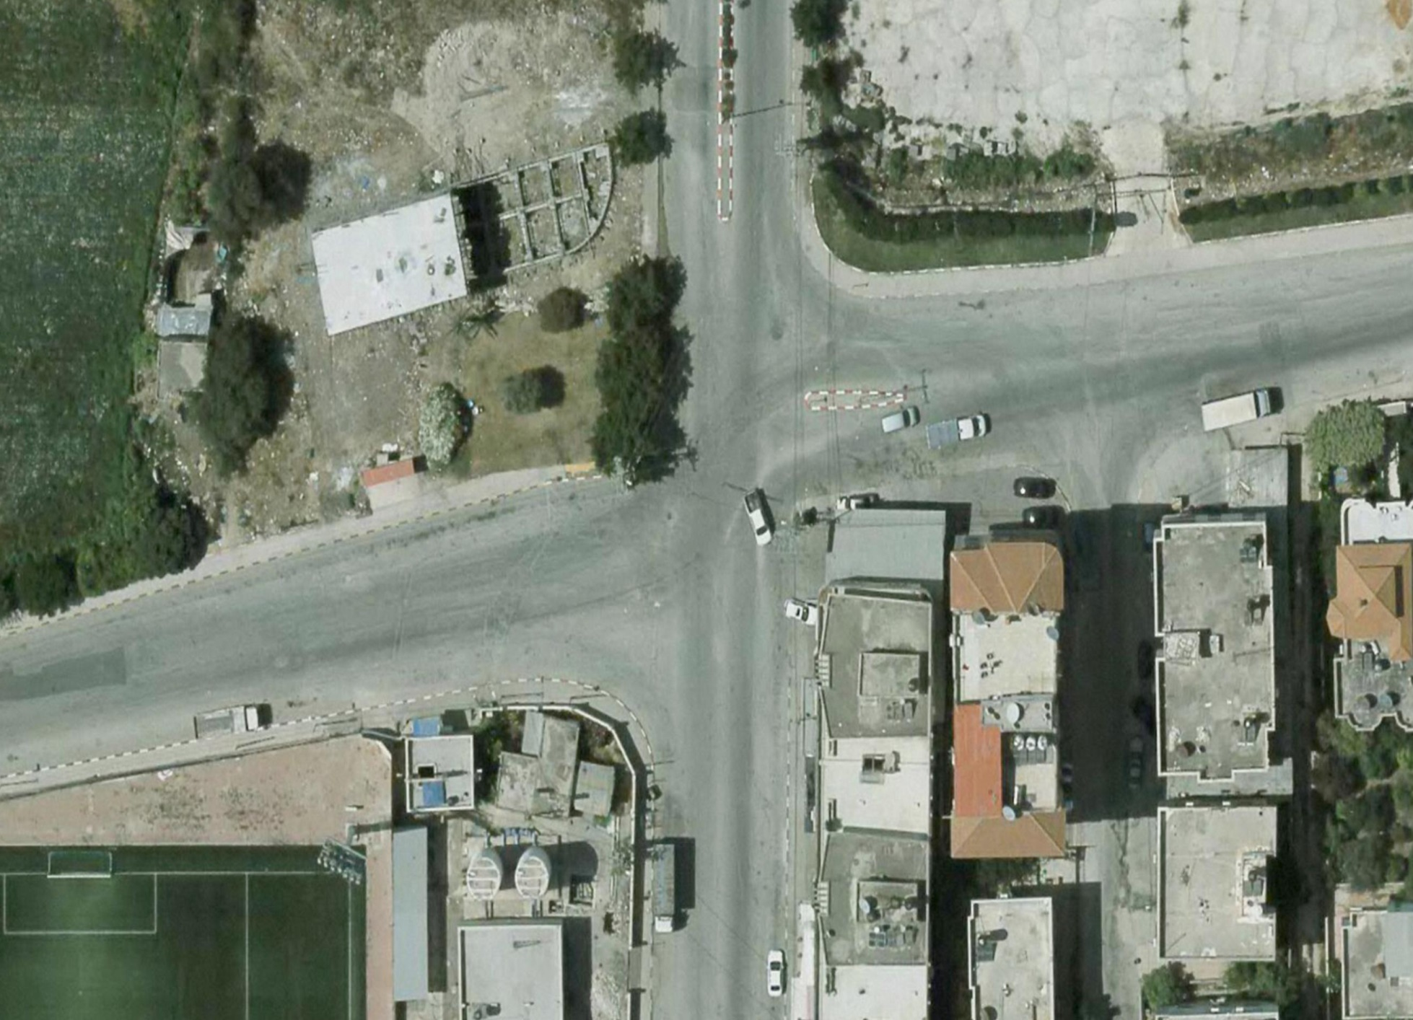
Al-Younis Intersection

Slide 18
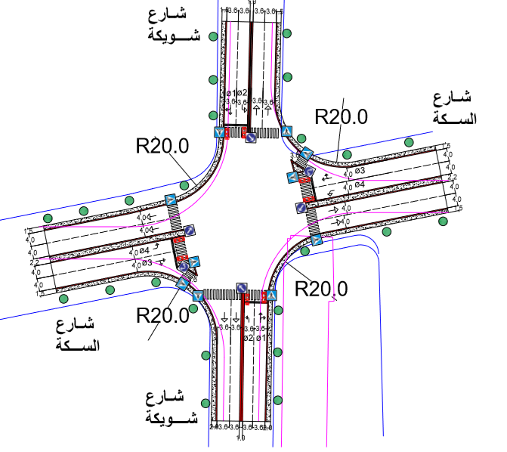
Suggestion

Slide 19
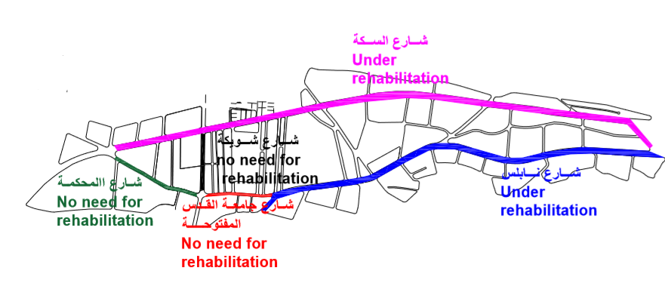
Overall Transportation Management Plan
Rehabilitation

Slide 20
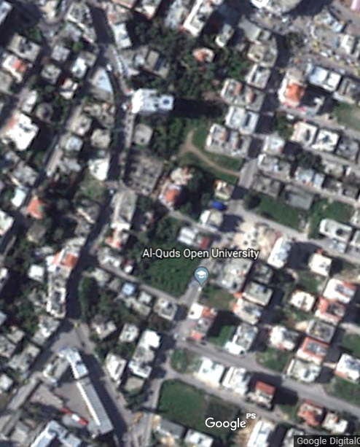
Arab Bank & KFC Streets

Slide 21
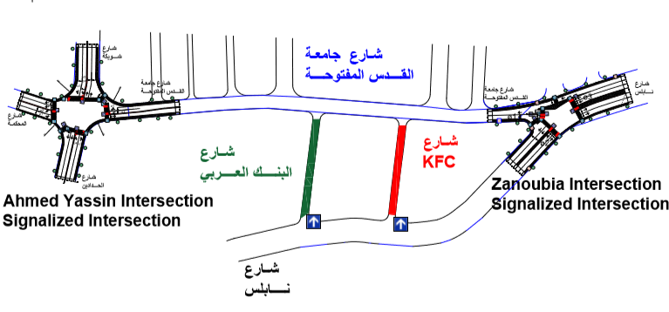
Suggestion

Slide 22
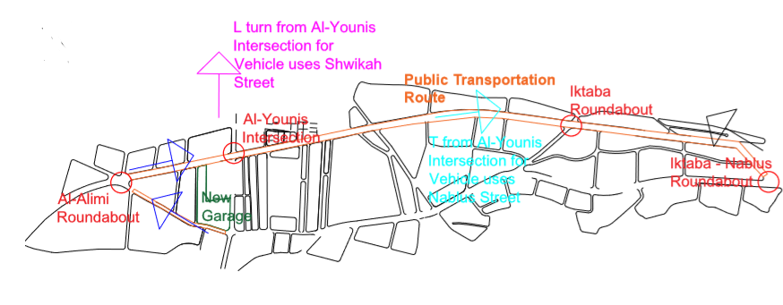
The Public Transportation Route

Slide 23
Overall Transportation Management Plan
Comparison of LOS at Intersections
Intersections | LOS before | LOS after
Iktaba-Nablus | B | B
Al-Salam | B | B
Hasouna | G | B
Tulkarm-Nablus | C | C
Tulkarm Refugee | B | B
Zanoubia School | C | C
Ahmed Yassin | D | C
Al-Alimi | D | C
Al-Younis | G | D
Iktaba | B | A

Slide 24
Conclusions
There are several problems related to the traffic and geometric conditions in the study area roadway network that need to be resolved.
The suggested improvement plan improves the geometric and traffic control at the key intersections, and it expected to reduce the conflict points, delay, and improve the traffic flow.
To implement this traffic management plan, cooperation between the Tulkarm Municipality and the police to apply the proposed plan is needed to ensure that the necessary laws are applied by the users

