Slide 1



CEE-LEARNING
BY: MISAM SBITANY & AYA KHALIFA
SUPERVISOR: DR.RAED

Slide 2


CONTENT
01
INTRODUCTION
02
OBJECTIVES
03
FEATURES
04
TOOLS USED
05
FUTURE WORK

Slide 3



INTRODUCTION
It is a mobile application and also a website for electrical and computer engineering students at An-Najah National University, so that the student himself can create an account as an expert or as an ordinary student, and then exchange information between them through booking, inquiring about a specific question and answering it, booking certain halls from For seminars and many other things.

Slide 4


OBJECTIVES
The first goal is for the student to be able to obtain an income for himself, by working in his free time in works in which he develops himself
The second goal is to increase the educational attainment of students and make it easier for them, as they can access information easily

Slide 5





FEATURES
Feature1
Feature2
Feature3
The expert can put the areas in which he excels, and encloses that in certificates.
The expert has a calendar where they can mark their availability, enabling students to
reserve appointments according to the expert’s schedule.
Students can book appointments, view their bookings, and access details about the
expert through our calendar.

Slide 6
FEATURES
Feature3
Feature4
Feature4
Experts can view the students who have booked appointments and access information
about them.
Experts can conduct online meetings with students using our application’s meeting
feature, which allows students to join the meetings.
All users can post questions, and other users can reply to them or search for any question.
Feature5
Feature6
Users can communicate with each other through the chat feature.
Experts receive notifications to stay informed about their booked appointments.

Slide 7
FEATURES
Feature7
Feature8
Feature9
Students can search for experts by writing statements related to specific expert descrip-
tions.
Users have the ability to rate experts and view their ratings.
The system displays the availability rooms of Engineering College at An-Najah National
University and enables users to make bookings after administration approval.
Feature10
Feature11
A recommendation system suggests similar experts based on students’ interests using a
cosine similarity .
Experts receive notifications to stay informed about their booked appointments.

Slide 8
FEATURES
Feature12
Feature13
An expert can see his earning with chart in his profile.
An administrative page on our website, which is capable of displaying user information
and facilitating the deletion of such data. Furthermore, the administrator has the ability
to access a chart showcasing the earnings.

Slide 9
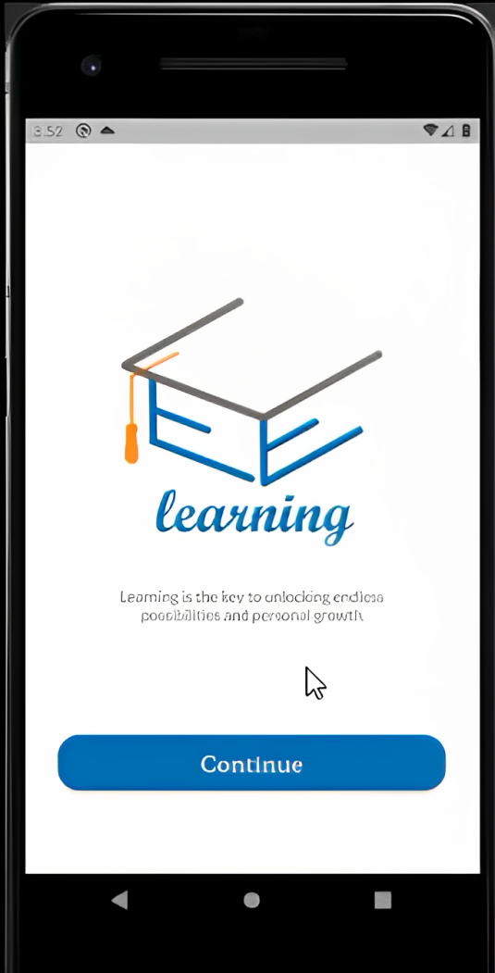
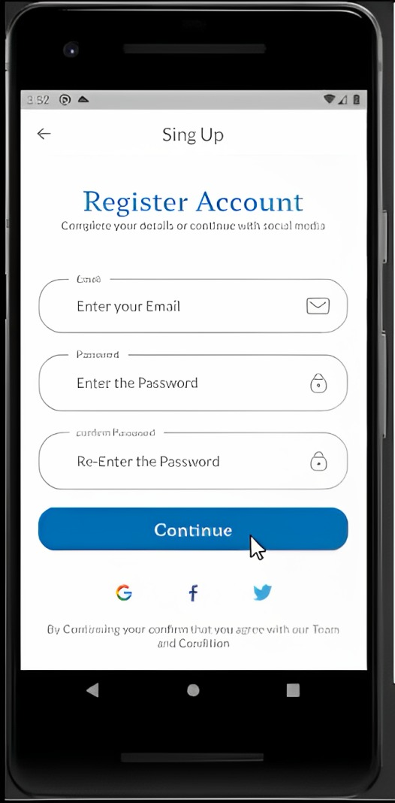
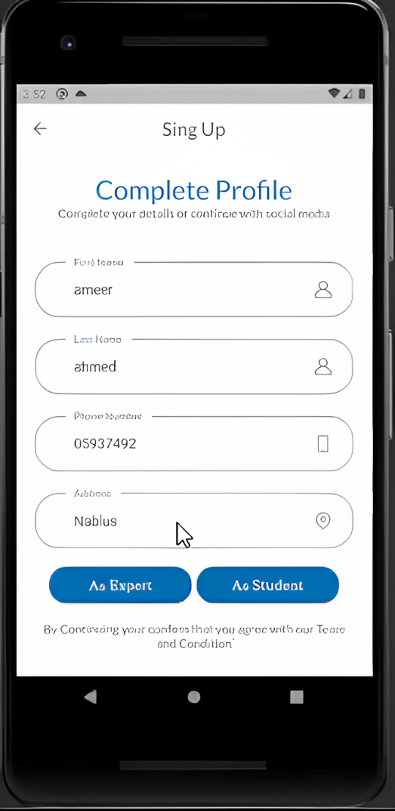
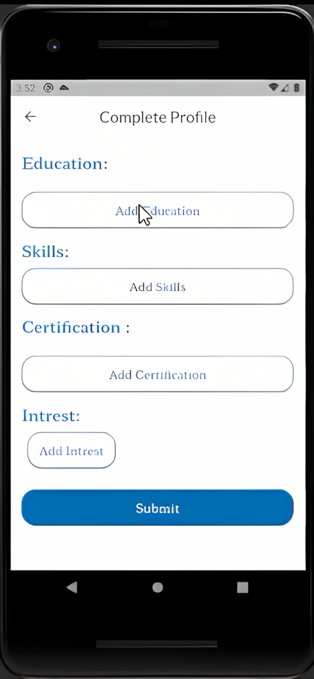

Slide 10
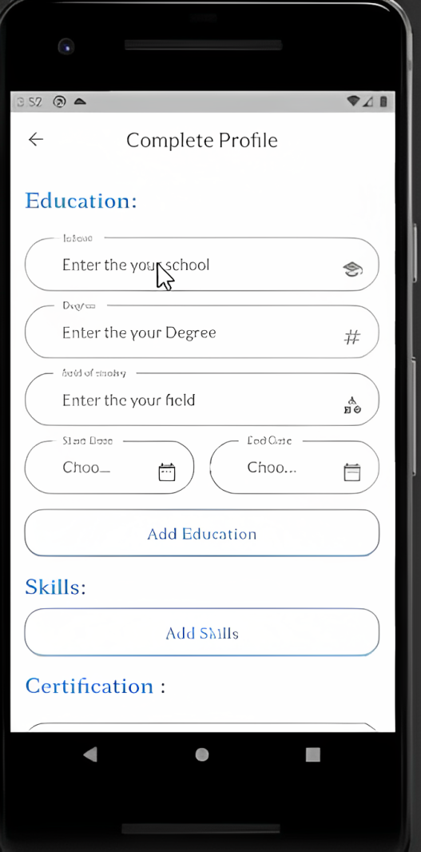
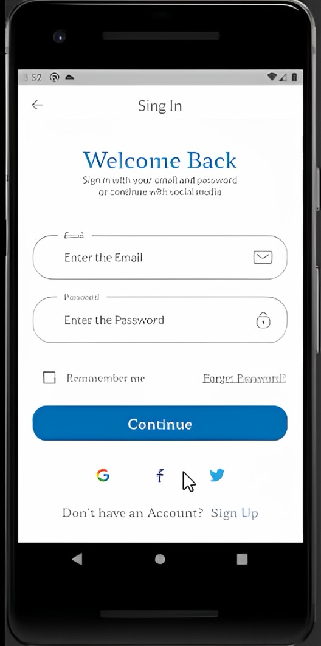

Slide 11
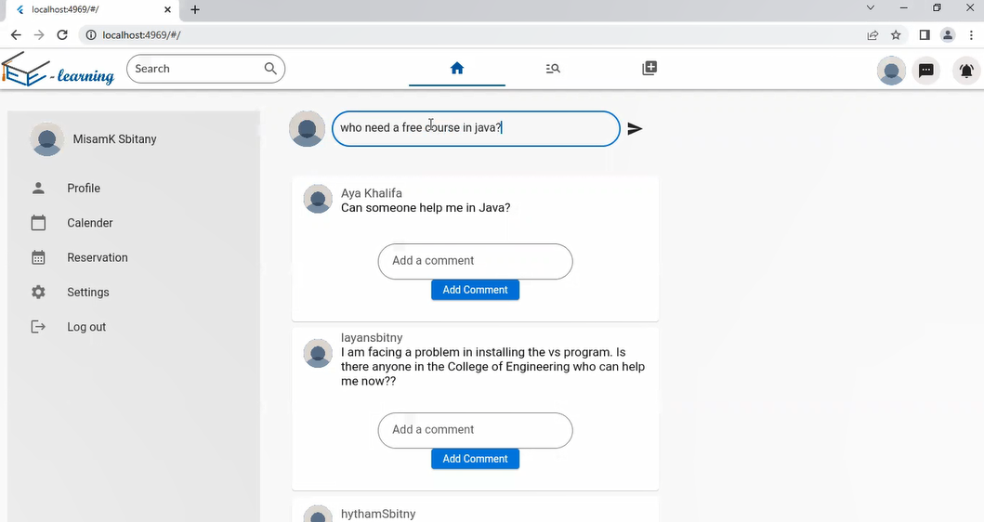
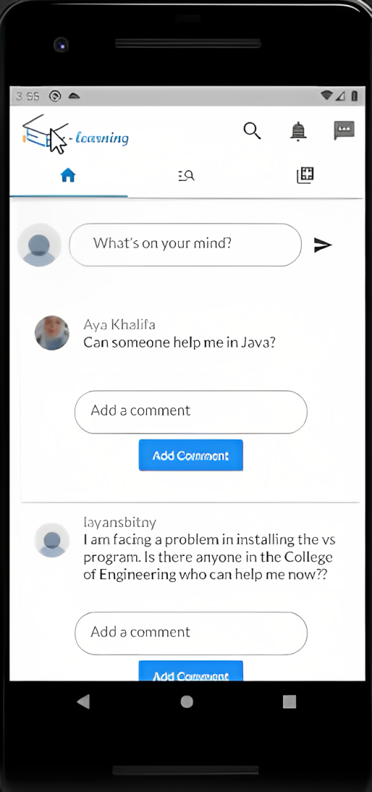
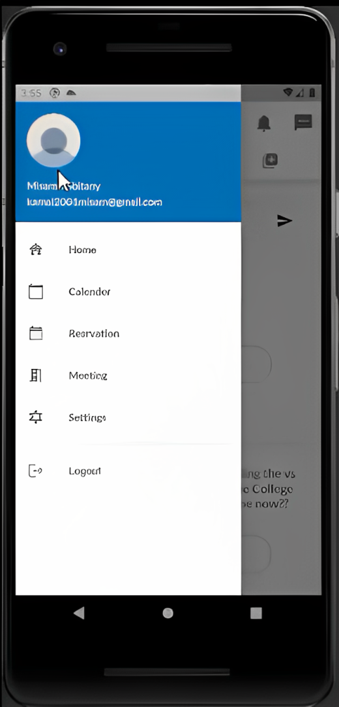
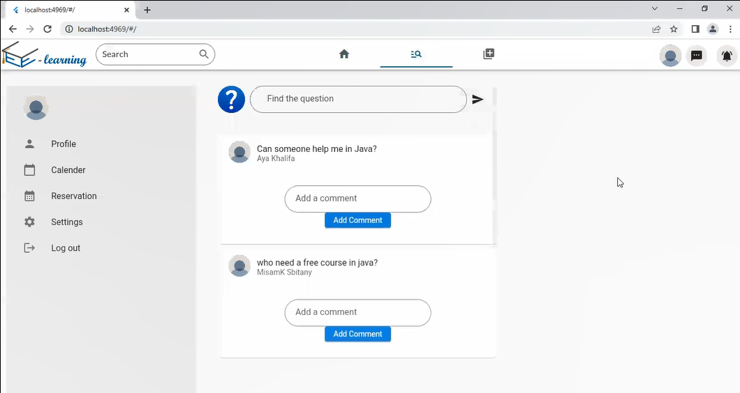

Slide 12
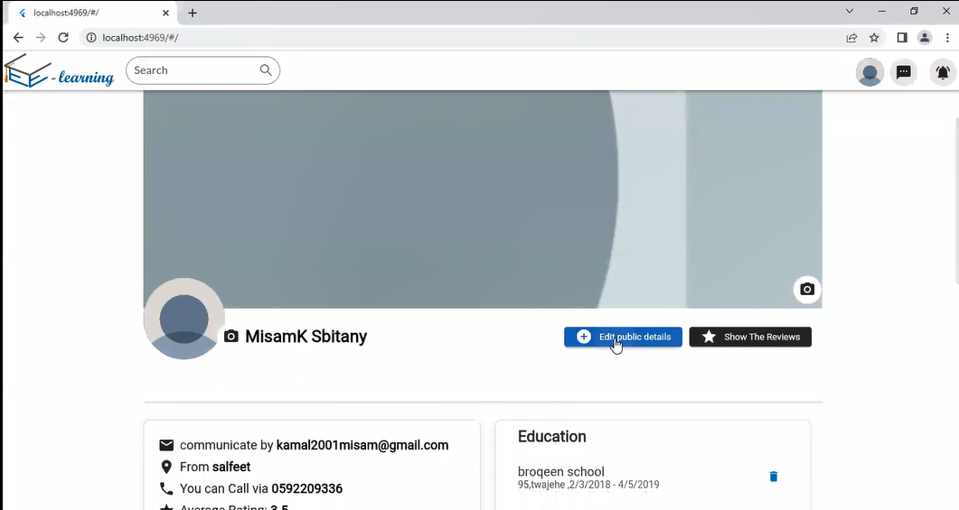
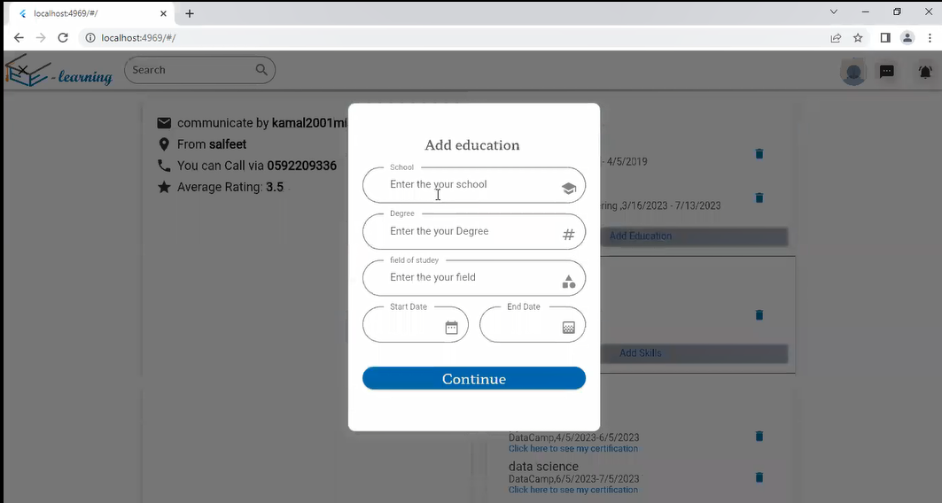
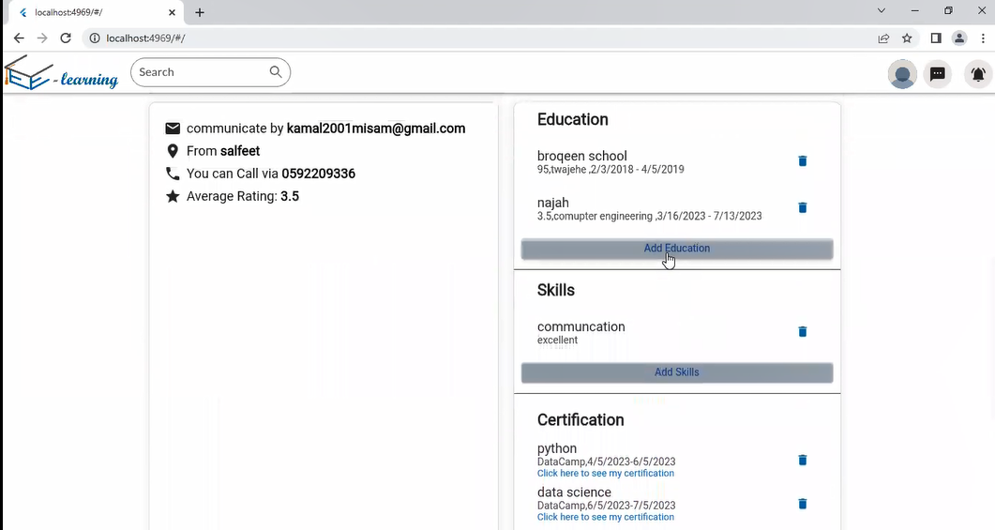
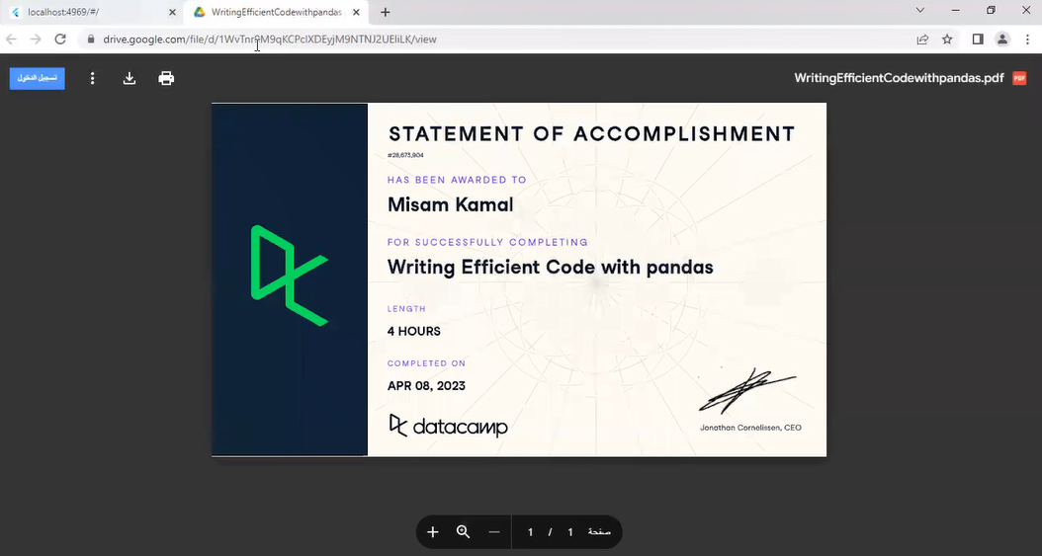

Slide 13
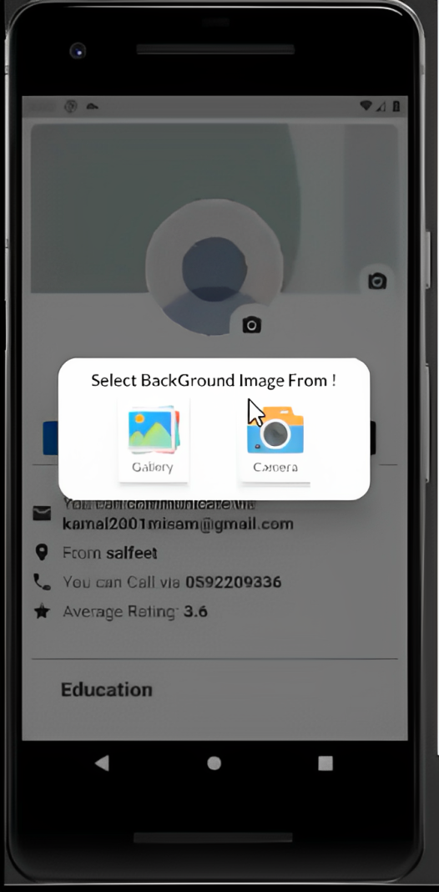
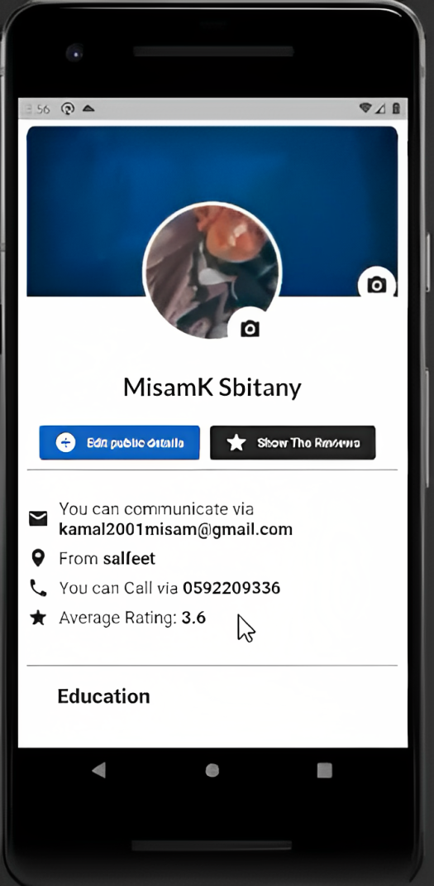
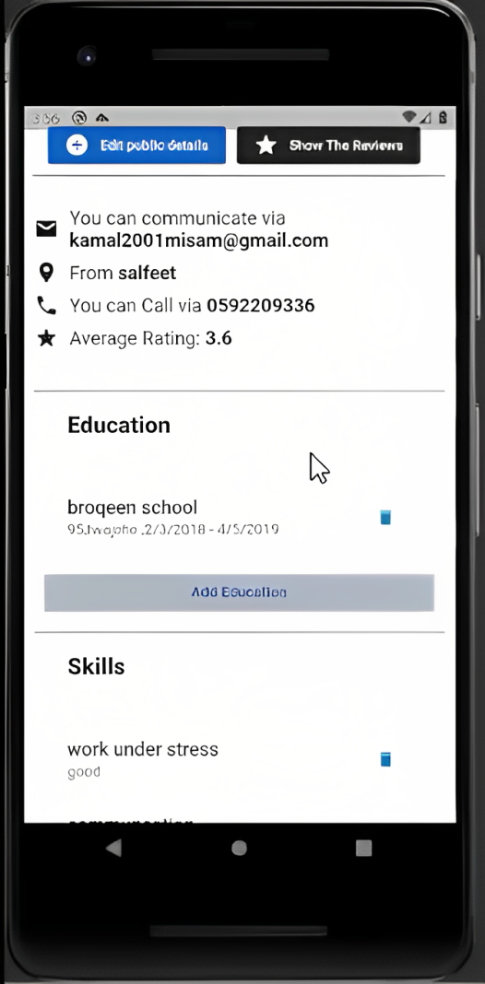
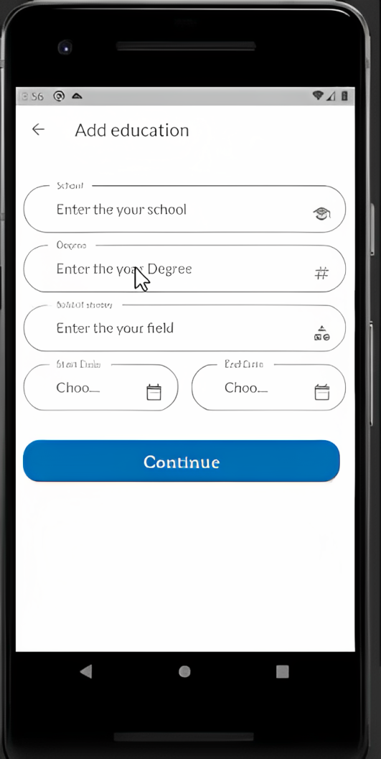

Slide 14
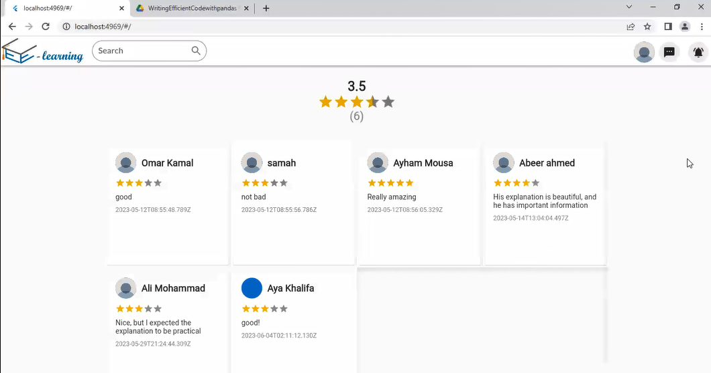
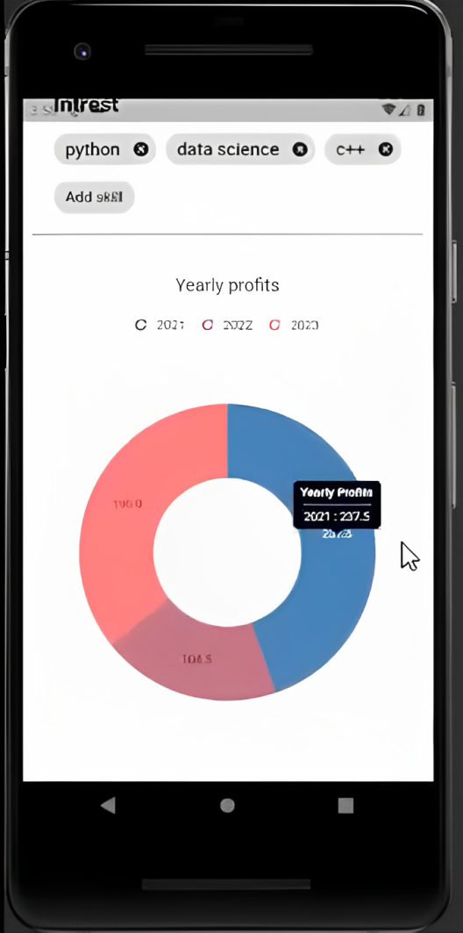
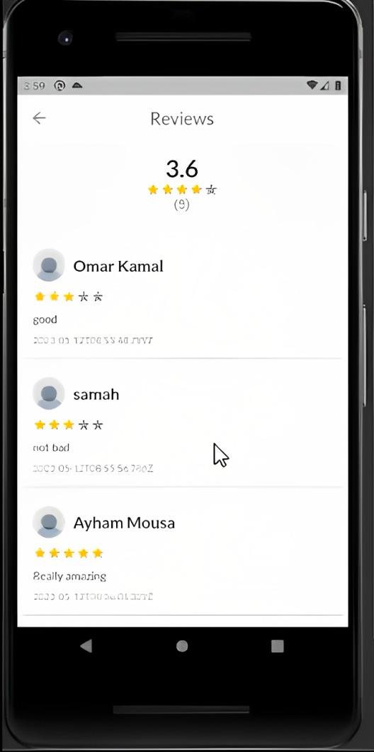
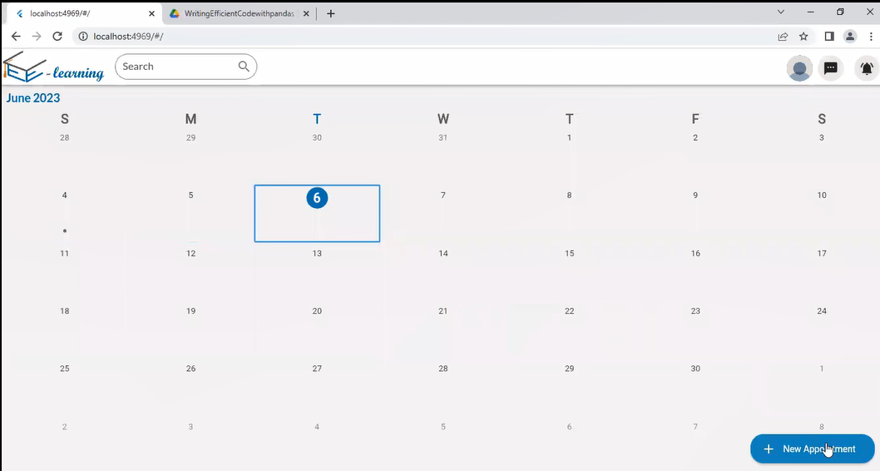
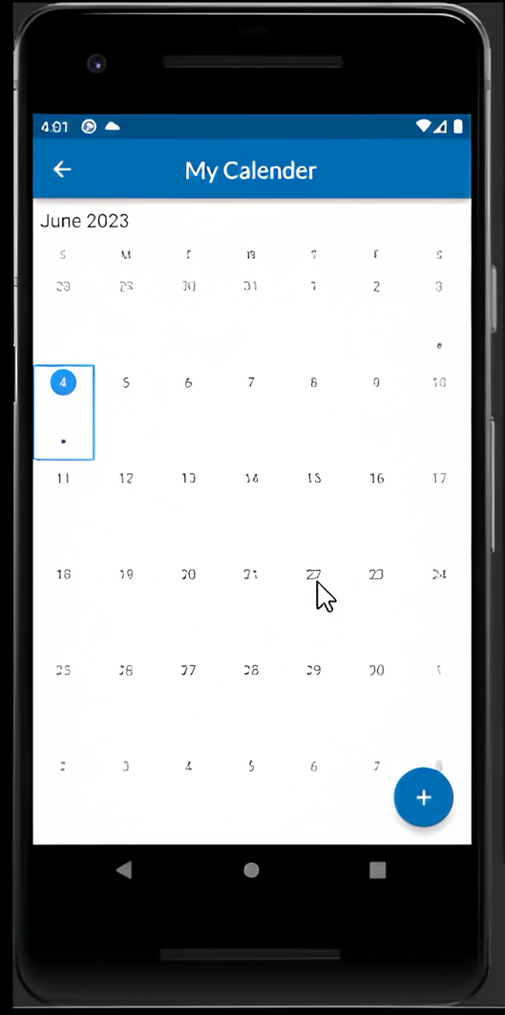
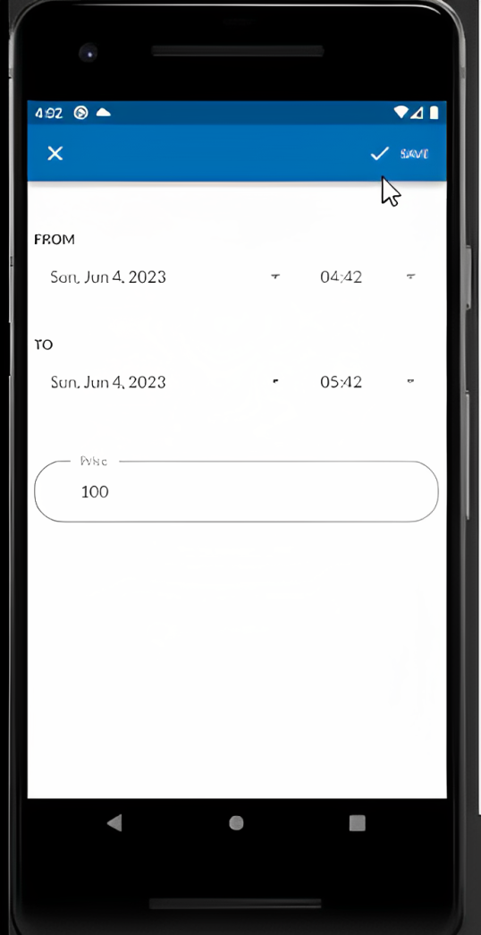

Slide 15
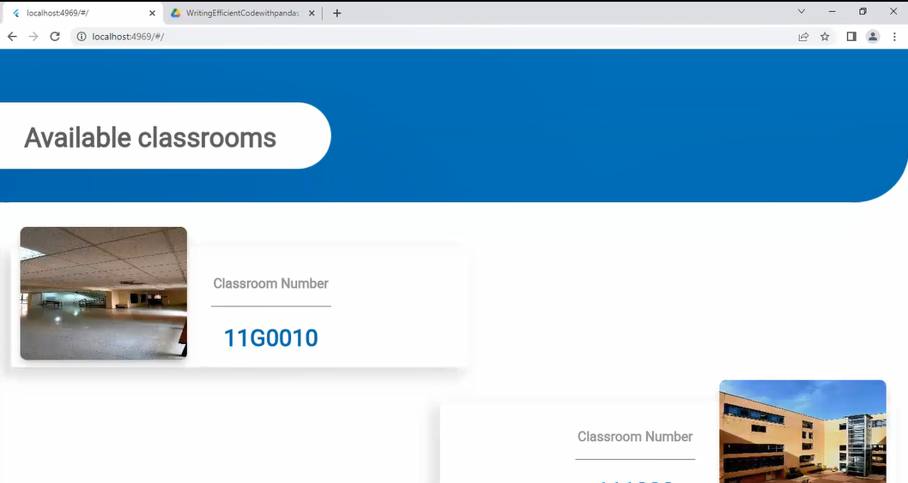
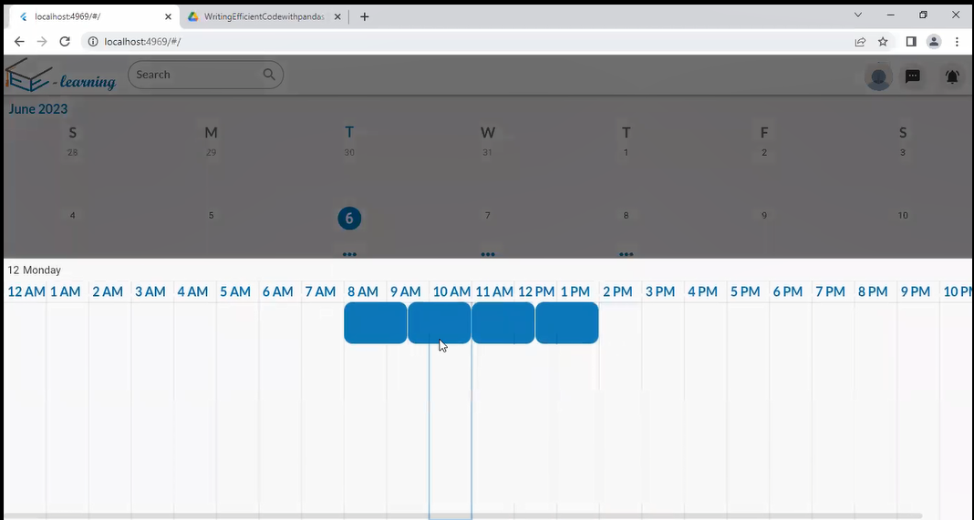
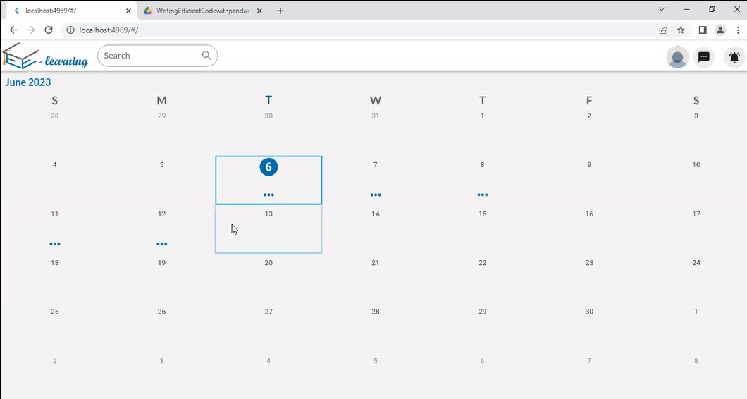
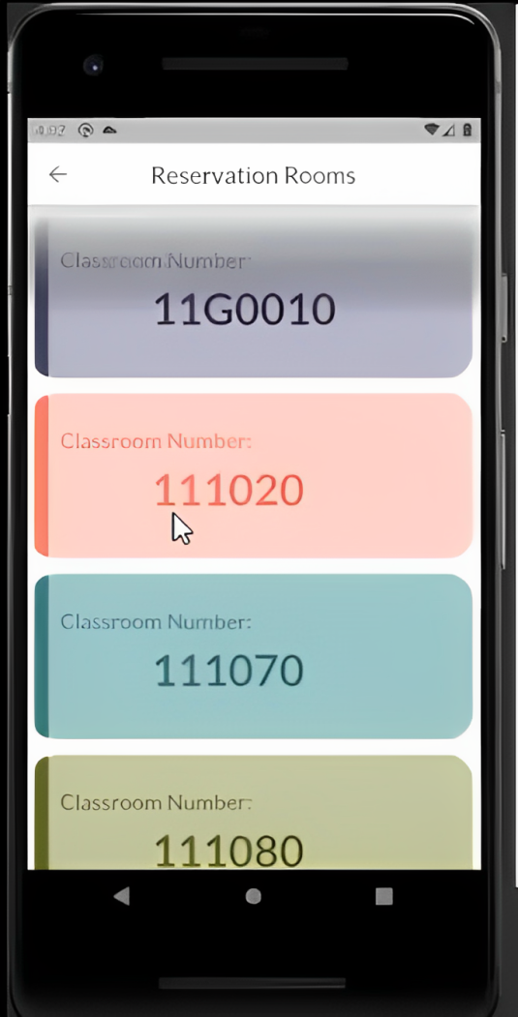
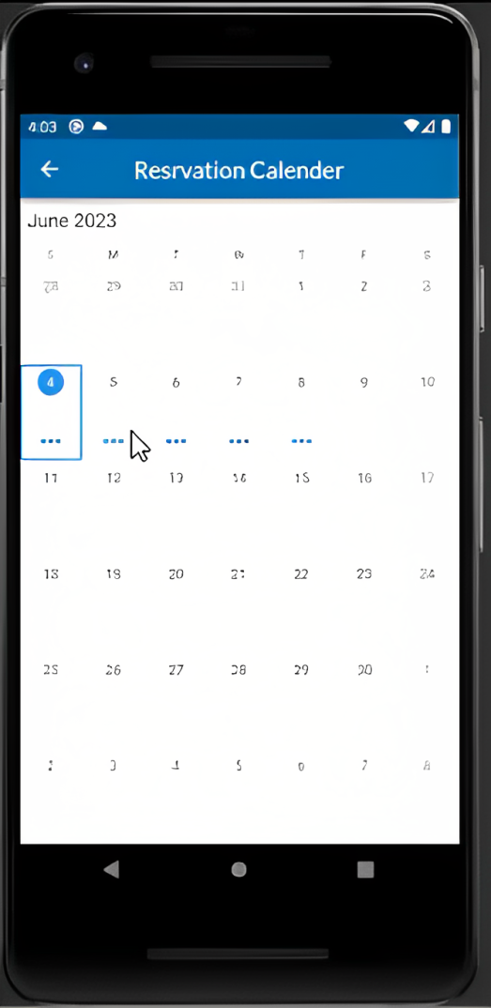
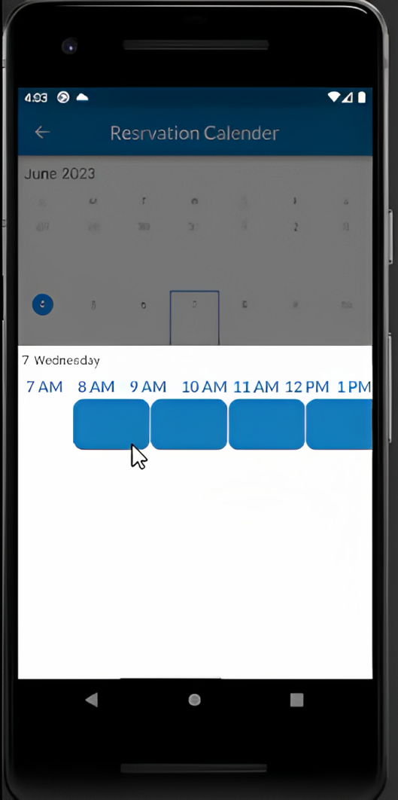

Slide 16
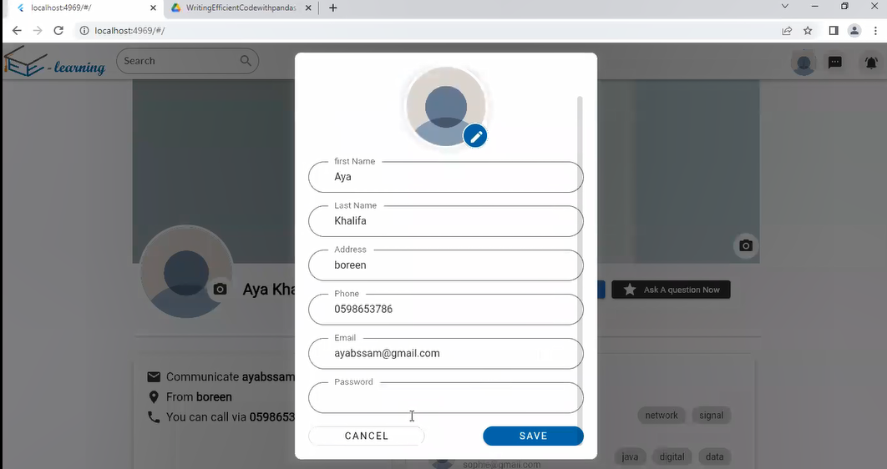
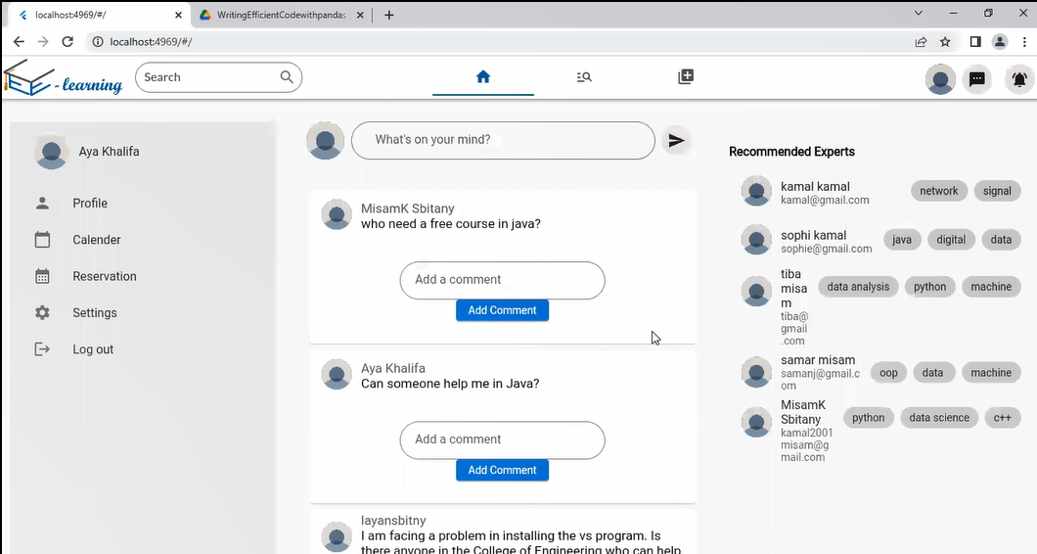
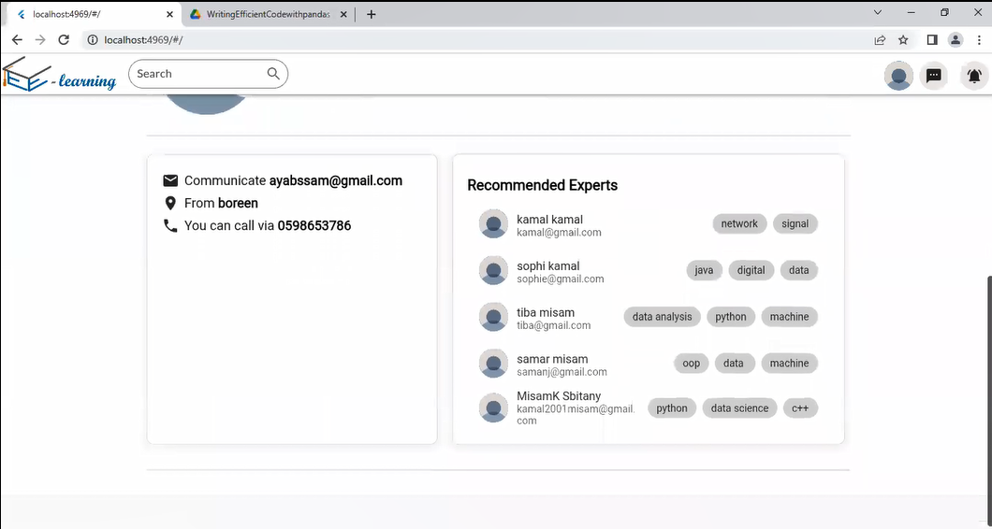
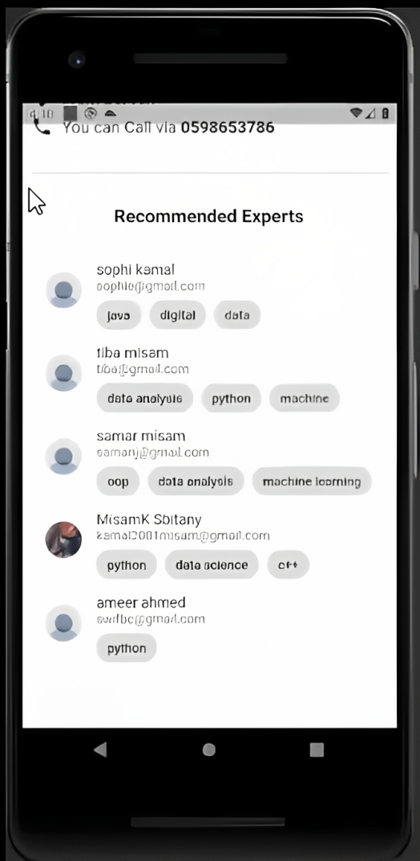

Slide 17
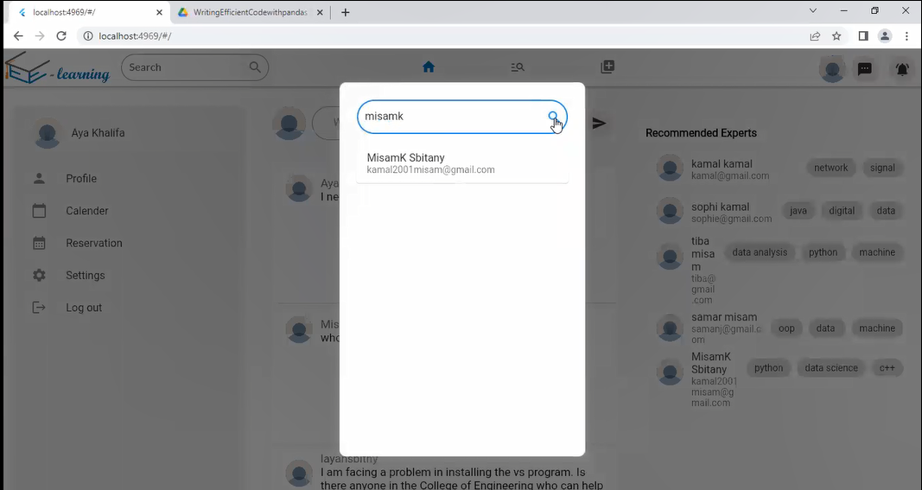
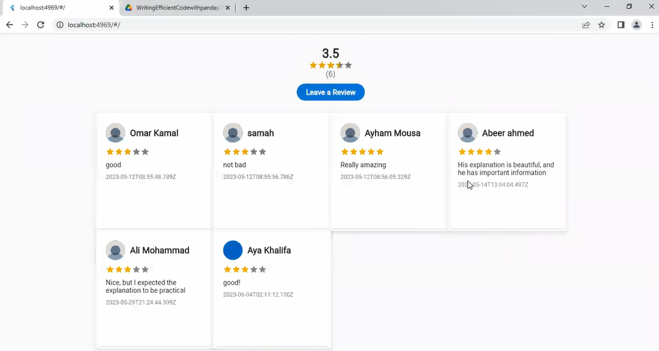
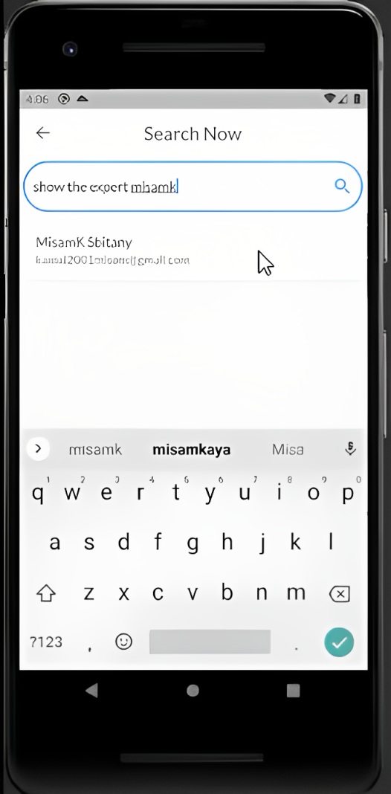
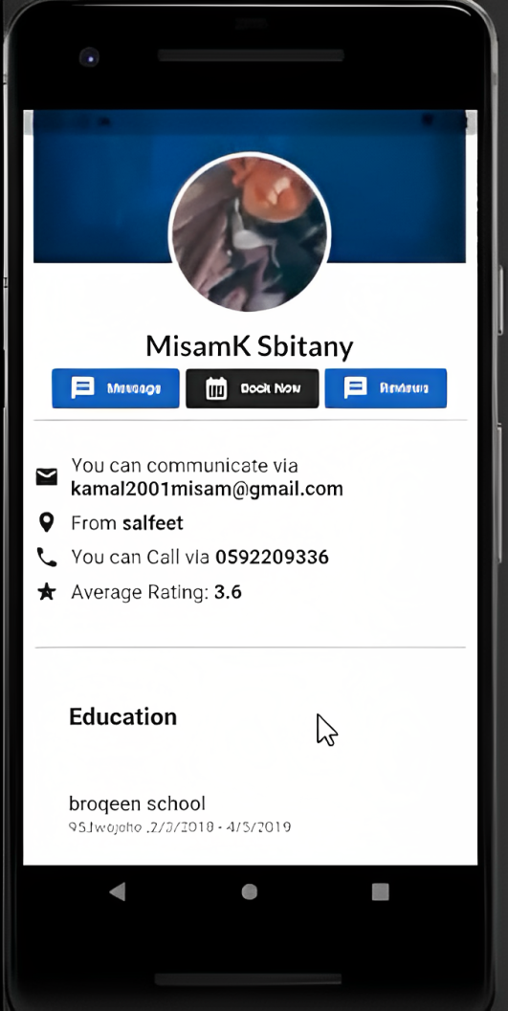
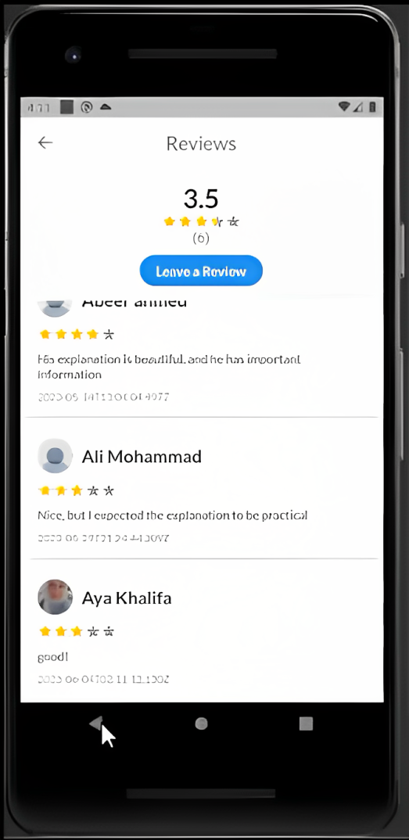

Slide 18
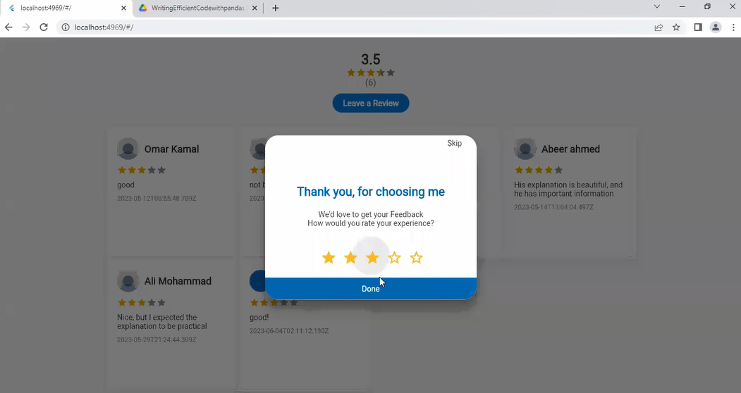
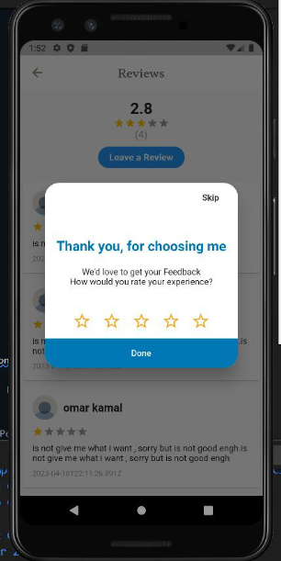
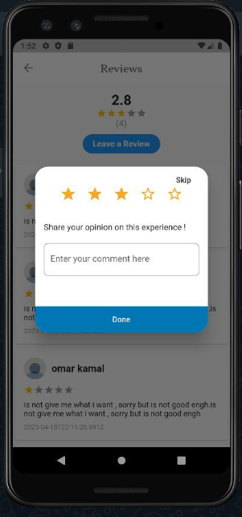
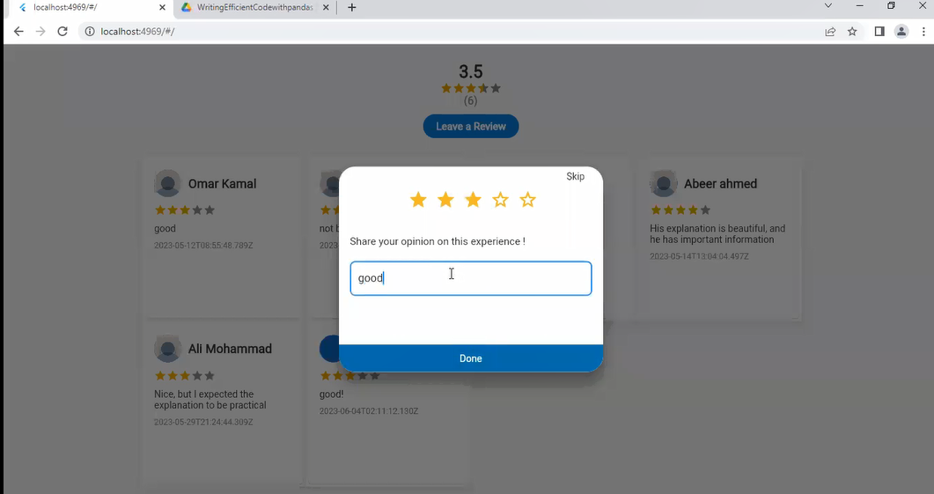

Slide 19
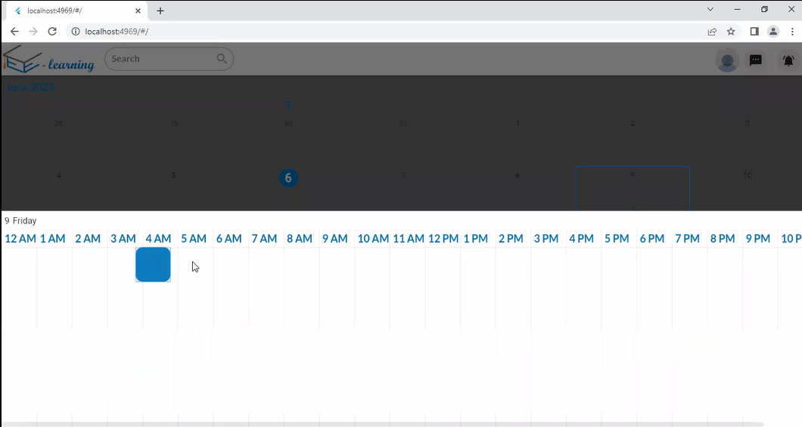
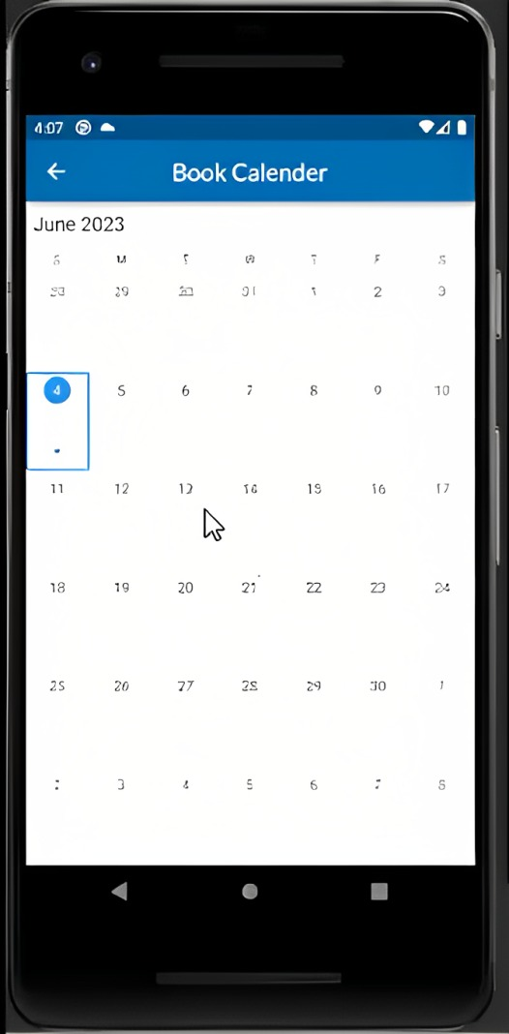
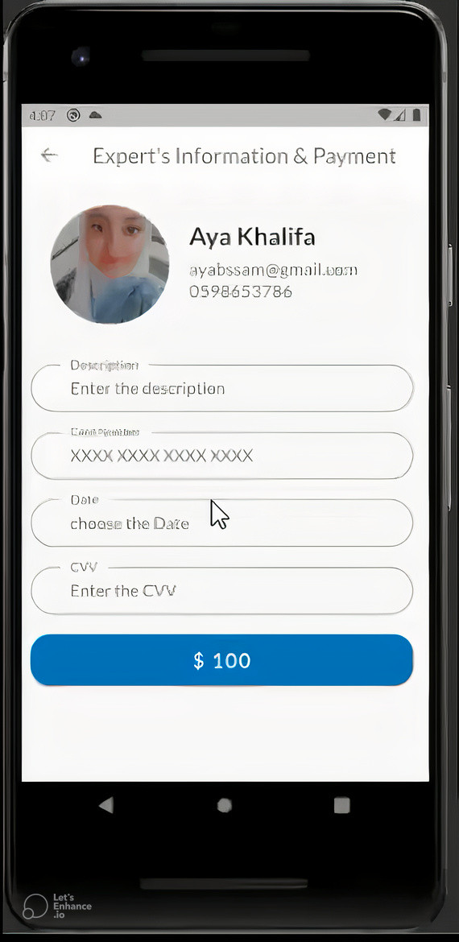
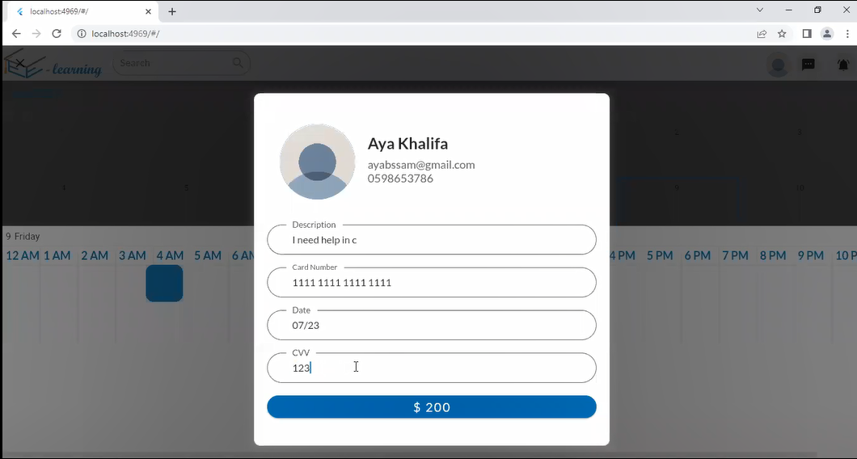

Slide 20
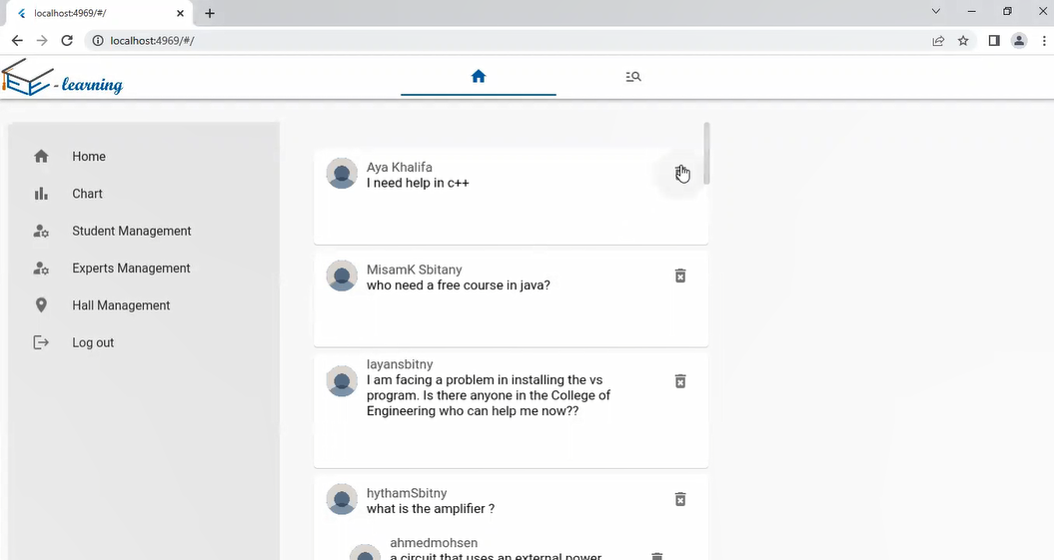
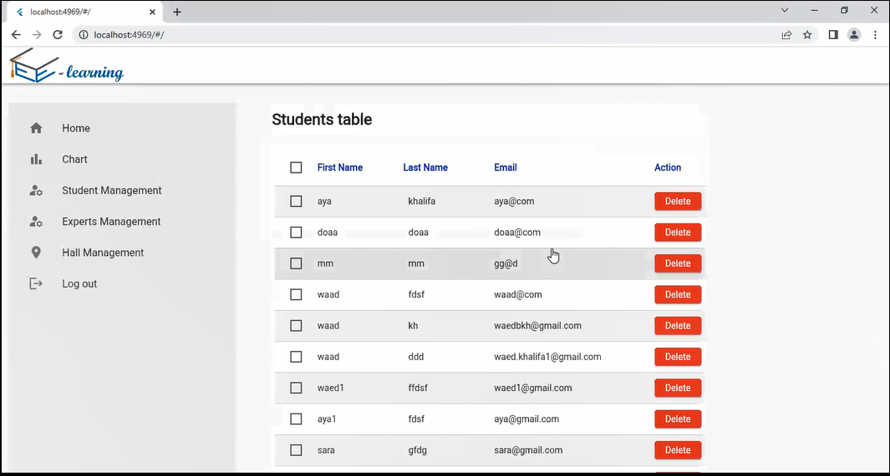
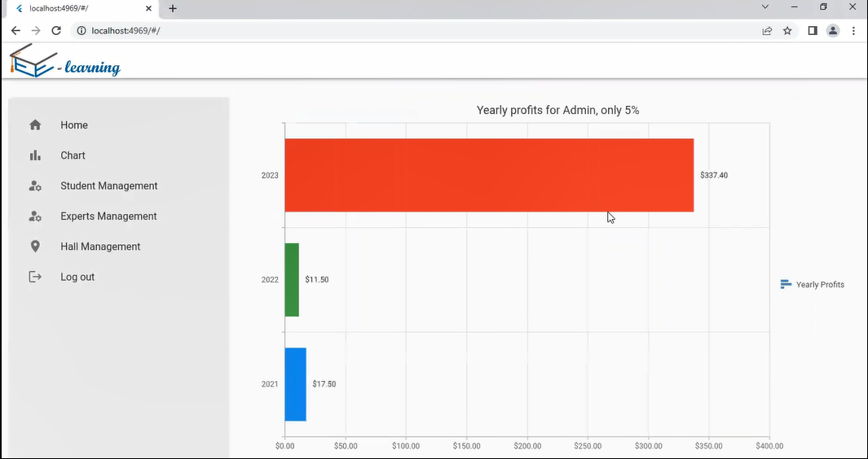


Slide 21








Slide 22




Slide 23



Slide 24



Slide 25





TOOLS
BACKEND
DATABASE
FIREBASE
FLUTTER

Slide 26


ML TOOLS
Python
Flask(framework for python)

Slide 27

FUTURE WORK
Due to time constraints, there are some features that can be added to the project later
Integration of GPS for Face-to-Face Meetings
Chat system ,We intend to improve it by adding voice messages, images.
Enhanced Recommendation Algorithms
FEATURE3
FEATURE1
FEATURE2

Slide 28
FUTURE WORK2
The possibility of adding pictures to the post
File Upload and Download Capability:
The user can make a follow to the experts
FEATURE3
FEATURE4
FEATURE2

Slide 29

THANK'S FOR WATCHING

