Slide 1
Pavement condition index calculation

Slide 2
Data Collection
Data for the project has been collected through conducting accurate condition assessment process of the existing pavement surface distresses

Slide 3
Purposes of Using Pavement Condition Data
Establishing Project Priorities
Establishing Options
Forecasting Performance
This information is useful for preparing long-range budget estimates of the cost to maintain the highway system at a minimum standard of performance.

Slide 4
Pavement defects types
Cracking
Patching and Potholes
deformations
Disintegration and wear

Slide 5
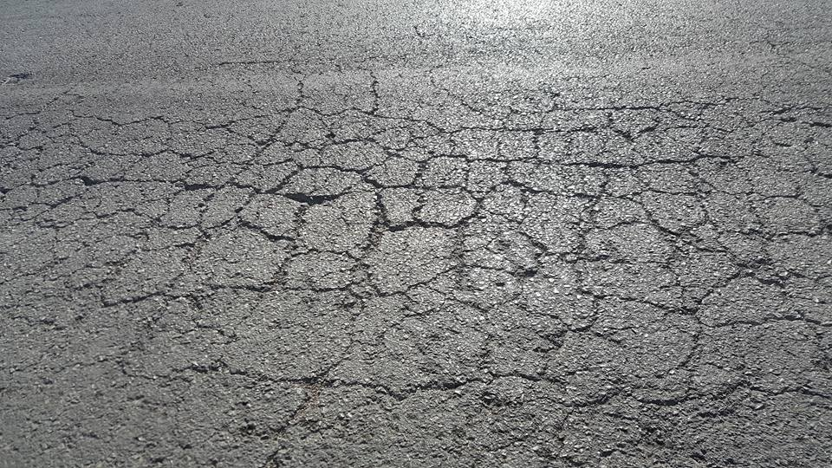
Some types of distresses on Ring Road
Alligator Cracks

Slide 6
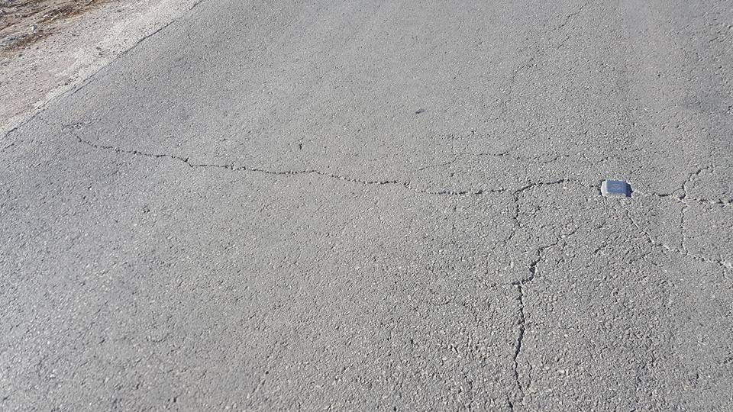
Transverse Crack

Slide 7

Raveling & Polished aggregate

Slide 8
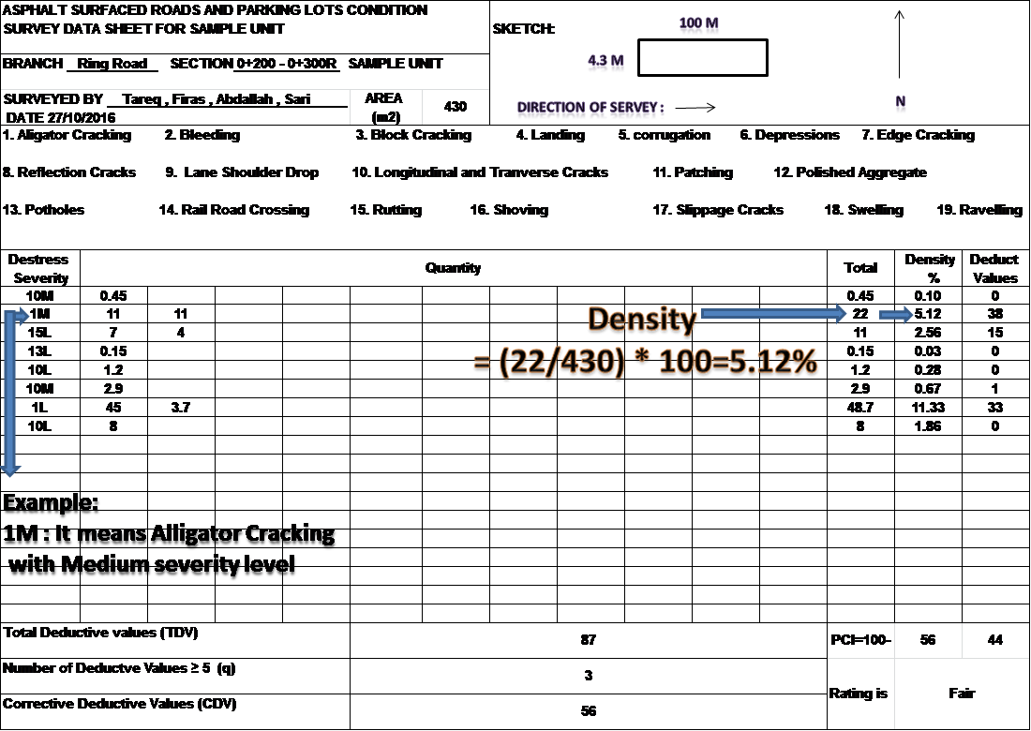
Example on calculation of (PCI)

Slide 9
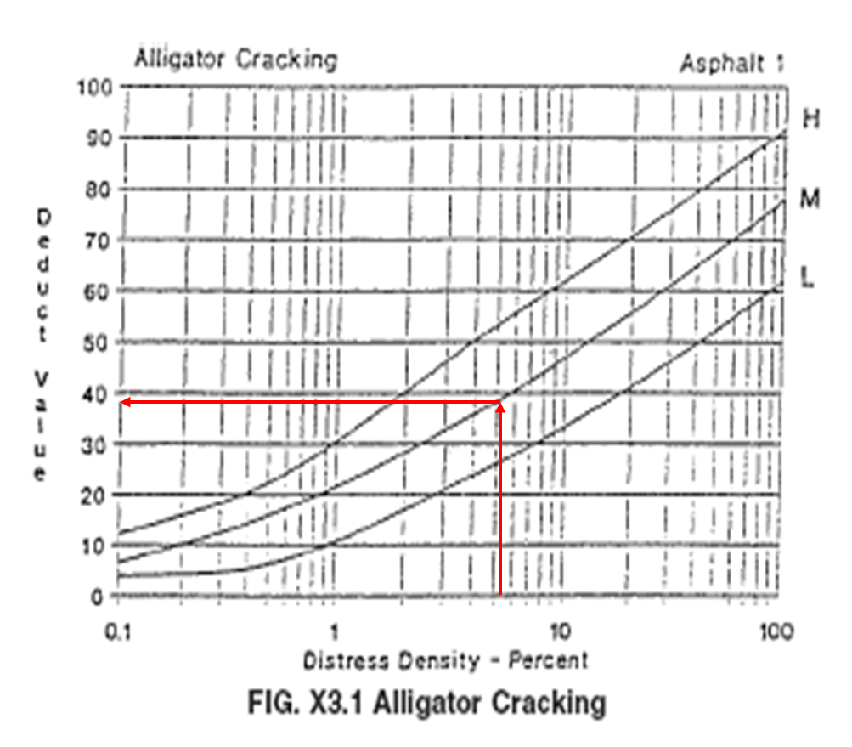
Deduct Value curve of Alligator Crack

Slide 10
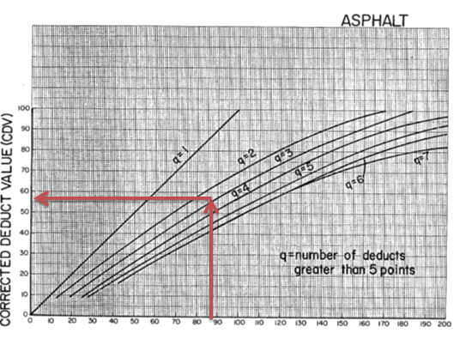
Correct Deduct Value curve (CDV)

Slide 11
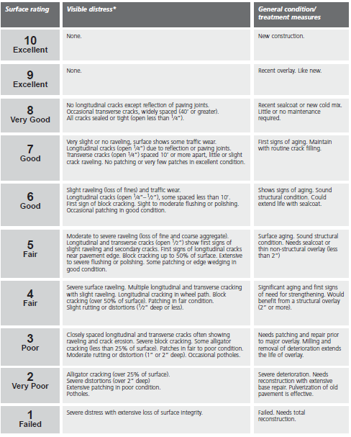
Paser Rating
System

Slide 12
Treatment and Cost
When defects occur in surface of pavement, it is preferred to make the proper maintenance to extend the life of the road
Some Types of treatments:
1- crack sealing:
Crack sealing is the process of cleaning and sealing or resealing of cracks in AC pavement to prevent the intrusion of water into cracks.

Slide 13
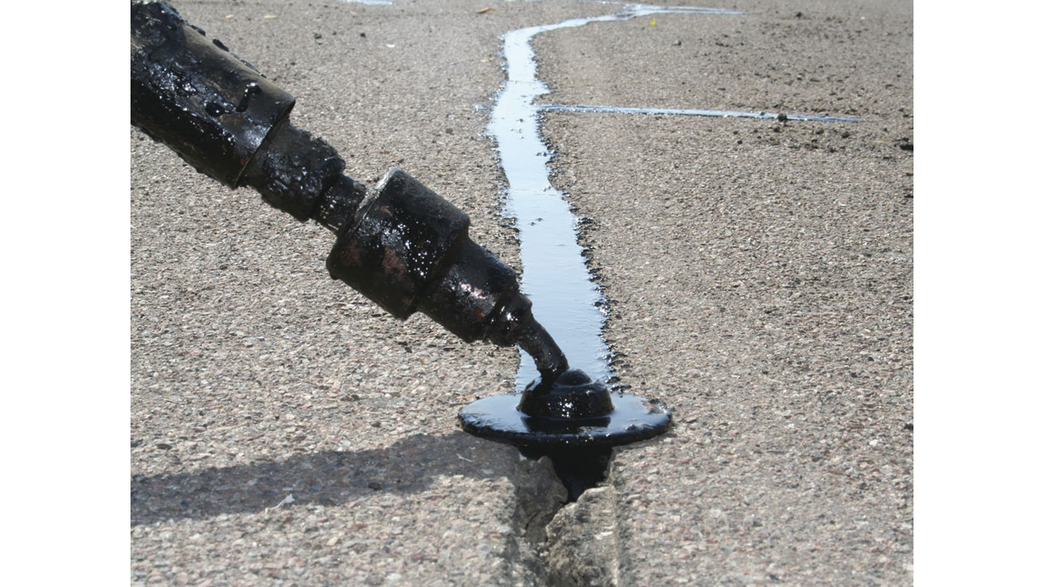

Slide 14
2- Full-Depth Patching :
This technique involves replacing the full depth of the AC layer and may include replacement of the base and subbase layers.
3- AC Overlay :
This technique involves adding one or more AC layers to an existing

Slide 15
4- Reconstruction :
Is the removal and replacement of existing pavement structure.
5- Cold Milling:
Cold milling is the removal of a given thickness of the surface layer using a machine containing a rotary drum with teeth.

Slide 16
Unit price / maintenance efficiency
The unit price is an important element
in the priority of
determining maintenance.
Unit Price US($) | Unit | Description of treatment
0 | - | Do nothing
3 | m² | routine crack filling
5 | m² | sealcoat
110 | ton | surface batching/deep
12 | m² | structural overlay
14 | m² | Structural asphalt layer without milling
16 | m² | major overlay, Milling and removal of deterioration
16 | m² | reconstruction with extensive base repair
30 | m² | Total Reconstruction

Slide 17
PCI, Rating ,Treatments and Price
Total Price($) | Unit price($) | Area(m²) | General condition/ treatment measures | Surface Rating | PCI | Section
3250 | 5 | 650 | Shows signs of aging. Sound structural condition. Needs sealcoat to extend the life of overlay | Good | 64 | 0+000 - 0+100
2050 | 5 | 410 | Shows signs of aging. Sound structural condition. Needs sealcoat to extend the life of overlay | Good | 60 | 0+100 - 0+200
5160 | 12 | 430 | Significant aging and first signs of need for strengthening. Would benefit from a structural overlay (2” or more). | Fair | 44 | 0+200 - 0+300
1260 | 3 | 420 | First signs of aging. Needs to maintain with routine crack filling | Good | 75 | 0+300 - 0+400
1110 | 3 | 370 | First signs of aging. Needs to maintain with routine crack filling | Good | 74 | 0+400 - 0+500
1850 | 5 | 370 | Shows signs of aging. Sound structural condition. Needs sealcoat to extend the life of overlay | Fair | 54 | 0+500 - 0+600
2200 | 5 | 440 | Shows signs of aging. Sound structural condition. Needs sealcoat to extend the life of overlay | Fair | 54 | 0+600 - 0+700
0 | 0 | 410 | Sealcoat or new cold mix. little or no maintenance required | Very good | 88 | 0+700 - 0+800
0 | 0 | 380 | New construction, No need to treatment | Excellent | 92 | 0+800 - 0+900

Slide 18
0 | 0 | 330 | New construction, No need to treatment | Excellent | 90 | 0+900 - 1+000
0 | 0 | 340 | New construction, No need to treatment | Excellent | 96 | 1+000 - 1+100
1800 | 5 | 360 | Needs sealcoat to extend the life of overlay. | Fair | 51 | 1+100 - 1+200
1200 | 3 | 400 | First signs of aging. Needs to maintain with routine crack filling | Good | 71 | 1+200 - 1+300
1900 | 5 | 380 | Shows signs of aging. Sound structural condition. Needs sealcoat to extend the life of overlay | Fair | 57 | 1+300 - 1+400
1080 | 3 | 360 | First signs of aging. Needs to maintain with routine crack filling | Good | 70 | 1+400 - 1+500
5440 | 16 | 340 | Severe deterioration. Needs reconstruction with extensive base repair | Very Poor | 22 | 1+500 - 1+600
1750 | 5 | 350 | Shows signs of aging. Sound structural condition. Needs sealcoat to extend the life of overlay | Fair | 56 | 1+600 - 1+700
6400 | 16 | 400 | Needs Patching and repair prior to major overlay, Milling and removal of deterioration extend the life of overlay | Poor | 33 | 1+700 - 1+800
6080 | 16 | 380 | Needs Patching and repair prior to major overlay | Poor | 36 | 1+800 - 1+900
9900 | 30 | 330 | Total Reconstruction | Failed | 18 | 1+900 - 2+000
1650 | 5 | 330 | Shows signs of aging. Sound structural condition. Needs sealcoat to extend the life of overlay | Good | 62 | 2+000 - 2+100
5440 | 16 | 340 | Needs Patching and repair prior to major overlay, Milling and removal of deterioration extend the life of overlay | Poor | 38 | 2+100 - 2+200

Slide 19
4200 | 12 | 350 | Significant aging and first signs of need for strengthening. Would benefit from a structural overlay (2” or more). | Fair | 40 | 2+200 - 2+300
9900 | 30 | 330 | Total Reconstruction | Failed | 0 | 2+300 - 2+400
9900 | 30 | 330 | Total Reconstruction | Failed | 18 | 2+400 - 2+500

Slide 20
Station | PCI | Surface Rating | General condition/ treatment measures | Area(m²) | Unit Price($) | Total Price
2+500 – 2+600 | 34 | Poor | Needs Patching and repair prior to major overlay, Milling and removal of deterioration extend the life of overlay | 650 | 16 | 10400
2+600 – 2+700 | 20 | Very Poor | Severe deterioration. Needs reconstruction with extensive base repair | 470 | 16 | 7520
2+700 – 2+800 | 58 | Fair | Surface aging. Sound structural condition. Needs sealcoat or thin non-structural overlay (less than 2”) | 340 | 5 | 17000
2+800 – 2+900 | 85 | Very Good | Sealcoat or new cold mix. little or no maintenance required | 400 | 0 | 0
2+900 – 3+000 | 59 | Fair | Shows signs of aging. Sound structural condition. Needs sealcoat to extend the life of overlay. | 370 | 5 | 1850
3+000 – 3+100 | 69 | Good | Shows signs of aging. Sound structural condition. Needs sealcoat to extend the life of overlay | 430 | 5 | 2150
3+100 – 3+200 | 50 | Fair | Surface aging. Sound structural condition. Needs sealcoat or thin non-structural overlay (less than 2”) | 360 | 5 | 1800

Slide 21
3+200 – 3+300 | 72 | Good | First signs of aging. Needs to maintain with routine crack filling | 410 | 3 | 1230
3+300 – 3+400 | 83 | Very Good | Sealcoat or new cold mix. little or no maintenance required | 380 | 0 | 0
3+400 – 3+500 | 84 | Very Good | Sealcoat or new cold mix. little or no maintenance required | 400 | 0 | 0
3+500 – 3+600 | 98 | Excellent | New construction, no need for treatment | 360 | 0 | 0
3+600 – 3+700 | 77 | Good | First signs of aging. Needs to maintain with routine crack filling | 390 | 3 | 1170
3+700 – 3+800 | 56 | Fair | Shows signs of aging. Sound structural condition. Needs sealcoat to extend the life of overlay. | 350 | 5 | 1750
3+800 – 3+900 | 91 | Excellent | New construction , no need to treatment | 400 | 0 | 0
3+900 – 4+000 | `94 | Excellent | New construction , no need to treatment | 400 | 0 | 0
4+000 – 4+100 | 29 | Very Poor | Severe deterioration. Needs reconstruction with extensive base repair. | 380 | 16 | 6080
4+100 – 4+200 | 82 | Very Good | Sealcoat or new cold mix. little or no maintenance required | 360 | 0 | 0
4+200 – 4+300 | 48 | Fair | Significant aging and first signs of need for strengthening. Would benefit from a structural overlay (2” or more). | 380 | 12 | 4560

Slide 22
4+300 – 4+400 | 62 | Good | Sound structural condition. Needs sealcoat to extend the life of overlay | 400 | 5 | 2000
4+400 – 4+500 | 49 | Fair | Significant aging and first signs of need for strengthening. Would benefit from a structural overlay (2” or more). | 350 | 12 | 4200
4+500 – 4+600 | 62 | Good | Shows signs of aging. Sound structural condition. Needs sealcoat to extend the life of overlay | 350 | 5 | 1750
4+600 – 4+700 | 42 | Fair | Significant aging and first signs of need for strengthening. Would benefit from a structural overlay (2” or more). | 360 | 12 | 4320
4+700 – 4+800 | 54 | Fair | Shows signs of aging. Sound structural condition. Needs sealcoat to extend the life of overlay | 350 | 5 | 1750
4+800 – 4+900 | 72 | Good | First signs of aging. Needs to maintain with routine crack filling | 370 | 3 | 1110
4+900 – 5+000 | 37 | Poor | Needs Patching and repair prior to major overlay, Milling and removal of deterioration extend the life of overlay | 330 | 16 | 5280

Slide 23
Total cost for all treatments and sections= 159,440$
Based on PCI values in this project, most of sections range from (40-65) which is corresponding to Preventive maintenance actions and Corrective action location

Slide 24
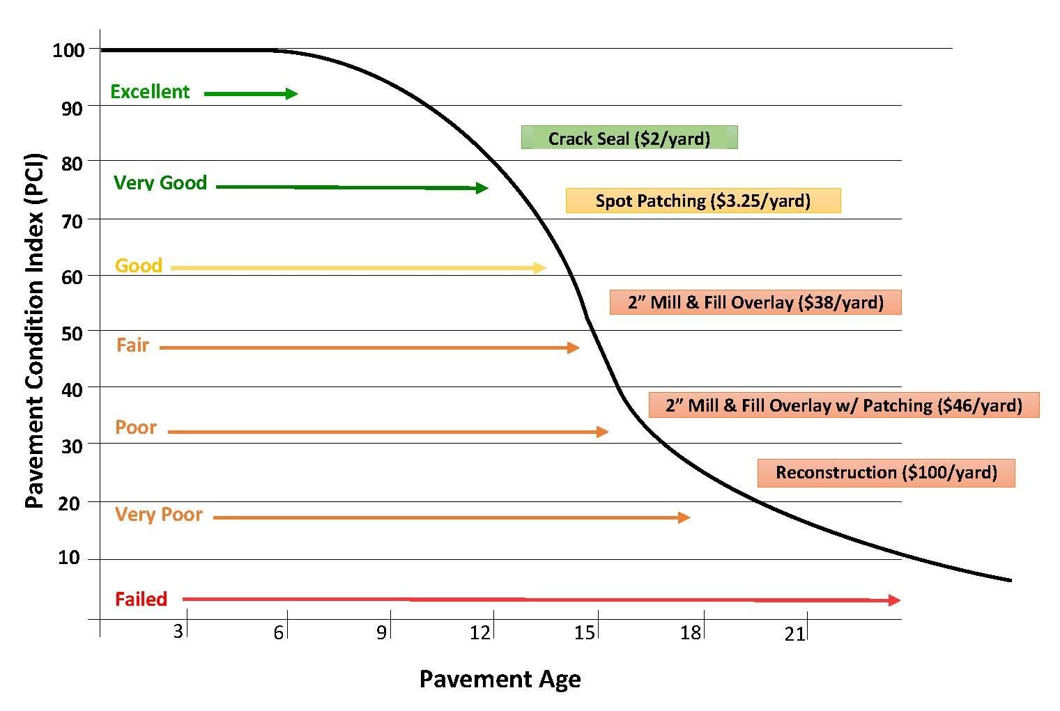
Pavement Deterioration Chart

