Slide 1
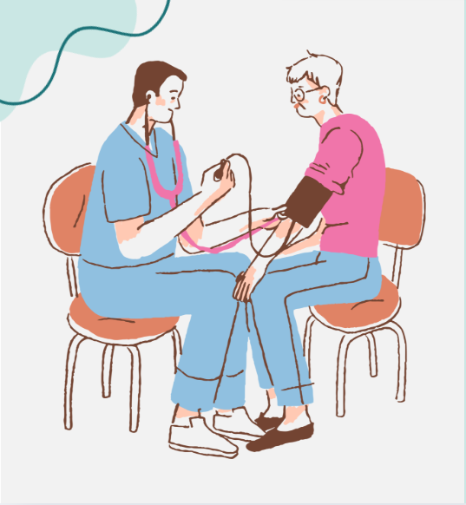
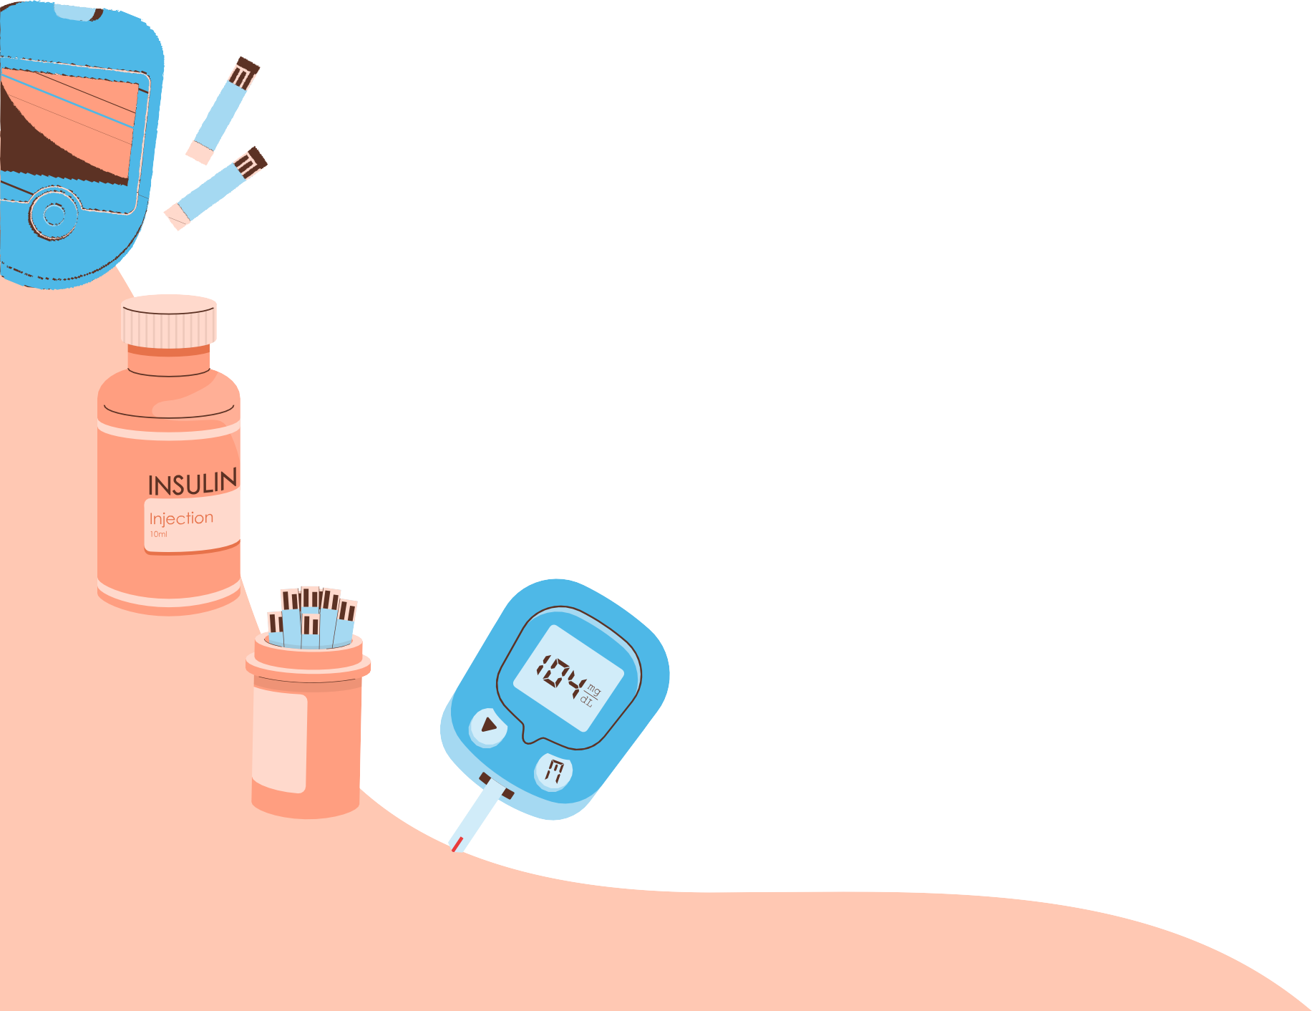
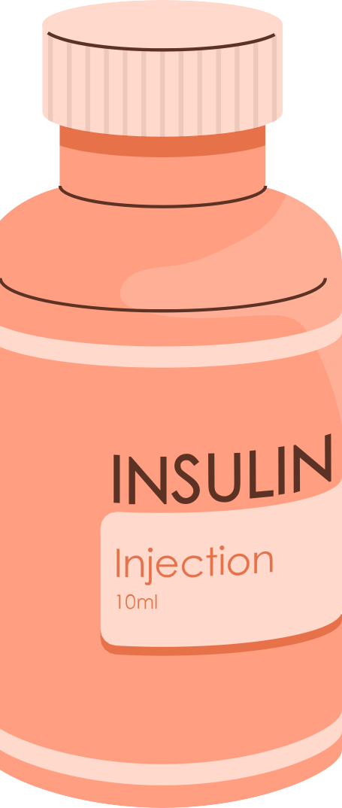
Smart HealthMed
Created by: Ahmad Abu Shams & Abdul Rahman Yahya

Slide 2
Introduction
Medication adherence and patient safety are major challenges for elderly individuals, as forgetting medication schedules or receiving incorrect doses can lead to serious health complications. Manual medication management increases the risk of human error. This project proposes a smart medication management system that uses IoT technology, automated medication dispensing, and real-time health monitoring to improve patient safety and ensure proper medication adherence.

Slide 3
Objectives
Design and implementation of a smart medication management system for the elderly.
Ensuring accurate and timely dispensing of medications.
Real-time monitoring of the patient’s vital signs and transmitting the measurements to a mobile application
Providing emergency notifications via SMS in case of falls to ensure a rapid response.
.

Slide 4
WHAT IS THE PROBLEM?
Many elderly patients often forget to take their medications on time, which can lead to serious health complications. In Palestinian hospitals, some patients face issues with medications being administered at incorrect times by nurses, or sometimes the medication may be completely forgotten. Medication distribution errors can negatively affect patient safety. Additionally, there is no smart system that automatically dispenses medicine and continuously monitors the patient’s health. In short, patient safety and adherence to medication schedules are not fully guaranteed in current manual systems.

Slide 5
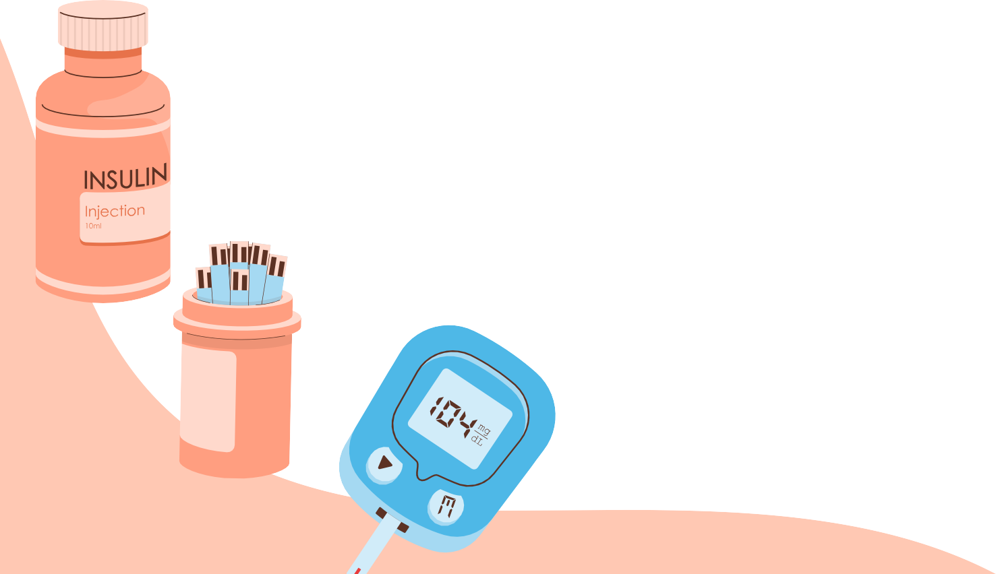
PROJECT STEPS
STEP 1
STEP 2
STEP 3
An external device containing slots holding medications that are dispensed to the patient either through a scheduled appointment or manually.
Another device contains sensors that measure temperature, heart rate, blood pressure, and detect falls.
Mobile application

Slide 6
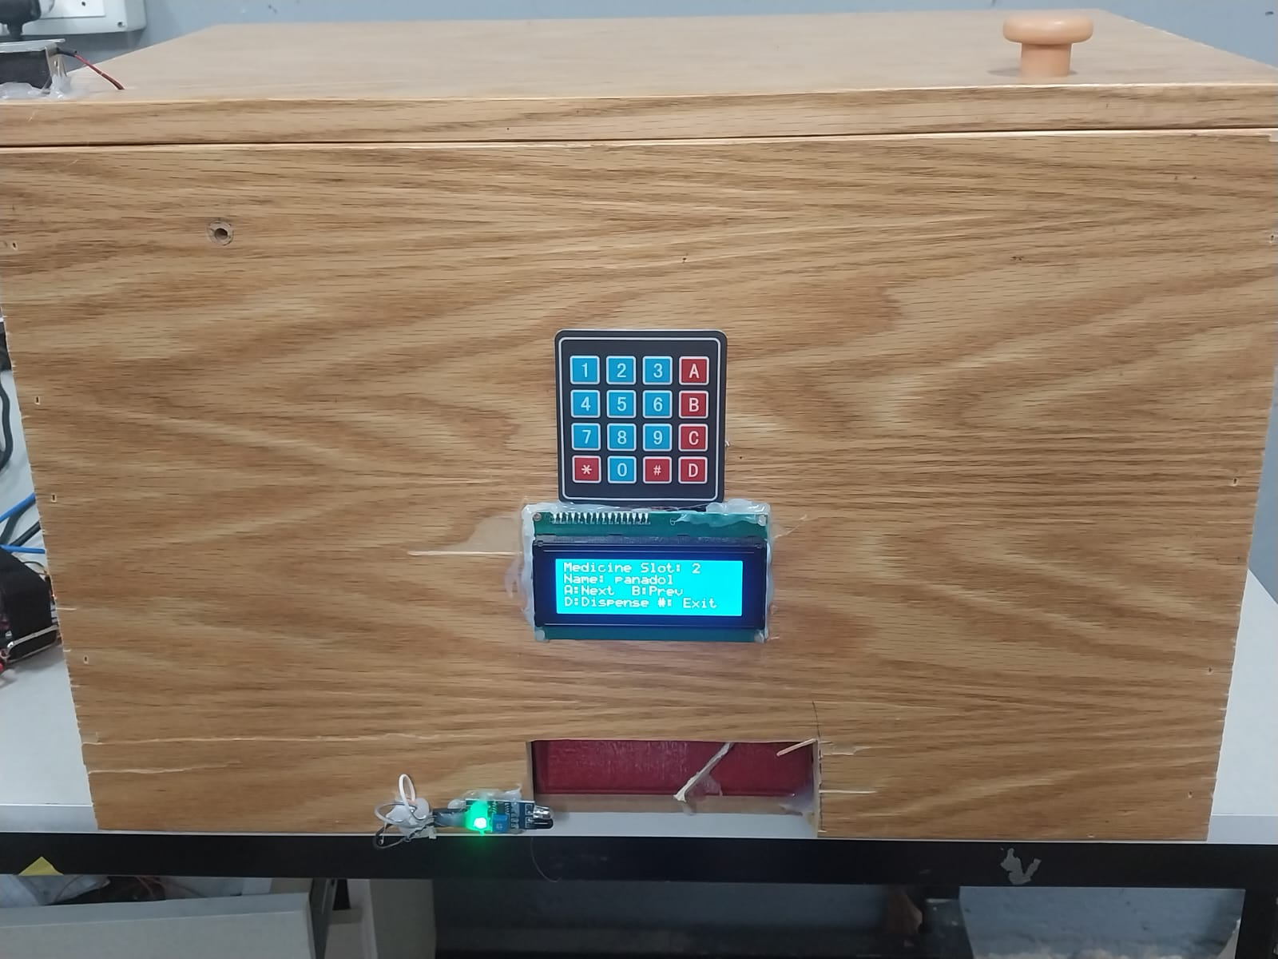
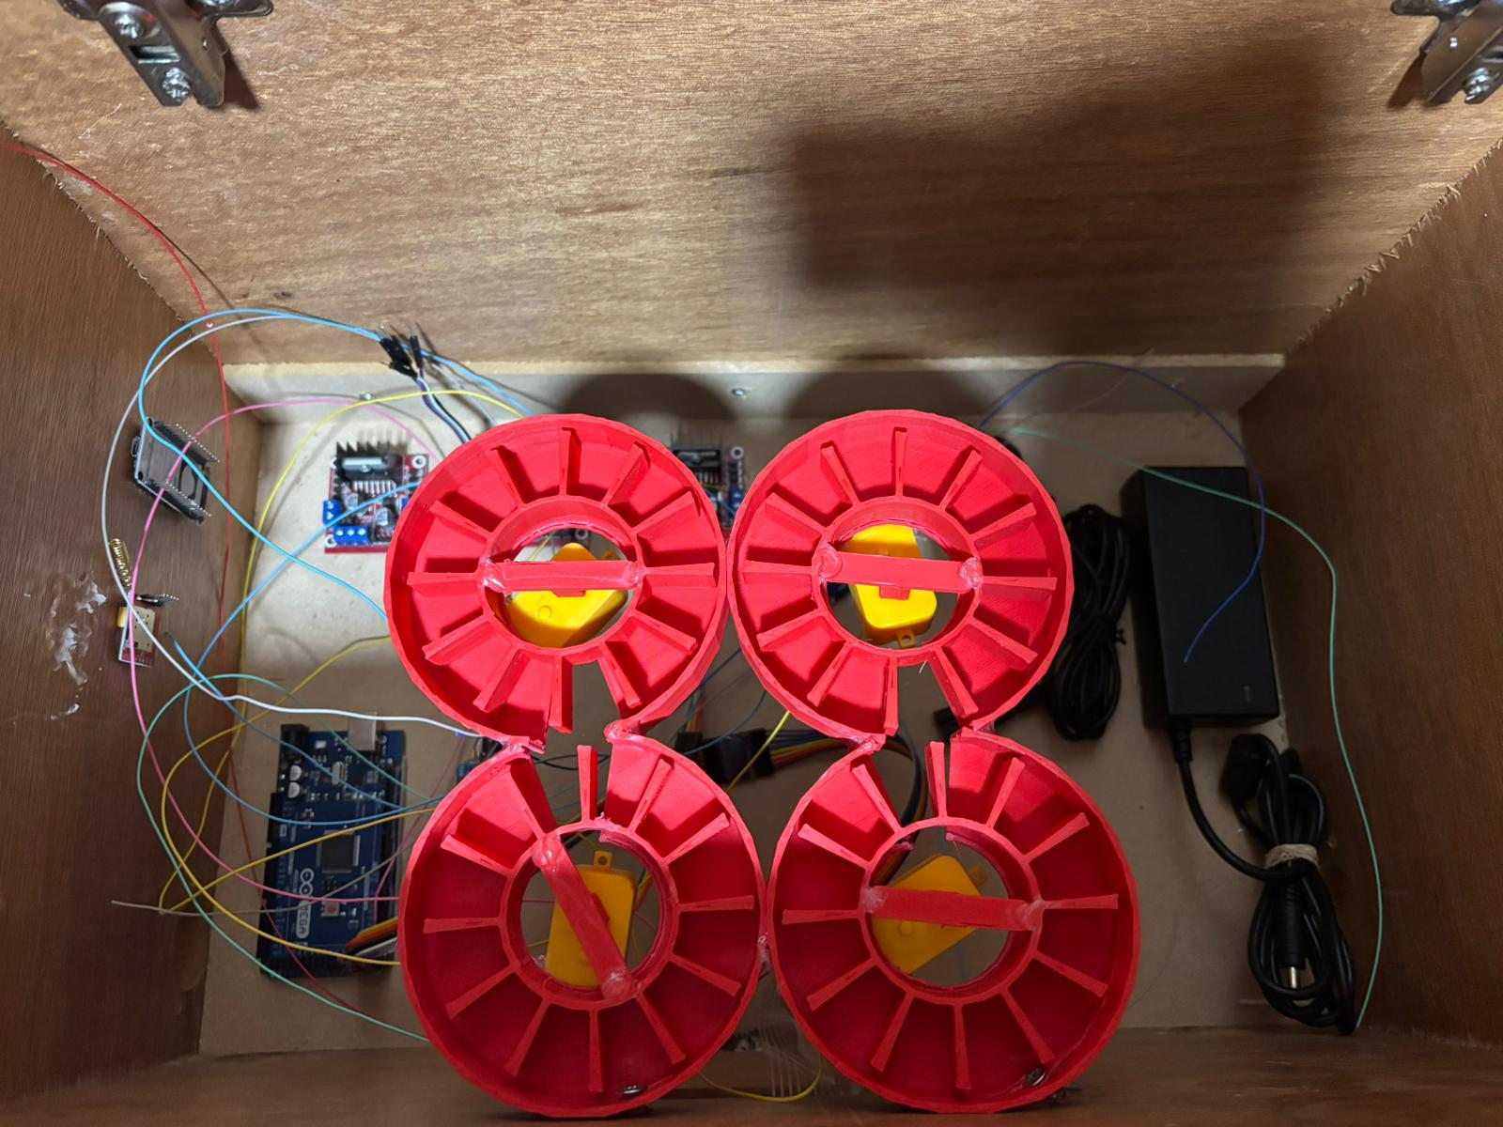
external device

Slide 7
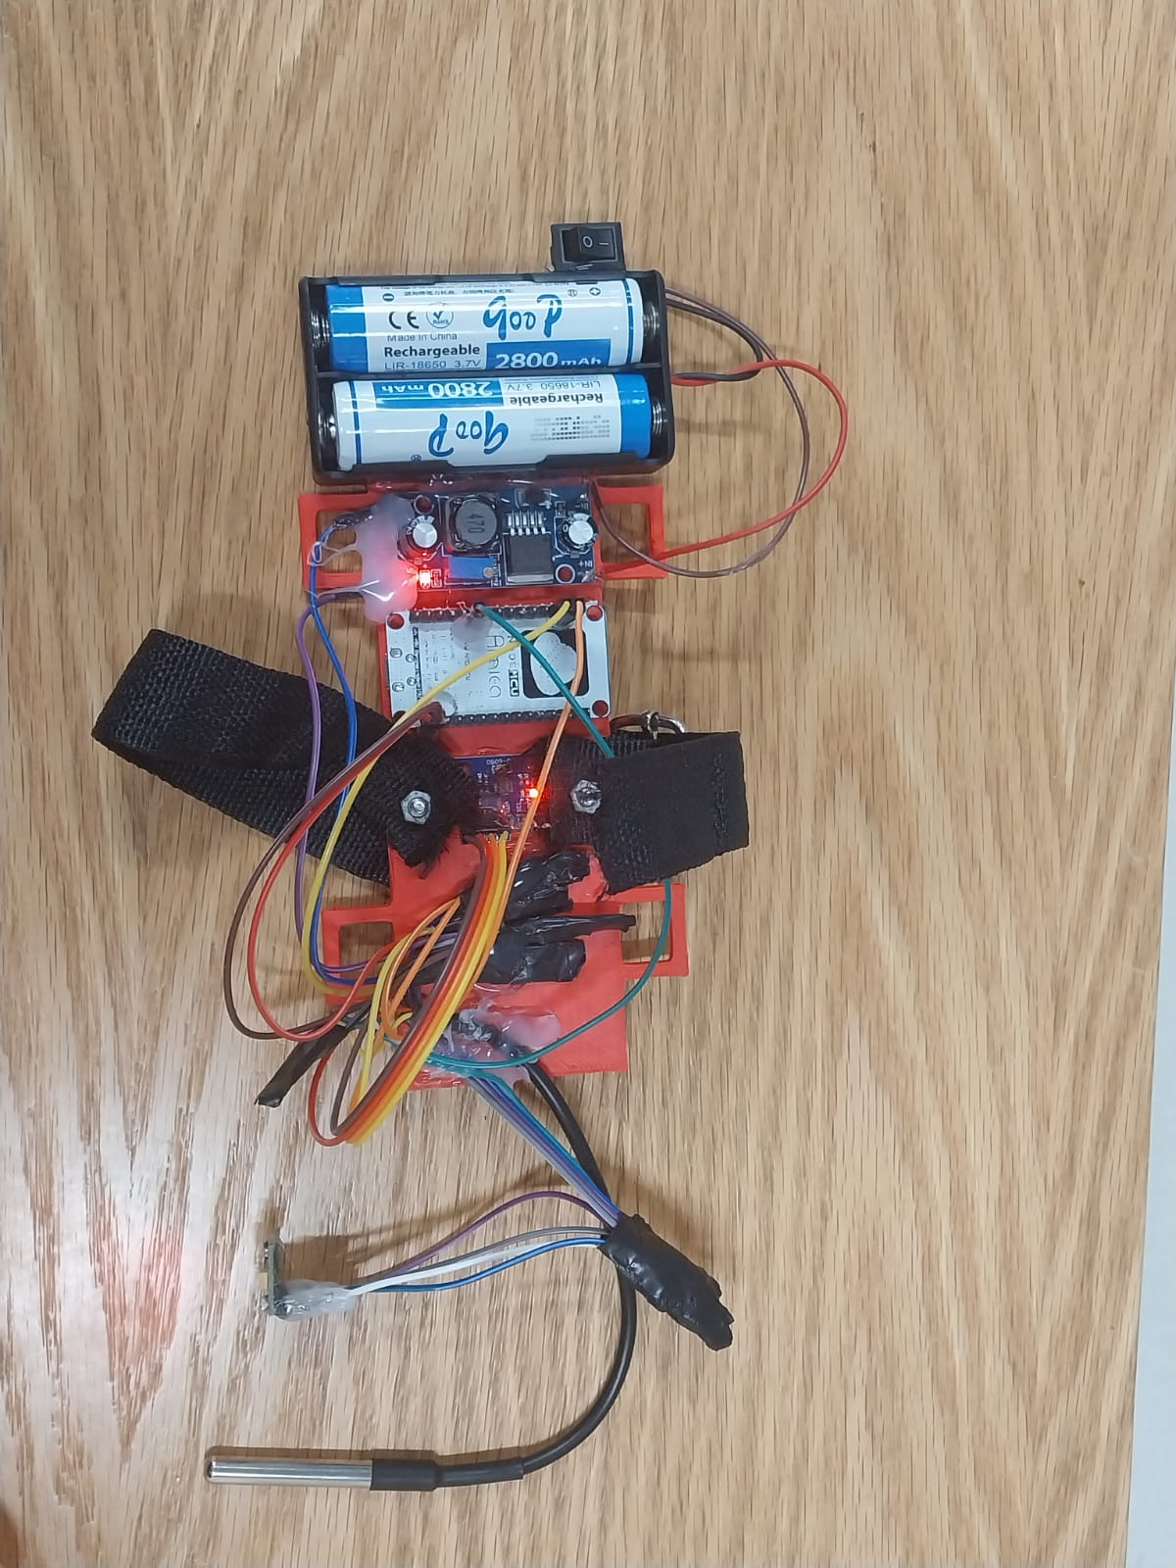
device contains sensors that measure temperature, heart rate, blood pressure, and detect falls.

Slide 8
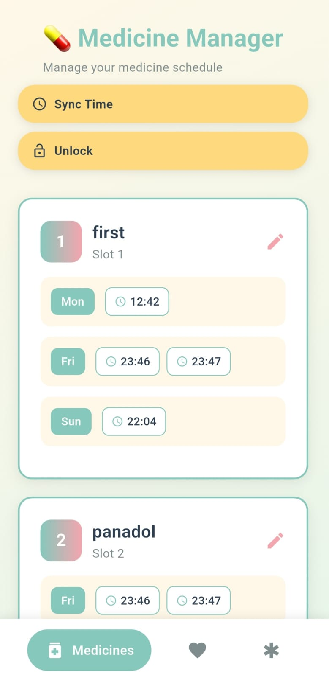
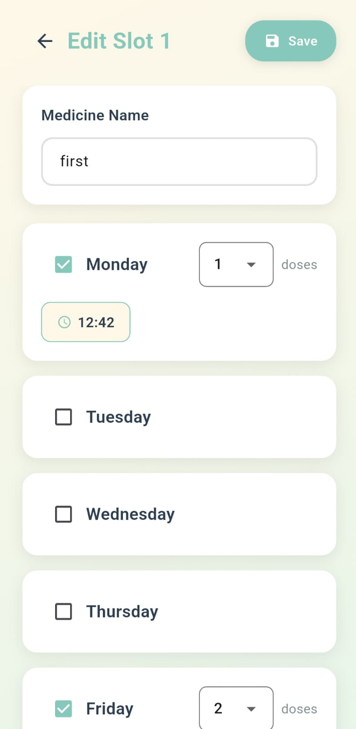
MOBILE APPLICATION

Slide 9
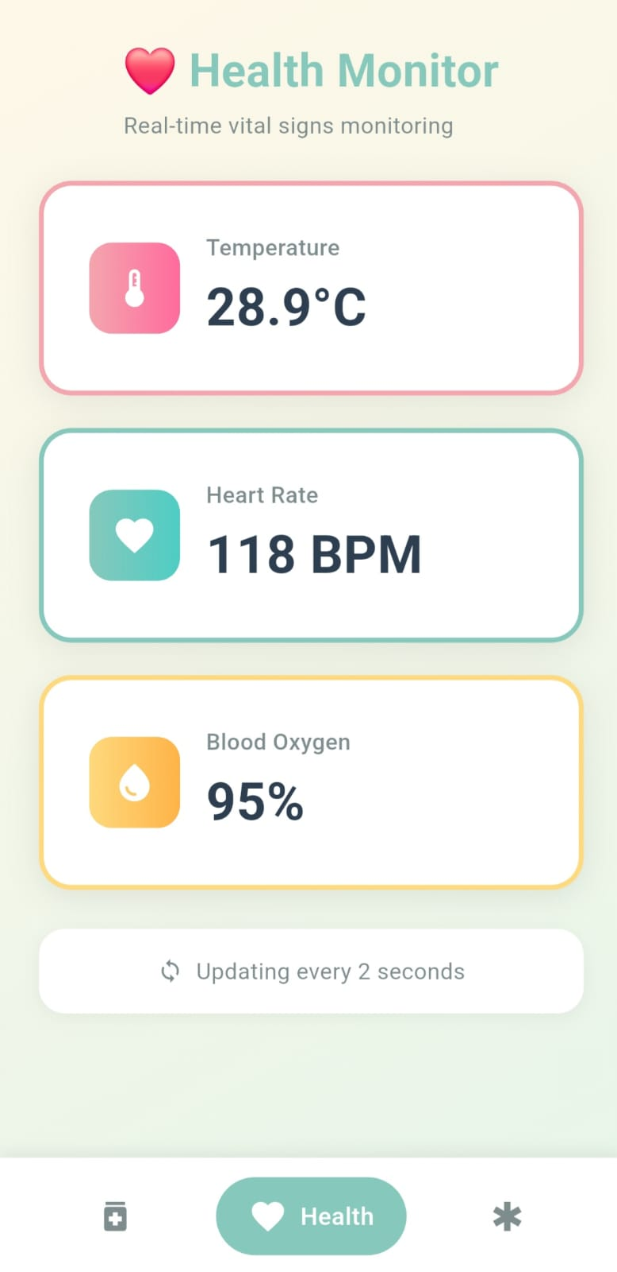
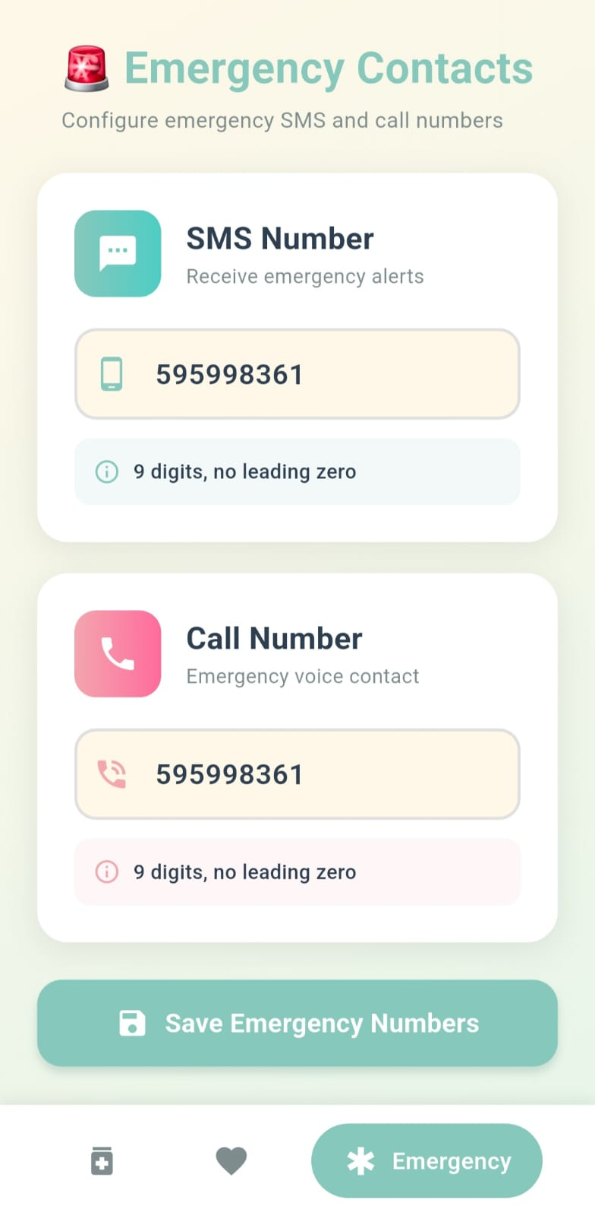
MOBILE APPLICATION

Slide 10
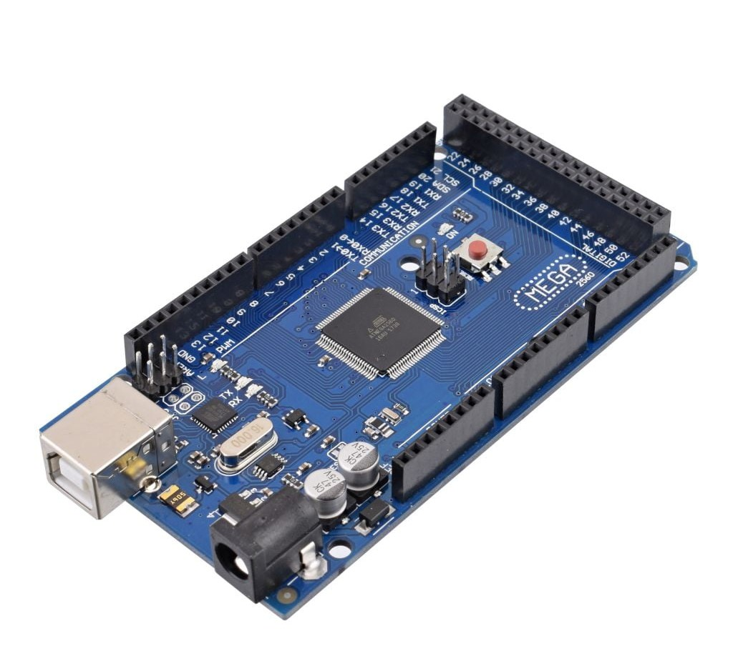
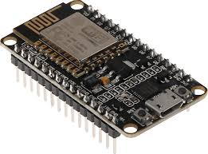
HARDWARE COMPONENT
ARDUINO MEGA
ESP8266

Slide 11
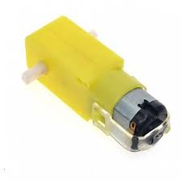
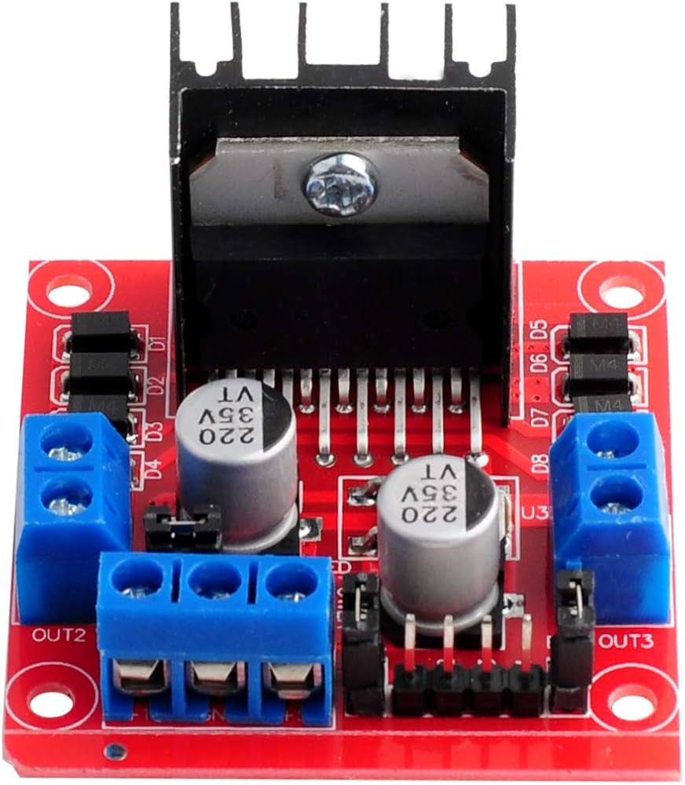
HARDWARE COMPONENT
DC MOTOR
H-BRIDGE L298N

Slide 12
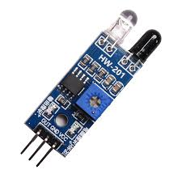
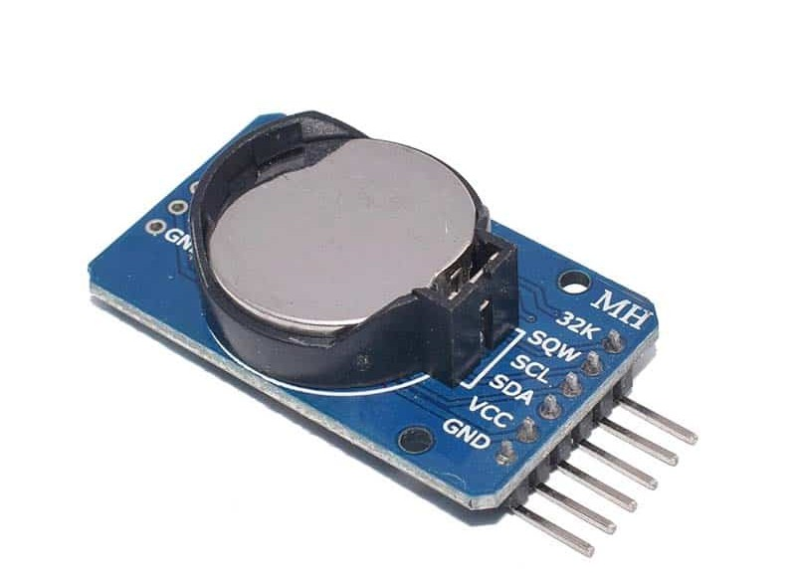
HARDWARE COMPONENT
IR SENSOR
RTC

Slide 13
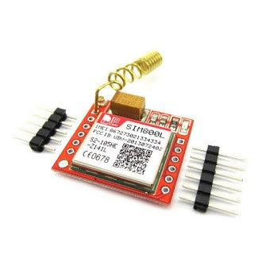
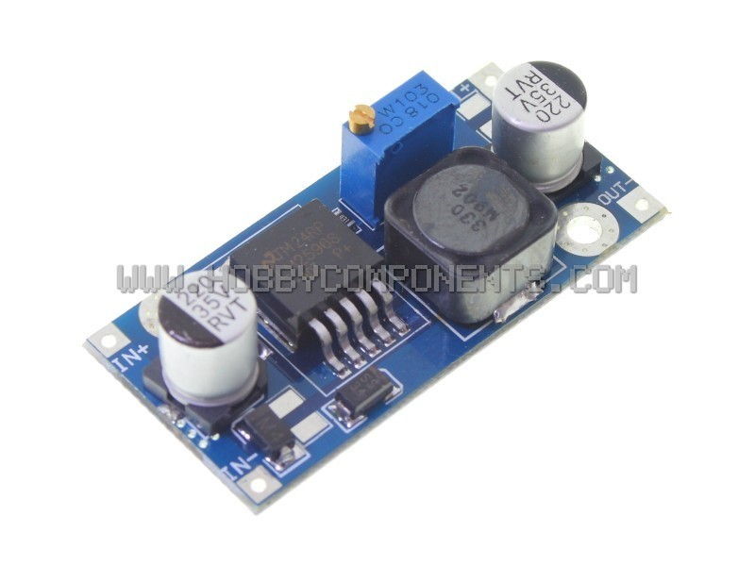
HARDWARE COMPONENT
Sm300l
dc to dc buck converter

Slide 14
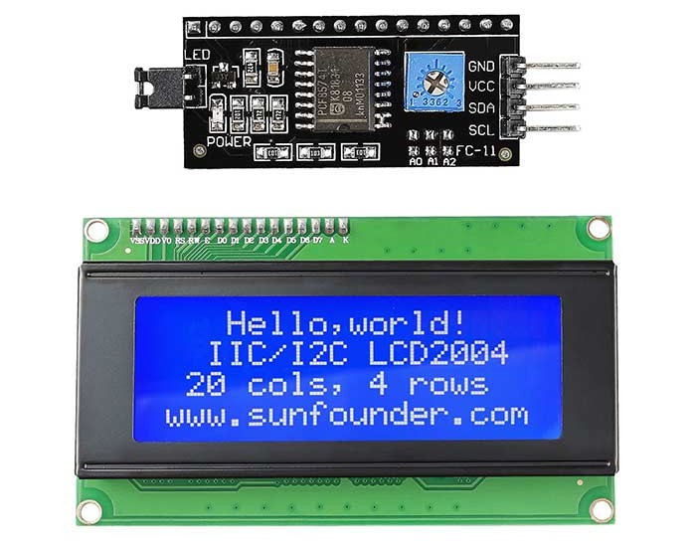
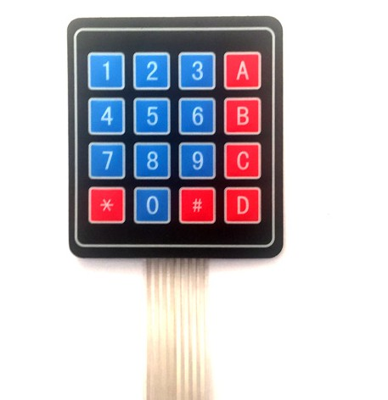
HARDWARE COMPONENT
LCD
KEYPAD

Slide 15
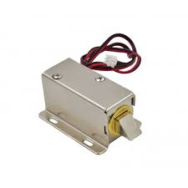
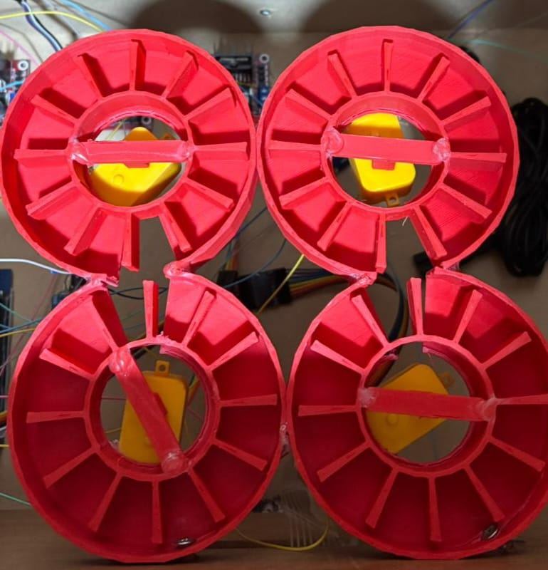
HARDWARE COMPONENT
Electromagnetic Lock
slots

Slide 16
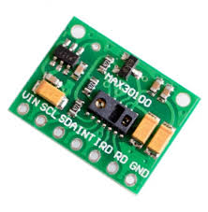
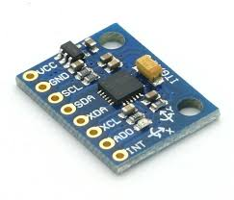
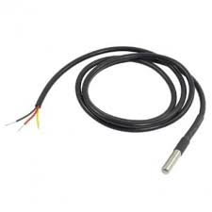
HARDWARE COMPONENT
temperature sensor
Max300100
.
MPU6050

Slide 17
Conclusion
The smart medication management system for the elderly provides accurate and timely medication dispensing, continuous monitoring of vital signs, and emergency notifications via SMS in case of falls. This integrated solution enhances patient safety, ensures better adherence to medication schedules, and supports rapid response in emergencies, ultimately improving the overall quality of care for elderly patients.

Slide 18
Constraints
Power Consumption Limited battery life of the wearable device that contains the sensors, requiring efficient power management to ensure continuous operation.
Budget Constraints Limited budget affecting the choice of sensors and hardware components.
Experience Level Limited experience with advanced IoT and medical sensors.

Slide 19
FUTURE WORK
Integrating Artificial Intelligence (AI) to analyze health data and predict potential risks.
Connecting the system with hospitals or doctors for real-time medical supervision.
Supporting multiple patients with centralized monitoring.

Slide 20
THANK YOU!

