Slide 1

An Najah National University
Department of mechanical Engineering
(Grafting Robot)
Prepared By:
Eid Hamdan
Supervisor:
Dr.majdi abu qari3

Slide 2
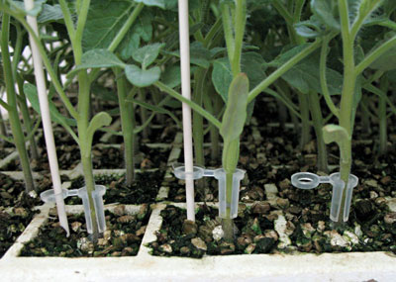
Introduction To Grafting
What is grafting??
Its an operation that connect two different parts of plants to gather by specific tool.

Slide 3
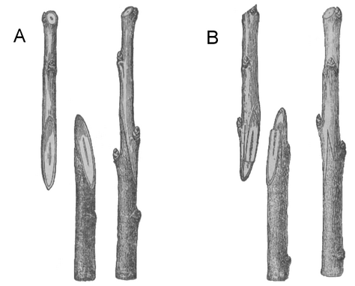
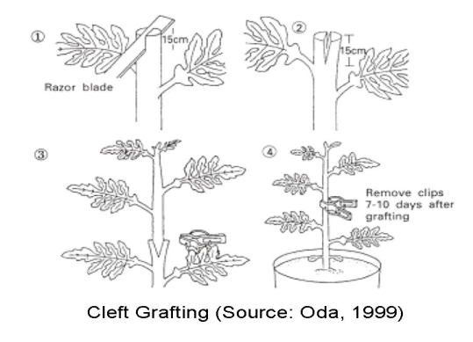
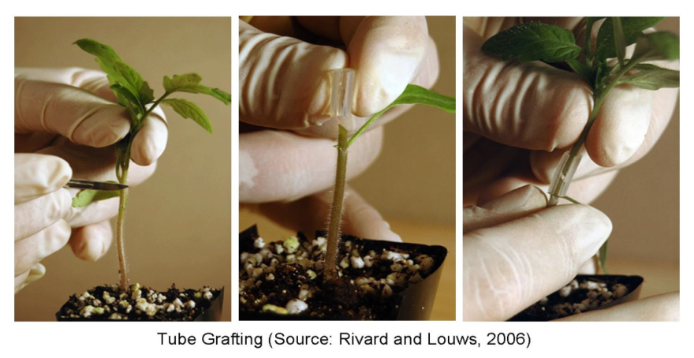
Types of tomato Grafting
Approach grafting:
Clef Grafting:
Tube Grafting:
is done by cutting opposing and complementary notches in the stem of the rootstock and scion.
is carried out when the plants are slightly larger, and a V-shaped cut is made in the stem of the scion
is carried out when the plants are very small and the rootstock and scion are held together

Slide 4
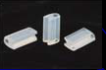
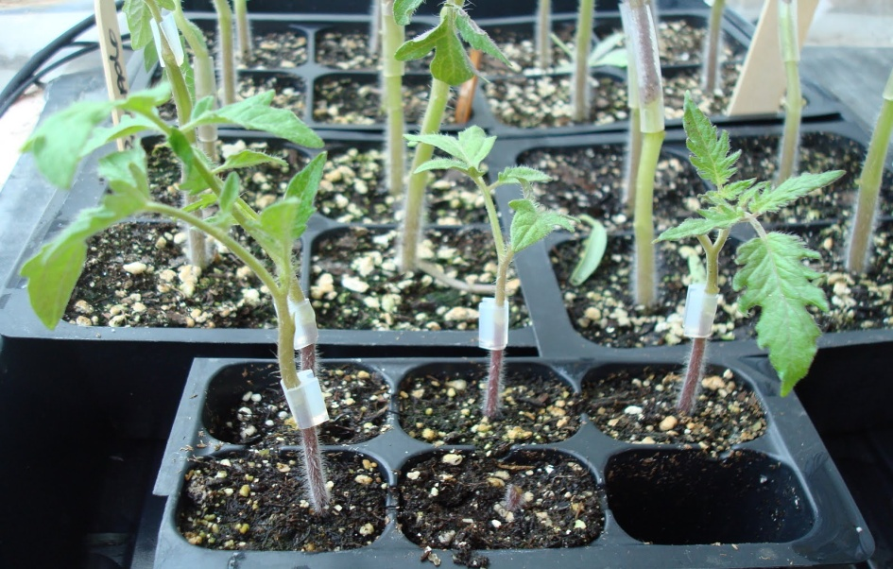
Why Tube Grafting??
Are the most commonly used in the world and known to everyone.
More effective ways and content.
Easy to use and learn.
Are abundant in Palestine.

Slide 5
Grafting Robot
The first commercial model of a grafting robot is made in (Japan) became available for cucurbits back in 1993
Advantages :
1 - save time
2 - Provide work effort
3 - Improve the agricultural field
4 - precision in the performance of the grafting process

Slide 6
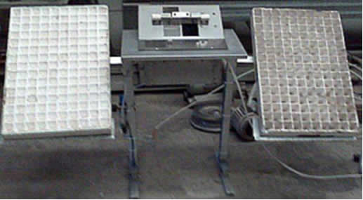
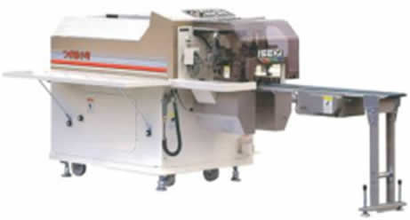
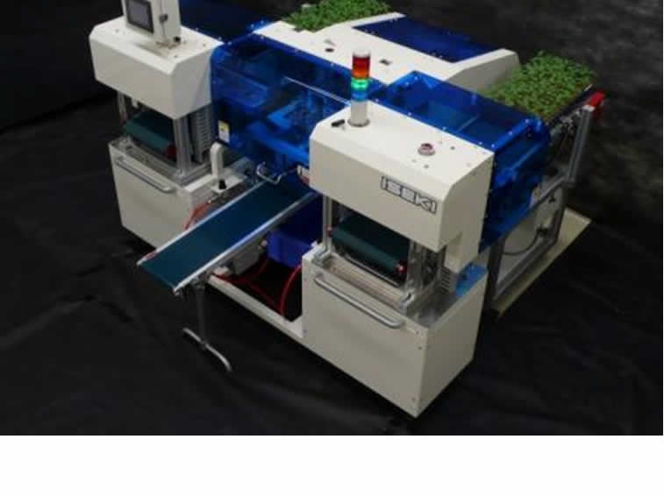
Types of Grafting Robots:
There are three types of grafting robots:
1- Manual machine:
2- semi automatic machine:
3- Fully automatic machine:
the cutting operation and the joining operation is done by the worker
The cutting operation is automatic and the joining operation is manual
The cutting operation and the joining operation is done automatically by the machine

Slide 7
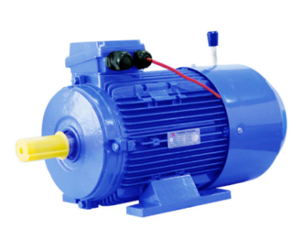
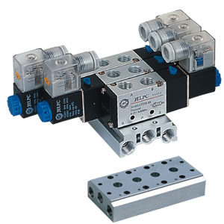
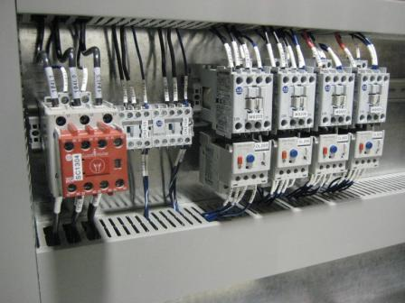
component
AC (3ph) Motor:
Pneumatic System:
Control System:

