Slide 1


July 7th, 2024
Faculty of Engineering & Information Technology
Chemical & Mechanical Engineering Departments
2023/2024
Exploring the Potential: Physico-Mechanical and Thermal Properties of Innovative Rubber-Infused Bricks
Prepared By:
Hisham Arabi
Mohammad Ateeq
Mohammad Joudeh
Osaed Bsharat
Supervised by:
Dr. Ramez Khaldi
Dr. Majd Eshtaya

Slide 2

Content
Objectives
Results
Recommendation
02
04
06
01
03
05
Introduction
Methodology
Conclusion

Slide 3
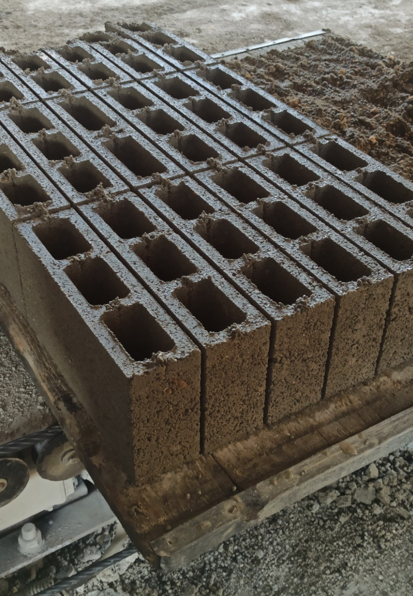
Introduction
Background:
Bricks: historical, durable material
Modern bricks: clay and concrete, specific properties and limitations
Study Focus:
Recycled rubber in bricks
Enhanced durability and thermal efficiency
Significance:
Sustainability: reduce rubber waste
Energy efficiency: improve building performance (thermal efficiency)
Comparison: new bricks vs. local standards and existing bricks

Slide 4
Solid Waste Components
Sustainable development.
Increasing demand for effective building materials.
Addressing global warming.

Slide 5
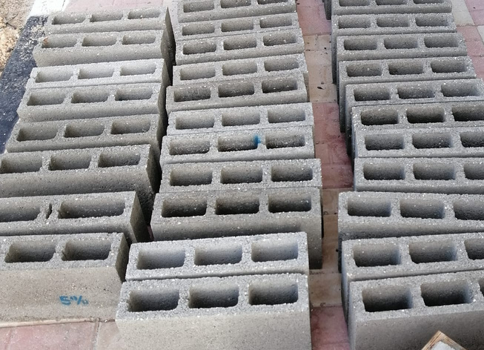
Bricks & Rubber
Bricks:
Bricks are fundamental in construction Also, its price is relatively low compared to other construction materials.
Durability and Longevity: Bricks are known for their robustness and long-lasting performance.
Sustainability: Bricks are reusable and recyclable, contributing to environmentally friendly construction practices.

Slide 6
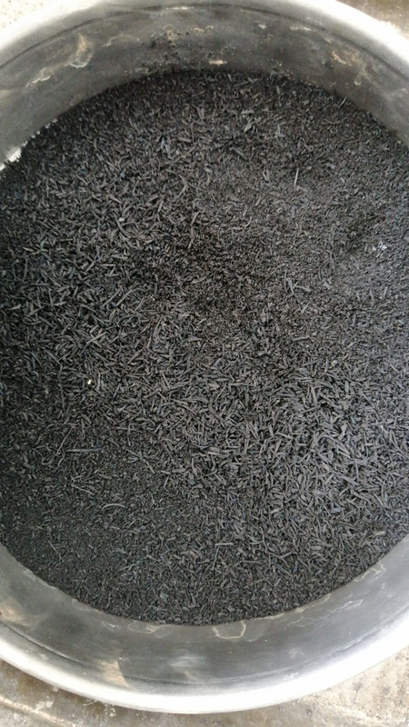
Bricks & Rubber
Rubber Waste:
Rubber is a plentiful and problematic resource in Palestine.
Innovation & Benefits:
Incorporating rubber into bricks to enhance thermal conductivity.
Utilizing scrap tires, difficult to decompose, reduces waste.

Slide 7

01
Incorporate rubber tire waste (0%, 5%, 10%, 15% & 20%) into concrete brick materials according to Palestinian standards.
02
Examine the thermal conductivity of the resulting bricks
Objectives
03
Evaluate mechanical properties: water absorption, density, and compressive strength
04
Compare results with Palestinian standards and specifications for concrete bricks
05
Compare reference bricks with local bricks.

Slide 8










Methodology
Materials
This section details all the materials utilized throughout the experiment.
Tests
The various tests conducted to analyze the mixtures and materials are outlined.
Experimental Procedure
This section explains the step-by-step procedures followed during the experiments.
Mixtures
This part describes the specific compositions and combinations of the materials used.

Slide 9
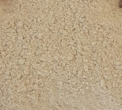
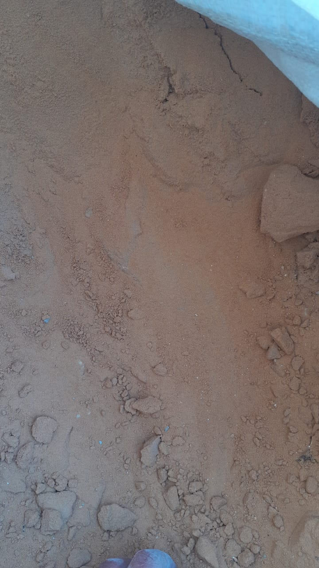
Materials
Size Ranges (mm) | Water Absorption | Moisture Content | Bulk Specific Gravity | Unit Weight Rodded (kg/m³)
0.075-4.75 | 3.8% | 4.4% | 2.61 | 1508
0.075-2.36 | 2.4% | 4.9% | 2.56 | 1494
Coarse Sand
Fine Sand

Slide 10
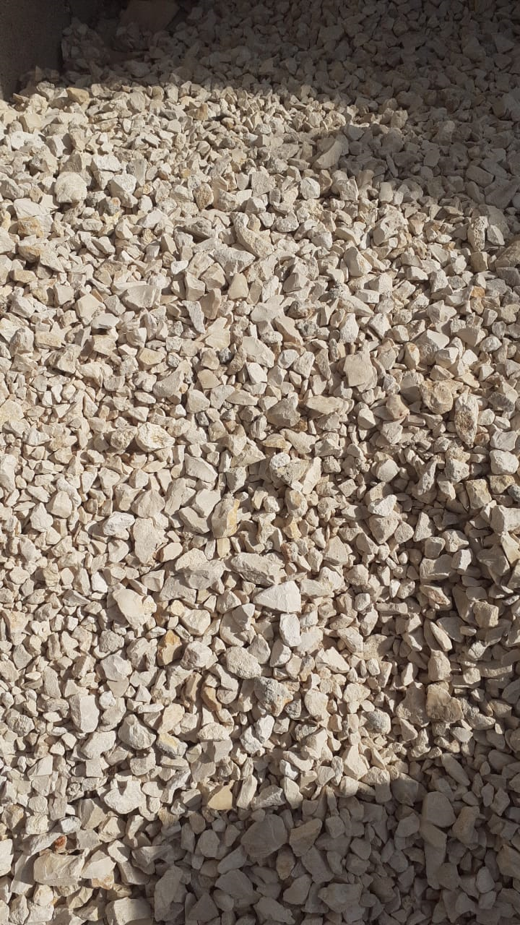

Materials
Size Ranges (mm) | Water Absorption | Moisture Content | Bulk Specific Gravity | Unit Weight Rodded (kg/m³)
0.15-4.75 | 1.0% | 3.1% | 2.59 | 1438.5
0.15-2.36 | 4.9% | 7.4% | 2.15 | 450
Coarse Aggregate
Rubber Powder

Slide 11
Tests
Density Test
Thermal Conductivity Test
Water Absorption & Moisture Content Test
Bulk Specific Gravity (BSG) & Unit Weight Rodded Test
Compressive Strength Test

Slide 12
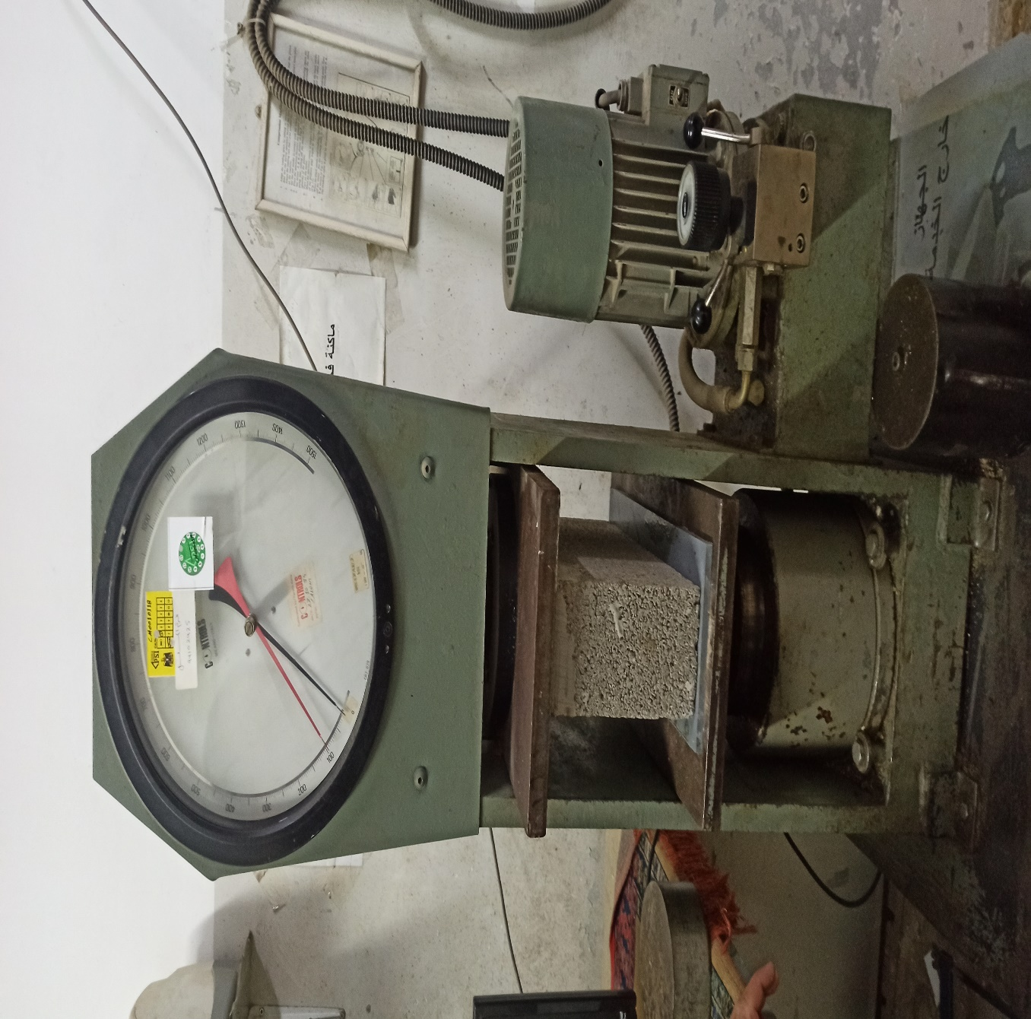
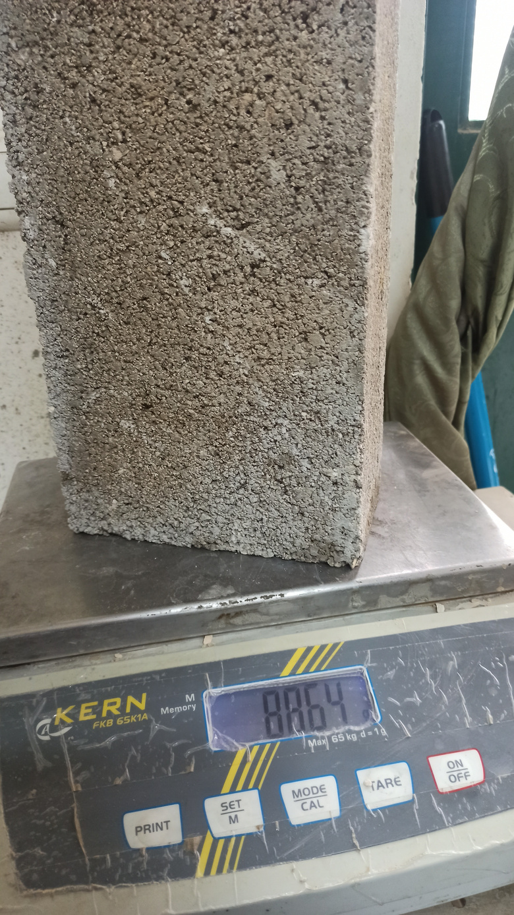



Tests
Density
Compressive Strength
Calculate the Density using the formula:
$$Density=\frac{Mass}{Volume}$$
Calculate the compressive strength using the formula:
$$Compressive Strength =\frac{Mximum Load}{Area of the brick}$$

Slide 13
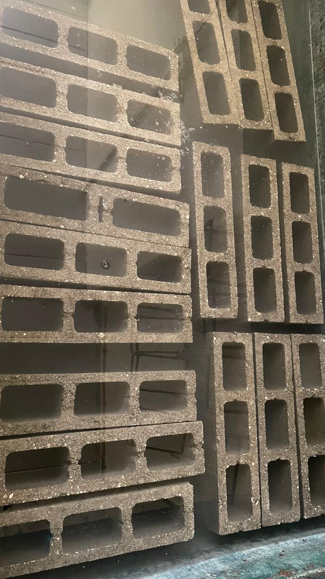
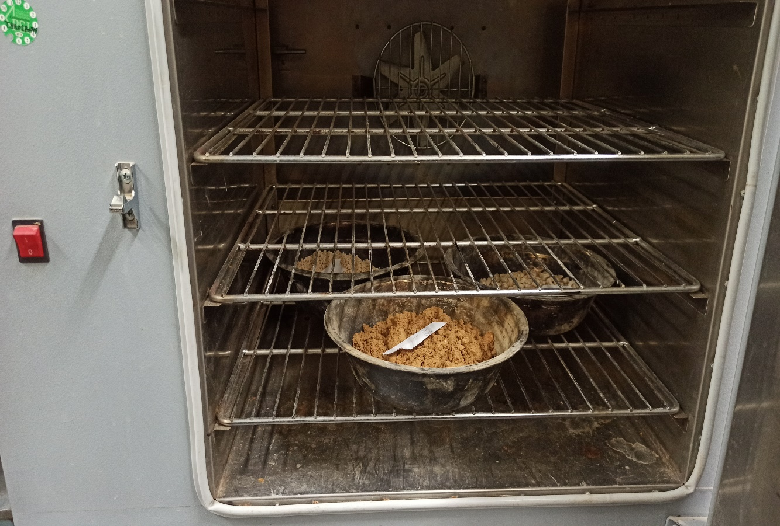


Tests
Water Absorption
Moisture Content
$Moisture Content \left(\%\right)=\frac{\left(Initial dry weight− Weight after drying\right)}{Weight after drying}$ $×100\%$
$$Water Absorption \left(\%\right)$$
$$=\frac{\left(Wet Weight−Dry Weight\right)}{Dry Weight}​×100\%$$

Slide 14
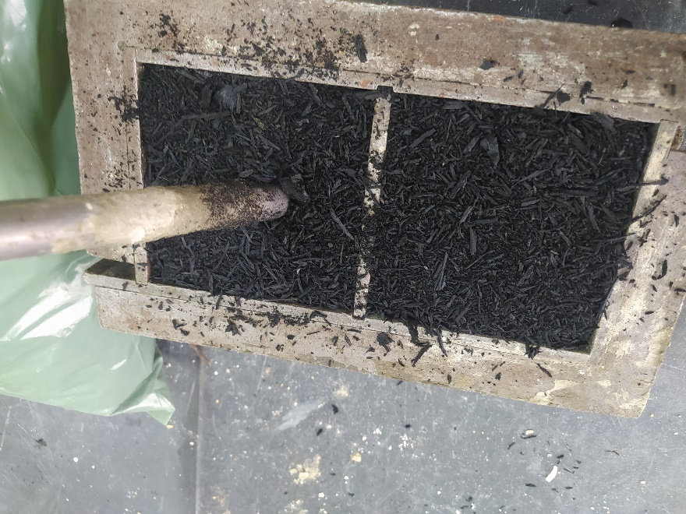
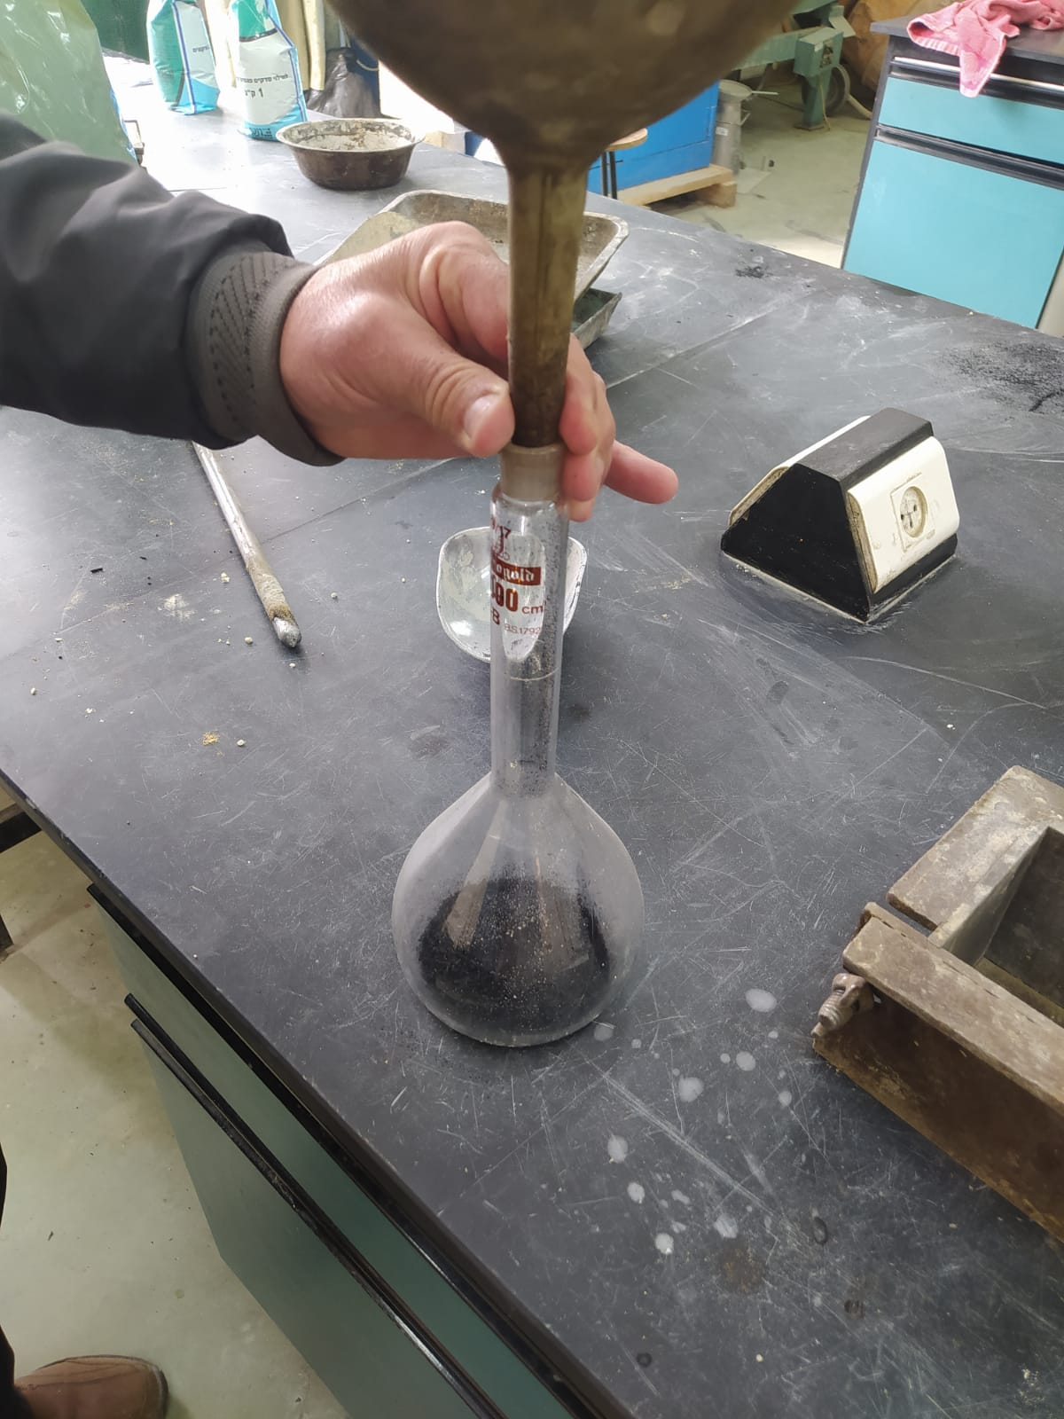


Tests
Unit Weight Rodded
$$Bulk Spacific Gravity$$
$$Bulk Spacific Gravity=\frac{Dry weight }{Weight after drying−weight in water}$$
$$Unit Weight Rodded =\frac{filled cube weight −empty cube weight}{Volume }$$

Slide 15

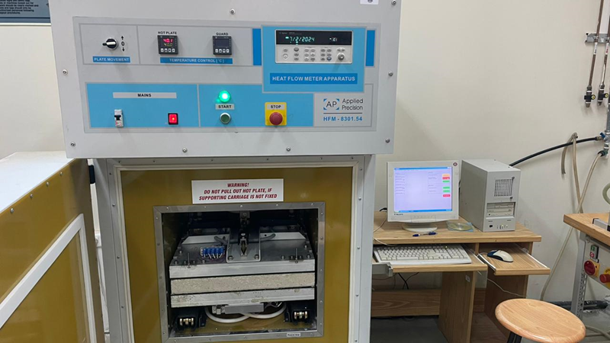
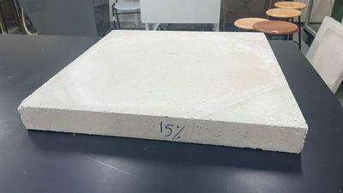
Thermal Conductivity Test
The thermal conductivity of a brick can be determined through a Heat flow meter apparatus. comprising two primary components: hardware and software. The hardware includes water and power inlet and outlet, a sample holder with two temperature-regulated layers (cold and hot), and an operational panel.

Slide 16
Mixing Materials Per Kg
Ratio | Cement | Coarse Aggregate | Fine Sand | Coarse Sand | Rubber Tire Powder | Water
CM | 26.5 | 55.65 | 87.19 | 42.67 | 0 | 7.80
CR50 | 26.5 | 55.65 | 87.19 | 40.53 | 1.09 | 8.03
CR100 | 26.5 | 55.65 | 87.19 | 38.4 | 2.2 | 7.77
CR150 | 26.5 | 55.65 | 87.19 | 36.27 | 3.29 | 7.76
CR200 | 26.5 | 55.65 | 87.19 | 34.13 | 4.41 | 7.74
            Size of brick used 400 $×$ 200 $×$ 100 mm (Length, Height & Width).
Notes:
Define CM and CR

Slide 17
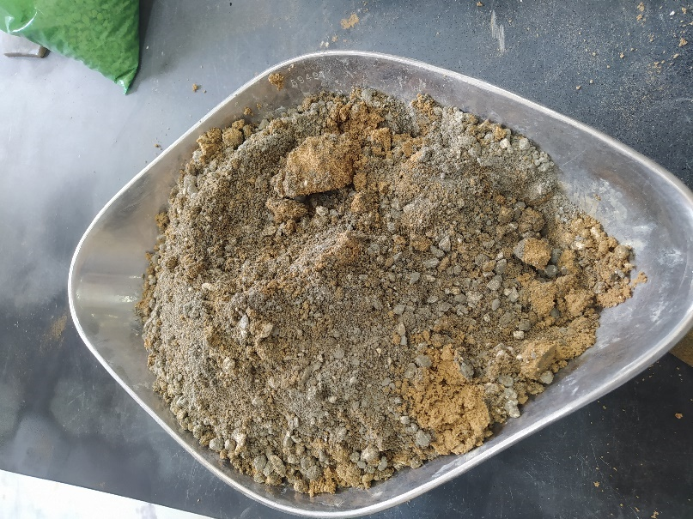
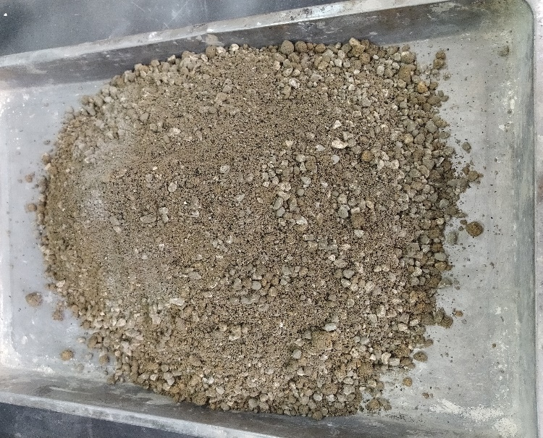
Experiment Steps
The process begins with placing the coarse aggregate in the drum mixer. Afterward, we add the coarse and fine sand followed by cement.
Once the initial dry materials are mixed, we add the rubber tire powder and mix thoroughly for 3 minutes.

Slide 18
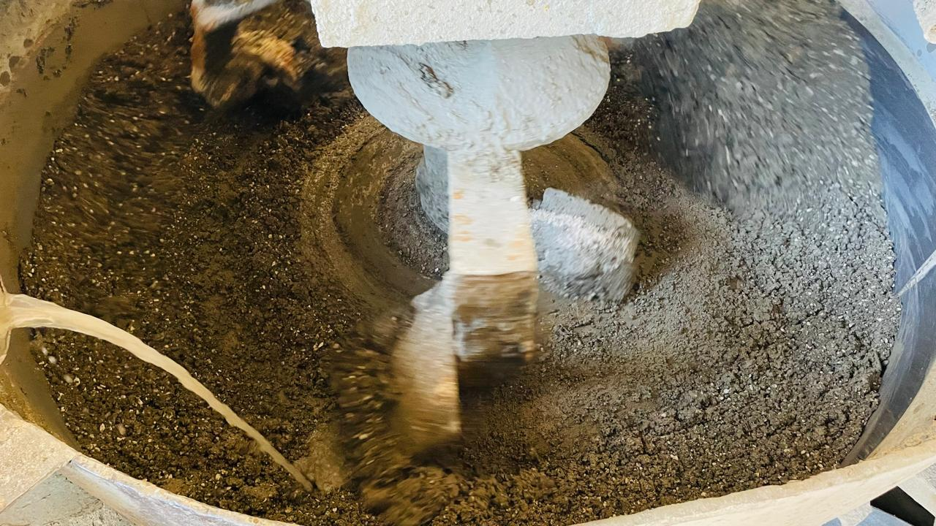
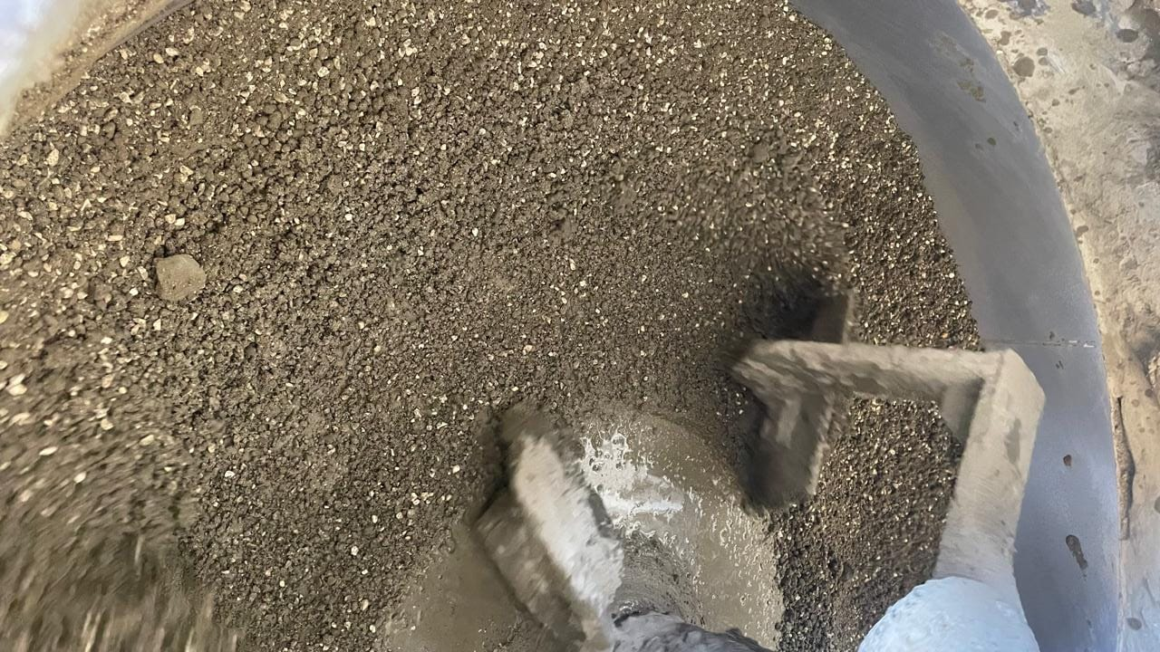
Experiment Steps
After mixing, we ensure the homogeneity of the dry mix through visual inspection and then gradually add water.
All components are then mixed for an additional 3-5 minutes to ensure complete integration.

Slide 19
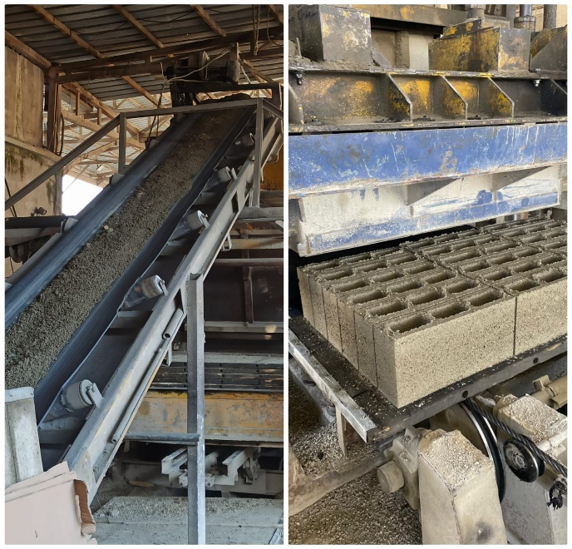
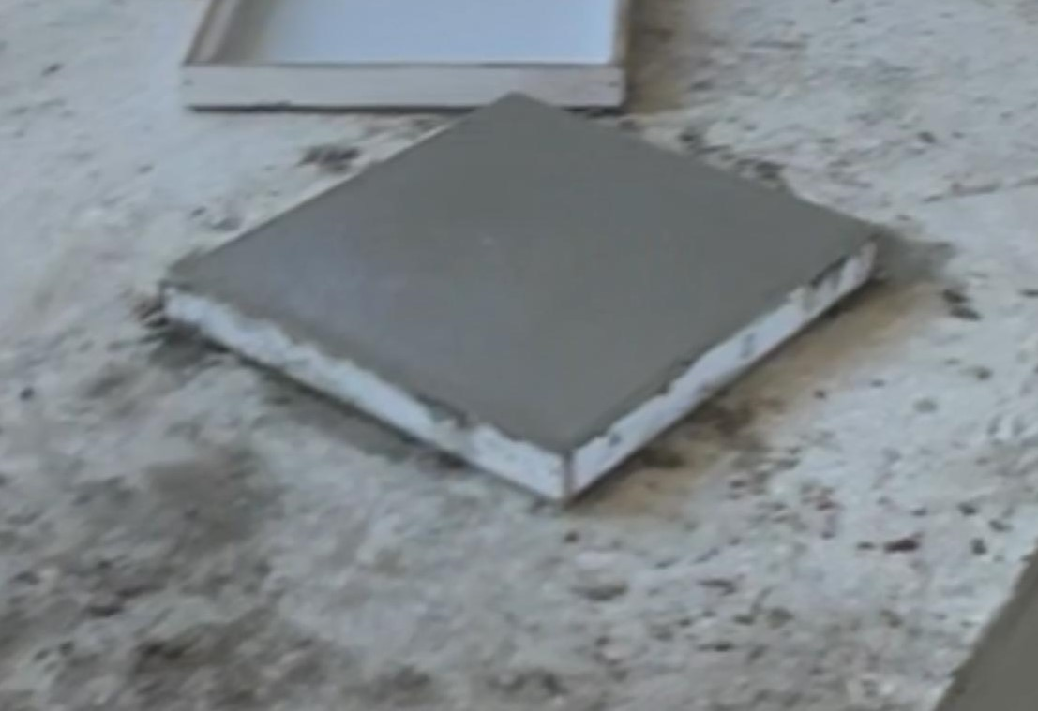
Experiment Steps
The thoroughly mixed batch is conveyed to the molds for pouring and compacting.
During the transfer process, a portion of the mixture is poured into a special mold (50 cm * 50 cm) for testing heat flow.

Slide 20
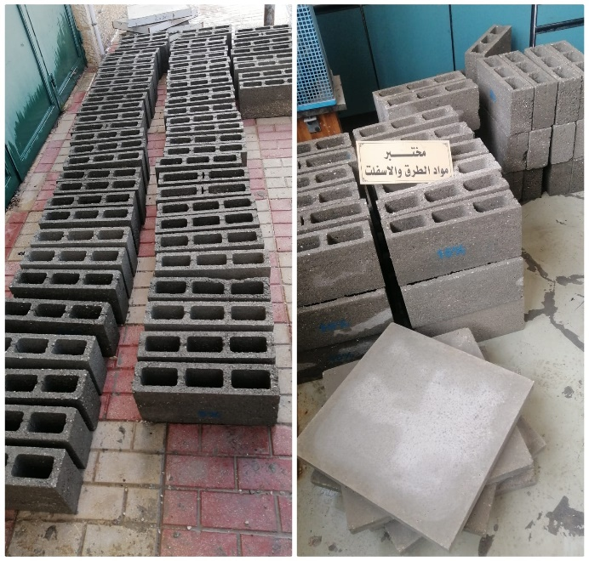
Experiment Steps
After allowing the blocks to set for 24 hours, we transfer them to a water bath for curing, maintaining a temperature range of 27 ± 2°C for 28 days.
For comparison, we produce reference concrete blocks using the same steps but without adding rubber tire powder.

Slide 21
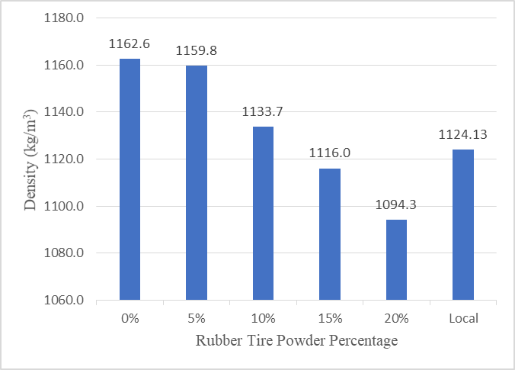
Results
Density Test:
The density of bricks decreases as tire rubber powder content increases, with all samples below 1650 kg/m³.
Incorporating tire rubber powder can reduce brick weight and is feasible within specified standards.

Slide 22
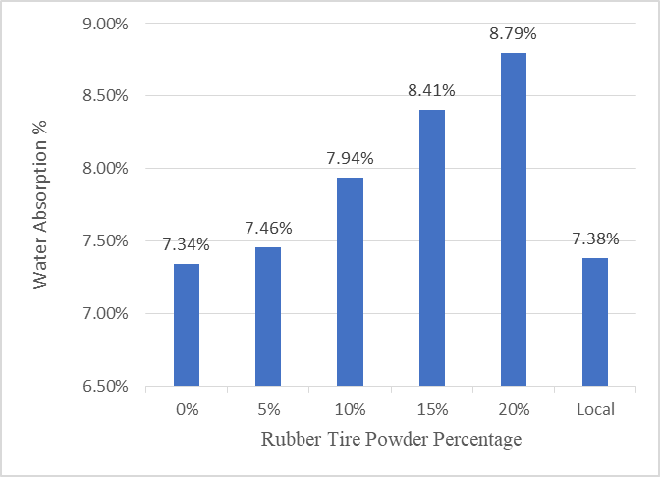
Water Absorption :
The results showed that the water absorption obtained from the average of three brick samples with varying percentages of rubber tire powder was less than 12% .
Indicate that increasing the proportion of tire rubber powder leads to increased water absorption.

Slide 23
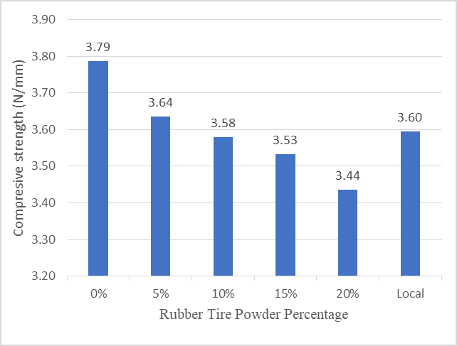
Compressive Strength:
Compressive Strength:
The results from testing bricks with different amounts of rubber tire powder indicated higher compressive strength, except for the 20% mix which was lower.
the compressive strength should be higher than 3.5 N/mm² .

Slide 24
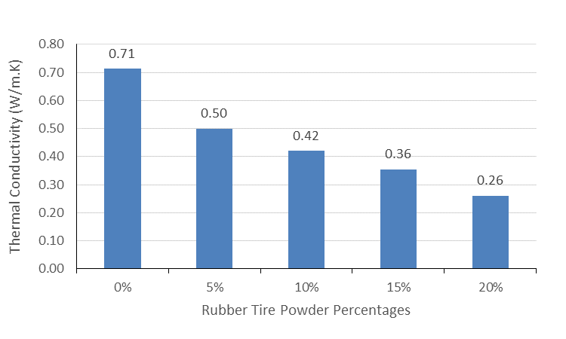
Thermal Conductivity :
Thermal Conductivity:
The results obtained from bricks with varying percentages of rubber tire powder showed that the thermal conductivity is lower than that of concrete bricks, ranging from 0.70 to 0.76 W/m·K

Slide 25
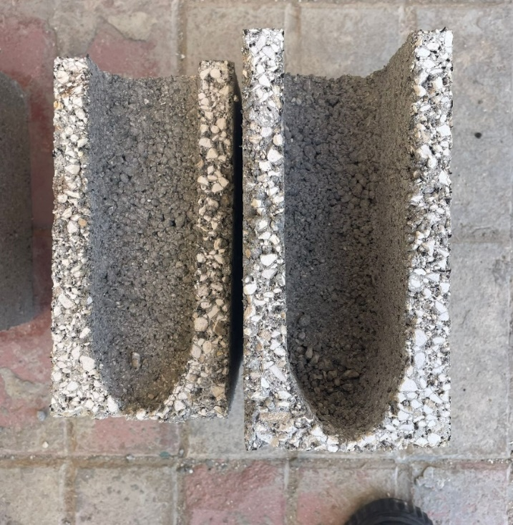
Conclusion
Density: Decreased by 6% with 20% rubber tire powder, within Palestinian standards.
Water Absorption: Increased by 20% with 20% rubber tire powder, within standards.
Compressive Strength: Decreased by 9% with 20% rubber tire powder, failing standards.
Thermal Conductivity: Decreased by 64.43% with 20% rubber tire powder.
Comparison with Local Brick: Reference brick (0% rubber tire powder) showed better density and strength, with water absorption within standards.

Slide 26
Recommendation
Future research should explore various proportions and combinations of tire rubber powder to improve thermal and structural properties, conduct life cycle assessments for environmental benefits, and perform long-term durability studies.
Analyzing real-world thermal performance, scaling up production, and experimenting with different rubber particle sizes are also essential for commercial viability and effectiveness.

Slide 27
THANK YOU!
"Brick by Brick, Stone by Stone, Every Great Thing was Built by Those Who Believed They Could.“
An-Najah National University

