Slide 1
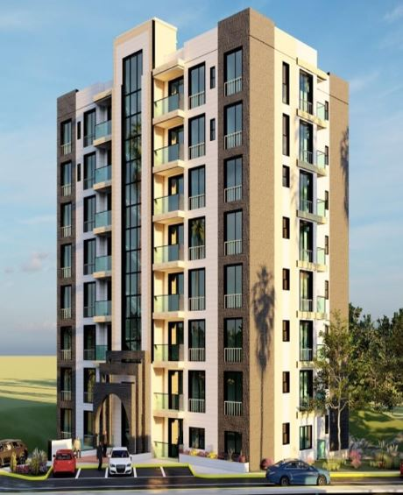
`
RECOMMENDATIONS
Ch.7
Application of Project Management Using 5D Analysis on a Rawabi Residential Building
Prepared by:
Diana Amr Hindya
Shahd Omar Ibrahim
Layth Munther Ibrahim
Supervisor: Eng. Reema Nassar
PRIMAVERA
NAVISWORKS
Ch.6
LUMION
Ch.5
Ch.4
METHODOLOGY
REVIT
Ch.3
Ch.2
INTRODUCTION
Ch.1

Slide 2
INTRODUCTION
General Background
Management is a set of principles relating to the functions of planning, organizing, directing, and controlling.
Engineering management is the application of management practice to engineering practice.
Building Information Modeling (BIM), which is an intelligent 3D model-based process, gives architecture, engineering, and construction professionals the insight and tools to plan, design, build and manage buildings and infrastructure more efficiently.

Slide 3
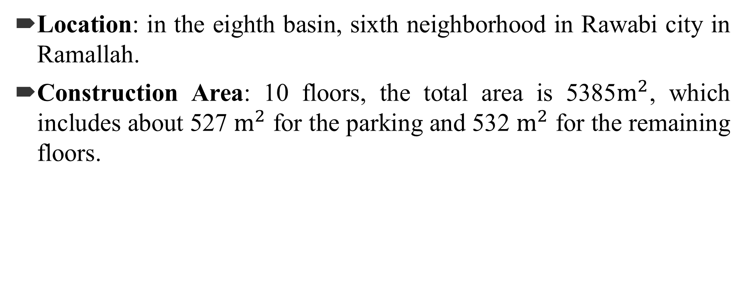
Case Study Information
Location: in the eighth basin, sixth neighborhood in Rawabi city in Ramallah.
Construction Area: 10 floors, the total area is 5385$m^{2}$, which includes about 527 $m^{2}$ for the parking and 532 $m^{2}$ for the remaining floors.

Slide 4
Objectives
Calculating the project quantities using Revit software and confirm results with manual ones, then compare them with the contractor’s Bill Of Quantity (BOQ).
Estimate the cost and time for the project using Primavera software.
Correlate the 3D model with time and cost to make the 5D model using Navisworks software.

Slide 5
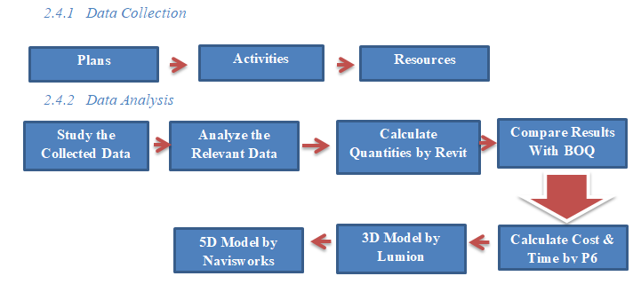
METHODOLOGY
Figure: Methodology Flow Chart

Slide 6
Limitations
This project deals with the structural and architectural plans only, but mechanical and electrical data were taken into consideration in the project duration.
The site modeling plan was not available but the amount of excavation was taken directly from BOQ.
The actual price of the project has not been taken because the project is under construction so a comparison of the cost cannot be done.
The exact finish date of the project has not been taken because the project is under construction so a comparison of time cannot be done.
Details of wall tiling in the kitchens and bathrooms were not viewed in plans.

Slide 7
REVIT
Definition
It is a BIM-based program that is widely used to create a model consisting of information that is identical to reality, the program allows users to design and build a 3D building, annotate the model with 2D drafting elements, and access building information from the building model database. So, it simplifies the process of quantifying and thus estimating the project cost.

Slide 8
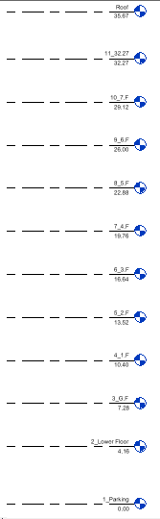
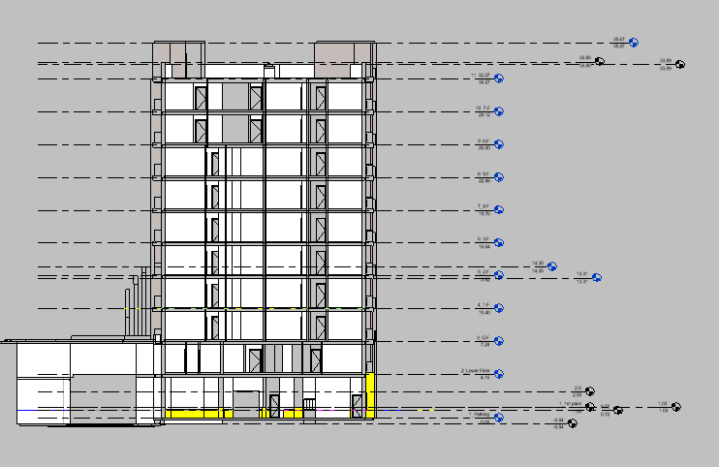
General Input
Levels
Figure: Structural and Architectural Levels

Slide 9
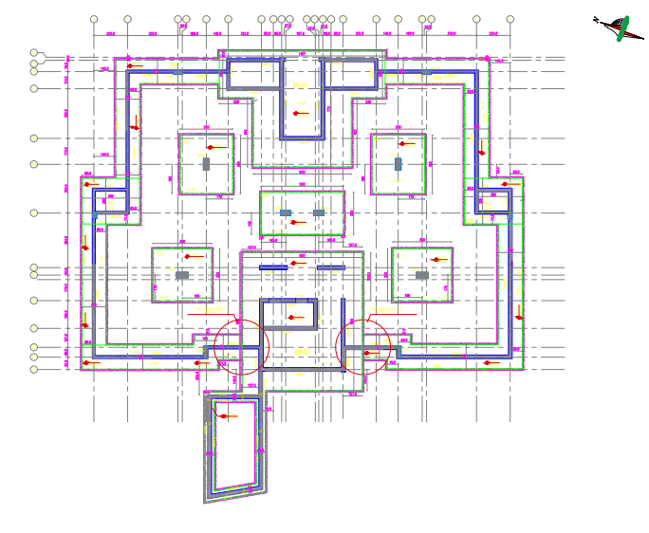
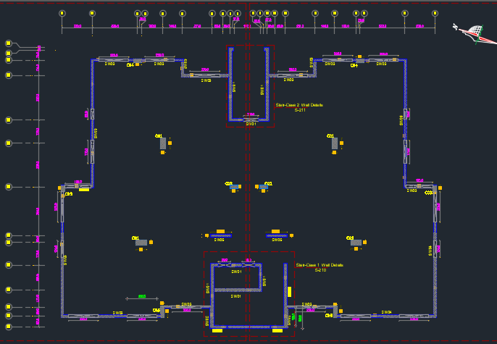
Structural Model
Defined data and inputs
Figure: Foundation Layout Figure: Columns and Walls Layout

Slide 10
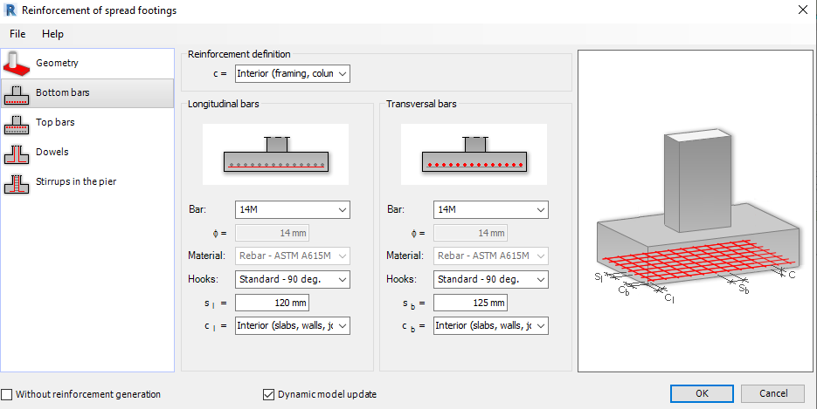
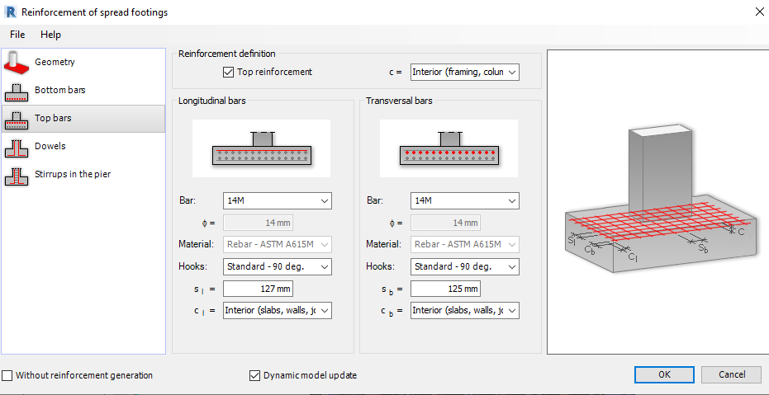
Figure: Combined Footing Reinforcement
Elements Definition and modelling
Footings: Four types (single, combined, mat and wall footing)

Slide 11
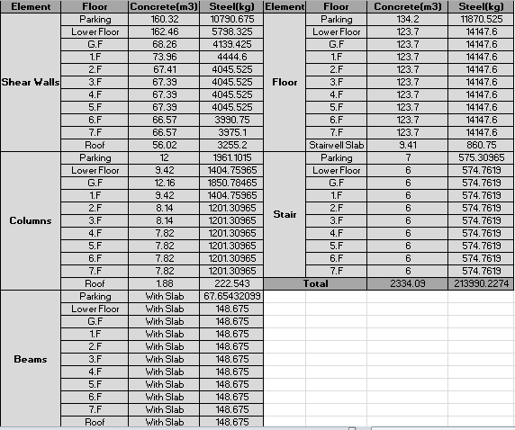
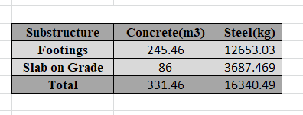
Quantity Survey
Table: Superstructure Quantities
Table: Substructure Quantities

Slide 12
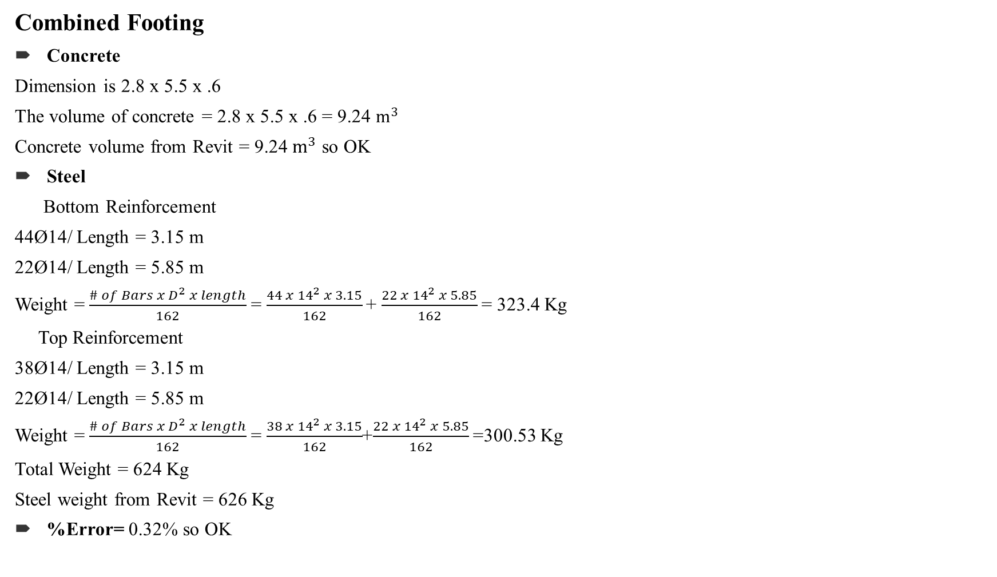
Verification
Combined Footing
Concrete
Dimension is 2.8 x 5.5 x .6
The volume of concrete = 2.8 x 5.5 x .6 = 9.24 $m^{3}$
Concrete volume from Revit = 9.24 $m^{3}$ so OK
Steel
Bottom Reinforcement
44Ø14/ Length = 3.15 m
22Ø14/ Length = 5.85 m
Weight =$\frac{{\# of Bars x D}^{2} x length}{162}$=$\frac{44 x {14}^{2} x 3.15}{162}$+ $\frac{{22 x 14}^{2} x 5.85}{162}$= 323.4 Kg
Top Reinforcement
38Ø14/ Length = 3.15 m
22Ø14/ Length = 5.85 m
Weight =$\frac{{\# of Bars x D}^{2} x length}{162}$=$\frac{38 x {14}^{2} x 3.15}{162}$+$\frac{{22 x 14}^{2} x 5.85}{162}$=300.53 Kg
Total Weight = 624 Kg
Steel weight from Revit = 626 Kg
%Error= 0.32% so OK

Slide 13
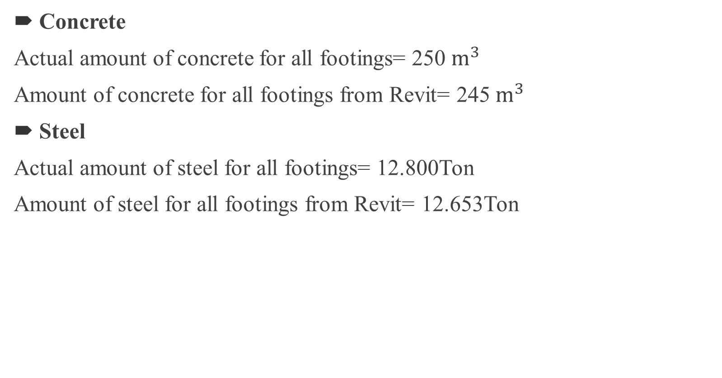
Comparison
Concrete
Actual amount of concrete for all footings= 250 $m^{3}$
Amount of concrete for all footings from Revit= 245${ m}^{3}$
Steel
Actual amount of steel for all footings= 12.800Ton
Amount of steel for all footings from Revit= 12.653Ton

Slide 14
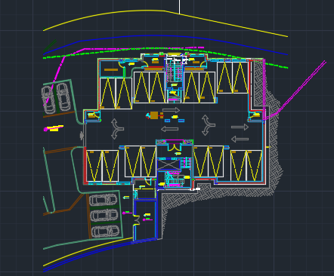
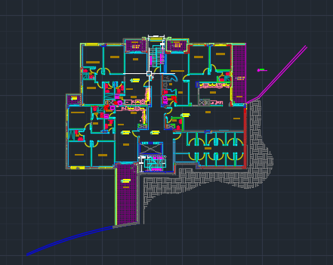
Architectural Model
Figure: Parking Floor Figure: Lower Floor
Defined data and inputs

Slide 15
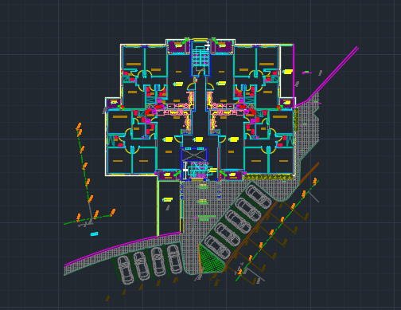
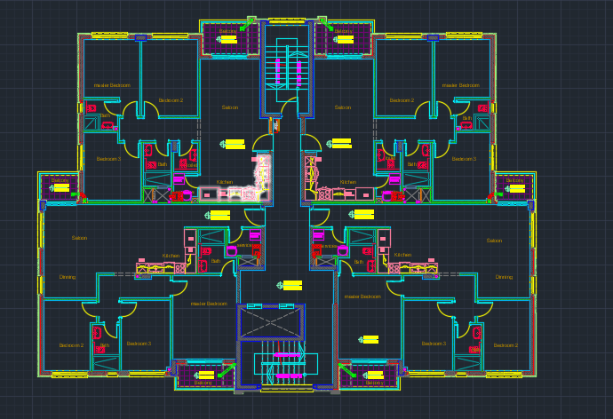
Figure: Ground Floor up to Fifth Floor Figure: Sixth and Seventh Floor

Slide 16
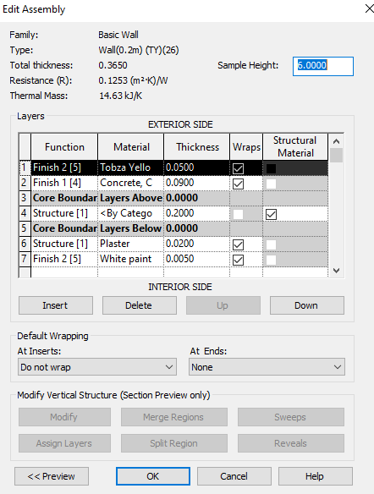
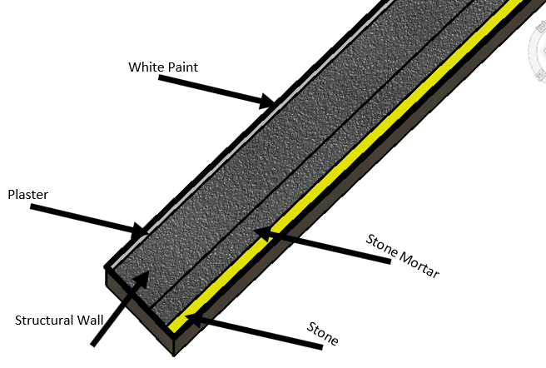
Walls: Different types of walls were used in this project namely exterior, interior, and curtain walls
Figure ‎: Composition of Tobza Yellow Exterior Wall

Slide 17
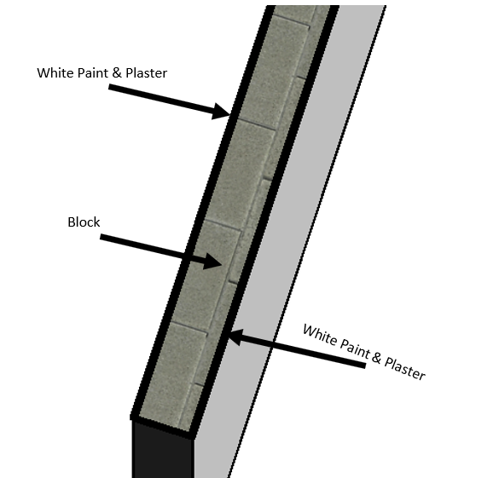
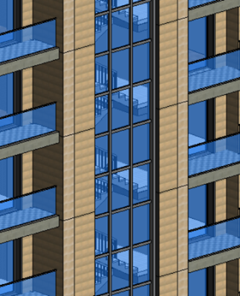
Figure ‎: Composition of Interior Wall
Figure ‎: Curtain Wall

Slide 18
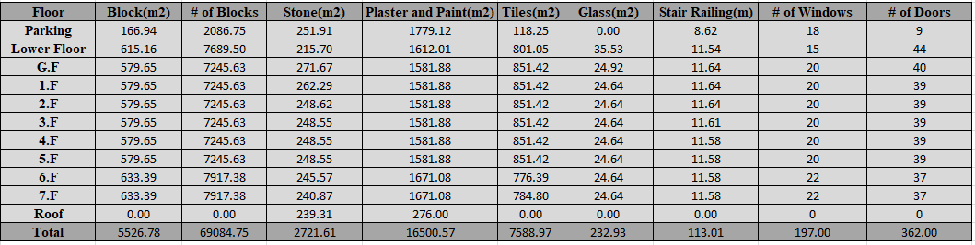
Quantity Survey
Table: Architectural Quantities

Slide 19

Verification
Stone (Brushed Gray) in First Floor
Front facade = 12.66 $m^{2}$
Side facades = 22.7 and 22.6 $m^{2}$
Back facade = 12.6 $m^{2}$
Stone area = 70.56 $m^{2}$
Stone area from Revit = 70.34 $m^{2}$ so OK
Actual value of all stones for 1F floor =260 $m^{2}$
From Revit = 262.29 $m^{2}$
Comparison

Slide 20
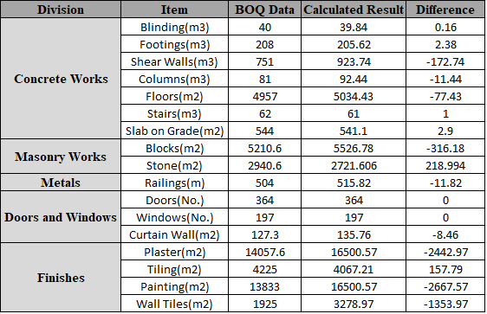
A comparison was done between the estimated quantities from the Revit and the ones provided in the contractor’s BOQ.
Table: Comparison Between BOQ and Calculated Results

Slide 21
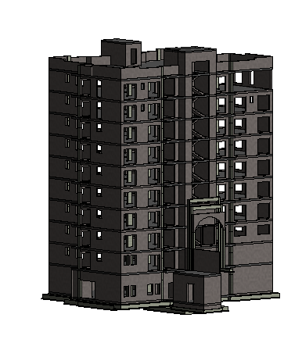
3D-Models
Figure: Structural Model

Slide 22
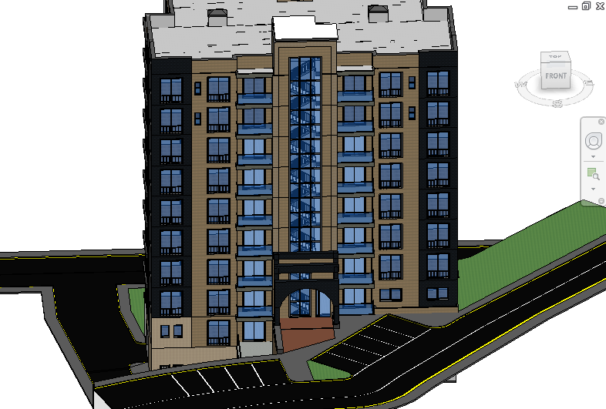
Figure: Architectural Model

Slide 23
LUMION
Definition
It is an architectural rendering software that makes it easy to transfer how your projects translate into real-life experiences and emotions.
Benefits
1. Show beauty and personality in the project
2. Make the design experience visible for everyone to see
3. Encourage the craft and inspire the vision

Slide 24
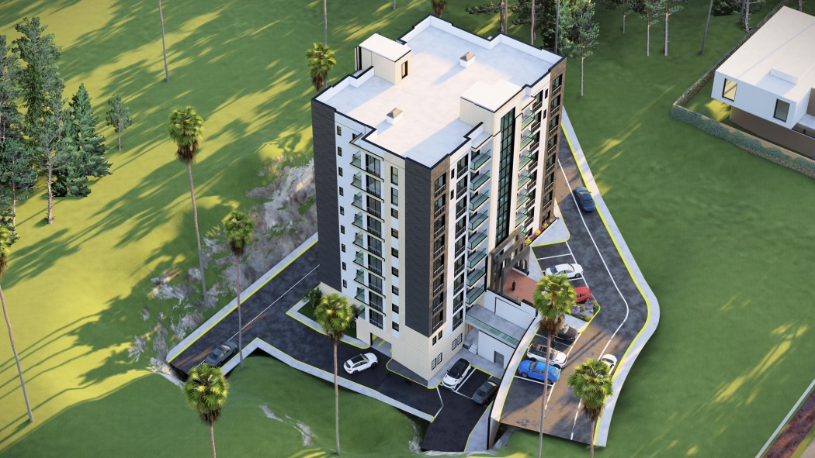
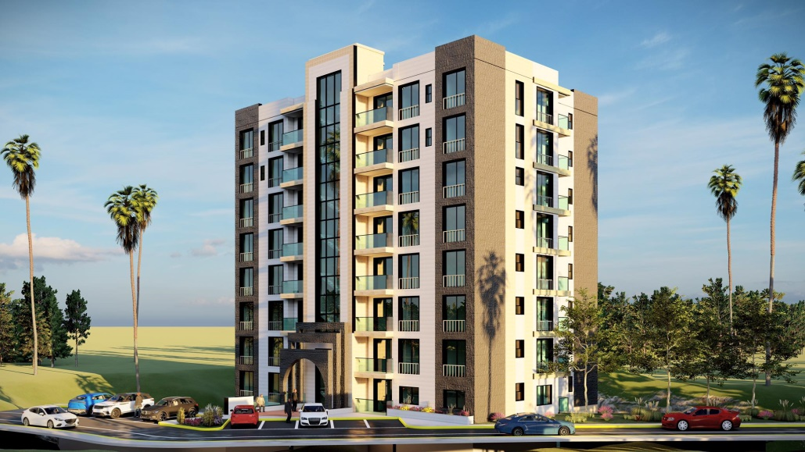
Figure: Lumion Render 1

Slide 25
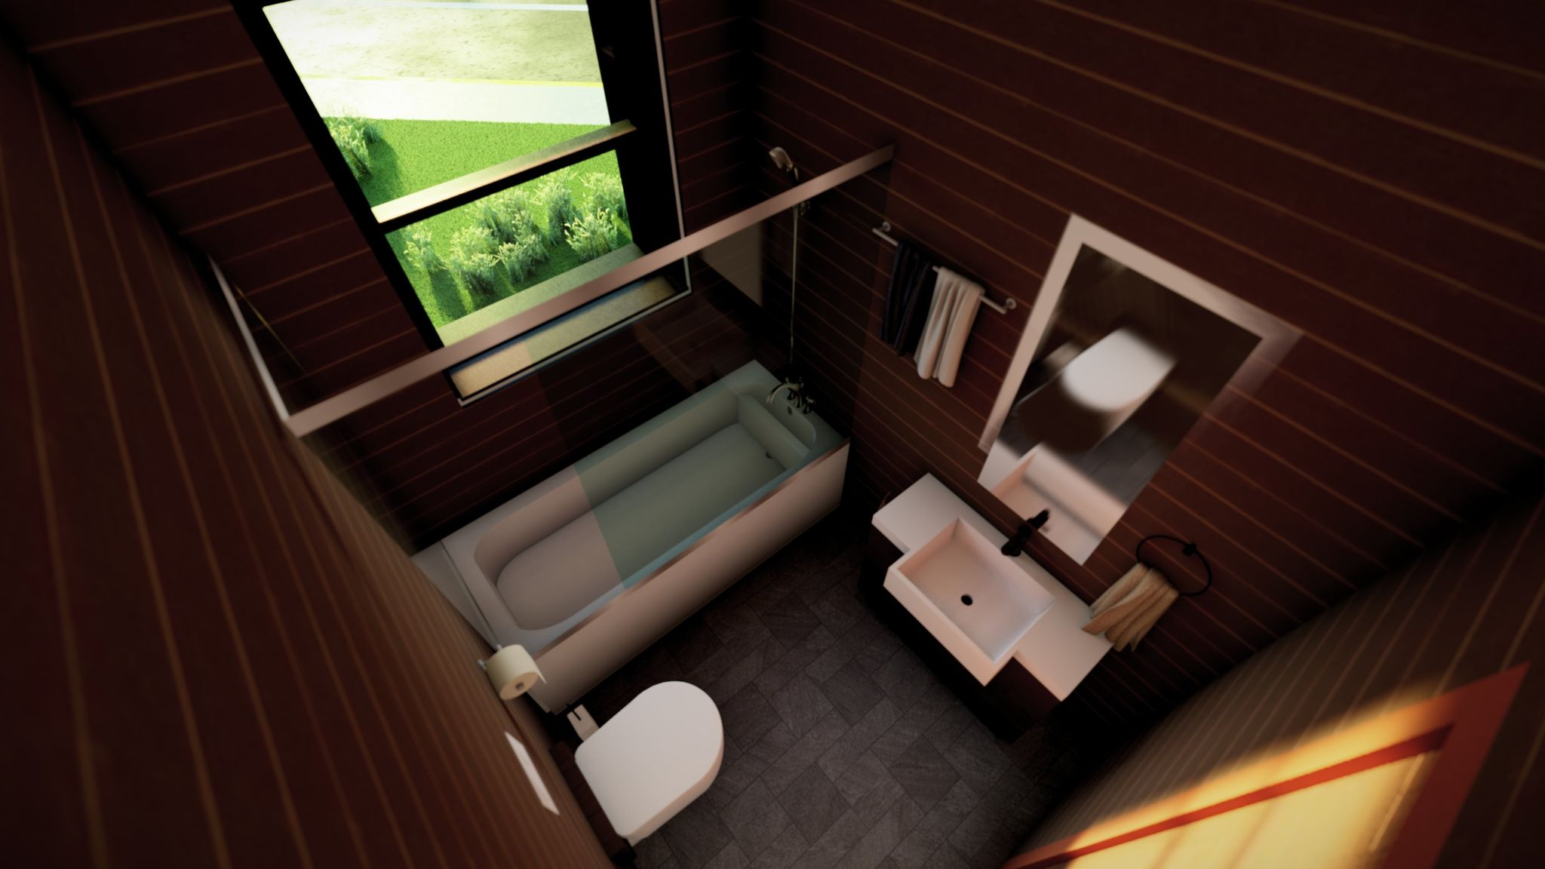
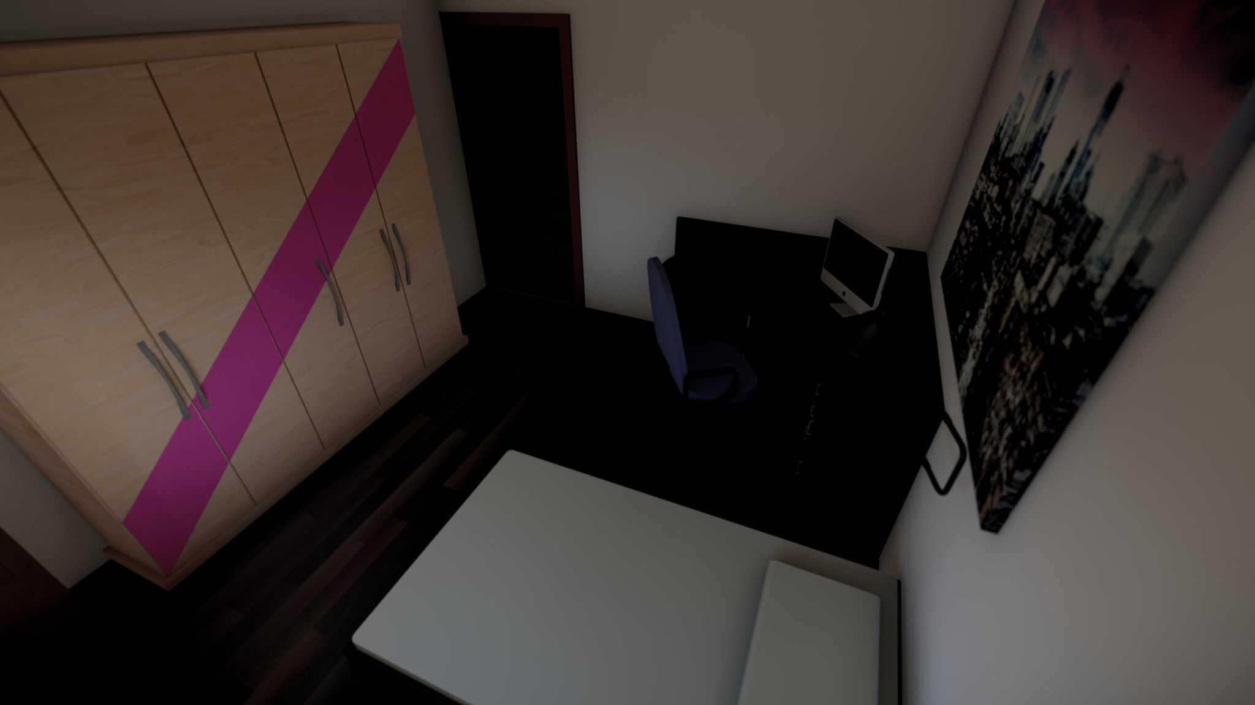
Figure: Lumion Render 2

Slide 26
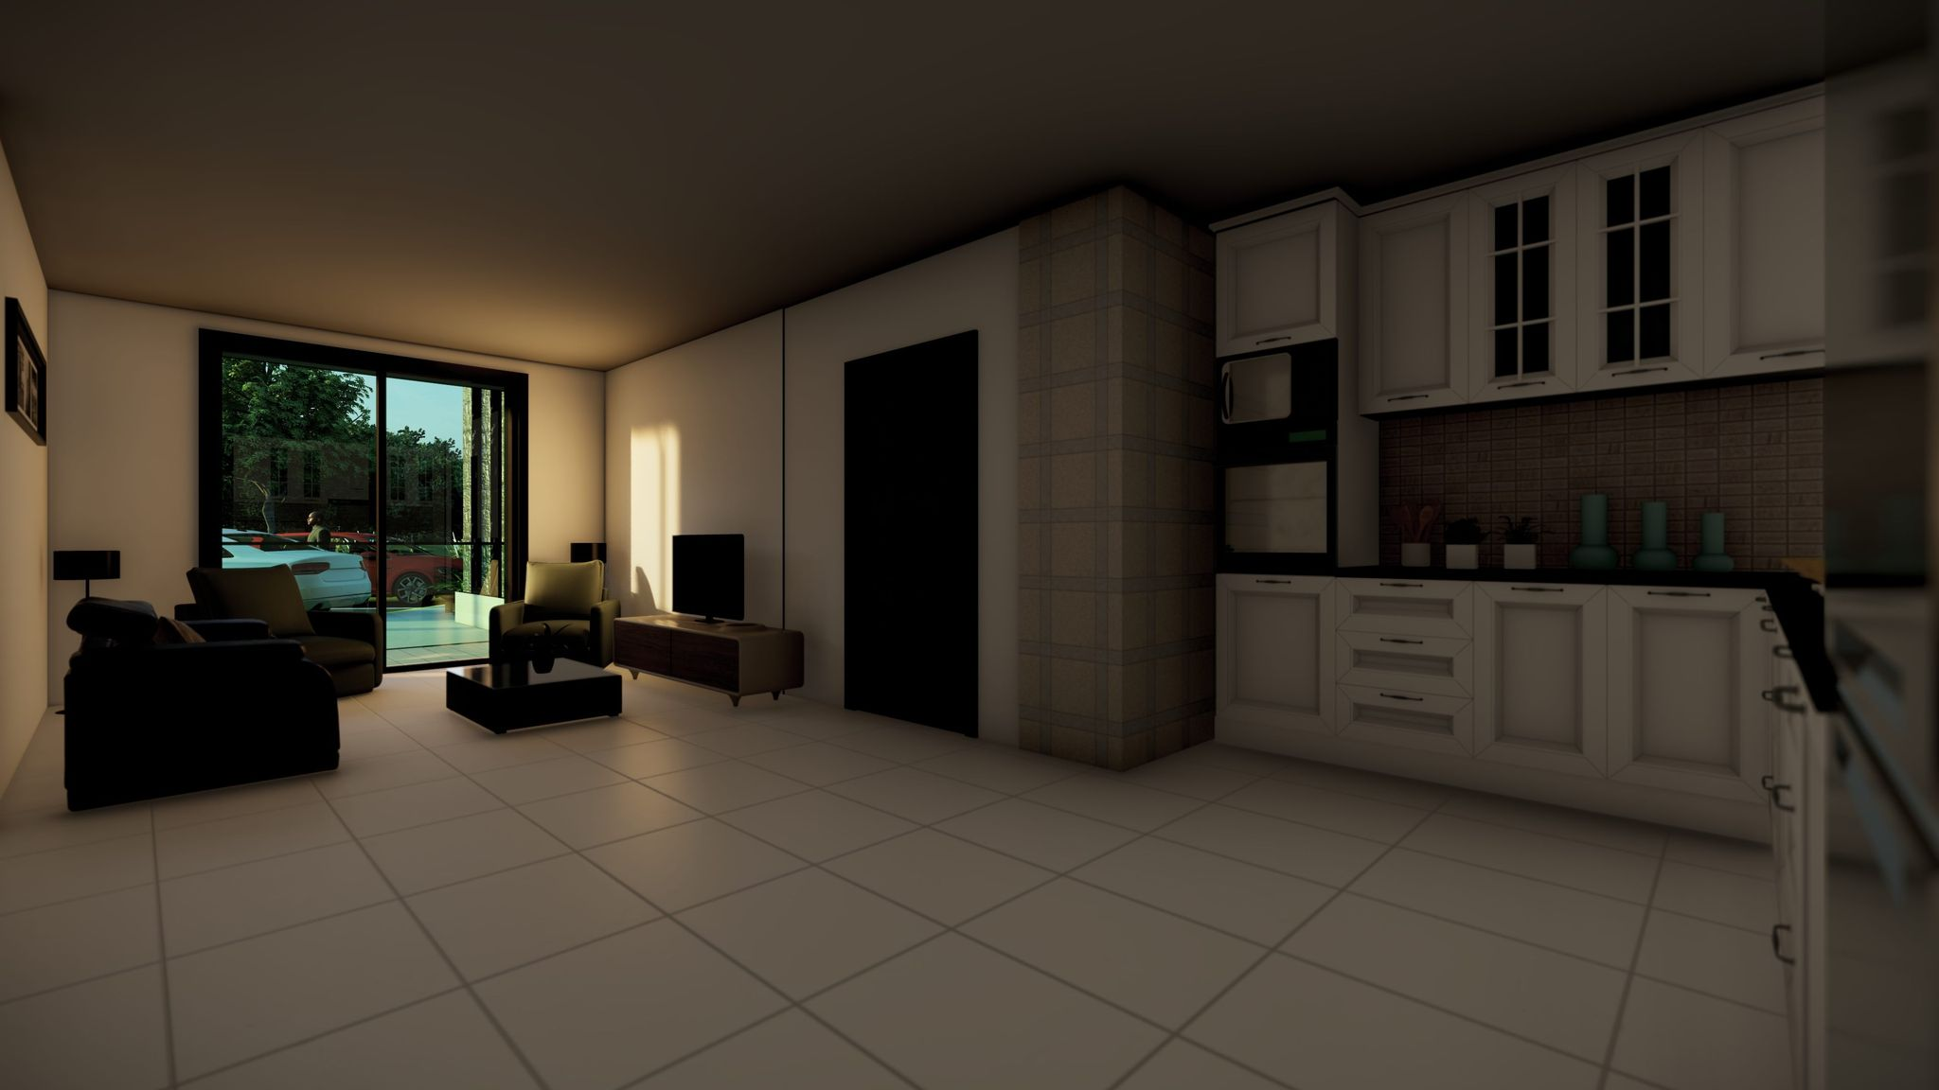
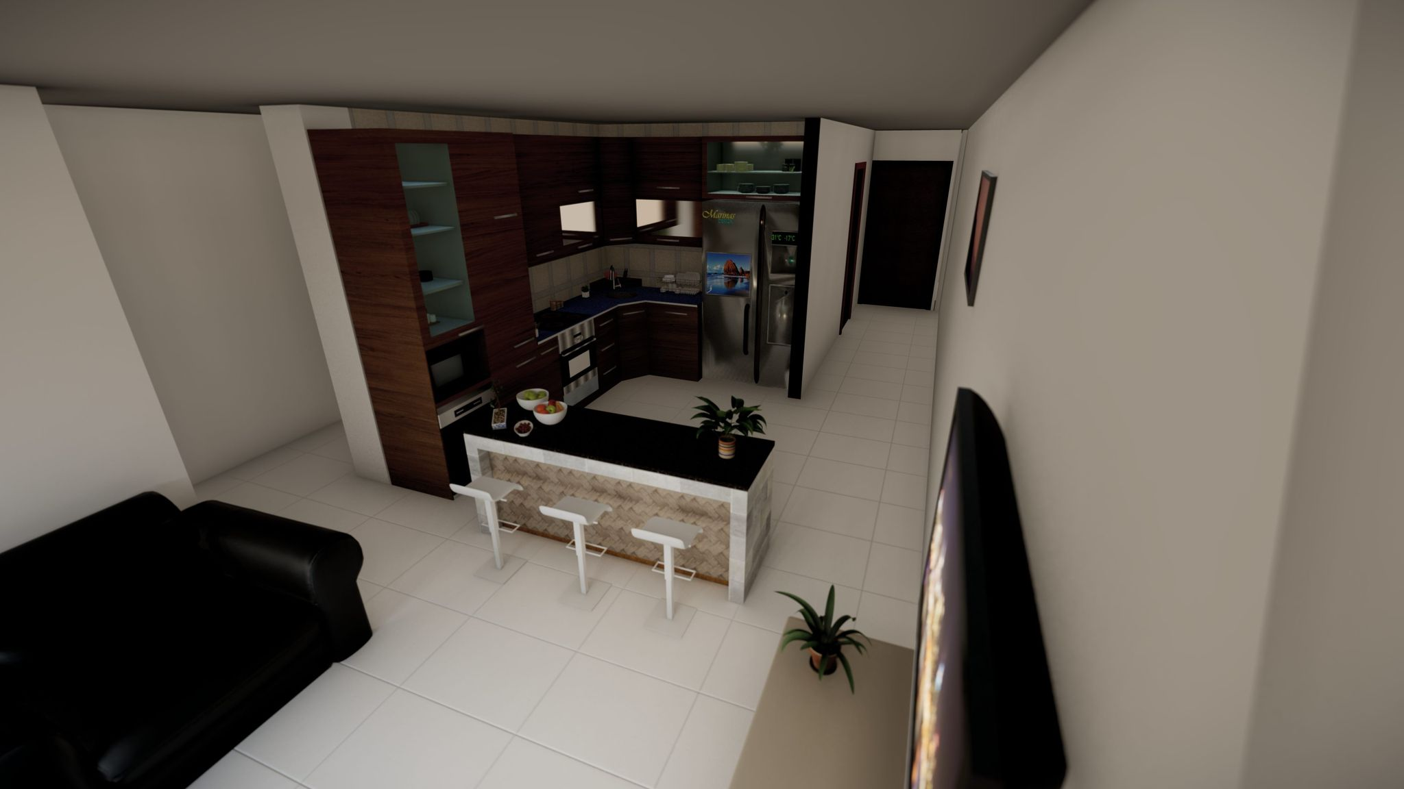
Figure: Lumion Render 3

Slide 27
Video

Slide 28
PRIMAVERA
Definition
It is one of the most useful and effective project management software available on the market. The entire project life cycle, be it simple or complex, can be planned, managed, controlled, and monitored using this software as it provides various basic tools.
Objective
It was used for time scheduling and estimating only the total direct budgeted cost.

Slide 29
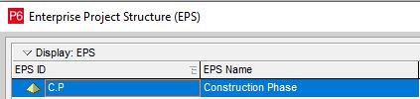
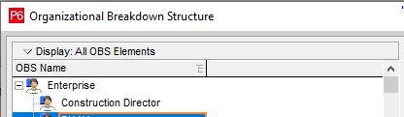
Input Data
Enterprise Project Structure (EPS)
Organizational Breakdown Structure (OBS)
Figure: EPS
Figure: OBS

Slide 30
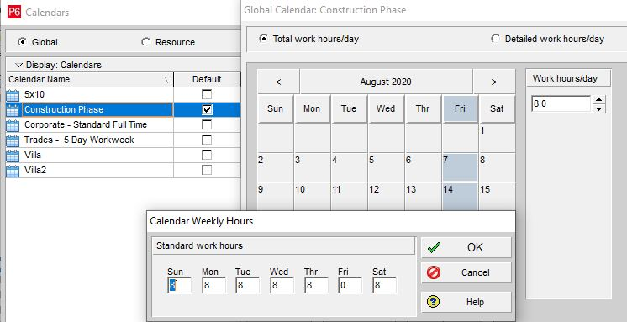
Calendar
Six days of work a week with 8 work hours/day. Friday is always a holiday, in addition to the official holidays in Palestine during the project duration.
Figure: Calendar

Slide 31
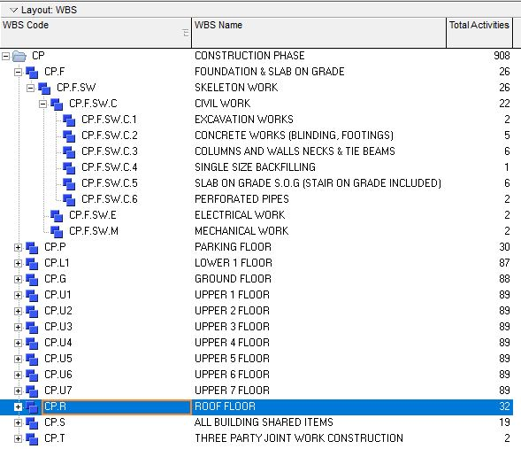
Work Breakdown Structure (WBS)
Figure: WBS

Slide 32
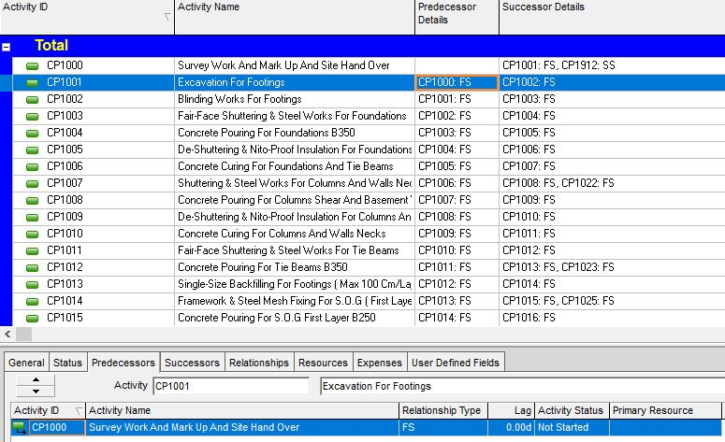
Activities’ Name and Relationships
Table: Activities’ Name and Relationships

Slide 33
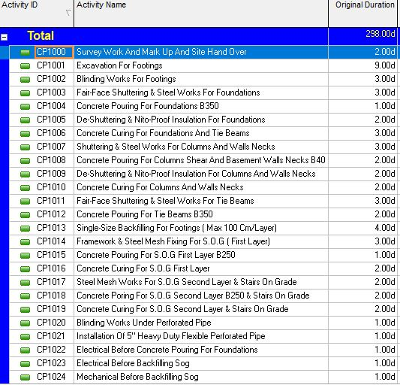

Original Duration
Duration = $\frac{Quantity}{Productivity rate for one crew x Number of crews}$
The original duration for each activity was taken from the contracting company directly based on its experience.
Table: Original Duration

Slide 34
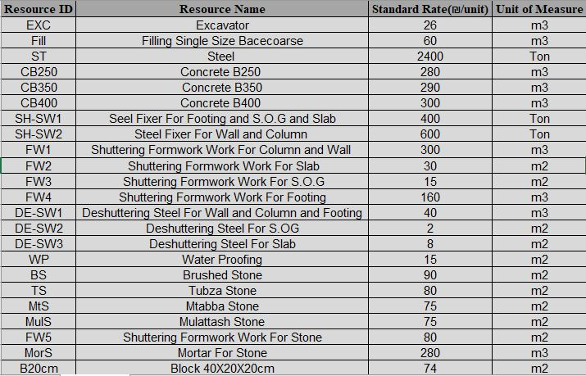
Resources
Table: Resources of the Project

Slide 35
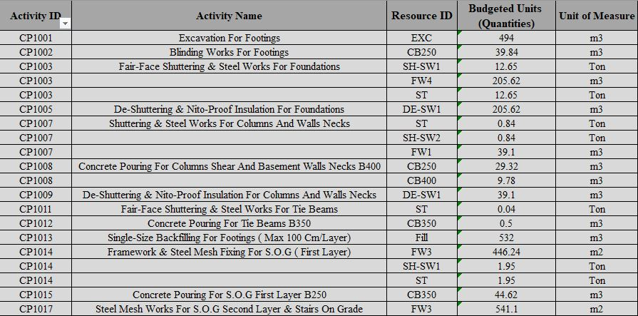
Quantities
Table: Quantities Required for Each Activity

Slide 36
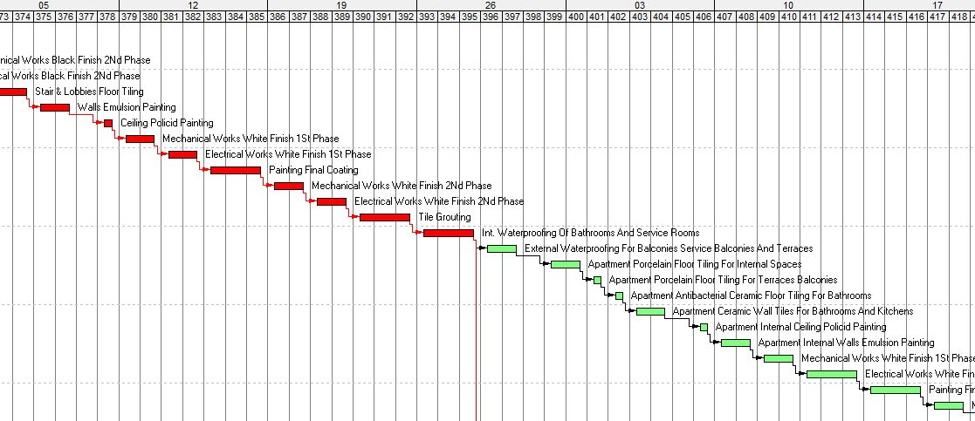
Output Data
Time Scheduling
The project started on 30th/Aug/2020 and will finish on 19th/Dec/2021 with calendar duration of 477 days and working duration of 397 days.
Gantt Chart
Figure: Gantt Chart

Slide 37
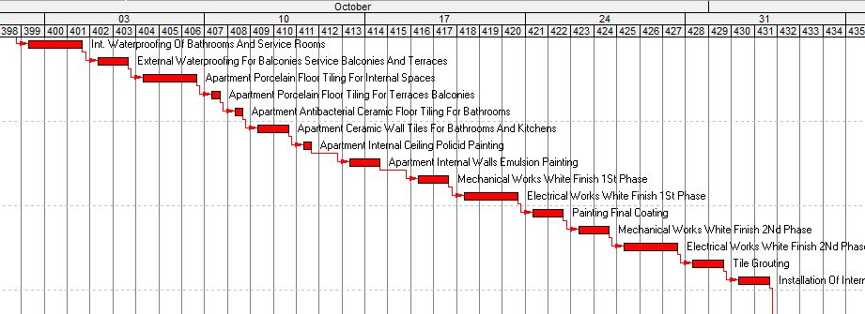
Critical Activities
Figure: Critical Activities

Slide 38
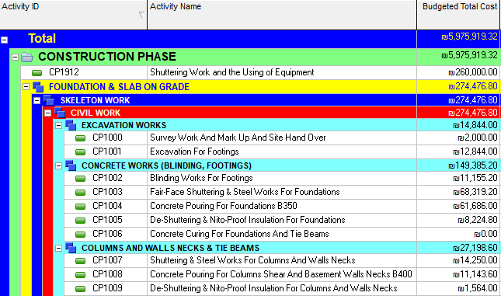
Cost Estimating
Only the total direct cost is calculated by multiplying the standard rate of each resource by the corresponding quantity and then importing them into Primavera through the cost loading resource.
The total direct cost is equal to 5,975,920 .₪
Figure: Cost Loading Resource
Figure: Direct Budgeted Cost

Slide 39
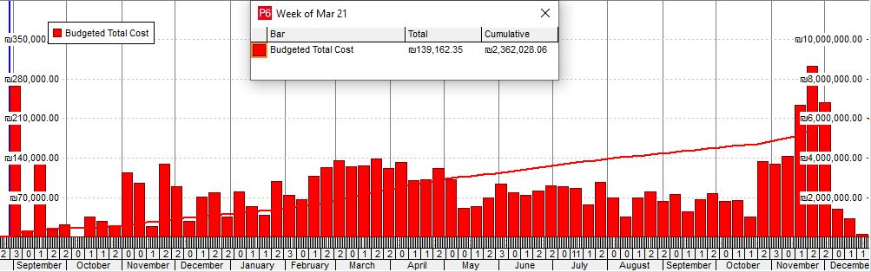
S-Curve
Figure: S-Curve for the Total Direct Budgeted Cost

Slide 40
Price
The job overhead was assumed to be 10% of the direct costs, the operating overhead 5% from the direct costs and job overhead, and the profit 15% of the total cost.
Direct Cost = 5,975,920₪
Job Overhead = 10% Direct cost = 597,592₪
Operating Overhead = 5% (Direct cost + Job Overhead) = 328,676₪
Indirect Cost = Job Overhead + Operating Overhead = 926,268₪
Total Cost = Direct Cost + Indirect Cost = 6,902,188₪
Profit = 15% Total Cost = 1,035,329₪
So, the Price = Total Cost + Profit = 7,937,517₪

Slide 41
NAVISWORKS
Definition
It is a 3D design review package for Microsoft Windows, and it is primarily used in the construction industries to supplement 3D design
Benefits
1. Control project outcomes
2. Resolve conflicts
3. Help in planning projects before construction

Slide 42
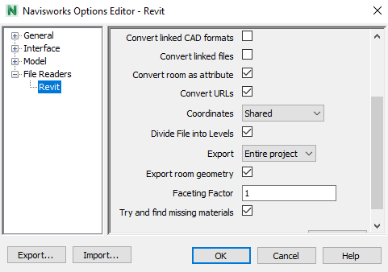
Input Data
Time Linear
NoteWorthy Composer (NWC) and Comma Separated Values (CVS) Files
Figure: Exporting NWC Files from Revit

Slide 43
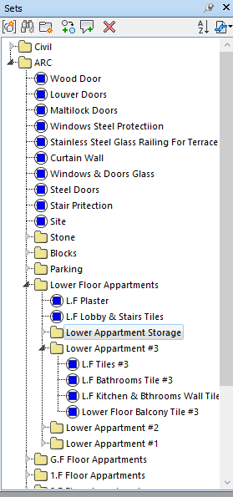
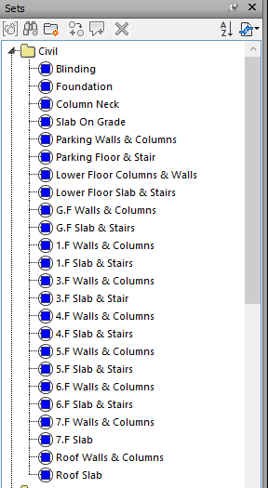
Architectural and Structural Sets
Figure: Architectural Sets Figure: Structural Sets

Slide 44
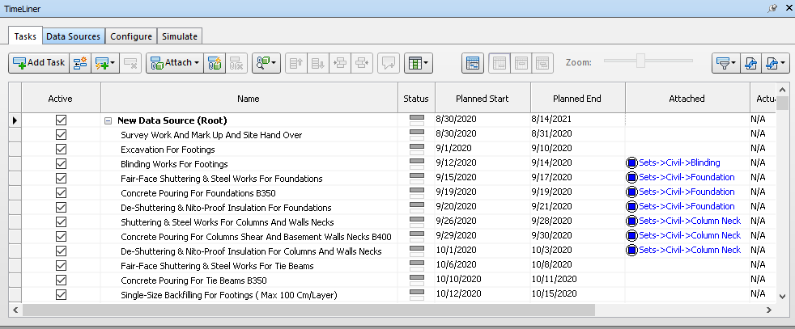
Sets Attachment to Activities
Figure: Sets Attachment to Activities

Slide 45
Video

Slide 46
RECOMENDATIONS
Using BIM in an integrated manner is very important in the management construction sector because it reflects reality in different aspects such as cost and time in particular.
Take the electrical and mechanical plans into consideration to achieve the best results.

