Slide 1



An-Najah National University
Faculty of Engineering and Information Technology
Management Information Systems Department

Slide 2
Dyarna E-commerce Platform
(Website and App Interfaces Design)

Slide 3

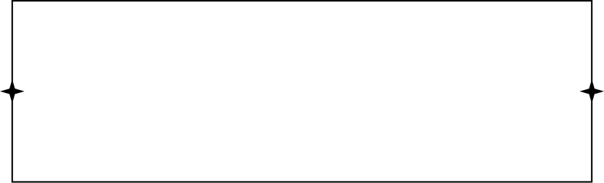
Aboute Dyarna
"Dyarna" is an online sales platform that was established to provide a store that contains all high-quality Palestinian products for consumers.
Why Dyarna Name
Because the word "Diyar" traditionally means homes, the name reflects our connection to Palestinian roots. Everything created in our "Dyarna" offers the products of the Palestinian home, bringing them from our "Dyarna" to the homes of our customers.

Slide 4
Vision:
To be the destination that starts from Palestinian markets and expands globally, to include everything imaginable from Palestinian products.
Mission:
Providing a modern shopping experience for traditional Palestinian products from Dyarna by providing all products on one platform.

Slide 5
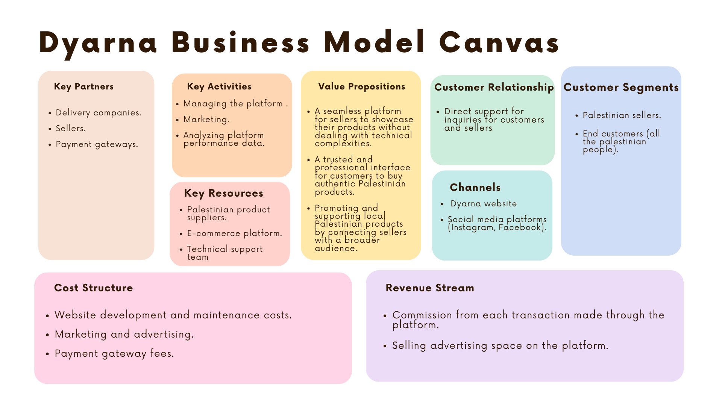

Slide 6
Why Sellers Will Use Dyarna
Integrated Platform
Cost Savings
Technical Support
Reach a wide and targeted audience
Low commission

Slide 7
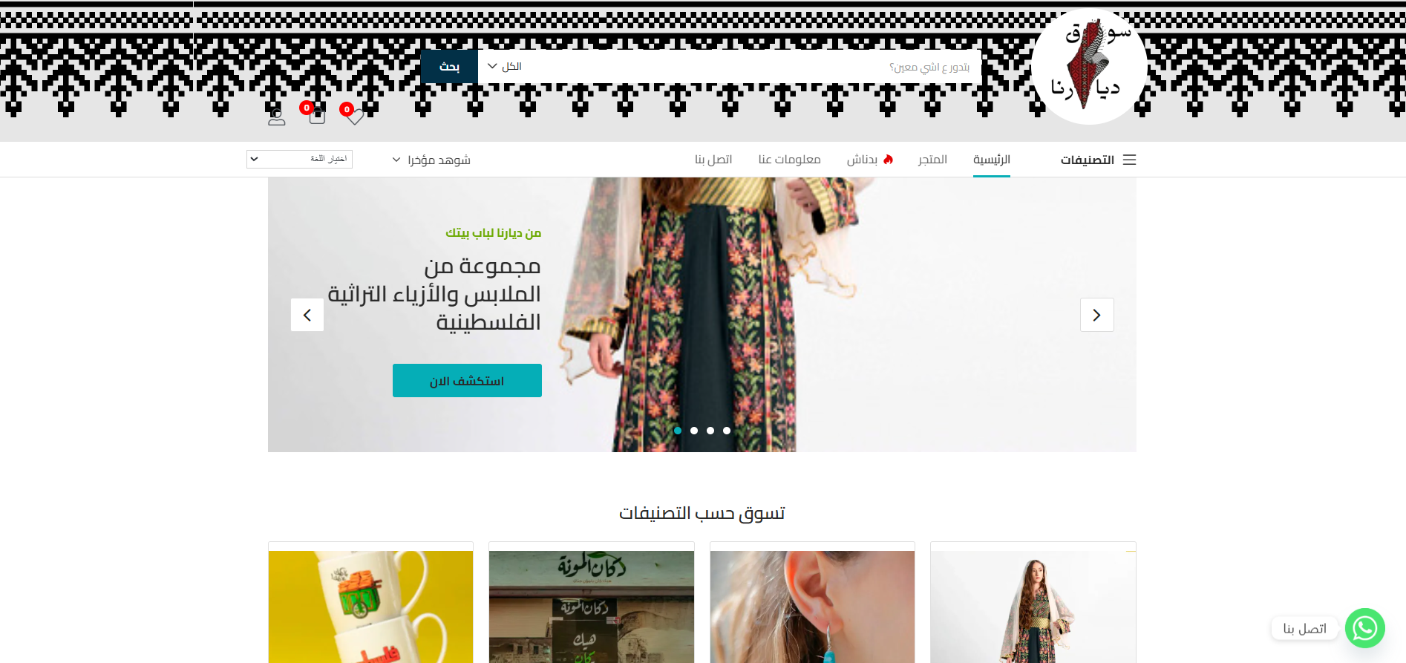
Home page

Slide 8
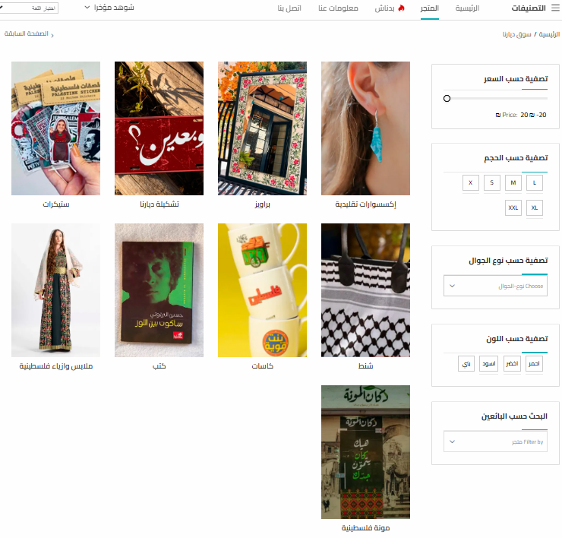
Store

Slide 9
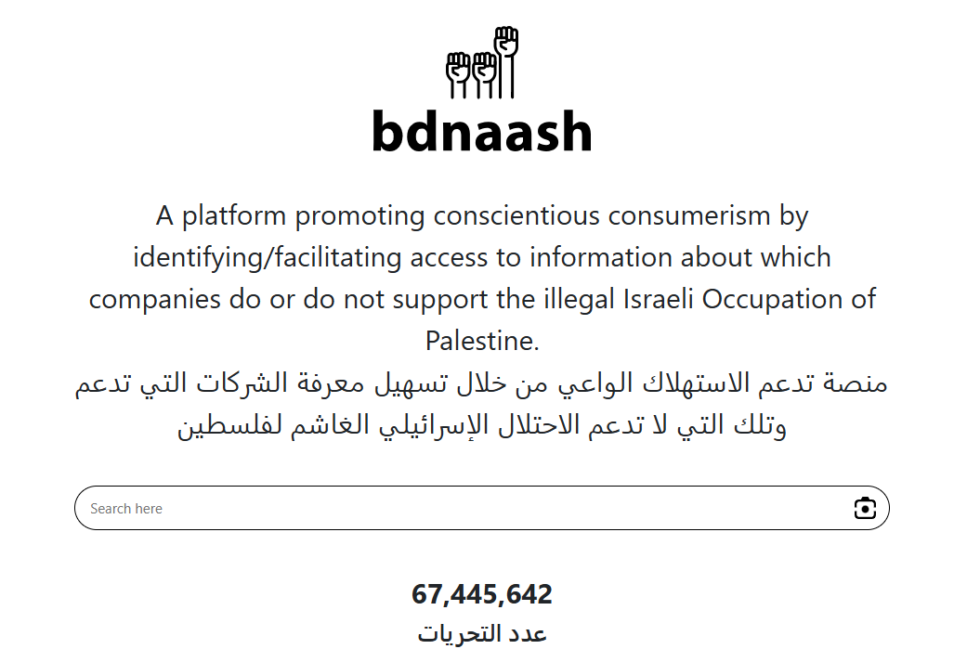
Boycott Companies Verification

Slide 10
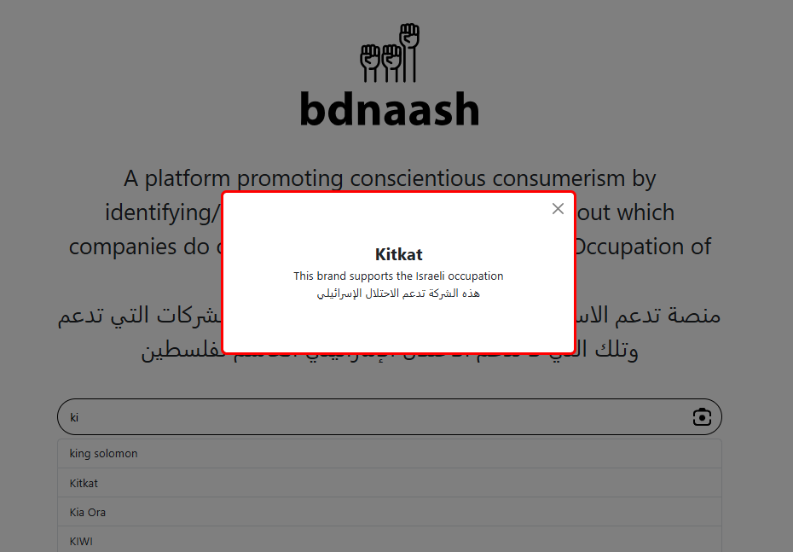
Boycott Companies Verification

Slide 11
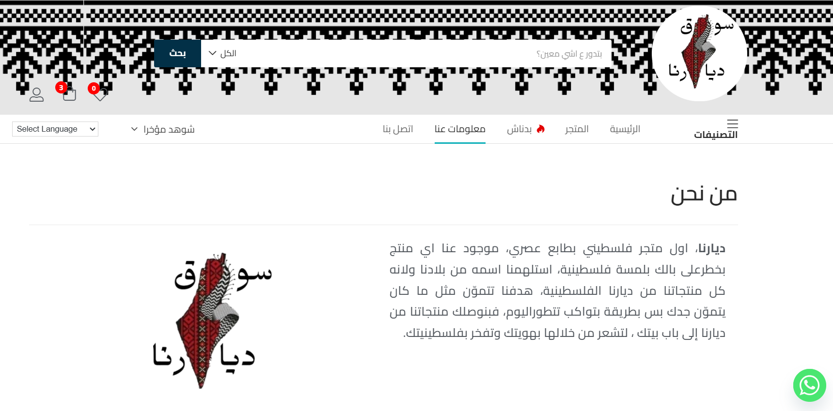
About Us Page

Slide 12
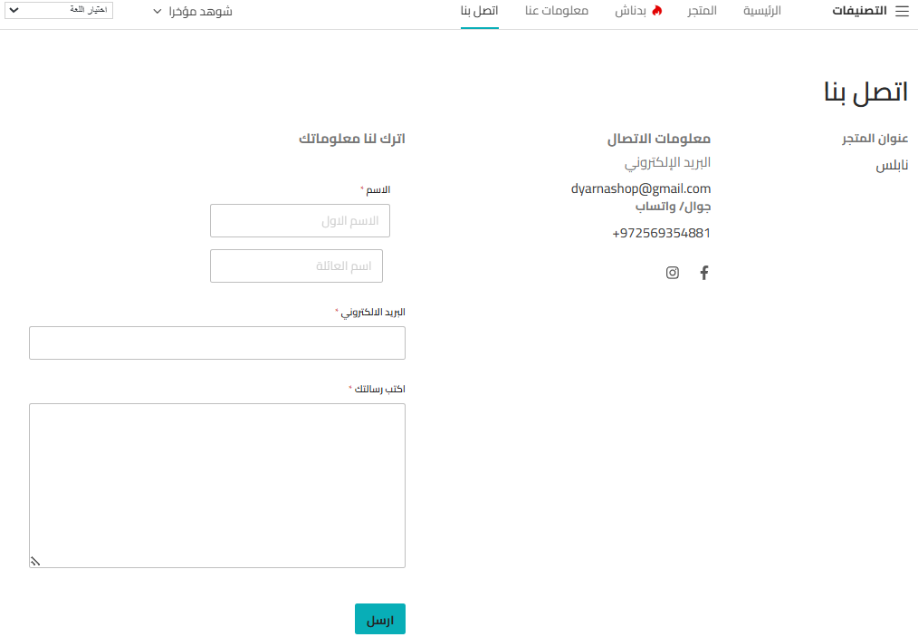
Contact Us Page

Slide 13
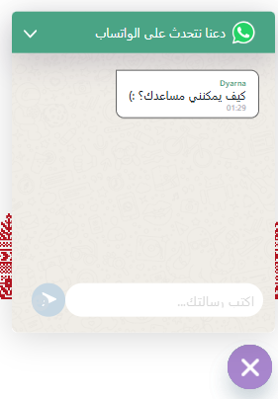

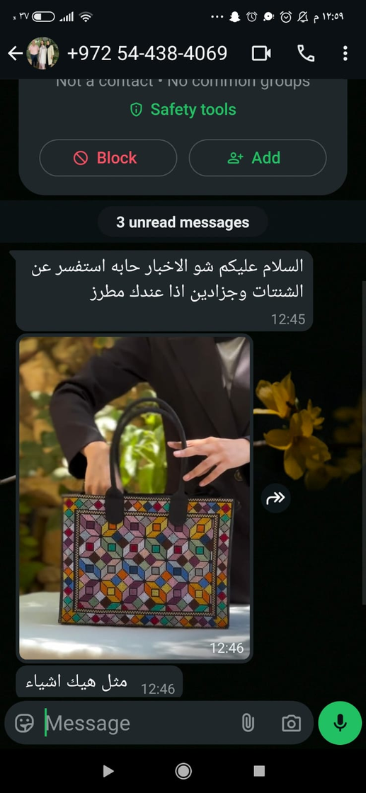
WhatsApp Support

Slide 14
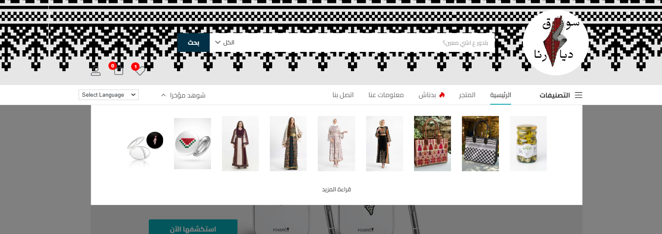

Recently Viewed

Slide 15
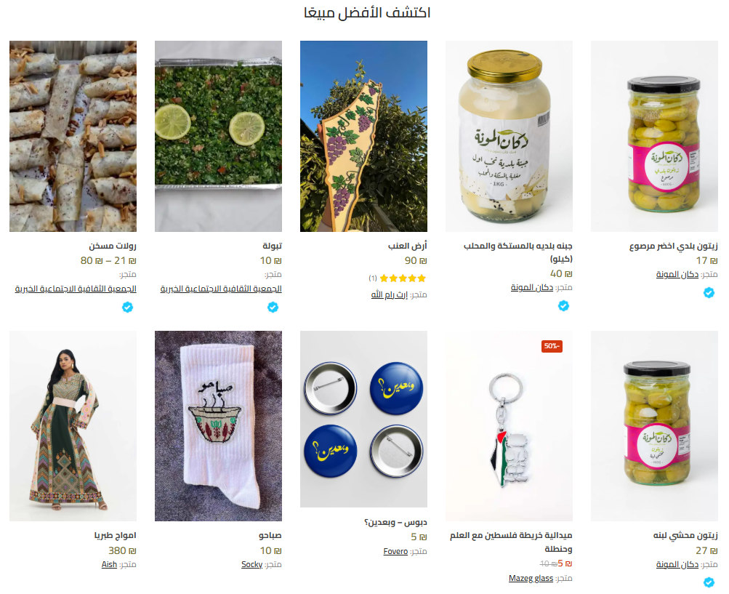
best seller

Slide 16
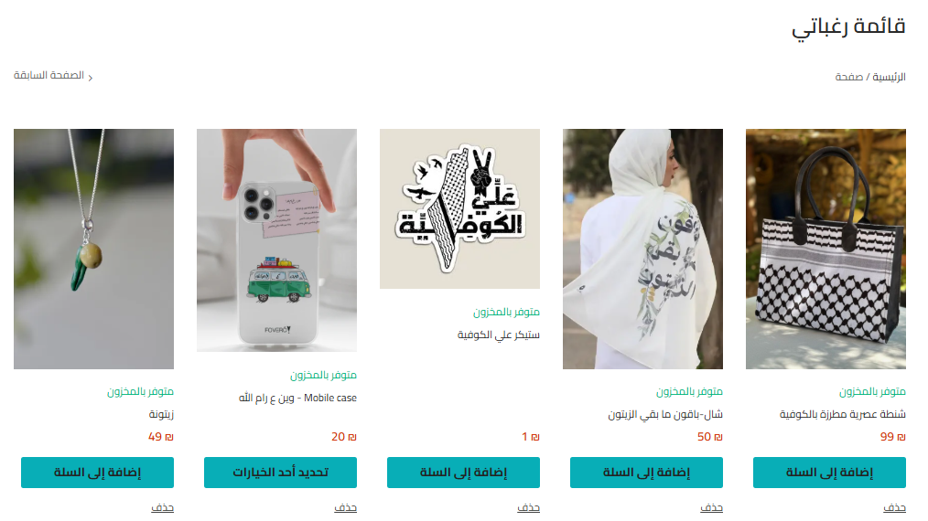
Whish List

Slide 17
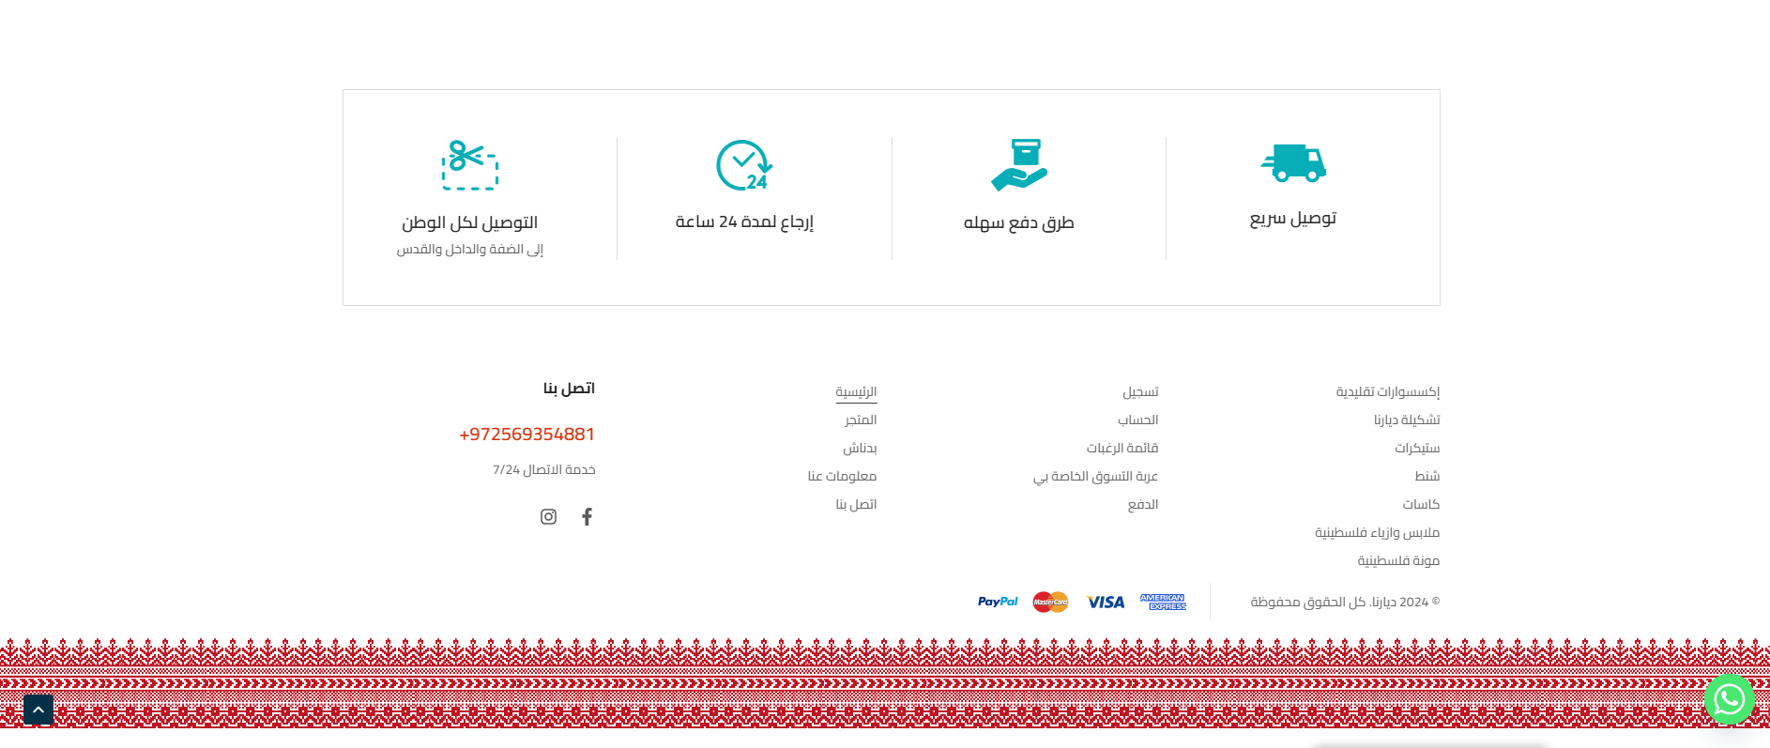
Footer

Slide 18
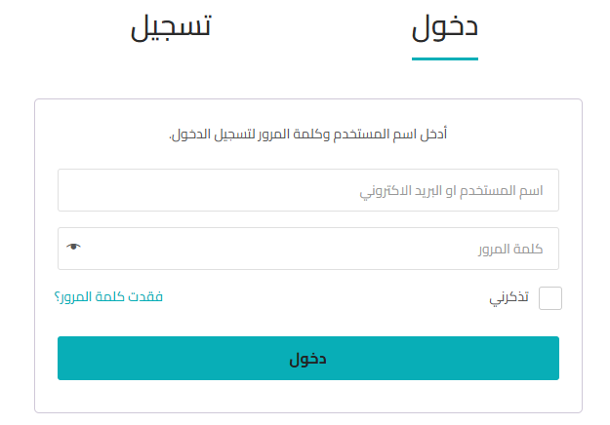
Sign In Page

Slide 19
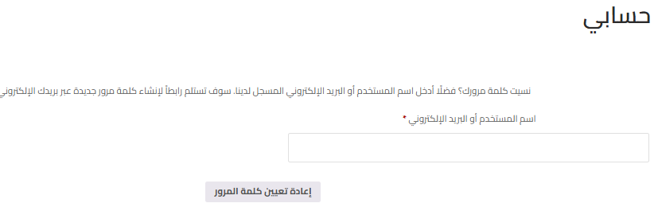
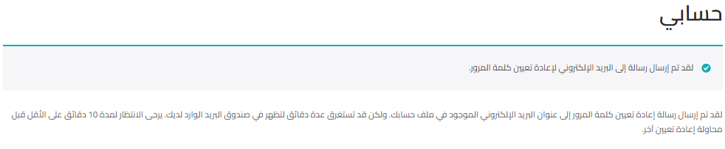
Forgot Password?

Slide 20

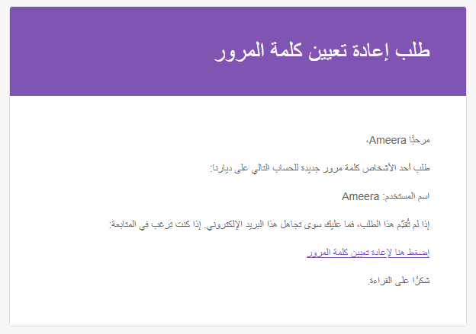
Reset Password

Slide 21
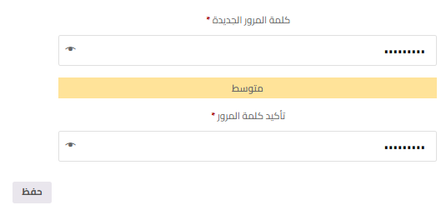
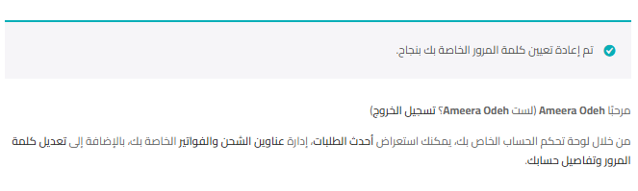
Reset Password

Slide 22
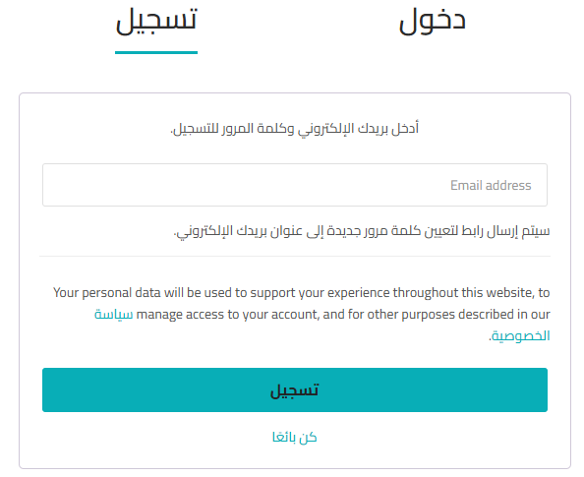
Sign Up Page

Slide 23
Sign Up Page

Slide 24
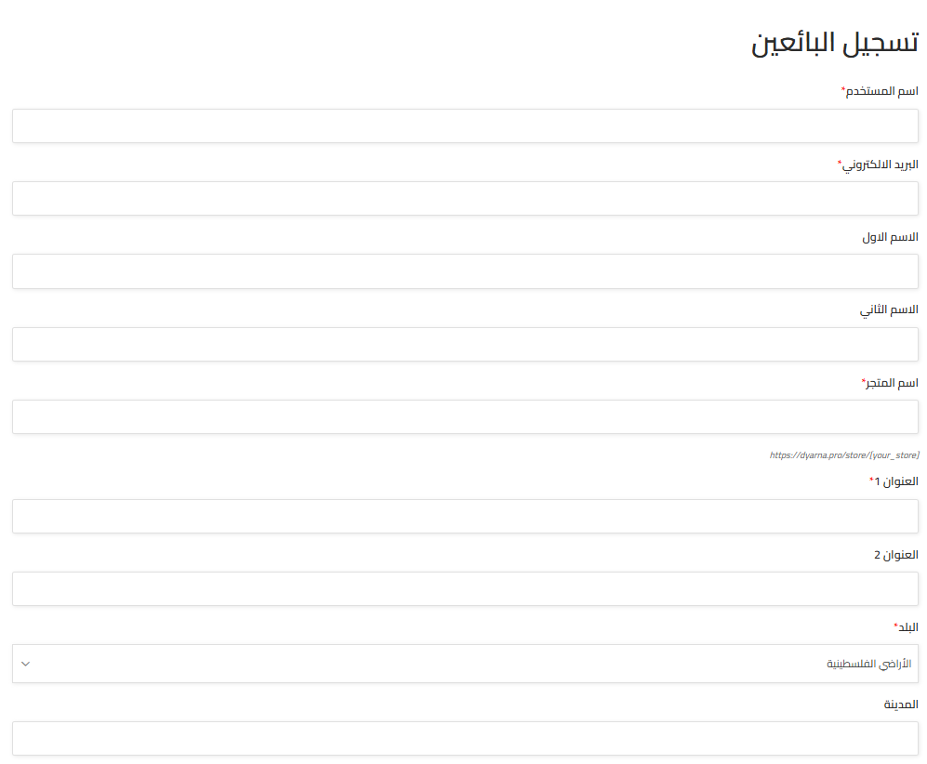
Become a Seller

Slide 25
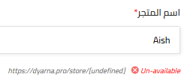
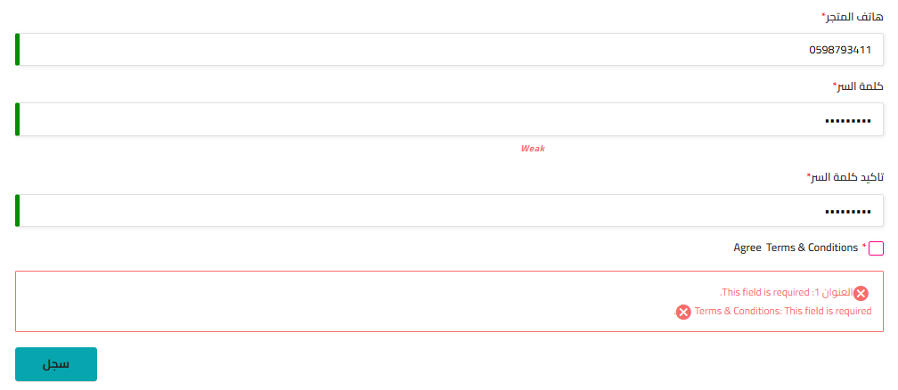
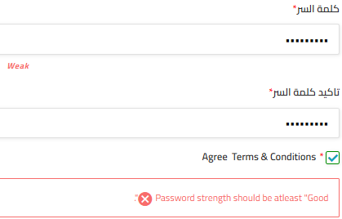
Data Valedation for regestration

Slide 26
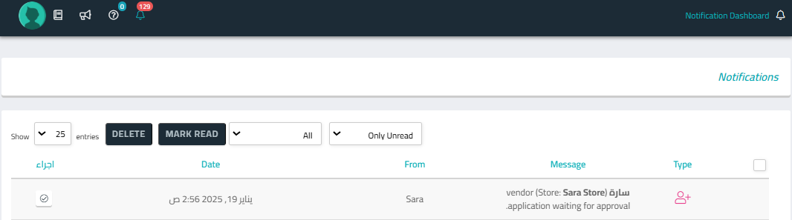
Vendor Application Pending Approval

Slide 27
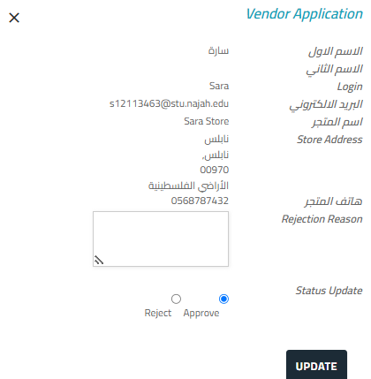
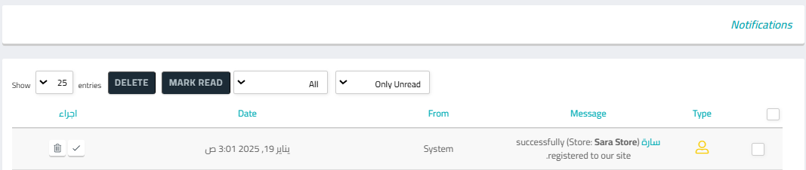
Vendor Application Approved

Slide 28
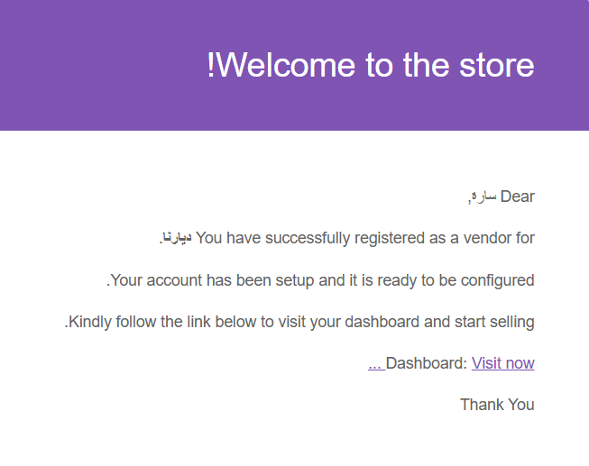
Store Setup Wizard

Slide 29
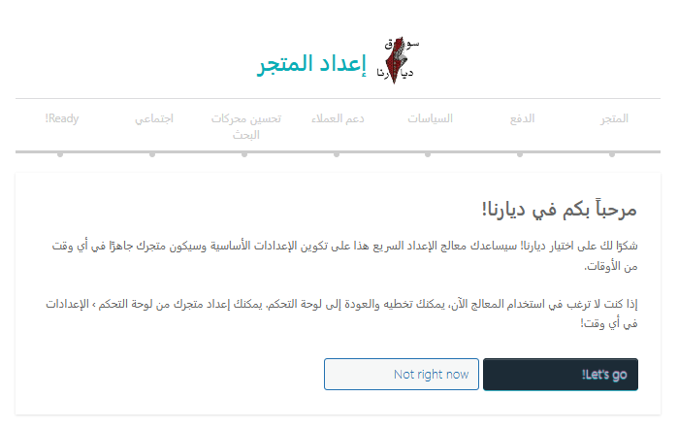
Store Setup Wizard

Slide 30
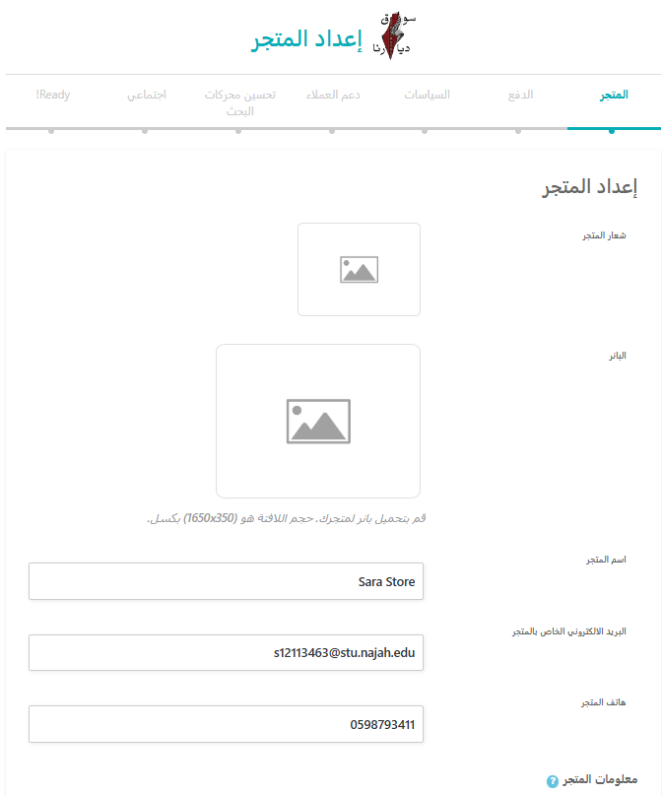
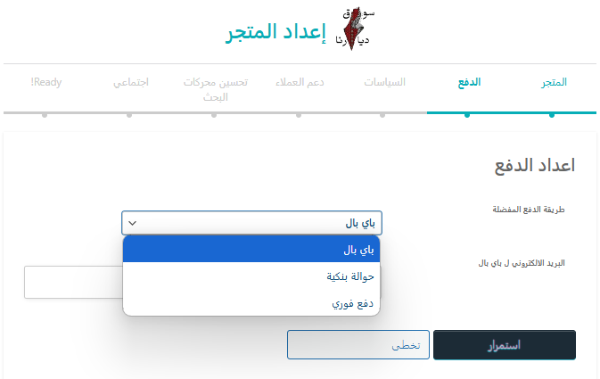
Store Setup Wizard

Slide 31
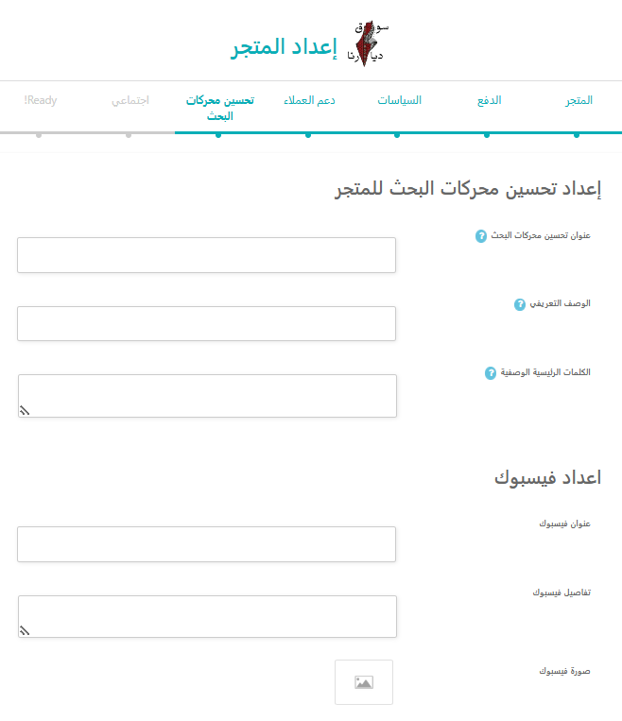
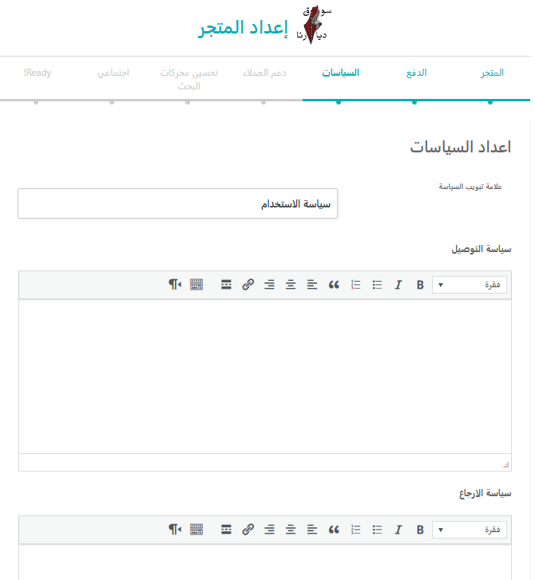
Store Setup Wizard

Slide 32
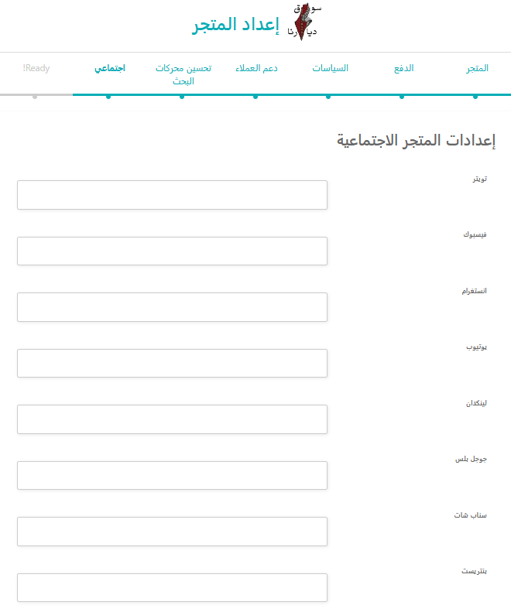
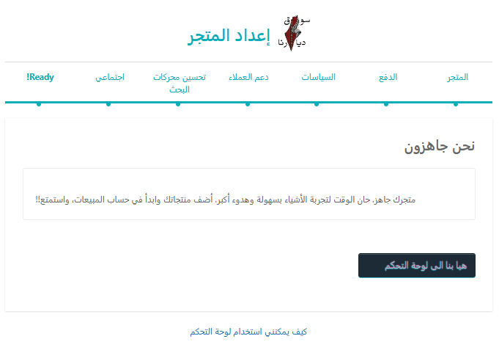
Store Setup Wizard

Slide 33
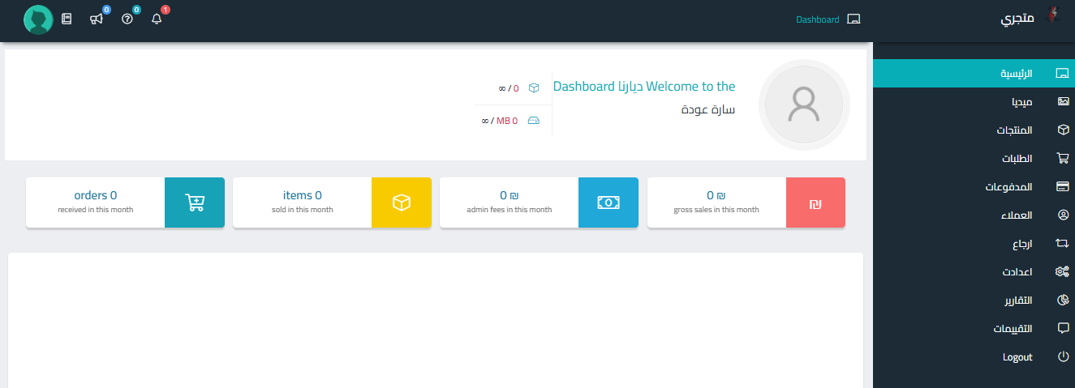
Store Setup Wizard

Slide 34
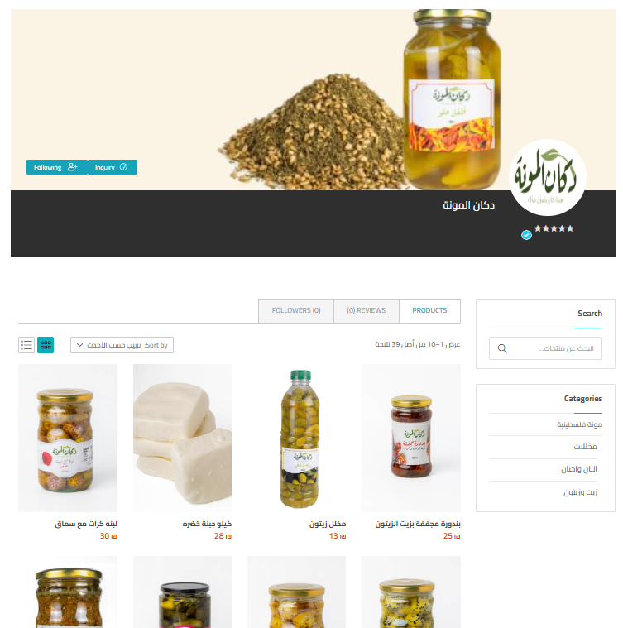
Seller Profile

Slide 35
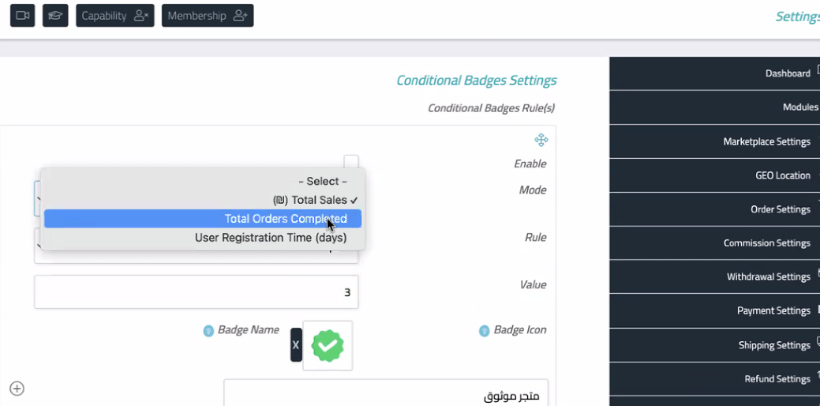
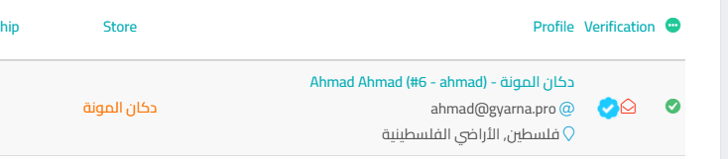
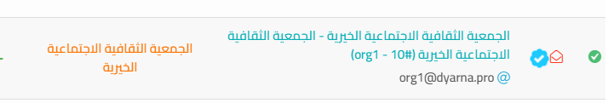
Verified Store

Slide 36

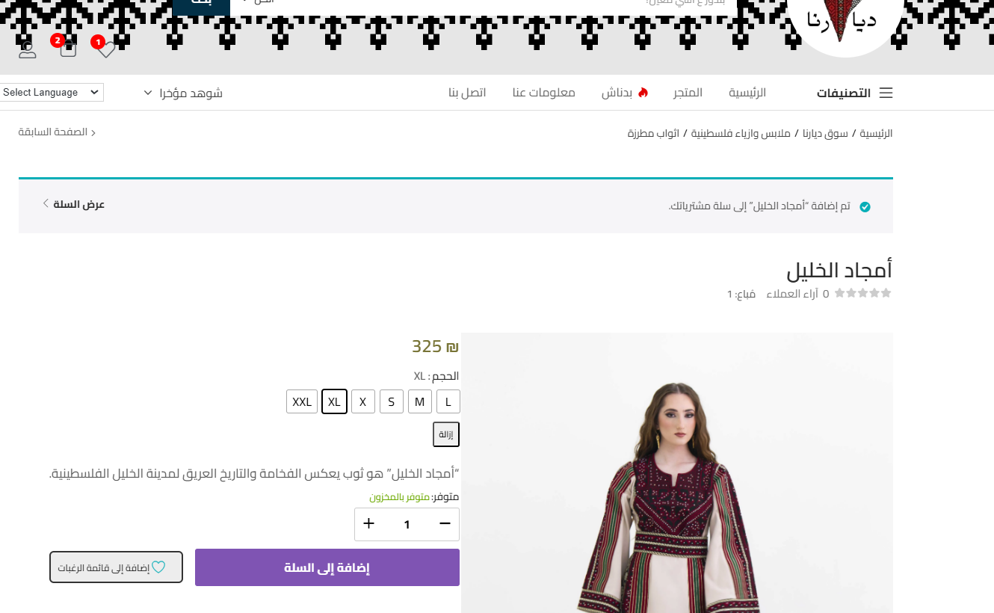
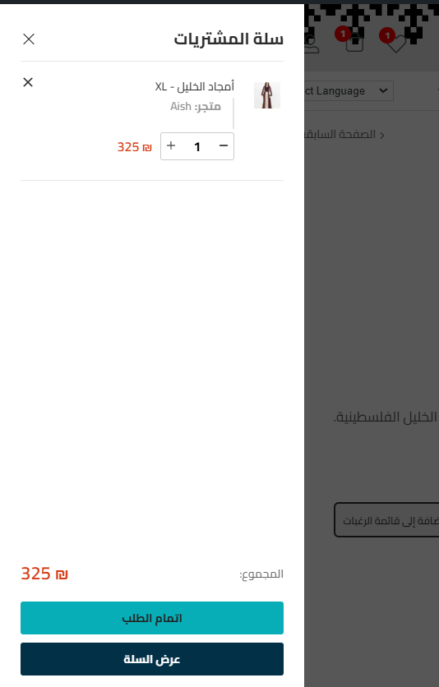
shopping cart

Slide 37
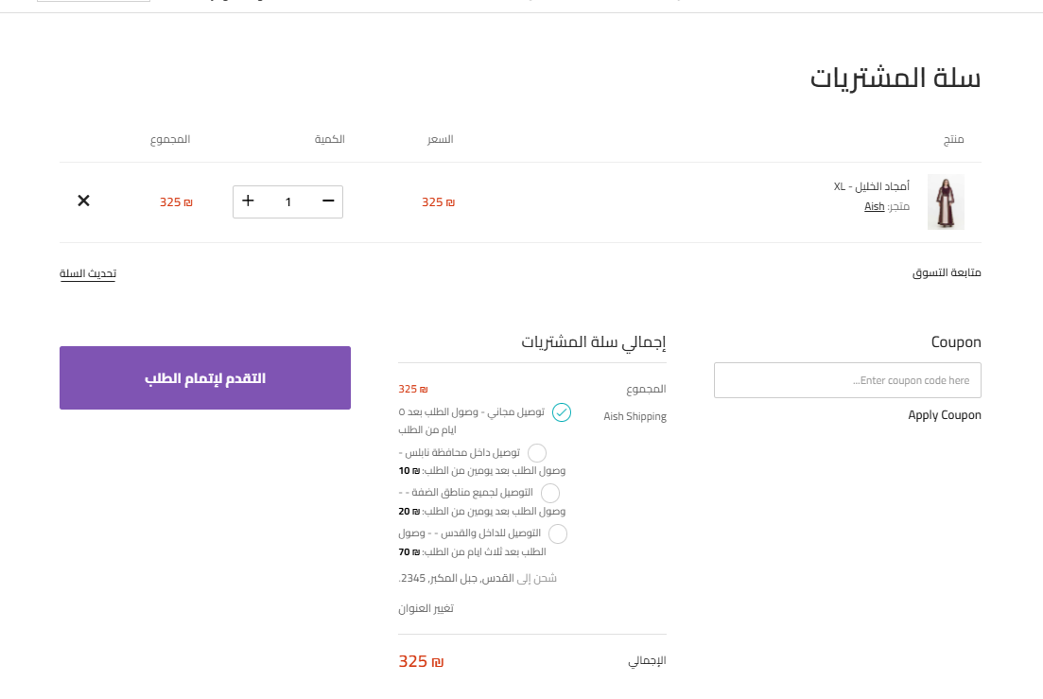
shopping cart

Slide 38
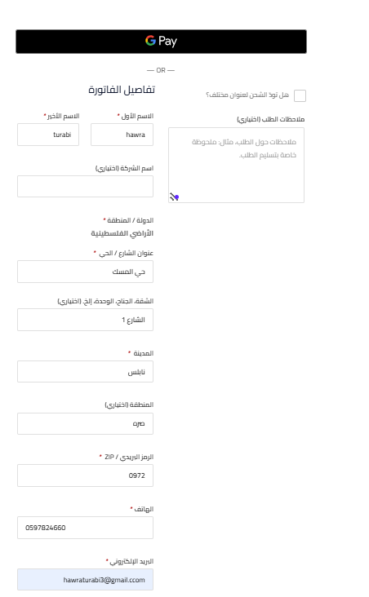
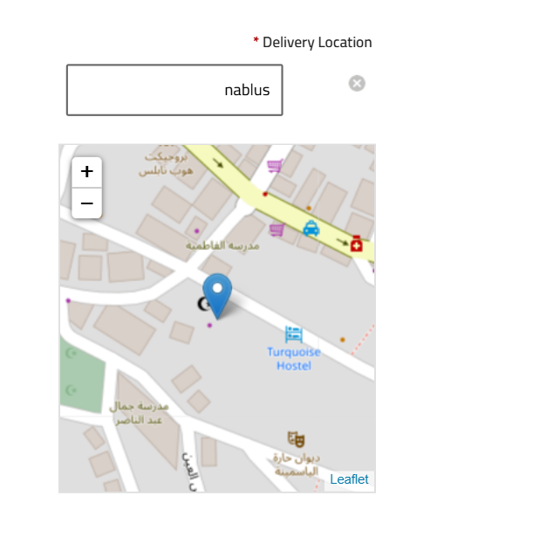
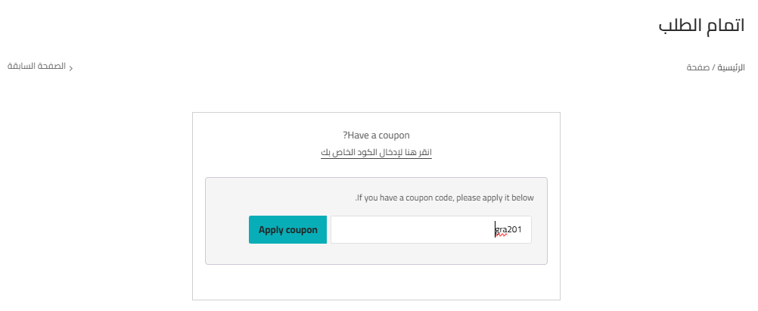
Checkout
(3)
(2)
(1)

Slide 39
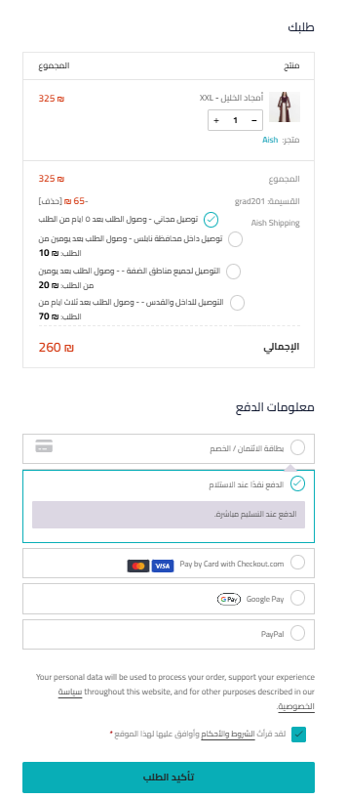
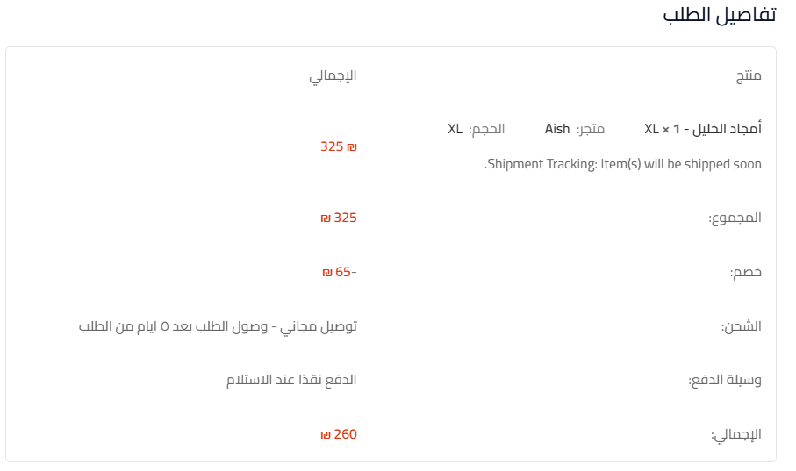

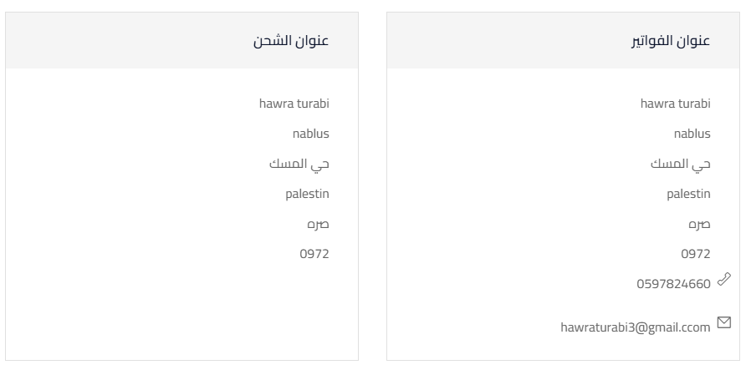
(4)
Order Details

Slide 40


Order Confirmation via Email

Slide 41


Purchase Discount
Admin side
Customer side

Slide 42


Feedback For Registered Users

Slide 43


Feedback For Non-Registered Users

Slide 44

Feedback For Non-Registered Users

Slide 45

Feedback Pending Admin Approval

Slide 46

Feedback Approved

Slide 47

customization

Slide 48


customization

Slide 49


customization

Slide 50

Filters

Slide 51


Color Options

Slide 52

Related Products

Slide 53

Related Products

Slide 54

Products by interest

Slide 55








Plugins used

Slide 56

Seller Dashboard

Slide 57

Products

Slide 58

Orders

Slide 59

Payments History

Slide 60

Cupons

Slide 61

Customers

Slide 62

Refund Requests

Slide 63

Reports

Slide 64

Seller Analysis

Slide 65


Analysis

Slide 66

Out of Stock Notification for Sellers

Slide 67

Admin Dashboard

Slide 68

Admin Dashboard

Slide 69


Commission
Admin said
Seller side

Slide 70

Commission
How to take?

Slide 71

Commission

Slide 72

Performance and Charts

Slide 73


Quick Analytics: Leader board

Slide 74


Quick Analytics

Slide 75



Social media

Slide 76



App Interfaces Design

Slide 77


(وَآخِرُ دَعْوَاهُمْ أَنِ الْحَمْدُ لِلَّهِ رَبِّ الْعَالَمِينَ)
Prepared and Presented By
👤 Ameera Odeh
👤 Rasha Shqeqat
👤 Hawra Turabi
Supervised By
🎓 Dr. Maher Arafat

