Slide 1
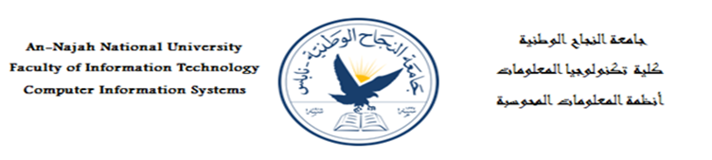
E-Book Social Media Application
Students:
11717744 Ezz AL-Dean Saeed
11612481 Ziad Hwaach
Supervisor:
Dr. Emmad Saadeh
A project report submitted in partial fulfillment of the requirements
for B.Sc. degree in Computer Since.
An-Najah National University
2018 / 2019
Notes:
11612481

Slide 2
Introduction
Nowadays, the phenomenon of social media has spread, as each site specializes in services that distinguish it from the other, for example YouTube is a social media for videos, Instagram is social media for photos.
E-book is mint to be a social media Application for books.
It’s a combination between a big library of electronic books and Social Media Platform.
E-Book: stands for tow references :
1-Electronic Books.
2-Entiraction Books

Slide 3
Abstract
E-book” is a web-based social media Application, specified for reading and communication activities.
The system provides services for anyone in the world either a reader, Author or students.
The program provides many services for readers who want to read and discuss what they have read with other people, as well as Authors who want to spread their ideas and talent to the world, as well as Students that need books with acceptable price.
The program is mint to be a social media for books, helping our customers to find any book they want and spread their opinion about it or even Publish their own in a fast, easy and the best way possible, and even helping them create new friends and chat with them.

Slide 4
Three Main Privileges
Reading and buying books.
View and Add a Feedback on books.
Socializing by add friends, posts, chat and see others post giving them a comments and licks.

Slide 5
Our Customers
The following are the system main actors:
Readers: They are our standard customers and they have the three main privileges.
Guest: They are the common people who visit the website without registered in the website and they can only view and search the books.
authors : They are the people how want to work and publish their writings on the website. They have the three main privileges + adding own books(writings).
Adman's: The team of E-Book social media website. They have all privileges from the three main + managing the website
students: Students who need affordable complete courses. They have the three main privileges + have more offers on books.

Slide 6
Three Questions Test
Is our Website is a Library:
Is there Available Books for our Customer to Reed and is there going to be new ones:
Is there going to be A feedback provided for every book and can they write there own.
Can they Publish there Own Books.
Is our Website is a Social Media.
Can they Publish Posts and see others.
Can they Add friends.
Can they Communicate with other

Slide 7
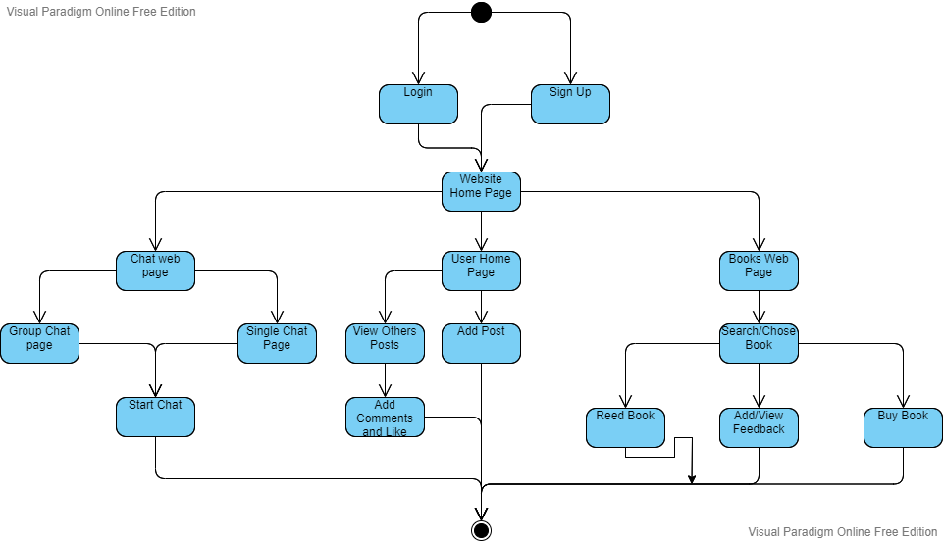
E-Book Diagram

Slide 8
Three Questions Test(ans.)
Is our Website is a Library:
Is there Available Books for our Customer to Reed and is there going to be new ones: Yes.
Is there going to be A feedback provided for every book and can they write there own: Yes.
Can they Publish there Own Books: Yes.
We have a Library…..
Is our Website is a Social Media.
Can they Publish Posts and see others: Yes.
Can they Add friends: Yes.
Can they Communicate with other: Yes.
We have a Social Media…..

Slide 9
Summary
E-book” is a web-based social media Application, specified for reading and communication activities.

Slide 10
Thank You

