Slide 1

GMAP
(Great Map)
Department of Computer Engineering
College of Engineering
An-Najah National University
Prepared by :
Saif Marwan & Osama Nabulsi
Supervisor Name:
Dr. Loay Malhis , Eng. Haya Sammaneh
Academic Year:
2011 – 2012

Slide 2

Contents
Introduction
Why This Project ???
Abstract
Features
Problems
Implementation
Recommendation
Demo

Slide 3
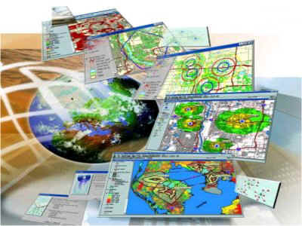
Introduction
A geographic information system (GIS), refers to any system that records and analyzes information linked to a geographic location.
It allows users to search for specific queries and draw conclusions from the analysis of the spatial information and data presented by the map.

Slide 4


Why this project ??

Slide 5
Abstract
Traditional maps waste the user time.
Develops smart CAD-enabled applications using Microsoft Visual Studio.Net software
Ability to instantly read and process data and graphics from CAD drawings and save the result to a file or database.

Slide 6
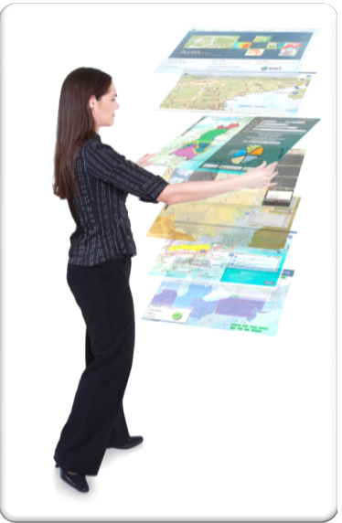
Abstract Cont’d
Facilitate access to computerized maps through a user friendly method which saves time and accuracy.
Includes creating ,managing and converting maps into dynamic ones with integrated database.

Slide 7
Features
We can redraw any map with AutoCAD DXF file format in our project.
Each entity is represent as autonomous object that has its own attributes can be edit easily.
Execute any query from data for reports and decision issues.
Import /Export data from/for another related program .
We took care to make this application user friendly and easy to use .
Can be used in both general and specific uses .
As a result, our application with its features came to provide maps guide and make it available for many public and global companies and sample users.

Slide 8
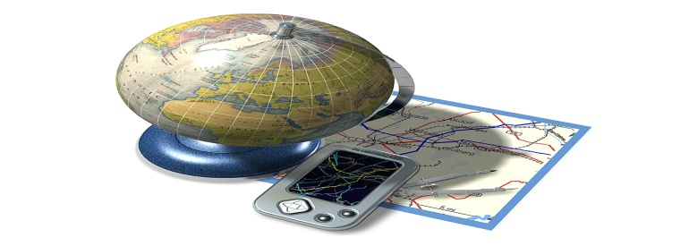
Features Cont’d
Photos
Water System
Electronic Maps
Google Maps
Road Maps
Civil Maps

Slide 9
Problems
Interface between CAD program and C# language.
Guarantee routing Algorithm.
Get a CAD file for new campus in our university showing all details ,in order to apply our program’s features on it.
Find a full view in real world to our university by Google Maps.

Slide 10
Implementation
Coordinate systems :
coordinate systems, projections
People are often mixing the above as if they were one and the same, so here’s a recap of them. One of the things you often find people saying is that “my data is in the WGS84 coordinate system”. This doesn’t really make sense, but I will get back to this later.
This is a very confusing subject, and I might have gotten a few things wrong myself, so please add a comment and I’ll update it ASAP.

Slide 11
Implementation Cont’d
Developer Form :
In this form, developer can redraw any map with AutoCAD file format in our project.
Read DXF file format from this map, and Developer Form can identify on DXF file format then redraw this map again with format that C# language can deal with it.

Slide 12
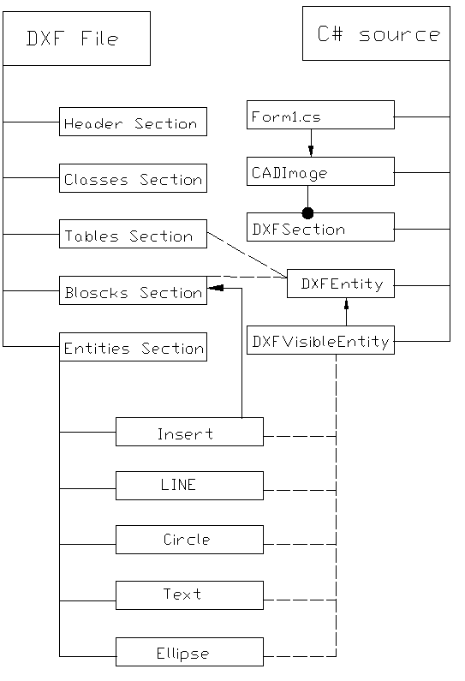

Slide 13
Admin Form :
Update the map using many tools in our project, and he can also add naming and information about company that he wanted from the user to know it by using this application.
Draw basic shapes such as circles ,lines ,points, polygons.
Import and export data from any other database, files.
Implement special query to analysis ,retrieve, edit data.
Insert photos ,label to specific items.

Slide 14
Screen Manager Form :
update events and advertisements and any messages, that the company want from the user to know for each mark place.
Http request with specific website for future expanded.
Guarantee no event conflict.
Server for other screen by TCP/IP protocol.

Slide 15
Real User Form :
This form is the interface between our application and the user, and by this form users can get a lot of information and details about company that is visited.
We achieved that the user not only can easily identify and recognize the path of his destination, but also he has other information about this target and he can get a sample photo of the map from this application to his mobile by Bluetooth.
Also, there is another feature, that the user can note the latest announcements and news and events about this company.

Slide 16
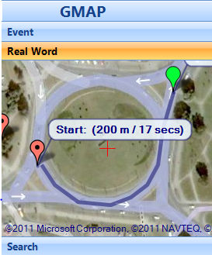
Cont’d
We provided a routing feature by free Google Maps API which enables us to get real view through http request then we will receive response that contain view from real world and routing from start point to end point which selected by user.

Slide 17
Recommendations
We look forward to create 3D showing for the company which used this application.
We look forward to create it, creating panoramic photo for each object in the map..
We can support this project with mobile tracking by GPS of user’s mobile, this feature will provide to the user his location exactly, then we can send to the user mobile alert if the user went through wrong paths.

Slide 18
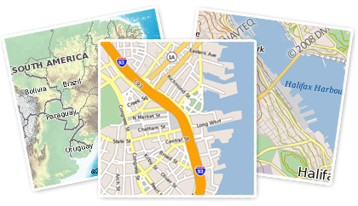
Demo

