Slide 1



Green house Machine
Supervised By: Dr. Hanal Abu Zant
Direct By: Seema ziyad& Lama kharaz

Slide 2







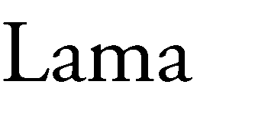




Slide 3








Outlines
1
3
5
2
4

Slide 4













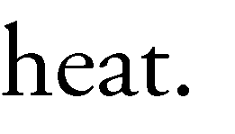

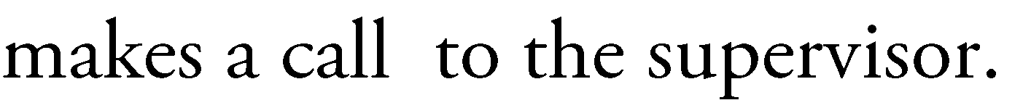

Slide 5
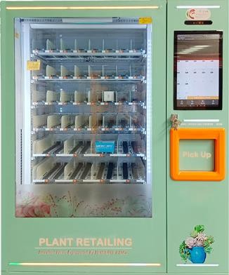
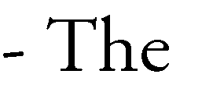
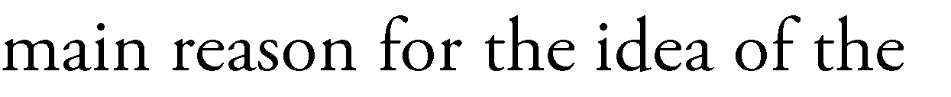




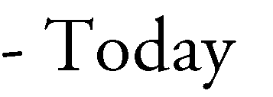
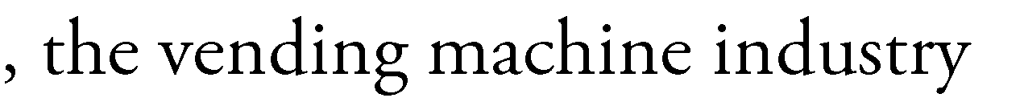
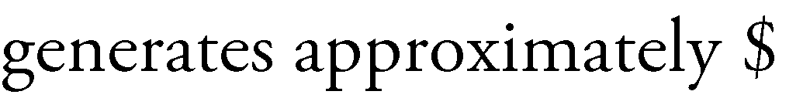



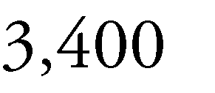


Motivation of the idea

Slide 6




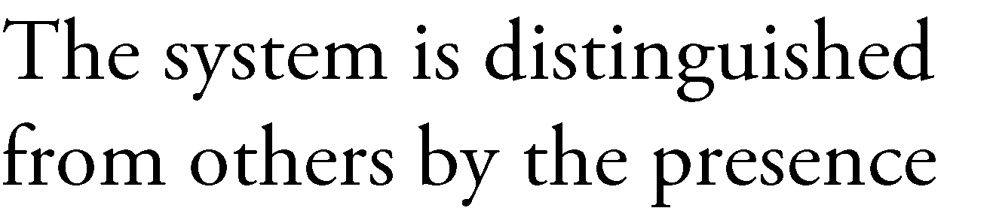







Our Feature
Nextion purchase
Smart green house
Secure purchase
Feature 1
Feature 2
Feature 3

Slide 7



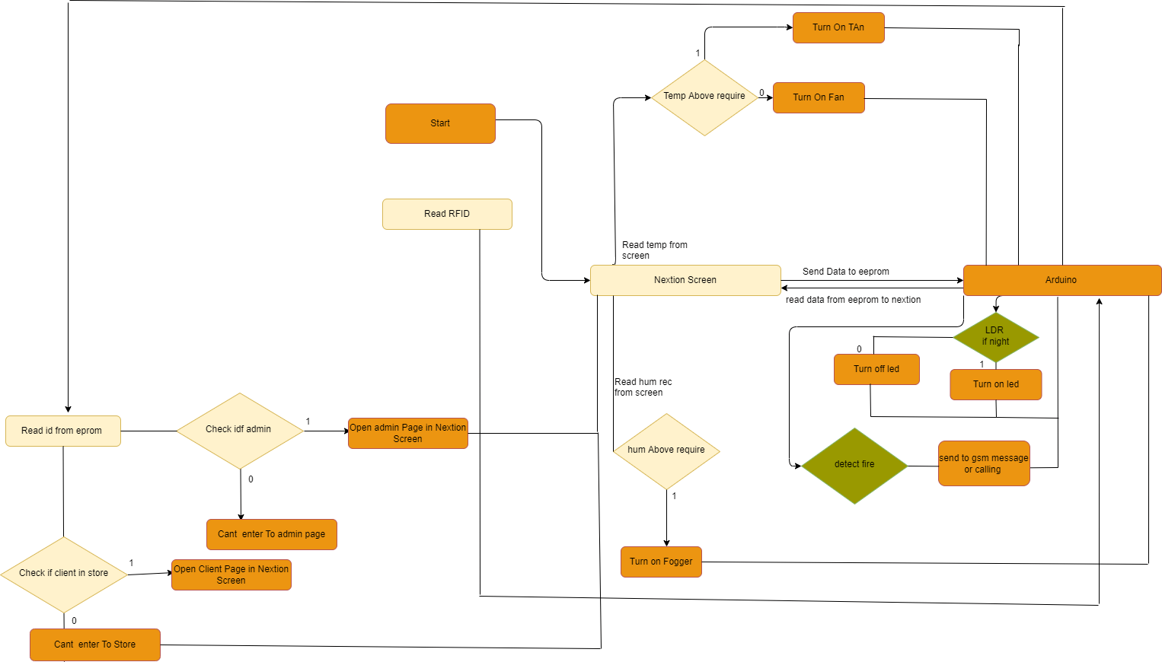

Slide 8






Slide 9

Future work
image processing technology
which is to find out the cause of plant disease and add fertilizer to it, if the plant does not improve, prevent from the store and inform the official.
automatic watering system
Automatic irrigation technology is used inside the machine when needed
01
03
Storing data on the server
In order for this machine to be used in all places and to identify all cards
Web support
So that the admin can control the machine in terms of adding customers through the web or
mobile app
02
04

Slide 10


Slide 11



