Slide 1



Sakni
By: Eba Khalil & Samah Sheeha
SUPERVISOR: DR.ALAA

Slide 2



CONTENT
INTRODUCTION TOOLS USED OBJECTIVES
FEATURES
FUTURE WORK
CONCLUSION

Slide 3



INTRODUCTION
Sakni is a web and mobile-based application designed to simplify student housing management.
It enables students to explore, select, and reserve rooms based on preferences and proximity to university campuses.
The platform streamlines the housing application process by integrating roommate matching, application tracking, and document submission.
Sakni enhances efficiency, transparency, and convenience for students and administrators.

Slide 4


OBJECTIVES
Help students find suitable housing options by providing detailed room information and location insights.
OUR GOAL
Assist administrators in managing housing applications with an organized, efficient platform.

Slide 5
OBJECTIVES
Simplify communication between students and the housing department to resolve issues promptly.
OUR GOAL
Facilitate the housing
process with document uploads, roommate matching, and real- time tracking.

Slide 6
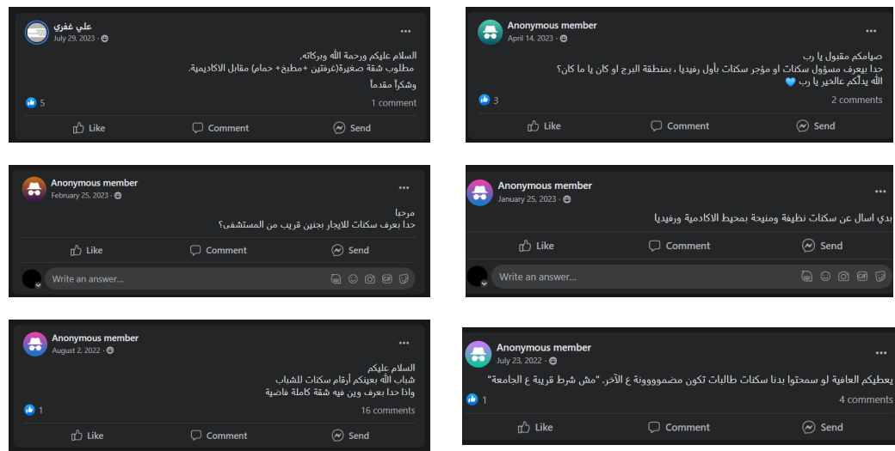

Slide 7
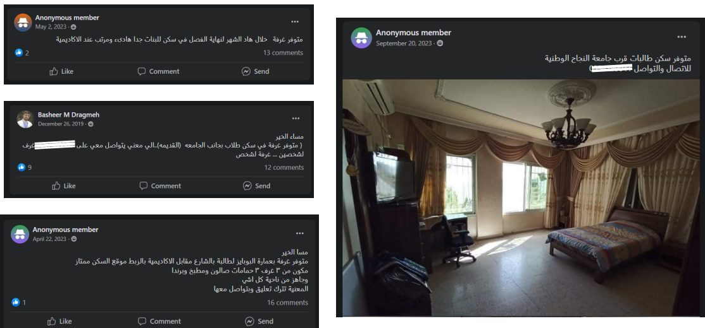

Slide 8






TOOLS
3
Front-End : Flutter (.dart)
Back-End : NodeJS (js)
Database : MongoDB

Slide 9

FEATURES

Slide 10

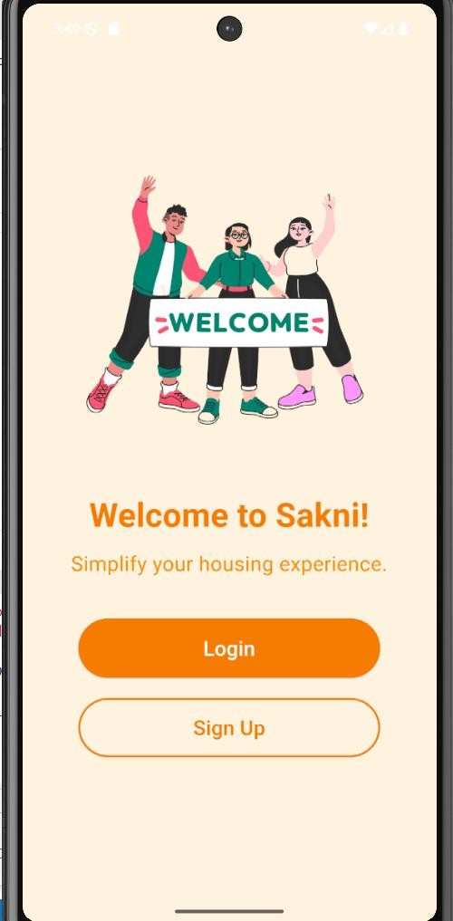
FEATURES
Onboarding screen

Slide 11
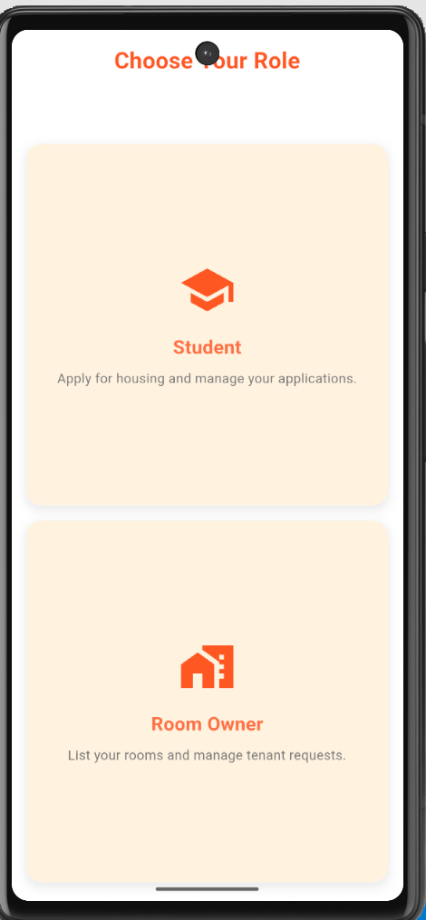
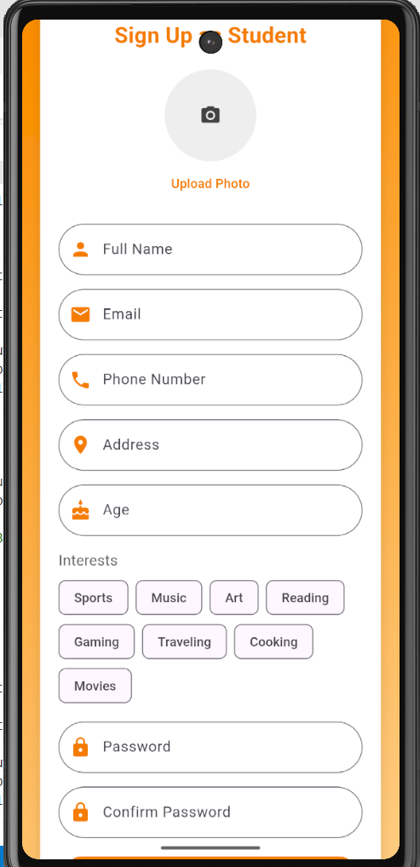
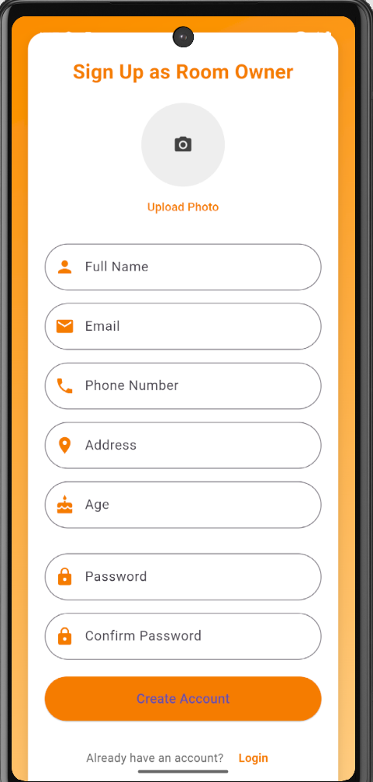
FEATURES
4
Sign Up Screens

Slide 12
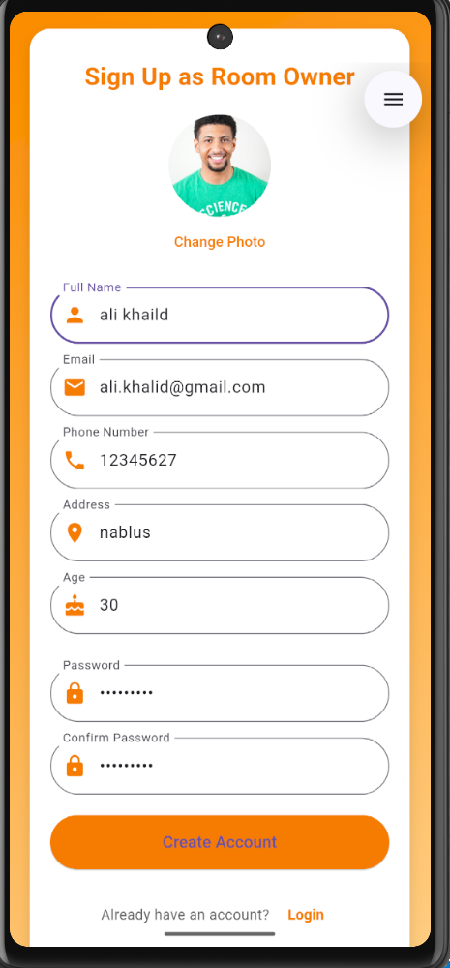
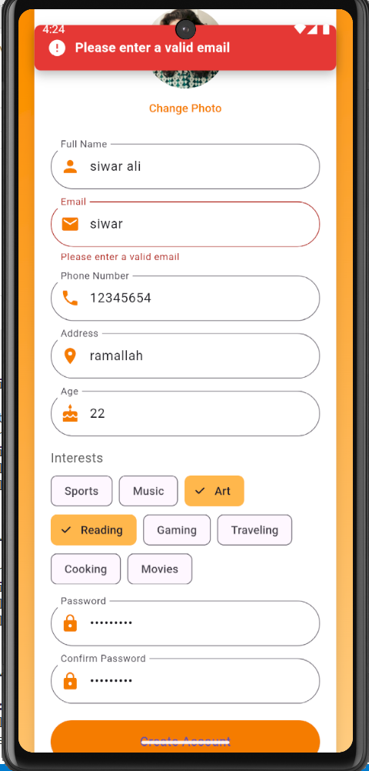
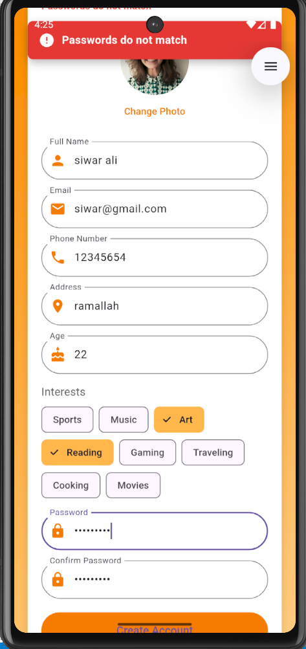
FEATURES
4
Sign Up Screens

Slide 13
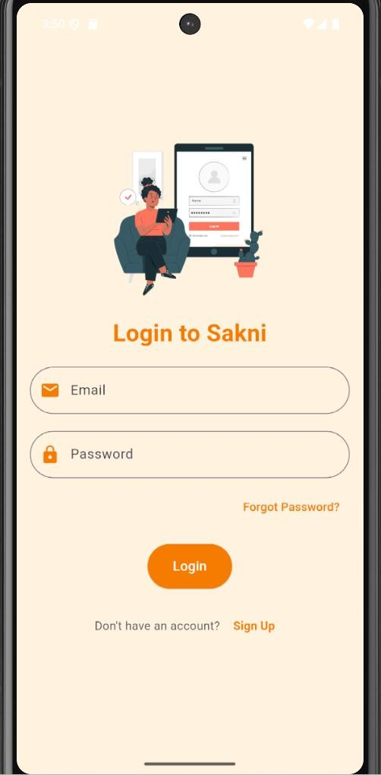
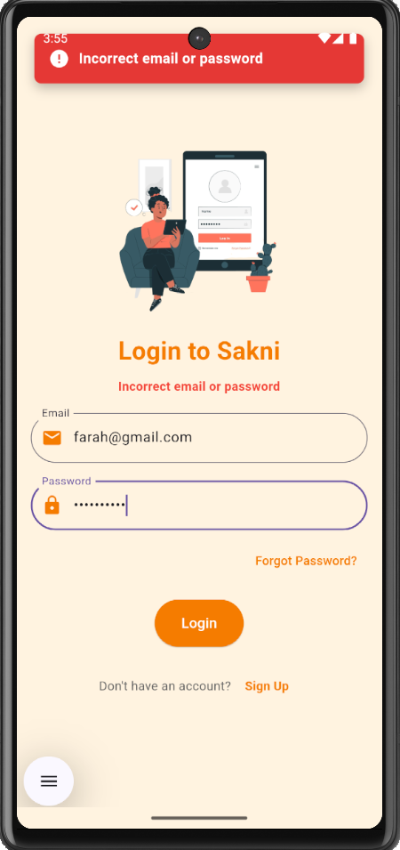
FEATURES
Log in Screens

Slide 14
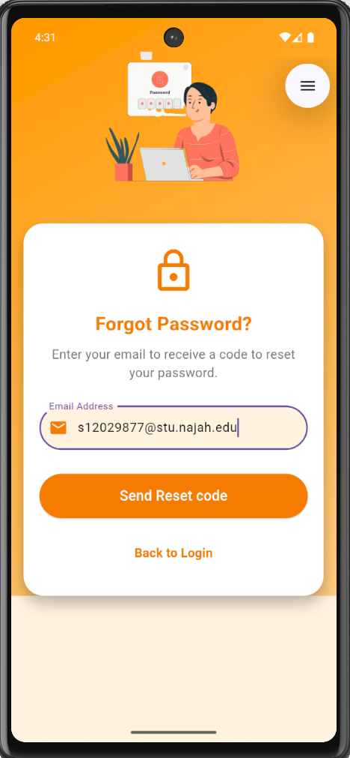
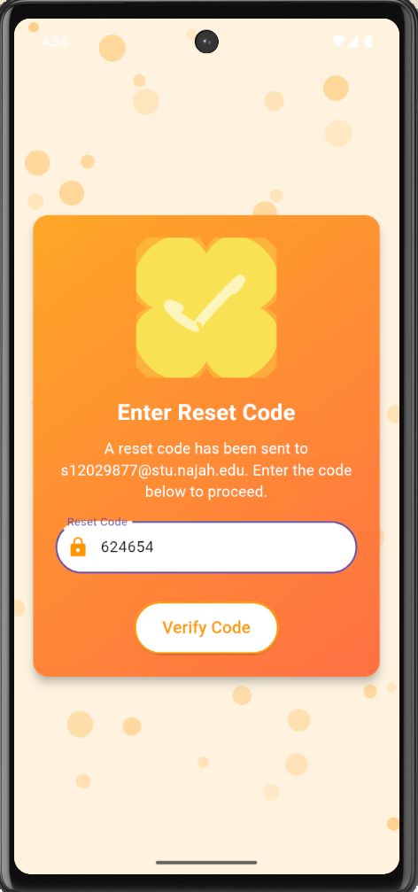
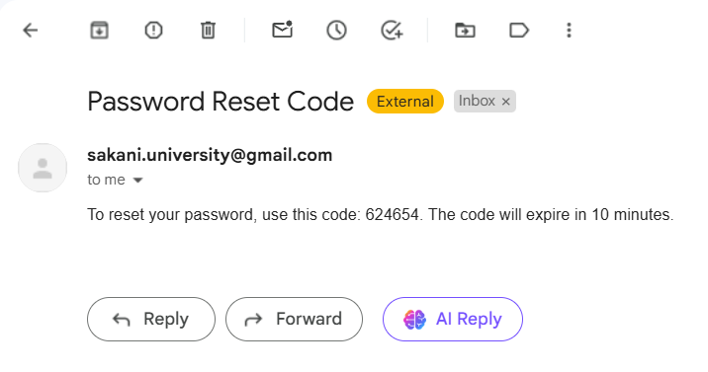
FEATURES
4
Forget Password Screens

Slide 15
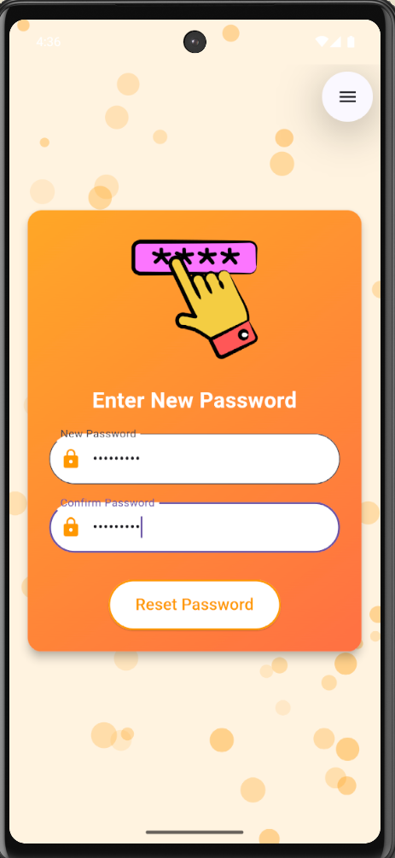
FEATURES
4

Slide 16



FEATURES
4
User
Admin
Room Owner

Slide 17
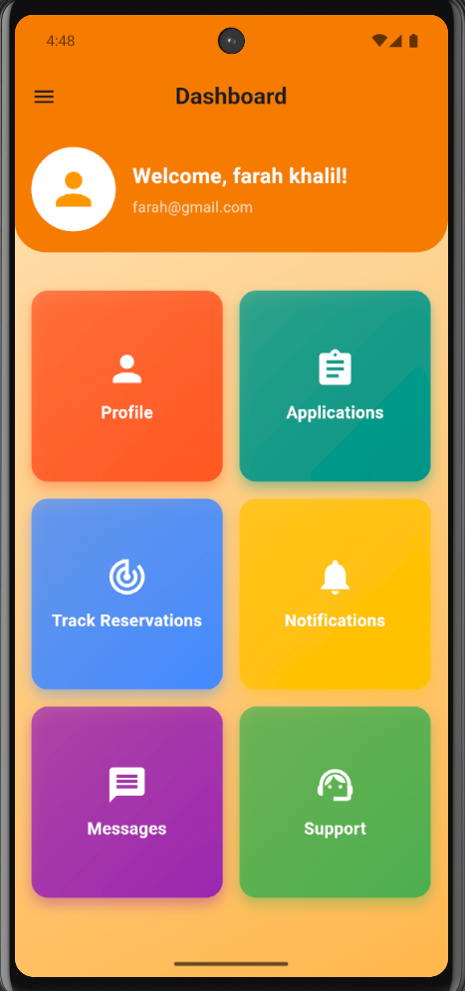
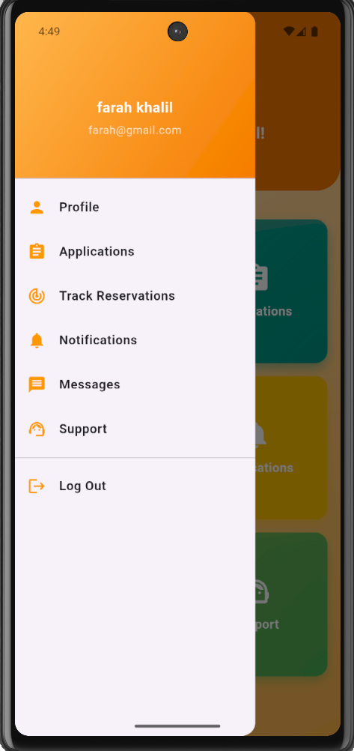
FEATURES
4
User Dashboard Screens

Slide 18
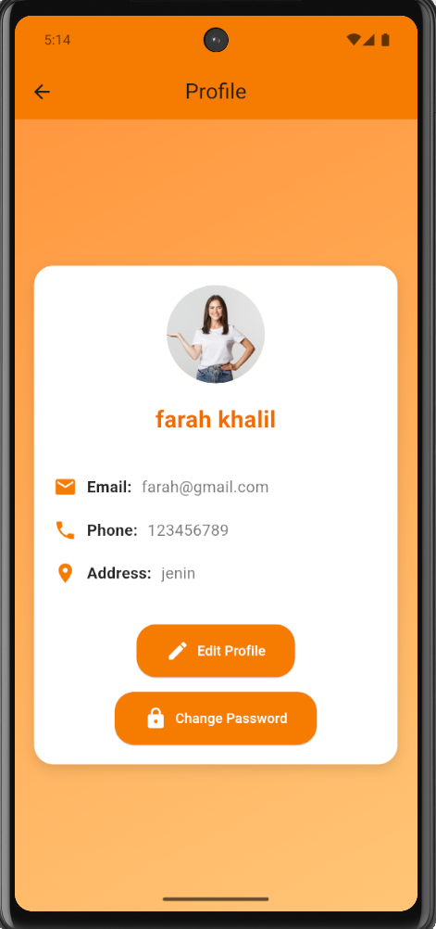
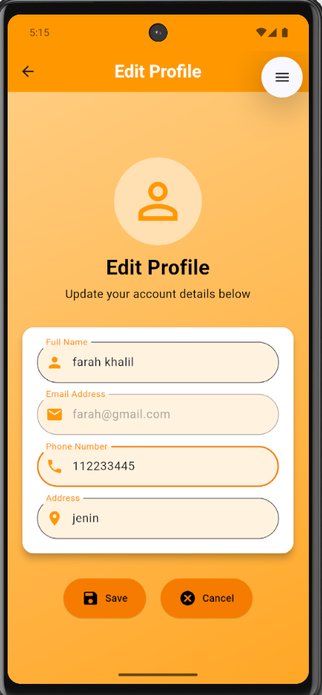
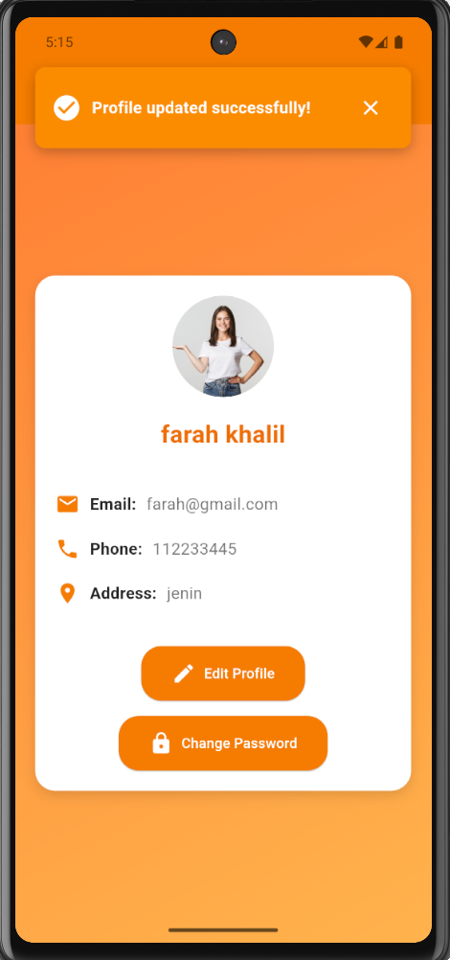
FEATURES
4
User Dashboard Profile Screens

Slide 19
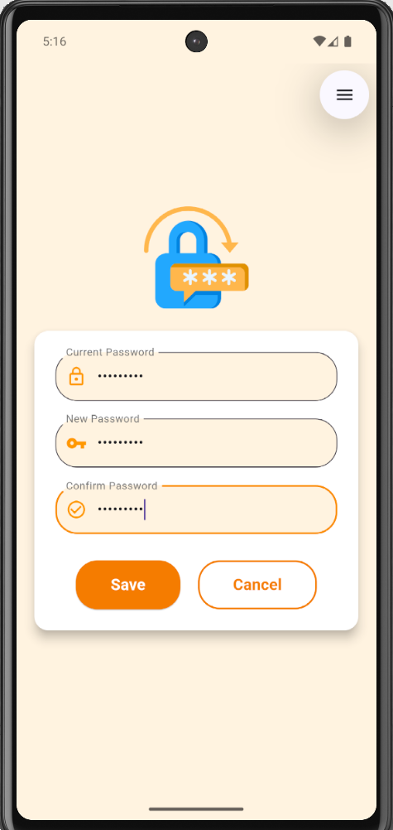
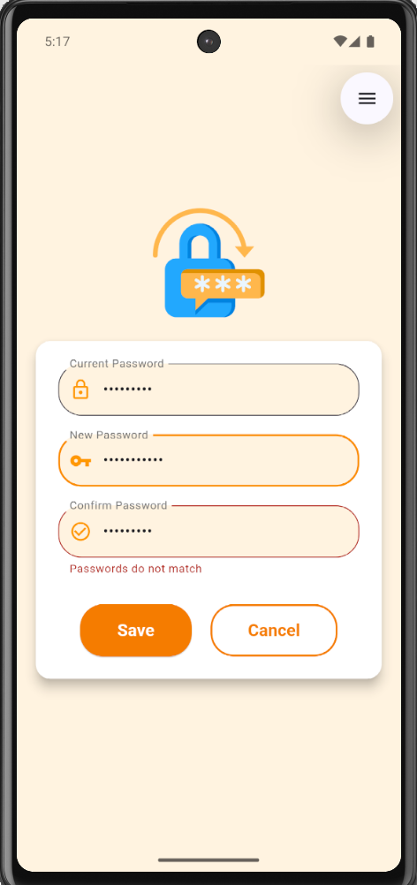
FEATURES
4
User Dashboard Profile Screens

Slide 20
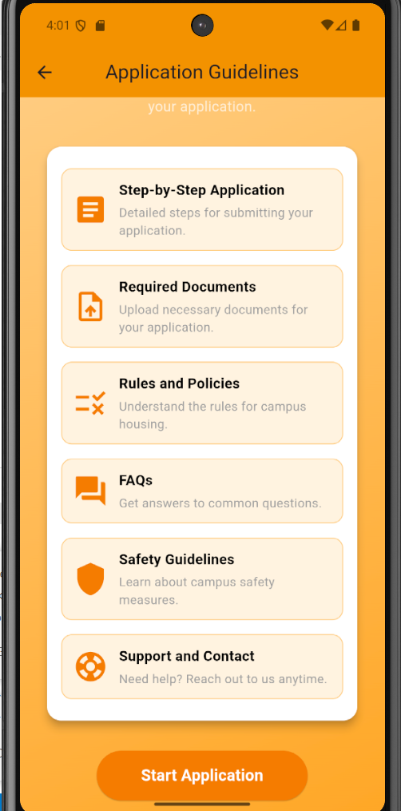
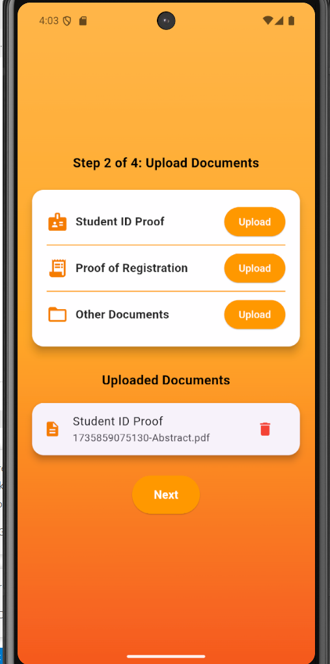
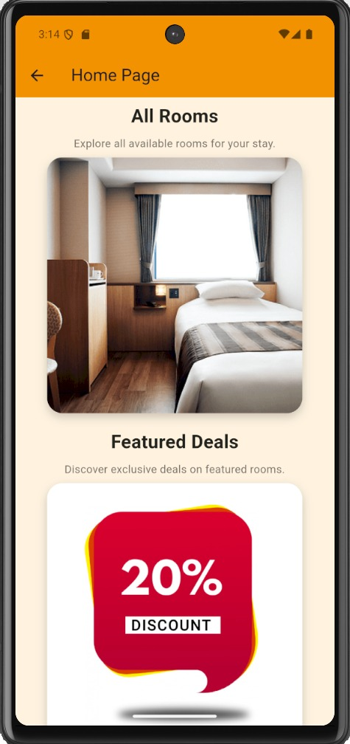
FEATURES
4
User Dashboard Application Screens

Slide 21
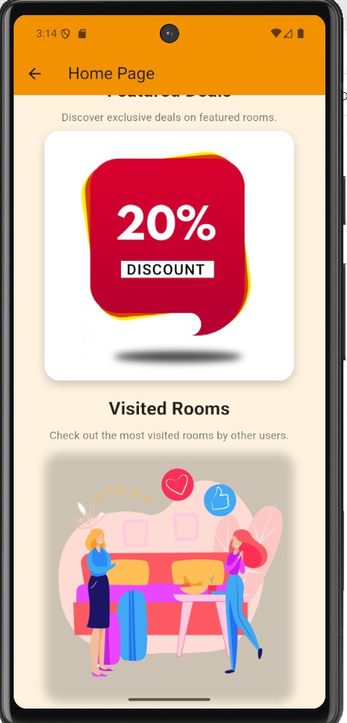
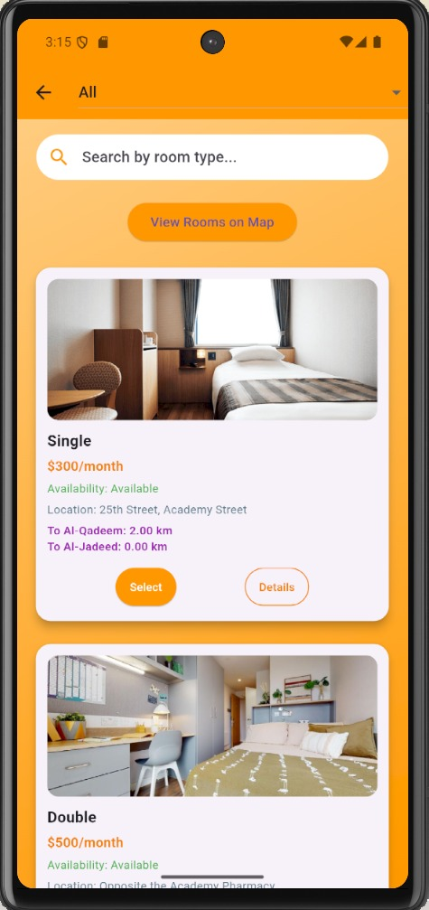
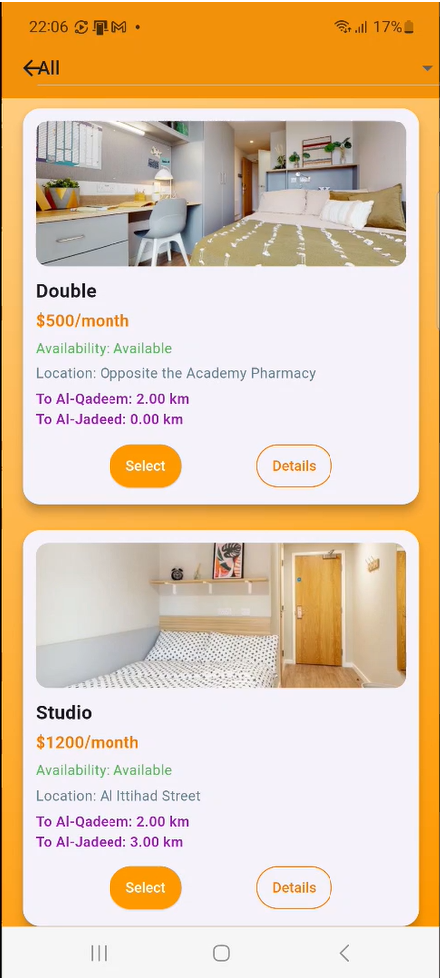
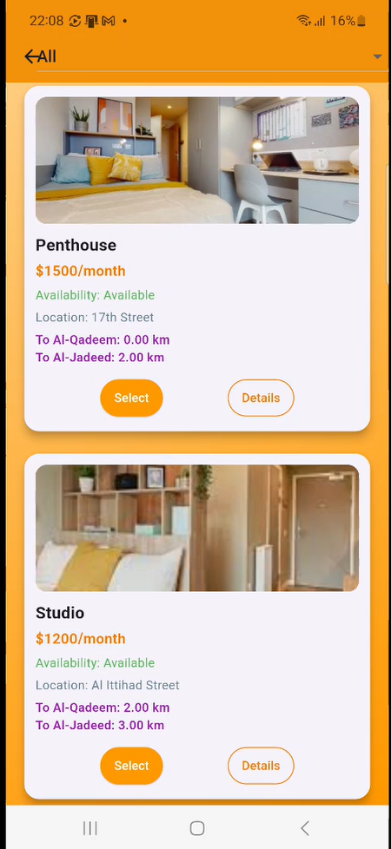
FEATURES

Slide 22
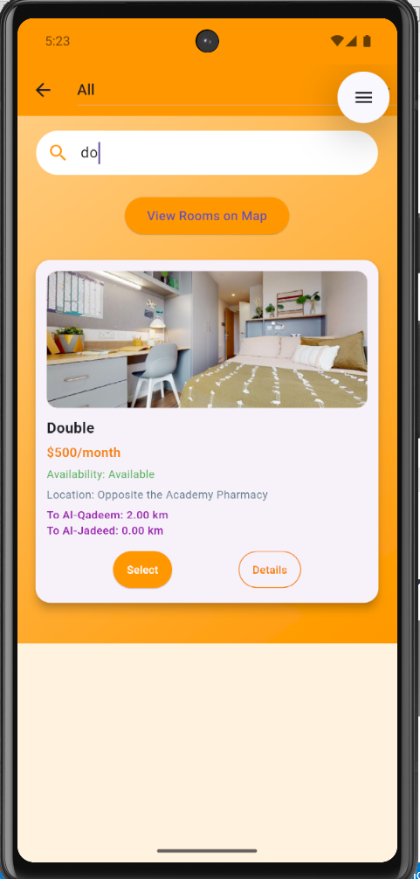
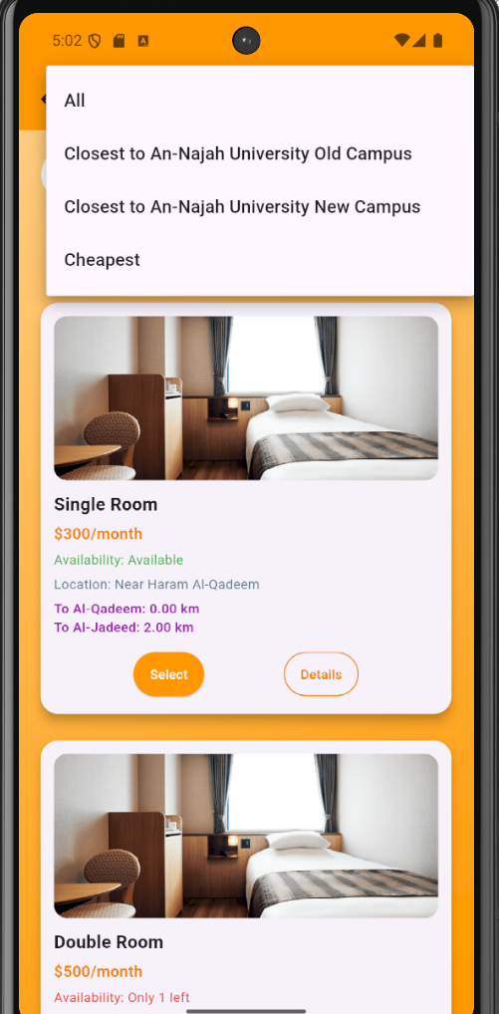
FEATURES

Slide 23
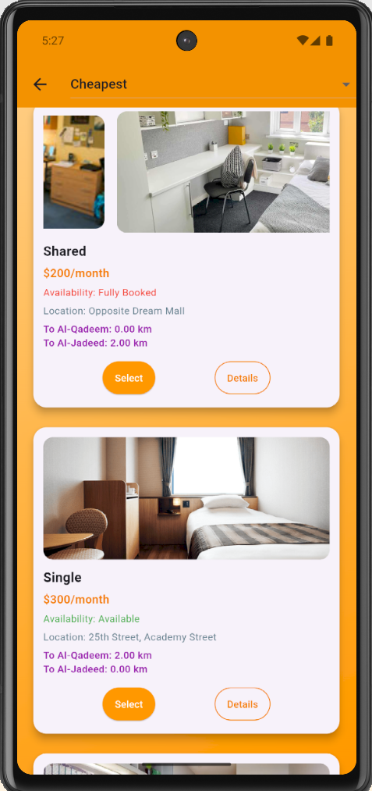
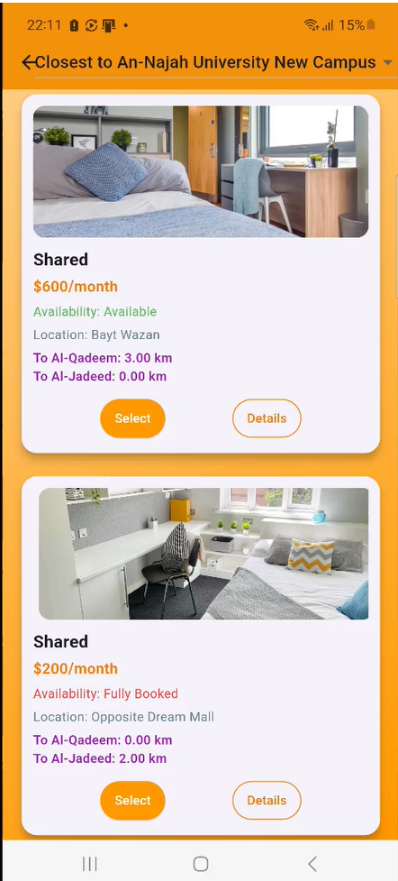
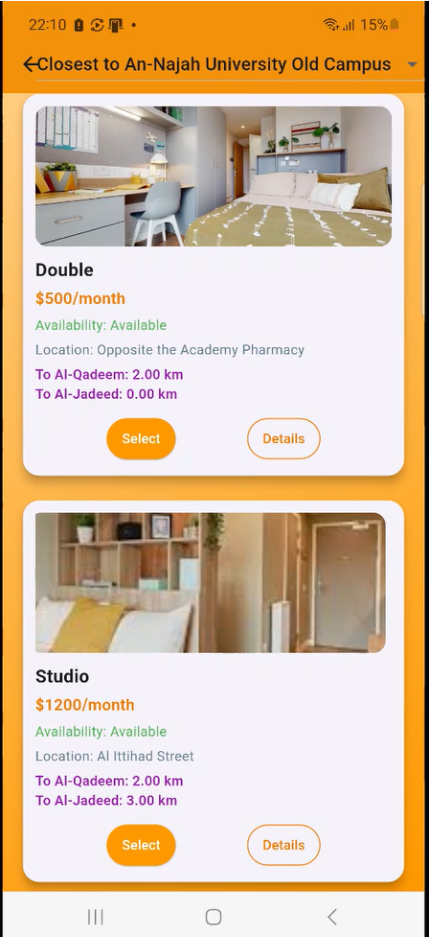
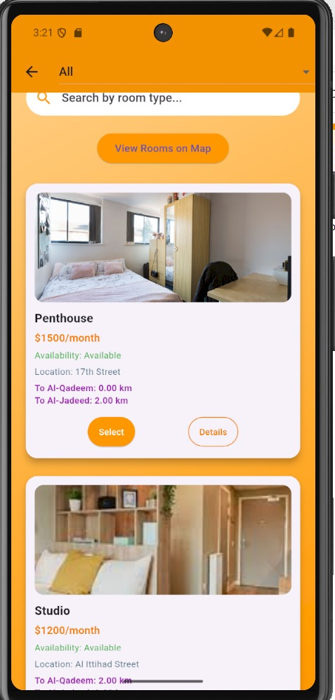
FEATURES

Slide 24
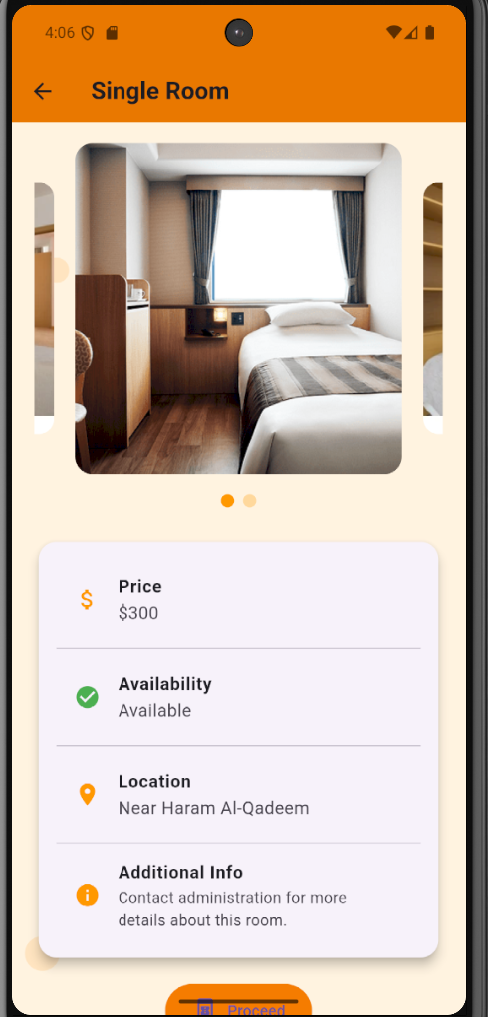
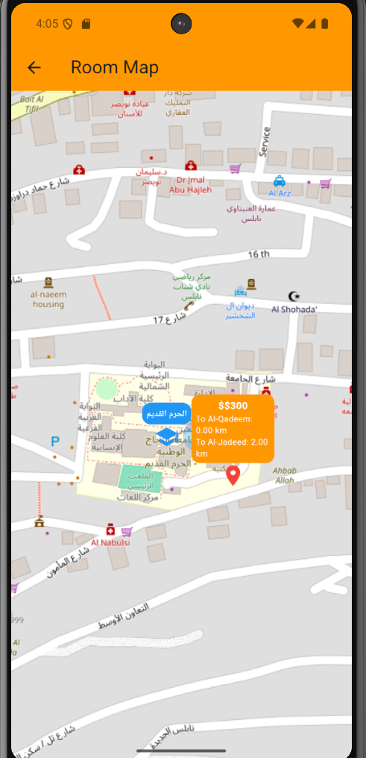
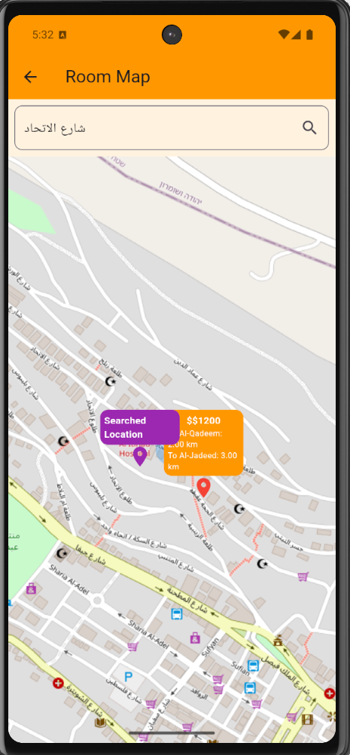
FEATURES

Slide 25
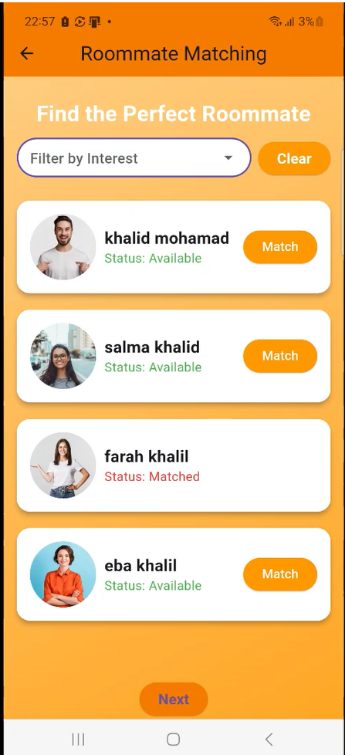
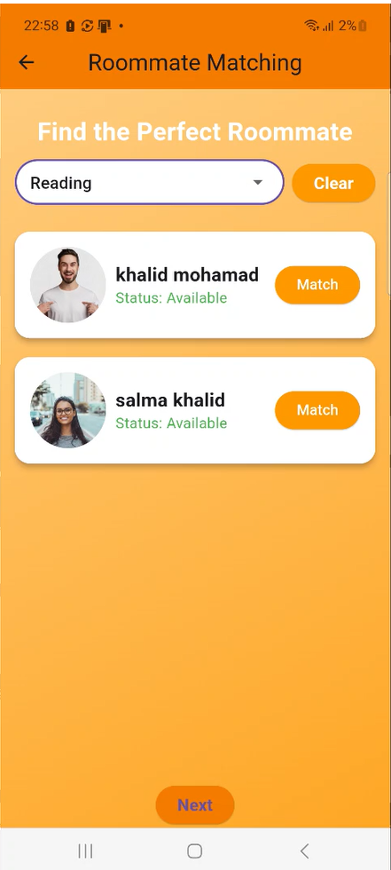
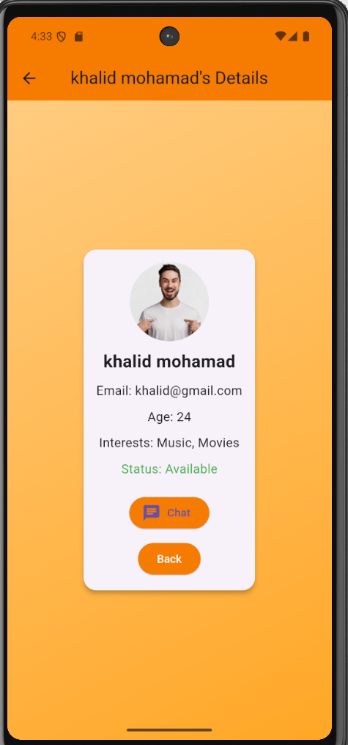
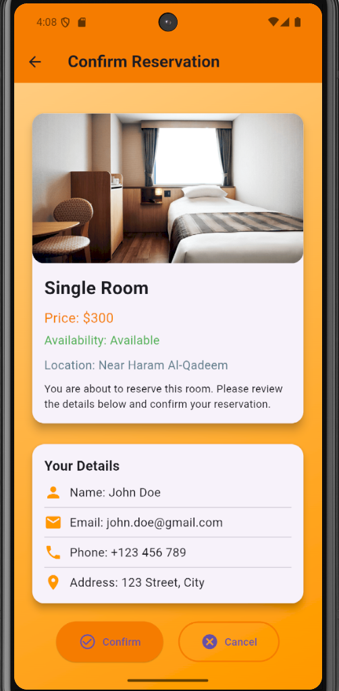
FEATURES

Slide 26
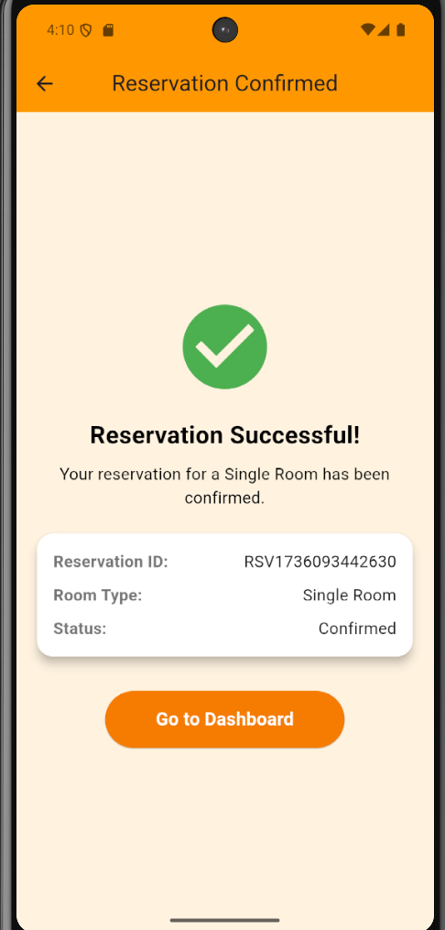
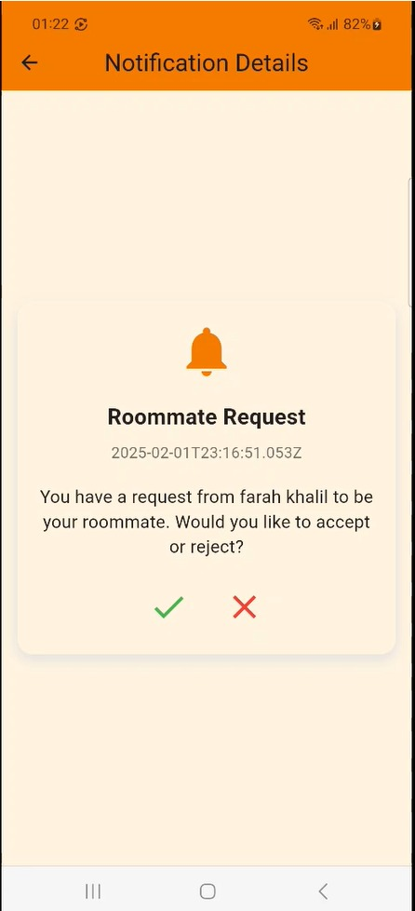
FEATURES

Slide 27
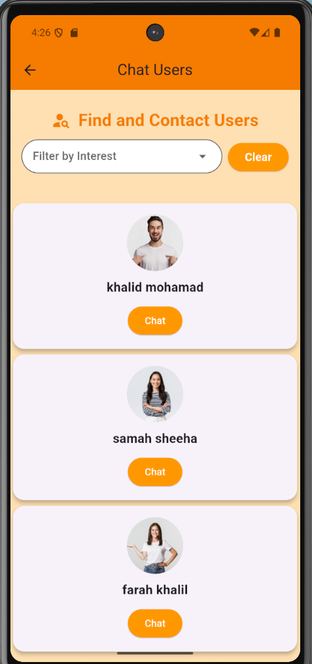
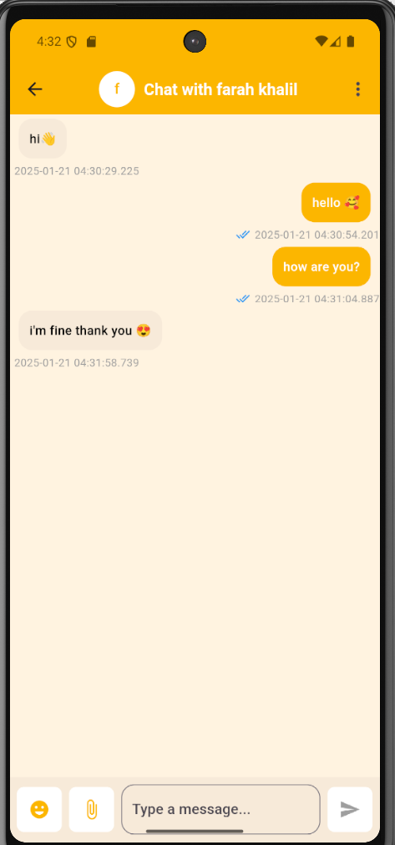
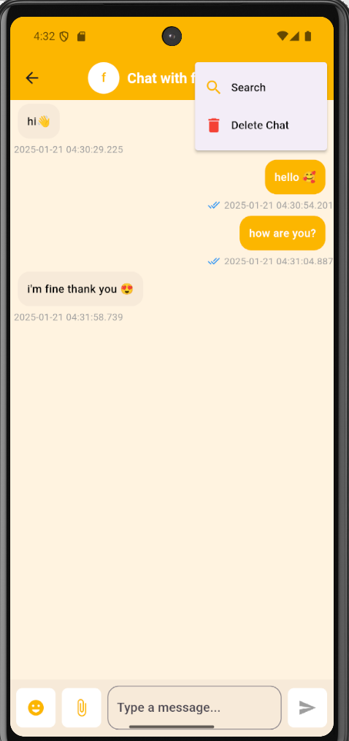
FEATURES
User Dashboard Messages Screens

Slide 28
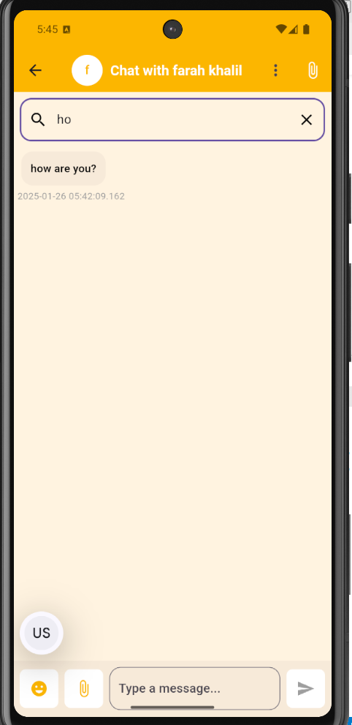
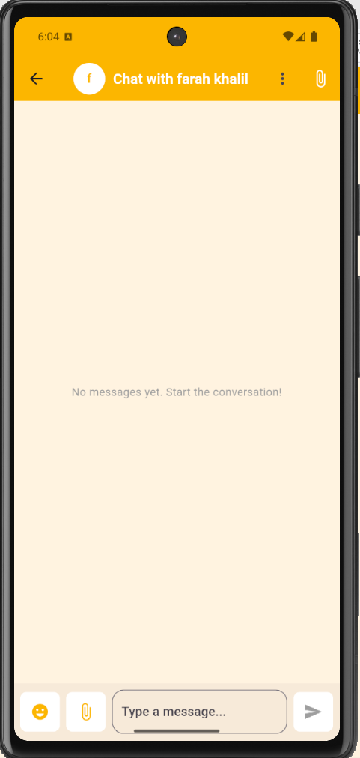
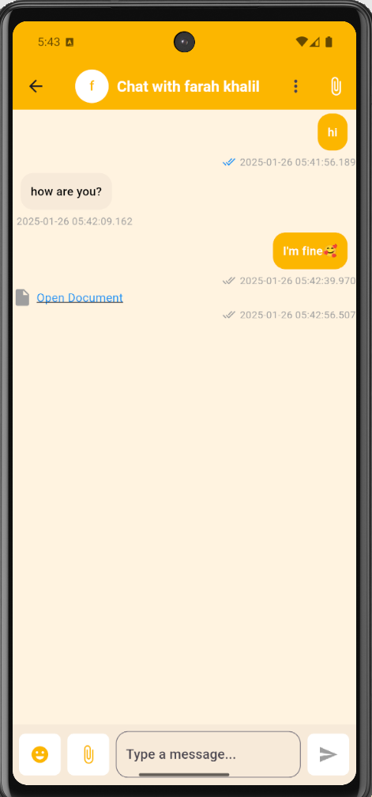

FEATURES
User Dashboard Messages Screens

Slide 29



FEATURES
User Dashboard Support Screens

Slide 30



FEATURES
User Dashboard Track Reservation Screens

Slide 31


FEATURES
4

Slide 32


FEATURES
User Dashboard Notifications Screens

Slide 33




FEATURES
4
Admin Dashboard –Manage Rooms Screens

Slide 34




FEATURES
4

Slide 35


FEATURES
4

Slide 36



FEATURES
4
Admin Dashboard –Manage Requests Screens

Slide 37



FEATURES
4
Admin Dashboard –Manage Students Screens

Slide 38




FEATURES

Slide 39

FEATURES

Slide 40


FEATURES
4
Admin Dashboard –Messages Screens

Slide 41


FEATURES
Admin Dashboard –Manage Room Owner Screens

Slide 42


FEATURES
Admin Dashboard –Reports Screens

Slide 43


FEATURES
Room Owner Dashboard Screens

Slide 44



FEATURES
Room Owner Dashboard –Manage Rooms Screens

Slide 45


FEATURES
4
Room Owner Dashboard –Manage Requests Screens

Slide 46

FEATURES
4
Room Owner Dashboard –Edit Room Owner Screens

Slide 47

FEATURES
4

Slide 48

FEATURES
4

Slide 49

FEATURES
4

Slide 50

FEATURES
4

Slide 51

FEATURES
4

Slide 52

FEATURES
4

Slide 53

FEATURES
4

Slide 54

FEATURES
4

Slide 55

FEATURES
4

Slide 56

FEATURES
4

Slide 57

FEATURES
4

Slide 58

FEATURES
4

Slide 59

FEATURES
4

Slide 60

FEATURES
4

Slide 61

FEATURES
4

Slide 62

FEATURES
4

Slide 63

FEATURES
4

Slide 64

FEATURES
4

Slide 65

FEATURES
4

Slide 66

FEATURES
4

Slide 67

FEATURES
4

Slide 68

FEATURES
4

Slide 69

FEATURES
4

Slide 70

FEATURES
4

Slide 71

FEATURES
4

Slide 72

FEATURES
4

Slide 73

FEATURES
4

Slide 74

FEATURES
4

Slide 75

FEATURES
4

Slide 76

FEATURES
4

Slide 77

FEATURES
4

Slide 78

FEATURES
4

Slide 79

FEATURES
4

Slide 80

FEATURES
4

Slide 81

FEATURES
4

Slide 82

FEATURES
4

Slide 83

FEATURES
4

Slide 84

FEATURES
4

Slide 85

FEATURES
4

Slide 86

FEATURES
4

Slide 87

FEATURES
4

Slide 88

FEATURES
4

Slide 89

FEATURES
4

Slide 90

FEATURES
4

Slide 91

FEATURES
4

Slide 92

FEATURES
4

Slide 93

FEATURES
4

Slide 94

FEATURES
4

Slide 95

FEATURES
4

Slide 96

FEATURES
4

Slide 97

FEATURES
4

Slide 98

FEATURES
4

Slide 99

FEATURES
4

Slide 100

FEATURES
4

Slide 101

FEATURES
4

Slide 102

FEATURES
4

Slide 103

FEATURES
4

Slide 104

FEATURES
4

Slide 105

FEATURES
4

Slide 106

FEATURES
4

Slide 107

FEATURES
4

Slide 108

FEATURES
4

Slide 109

FEATURES
4

Slide 110

FEATURES
4

Slide 111

FEATURES
4

Slide 112

FEATURES
4

Slide 113

FEATURES
4

Slide 114

FEATURES
4

Slide 115

FEATURES
4

Slide 116

FEATURES
4

Slide 117

FEATURES
4

Slide 118

FEATURES
4

Slide 119

FEATURES
4

Slide 120

FEATURES
4

Slide 121

FEATURES
4

Slide 122

FEATURES
4

Slide 123

FEATURES
4

Slide 124




Future Work
Expanding the application to include student housing management for other universities in addition to An-Najah National University.
Expanding the scope of housing-related services.
Expanding integration with payment systems.

Slide 125
Future Work
Enhancing the experience of communication and collaboration.
Introducing a rating and review system for rooms and owners.

Slide 126
CONCLUSION
Sakni simplifies the student housing experience by streamlining applications, roommate matching, and communication with administrators. Designed for efficiency and transparency, it addresses key challenges students face. With plans to expand to more universities, Sakni aims to enhance accessibility and convenience, making the housing process seamless for all users.

Slide 127
Thank you

