Slide 1

Building Engineering Department
Redesign of Nablus Specialist Hospital
Prepared by:
Hayat Hassoun
Raghad Khalil
Yasmeen Surakji
Supervisor: Eng. Hasan Mathar

Slide 2
Site Location
Quantity Surveying
Architectural Design
Topics:
Environmental Design
Structural Design
Safety Design
Electrical Design
Mechanical Design

Slide 3
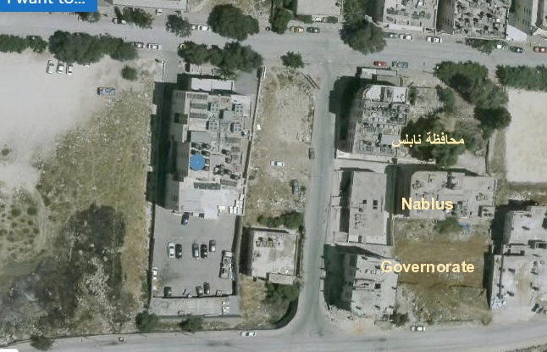
Site Location
Figure: Nablus Specialist hospital site.

Slide 4
Adjacent Buildings

Slide 5
Architectural Design

Slide 6
Architectural Design
Total area for the hospital is 11814.54m^2.
Total number of floors is 13 floors.

Slide 7
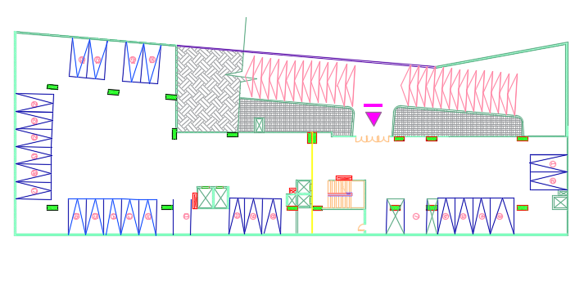
Basement 3
Basement 2

Slide 8
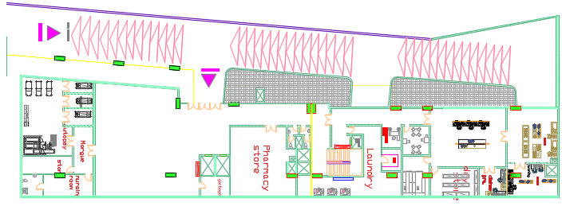
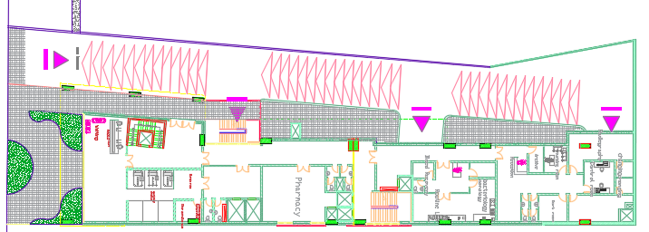
Basement 1 floor.
Ground floor.

Slide 9
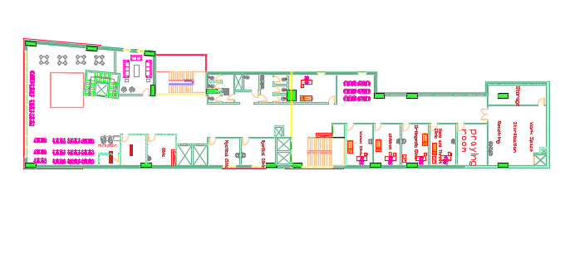
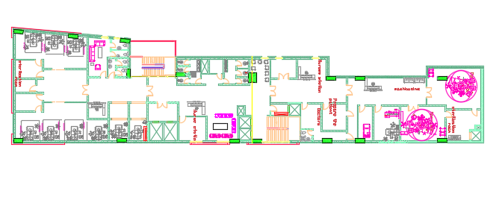
First floor.
Second floor.

Slide 10
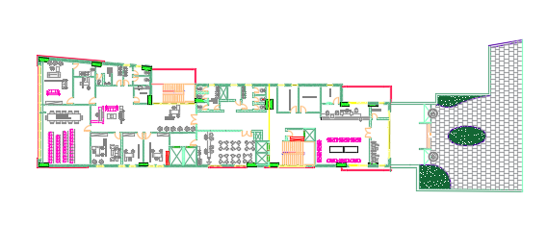
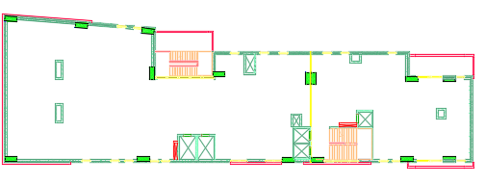
Third floor.
Mezanen floor.

Slide 11
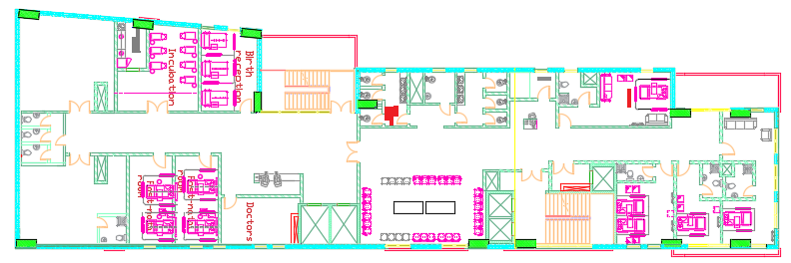
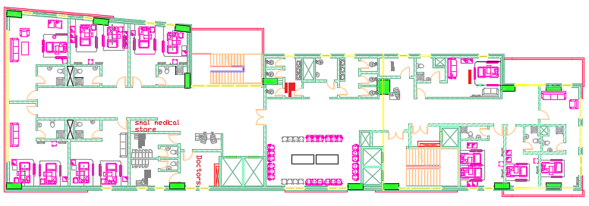
fourth floor.
fifth floor.

Slide 12
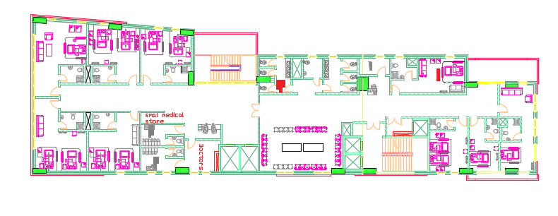
Duplicate floors (4).

Slide 13
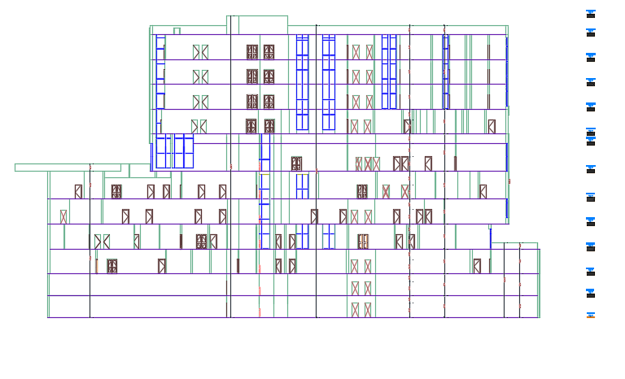
West elevation.

Slide 14
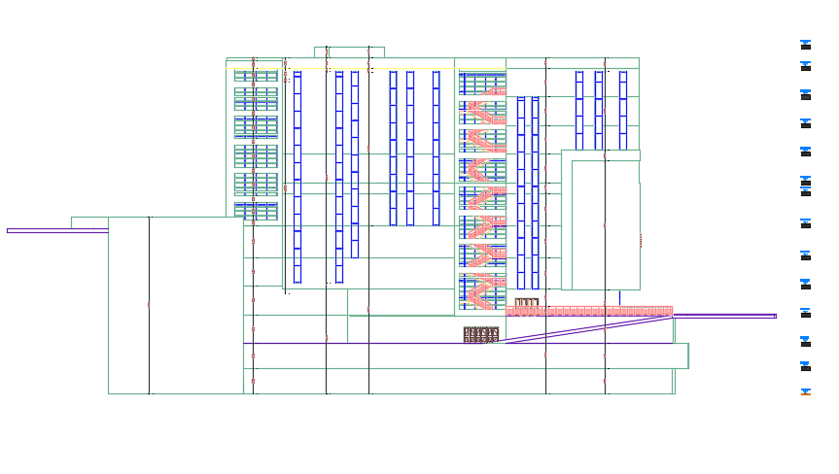
East elevation.

Slide 15
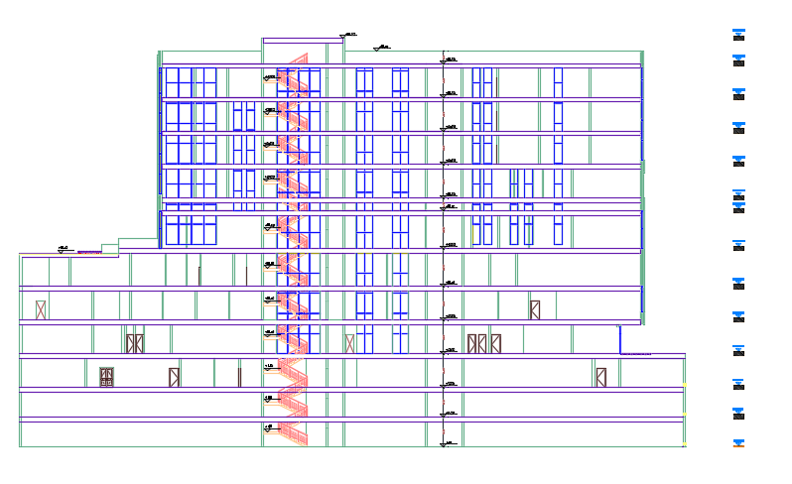
Section 1-1:

Slide 16
Environmental Design

Slide 17
Environmental Design
Thermal Design.
Daylight .
Acoustical design.

Slide 18
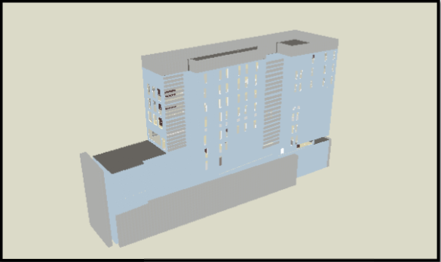
Thermal Design.
Figure: 3d model for the hospital.

Slide 19
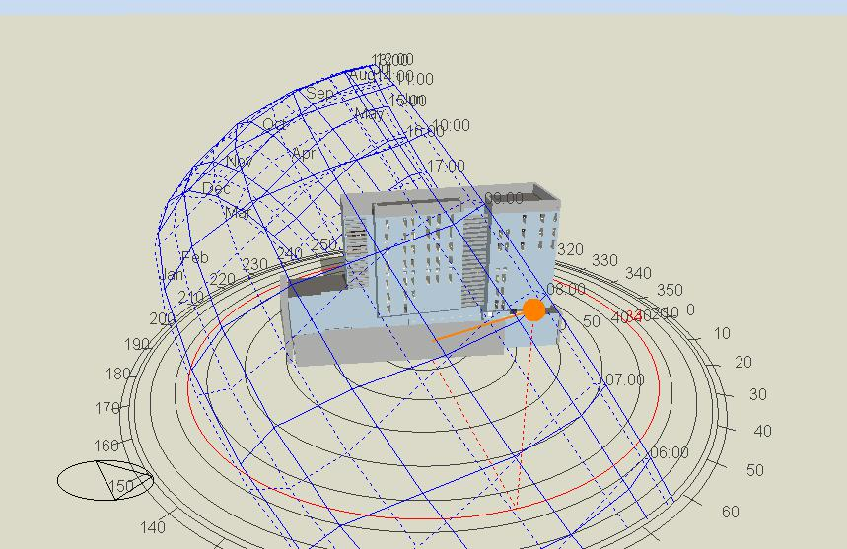
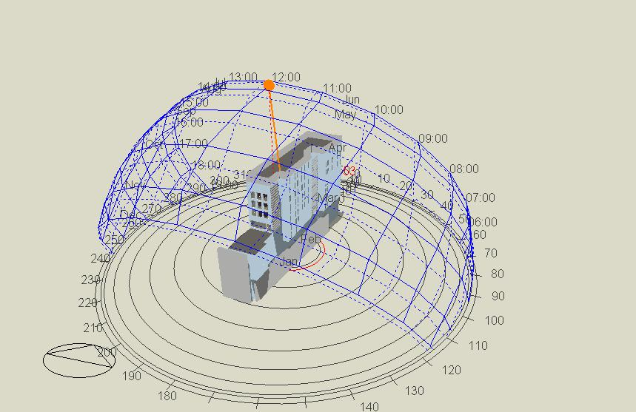
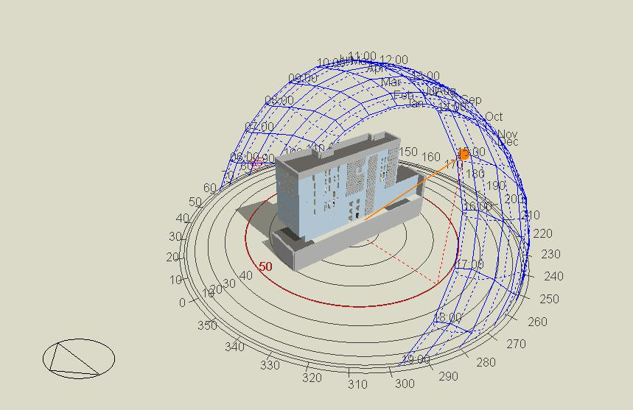
Shading in the building in summer day.
at 8:00 am.
at 12:00 pm.
at 15:00 pm.

Slide 20
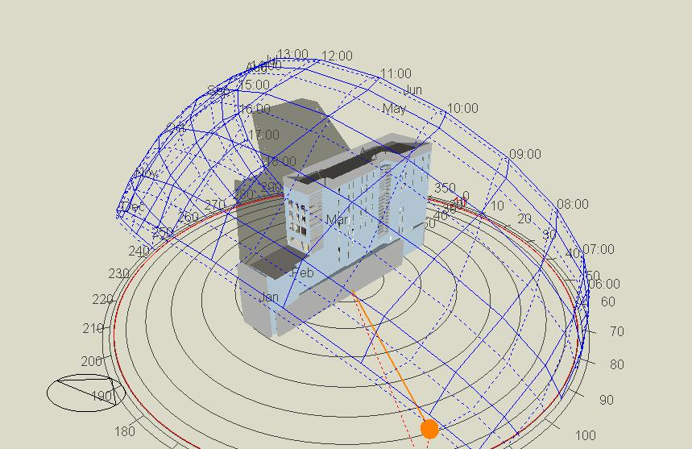
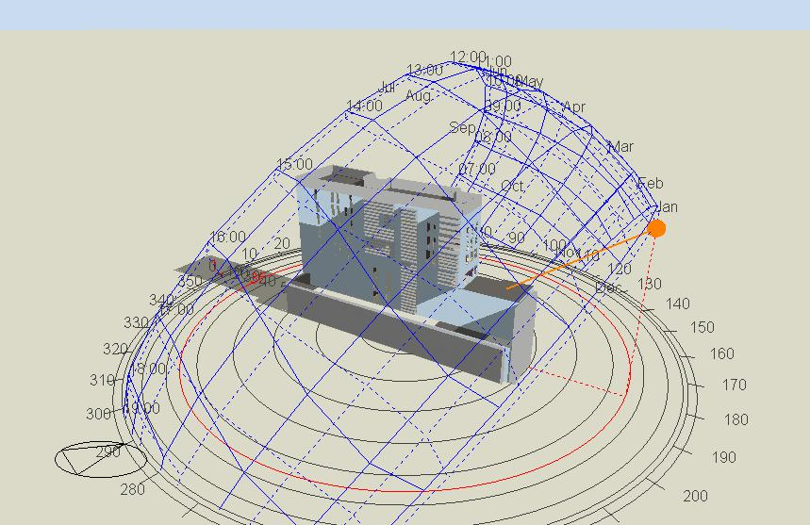
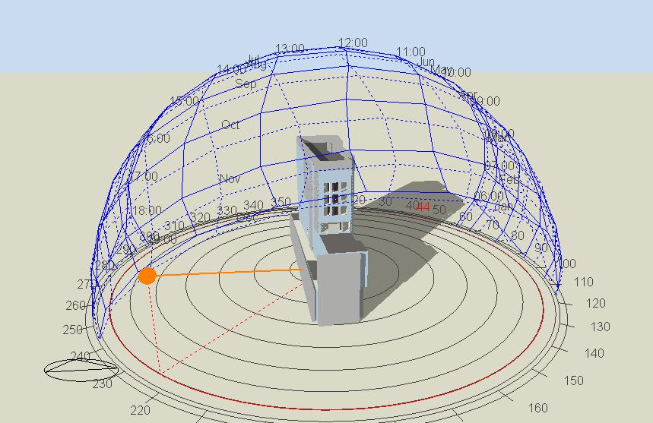
Shading in the building in winter day.
at 8:00 am.
at 12:00 pm.
at 15:00 pm.

Slide 21
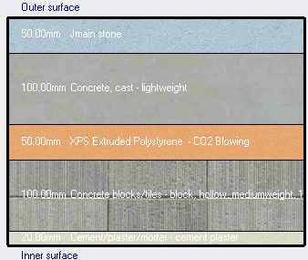
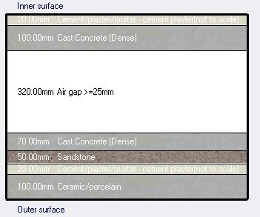
Layers of external walls & slab.
U value for external walls = 0.41.
U value for slab=1.34.

Slide 22
Energy per conditioned building area.
 | Energy per total building area (KWh/m^2)
Total site energy | 561.95
Total source energy | 1157.5
Heating and cooling for building.
Total Heating (KWh) | Total cooling (KWh)
30784.13 | 267750.37

Slide 23
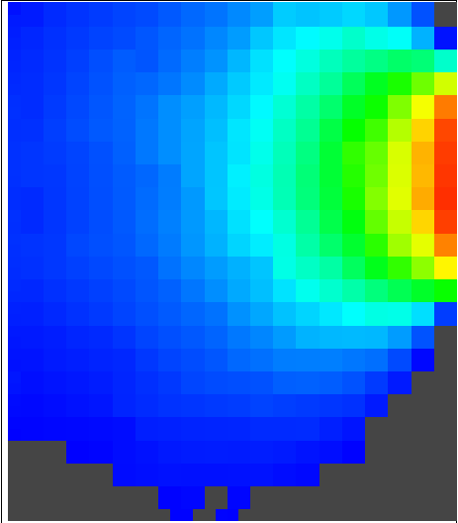
Daylight .
DF | Room
2.1 | Bedroom
3.4 | Finance manager
2.6 | Doctor room
2.9 | clinic
Table: Day lighting for different spaces.
Figure: Day lighting for clinic.

Slide 24
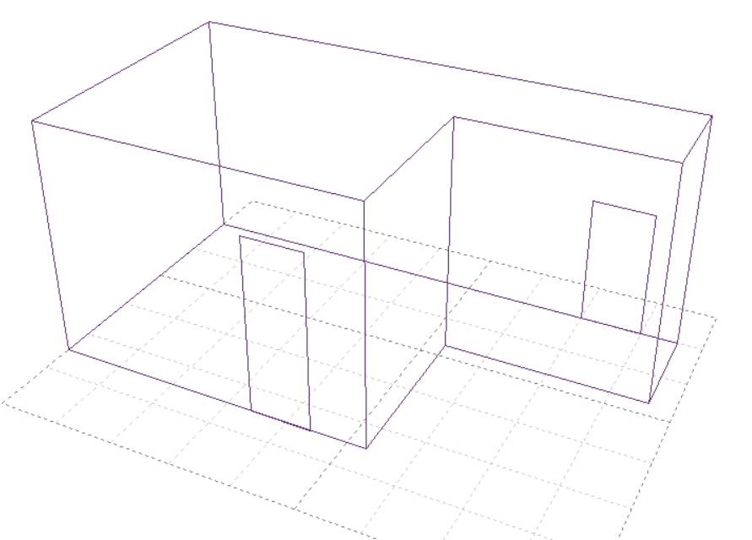
Acoustical design.
A patient room is selected as a sample of calculation.
Calculated parameters:
1- Reverberation Time
2- STC value
3- IIC value
Figure: A 3d model from Ecotect for the bedroom

Slide 25
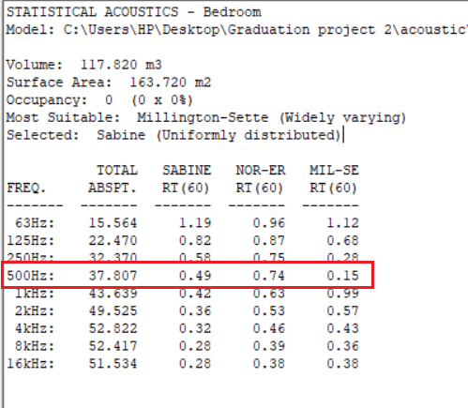
1- Reverberation Time
Using Ecotect software program, the calculated value is 0.49 and the recommended is ( 0.4 – 0.7 )

Slide 26
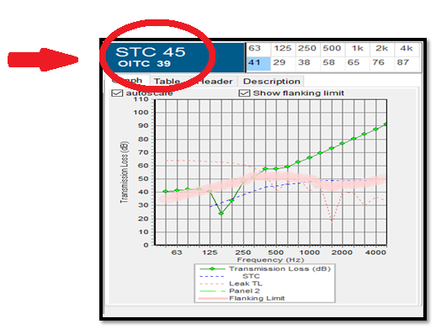
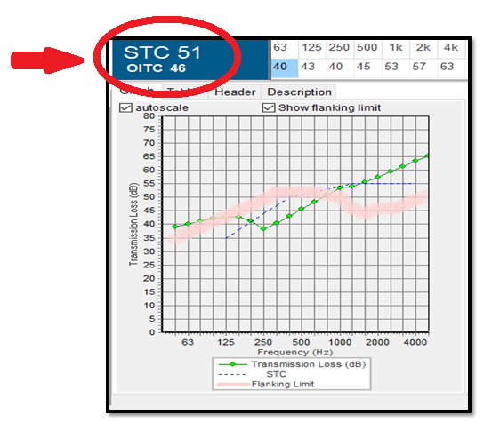
2- STC value
The recommended value is 45 for the exterior wall
The recommended value is 50 for patient room with adjacent waiting area
Figure: STC for bedroom with waiting area
Figure: STC for exterior wall

Slide 27
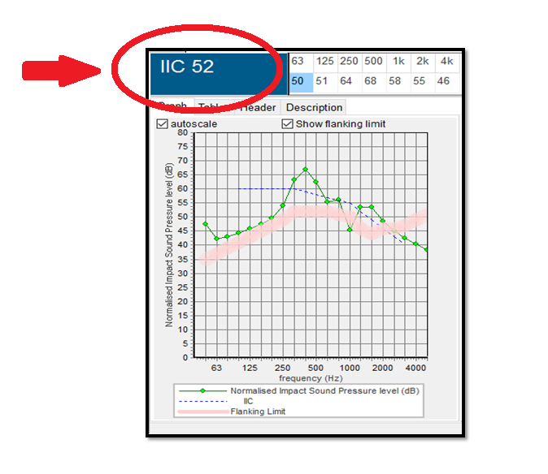
3- IIC value

Slide 28
Mechanical Design

Slide 29
Mechanical Design
Drainage System.
Water System.
HVAC System.

Slide 30
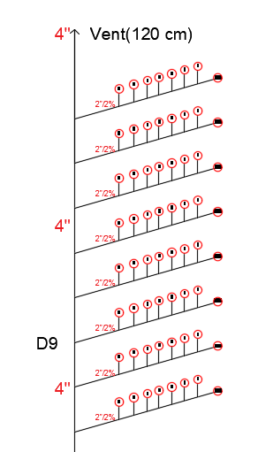
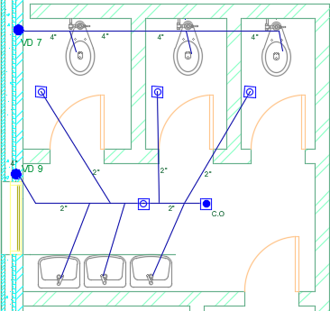
Drainage System.
Figure: Drainage system for zone 9.
Figure: Drainage system for zone 9.

Slide 31
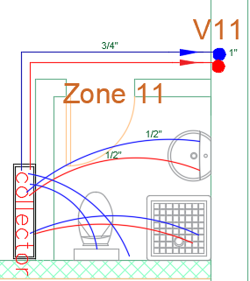
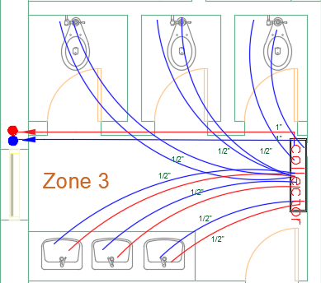
Water System.
-Water source.
-Number of tank.
-Storm water.
Figure: Water distribution system.

Slide 32
HVAC System.
-Using VRF system.
-Main components of centralized system are:
  Outdoor unit.
  Inside unit (fan coil)
  Collectors
  Ducts.
  Diffusers.
  Grills.

Slide 33
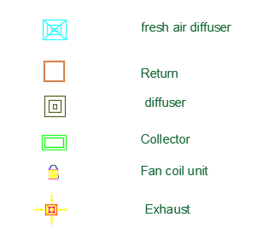
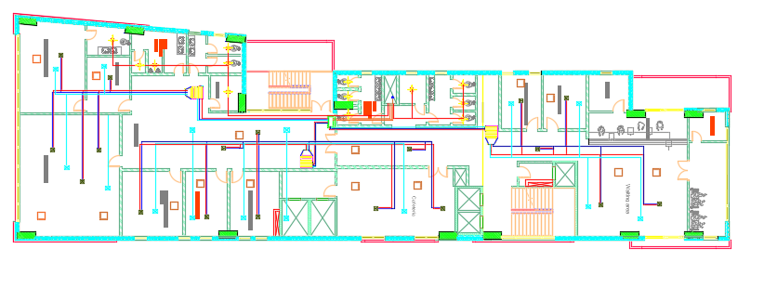
Figure: Distribution of VRF system in third floor

Slide 34
Electrical Design

Slide 35
Electrical Design
Artificial Lighting.
Sockets.
Cameras and sound speakers.

Slide 36
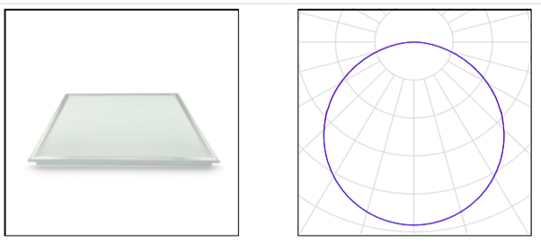
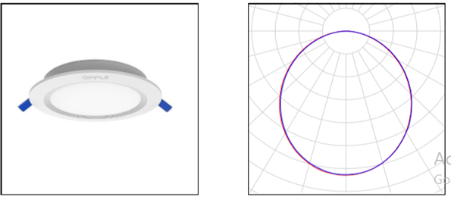
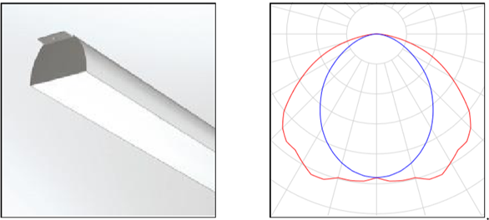
Artificial Lighting.
Dialux.evo software program was used.
Luminarie type
LED (ceiling recessed)
LED (spot light)
Fluorescent (ceiling mounted)
Table: Types of luminaries
Figure: Luminaries shape

Slide 37
Space | Lux Standard | Lux calculated | Glare Standard | Glare calculated | Uniformity Standard | Uniformity calculated
Bedroom | 300 | 305 | 19 | 14 | 0.6 | 0.65
Clinic | 300 | 336 | 19 | 14 | 0.6 | 0.64
Emergency | 500 | 587 | 19 | 14 | 0.7 | 0.71
Intensive care | 500 | 500 | 22 | 13 | 0.6 | 0.63
Operation room | 1000 | 1053 | 19 | 11 | 0.6 | 0.6
Waiting area | 200 | 342 | 22 | 15 | 0.6 | 0.65
Corridor | 200 | 283 | 22 | 15 | 0.4 | 0.53
Stair | 100 | 144 | 25 | 13.8 | 0.6 | 0.76
Office | 500 | 559 | 19 | 13 | 0.6 | 0.75
Garage | 75 | 75 | 19 | 18.4 | 0.4 | 0.4
Table: Simulation results for the selected spaces.

Slide 38
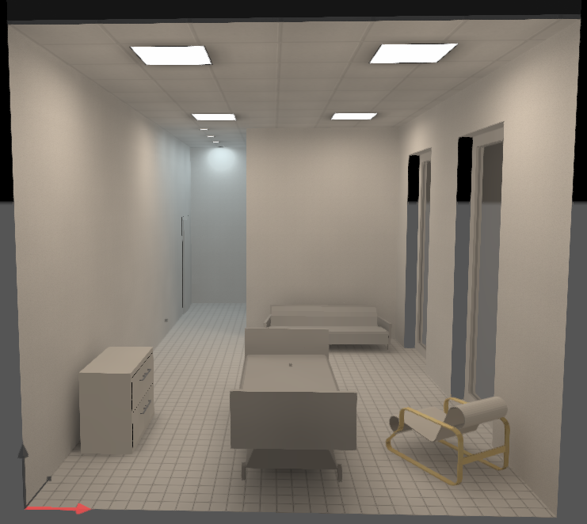
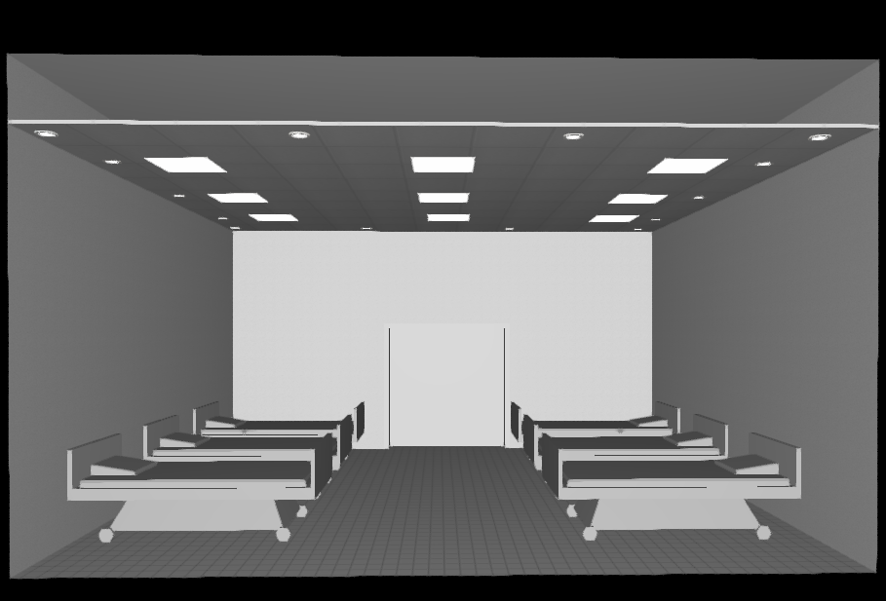
Figure: 3D model for patient room from Dialux
Figure: 3D model for Emergency room from Dialux

Slide 39
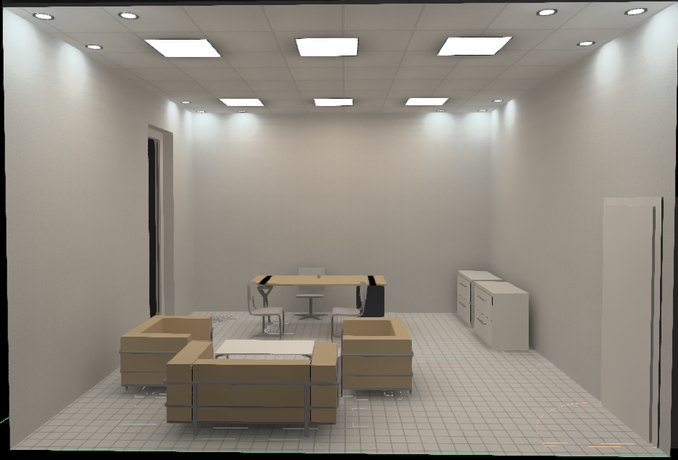
Figure: 3D model for office from Dialux

Slide 40
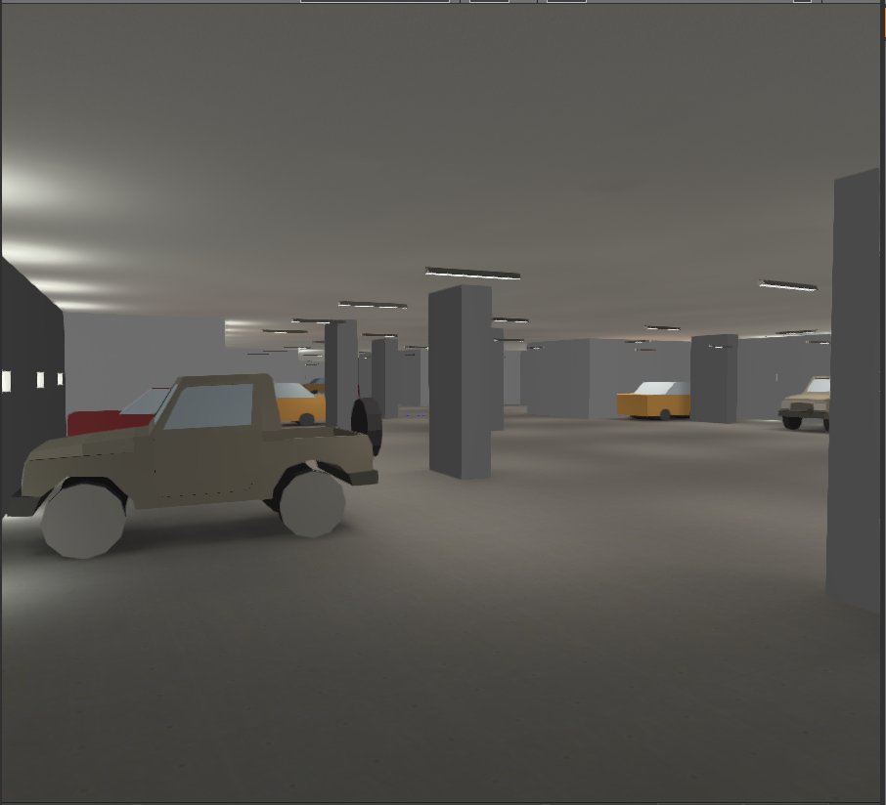
Figure: 3D model for Garage from Dialux

Slide 41
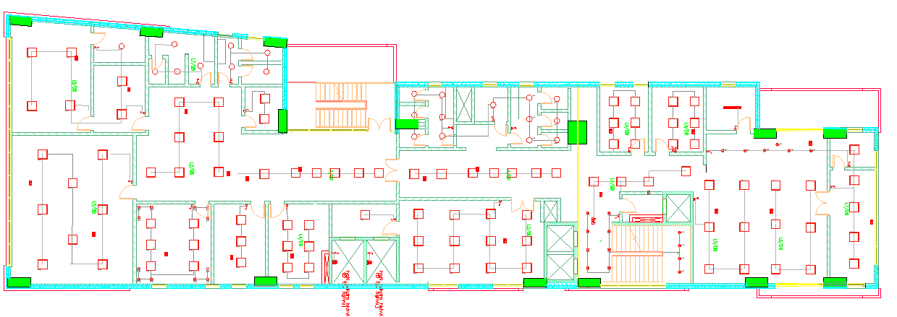
Figure: Luminaries distribution in the third floor.

Slide 42
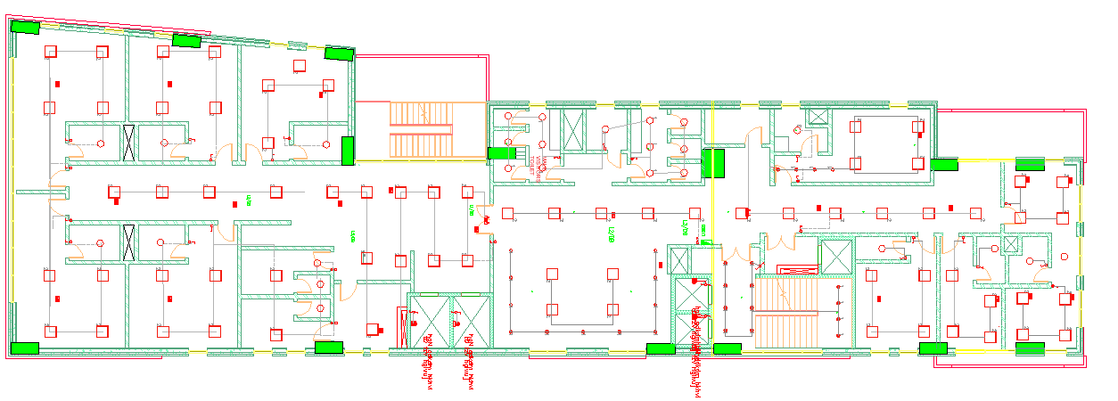
Figure: Luminaries distribution in the fifth floor.

Slide 43
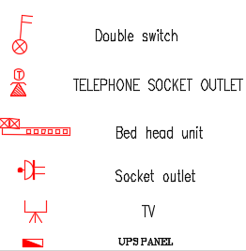
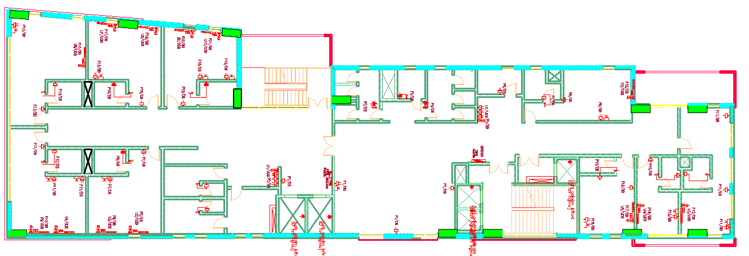
Sockets.
Figure: Sockets distribution in the fifth floor.

Slide 44
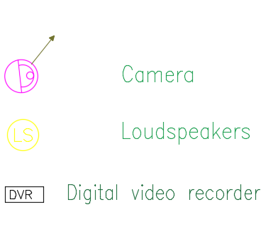
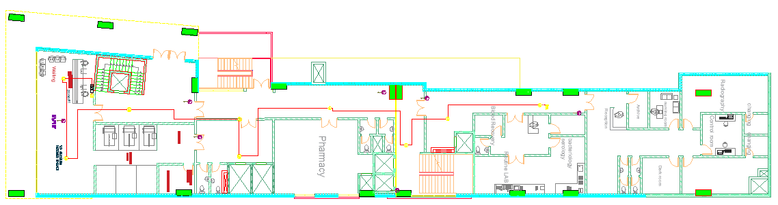
Cameras and sound speakers.
Figure: Cameras and sound speakers distribution in the ground floor.

Slide 45
Safety & fire Design

Slide 46
Types of safety system used in building:
Detectors (smoke, heat and flame).
Fire extinguishers.
Hose station.
Manual call point/Break Glass.
Water Sprinklers.
Internal/External siren with flasher.
FM-200 fire suppression.
Emergency exit signs.

Slide 47
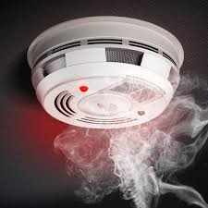
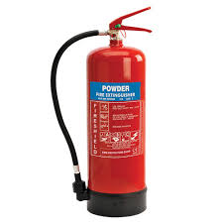







Slide 48


Detectors (smoke, heat and flame).
Figure: The distribution of smoke detectors.

Slide 49


Figure: The distribution of heat detectors.

Slide 50


Figure: The distribution of flame detectors.

Slide 51


Fire extinguishers.
Figure: The distribution of Fire extinguishers

Slide 52


Hose Station.
Figure: The distribution of Hose Station.

Slide 53


call point/ break glass.
Figure: The distribution of call point.

Slide 54


Water Sprinklers.
Figure: The distribution water sprinklers.

Slide 55


Figure: Emergency exit signs.

Slide 56

Figure: Evacuation for the fourth floor.

Slide 57

Figure: Evacuation for the first floor.

Slide 58
Structural Design

Slide 59
Structural Design
Codes and Standards:
ACI -318-14 for reinforced concrete structural design.
UBC -97 for earthquake design.
ASCE for load combinations
For the design of the structure and its elements ETABS , SAP, SAFE and hand calculations were used

Slide 60
Design data:
Concrete strength, f’_{c}= 28 MPa for slabs and other elements.
Steel yield strength f_{y} = 420 MPa.
Bearing capacity for soil = (120) ( 350_400) kN/m²

Slide 61

Seismic Design data:
The city of structure is Nablus.
The seismic zone factor. Z = 0.2.
The soil profile is type Sc.
The acceleration seismic coefficient Ca = 0.16
The velocity seismic coefficient Cv = 0.16
The Seismic importance factor is 1.25
The structural design type is intermediate, R=5.5

Slide 62
Sections Dimensions:
Structural Element | Dimensions
U-boot Slab | 55cm
Columns | (60X150) , ( 90X200 ) , ( 150X250)
Beams | (80 X 90 )
Table: Structural elements dimensions.

Slide 63

Modeling:
Figure: A 3d model from Etabs software

Slide 64
Verification of the model:
Compatibility check
Equilibrium check

Slide 65

Compatibility check :

Slide 66
Equilibrium Check :
Load Case | ETABS | Manual | Error % | Status
 | KN
Dead | 74274.75 | 73945 | .4 | ok
Live | 19950.29 | 19300 | 3 | ok
SID | 17959.05 | 17370 | 3 | ok
Table: equilibrium check .

Slide 67
Seismic Design checks:
Time Period Check
)0.889 < 1.081)
Deflection check
31 mm < 39.9 mm
Modal participating mass ratio check
.9611 > 0.90
.9907 > 0.90
Base shear check
3972. kN > 2138.9 kN
40921 kN > 2138.9 kN

Slide 68

Slab and beams :

Slide 69

Slab Reinforcement :

Slide 70

Slab Reinforcement:

Slide 71

Beams Reinforcement:

Slide 72


Sections in Beams Reinforcement:

Slide 73


Columns Reinforcement:

Slide 74


Footing Reinforcement:

Slide 75


Shear wall Reinforcement:

Slide 76

Stairs Reinforcement:

Slide 77

Stairs Reinforcement:

Slide 78
Sheet piles:
Sheet piles design to prevent soil sliding
Depth of sheet piles reach to (7_11) meters with diameter of 60 cm

Slide 79
Quantity Surveying

Slide 80
Quantity Surveying
Type | Cost
Structural total cost (NIS) | 13, 528, 844
Mechanical total cost (NIS) | 2, 620, 149
Electrical total cost (NIS) | 425, 205
Total cost (NIS) | 16 ,393 ,998
Total Unit cost (NIS/m2) | 1483

