Slide 1


AI Powered Educational Center Management and Guidance Application
EduSpark Application

Slide 2

EduSpark Application: An Introduction
Introduction
EduSpark is a revolutionary AI-powered application designed to optimize the management and guidance of educational centers.
Problems
Traditional educational centers often face challenges with inefficient resource allocation, personalized learning, and data analysis.
Work Significance
EduSpark empowers educational centers to enhance educational center efficiency, and support future-ready skills development.
Objectives
EduSpark aims to address these challenges by providing a personalized course recommendations, and AI-driven assistance.

Slide 3

System Architecture
Presentation Layer
Business Logic Layer
Data Layer
The user interface, built with technologies like React allows students, instructors, parents, and admins to interact with EduSpark.
Powered by Django and Python, it handles complex operations like AI-driven recommendations, user authentication, and payment processing.
SQLite efficiently stores and manages essential data such as user profiles, courses, chat history, and payment records.

Slide 4







Tools and Development Environments
Visual Studio Code
Android Studio
PyCharm
A popular code editor for various programming languages.
An IDE specifically designed for building Android applications.
A powerful IDE focused on Python development.
GitHub Desktop
Postman
SQLite
A user-friendly graphical interface for managing Git repositories.
Software application that enables you to test and interact with APIs.
Embedded, server-less relational database management system.

Slide 5




Languages and Frameworks
React
React Native
Django
Python
JavaScript library used to build interfaces for web applications.
Framework to build native mobile apps using JavaScript.
High-level Python framework for building web applications.
Programming language known for wide range of libraries.

Slide 6

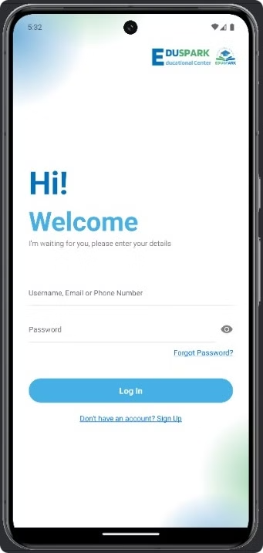
EduSpark: Key Features
Course Reservation System
Explore Courses
AI Recommendation System
Material Management
Personalized Calendar
Payment Integration
Notifications System
Rating System
AI-Powered Chatbot
Chat Between Users
Dashboard

Slide 7

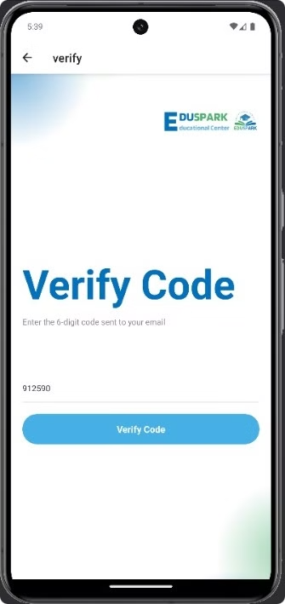
Functional Requirements
User Authentication
Securely manage user accounts, including registration, login, and password recovery.
Role-Based Access Control
Restrict access to features and functionalities based on user roles (Admin, Student, Instructor, Parent).
Course Management
Enable administrators to create, edit, and manage courses, including curriculum, materials, and scheduling.
Enrollment and Payment
Facilitate course enrollment, track payment status, and generate invoices.

Slide 8

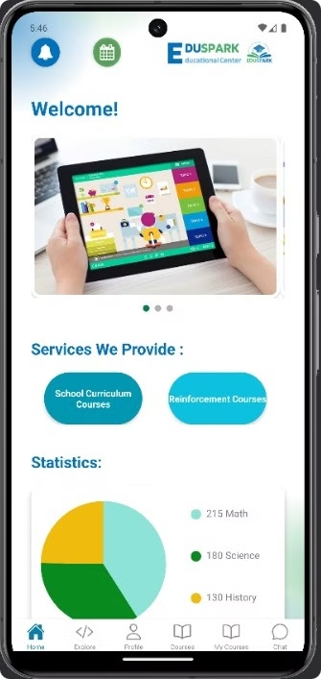
Functional Requirements
AI-Driven Recommendations
User Interaction
Features for student-instructor communication, including live chat and chatbot assistance.
Personalized course suggestions based on age, specialization, learning preferences, and market trends.
Rating and Feedback System
Calendar and Notifications
Allowing students to rate courses and provide feedback for continuous improvement
A comprehensive calendar to track course schedules and important dates.

Slide 9

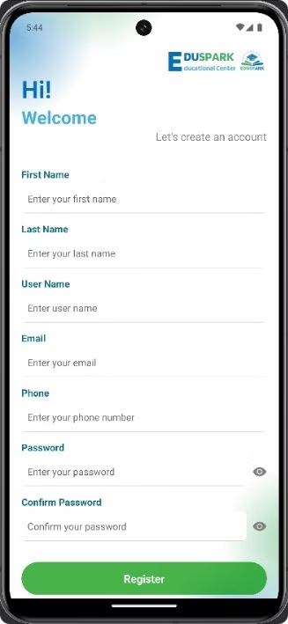
Authentication and Validation
Secure login, sign-up, and password recovery features.
Authentication and validation for all users, ensuring data security.

Slide 10

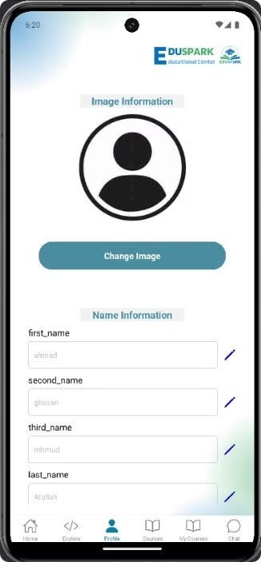
Profile Management
EduSpark empowers users to manage their profiles comprehensively. Users can update their personal information, including profile pictures, and access role-specific details.

Slide 11

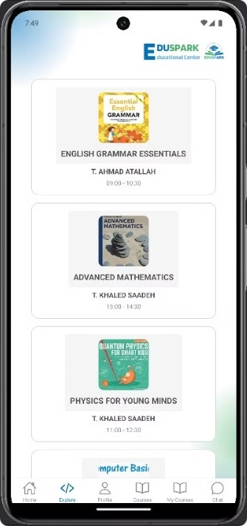
Course Recommendations
EduSpark leverages AI to suggest courses tailored to individual learners' needs. The system analyzes factors like age group, educational level, and previous course selections to provide personalized recommendations.
This intelligent guidance ensures learners discover courses aligned with their interests and learning goals, enhancing their educational journey.

Slide 12

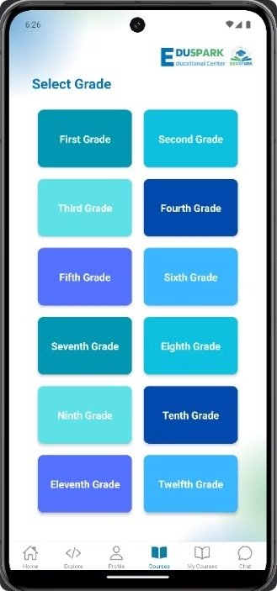
Course Categorization
Grades 1-12
Primary Level
Provides courses tailored to specific grade levels.
Offers courses designed for early childhood education.
Secondary Level
University Level
Focuses on courses for middle and high school students.
Provides courses for undergraduate and graduate students.
Employed Level
Offers courses for professionals seeking to enhance their skills, advance their careers, or acquire new knowledge.

Slide 13

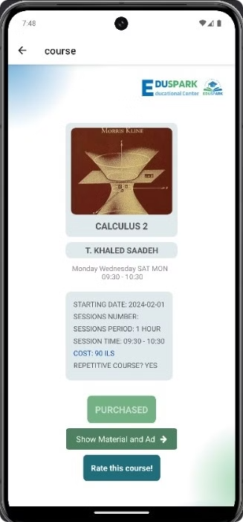
Course Browsing and Booking
Selecting a course based on age group, category, or specialization.
Ensuring users cannot book a course if they are already registered in it.
Successful booking only after completing the payment process via Visa or MasterCard.

Slide 14

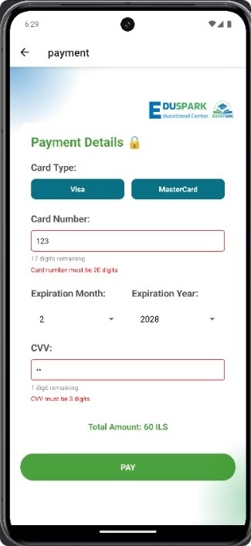
Payment Integration
1
Secure Online Payments
EduSpark facilitates secure online payments through Visa or MasterCard.
2
Payment Confirmation
Payment completion is mandatory to confirm course bookings.

Slide 15

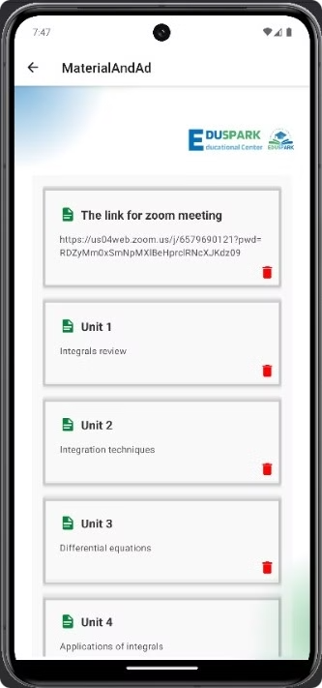
Educational Content Management
Text-Based Content
Multimedia Files
Instructors can upload educational articles, notes, and study guides.
Upload PDFs, documents, presentations, images, and videos.
Notifications
Students are notified when new content is added to enrolled courses.

Slide 16

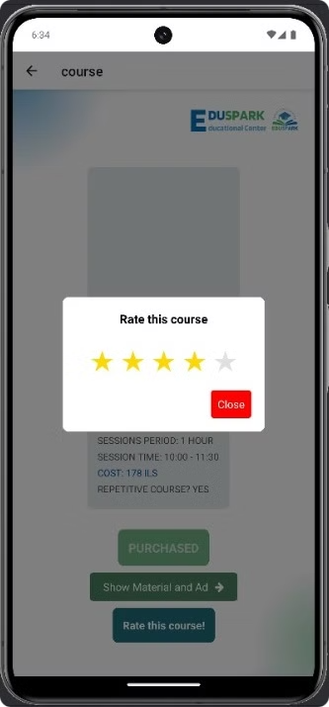
Teacher Rating System
Students can rate instructors at the end of each course, allowing for feedback and quality improvement.
Provides valuable insights for educators and helps improve the quality of courses.
Encourages a culture of continuous improvement and excellence in teaching.

Slide 17

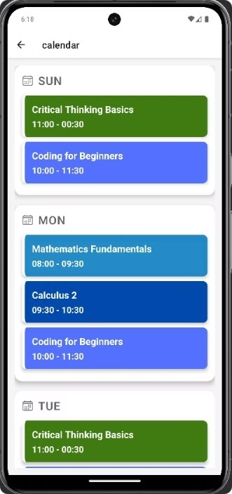



Calendar and Courses
Personalized Calendar
Users can manage and plan their activities effectively.
Course Details
Details about the scheduled sessions for each course.
Calendar Integration
A visual calendar displaying all scheduled courses and key dates.

Slide 18

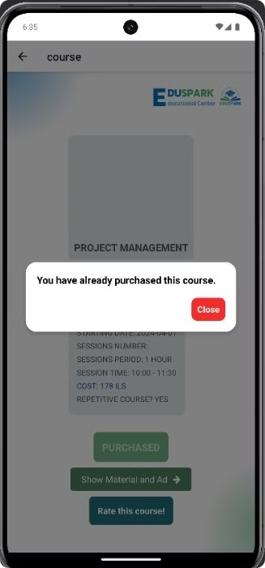
Notifications and Alerts System
Course Registration
Payment Notifications
Confirmations for successful course registration.
Alerts for successful payments and upcoming deadlines.
Course Start Reminders
Purchased Alert
Notifications before the start date of a course.
Alerts for purchased course.

Slide 19

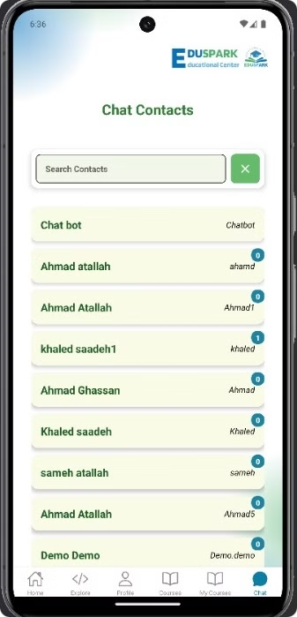
User Chat System
Peer-to-peer chat system enabling communication between users and instructors.
Users can chat directly with each other.
Search functionality to find any registered user (students, instructors, or trainers) and initiate a conversation.
Secure and private messaging platform.

Slide 20
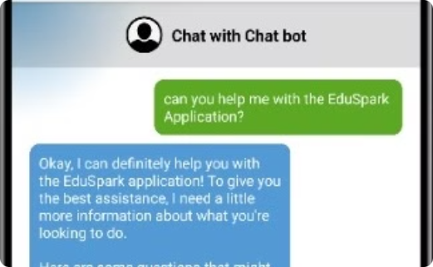
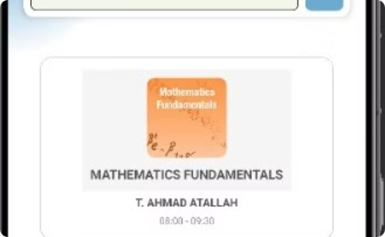
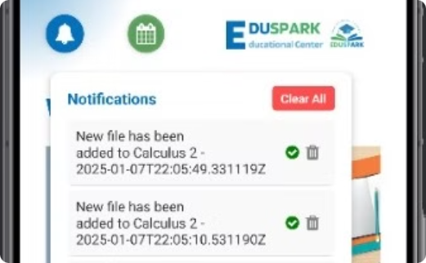
AI-Powered Features
Chatbot Integration
Personalized Recommendations
Notifications and Alerts
Gimeni, the AI-driven chatbot, provides 24/7 support, answers user queries, and offers personalized recommendations.
AI analyzes user data like age, interests, and past interactions to suggest suitable courses.
AI automates notifications for reminders, updates, and confirmations, ensuring users stay informed.

Slide 21




Administrative Tools
Student Data Management
Instructor Scheduling
A comprehensive dashboard to manage student data, including academic records, attendance, and performance.
Tools for scheduling instructor availability, assigning courses, and tracking workload.
Course Details
Progress Tracking
A central hub for managing course information, including descriptions, curriculum, and materials.
Features for monitoring student progress, evaluating performance, and identifying areas for improvement.

Slide 22



Results and Analysis
Performance Metrics
Student Feedback
Course Effectiveness
Analyze key metrics like user engagement, course completion rates, and instructor ratings.
Gather and analyze student feedback to identify areas for improvement and enhance the learning experience.
Evaluate the effectiveness of courses based on student performance and feedback, optimizing content and deli

Slide 23

Conclusions and Recommendations
EduSpark presents a comprehensive platform for efficient educational center management.
The platform leverages AI to personalize the learning experience, optimize resource allocation, and enhance student engagement.

Slide 24
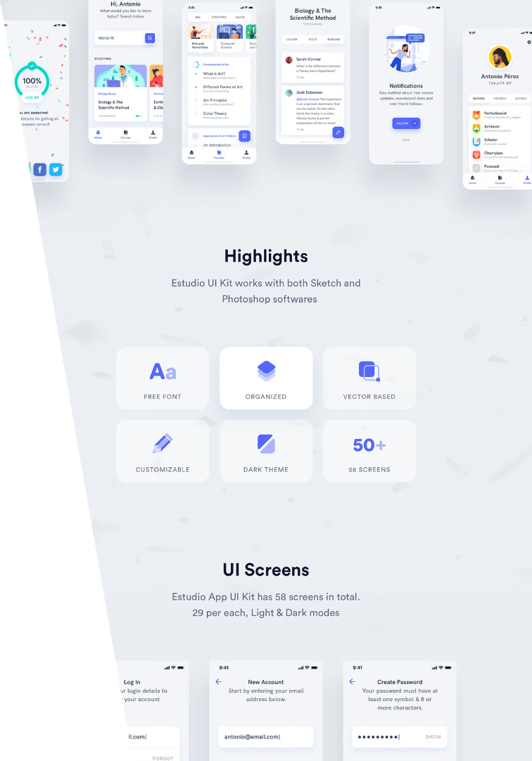

Discussion
The development of the AI-Powered Educational Center Management and Guidance Application highlights the integration of cutting-edge technology to address critical needs in the education sector.
This application successfully combines personalized learning, streamlined management, and AI-driven insights, making it a robust solution for students and educational centers alike.

Slide 25


Thank You!

