Slide 1
Wind Turbine Design
And evaluation
Kamel Husein Iweida
Mohammad Husam Barham
Mohsen Mohammad Marie
Mustafa Ali Saleh

Slide 2
objective
In this project wind turbine system will be constructed to generate power to supply electricity for buildings demands and batteries

Slide 3
Overview
blades of the wind turbine will be designed and manufactured based on the specific of the wind generator.
the wind turbine will be installed on roof of scientific centers building and then the wind turbine will be connected by wire into control unite in the energy research center (ERC) , the control unit will be connected with batteries and inverter .
project data of the wind speed will be measured by using anemometer , at the same time the value of current and voltage will appear on the computer screen which interface with PIC , then the data obtained will be tabulated and analyzed.

Slide 4
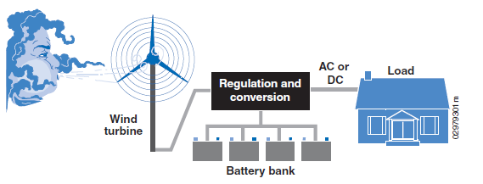
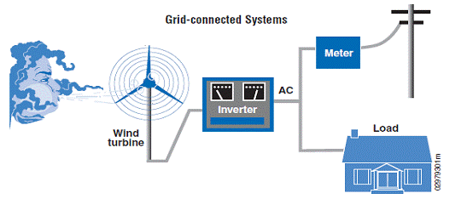
TURBINE OPERATION MODES
Stand Alone system
Connect to the Utility Grid

Slide 5
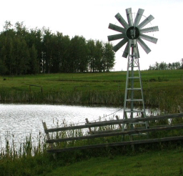
Application
Electricity Production
Wind Energy for Water Applications
Water Pumping
Industrial Applications
Telecommunications
weather stations
windmill

Slide 6
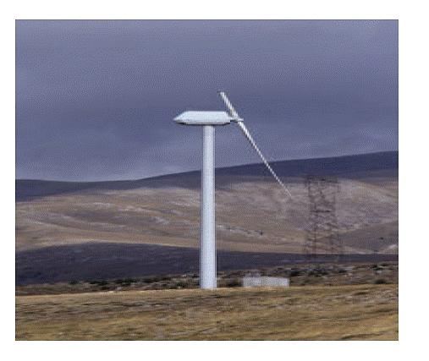
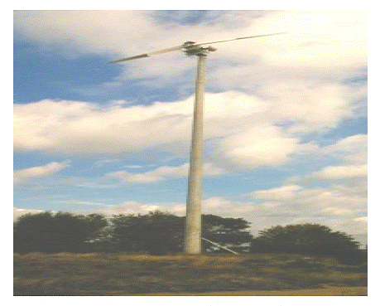
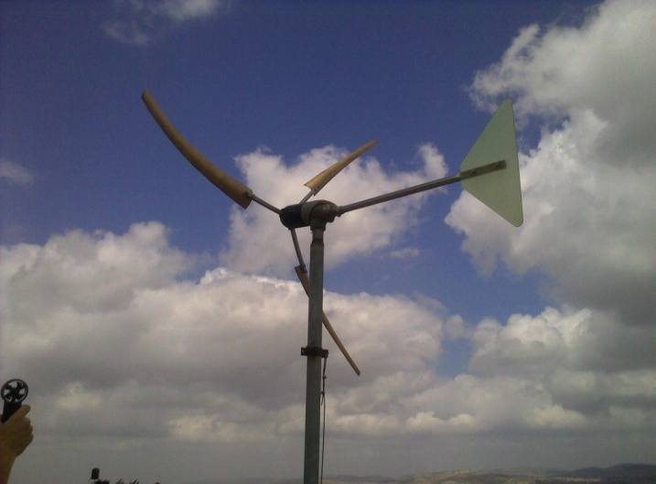
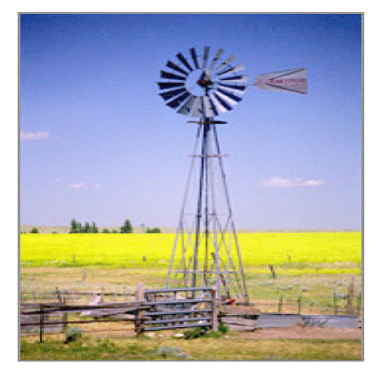
Wind Turbine
TYPE WIND TURBINE:
HAWT

Slide 7
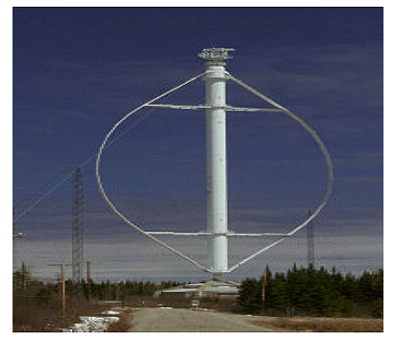
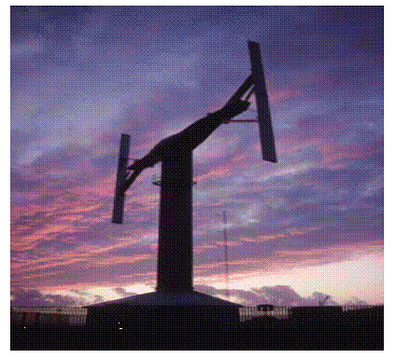
Type of wind turbine (cont)
VAWT

Slide 8
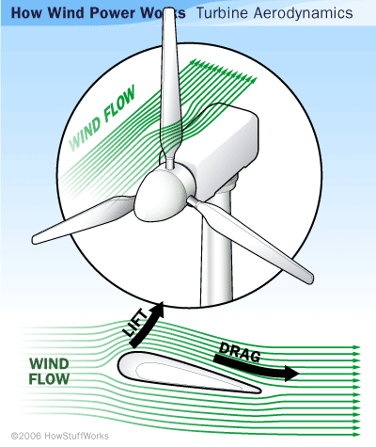
Turbine Aerodynamics

Slide 9
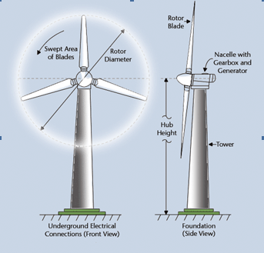
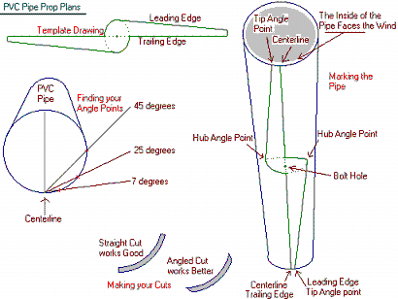
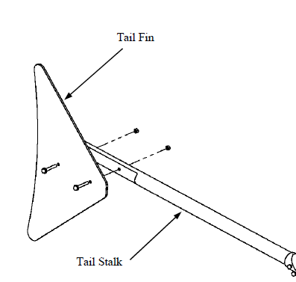
Project components

Slide 10
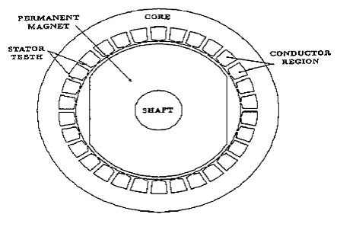
generator
The Permanent Magnet Generator

Slide 11
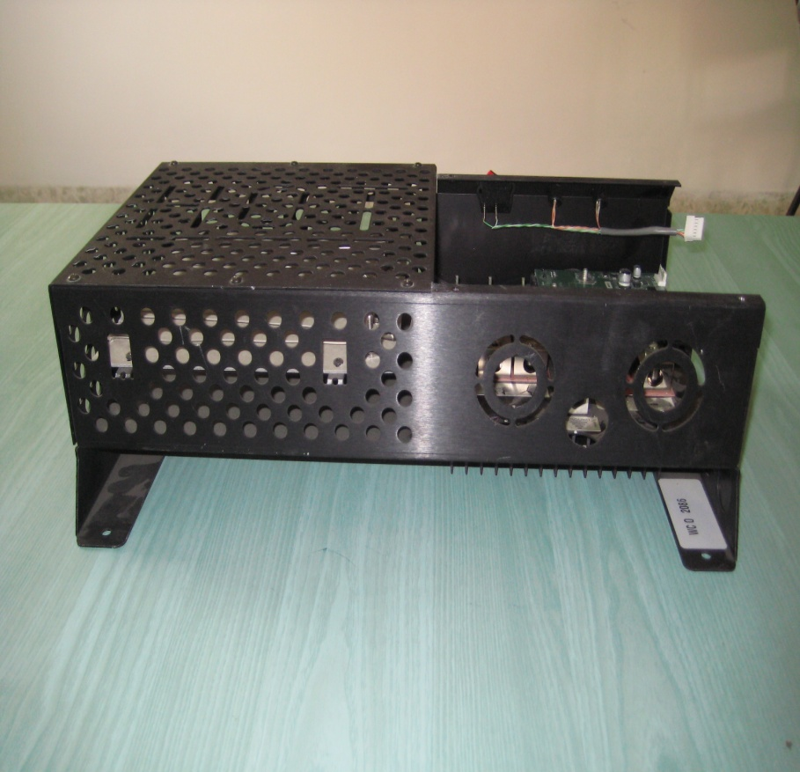
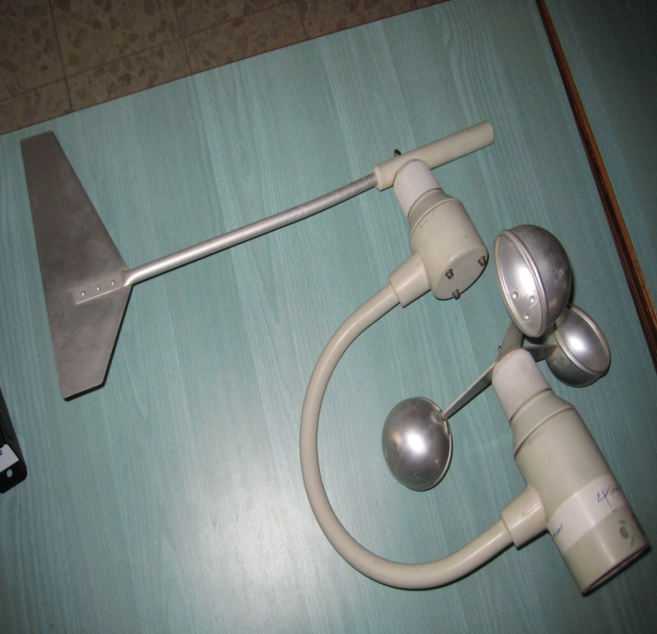
Controller system & Anemometer

Slide 12
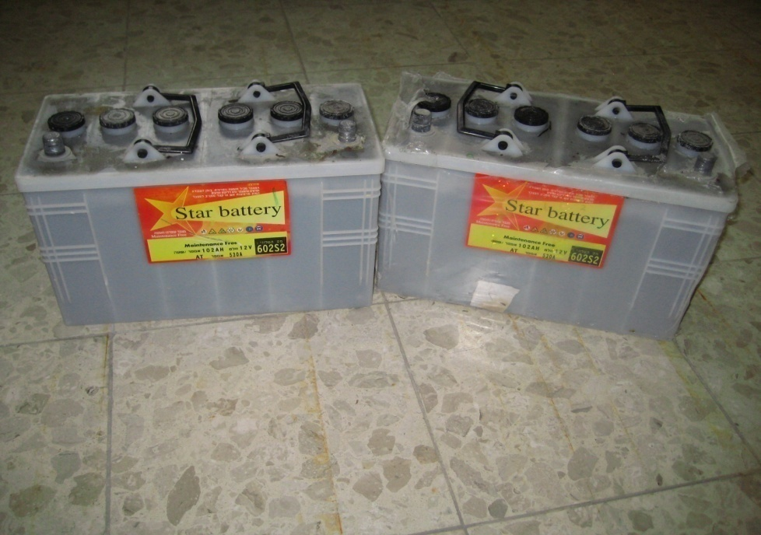
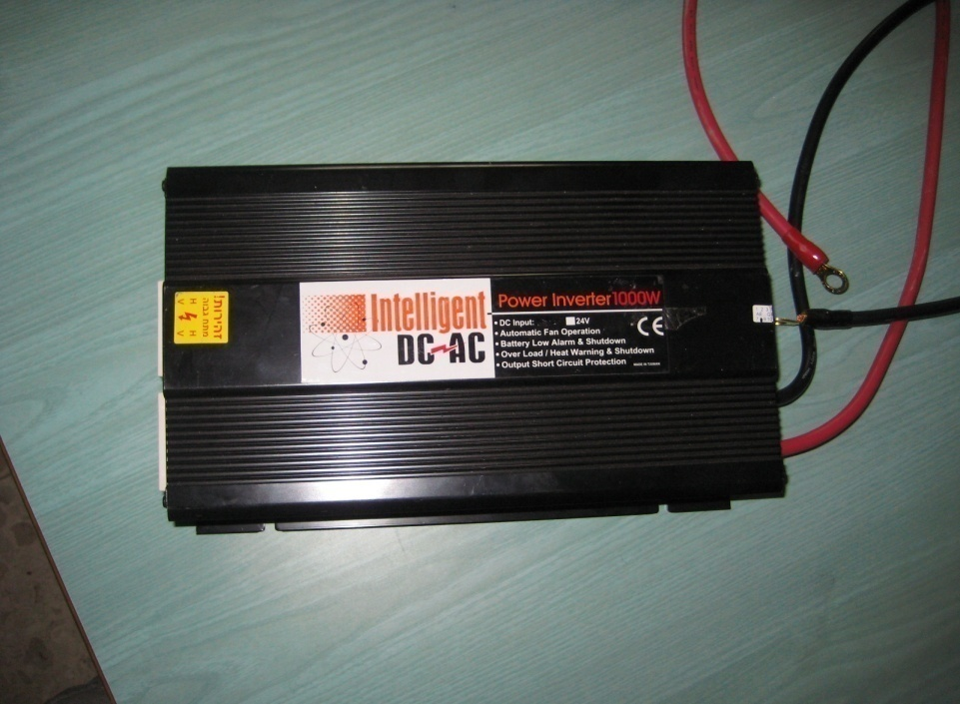
Battery& Inverter

Slide 13
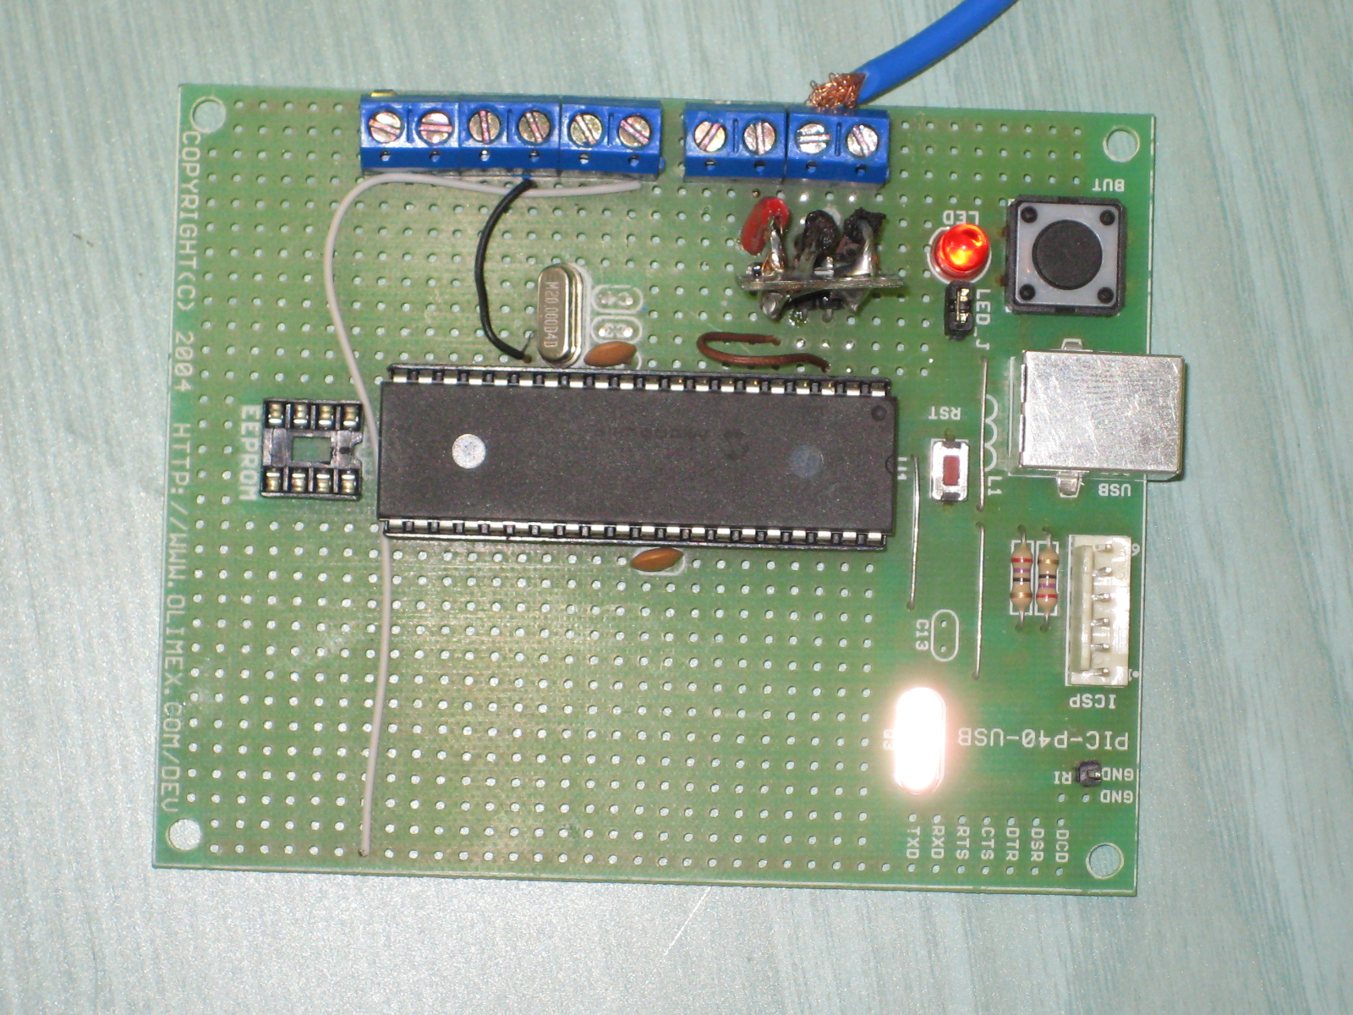
pic

Slide 14
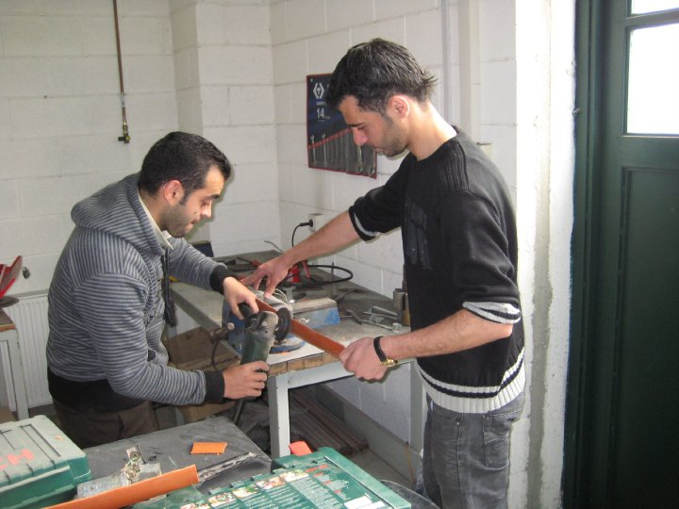
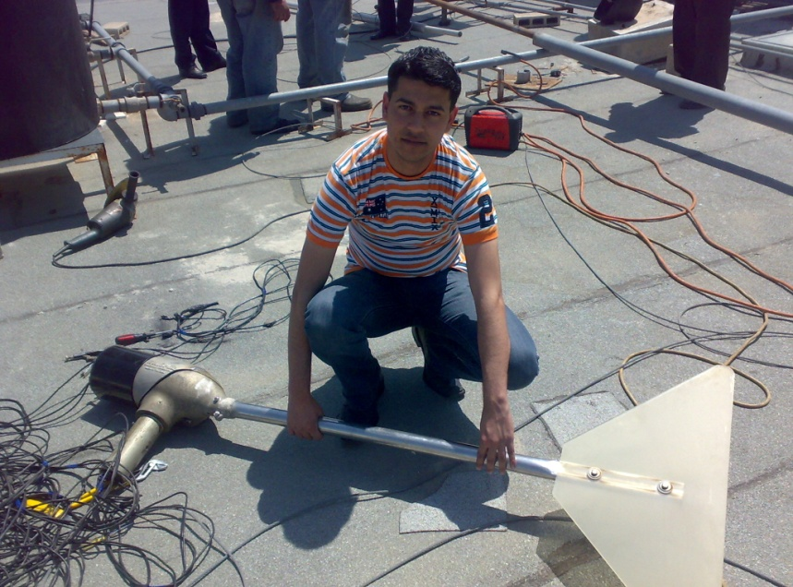
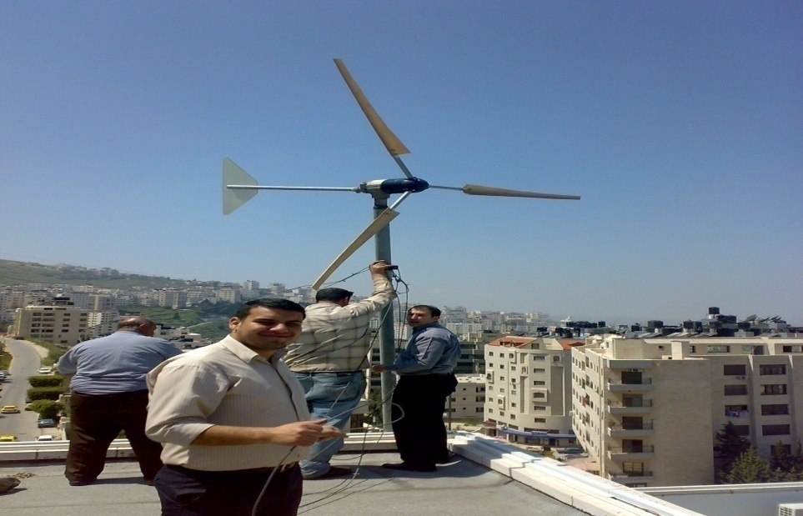
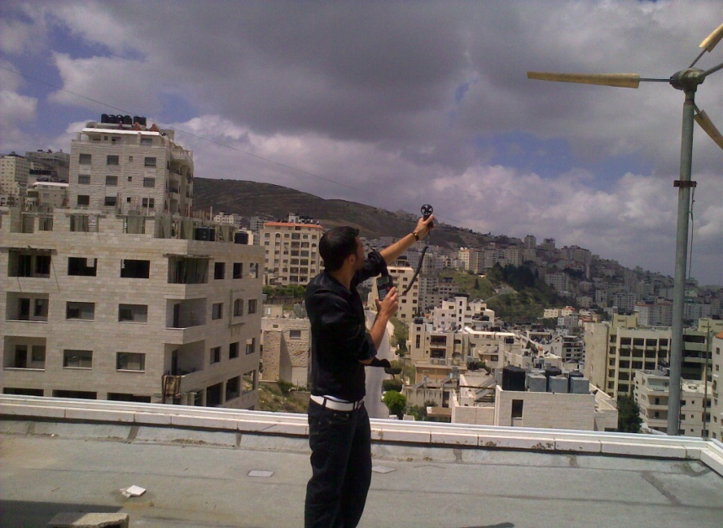
Procedure

Slide 15
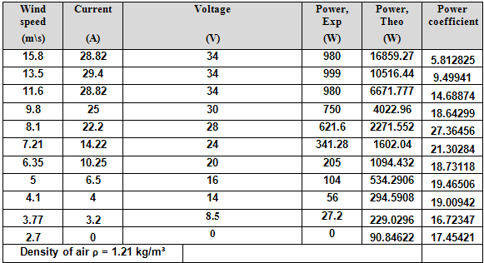
Analysis data
P_{theo}= 1/2 ρ π r² V³
P_{exp}= V*I
P_{coff} = P_{exp} /P_{theo}

Slide 16
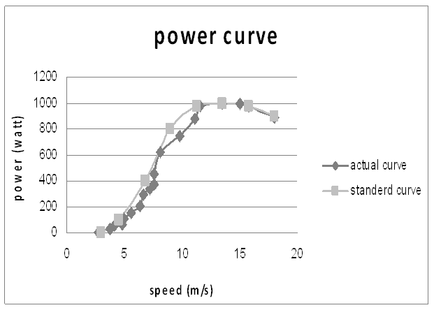
Analysis data (cont)
Power Curves

Slide 17
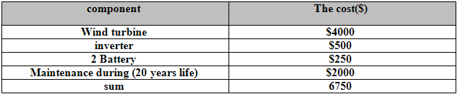
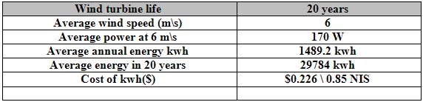
Cost in $ for different component & reliability

Slide 18
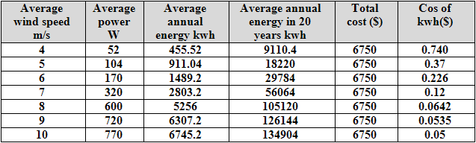
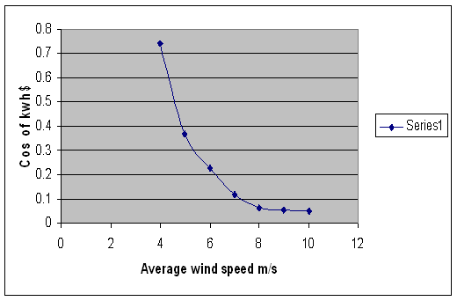
relationship between wind speed and cost of Kwh($)
cost of kwh at different average annual wind speed

Slide 19
Conclusion & Recommendation
The best and the only choice for Palestinians is develop their renewable energy source in order to achieve their energy needs .
Site location is a crucial element, and will have a major impact on which turbine you can consider. Turbines are best placed with enough open space to allow the wind direct access to the rotor.
Similar wind turbine project can be conducted for other sites in Palestine that have strong wind speeds ( as Hebron and Ramallah ) .

Slide 20
Thank You for Your Time and Attention
!!!!

