Slide 1
Graduation project 2
Wireless InSite Propagation Model
By
Noah Anan
&
Ameer Obaid
Supervisor:
Dr. Saed Tarapiah

Slide 2
outline
Introduction.
Music algorithm.
Localization using TOA Method.
Why using TOA method.
Results of localization.
Conclusion.

Slide 3
Introduction
In last project the mobile phone was used to take actual measurements to compare with the software measurements from Wireless InSite program, using these measurements to know location of user depending on RSSI.
we use another technique (TOA) to see the difference in the results in previous technique. To see a relation between AOA and received power, we used Music algorithm and also, we can figure out where is a peak power at specific AOA.

Slide 4
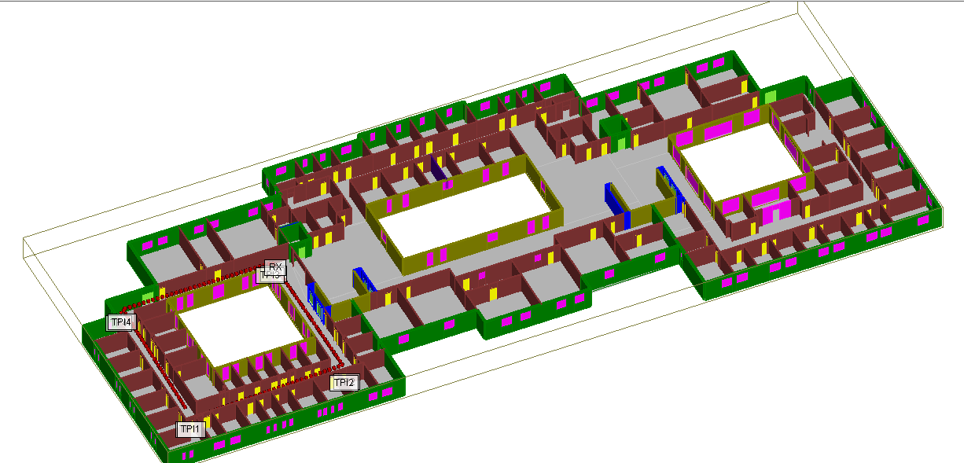
Second floor on Wireless Insite Software

Slide 5
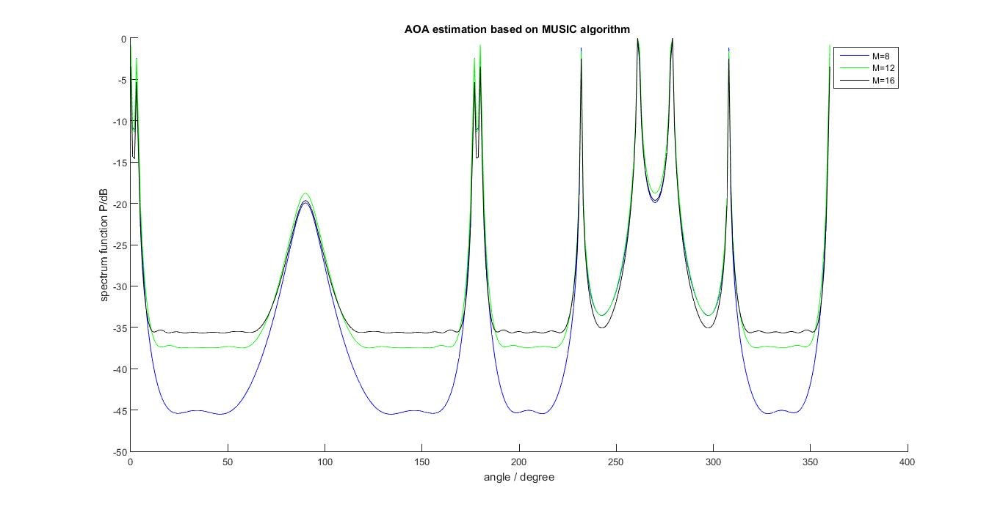

Music algorithm
Why using Music algorithm?
To see the relation between AOA & Received power also, to figure out where is a peak power at specific AOA.
We took different parameters to see the effect in the results:
Case 1:
N(number of samples)=129
diff M(number of antennas

Slide 6
In case 1 : Note that as the number of array elements “M” increases, MUSIC spectrum peaks become sharper (high accuracy and resolution).
Case 2: angle of arrival from TP2

Slide 7
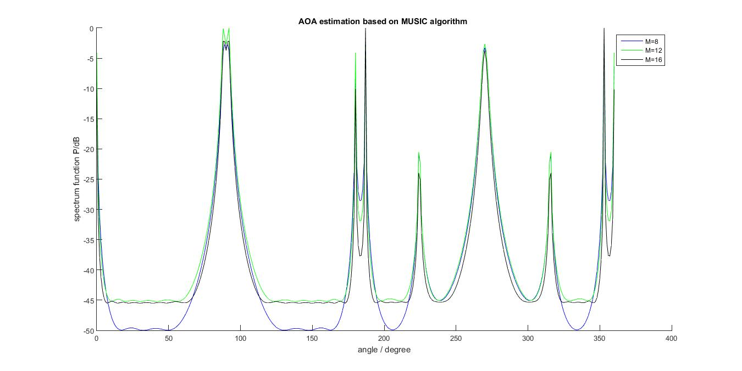

Slide 8
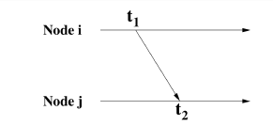
Localization using TOA (time of arrival) method
The time of arrival (TOA) method rely on the propagation time of a signal traveling from the transmitter to the receiver. In the TOA method the one-way propagation time is determined and the distance between reference node and transmitter is estimated.
The TOA method is based on combining estimates of the time of arrival of the transmitter signal, when arriving at several different reference nodes as shown in figure:
The time of Arrival(TOA) (ti) estimate can be used to determine the distance (d) between transmitter and receiver by using the following equation:
d=(t2-t1)*c
c :is the speed of light.
T2: is the TOF.
t1 :is the actual time
instant at which
the transmitter
device starts transmission .

Slide 9
Why using TOA method
By using this technique, high accuracy can be achieved in position location of a target node.
The distances between reference node and target node when increased do not affect the accuracy of calculations like in other methods such as RSS method.

Slide 10
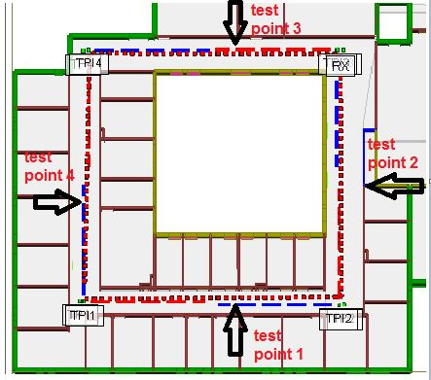
We took four test points on the Wireless Insite Program as shown below:

Slide 11
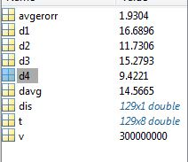
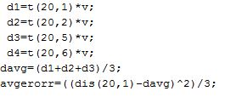
Results of Localization
Case 1:
First test point (first corridor)
We took the receiver number 20 (Rx=20)

Slide 12
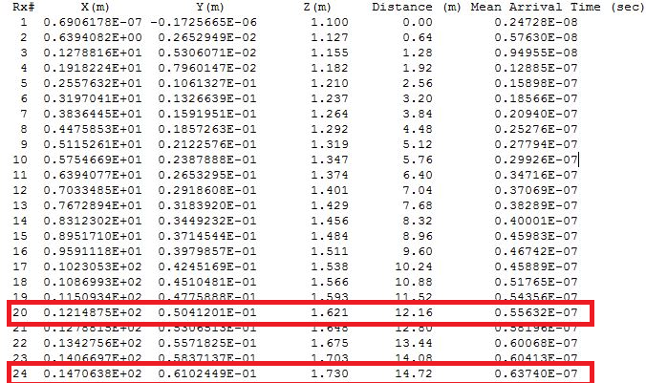
From wireless InSite, we see the davg closest to 24( receiver number) with position (14.7m,0.061m)

Slide 13
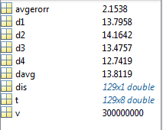
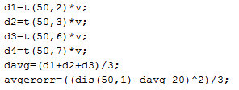
Case 2:
Second test point (second corridor).
We took the receiver number 50 (Rx=50).
From wireless InSite, we
see the davg closest
to 54(receiver number)
with position (20.9m,12.9m).

Slide 14
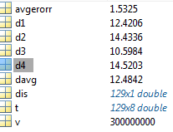
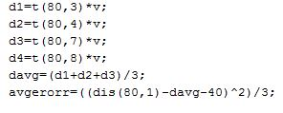
Case 3:
Third test point (third corridor).
We took the receiver number 80 (Rx=80).
From wireless InSite, we
see the davg closest
to 83(receiver number)
with position (10.2m,20.8m).

Slide 15
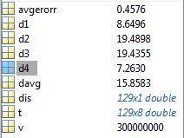
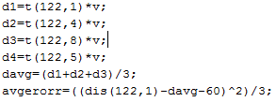
Case 4:
fourth test point (fourth corridor).
We took the receiver number 122 (Rx=122).
From wireless InSite, we
see the davg closest
to 120(receiver number) with
position (-0.037m,7.18m).

Slide 16
Conclusion
The principal result of this project is a localization using time of arrival method. after validating the results and comparing with results in RSSI method, we concluded that TOA method is more accurate (Less error) than RSSI. Using Music algorithm, we can know where is a peak power at specific AOA.

