Slide 1
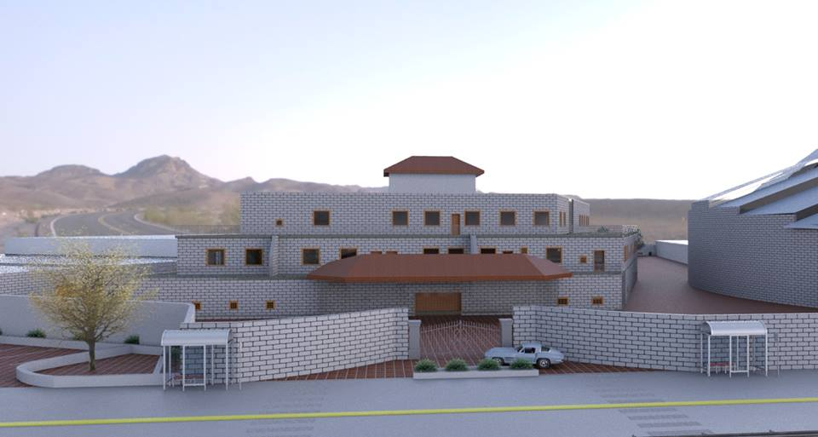

An- Najah National University
Building Engineering Department
Sport Association
Prepared by: Alia’a Jamal
Haneen Qatanani
Sewar Bani Odeh
Supervisor: Dr.Muhannad Haj Hussein

Slide 2
Outline
1
Introduction
2
Architectural Design
3
4
5
Structural Design :1-steel
Environmental Design
2-concrete
Mechanical Design
6
Electrical Design

Slide 3
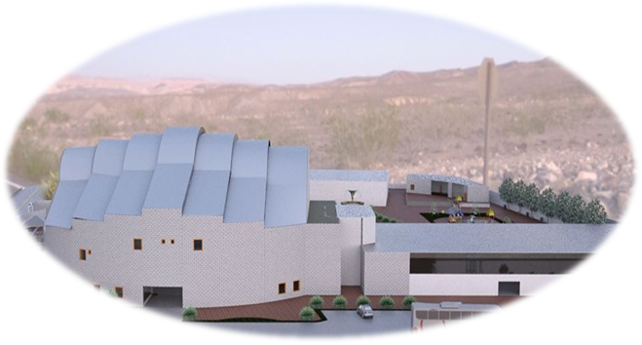
Introduction
Our project is sport association and it is a re design architectural student project of 3rd year in architectural department.

Slide 4
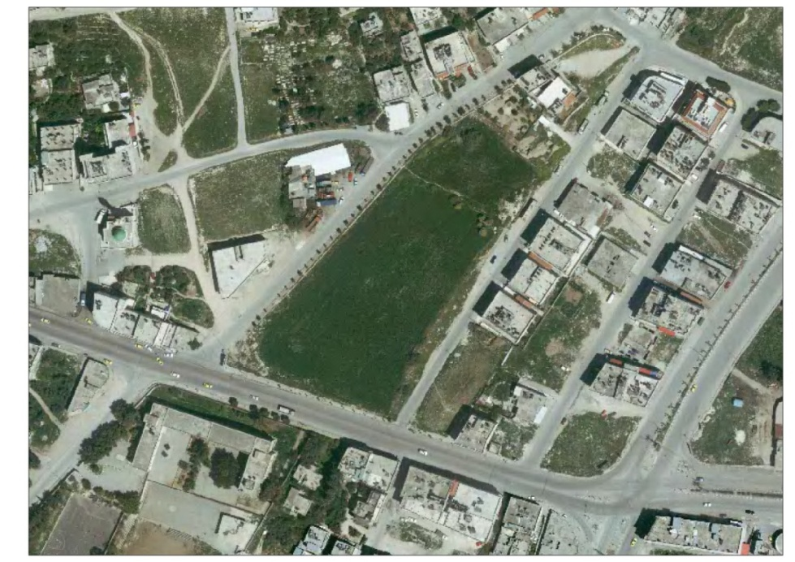
Site of the project
The selected site is located in the east side of Nablus city, at Amman Street. On the south side of the site there is "Qadri Tuqan" school, the site is surrounding by four streets, two of them are main streets. Land topography is flat with very small slope.
Project site

Slide 5
Climatic conditions of Nablus City
25
70

Slide 6
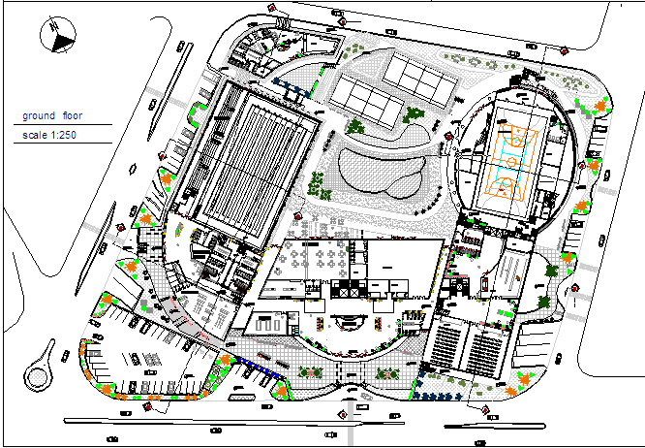
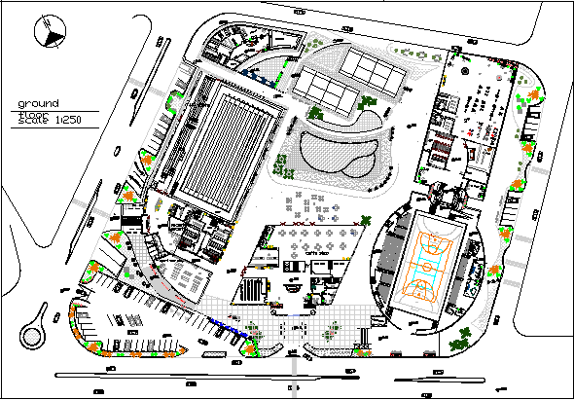
Architectural design
The original master plane
The new master plane

Slide 7
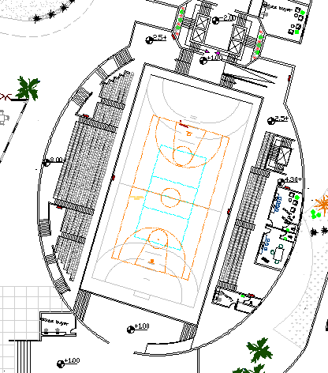
The level of the hall will be (+1) from the ground and its full area about 2227m² with height of 20m this hall has many sports such as handball, basketball ,and fastle.
The seating of the stadium enough for 600 spectators.

Slide 8
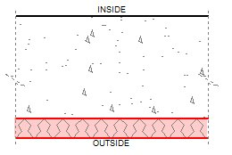
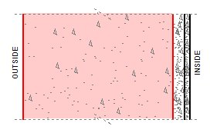
The material that used in the multisport hall
1-Floor material : the floor consist of two layers
- Linoleum : thickness = 0.047 m
Concrete : thickness = 0.25 m
2-Wall material : the wall consist of three layers
-Concrete Lightweight : thickness = 0.27 m
- Fiberglass : thickness = 0.02 m
-Gypsum : thickness = 0.010m

Slide 9
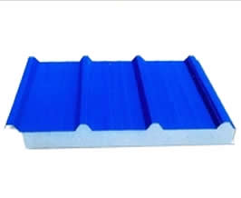
3-Roof material : the ceiling consist of three layers
- Aluminum : two layers of aluminum with thickness = 0.002m
Polystyrene Foam : thickness = 0.036 m
4-Windows material : the window consist of three layers
- Glass standard : two layers of glass with thickness = 0.006m
- Air gap : thickness = 0.030 m

Slide 10
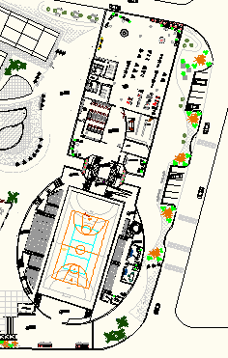
Entrances and exits

Slide 11

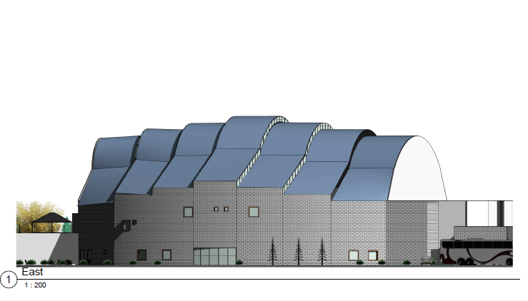
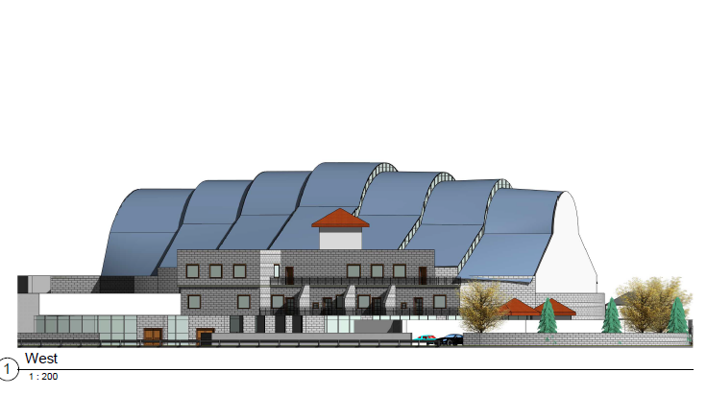
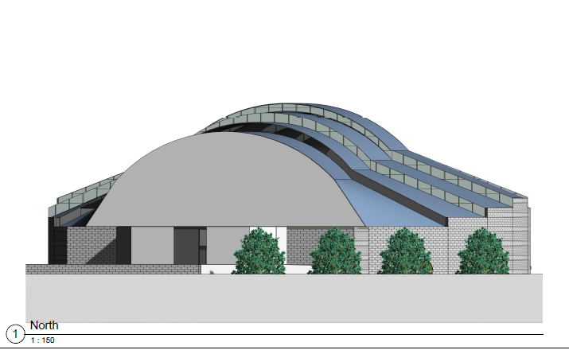
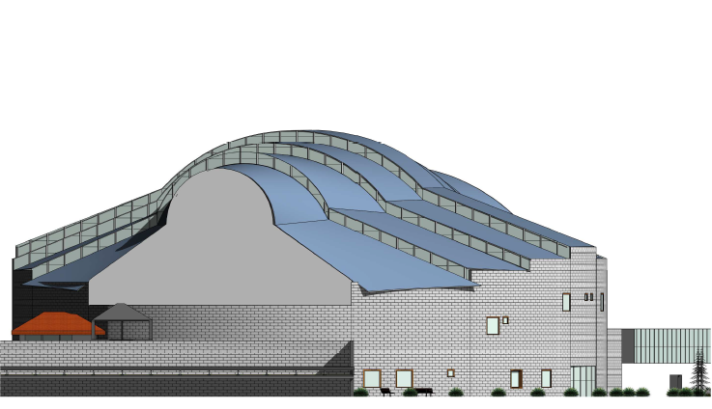
:Elevations
East elevation
North Elevation
West elevation
South elevation

Slide 12
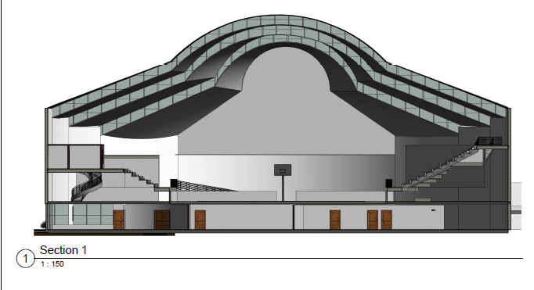
Section in the hall

Slide 13
Architectural Quantities
Quantity | unit | Finishing
3931 | M² | plaster
1592 | M² | Fiberglass
1590 | M² | Gypsum Board
4640 | M² | Cover
1603 | M² | panting
3570 | M² | Floor tile
240 | M³ | Sand Fill
1039 | M² | Linoleum
20703 | block | internal wall block

Slide 14
Structural design
Design data:
1. The cover of the Multisport hall will be steel structure.
2.The steel structure consist of forty four triangle trusses.
3. The analysis and design are done using 3D model using SAP2000 program, and AutoCad program for all drawings.
4. The trusses member are HSS
5. The members were connected by E70xx weld.

Slide 15
The loads on the truss :
Dead load = 0.08 KN/m²
Live load = 1.0 KN/m²
Wind load = 0.27 KN/m²
Equipments weight = 0.2 KN/m²

Slide 16
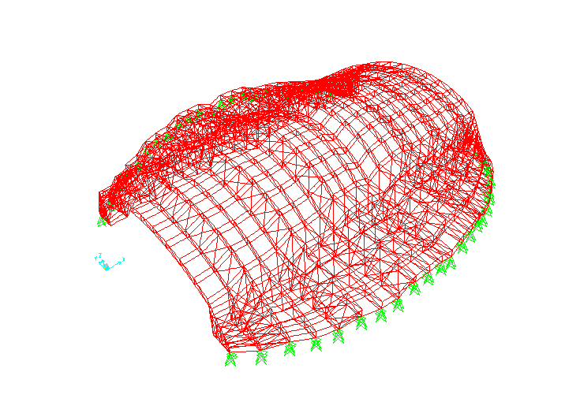
Model design on SAP
1.Deformed shape for roof

Slide 17
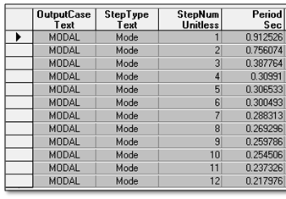
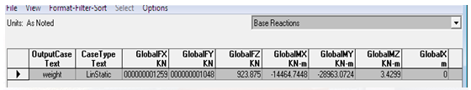
2.Modal periods
3.The total roof weight

Slide 18
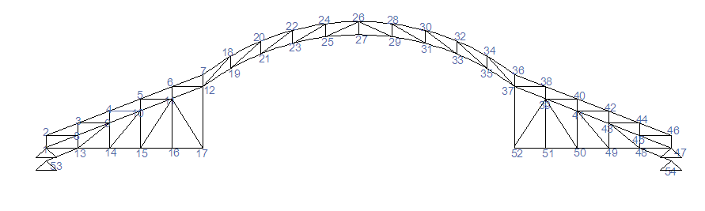
Design Truss (1)

Slide 19
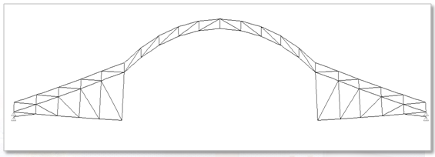
1.Truss weight =21.255KN
2. Deformed shape
3.Deflection at joint 26
Allowable deflection =9.5 cm
* Deflection from dead load = 0.77
* Deflection from live loads = 1.59
26

Slide 20
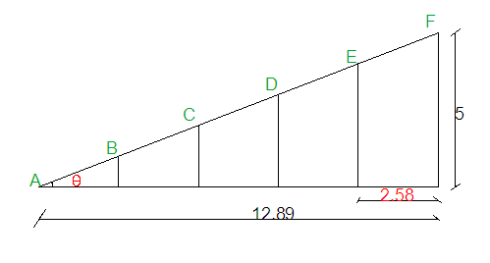
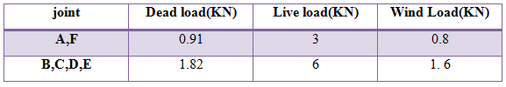
Triangle truss
The base at level =9 m

Slide 21
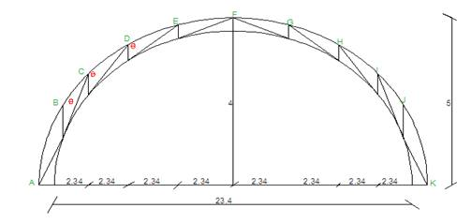
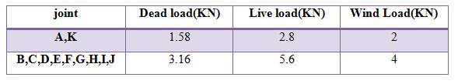
Arch trusses

Slide 22
Tension and compression member design
Tension member:
ФPn for all tension member > the tension force through members
Slenderness Check : L/rmin < 300 for all members.
Compression member:
Ф pn(compression) > ФFcr for all compression members
local buckling check : Bf/Tf ≤ 1.4(E/Fy)^0.5 for all members
Slenderness Check : L/rmin < 300 for all members

Slide 23
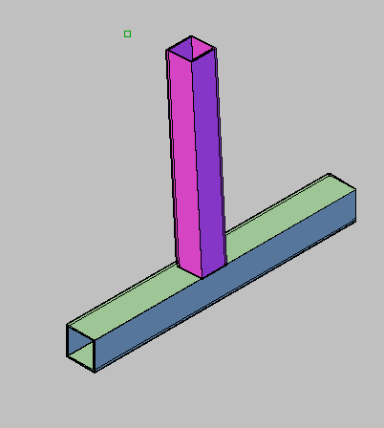
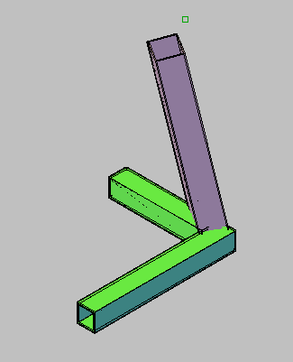
Connections design
a min =3mm and a max =4.8
TS2*2*316
TS3.5*2.5*316
E70XX
E70XX
3
TS2*2*316
6.5
TS2*2*316
TS2*2*316
16
TS2*2*316
1

Slide 24
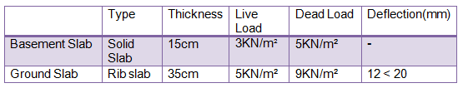
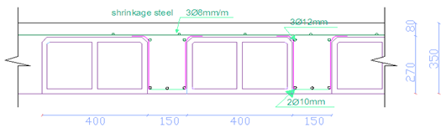
Concrete structural element design
Slab :
Ground Slab:

Slide 25
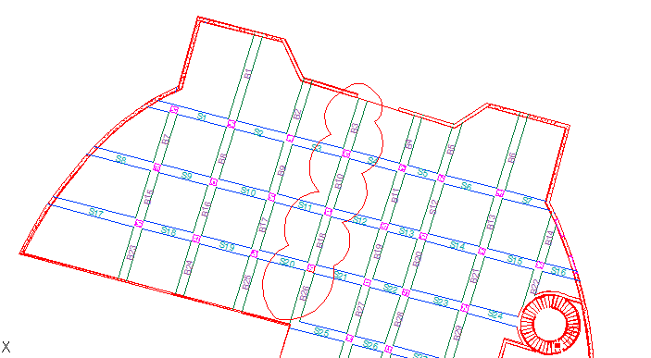
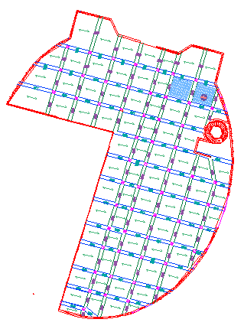
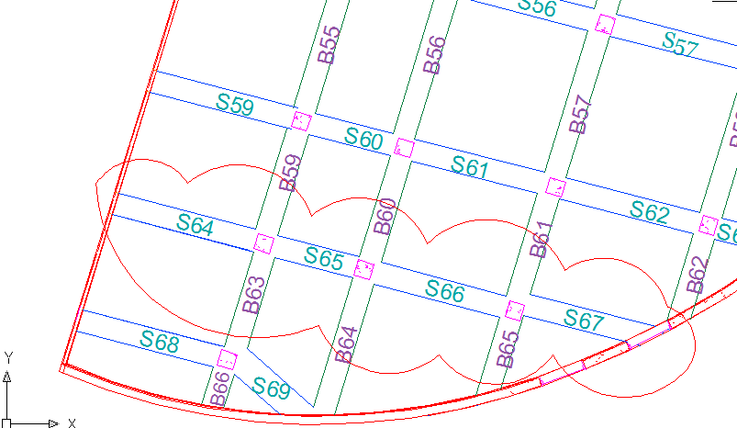
Beam Design
Main beam
secondary beam

Slide 26

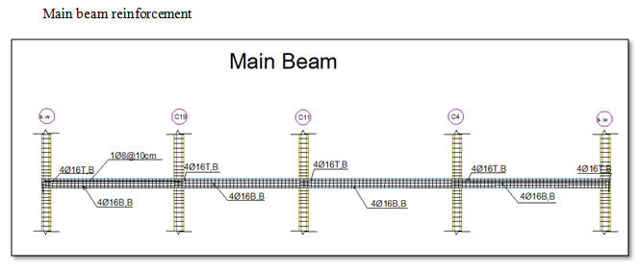
Beam Design
Main beam

Slide 27
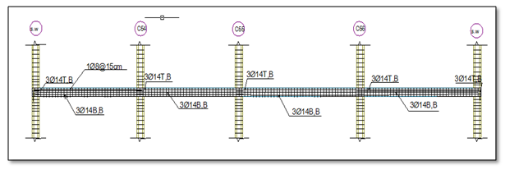
Secondary beam
Beam dimension =400*350 mm
Use 3 Ø14 mm
Use 1 Ø8mm stirrup /150 mm.

Slide 28
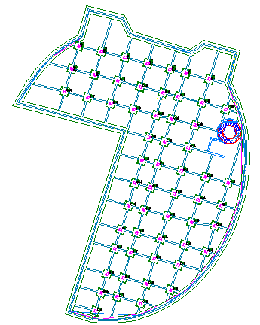
Column Design

Slide 29
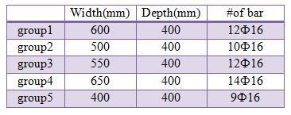
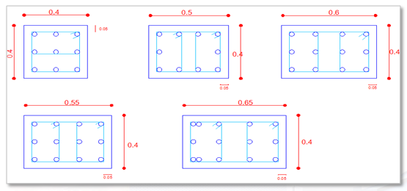
Column Design

Slide 30
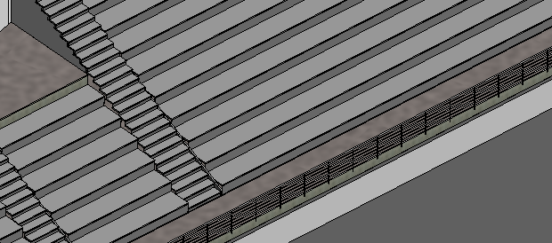
Design of seating
seating dimension=0.8*0.45
design as one way solid slab
5Ф18mm/m
shrinkage steel : 7Ф12mm/m
Check for shear:
Vc=370 KN > Vn=92 KN...................OK

Slide 31
Seismic Design
Buildings in Nablus city, Number of stories = 2 stories.
Nablus @ zone 2B → Z= 0.2→Soile is Sc .
R= 5.5 .
V = V_{max} = 664.6 ton→6646KN
T= 0.33 sec

Slide 32
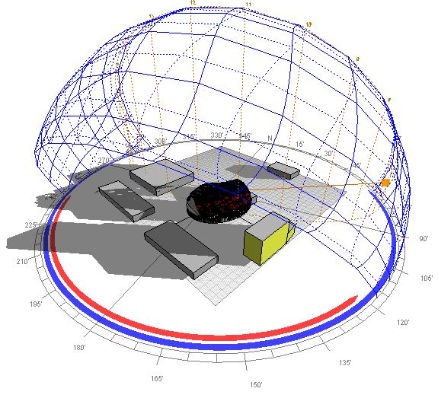
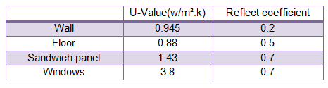
Environmental Design

Slide 33
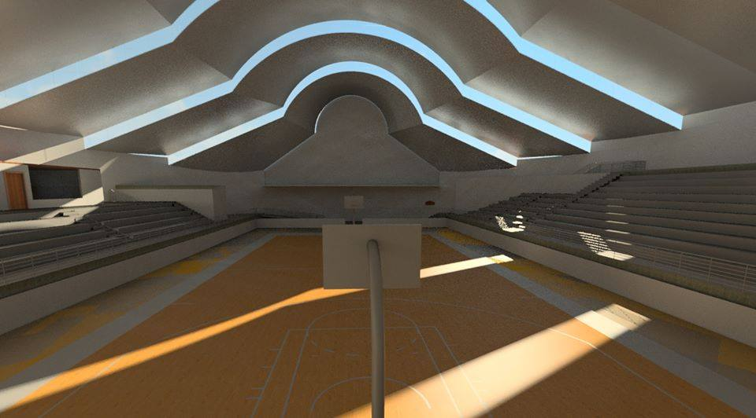
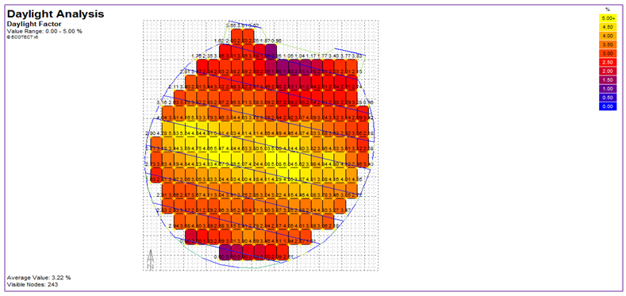
Multisport hall
Daylight factor

Slide 34
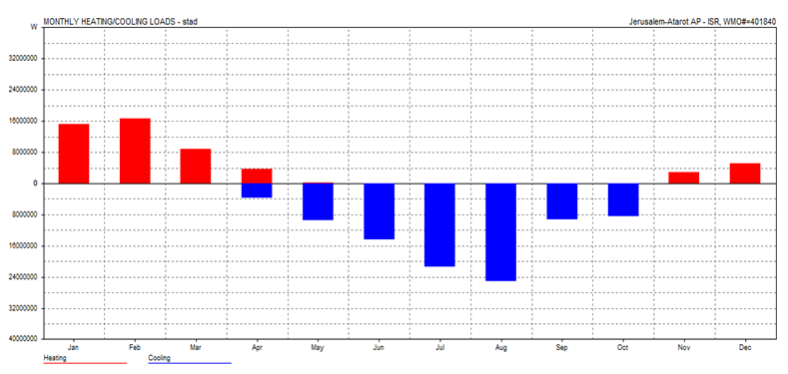
Monthly heat loses / Gain
224kw
265kw

Slide 35

Acoustics analysis
The recommended value of reverberation time about 1.6 to 1.8 , and the estimated STC value = 56 dB .
Values of RT at specified frequencies:

Slide 36
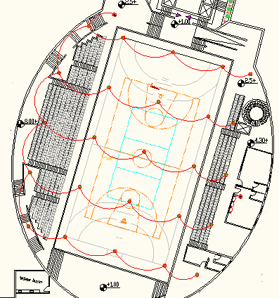

Slide 37
Electrical Design
Electricity is the most important invention in the history of humanity and its application spread in our life to reach everything, from lighting in our rooms to the huge generators in electrical networks.
Dialux program for the design and analysis of industrial lighting.

Slide 38
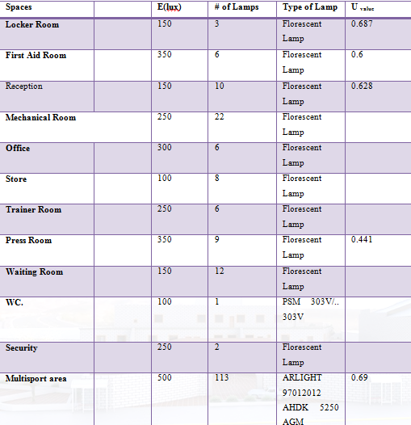
1. Lighting Design
Information about lighting design using in Dialux program.

Slide 39
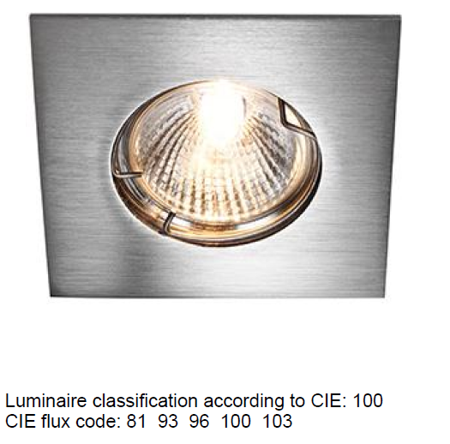
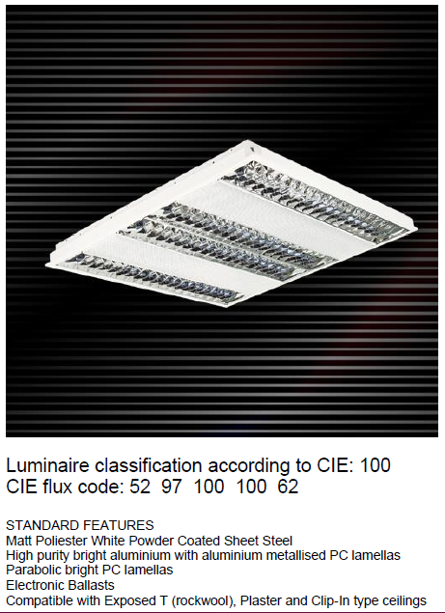
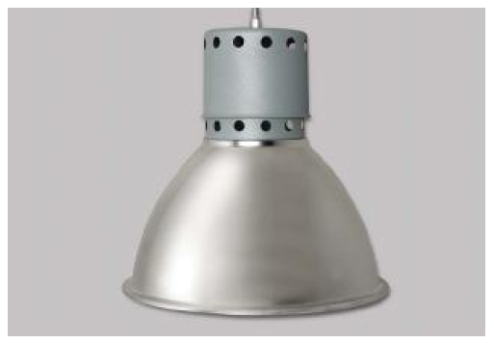
Types of Lamps :
Lamp for Bathroom
Fluorescent Lamp.
Lamp for multisport hall

Slide 40
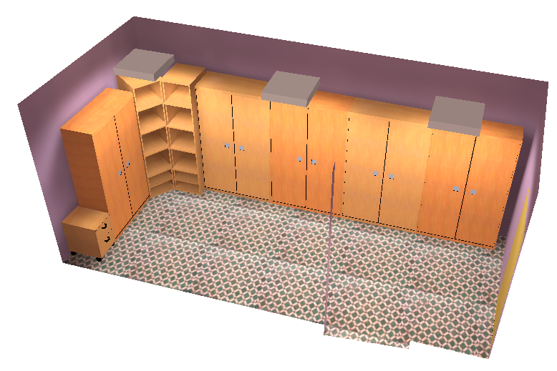
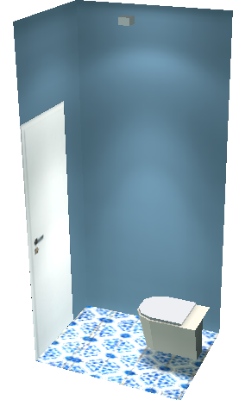
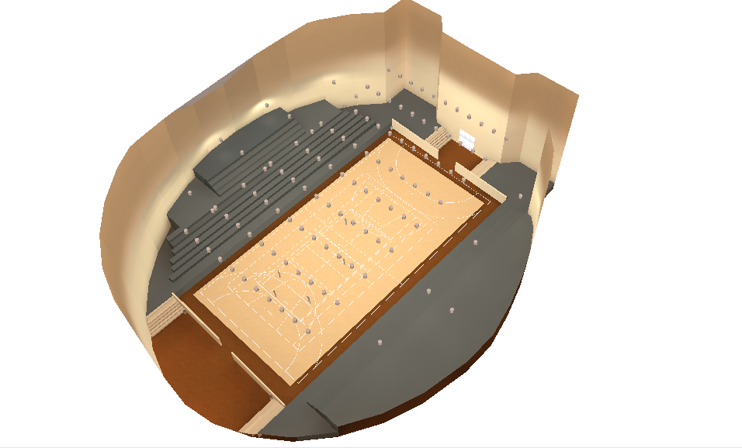


B. Lighting design by Dialux program for some spaces :
WC.
Locker room
Multisport hall.
First aid room
Reception

Slide 41
2. Socket Design
The sockets have different rated current because it depends on the load which we are going to connect with the sockets.
For calculation we assumed :
D.F: diversity factor = 0.2
S.F: safety factor = 1.2
P.F: power factor =0.8

Slide 42
In the result ,
Total current | # of socket
28 | 14 | Ground floor
108 | 22 | Basement floor

Slide 43


Multisport hall lighting and socket.
Basement Lighting and socket.

Slide 44

Electrical Equipment Quantities

Slide 45
Mechanical Design
This part will talk about mechanical services in the building, which include air conditioning systems, equipments, water supply and fire system.
  HVAC Design
    We design in July month
    Inside design condition (Tin)=22Cº
    Outside design condition (To) = 32Cº

Slide 46


Distribution of Diffusers and grills

Slide 47


  2. Water Supply System
  Feed water to the building divided into two main sections: the cold water supply and hot water. Each system consists of several subsystems.
Water supply system

Slide 48

  3. Drainage System
  The drainage system consists of:
  1. Black water design.
  2. Grey water design.
Drainage system

Slide 49
Thus ….
Use 2” PVC pipe to connect shower and lavatory with the floor trap.
Use 4” PVC pipe for floor trap.
Use 6” steel pipe for manholes

Slide 50


4. Fire System
Hose Station and Fire alarm

Slide 51

Mechanical Equipment quantities

Slide 52
References:
Nuvert,1970
International plumping code, 1997
Ashlle
The American Concrete Institute ‘’ACI’’ code
NFPA

Slide 53


Slide 54

Thank You For Listening

