Slide 1
Developing a Catalytic Pyrolysis Of Scrap Tires

Slide 2
Introduction
Since, the early days of tire usage and the disposal of scrap tires has been a major problem worldwide.
In West bank, Palestine there are 390 thousand of scrap tires.
Therefore thousands of tires are at junkyard
One of the ways to disposal the waste tires is to burn them
land filling, grinding and reclaiming are another ways of disposal the waste tires

Slide 3
Introduction
pyrolysis is chemically decomposing of organic materials in absence of oxygen at elevated temperature.
The products of pyrolysis of waste tires are gas, pyrolytic oil and char
Catalyst is a substance which is added to the reaction in order to increase the rate of the reaction and to enhance the products obtained from the reaction
very small amount of catalyst is required to alert the reaction because it is not consumed in the reaction and could act repeatedly.

Slide 4
Literature review

Slide 5
Non Catalytic Pyrolysis of Waste Tiers

Slide 6
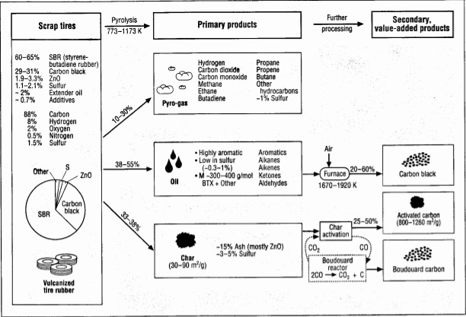
Wójtowicz, M.A. and M.A. Serio. (1996)

Slide 7
Fernández, A. and C. Barriocanal, et al. (2012)
Pyrolysis for ﬁbres with Batch reactor, 350°c temperature and Atmospheric pressure.

Slide 8
Catalytic Pyrolysis of Waste Tiers

Slide 9
Shah, J. and M. Rasul, et al. (2008)
pyrolysis for waste tires with Catalysts MgO and CaCO3.With Batch reactor, 350°c temperature,2 hour duration and Atmospheric pressure.

Slide 10
Shah, J. and M. Jan, et al. (2009)
pyrolysis for waste tires with Catalysts Al2O3 , SiO2 and Al2O3 + SiO2 .With Batch reactor, 400°c and Atmospheric pressure.

Slide 11
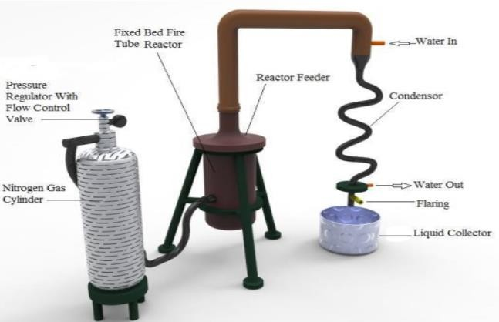
Shameem Hossain, M., et al. (2017)
pyrolysis for waste CT(catalyst tiers ratio) with Catalysts ZSM-5 and zeolite.at 300°-600°c temperature.

Slide 12
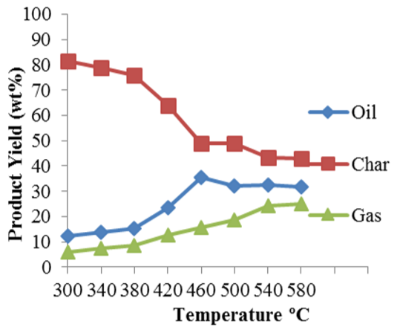
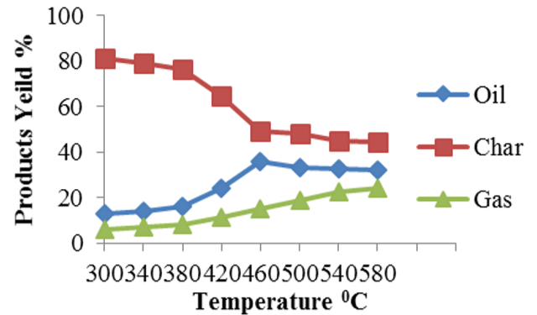
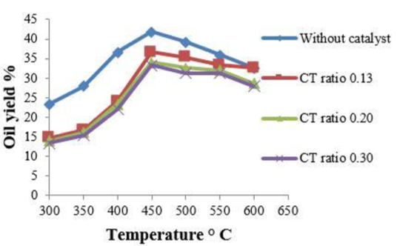
The results
CT ratio 0.15
CT ratio 0.1
The results

Slide 13
Catalytic Processes

Slide 14
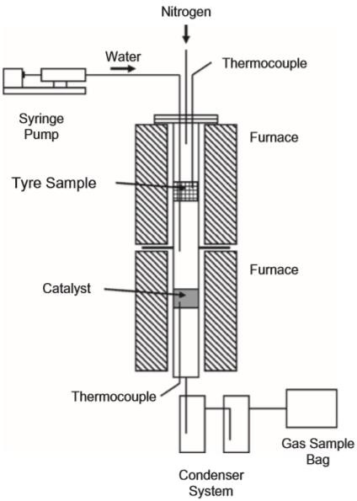
Elbaba, I.F. and P.T. Williams. (2010)
A two-stage pyrolysis-gasification fixed bed reactor for waste tiers . With Catalysts Ni−Mg−Al. at a pyrolysis temperature of 500°C and gasification temperature of 800°C.
Increase in H2 and CO concentrations and decrease in CH4 and C2-C4 concentrations when the Ni-Mg-Al catalyst was added.

Slide 15
Experimental Setup

Slide 16
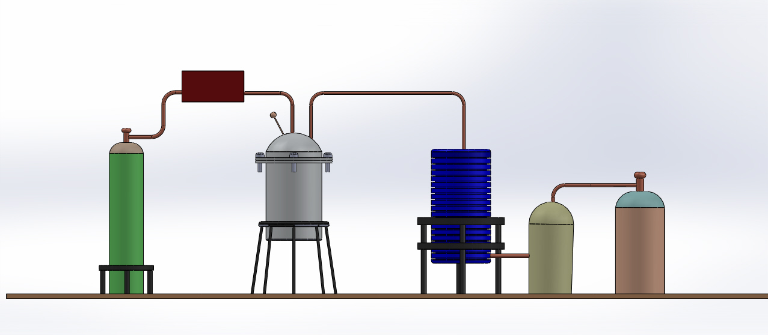
Front View of Setup

Slide 17
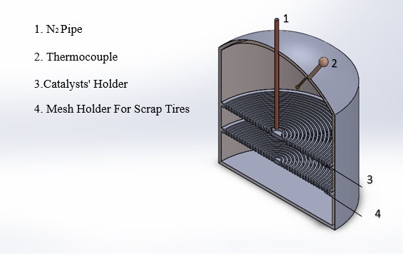
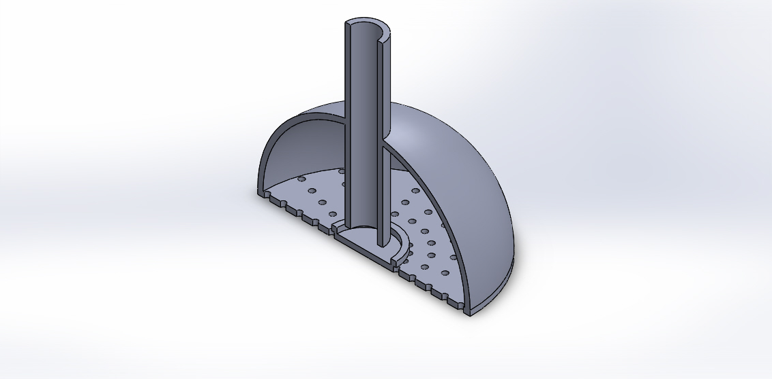
Fixed-Bed Reactor

Slide 18
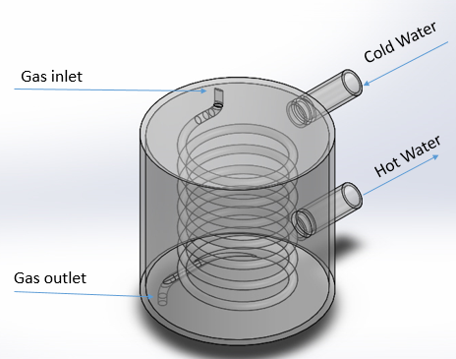
Cooling System

Slide 19
Methodology

Slide 20
Study Methodology
Task #1 To conduct a comprehensive literatures reviews
Task #2 To synthesize the catalyst
Task #3 To examine the effect of catalysts’ holders
Task#4 To design an experimental setup

Slide 21
Conclusion

Slide 22
Conclusion
literature reviews published
Information about environmental problems
pyrolysis process was chosen to take place in the recycling process due to its big advantages
enhance and modify pyrolysis process
experimental setup was designed

Slide 23
Thank You

