Slide 1
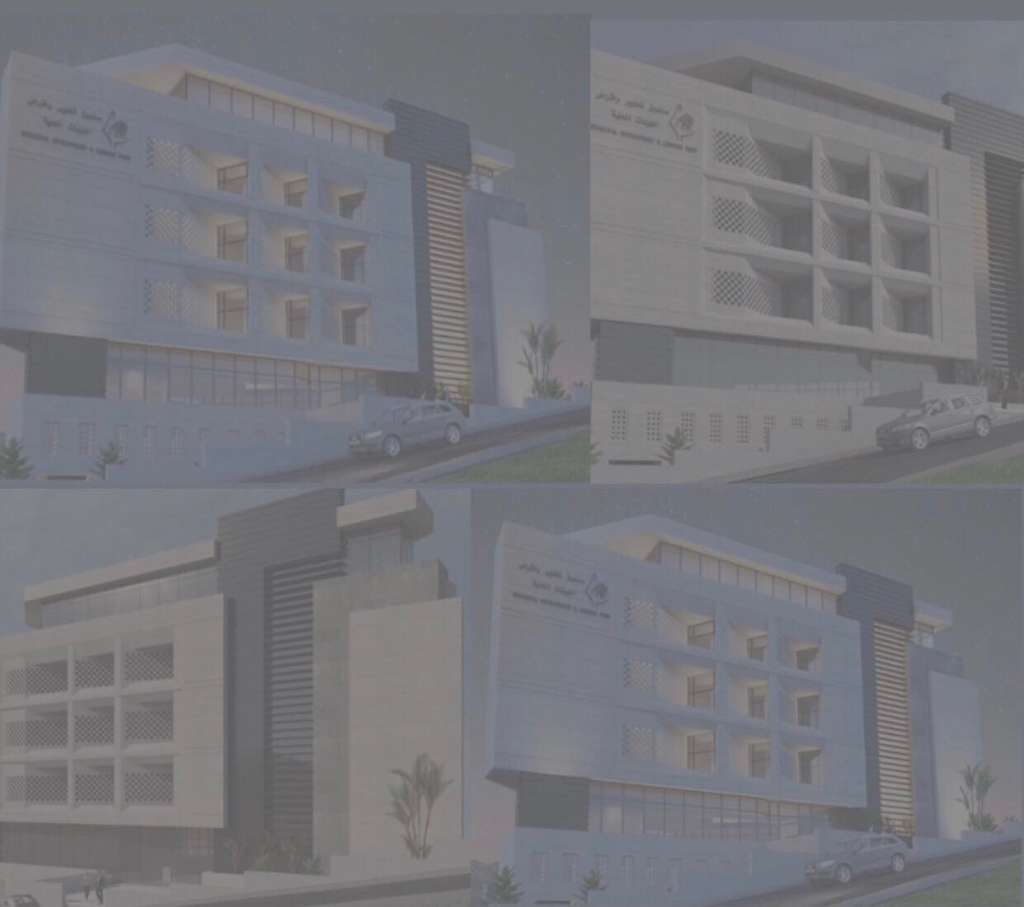

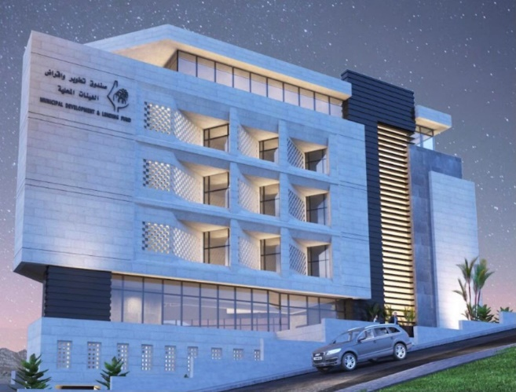
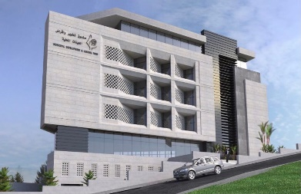
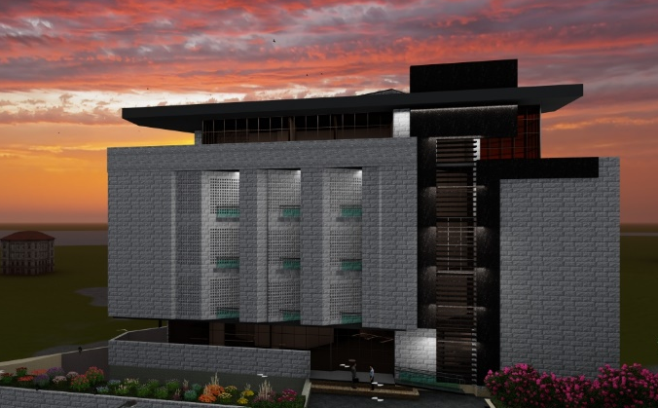
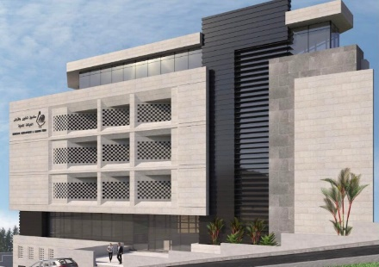
An-Najah National University
An Integrated Re-Design For The Development and Lending Fund for Local Authorities Building
Prepared By :-
- Laith Takatek
-Raghad Al-Agbar
-Raghad Odeh
Under Of Supervisor:-
Dr. Ahmad Saleh
2021-2022
1

Slide 2
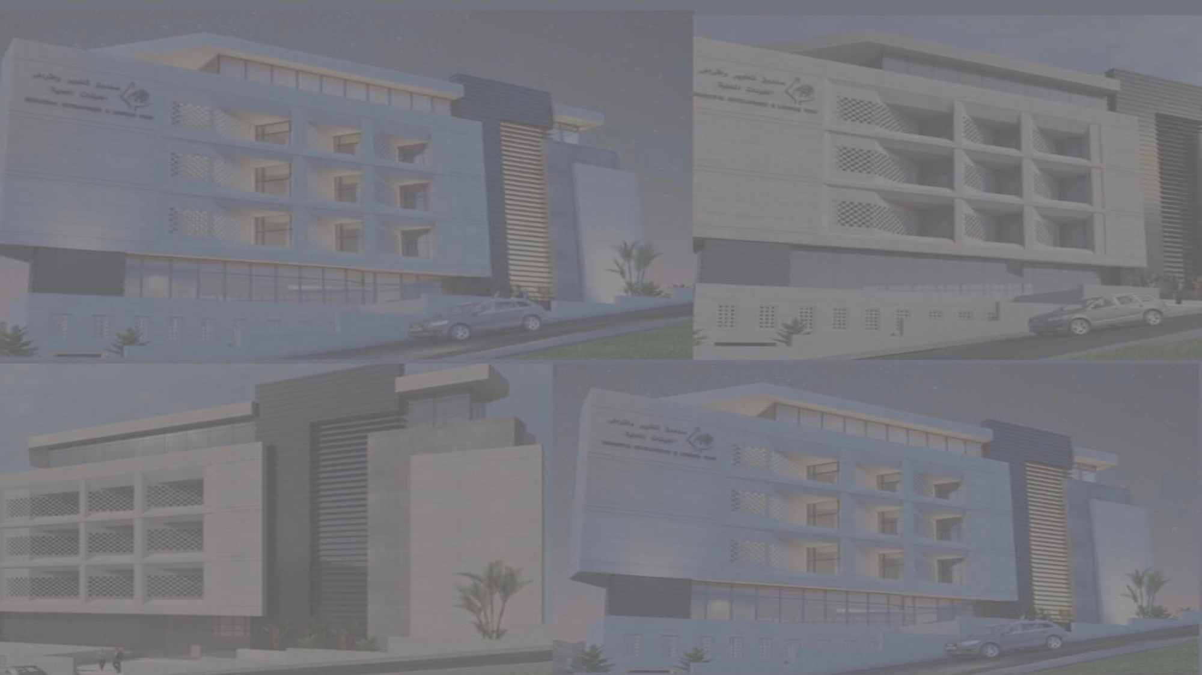

Introduction
Site Analysis
Architectural Aspect And Consideration
Lumion 3D Model
Environmental Aspect And Consideration
Structural Aspect And Consideration
Electro - Mechanical Aspect
Quantity Surveying And Cost Estimate
2

Slide 3
Introduction
This Project represent an integrated Re-design for the development and lending fund for local Authorities Building , in the area called Dar Jerries' in Ramallah , that was established in 2005 by the Palestinian government to serve as the main channel to support the process of reform and development of local authorities.
3

Slide 4
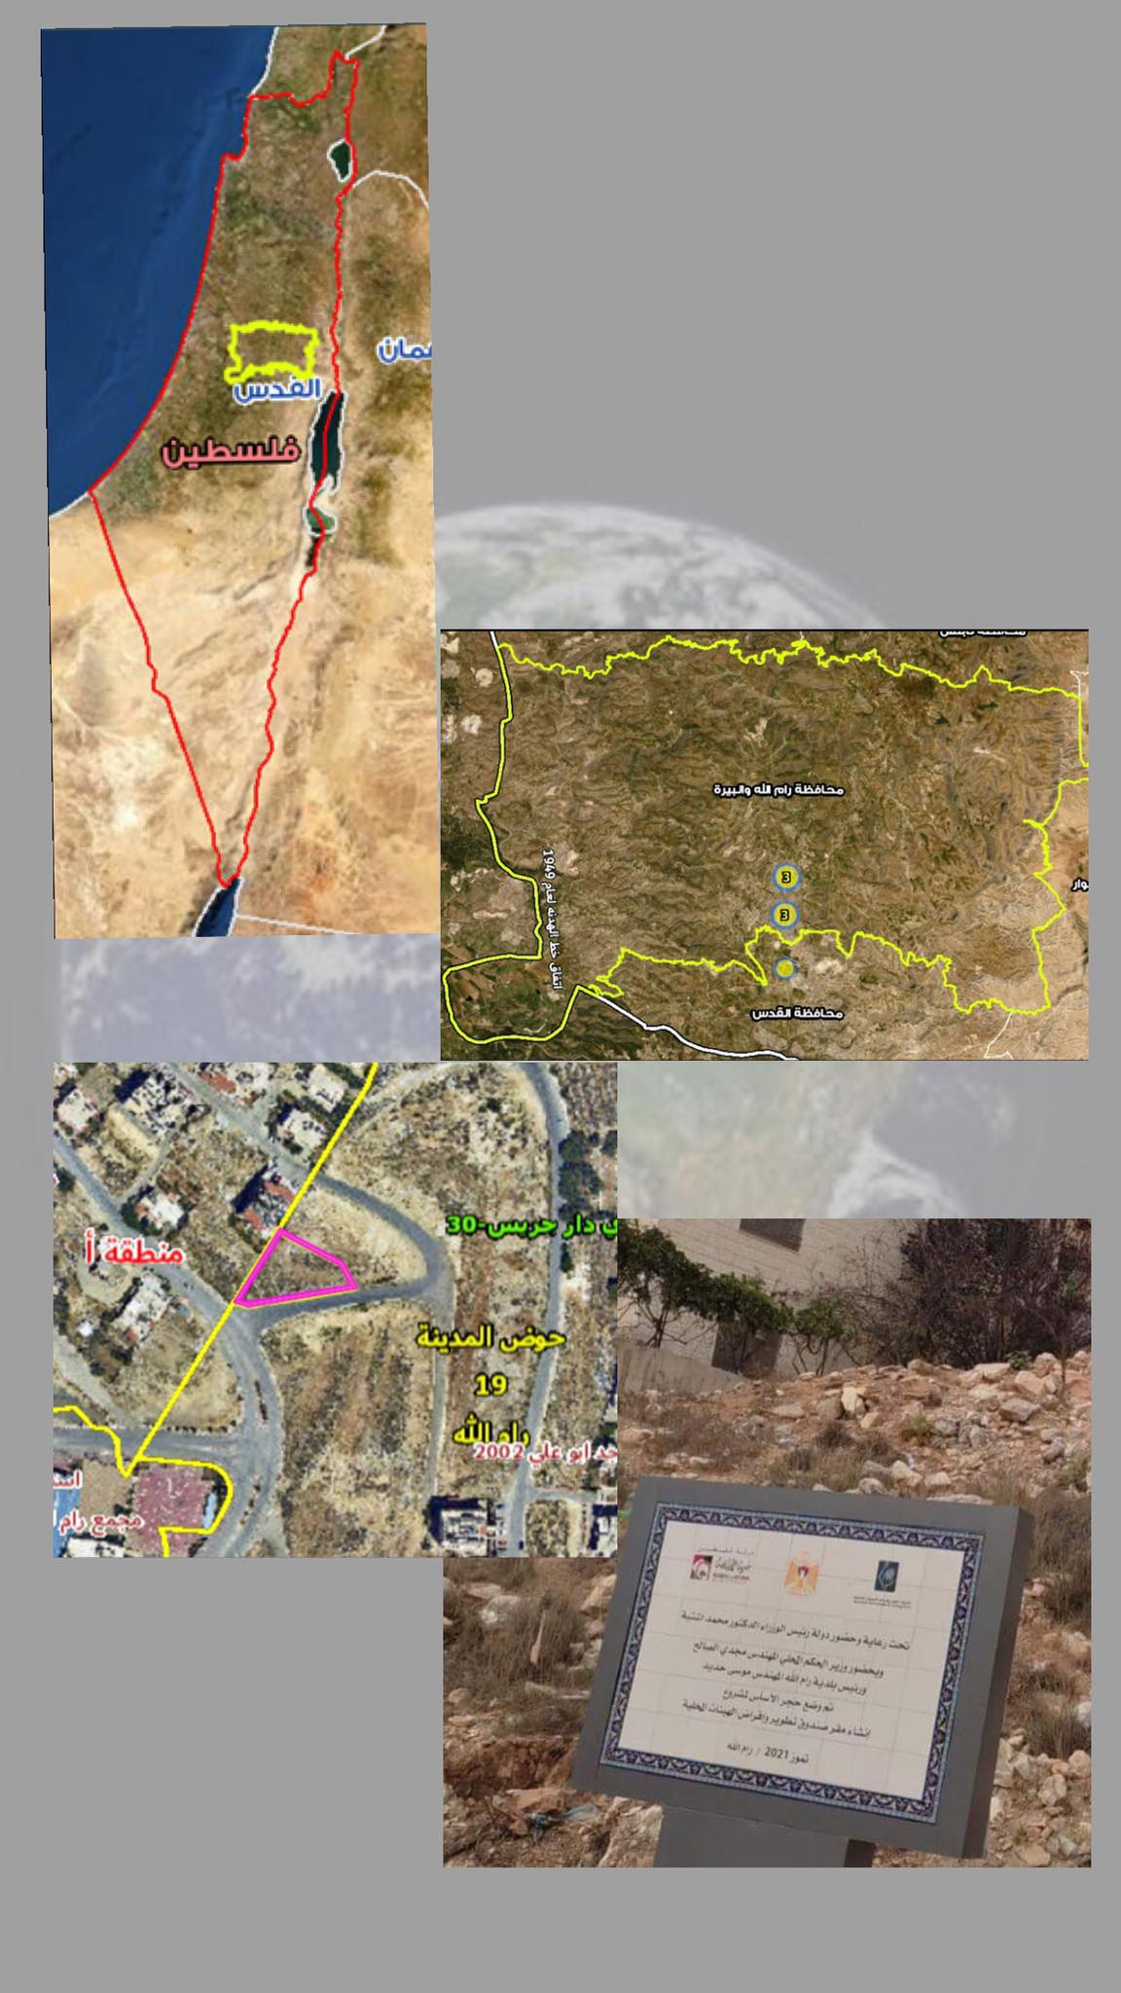
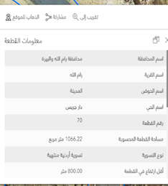
Site Analysis
4

Slide 5
Architectural Aspect And Consideration
8

Slide 6
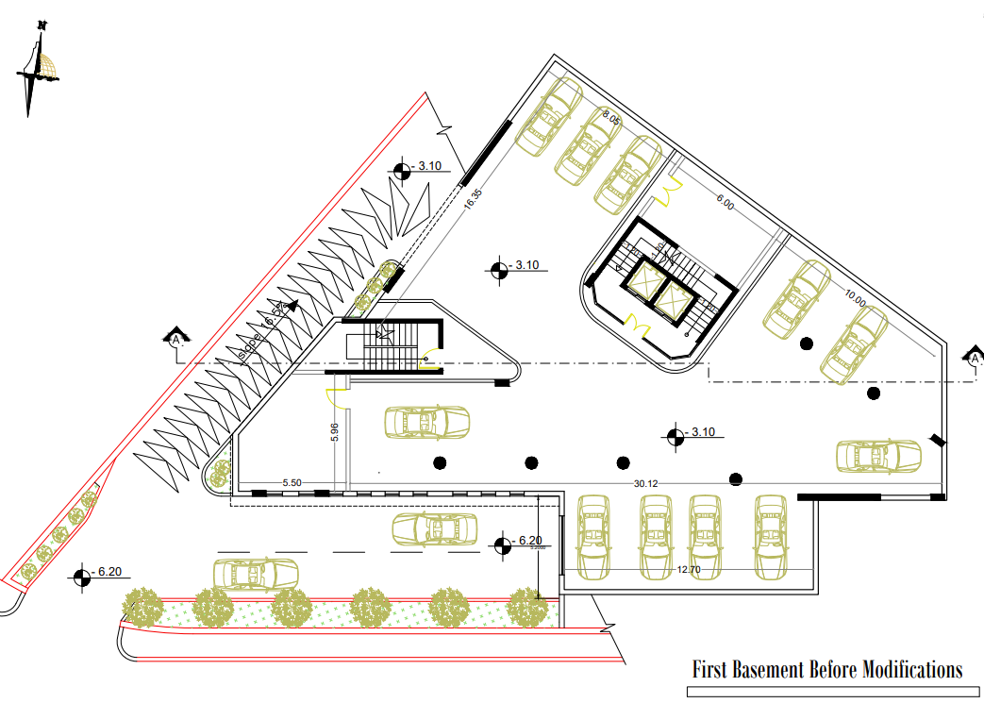
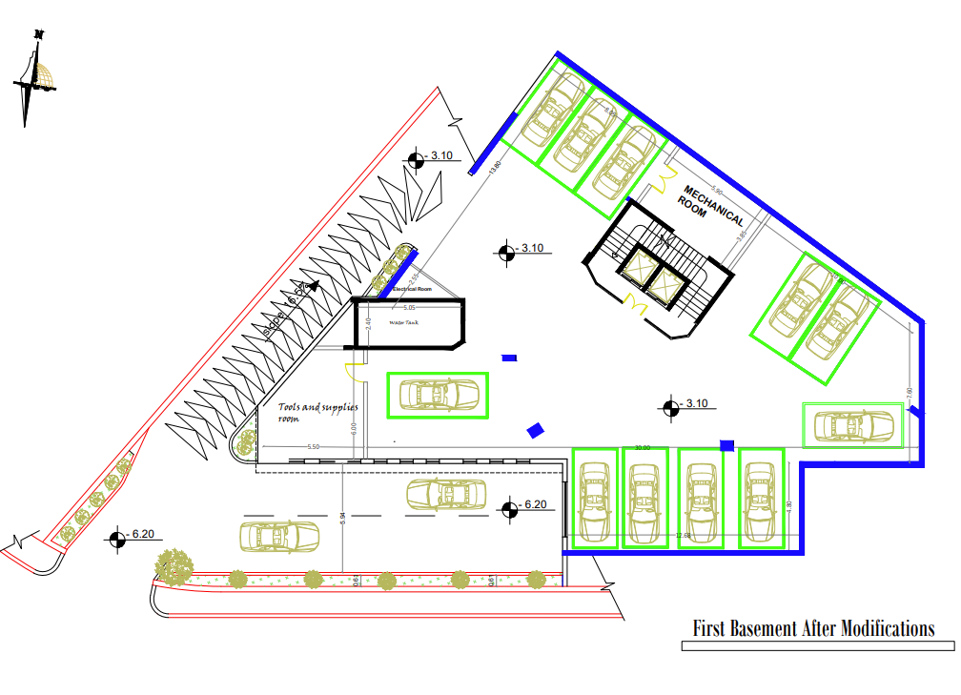
Architectural Aspect And Consideration
First Basement Before Modification
First Basement After Modification
9

Slide 7
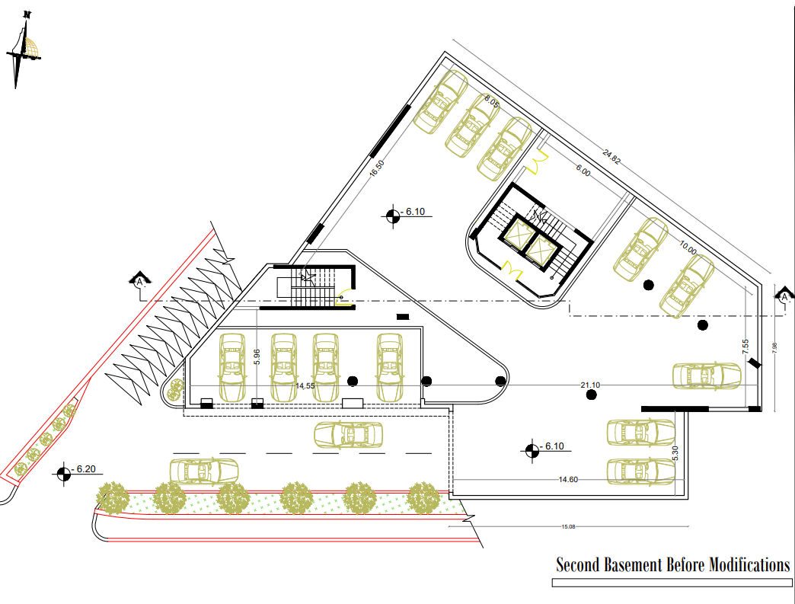
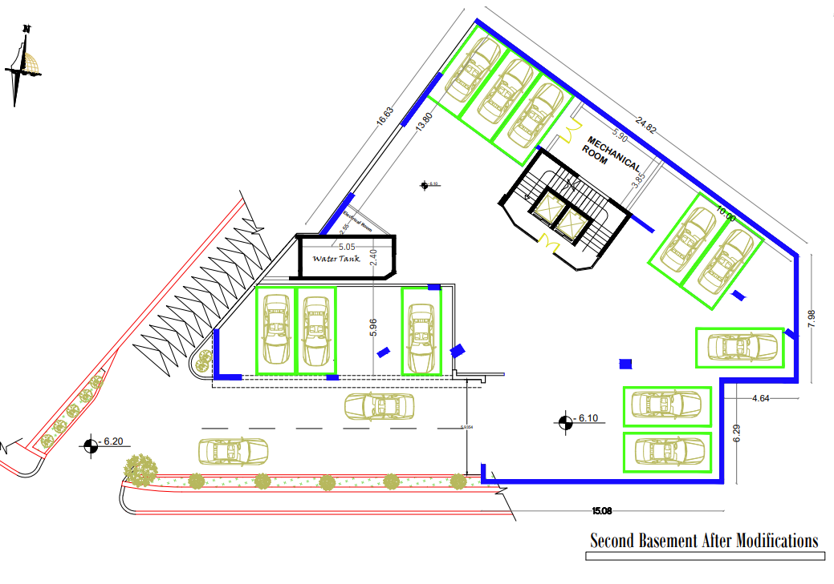
Architectural Aspect And Consideration
Second Basement Before Modification
Second Basement After Modification
10

Slide 8
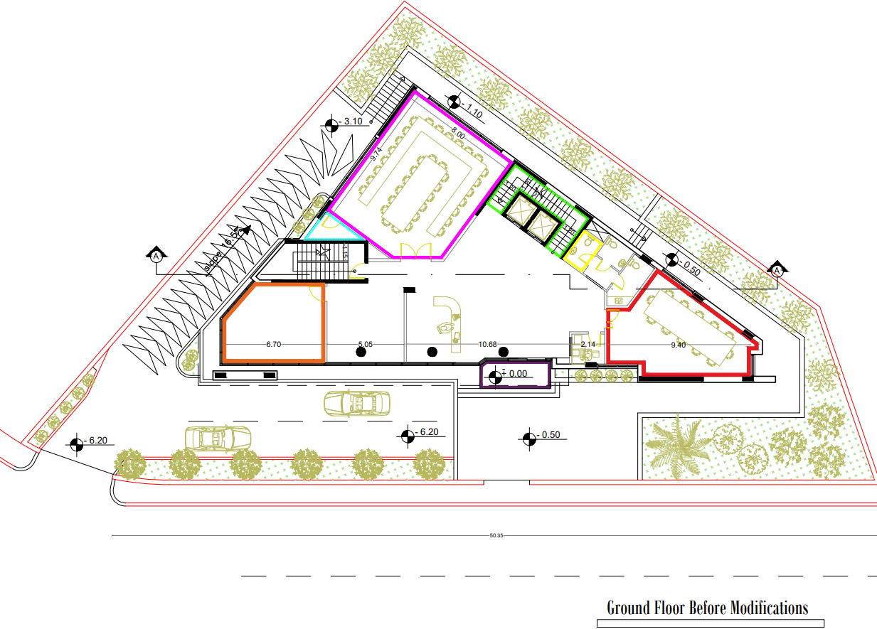
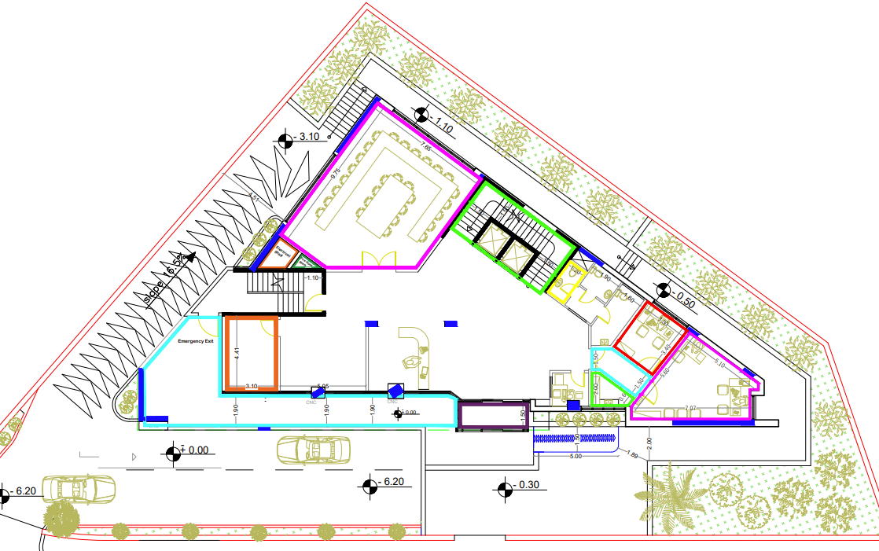
Architectural Aspect And Consideration
Ground Floor Before Modification
Ground Floor After Modification
11

Slide 9

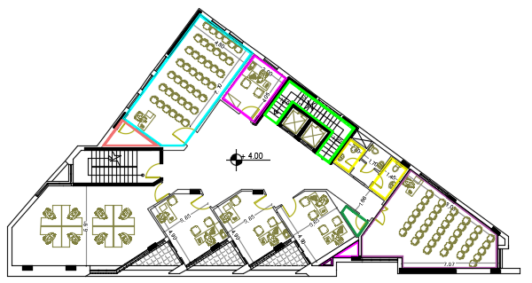
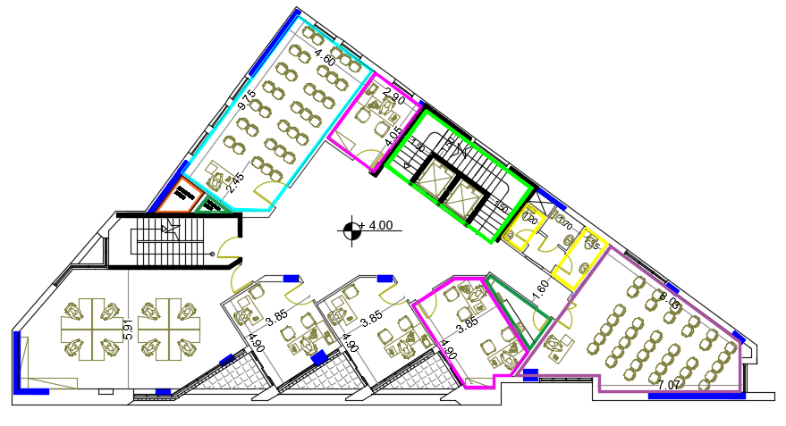
Architectural Aspect And Consideration
First Floor After Modification
12

Slide 10
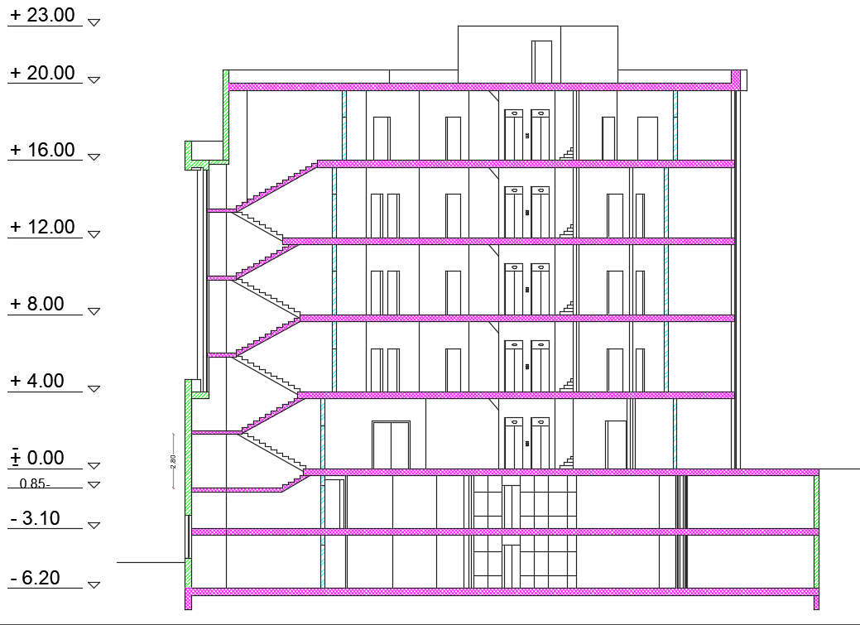
Architectural Aspect And Consideration
Section A-A After Modification
13

Slide 11
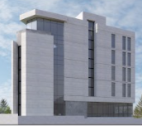
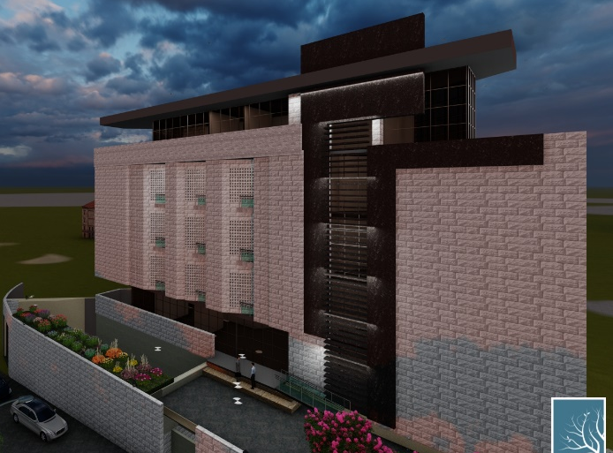
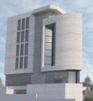

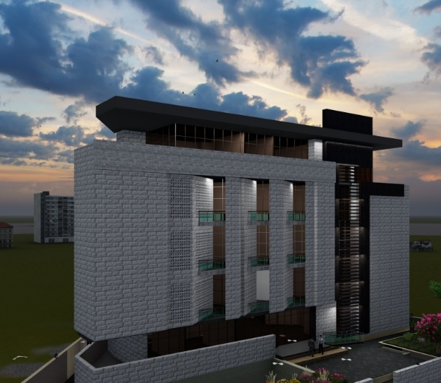
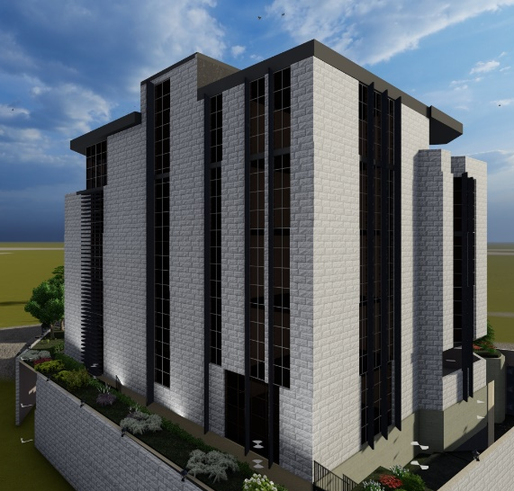

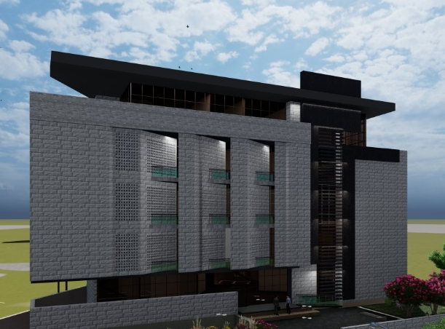
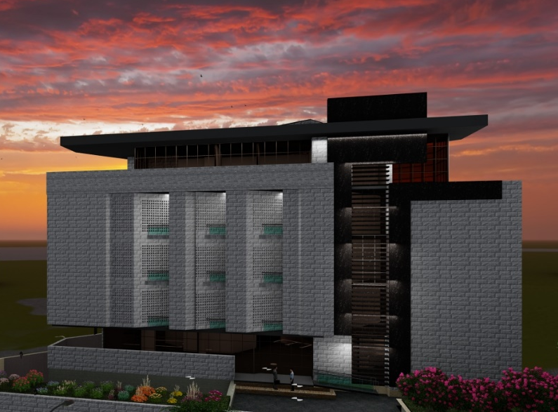
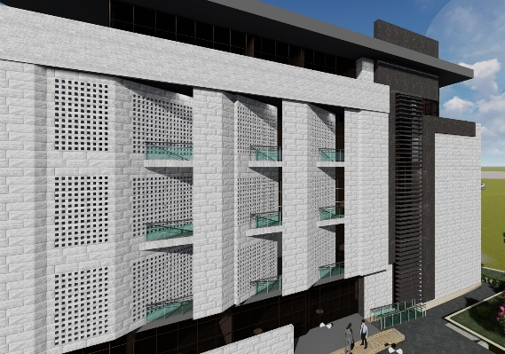
Lumion 3D Model
14

Slide 12
Environmental Aspect And Consideration
15

Slide 13
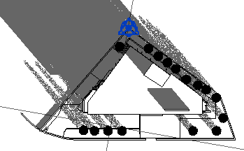
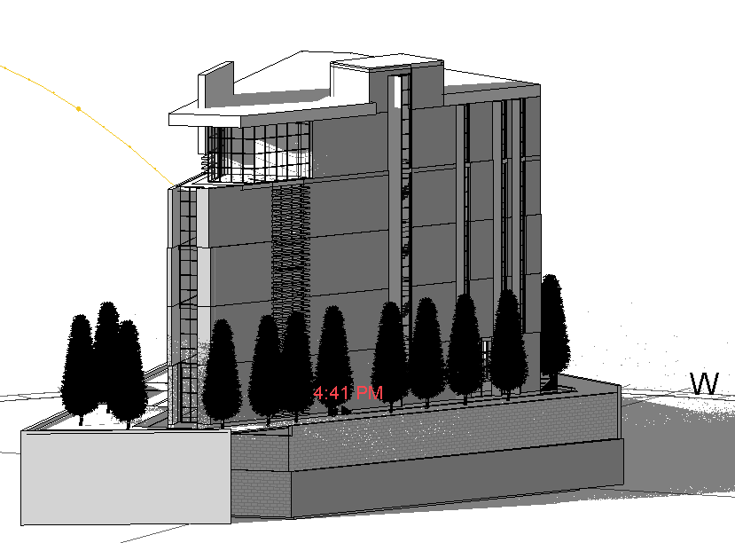
Shading
21/12 – 8:AM
16

Slide 14
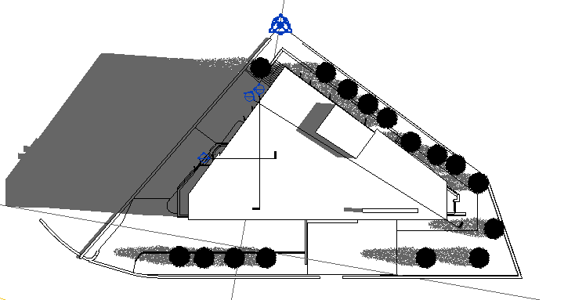
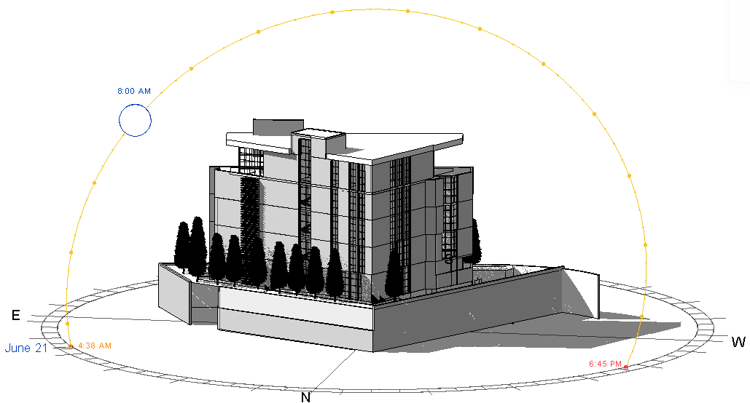
Shading
21/6 – 8:00 AM
17

Slide 15
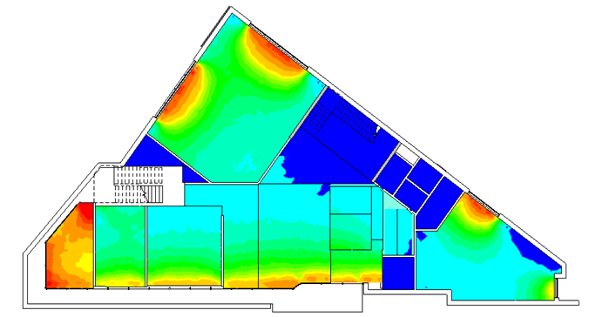
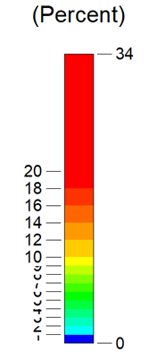
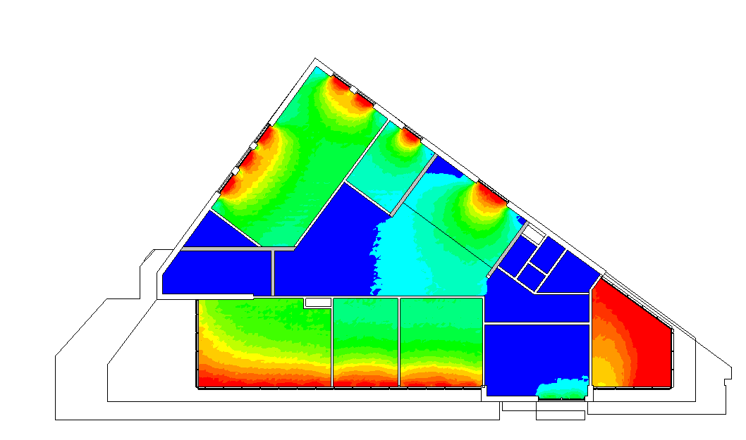
Daylight Factor
Before Modification
Ground floor
Fourth floor
18

Slide 16
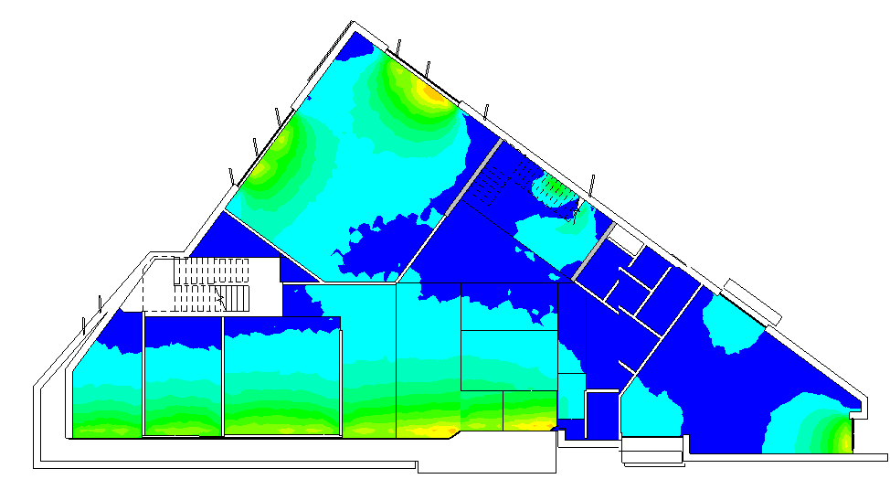
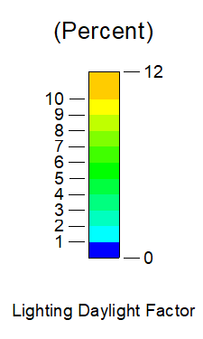
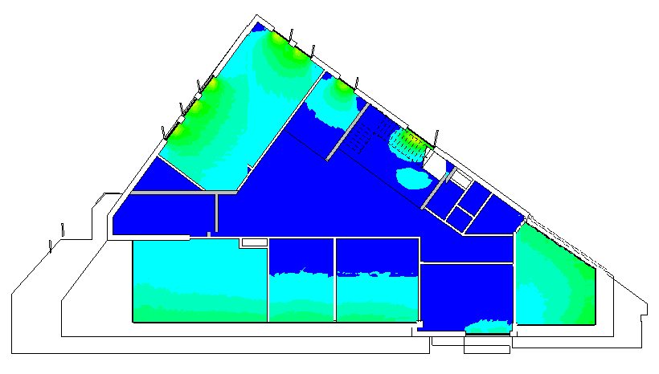
Daylight Factor
After Modification
Changing the type of glass and vertical louvers
Ground floor
Fourth floor
19

Slide 17

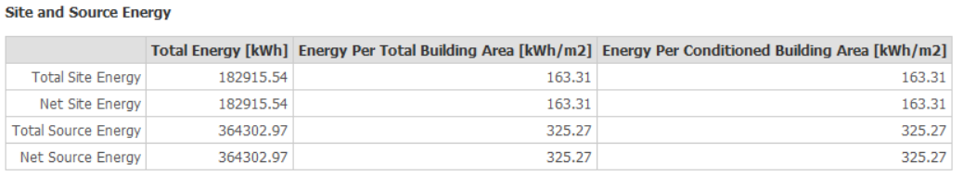
Total site energy of building= 163.31 KWh/m² , which is less than the standards that equals to 52.9 KBtu/ft² = 600 KWh/m².
20

Slide 18
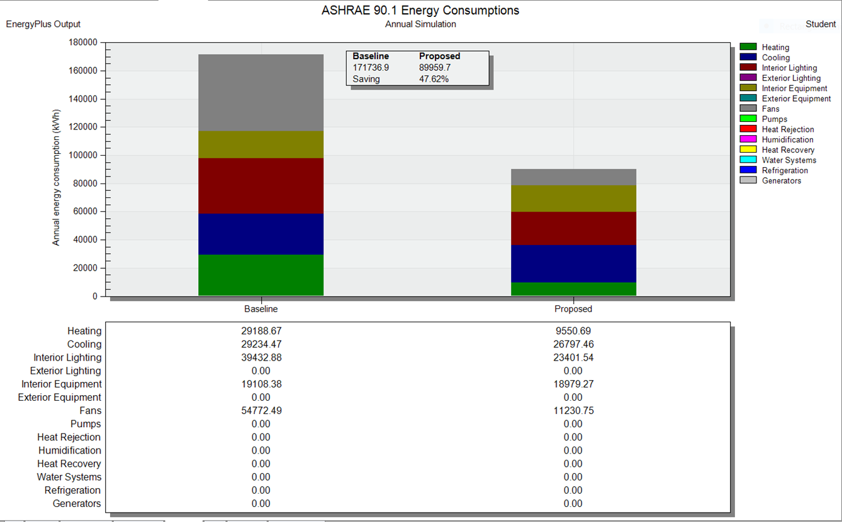
21

Slide 19
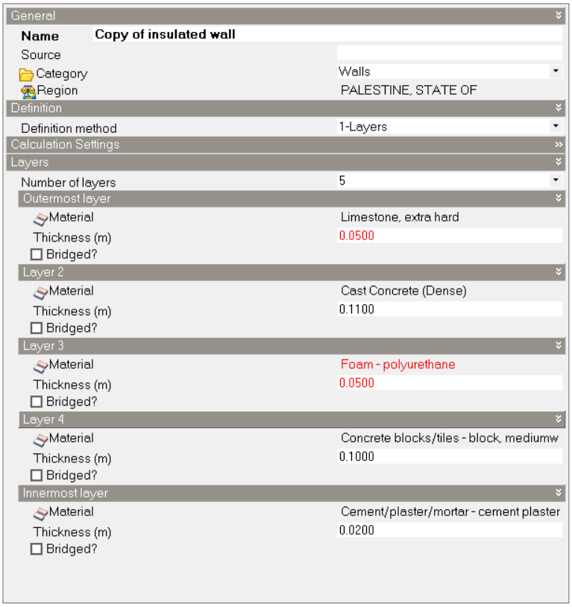
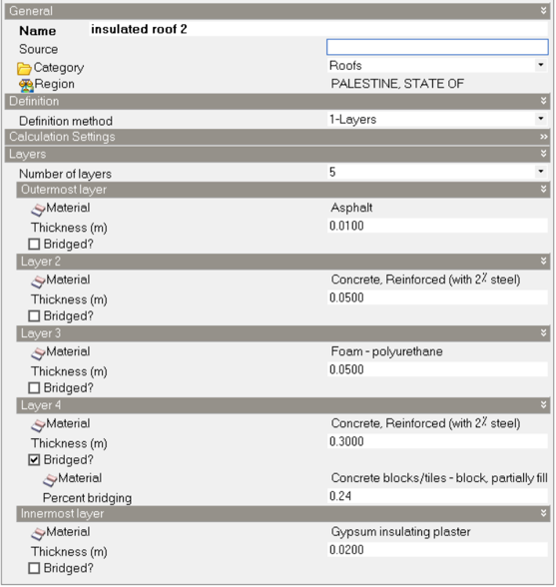
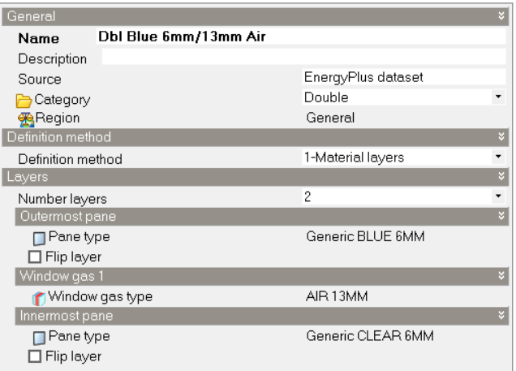
Heating & Cooling Load
U-Value After Modification
U – value =0.38 W/m².K
U – value =0.45 W/m².K
U – value =1.78 W/m².K
22

Slide 20
Structural Aspect And Consideration
23

Slide 21
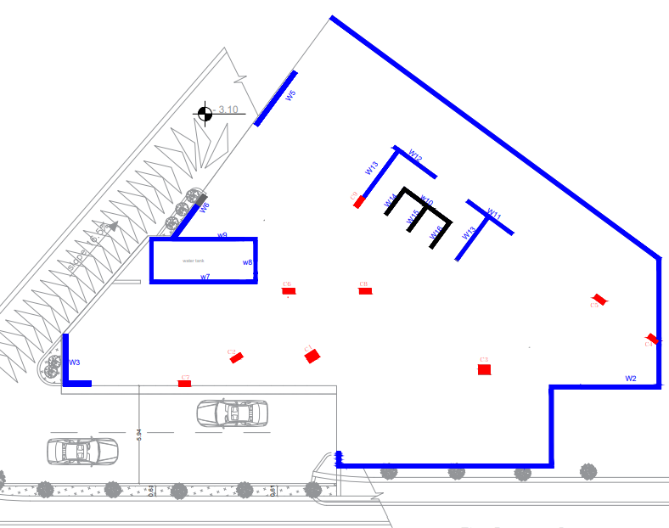
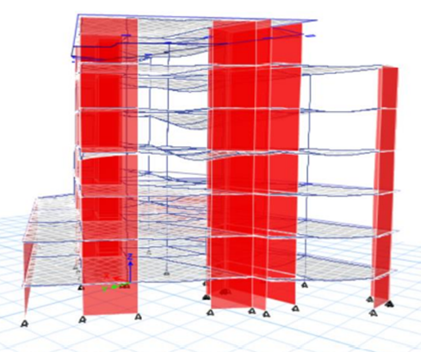
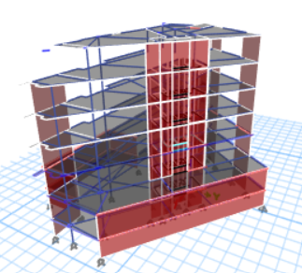
Structural Aspect And Consideration
3d modeling
Dead load (weight of structural elements)
Live Load= 5 KN/m²
Superimposed Load (weight of tiles, mortar, fill... etc.) =3.5 KN/m²
Weight of external stone walls will be between (18-22) and suppose its 21.00 KN/m (Applied on external beams)
Weight of Curtain walls = 0.60KN/ m2
Block
The building was designed as a single block, after making sure that the length and width of the building does not need Expansion joints.
24

Slide 22
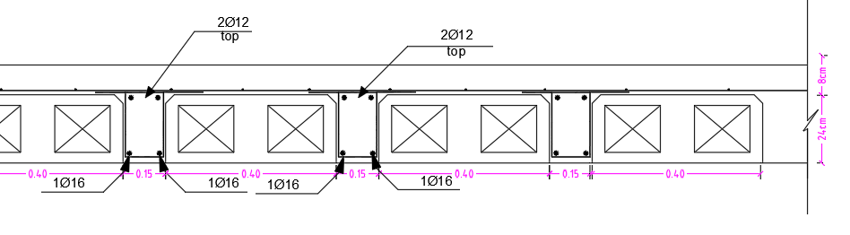
Slab Design
One and Two-way ribbed slab with hidden beams
slab thickness 320 mm as shown in figure , we use 240 mm hollow block thickness, and we add 20 mm of concrete to be more easy to design
25

Slide 23
Structure Element Design
Column
Shear Wall
26

Slide 24
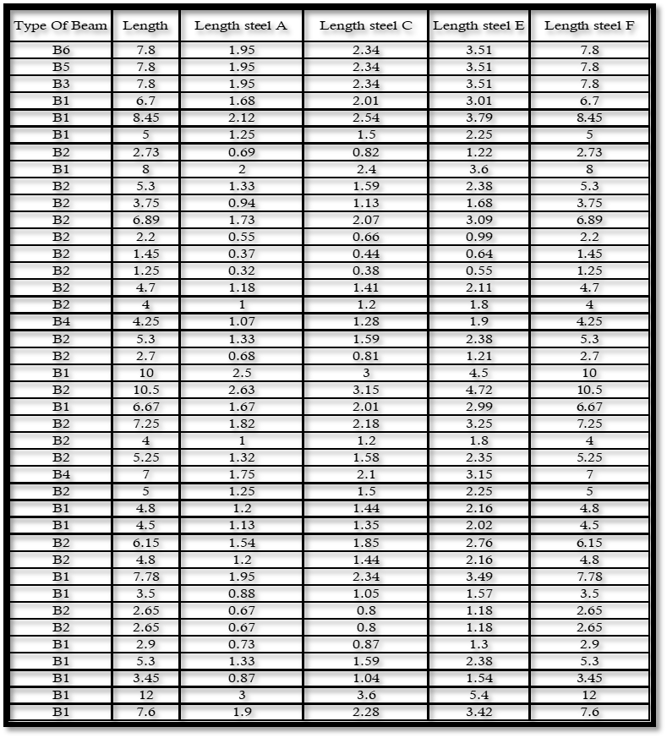
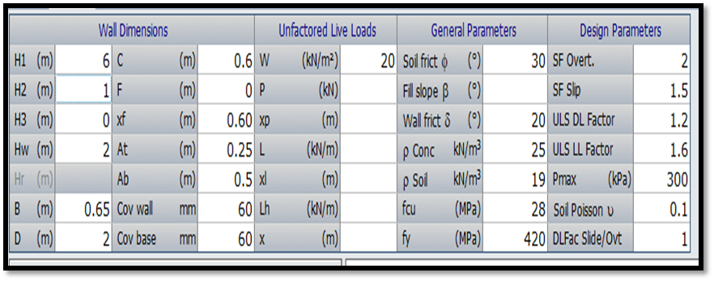
Structure Element Design
Beam
Shows all information added to brokon software to design retaining wall
27

Slide 25
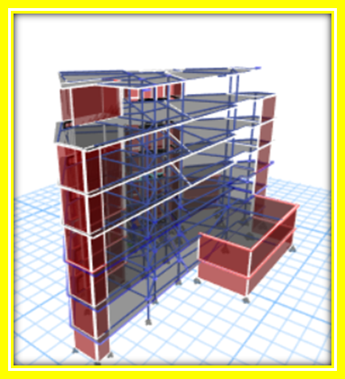
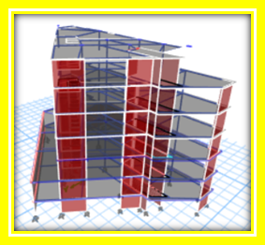
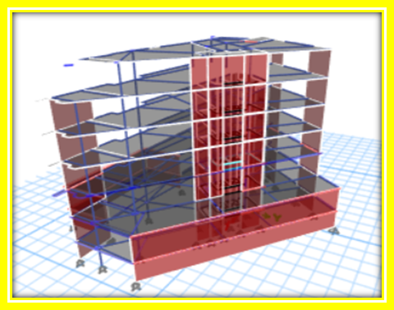
ETABS Structural Model
Checks will do:
Equilibrium check
Compatibility check
Internal forces check
28

Slide 26
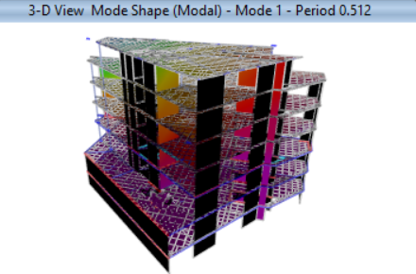


Equilibrium Check
Compatibility check
from mode 1
Compatibility check
29

Slide 27




Internal Forces Check
Column that was chosen
Stress strain for column
Total axial from l.l =$5∗22.5∗7=787.5$
Total axial from l.l =$805 from ETABS$
% Error= $\frac{\left(805−787.5\right)}{805}$ =2.17 %
3d modeling for axial load
30

Slide 28




Internal Forces Check
3D modeling for moment in beams
check moment & shear in beams
Wu _{beams}=$(5∗\frac{10.2}{0.55}$)+( 0.6*0.3* 25*1.2).
Wu _{beams}=99.9
M _{by hand} =$99.9∗\frac{6.5∗6.5}{8}$=527
From ETABS:
+M₁=426
-M₂=200
+M₂=265
Shear=359
$M total=\frac{426+265}{2}+200$=578
% Error= $\frac{\left(578−527\right)}{578}$ =8.8%
Shear=$1.15Wu∗\frac{ln}{2}$
Shear=$1.15∗99.9∗\frac{6.8}{2}$=373
% Error= $\frac{\left(373−359\right)}{373}$ =3.75%
2D modeling for moment in beams

Slide 29






Internal Forces Check
One way slab
+M1=29
-M2=60
+M2=17
M total $=\frac{29+17}{2}+60$=83
M by hand = $10.2∗\frac{{7.7}^{2}}{8}$=75.6
% Error$=\frac{\left(83−75.5\right)}{83}$ =9%
Two way slab m22
Two way slab m11
+M=27
-M=89
+M=36
$M total=\frac{27+36}{2}+36$=120.5KN
M _{by hand} = $10.2∗\frac{{4.5}^{2}{5}}{8}$=129
% Error$=\frac{\left(129−120.5\right)}{120.5}$ =7.13%
+M=16
-M=63
+M=82
$Mtota; =\frac{16+82}{2}+63$=112KN
M _{by hand} = $10.2∗\frac{{7.2}^{2}{2}}{8}$=132
% Error= ((132-112))/112 =17.8%

Slide 30

Structural Aspect
Seismic checks For Block
Structure Period Check:
Method A:
T = Ct (hn)^{3/4}
Ct = 0.035 (0.0853) for steel moment resisting frames.
Ct = 0.030 ( 0.0731) for reinforced concrete moment resisting frames.
Ct = 0.02 (0.0488) for all other buildings.
Method B:
T from etabs shall be <= 1.4* T method A
Calculations:
T = 0.0731 (29)^{3/4} =0.91second
1.4* T=1.4*0.91=1.27seconds
Tx _{from etabs}=0.601<= 1.27, so the first check is acceptable.
Ty _{from etabs}=0.752<= 1.27, so the first check is acceptable

Slide 31
Structural Aspect
Seismic checks For Block
Checks Participating Mass Ratio
As shown in the previous table sum of x and sum of y more than 90%, and that’s after added 12 modes to be an outcome 24 modes instead of 12 modes .

Slide 32

Structural Aspect
Seismic checks For Block
Base shear By Hand Calculations:
Base shear check
V=min$\left[2.5 Ca,Cv/T\right]$ x W x $\frac{I}{R}$ where:
Ca =0.18 , Cv =0.25
I=1,R=5.5
Tx _{from etabs}=0.601, Ty _{from etabs}=0.752
W=dead load+SID+0.3Live load
W=31127+20139.99+ (0.3*14849.85)=55722.02 KN
V_{x}=min$\left[2.5∗0.18,0.25/0.601\right]$ x 55375.32 x $\frac{1.25}{5.5}$ =5367.93
V_{y}=min$\left[2.5∗0.18,0.25/0.752\right]$ x 55375.32 x $\frac{1.25}{5.5}$ =4210.14
V_{x from etabs}=5177.07 KN
V_{y from etabs}=4137.52 KN
Base shear from Etabs:
Percentage Error:

Slide 33

Structural Aspect
Seismic checks For Block
Shows Drift Checks
ΔM=0.7*R* Δs from etabs
Drift limitation (Δ) =0.025x h story if period less than 0.7second.
Drift limitation (Δ) =0.02 x h story if period more than 0.7second.
ΔM shall be <= Drift limitation (Δ)
Sample calculations for storey1:
Height=2750mm
dis x=0.231mm from etabs ,drift x=0.231-0=0.231mm
dis y=0.307mm from etabs ,drift y=0.307-0=0.307mm
ΔM_{x}=0.213*5.5*0.7=0.889mm
ΔM_{y}=0.0.307*5.5*0.7=1.182mm
ΔM_{ult}=0.02*2750=55mm
ΔM_{x}<= ΔM_{ult} so check is acceptable.
ΔM_{y}<= ΔM_{ult} so check is acceptable

Slide 34


Structure Detailing
Beam Plan
Ground Floor Beam Plan
Second Basement Beam Plan

Slide 35



Structure Detailing
Beam 2 Detail

Slide 36



Structure Detailing
Beam 3 Detail

Slide 37





Structure Detailing
Column Detail
Cross Section Of C6
Cross Section Of C3
Cross Section Of C9
Cross Section Of C5

Slide 38



Structure Detailing
Slab Detail Design

Slide 39


Structure Detailing
Shear Wall Detail

Slide 40


Structure Detailing
Mat Foundation Detail
Calculation Of Reinforcement
Min reinforcement = 0.0018 *b * h
Min reinforcement = 0.0018 * 1000 * 900 =1620 mm²/m
Use 1 Ø 18 @ 140 mm in directions 1-2 for top bars
Calculation Of Stud
$\frac{A_{v}}{s}=7.2 {mm}^{2}/mm$
$ρ_{st}=\frac{A_{v}}{sb_{0}}=\frac{7.2}{5920}=0.00122$
Assume 1φ8 mm studs ➔ $A_{st}=50 {mm}^{2}$
$s=\sqrt{\frac{50}{0.00122}}=202 mm< s_{max}=\frac{d}{2}=415 mm$ Use s = 200 mm
$A=\frac{b_{0}dτ}{∅v_{cp}}=\frac{5920×830×1.86}{1.32}=6923×{10}^{3}{mm}^{2}$
$b_{02}d_{2}=\left(\#x+b_{02}\right)d=6923×{10}^{3}$ ➔ $\left(4x+5920\right)830 =6923×{10}^{3}$
x = 602 mm Use x = 600 mm

Slide 41




Structure Detailing
Retaining Wall Detail

Slide 42





Structure Detailing
Water Tank Detail

Slide 43



Structure Detailing
Stair Detail

Slide 44
Electro - Mechanical Aspect

Slide 45

Fire Safety Design
Evacuation Way For Ground Floor

Slide 46

Fire Safety Design
Evacuation Way For First Floor

Slide 47


Fire Safety Design
Evacuation Way For First Basement
Evacuation Way For Second Basement

Slide 48





Fire Safety Design
The symbols of suppression system
The symbols of Detector
Co2 Extinguishers
Emergency signs and light
Water Sprinklers

Slide 49


Fire Safety Design
Fire Fighting Design For Ground Floor
Emergency Sign & Light Design For Ground Floor

Slide 50


Fire Safety Design
Fire Fighting Design For First Basement
Emergency Sign & Light Design For First Basement

Slide 51


Fire Safety Design
Fire Fighting Design For Second Basement
Emergency Sign & Light Design For Second Basement

Slide 52


Fire Safety Design
Detector Distribution
Detector Distribution For Ground Floor
Detector Distribution For First Floor

Slide 53


Fire Safety Design
Detector Distribution For First Basement
Detector Distribution For Second Basement

Slide 54

Water Supply Design
The maximum number of people may exist inside the Project at the same time, equals 100 person.
In addition, the average daily consumption per person is 15 liters.
Water consumption = 0.015 m³/day × 100person=1.50 m³/day.
Use 2 tanks each tank is 1000 L
Water demand amount in each floor

Slide 55
Water Supply Design
Diameters of the used pipes for vertical feeder 1 .
Diameters of the used pipes for vertical feeder 2.

Slide 56


Water Supply Design
Water Supply Design For Ground Floor
Water Supply Design For First Floor

Slide 57

Water Supply Design
Water Supply Design For Second & Third Floor

Slide 58

Drainage System Design
Shows Number Of DFu
Drainage System For Ground Floor
Shows Diameter And Slop Pipe

Slide 59


Drainage System Design
Drainage System For First Floor

Slide 60

Drainage System Design
Manhole Distribution On Second Basement

Slide 61

Drainage System Design
Roof slope plan

Slide 62



Hvac Design
The using system is VRF system, with three main component
Out Door Unit
Controller
Diffuser

Slide 63


Hvac Design
Hvac Design For Ground Floor
Hvac Design For First Floor

Slide 64

Hvac Design
Hvac 3D Model Design

Slide 65







Artificial Lighting Design
Type of used Luminaires

Slide 66



Artificial Lighting Design
Office
Meeting Room
Cafeteria

Slide 67


Artificial Lighting Design
Artificial Lighting For Ground Floor

Slide 68

Artificial Lighting Design
Artificial Lighting For First Floor

Slide 69



Artificial Lighting Design
Artificial Lighting For Second & Third Floor
Artificial Lighting For Fourth Floor

Slide 70


Artificial Lighting Design
Artificial Lighting For First Basement
Artificial Lighting For Second Basement

Slide 71



Power Design
Power Design For Ground Floor
Power Design For First Floor

Slide 72


Power Design
Power Design For Second & Third Floor
Power Design For Fourth Floor

Slide 73


Power Design
Power Design For First Basement
Power Design For Second Basement

Slide 74



Acoustical Design
Lecture hall
Noted :- that after the modification, the area RT60 became within the required range (0.6-1.3)for medium frequency

Slide 75



Acoustical Design
Lecture Hall - Exterior Wall
The component of wall are 70mm stone,110mm concrete,50mm polystarine,100mm hollow block,20mm plaster, total thickness is 350mm
The component of glazing: 6.4laminated glass, 12mm air, 6.4mm laminated glass, and 2mm acoustic resin for each side
As shown in previous figure the total STC for exterior wall =50 and this value its very good and acceptable compare with standard .

Slide 76


Acoustical Design
Lecture Hall – Interior Wall
The component interior wall: 25mm plaster, 100mm hollow block, 25mm plaster ,Total thickness =150mm
As shown in previous figure the total STC for exterior wall =44 and this value its very good and acceptable compare with standard .

Slide 77
Quantity Surveying And Cost Estimate

Slide 78
Quantity Surveying And Cost Estimate

Slide 79





Thank You For Listening

