Slide 1
RFID Technology
Prepared by:
Ahmad Adel Rahwan
Asem Fathi Shtahey

Slide 2
RFID - Introduction
Radio-frequency identification (RFID) is an automatic identification method, relying on storing and remotely retrieving data using devices called RFID tags or transponders.
RFID (radio frequency identification) is a technology that incorporates the use of electromagnetic or electrostatic coupling in the radio frequency (RF) portion of the electromagnetic spectrum to uniquely identify an object, animal, or person.
An alternative to bar code.

Slide 3
History of RFID
Invented in 1948 by Harry Stockman.
Initial application was during World War II-The United Kingdom used RFID devices to distinguish returning English airplanes from inbound German ones. RADAR was only able to signal the presence of a plane, not the kind of plane it was..
Came into commercial use only in 1990s.

Slide 4
Uses of RFID
Used where unique identification is needed.
Large Retail companies – Product Tracking.
Hospitals & Nursing Homes – Patient Tagging .
Airports – Baggage Tracking.
Security Applications – Contactless Smart Cards.
RFID Readers could also WRITE onto Tags.
RFID Sensors to sense temperature, movement, radiation, food quality.
Passports-UK, Australia, Finland, Ireland.
RFID is used in Libraries.
Replacing Barcodes.

Slide 5
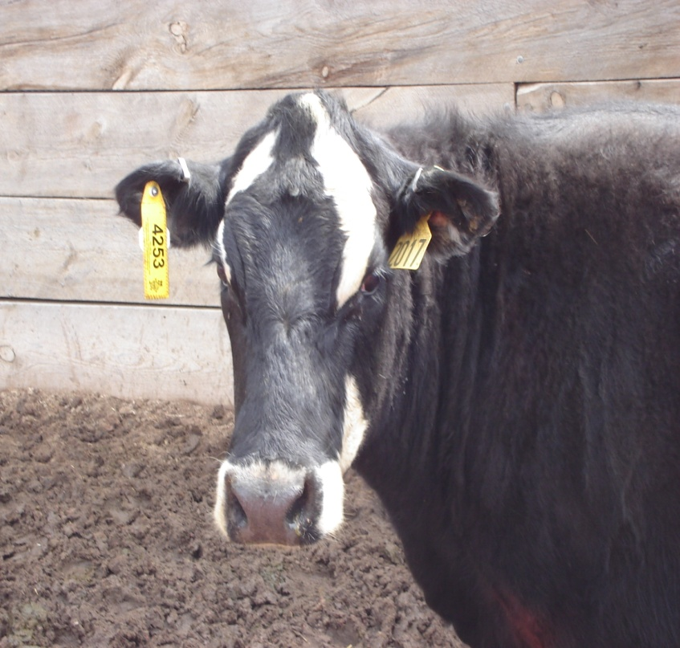
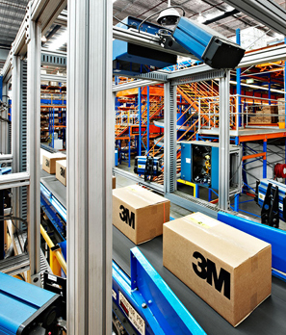
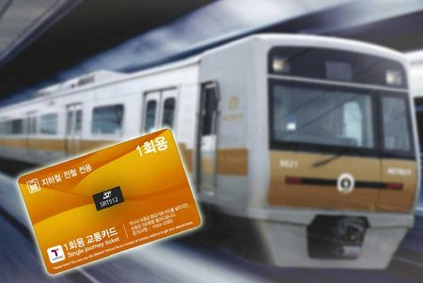
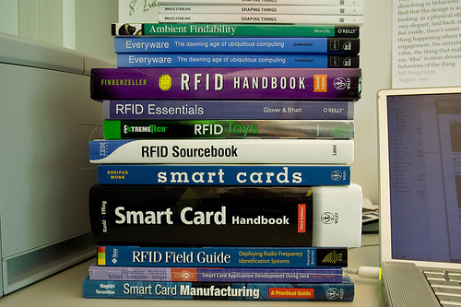

Slide 6
RFID Vs BarCode
RFID Forging is more difficult compared to barcode.
RFID is comparatively faster.
RFID Can read multiple tags where barcode
can only read one tag at a time.
The life time of RFID is larger than barcode
(from 2-4 years).
RFID Relatively expensive as compared to Bar Codes(Reader 1000$, Tag 20 cents a piece).

Slide 7
TAGs
An RFID tag is an object that can be stuck on or incorporated into a product, animal, or person for the purpose of identification using radio waves .
Types of tags
1.Active : has an internal battery to power them.
2.Passive: does not contain a battery; the power is supplied by the reader. When radio waves from the reader are encountered by a passive rfid tag, the coiled antenna within the tag forms a magnetic field. The tag draws power from it, energizing the circuits in the tag. The tag then sends the information encoded in the tag's memory.

Slide 8
TAGs cont.
Each tag contains a unique code that facilitating the identification process & is known as EPC (Electronic Product Code ).
E.g. 613.23000.123456.123456789 (96 bits)
Header – defines version of EPC(8 bits)
EPC Manager – describes originator of EPC (Product manufacturer) (28 bits)
Object Class - Could describe the product type (24 Bits)
Serial Number – Unique ID for that product item (36 Bits)

Slide 9
Passive TAGs
  Tag contains an antenna, and a small chip
  that stores a small amount of data
  Tag can be programmed at manufacture
  or on installation
  Tag is powered by the high power electromagnetic field generated by the antennas – usually in doorways
  The field allows the chip/antenna to reflect back an extremely weak signal containing the data.

Slide 10
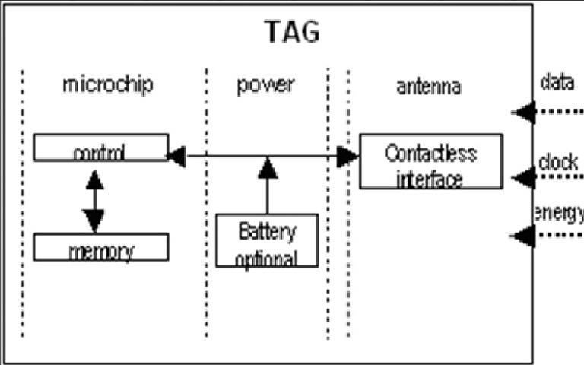

Slide 11
RFID Reader
The RFID reader consists of transmitting and receiving sections. It transmits a carrier signal, receives the backscattering signal, and performs data processing.
The reader also communicates with an external host computer. This circuit is designed for a read range of 5 ~ 7 cm.

Slide 12
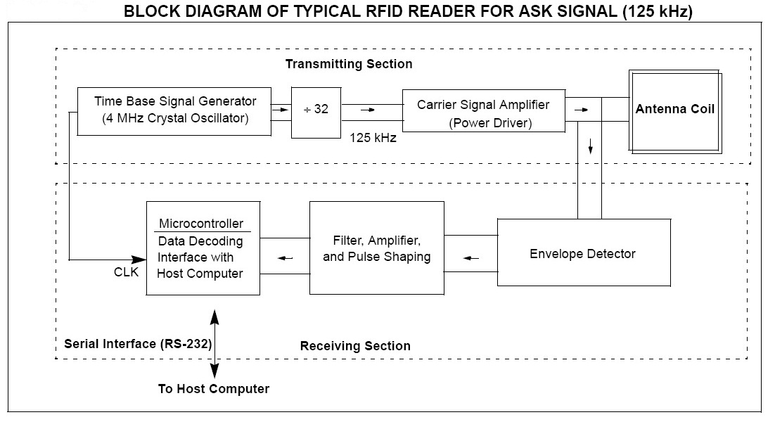

Slide 13
Transmitting Section
The transmitting section contains circuitry for a carrier signal (125 kHz), power amplifiers, and a tuned antenna coil. The 125 kHz carrier signal is typically generated by dividing a 4 MHz (4 MHz/32 = 125 kHz) crystal oscillator signal. The signal is amplified before it is fed into the antenna tuning circuit. A complementary power amplifier circuit is typically used to boost the transmitting signal level.

Slide 14
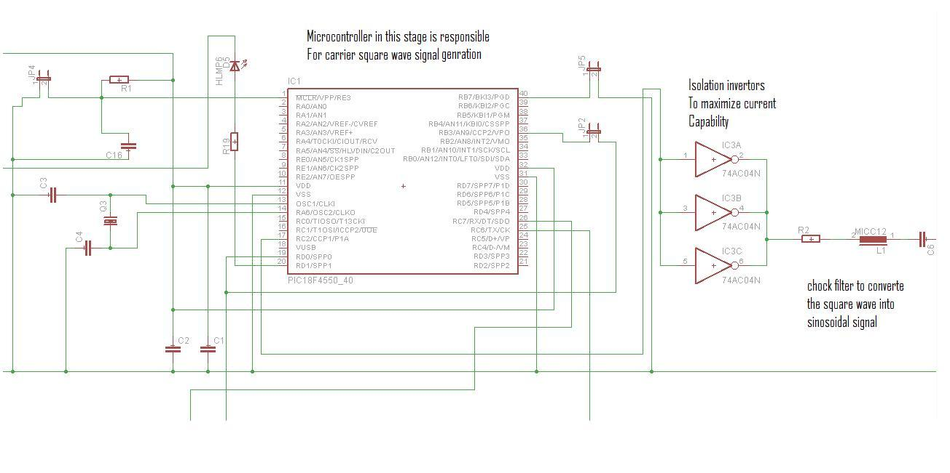

Slide 15
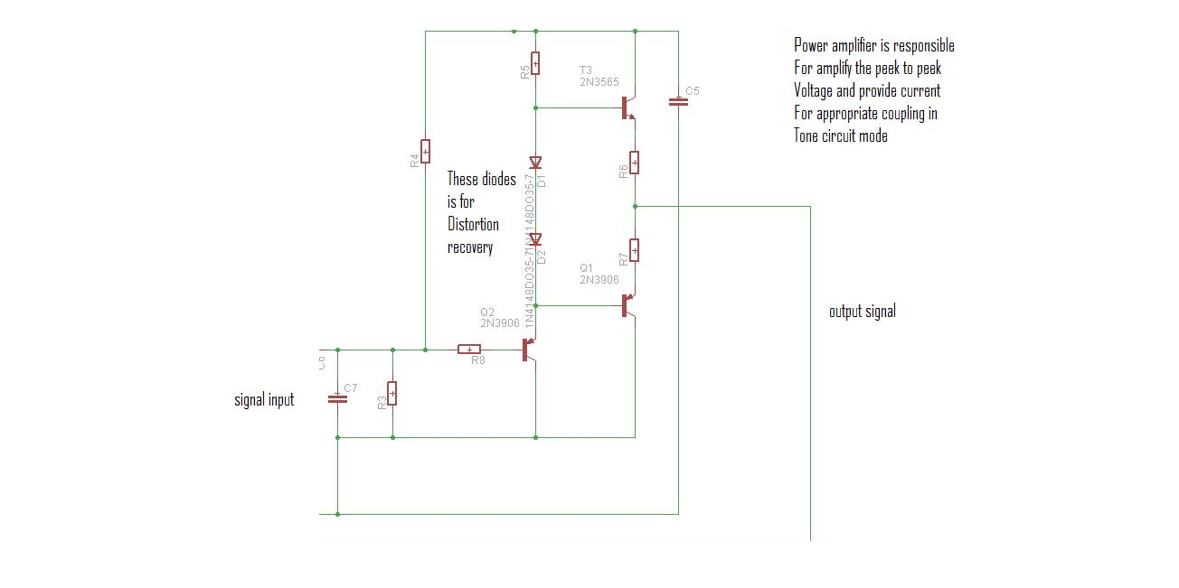

Slide 16
Receiving Section
The receiving section consists of an antenna coil,demodulator, filters, amplifiers, and microcontroller. In applications for close proximity read range, a single coil is often used for both transmitting and receiving. For long read-range applications, however, separated antennas may be used.

Slide 17
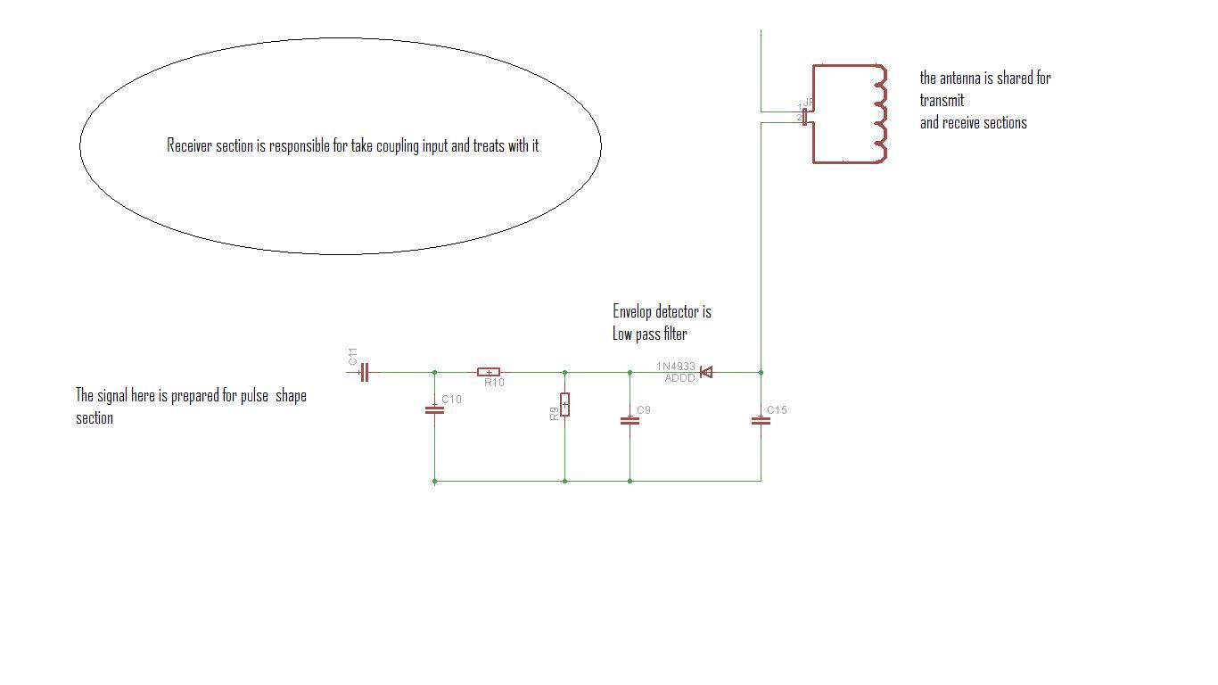

Slide 18


