Slide 1

Applying Statistical Quality Control (SPC) Tools
In The National Beverage Company Coca-cola/Cappy
Presented To :
Dr. Tamer Haddad
Dr. Mohammad Othman
Dr. Yahya Saleh
Prepard by :
Yasmeen Mayyaleh
Nael Salman

Slide 2
Outline
Introduction
Problem Statement
Objectives
Standards
Methodology
Results and analysis
Improve the capability
Conclusion
Recommendations

Slide 3
Introduction
Our project studies the application of statistical process control in The National Beverage Company(NPC) Coca-Cola/Cappy in Tulkarem - Palestine, to control and improve the quality of their products and find out any shortcoming in its quality level in any production stage.
The company was founded in 1998 as an investment in Palestine. It has been incorporated as a private limited company in the food and beverage business. NBC is authorized with the multinational Coca-Cola Corporation to manufacture high-quality carbonated soft drinks, mineral water, and juices using state-of-the-art manufacturing technology. We will work with the Northern Distribution Center which is located in the village of Kufr Zebad in the Tulkarem district.

Slide 4
PROBLEM STATEMENT :
The main goal is to control the process using SPC tools to maintain the high quality of products consistently By taking the measurements of tests and after translated them by the normality plots, it turned out to us that the data is non-normal, and this is the main problem in the analysis process.
So ,the data was converted to the normal distribution , to continue analyzing data and monitoring data to reduce the variation.
In other hands, all possible SPC tools not only the control charts were used, these tools helped in the know the roots causes of the problem in an objective manner and to try to not repeat.

Slide 5
Objectives :
To study and Implement statistical process control tools in the Cappy factory.
To monitor the production process and reduce the variation.
To study the effectiveness of using the SPC on the process.
Explaining the causes of variation that occur by using the SPC tools.
To study the weak points in the process and correct them.
To take advantage of the results obtained to develop the products

Slide 6
Standards :
The label of prepackaged food products (PS / - 135: 2007)
Deviation in the weights and sizes of that is packaged and prepared for sale (MF 21-1997)
Soft Drinks (PS / -23; 2014)

Slide 7
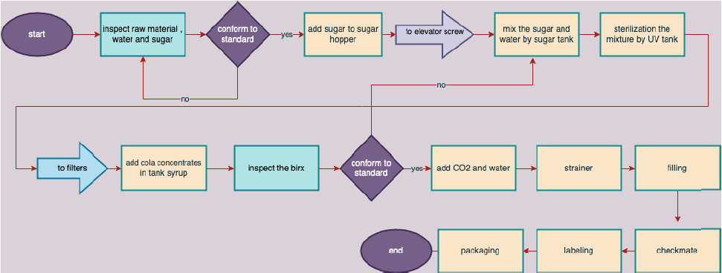
Methodology
Process Flow Chart

Slide 8
Tests and inspections
Inspections for the same cola bottle before it enters the production lines
CSD (carbonated soft drink) line checklist
Half-hours checks
Periodic checks made through the production line
Package integrity
Very important periodic inspections during production

Slide 9
Results and analysis :
The SPC tools such as : normality test , histogram , control charts , and capability plots , was generated to four test such as :
Torque test
Brix test
Net content test
Co2 test

Slide 10
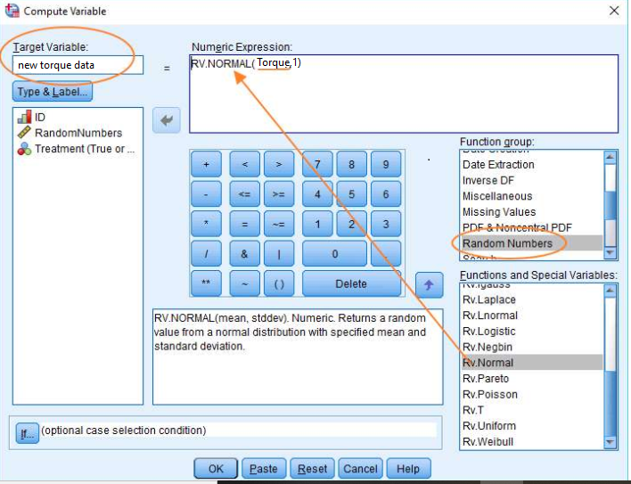
Applying the normality test shows the non-normal distribution data for many tests data , so data were converted to normal by the SPSS program using RV. NORMAL (mean, stddev)

Slide 11
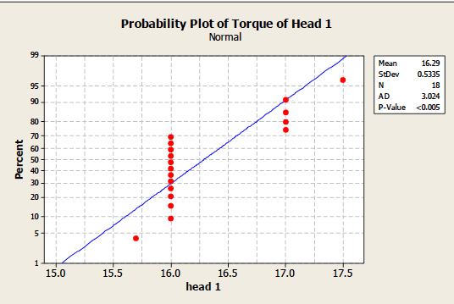
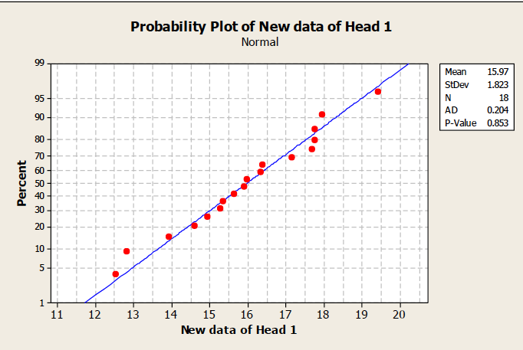
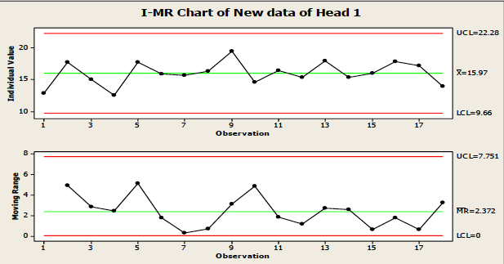
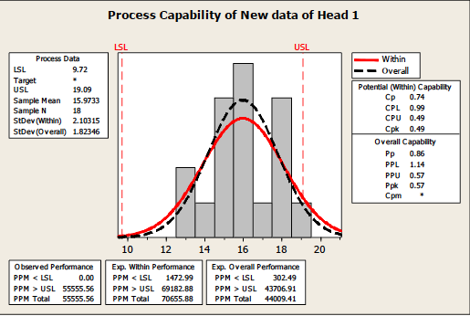
Torque test :
The graphs below , show the normality plots before and after convert the data to normal distribution :
For Head 1 :
Cpk 0.49 < 1.34
Not capable process

Slide 12
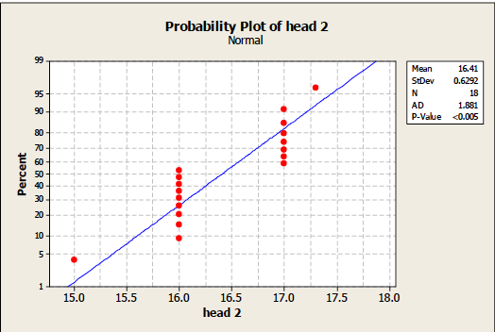
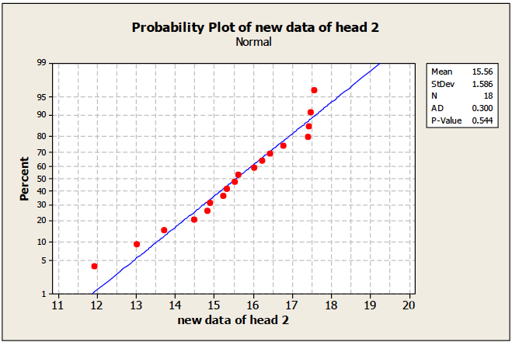
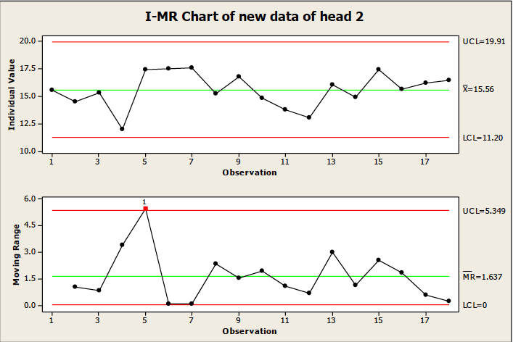
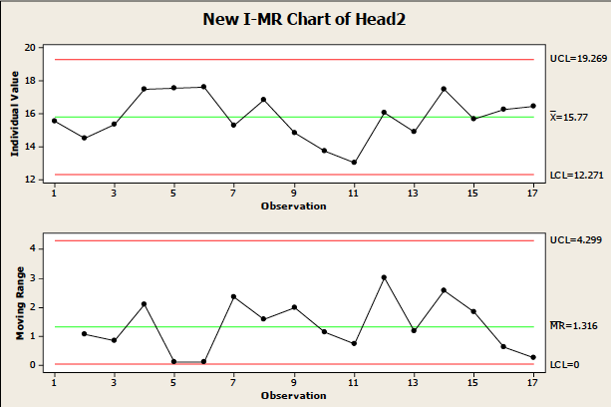
For head 2
Point number 4 was eliminated because it out of control limits.

Slide 13
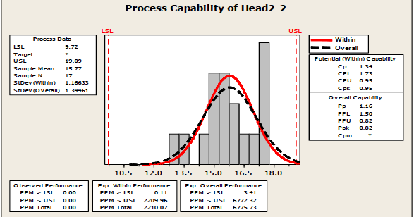
Capability plot for head 2
Cpk 0.95 < 1.34
Not capable process

Slide 14
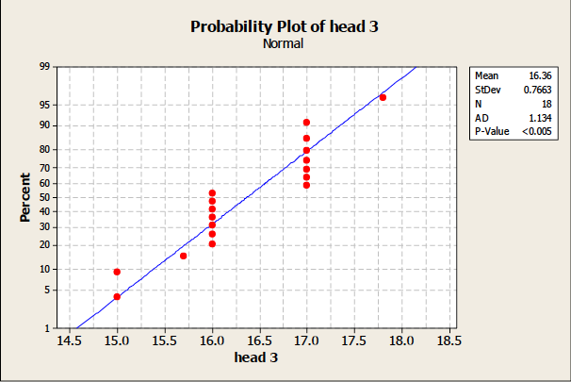
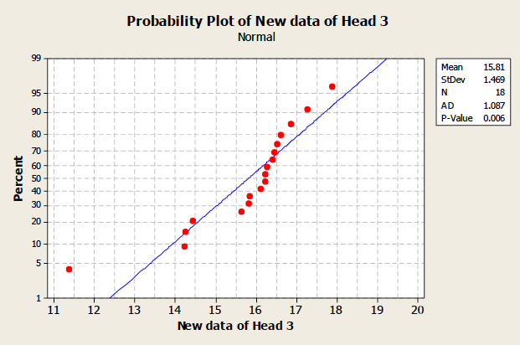
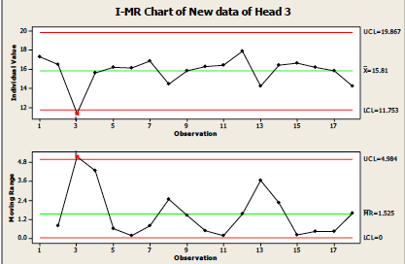
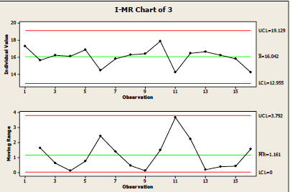
For head 3
For head 3
Point Number 2, 3 Was Eliminated Because It Out Of Control Limits.

Slide 15
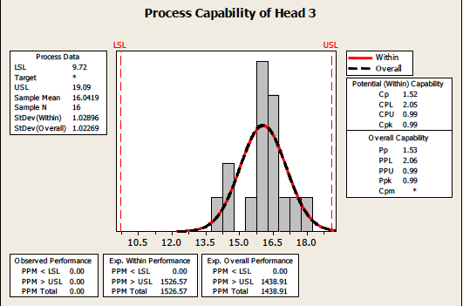
Capability Plot
Cpk 0.99 < 1.34
Not capable process

Slide 16
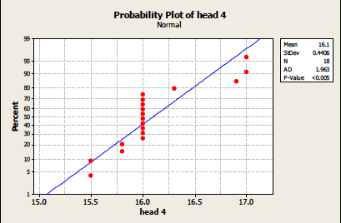
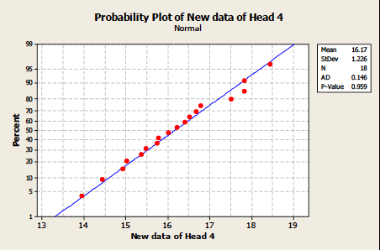
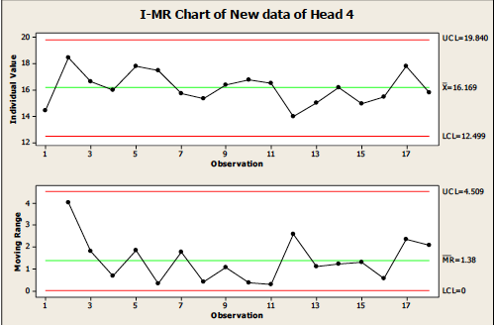
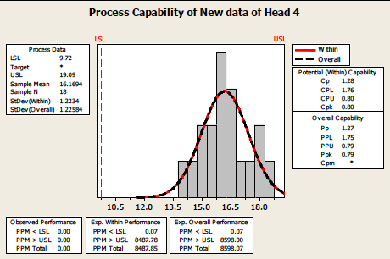
For head 4
For head 4

Slide 17
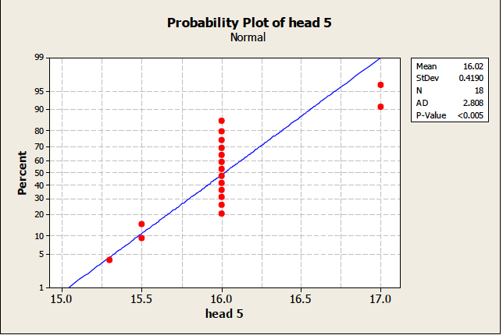
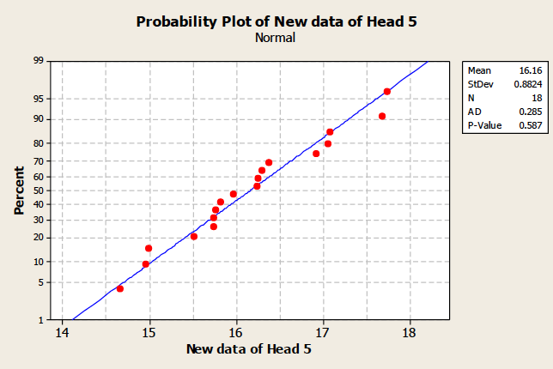
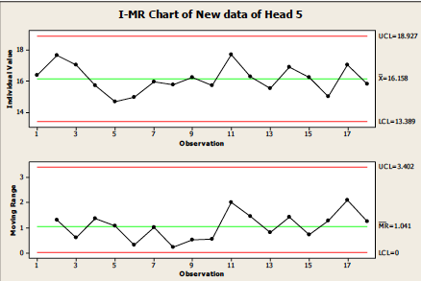
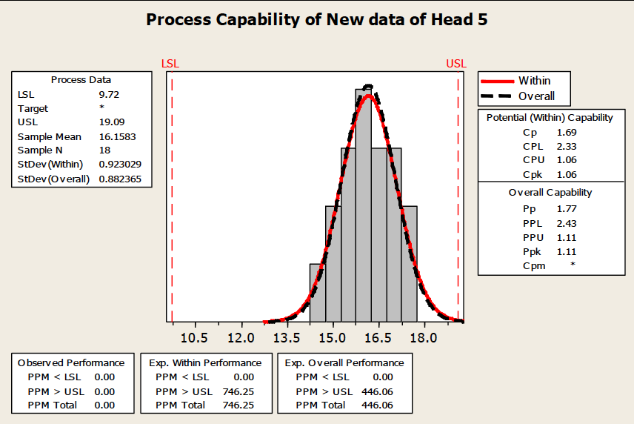
For head 5 :
For head 5

Slide 18
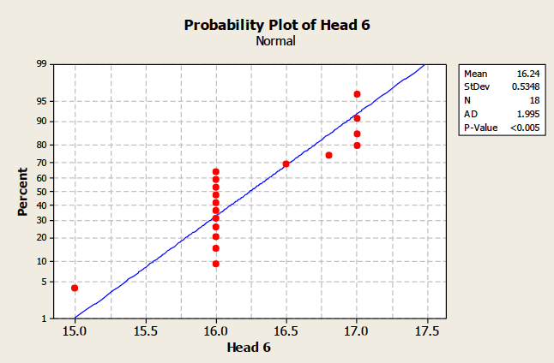
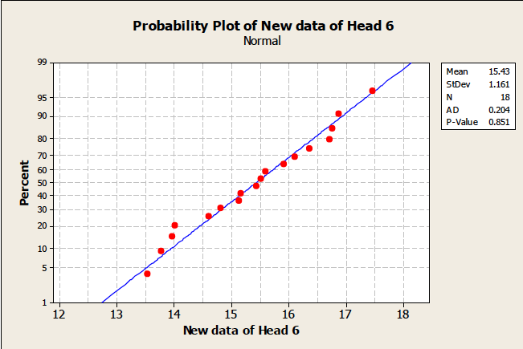
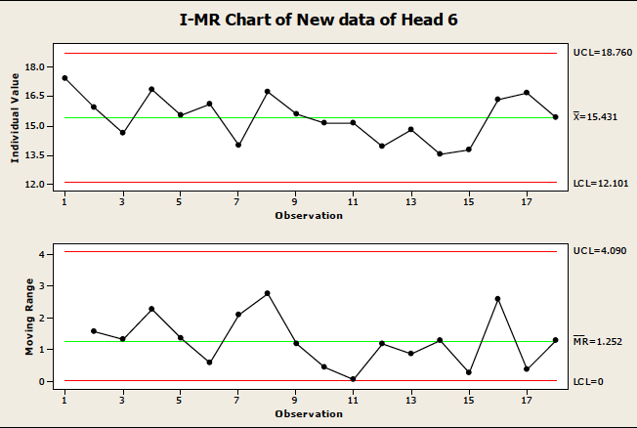
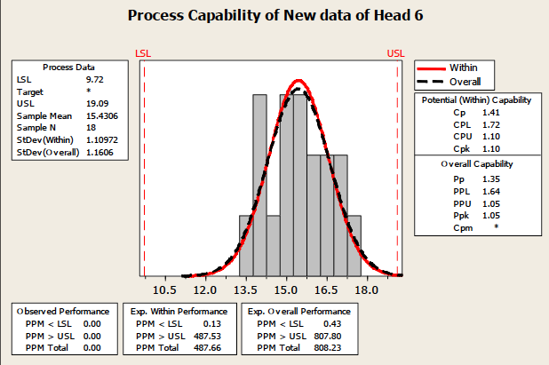
For head 6 :
For head 6

Slide 19
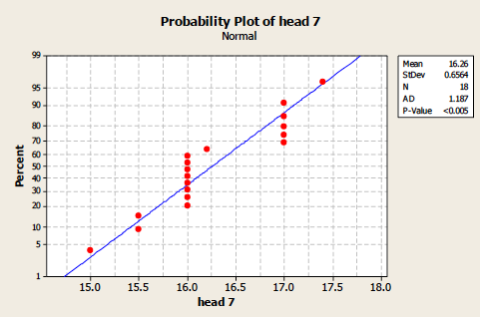
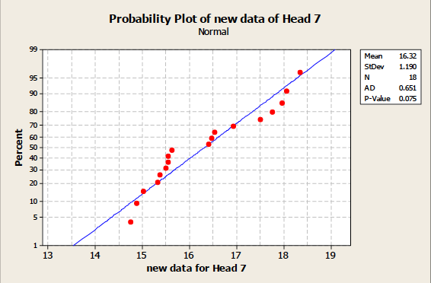
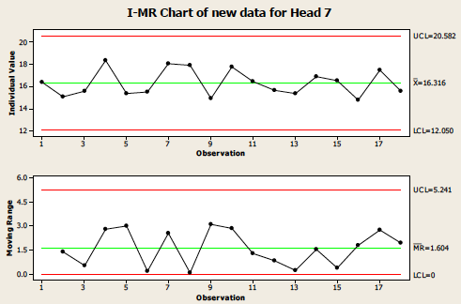
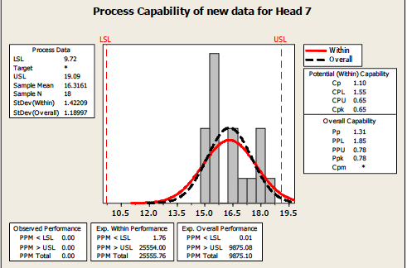
For head 7 :
For head 7

Slide 20
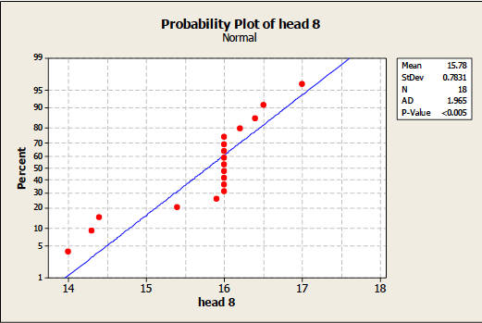
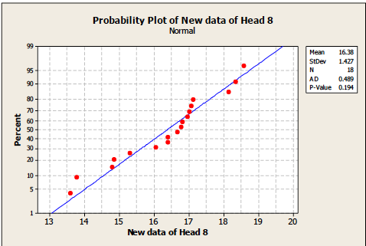
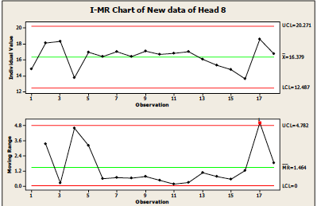
For head 8 :
For head 8
the control chart for new normal data detect
one point outside the limit (point 16)
so the process is out of control,
and there is trend pattern which there is a special cause

Slide 21
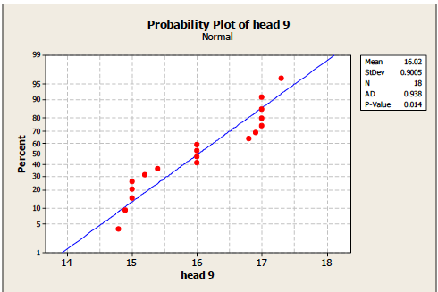
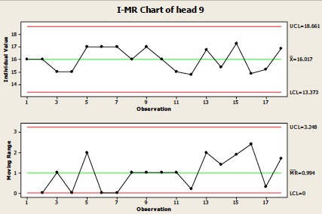
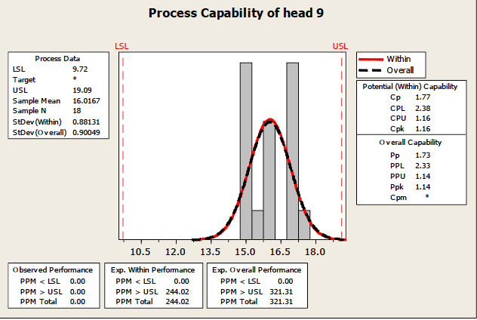
For head 9 :
For head 9
p-value =0.014 > 0.005
so the data normal.

Slide 22
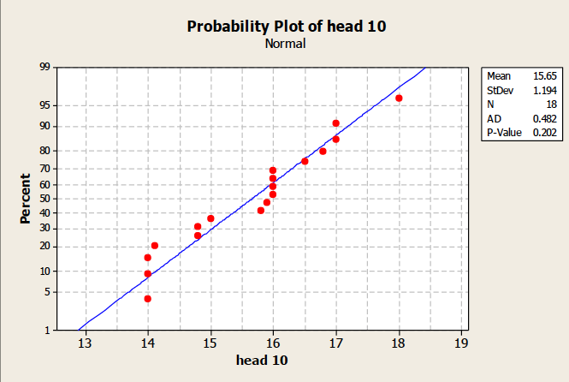
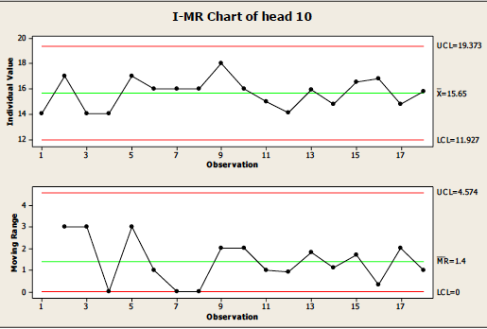
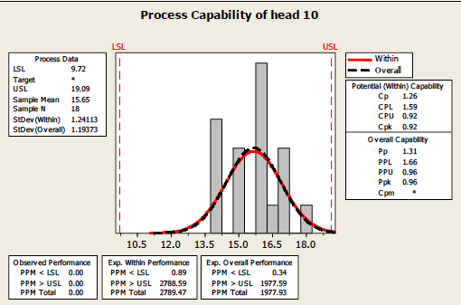
For head 10
p-value = 0.202> 0.005, the data normal.

Slide 23
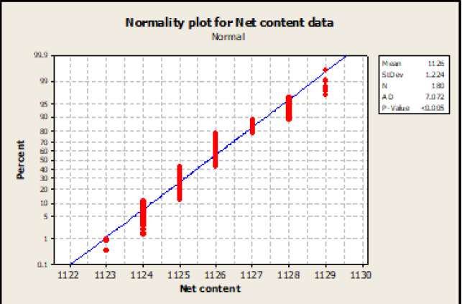
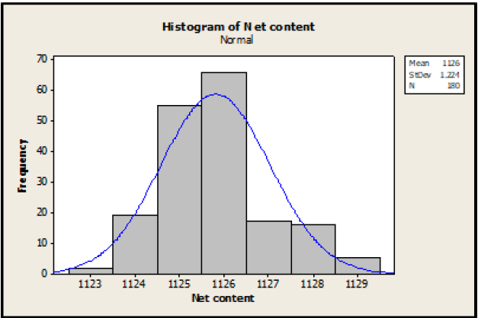
Net content test:

Slide 24
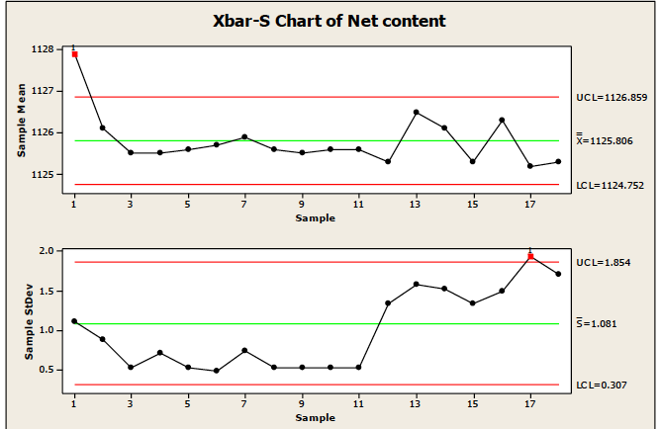
Control Chart
The figure shows that the process out of control because the data take a trend pattern and there is a point out of limits (point 1,17).

Slide 25
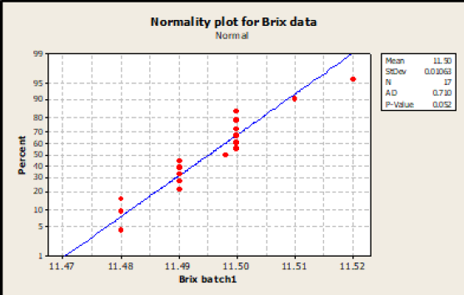
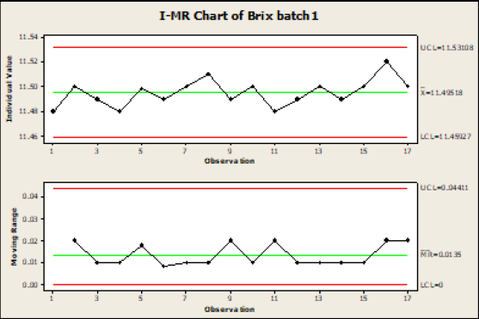
Brix (batch 1)

Slide 26
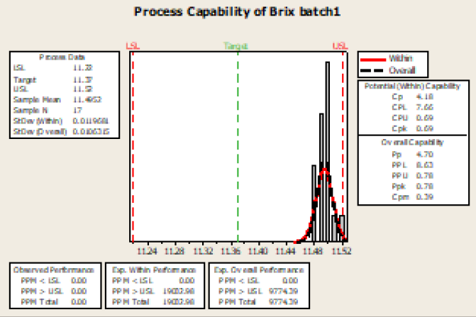
Capability Plot

Slide 27
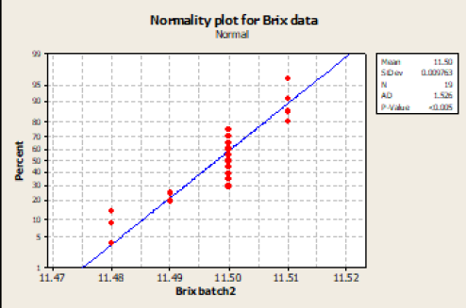
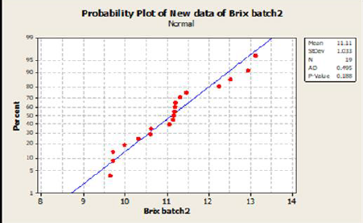
Brix ( batch 2 )

Slide 28
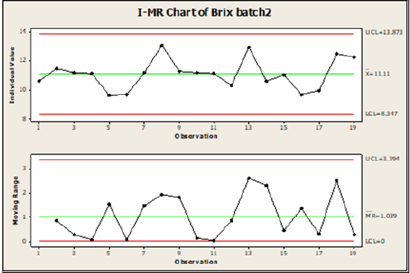

Cpk 0.03 < 1.37
Control chart
Capability plot

Slide 29


CO2 test :

Slide 30



Slide 31

Cause and effect diagram

Slide 32
Out Of Control And Solutions (Torque):
Tester must be calibrated periodically to assure that it is reading accurately.
The possibility of operator reading error, and here can be using here is model can send the data for printer memory in statistical process control, also Bottles must be clamped in the middle of device
The method of applying the force on the cap. different ways can change the amount of removal torque recorded. Providing a cap chuck with a T or round handle can reduce varying gripping. This forces all operators to hold the cap in the same way.
The inside diameter of the cap and outside diameter of the neck must be appropriate, so check the diameter for the cap and the neck frequently, many causes can affect the neck such as the expansion and shrink factor.

Slide 33
Out Of Control Process And Solutions (Net content) :
The variation in the net content may be a result of deviations in the filling, which can reduce by calibrating, checking, and make maintenance for the machine
temperature of the liquid affects the volume of the packaged product, so must controlling the temperature in the factory.
The moisture affects the weight or the volume of the packaged bottle

Slide 34
improve the capability :
after observed that all of the processes are not capable to produce product meet specifications. although most process is in control but does not meet the specifications , we suggest some ways to improve the capability
Reduce Non-Value-Added Steps
Reduce the common cause variation
Reduce special Cause Variation
Move the Mean to Improve Process Capability
Improve the Measurement System

Slide 35
Conclusion :
In this project, we studied the control tools in the statistical process, We have focused basically on normality test and control charts and implement the procedure using the given data from the factory on torque, net content, Brix, and the CO2 and Some calculations were done on the means and standard deviation of the data, the main aim of this calculation is to monitor the process if it is in control or out of control. and we have noticed that there is a problem in the normality of data.
It was our goal, by making it normal distribution data to complete the analysis, so the data was converted by SPSS program and comparing our analysis with factory analysis and show it in this project.
After making our analysis, there is out of control processes found, so we tried to explain the reasons for this to eliminating out-of-limits data. in addition to using the cause and effect diagram used to identifies possible causes for an effect or problem.

Slide 36
Recommendations :
Check the normality test to ensure the normal distributions of data before constructing the control charts and capability plots.
Maintain the process within the specifications limit, by exploring the causes that make the process non-capable and detect the possible solutions for it
The factory has to use the seven tools of process control, not only the control chart, such as the histogram

Slide 37
Use the tools that expect potential problems such as the cause and effect diagram, and sure to adjust before it makes any effect on the process.
Conducting periodic checks for the testing devices to maintain correct values for the tests
Train the employee on the Tools and the causes of variability and the corrective actions when necessary with a series of procedures for a quick response.

