Slide 1
COUNSELOR
Graduation project I
Supervisor: Dr. Luai Malhis.
Prepared by: Yara Abuamsha & Israa Ihbeisheh

Slide 2
Content List
ـــــــــــــــــــــــــــــــــــــــــــــــــــــــــــــــــــــــــــــــــــــــــــ
Motivations
Introduction
Agent facilities in a quick scene
Lawyers facilities in a quick scene
Admin facilities in a quick scene
Tools and Programs
Future Work
Demo

Slide 3
Motivations
ــــــــــــــــــــــــــــــــــــــــــــــــــــــــــــــــــــــــــــــــــــــــــ
To simplify the relation & way of communication between both lawyers and their agents.
To simplify a lawyers’ job and help them arrange their work.
To help agents reach their lawyers very easily.

Slide 4
Introduction
ـــــــــــــــــــــــــــــــــــــــــــــــــــــــــــــــــــــــــــــــــــــــــــ
Counselor is an interactive lawyers – customer’s application that will help both customers and lawyers to fulfill their goals and any obstacle they may face communicating with each other.
This application covers 3 types of users:
1) Agents
2) Lawyers
3) Admin

Slide 5
Features
ـــــــــــــــــــــــــــــــــــــــــــــــــــــــــــــــــــــــــــــــــــــــــــ
Public Features:
Consultations – Public and Private.
View of Laws and legislations.
View of Courts.
Private Features:
Communication between lawyers and agents.

Slide 6
Agent facilities in a quick scene
ـــــــــــــــــــــــــــــــــــــــــــــــــــــــــــــــــــــــــــــــــــــــــــ
An agent can have his/her own account by signing in, or sign up to website and wait for the admin’s confirmation.
They can review the public consultations, a list of courts, lawyers and laws.
Preview their cases and sessions.
Send messages to their lawyers and reply to lawyer’s messages or consultations.

Slide 7
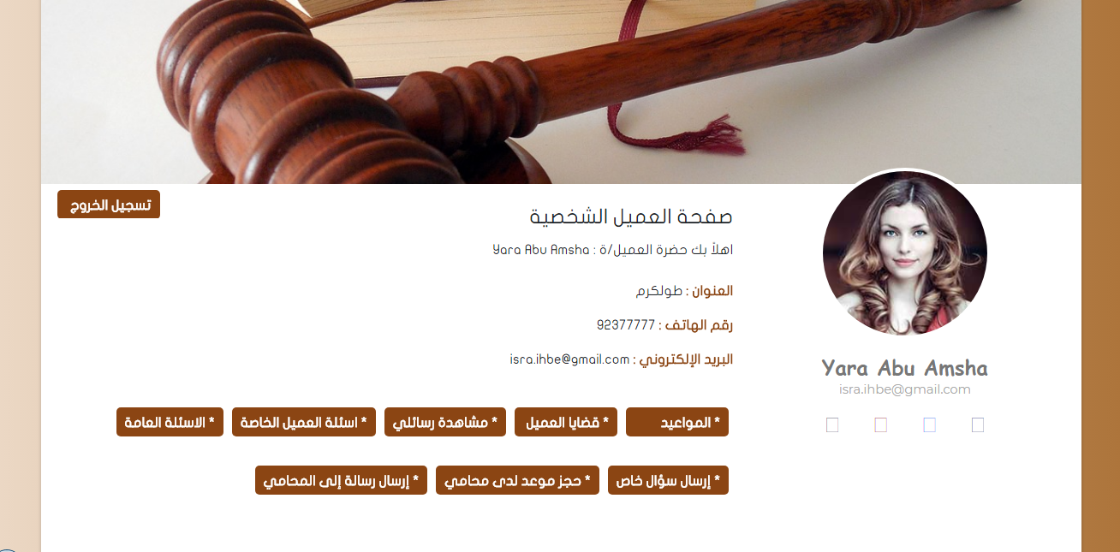
Agent’s Profile Page
ـــــــــــــــــــــــــــــــــــــــــــــــــــــــــــــــــــــــــــــــــــــــــــ

Slide 8
Lawyers facilities in a quick scene
ـــــــــــــــــــــــــــــــــــــــــــــــــــــــــــــــــــــــــــــــــــــــــــ
Lawyers can have their own account simply by using their username and a password or sign up to website and wait for the admin’s confirmation.
They also can review their Agents, and agent’s cases and every court session, edit these sessions and add more than one session to each case.
Review the public and private consultation from the agents and answers them.
Review agent’s appointments and confirm each one of them.
Reply agent’s messages and send messages to other lawyers to consult them.
Share their cases with other lawyers, or move cases completely to any lawyer.

Slide 9
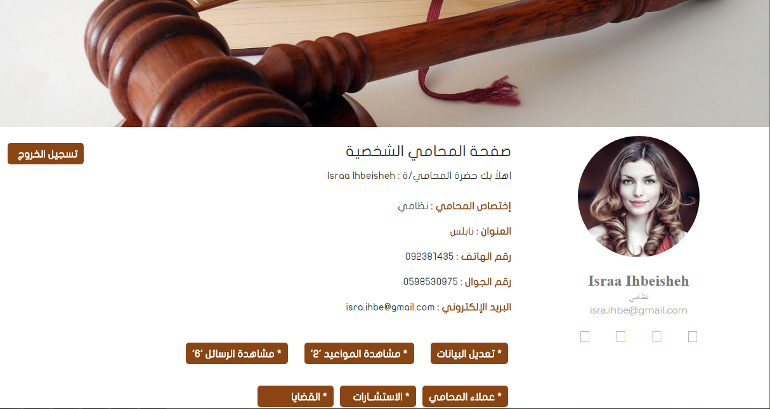
Lawyer’s Profile Page
ـــــــــــــــــــــــــــــــــــــــــــــــــــــــــــــــــــــــــــــــــــــــــــ

Slide 10
Admin facilities in a quick scene
ـــــــــــــــــــــــــــــــــــــــــــــــــــــــــــــــــــــــــــــــــــــــــــ
Can do any task implemented in the application such as:
Adding, removing or editing a lawyer, court, judge, law.
Enable publishing the public consultation, so that any lawyer can see it.
Confirm the user’s sign up requests, as an agent or a lawyer.
And an admin has her own page that should simplify her work.

Slide 11
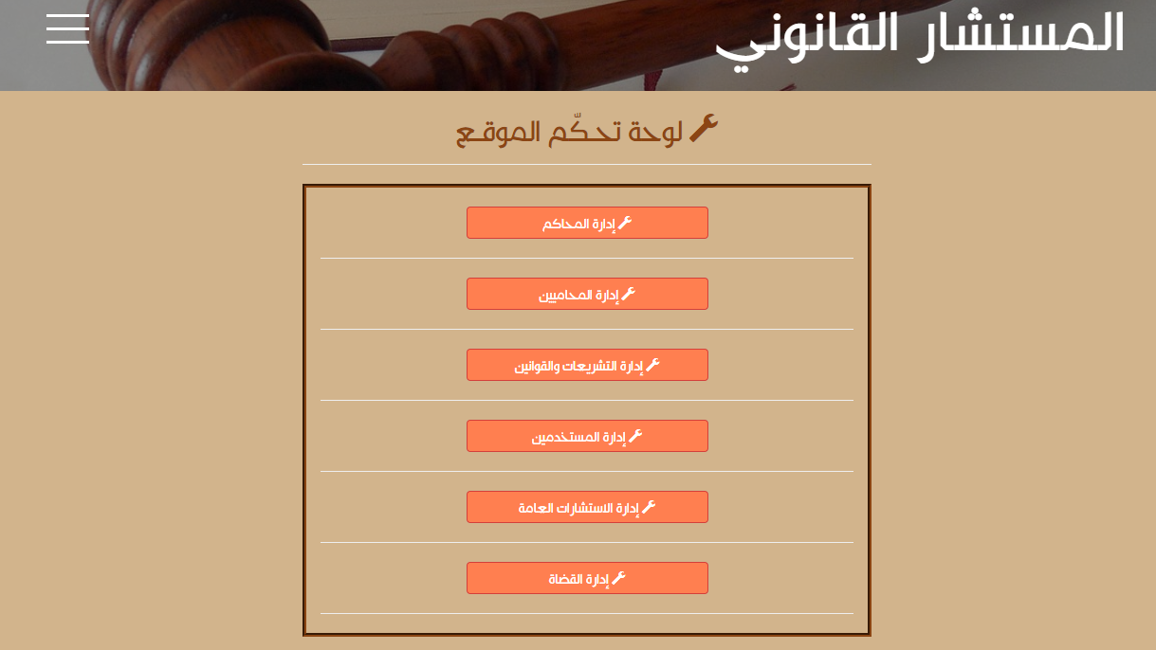
Admin’s Page
ـــــــــــــــــــــــــــــــــــــــــــــــــــــــــــــــــــــــــــــــــــــــــــ

Slide 12
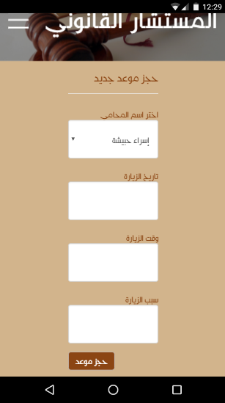
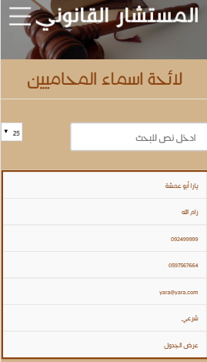
Responsivity
ـــــــــــــــــــــــــــــــــــــــــــــــــــــــــــــــــــــــــــــــــــــــــــ
Create an Appointment View
Lawyer’s List Table View

Slide 13
Tools and Programs
ـــــــــــــــــــــــــــــــــــــــــــــــــــــــــــــــــــــــــــــــــــــــــــ
Interviewing multiple lawyers for gathering information.
MVC “ Model-View-Controller” used with Visual Studio 2015 for implementing the application.
ASP. Net MVC with HTML5, CSS3, C#, JavaScript, MediaQuery.
SQL-Server 2014 for database implementation.
Bootstrap for website’s Responsivity & DataTables for tables reviewing.

Slide 14
Constrains
ـــــــــــــــــــــــــــــــــــــــــــــــــــــــــــــــــــــــــــــــــــــــــــ
One of the constraints we faced was selecting the idea of the project as we wanted to make something new and practical. It took us some time to agree on such idea.
Also learning the concepts of MVC was a bit challenge for us, since it was something new that we didn’t learn before.

Slide 15
Future Work
ـــــــــــــــــــــــــــــــــــــــــــــــــــــــــــــــــــــــــــــــــــــــــــ
The application can help in a cost-effective way since the developers can improve it to gain some fees by managing the financial relationships between the lawyers and agents.
Convert the website into a mobile application.
Provide the interface with different languages to expand it globally.

Slide 16
DEMO
ENJOY!

Slide 18
Any Questions?
Thanks For all of your patience.

