Slide 1
Bluetooth Technology applications
Submitted By:
Bahaa Ghithan.
Mais Abu Rajab.
Ghadeer barham.
Supervisor:
Dr. Falah mohammed.

Slide 2
Outlines
Introduction .
Advantages Of Bluetooth
Why Bluetooth not RFID
Components
Applications Flow chart .
Budget
Questionnaire & Results .
Conclusion .
the future work .

Slide 3
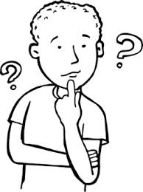
Introduction
Where’s my key?
My kids can’t deal with devices
Oh..i forget my wallet
Where’s my kids?

Slide 4
Advantages Of Bluetooth
Simple Setup
Compatibility
An economic wireless solution for short distance
Low power consumption.

Slide 5
Why Bluetooth not RFID
parameter | RFID | BLuetooth
Application | limited amount ofapplication | wide range of application(voice&data)
Frequency | varies | 2.4GHz
Max coverage range | 3meter | 100meter
Data rate | varies | 22Mbps
Problems | RFID Reader Collision | ………….
 | RFID Tag Collision | ………….
 | Security, privacy with RFID | ………..

Slide 6



Basic Components
Bluetooth
Arduino
Android

Slide 7
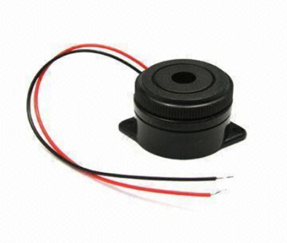
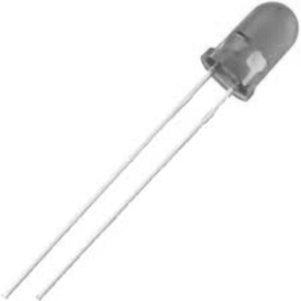
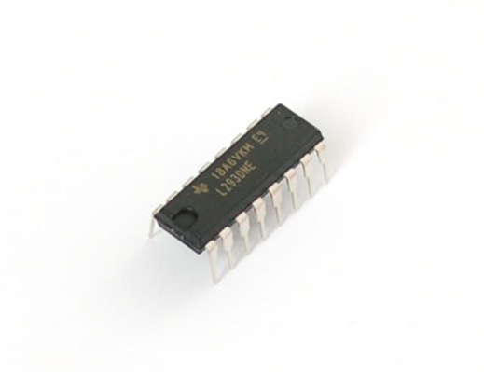
Secondary components
Alarm units
buzzer
led
control units
L239D

Slide 8
Block Diagram
Data processing unit
Power supply
Control unit
Alarm unit
Bluetooth HC-05

Slide 9
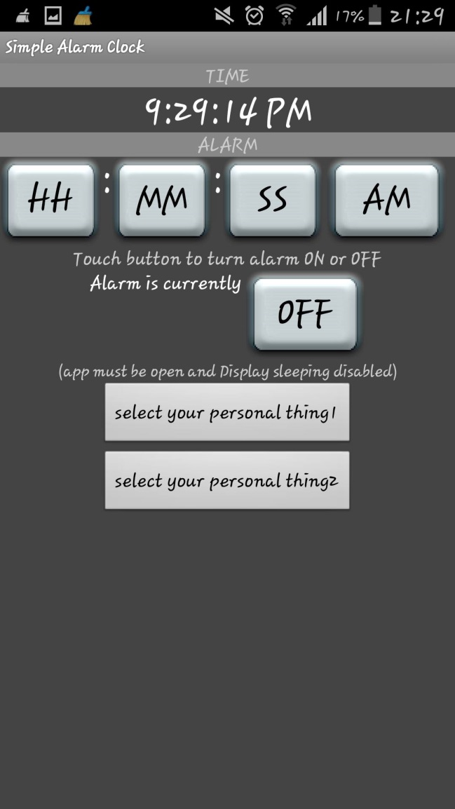
Revealer forgotten stuff

Slide 10
Flow chart #1

Slide 11
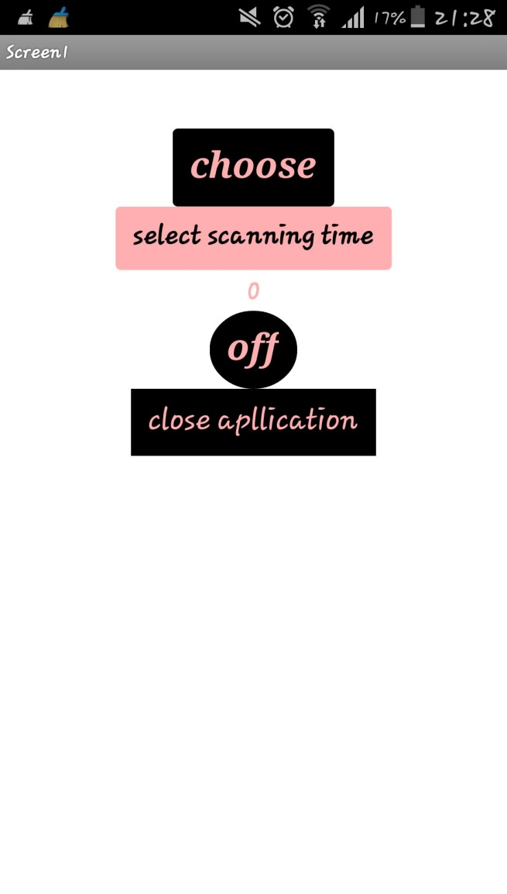
Children monitor

Slide 12
Flow chart #2

Slide 13
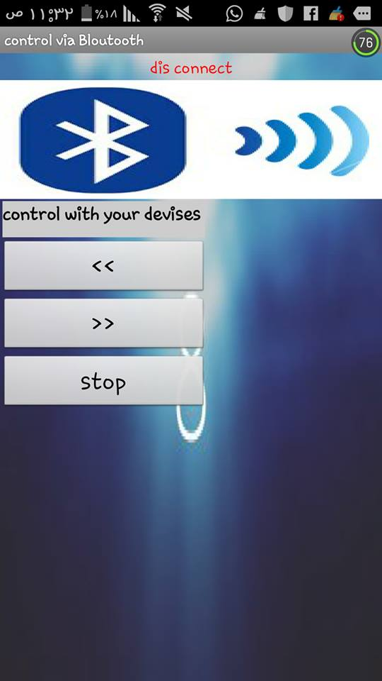
control A DC motors

Slide 14
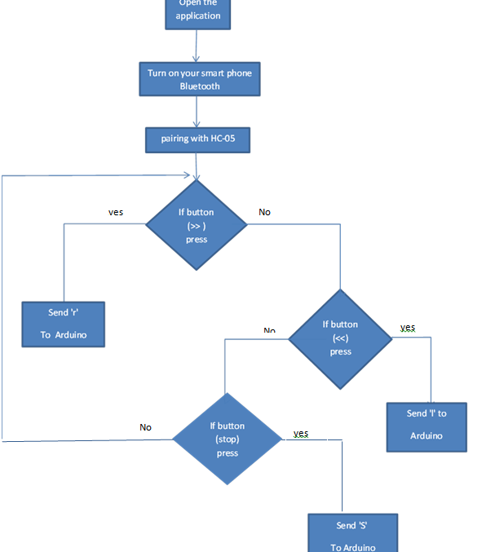
Flow chart #3

Slide 15
Budget
Component | Component Price
HC05 Bluetooth module | 50 NIS
Arduino Uno | 70 NIS
Wires and N… | 10 NIS
L293D | 20
Total cost | 150 NIS

Slide 16
Questionnaire
Q #
1 | Do you have a smartphone that supports Bluetooth technology ?
2 | Do you look at Bluetooth as a useful technology in your everyday life ?
3 | Do you suffer from missing or forgetting your stuff when you get out of your house ?
4 | Do your kids get out usually to play in the front street without your notice ?
5 | Do you wish to control stuff in your house via your smartphone ?
6 | If there were some available applications with special devices to solve all above problems, would you wish purchasing them ?
7 | Would you consider purchasing such a system for a cost of 7$ ?

Slide 17
Result of questionnaire

Slide 18
Future work
GPS out door.
Leak water detection

Slide 19
Conclusion
In the second semester, we succeed in implementing 3 different Bluetooth systems by using Bluetooth module, Arduino , Alarm or control units and android application .

Slide 20

Any Question

Slide 21


