Slide 1

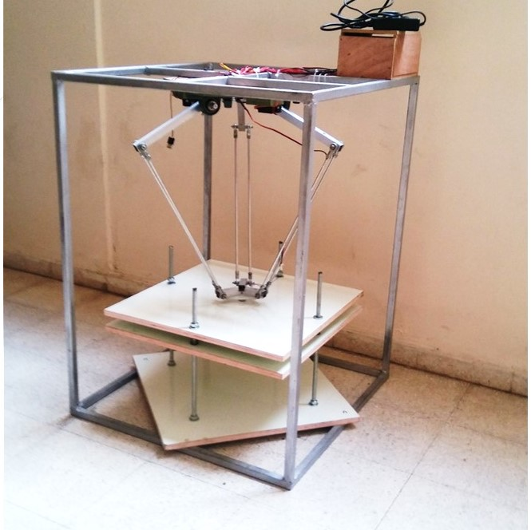
Pick & Place
Delta Robot

Slide 2

Review Project 1
Design Of work
Building Robot
Physical Work
Future Work

Slide 3
Project1
Definition of Delta robot
Analysis
Literature Review
DOF
Kinematics
Work Space
Dynamic Analysis
Invers Kinematic
Application (Pick & Place)
Review

Slide 4

Project 2
Design Of Work
Building Robot
Project Plane

Slide 5
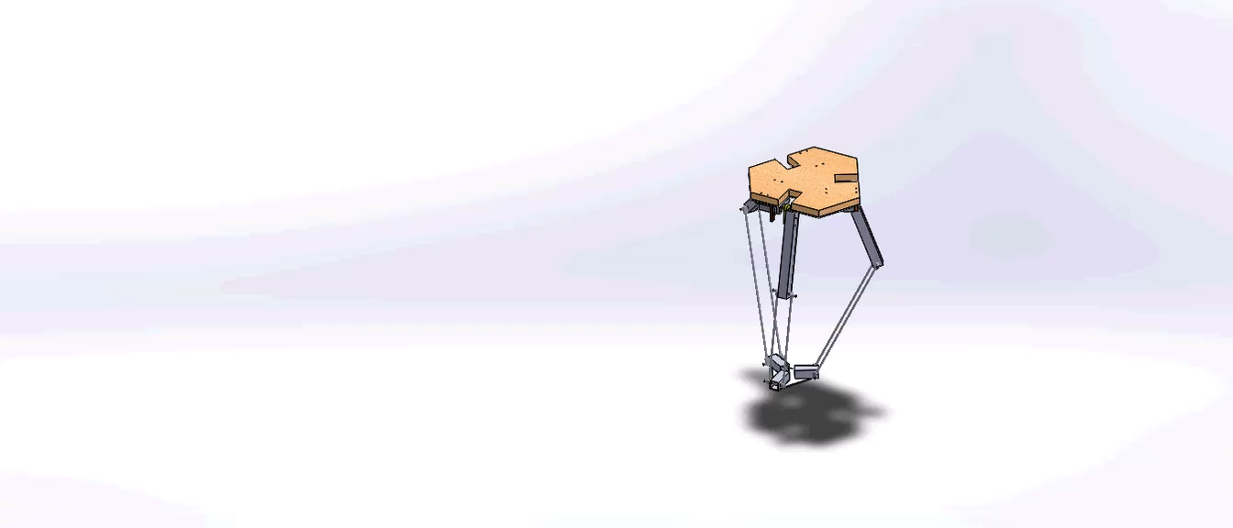
First Step

Slide 6
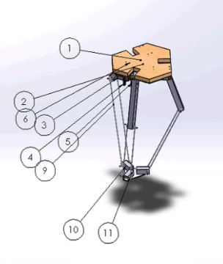
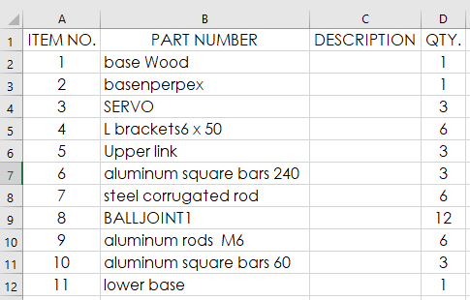

Slide 7
Cost
Actual
Advance work
Challenges
Primary
Primary work

Slide 8
Second Step
Electrical
Mechanical
Control
Building Robot

Slide 9
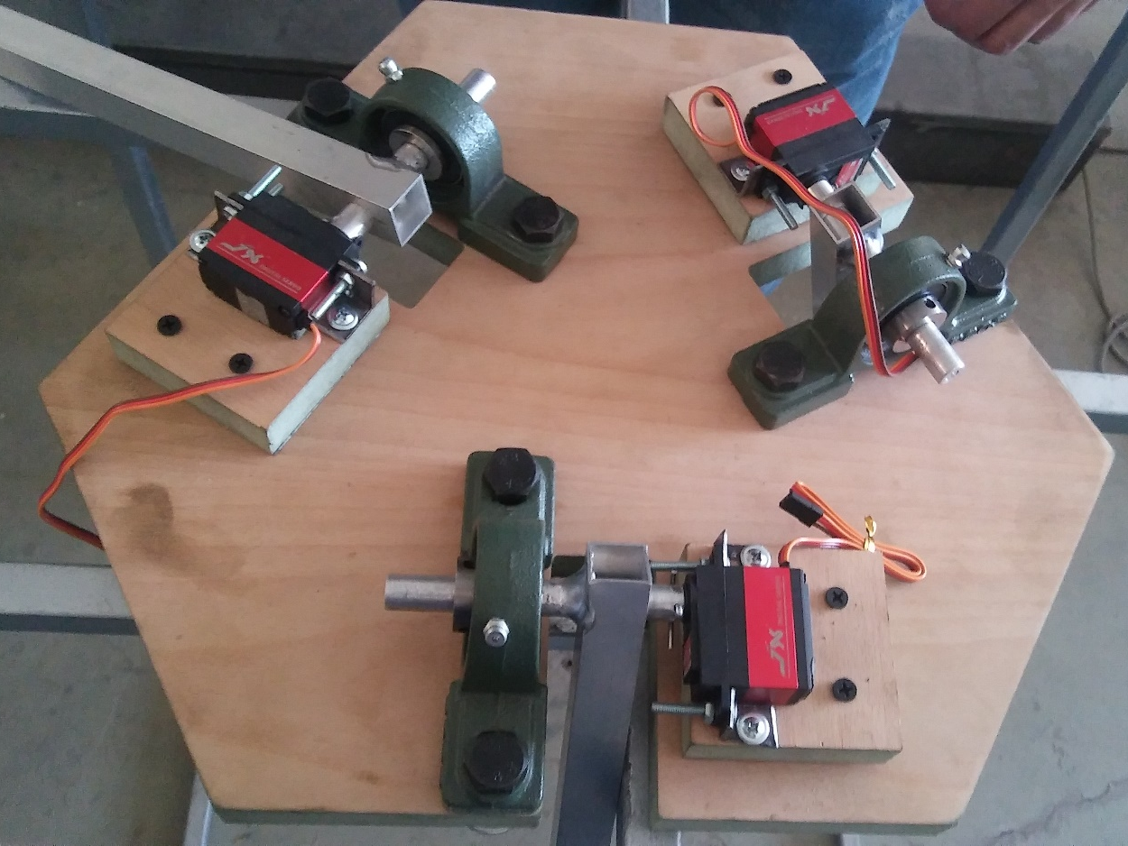
Upper Connection:
Depend on Wight and torque analysis we chose 6221 servo motor
Table
Frame
Robot
Lower Part
Ball Joint
Upper Base
West Robot
Upper arm with shaft
Lower Base

Slide 10
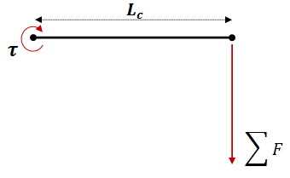
𝜏 = L*ΣF
L=control arm
ΣF=the total force =Σm*g
Σ m=mass control arm +mass of lower arm+ spherical joint +1/3 traveling plate Σm = 68+2*32+4*26+32
Σm =282gm
𝜏 = 21*0.282
𝜏 =5.922kg.cm (max)

Slide 11
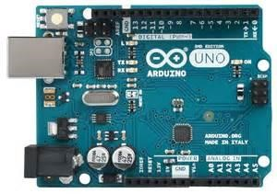
Arduino UNO microcontroller

Slide 12
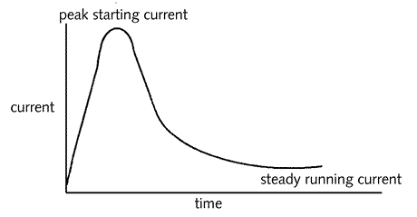
Servo motor
The servo motor that we used have these characteristics :
1- 0.9 A starting current
2- 360 mA running current
3- 6 volt running voltage

Slide 13
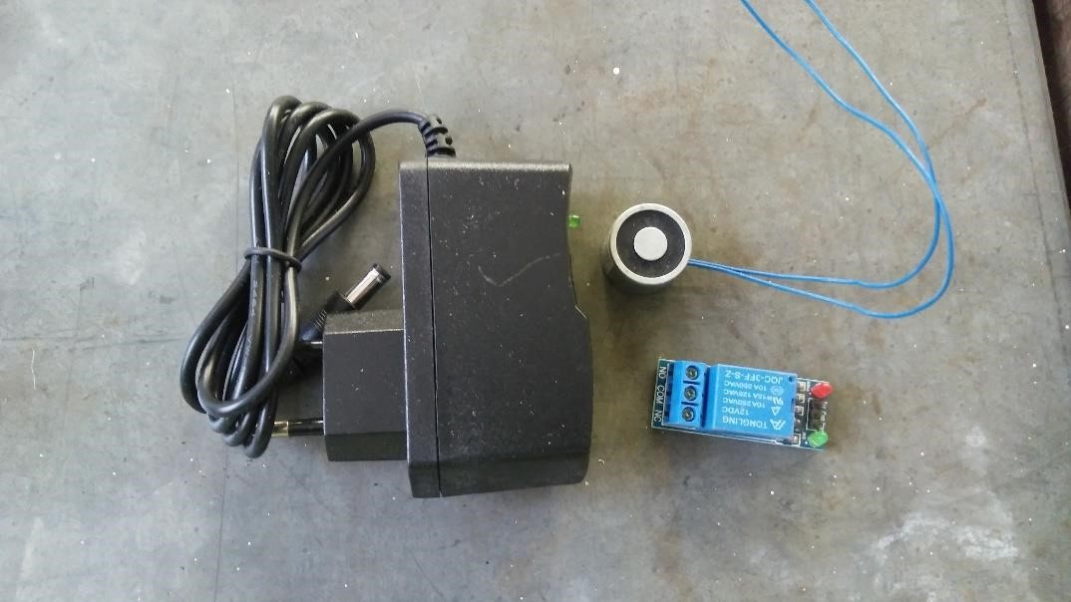
Magnetic gripper
The magnetic gripper needs a 12 v voltage and 0.25 A current to run. And it can handle up to 2.5 kg.

Slide 14
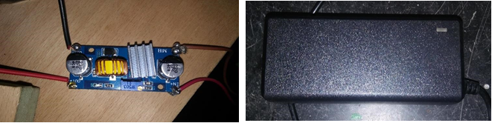
Power supply and voltage regulator
Voltage regulator
Power supply

Slide 15
End Effector Circuit
Power Circuit
Actual Work

Slide 16
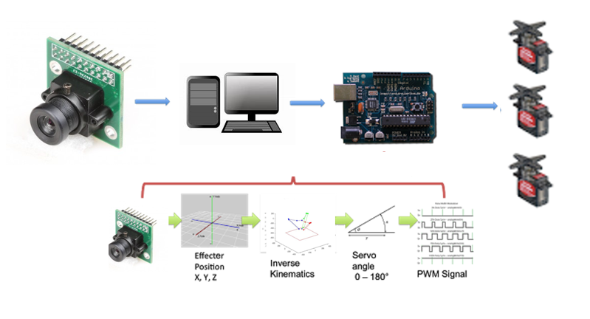

Slide 17
Piece
Camera Process
Center of Piece

Slide 18
Future Work
Control
Respray bi, Open cv
End effector
Vacuum
Frame
Belt

