Slide 1
April App Presentaion
Prepared by :
Ayat Salman
Nowwar Kusa

Slide 2
Outline
Introduction
Modules
Sign up (Desktop & mobile)Family Game
Drawing & Coloring Game
Conversation Game
Constraints
Future Work

Slide 3
Introduction
App Name
Current Problems

Slide 4
Tools
Ionic 3
Firebase DB
Adobe After Effects
Adobe Illustrator
Lottie
Speech recognition
Trello
Bitbucket

Slide 5

Sign Up (Desktop & Mobile)

Slide 6
Modules
Sign up (Desktop & mobile)
Family Game
Drawing & Coloring Game
Conversation Game

Slide 7
Family Game Demo

Slide 8
Drawing and coloring Game
1-Purpose.
2- Levels.
3-Configurations.
4-Scoring.

Slide 9
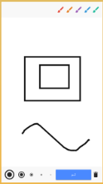

Drawing Game Scoring

Slide 10
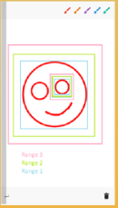
Coloring Game Scoring

Slide 11
Conversation Game
1-Purpose.
2-Configurations.
3-Character and caregiver audio recording.
4-Scoring.

Slide 12
Conversation Demo

Slide 13
Constraints
1-Choosing the idea of the project.
2-Time constraints.
3-Adobe Flash.
4- TTS plug in.
5-Scoring technique.

Slide 14
Future Work
1- Add more games.
2- Make the app itself suggest a suitable level to the teacher according to child progress.
3- Make a chat system between the family and the caregiver.
4- Make a separate application for the caregiver.
5- Redesign the games using more professional tools and programs like unity.
6- Add more features to the character like eye gaze.
7- Expand the Family game to have configurations done by the caregiver like adding more pictures from the caregiver side.
8- Make a separate section to be used by the therapists for researches.

