Slide 1
Shopping for the blind
Prepared by : Mostafa Alshaer
Khaled Kayed
Supervisor : Dr.Loai Malhees

Slide 2
OUTLINE
What is Shopping for the blind ?
Overview.
Components.
Methodology.
Constrains.
Future work.
Demo.

Slide 3
What is Shopping for the blind ?
system that enables blind people to shop without the need for help.
the product id be stored on RFID chip.
the blind uses a device to read the products and give products' information in the form of voice.

Slide 4
Overview
The project consists of two main parts:
Identify the product.
Quick Search for Products.

Slide 5
Components
RFID reader - RC522.
RFID cards.
MP3 player.
Arduino Nano.
Voice Recognition Module V3.

Slide 6
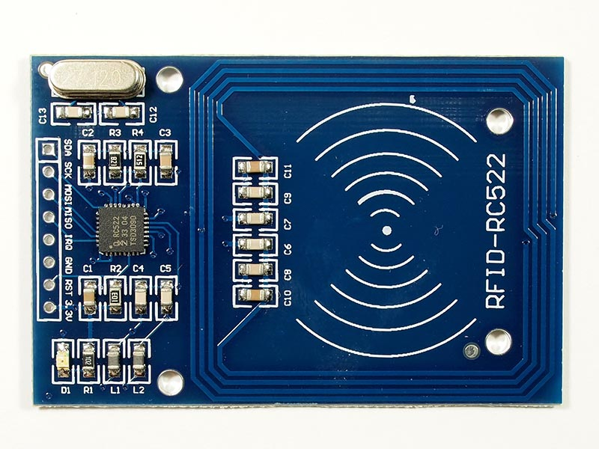
RFID reader - RC522

Slide 7
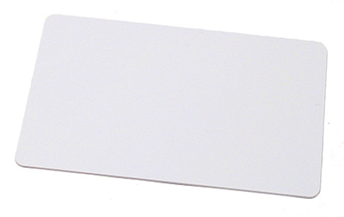
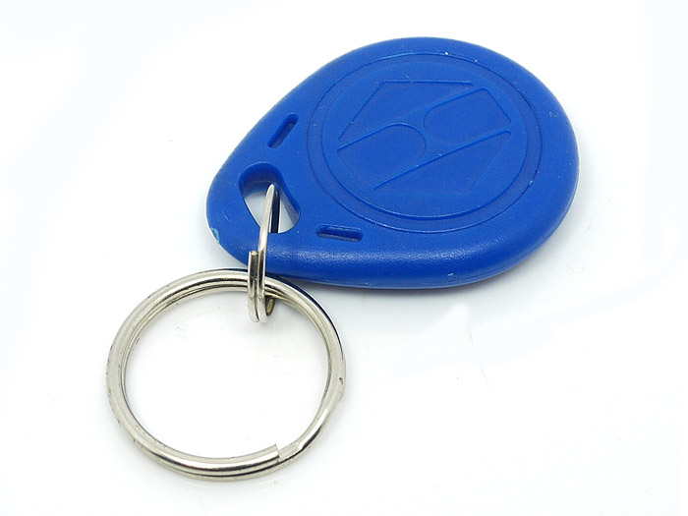
RFID cards

Slide 8
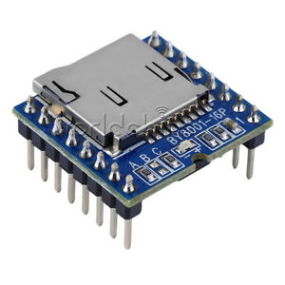
MP3 player

Slide 9
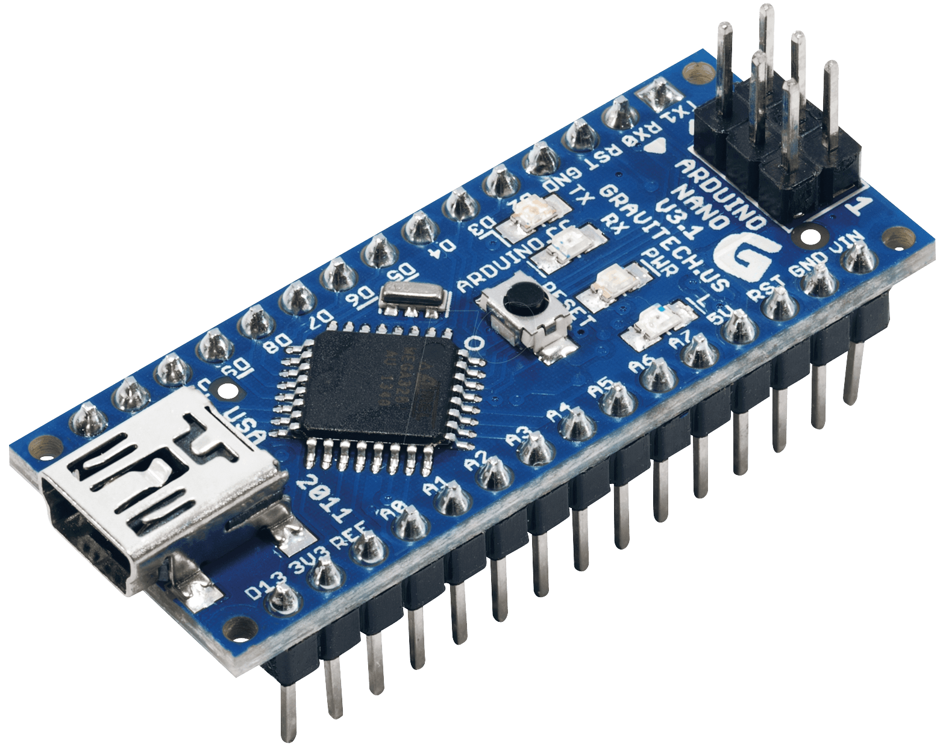
Arduino Nano

Slide 10
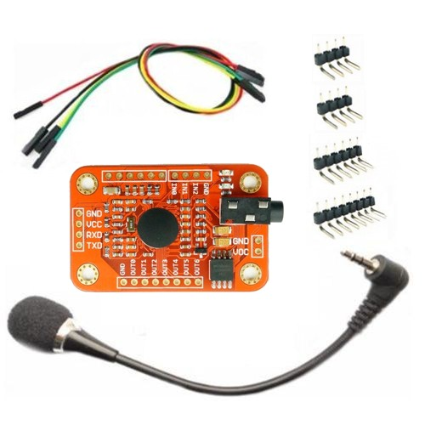
Voice Recognition Module V3

Slide 11
Methodology
Project main parts:
Tags reading using RFID Reader.
Play track for an product using MP3 player.
Training VRM v3 on voices of products.
Voice detection using VRM v3 .

Slide 12
Methodology
Our device works on two modes :
First mode : RFID reader reads card and MP3 play track that related to this card.
Seconed mode : user enters set of products by VRM and then device works as in previous part but only for prducts that user enters.

Slide 13
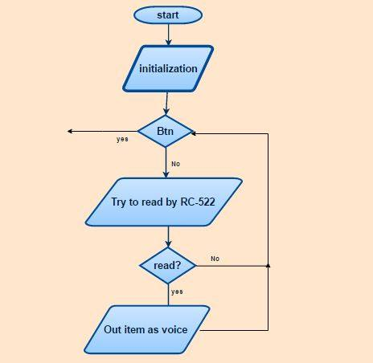
First mode

Slide 14
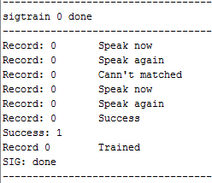
Seconed mode
Before implementing seconed mode we must train VRM v3.
Sigtrain :

Slide 15
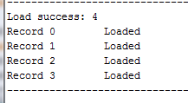
Seconed mode
Load :

Slide 16
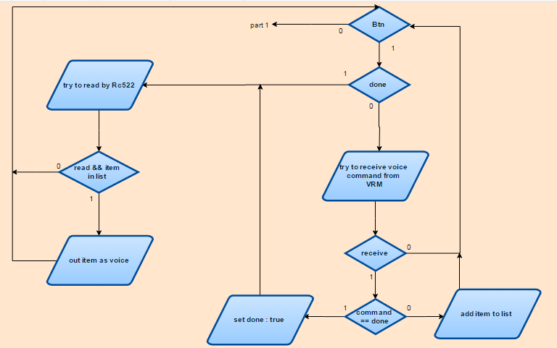
Seconed mode

Slide 17
Constrains
VRM can train only on at most 80 voice.
RFID reader can read from 10 cm at
most.

Slide 18
Future work
Make device smaller as Possible.
Develop the design.
Make device work only for first mode and if you want a seconed mode you can connect VRM to your device.

Slide 19
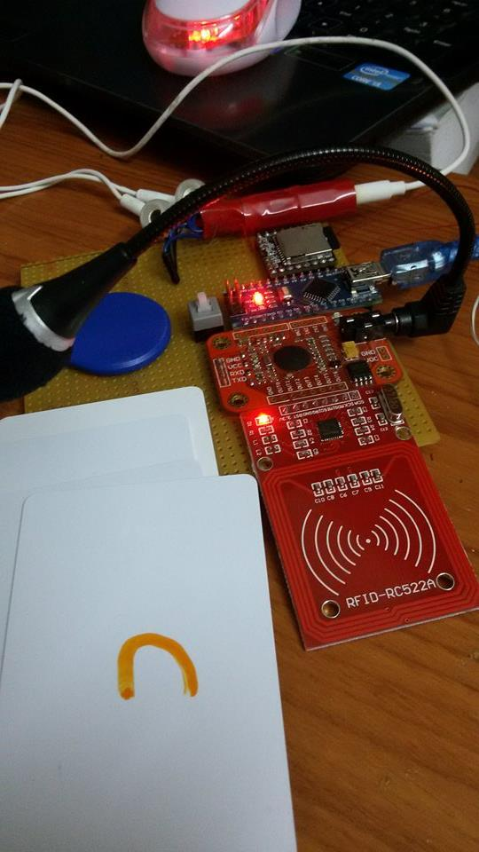
Result

Slide 20
Demo
Demo

Slide 21
The end
Thank you

