Slide 1
KANRI
Presented by
Maya Yacoub 11819884
Israa Shtayeh 11819805
Supervised by Dr. Ra’ed Qadi

Slide 2

Outline
What is KANRI?
Why KANRI?
Features
What is KANRI built on?
Why using these techniques?
KANRI contents
Future Work

Slide 3
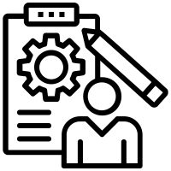

What is KANRI?
It is an Android application serving in the field of project management and task organization.

Slide 4
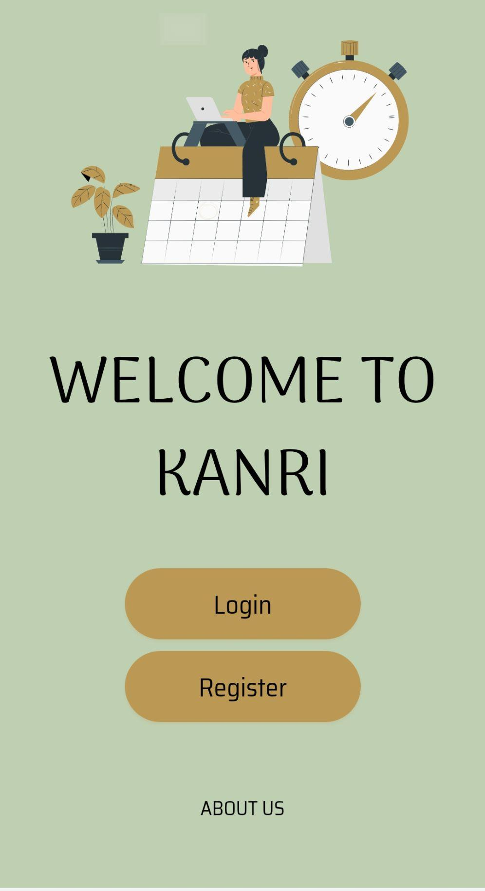

Why KANRI?
To satisfy the end-user's need for a user-friendly, flexible, and free online tool to assist them with project and task management.
If you don’t know where you are going. How can you expect to get there?
– Basil S. Walsh

Slide 5







Features
Full Control
Chat / Call
Notifications
As Customer service
Establish, or join projects
Track tasks

Slide 6

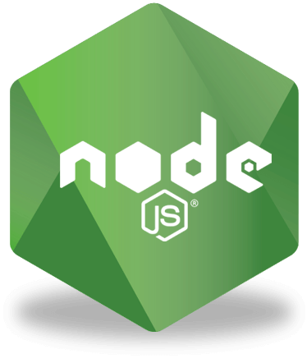


What is KANRI built on?
React Native
React
Node.js
Mongodb
Firebase

Slide 7
Why these techniques?
React Native & React.js
Open source frameworks.
Great performance.
Write once and use everywhere.
Moveable (React Native).
Notes:
Great Performance: Instead of mainly using the central processing unit (CPU), React Native apps take advantage of the graphics processing unit (GPU)
Moveable:If it is desired or becomes necessary to move the app to another development framework in the future, app developers don’t need to start over.

Slide 8
Why these techniques?
Node.js
Open source run-time environment.
Very fast.
Single threaded, highly scalable.
Alot of npm packages.
Notes:
Being build on google chrome's V8 javascript engine node js library is very fast in code execution .

Slide 9
Why these techniques?
Mongodb
Fast query response.
Document-Oriented database (NoSQL).
More scalability & flexibility.
Firebase
Real-time database.
Cloud messaging.
Notes:
Nosql: there are different documents which can store different types of data.

Slide 10
KANRI Contents
Android mobile application with all features
Website with some features
Admin website to manage users

Slide 11


Similar tools
KANRI
Microsoft
ASANA
Zoho
Monday
Costly
Internal Chat
Customer service
Users
awareness
Complexity
Notes:
Nosql: there are different documents which can store different types of data.

Slide 12
Future work
More Notifications
Paypal feature
Apply tasks’ dependency feature
Apply multiple members for one task
Generate PDF reports for customer and project leader

Slide 13
Thank you

