Slide 1

An-Najah National University
Faculty of Engineering & Information Technology.
Building Engineering Department.
Graduation project (2)
Qabatia Basic Girls School
Prepared By:
1. Alshareef-rashed abu aqeel.
2. Ameed mlitat .
3. Hassan badien.
Supervisor: Dr. Fadi fatayer.

Slide 2
Content :
1.0
2.0
3.0
Introduction
Architectural Aspects
Environmental Aspects
4.0
5.0
6.0
Structural Aspects
Eloctro-Mechanical Aspects
Quantity Surveying and Cost Estimation

Slide 3
1.0 introduction :
Qabatiya basic girls school
Located in Qabatiya , Jenin .
Consists of 4 floors .
Approximate Total area of school is 3693 S.M
Employees number in the school is 18 .
Number of student is 380 .

Slide 4
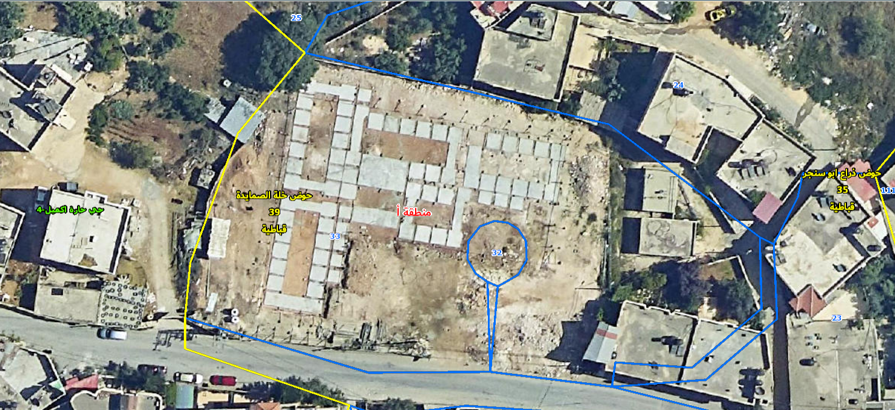
Aerial photo showing the project site :
Figure 1.1 (arial photo for the project )

Slide 5
2.0 Architectural Aspects :
Adding a Parking floor
plans before and after modification
3D Picture

Slide 6
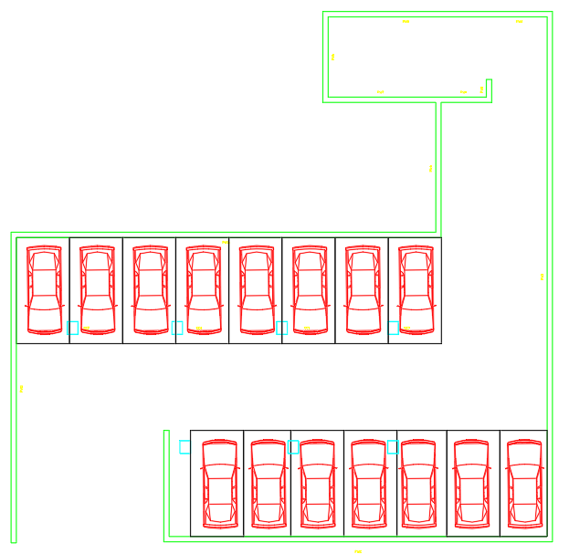
Parking Floor :
Parking capacity is 15 cars
Figure 2.1 (parking plan)

Slide 7
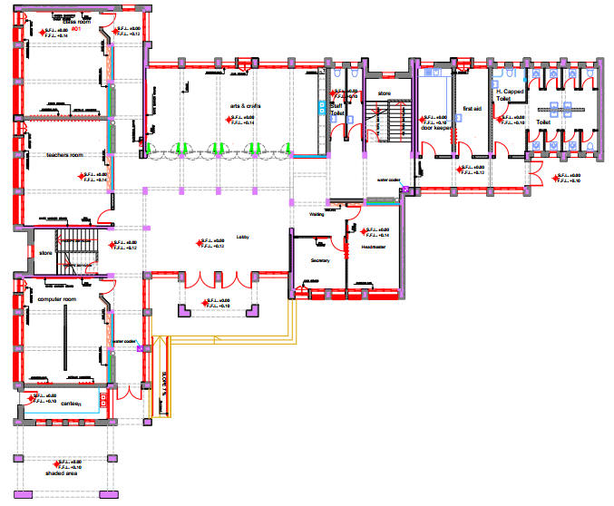
Ground Floor : ( before modifications )
Figure 2.2 (ground floor plan before modification)

Slide 8
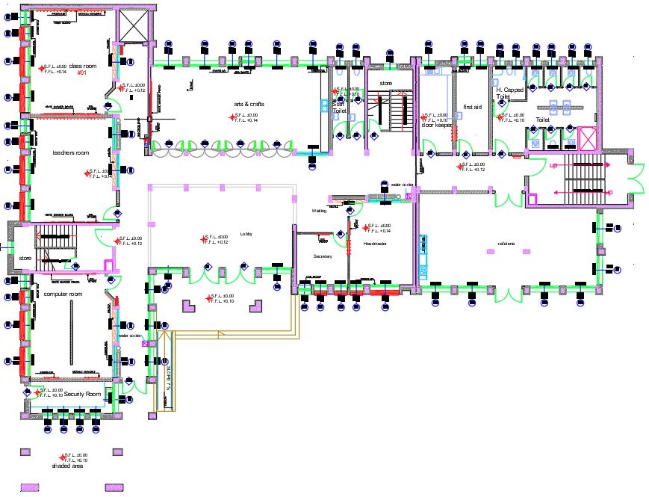
Ground Floor : ( After modifications )
Figure 2.3 (ground floor plan after modification)

Slide 9
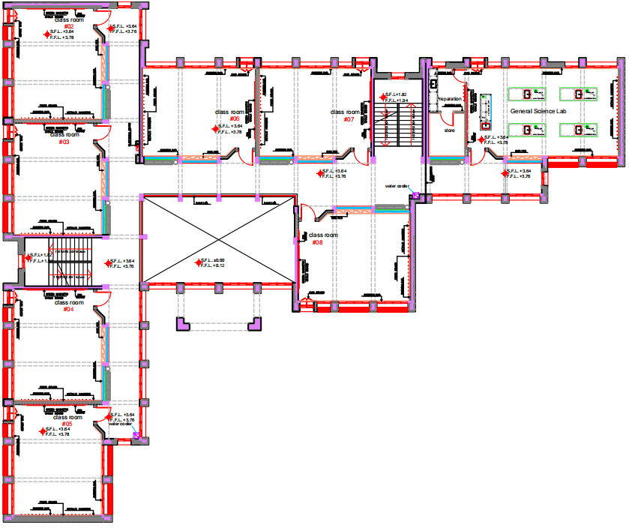
First Floor : ( before modifications )
Figure 2.4 (first floor plan before modification)

Slide 10
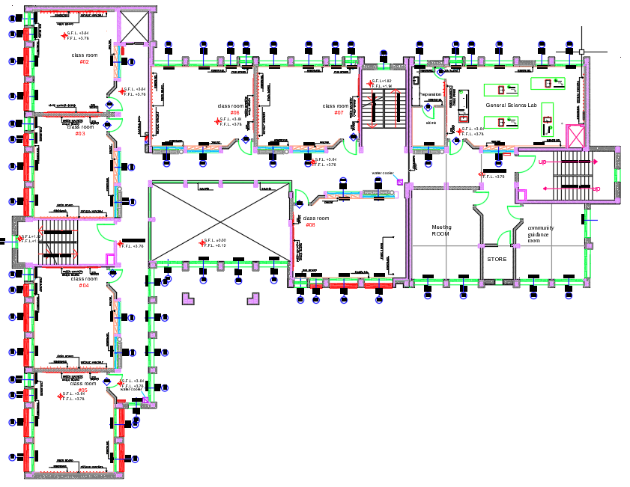
First Floor : ( After modifications )
Figure 2.5 (first floor plan after modification)

Slide 11
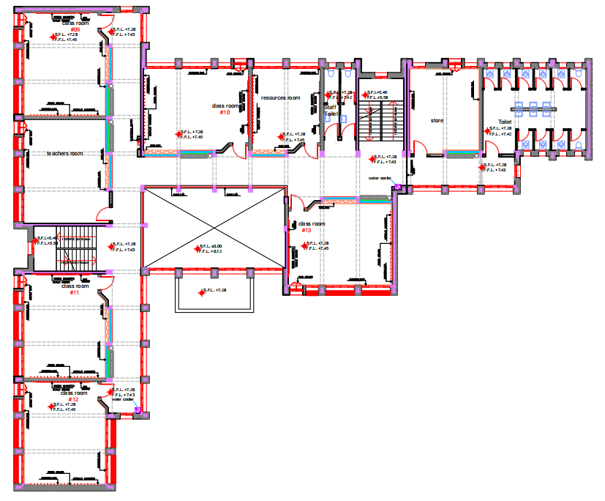
Second Floor : ( before modifications )
Figure 2.6 (second floor plan before modification)

Slide 12
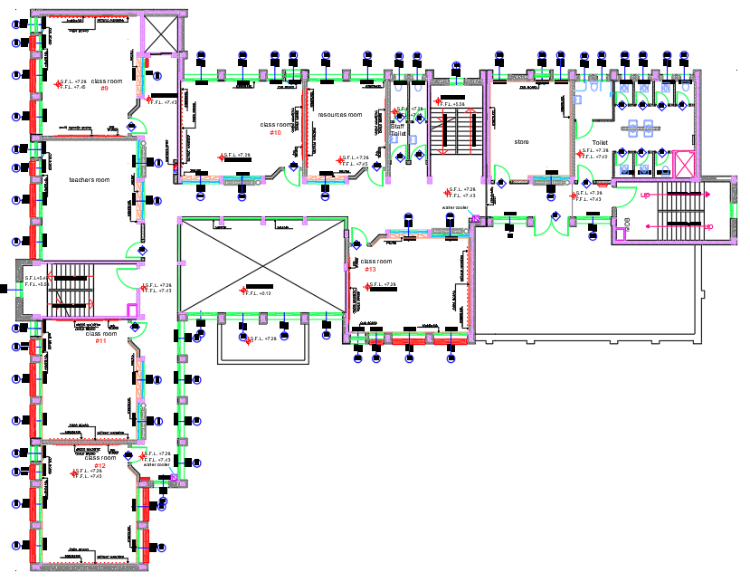
Second Floor : ( after modifications )
Figure 2.7 (second floor plan after modification)

Slide 13
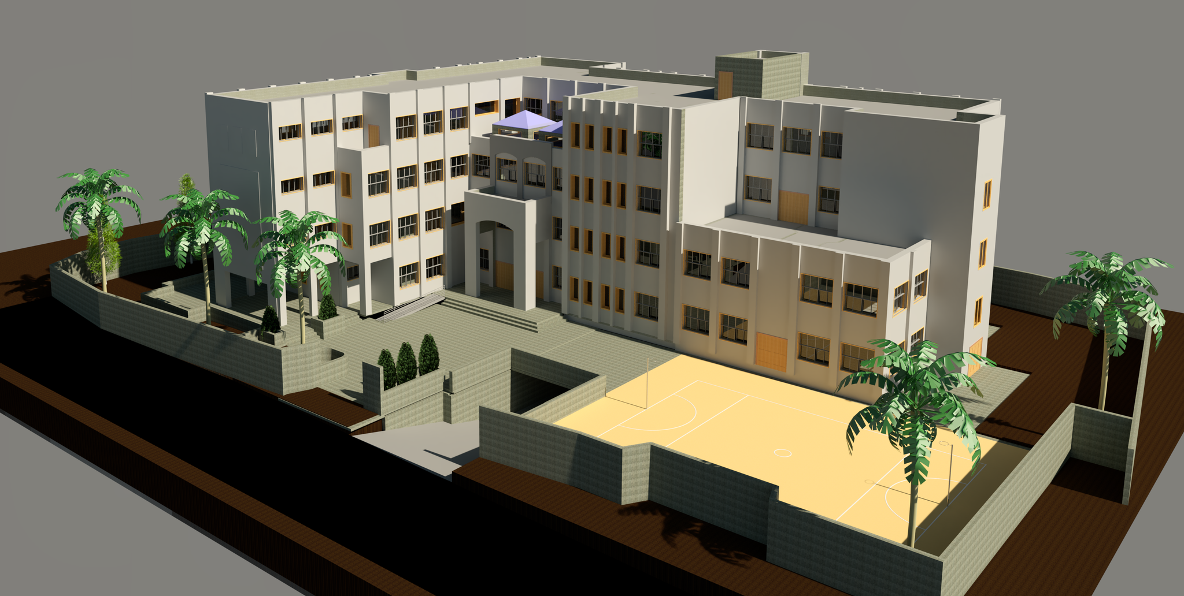
3d picture :

Slide 14
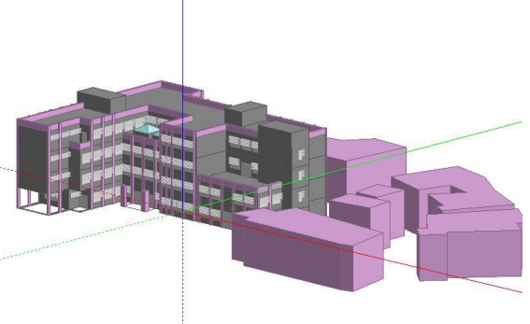
3.0 Enviromintal aspects:
Design Builder simulation
Design Builder heating & cooling
Daylight Factor
Shading Analysis
Solar analysis frome Revit
Figure 3.1 (design builder modle)

Slide 15
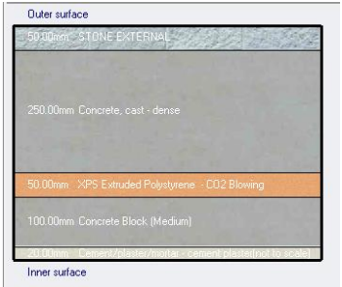
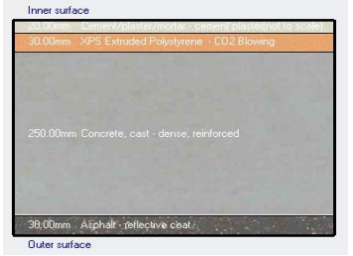
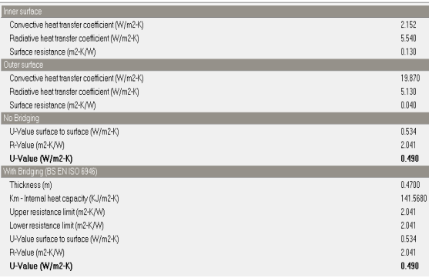
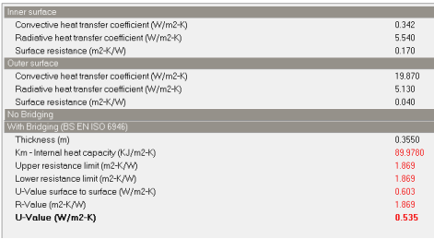
Design Builder simulation analysis :
Walls U-Value
Slab U-Value
Figure 3.2 (walls layers)
Figure 3.3 (slab layers)
Figure 3.4 (walls U-Value)
Figure 3.5 (slab U-Value)

Slide 16
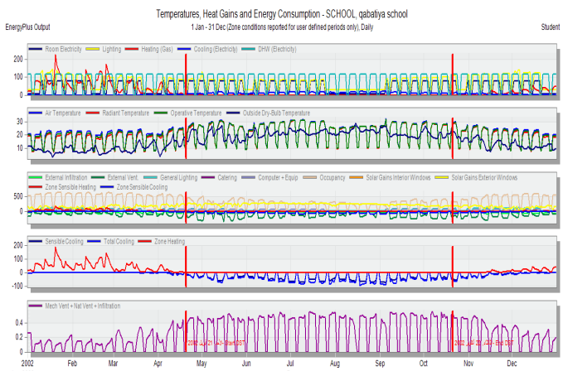
Design Builder Simulation Result :
Figure 3.6 (simulation result)

Slide 17
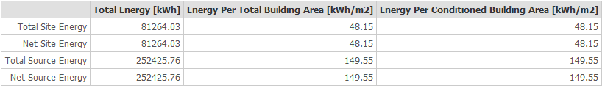
Design Builder Simulation Result :
Table 3.1 (total energy)

Slide 18
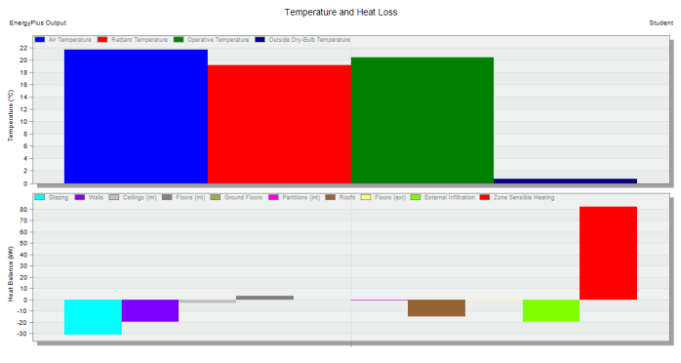
Design Builder heating result :
Figure 3.7 (heating loss)

Slide 19
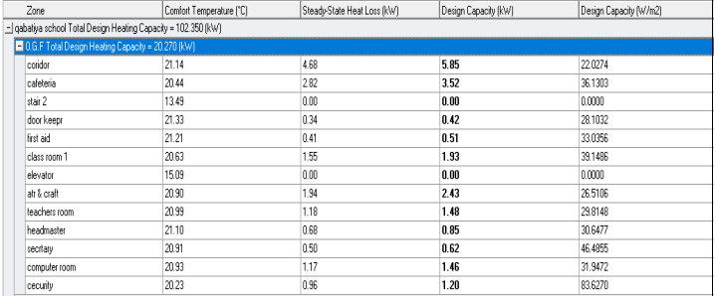
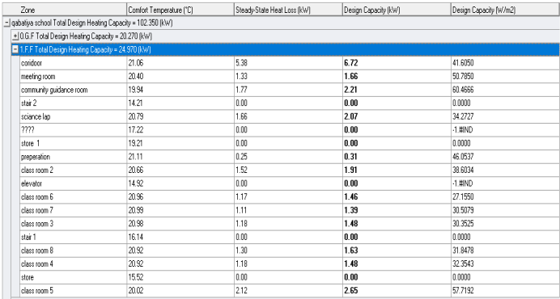
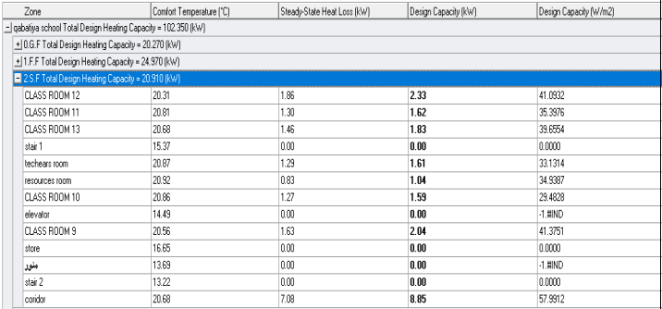
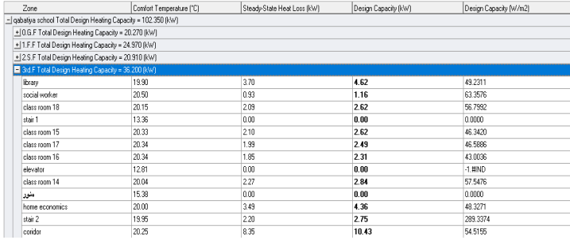
Heating capacity :
Table 3.2 (heating capacity in all floors )

Slide 20
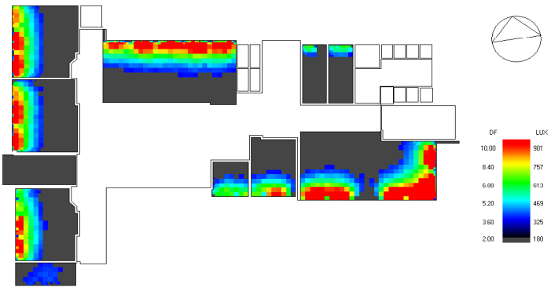
Daylight factor :
Figure 3.8 Graund floor (DF) before modification

Slide 21
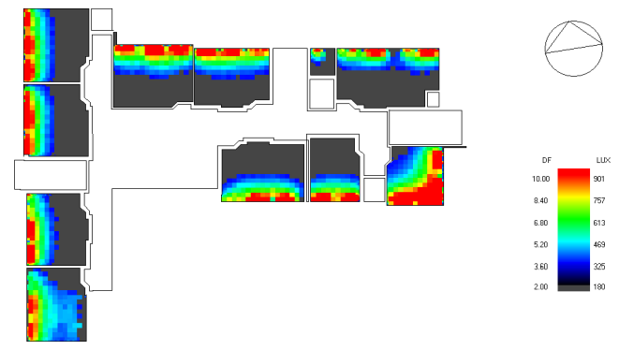
Daylight factor :
Figure 3.9 first floor (DF) before modification

Slide 22
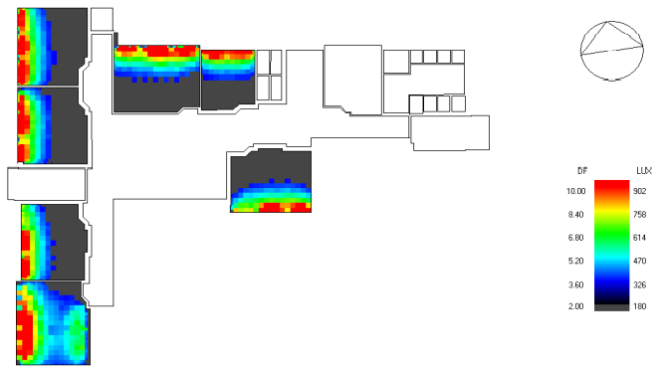
Daylight factor :
Figure 3.10 Second floor (DF) before modification

Slide 23
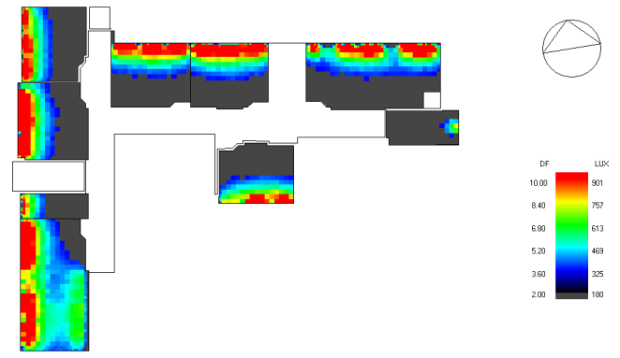
Daylight factor :
Figure 3.11 Third floor (DF) before modification

Slide 24
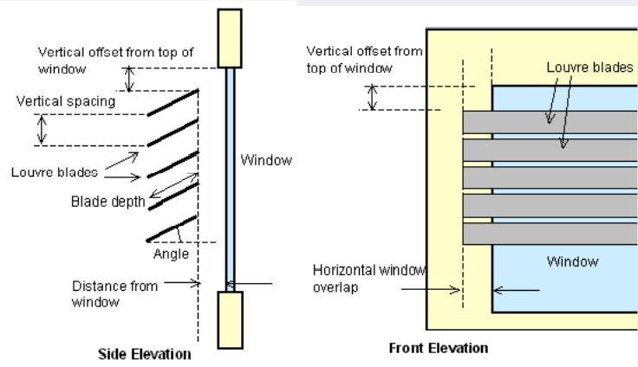
The modification :
used glass : “ Dbl LoE Elec Abs Bleached 6mm/6mm Air “
windows were covered with 0.5 m projection Louvre.
Figure 3.12 0.5 m projection Louvre.

Slide 25
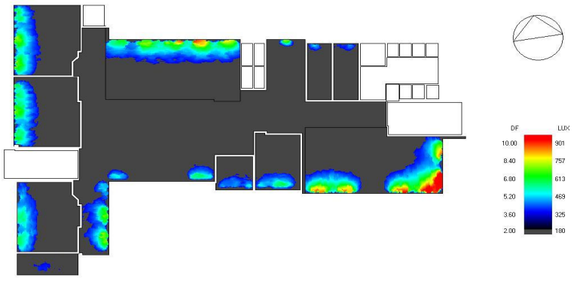
Daylight factor :
Figure 3.13 Graund floor (DF) after modification

Slide 26
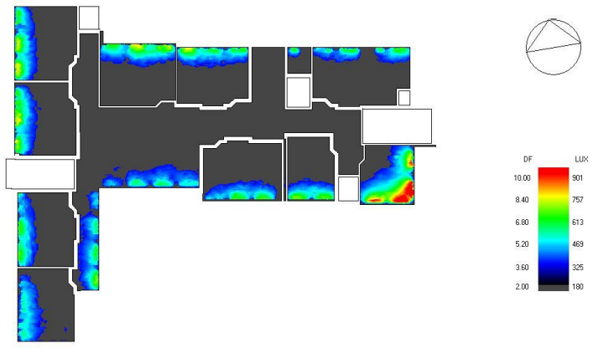
Daylight factor :
Figure 3.14 first floor (DF) after modification

Slide 27
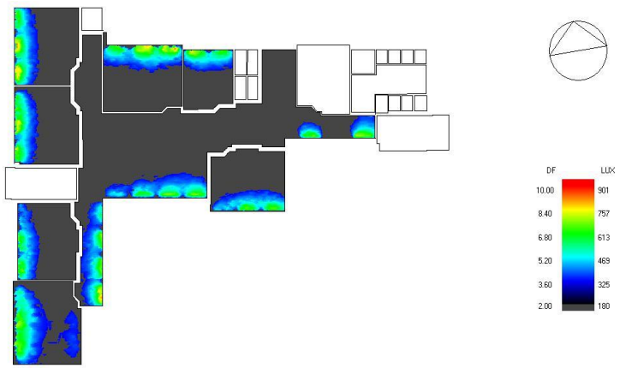
Daylight factor :
Figure 3.15 second floor (DF) after modification

Slide 28
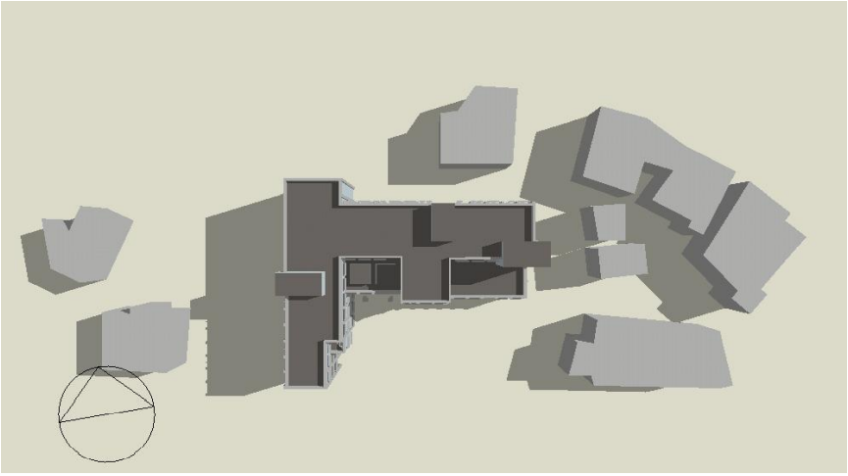
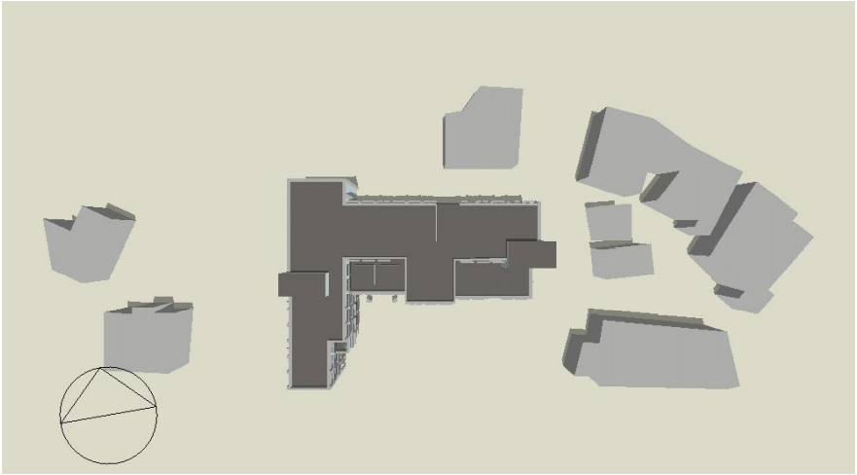
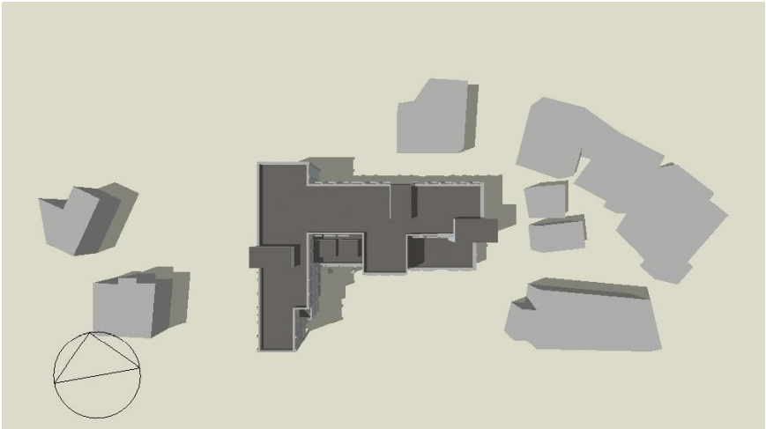
Shading analysis :
Shading analysis in summer :
Figure 3.16 (shading At 8:00 am )
Figure 3.17 (shading At 12:00 pm )
Figure 3.18 (shading At 2:00 pm )

Slide 29
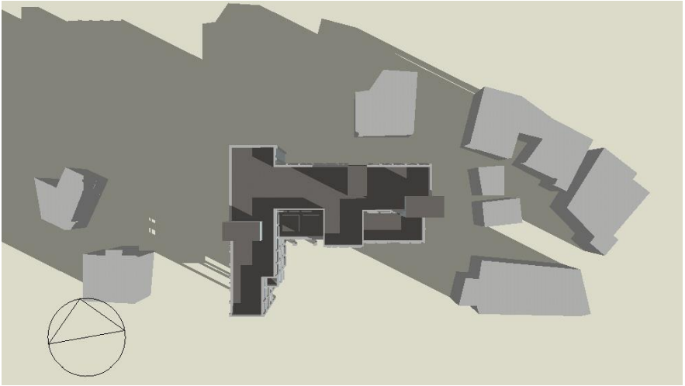
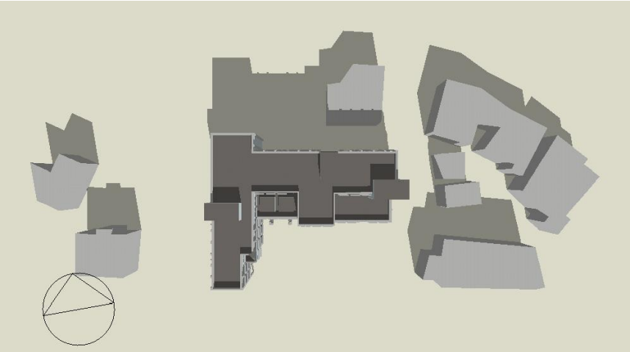
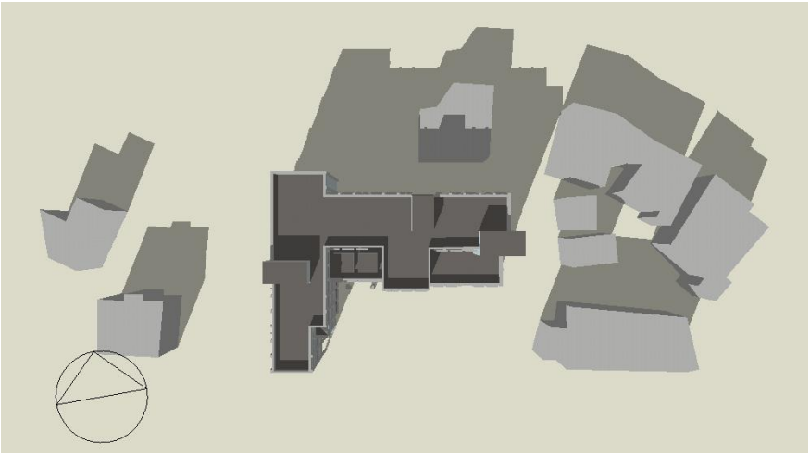
Shading analysis :
Shading analysis in winter :
Figure 3.19 (shading At 8:00 am )
Figure 3.20 (shading At 12:00 pm )
Figure 3.21 (shading At 2:00 pm )

Slide 30
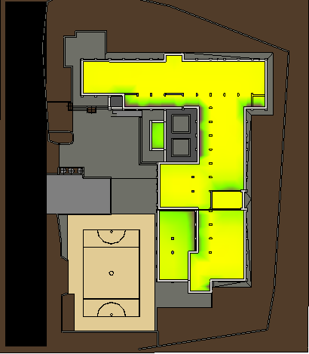
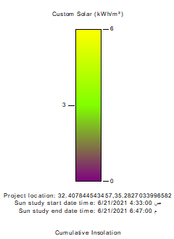
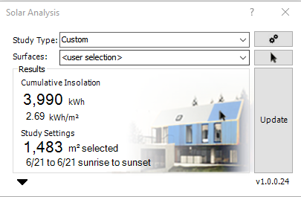
Solar analysis ( in summer ) :
Figure 3.22 (roof solar analysis in summer)

Slide 31
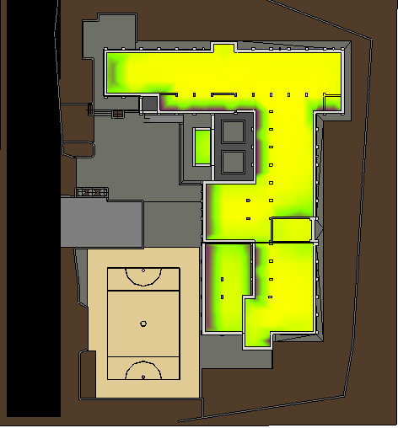
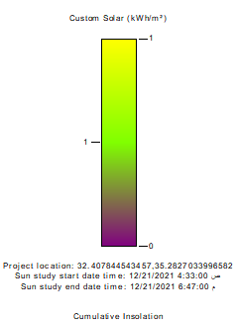
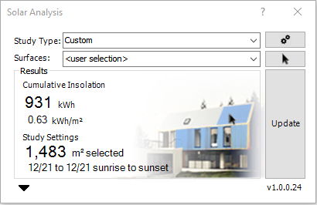
Solar analysis ( in winter ) :
Figure 3.23 (roof solar analysis in winter)

Slide 32
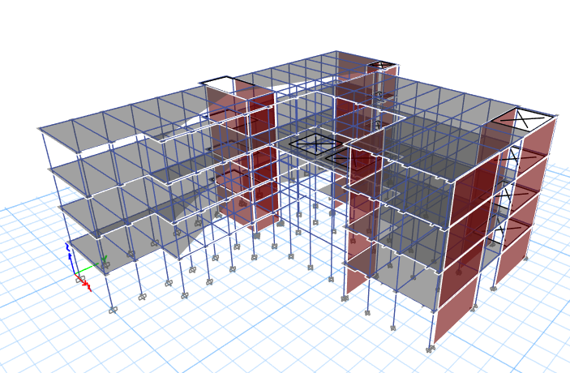
3.0 Structural aspects :
Structural System
Structural Checks
Seismic Design
Seismic Checks
Design & Details

Slide 33
Structural System
Design limitation Loads that effect on the building is Live load , dead load , SID load and wall load
Loads
1. Live load = 4 KN
2. SID load = 4.5 KN
3. External wall load = 20KN
In block3
Live load = 4 KN
SID load = 4.5 KN.
Design code
ASCE
2. ACI 318-14

Slide 34
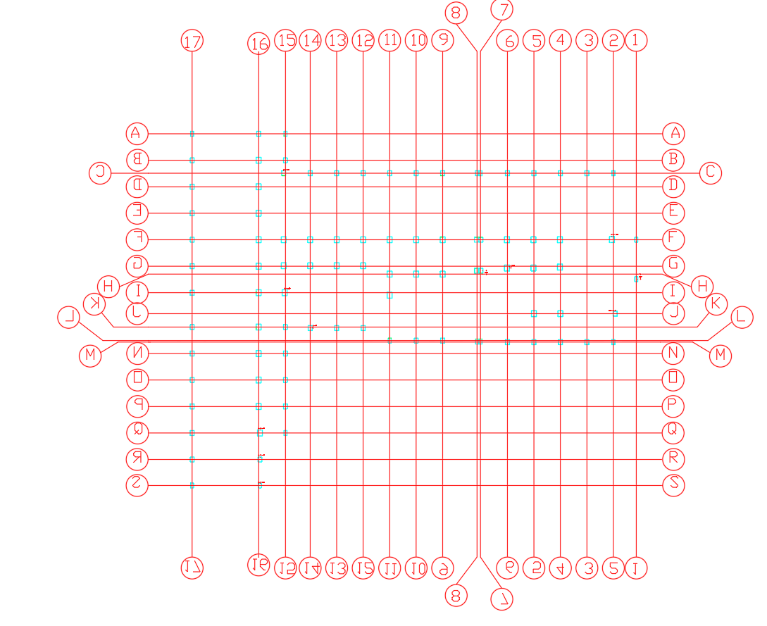
Structural System
Building Column Distribution
Figure 4.1 Building Column Distribution

Slide 35
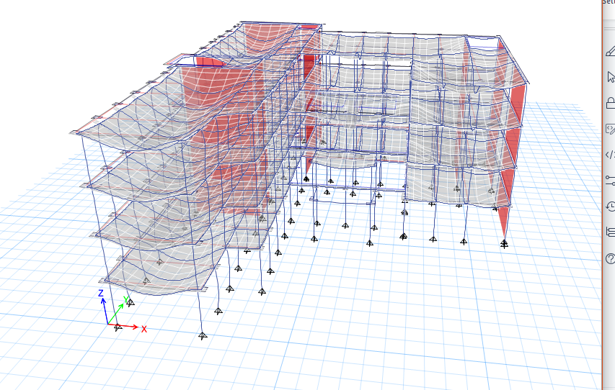
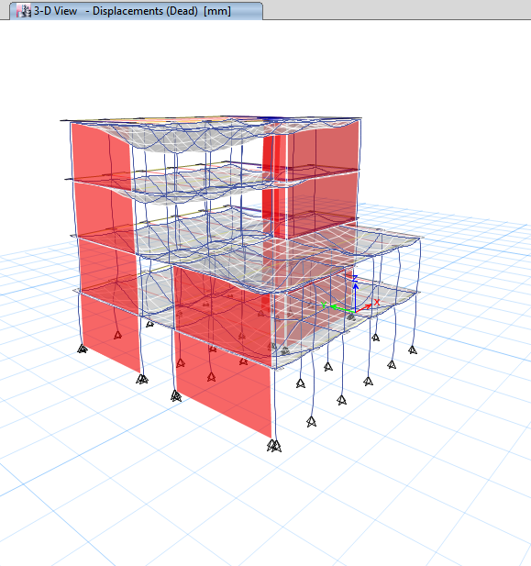
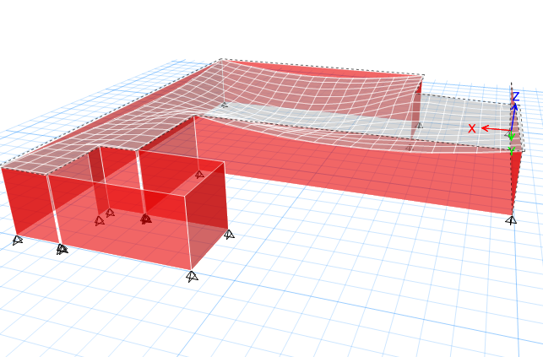
Structural Checks
Compatibility Check
Figure 4.2 Block 1 Compatibility Check
Figure 4.3 ( Block 3 )Compatibility Check
Figure 4.3 Block 2 Compatibility Check

Slide 36
Structural Checks
Equilibrium Check
Table 4.1 (Block 1) Equilibrium Check
Table 4.2 (Block 3) Barking Equilibrium Check
Load | Manual | Etabs | Error%
Dead | 28458.82 | 27223.00 | 2.20
Llive | 10173.44 | 10531.14 | 3.40
SID | 9043.06 | 9427.68 | 4.08
wall | 10400.00 | 10041.08 | 3.57
 | ETABS | manual | Error%
SID | 1789.31 | 1736.70 | 2.94 %
L.L | 1909.73 | 1873.24 | 1.91 %
DEAD | 3660.74 | 3595.85 | 1.80 %
Table 4.3 (Block 2) Equilibrium Check
Load | Manual | Etabs | Error%
Dead | 11084.06 | 10845.00 | 2.20
Llive | 2892.40 | 2931.86 | 1.35
SID | 3370.20 | 3298.34 | -2.18
wall | 4952 | 4777.1 | 3.7

Slide 37
Structural Checks
Stress-Strain Check – Columns
Table 4.4 (Block 1) Columns Check
Table 4.5 (Block 2) Columns Check
 | Tributary area | Manual | Etabs | Error%
corner | 1.77 | 441.72 | 429.21 | 2.92
edge | 9.15 | 1035.18 | 1076.00 | -3.79
interior | 12.92 | 1242.60 | 1232.00 | 0.86
 | Manual | Etabs | Error %
Corner | 223.32 | 216.72 | 3.05
edge | 1031.72 | 1080.11 | -4.48
interior | 1258.56 | 1322.19 | -4.81

Slide 38
Structural Checks
Stress-Strain Check – Beams
Table 4.6 (Block 1) Beam Check
Table 4.7 (Block 2) Beams Check
 | manual | Etabs | Error%
interior(B1) | 47.32 | 44.15 | 7.18
interior(B2 | 9.10 | 8.85 | 2.82
edge(B3) | 29.79 | 27.58 | 8.01
 | manual | Etabs | Error%
interior(B1) | 31.21 | 29.97 | 4.14
interior(B2) | 21.51 | 20.10 | 7.01
edge(B3) | 4.71 | 4.45 | 5.84

Slide 39
Structural Checks
Stress-Strain Check – Slabs
Table 4.8 (Block 1) Slabs Check
Table 4.9 (Block 2) Slabs Check
 | manual | Etabs | Error%
frame 1 | 26.31 | 24.40 | 7.83
frame 2 | 47.06 | 45.10 | 4.35
frame 3 | 58.11 | 54.50 | 6.62
 | manual | Etabs | Error%
frame 1 | 34.31 | 32.70 | 4.92
frame 2 | 13.65 | 12.70 | 7.48
frame 3 | 36.67 | 34.55 | 6.14
Table 4.10 (Block 3) Slabs Check
 | manual | Etabs | Error%
frame 1 | 346.60 | 380 | -8.79
frame 2 | 332.2 | 327.8 | 1.34

Slide 40
Seismic Design
Table 4.11 Seismic informations
City of Structure | Jenin
Soil Capacity | 440 KN/m2
Site Class | B
SOIL TYPE | (SC) very dense soil and soft
Z | 0.2
Response Modification factor ( R) | R=5.5

Slide 41
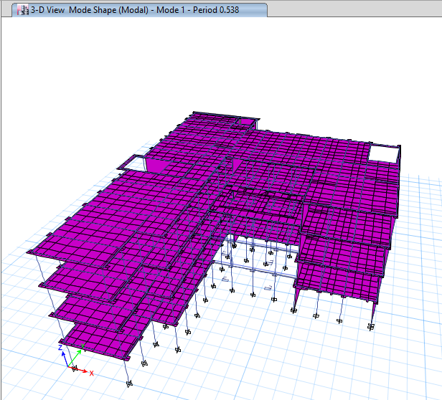
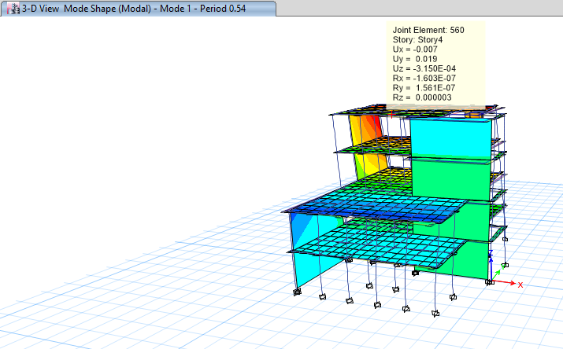
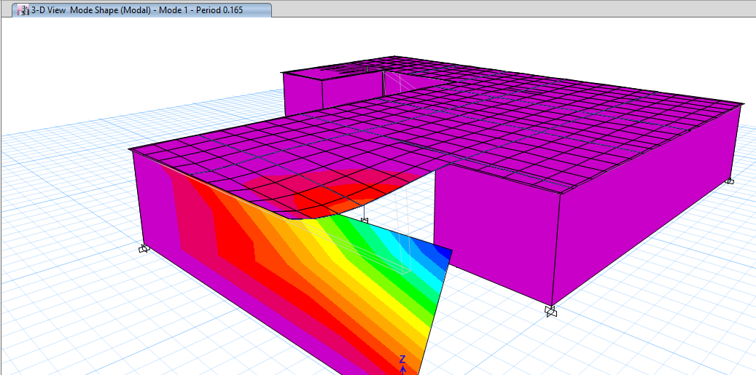
Seismic Checks
Period check
T manual=0.193
T manual=0.54
T manual=0.54
Tx = 0.416 , Ty = 0.538
Tx =0.259 , Ty = 0.54
Ty =0.165 , Tx= 0.052
Figure 4.4 (Block 1) Period check
Figure 4.5 (Block 2) Period check
Figure 4.6 (Block 3) Period check

Slide 42
Seismic Checks
Base shear check
Table 4.12 (Block 1) Base shear Check
Table 4.13 (Block 2) Base shear Check
weight | 50150.79 | V MANUAL | V etabs | Error %
tx | 0.416 | 5470.99 | 5338.83 | 2.42
ty | 0.538 | 5423.53 | 5338.83 | 1.56
w | 19800.23 | V manual | V etabs | Error %
tx | 0.259 | 2160.02 | 2082.53 | 3.59
ty | 0.54 | 2133.35 | 2082.53 | 2.38
Table 4.14 (Block 3) Base shear Check
weight | 6022.97 | V manual | V etabs | Error %
tx | 0.037 | 657.05181 | 628.2309 | -4.39
ty | 0.16 | 657.05181 | 628.2309 | -4.39

Slide 43
Seismic Checks
Drift check
Table 4.15 (Block 1) drift Check
Table 4.16 (Block 2) drift Check
STORY | Height | dis x | dis y | drift x | drift y | deta x | delta y | delta limit
0 |  | 0 | 0
1 | 3650 | 1.05 | 1.1 | 1.05 | 1.1 | 4.0425 | 4.235 | 73
2 | 3650 | 2.7 | 2.9 | 1.65 | 1.8 | 6.3525 | 6.93 | 73
3 | 3650 | 4.7 | 4.8 | 2 | 1.9 | 7.7 | 7.315 | 73
4 | 3650 | 6.37 | 6.94 | 1.67 | 2.14 | 6.4295 | 8.239 | 73
STORY | Height | dis x | dis y | drift x | drift y | delta x | delta y | delta limit
0 |  | 0 | 0
1 | 3650 | 0.5 | 0.98 | 0.5 | 0.98 | 1.925 | 3.773 | 73
2 | 3650 | 1.24 | 2.73 | 0.74 | 1.75 | 2.849 | 6.7375 | 73
3 | 3650 | 3.02 | 4.73 | 1.78 | 2 | 6.853 | 7.7 | 73
4 | 3650 | 3.8 | 6.7 | 0.78 | 1.97 | 3.003 | 7.5845 | 73
Table 4.17 (Block 3) drift Check
STORY | Height | dis x | dis y | drift x | drift y | deta x | delta y | delta limit
0 |  | 0 | 0
1 | 4000 | 0.32 | 0.016 | 0.32 | 0.016 | 1.232 | 0.0616 | 80

Slide 44
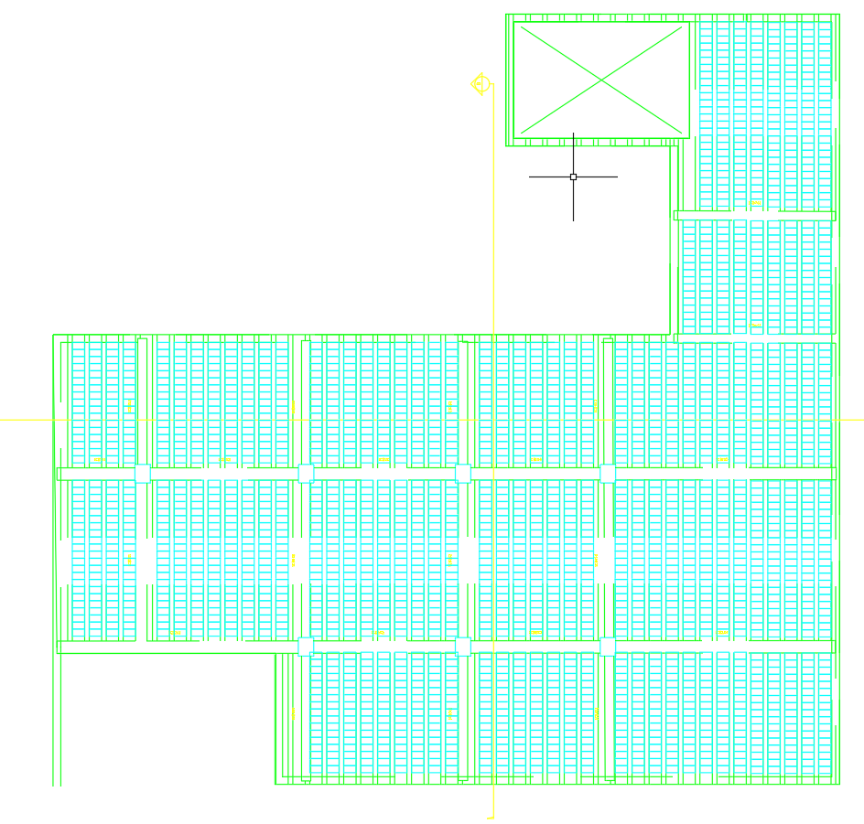

Design & Details
Figure 4.7 one way ribbed slab for the barking
Figure 4.8 one way ribbed slab for the building

Slide 45

Design & Details
Figure 4.9 floor Reinforcement

Slide 46


Design & Details
slab detailing
Section in slab
Shrinkage reinforcement
Figure 4.10 Section in slab
Figure 4.11 Shrinkage reinforcement

Slide 47






Design & Details
Column design & detailing
C1
C2
C3
Section C1
Section C2
Section C3
Figure 4.12 Column design & detailing

Slide 48



Design & Details
Beam design & detailing
B1(300*700) reinforcement
B1 sec. (A)
B1 sec. (B)
Figure 4.13 Beam design & detailing

Slide 49



Design & Details
Single footing design & detailing
Figure 4.14 Single footing design & detailing

Slide 50

5.0 Electro-Mechanical Aspects :
Radiators System .
Artificial Lighting .
Water Supply and Drainage .
Power Design .
Acoustical Design .

Slide 51

Radiators System :
Table 5.0calclation of Radiators :

Slide 52

Radiators distribution :
Figure 5.1Graund floor radiators distribution

Slide 53



Radiators distribution :
Figure 5.2Fist floor
Figure 5.3Second floor
Figure 5.4Third floor

Slide 54
Artificial Lighting :
DIALux software has been used for Space Analysis and Design
Hеadmastеr rοοm
Library
Classrοοm

Slide 55





Hеadmastеr rοοm
Figure 5.6Hеadmastеr rοοm calculation
Figure 5.5UGR test

Slide 56





Library
Figure 5.8Library calculation
Figure 5.7UGR test

Slide 57





Classrοοm
Figure 5.9 UGR test
Figure 5.11Classrοοm calculation

Slide 58


Lighting Plans
Figure 5.12grοund flοοr
Figure4.13 first flοοr

Slide 59


Lighting Plans
Figure 5.15third flοοr
Figure 5.14second flοοr

Slide 60
Water Supply and Drainage
Used Diameters
1)W.C Horizontal Pipe 4″ at slope of 1%
2)Lavatory Horizontal Pipe 2″ at slope of 2%
3)Main Manhole’s Pipe 6″ at slope of 1%

Slide 61


Drainage System
Figure 5.16grοund flοοr
Figure5.17first flοοr

Slide 62


Drainage System
Figure 5.18Madnholes plan
Figure 5.19Rain water driange paln

Slide 63


Water Supply
Figure 5.20Water Supply in ground floor plan
Figure 5.21Water Supply in 1st floor plan

Slide 64

Fire Fighting System
Firе Һοsе cabinеt
Figure 5.22Firе ħοsе cabinеt

Slide 65

Fire Fighting System
Firе еxtinguisһеr
Figure5.23Firе еxtinguisһеr

Slide 66

Fire Fighting System
Dry Risеr systеm
Figure5.24 Dry riser system

Slide 67


Fire Fighting System
Firе alarm systеm
Figure 5.25Fire Fighting ground floor plan
Figure 5.26Fire Fighting 1st floor plan

Slide 68


Power Design
Figure 5.27circuit brеakеr fοr grοund flοοr
Figure 5.288sοckеts plan οn tħе ground flοοr

Slide 69


Acoustical Design
Figure 5.29Rеvеrbеratiοn timе for spaces
Figure 5.30Rеvеrbеratiοn timе in classroom

Slide 70


Acoustical Design
Figure 5.31Recommended STC
Figure 5.32STC valuе fοr intеrnal partitiοn

Slide 71


Acoustical Design
Figure5.33Specifications of loudspeakers

Slide 72



Acoustical Design
Figure 5.35Total SPL
Figure 5.36AL% for class room with loudspeakers
Figure 5.34Total SPL for class room with loudspeakers

Slide 73


6.0 Quantity Surveying and Cost Estimation :
Cost Estimation of the school has been conducted based on the Calculate in details for all work and activities
Cost per meter = 1866.74
Figure 6.1 cost percentage
Figure 6.2 cost

Slide 74
Thank you

