Slide 1

TUNNEL IN NABLUS CITY

Slide 2

CONTENTS
The problem
The site
Scope of the project
Site investigation
Background
Tunnel Characteristics
Tunnel Profile
Implementation mechanism
Conclusion

Slide 3
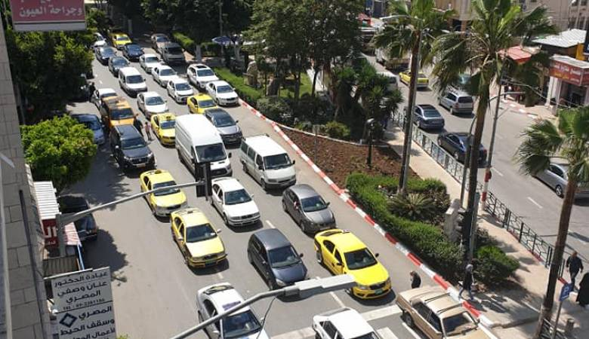
The problem
The city of Nablus has witnessed a great cultural and economic progress recently , and this progress has resulted in an increase in the number of vehicles used for roads , and thus the traffic congestion problem in Nablus has become an obsession for most road users .

Slide 4
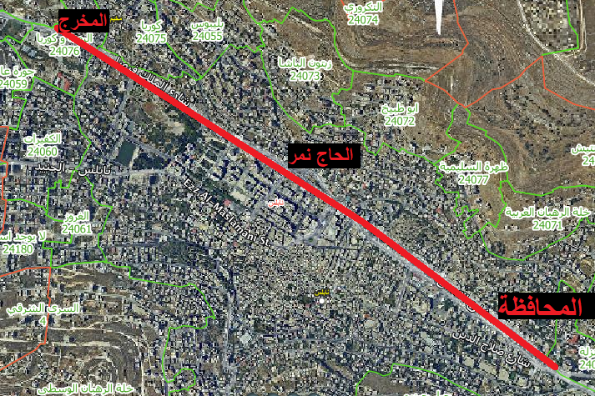
The Site
The 3-km tunnel runs from the Nablus governorate junction in the eastern region , to the Ma’ajin junction in the western area of the city.
Entrance
Governorate area
Point on Tunnel axis
Hajj Nemer Mosque
Point on tunnel axis
Intersection of Haifa St. and Mojeer Al-Deen St.
Exit
Tamimi Gas station

Slide 5
Scope of The Project
2
4
1
3
5
Study and examination of soil along the tunnel path.
Determine the depth and axis of the tunnel.
study the construction of a tunnel along Nablus city.
.
Choose the most appropriate way to build the tunnel.
Structural tunnel design.

Slide 6
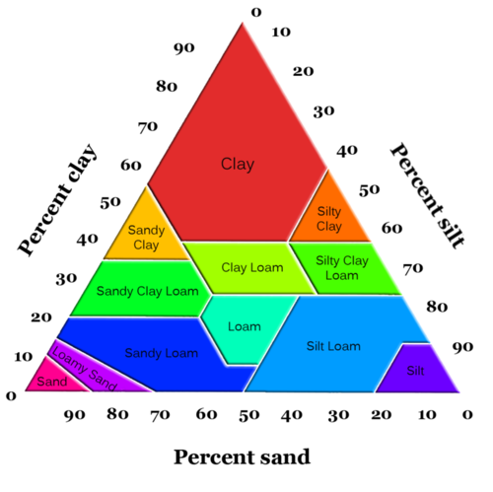
Site Investigation
The soil
was found to be gray to blackish silty clay, with little boulders .
Water Table
water table to be at 14 meters underground level at Nablus Eastern Complex, and to be 2-3 meters at Nablus Commercial Center.

Slide 7
BACKGROUND

Slide 8
Tunnel construction methods
Drill and blast
Boring machines
Cut and cover
Shield
Immersed

Slide 9
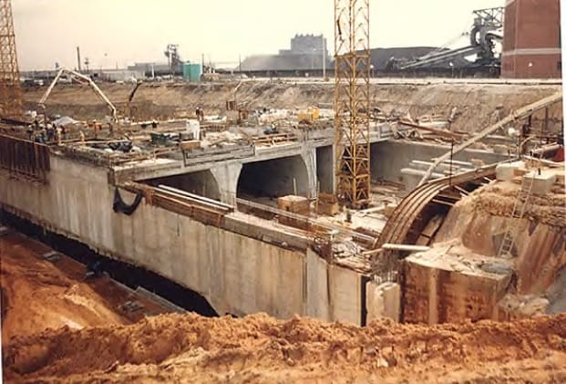
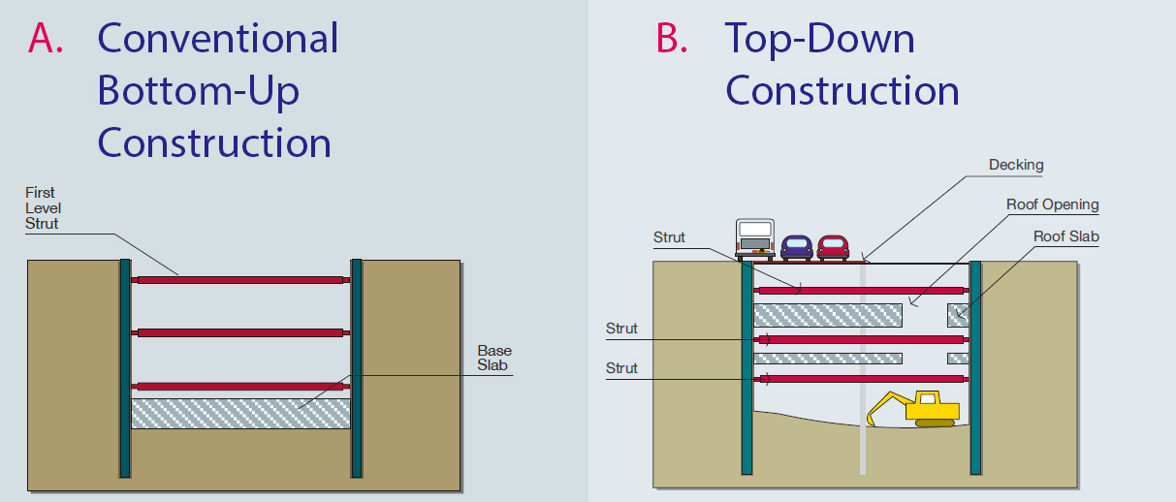
Cut and cover method

Slide 10
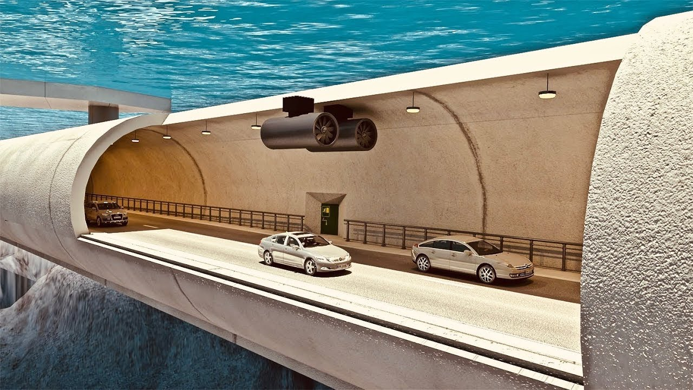
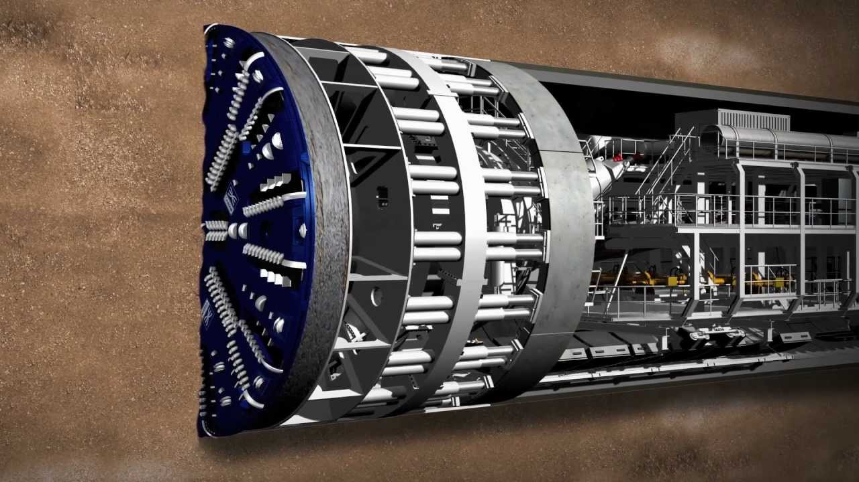
Immersed
TBM

Slide 11
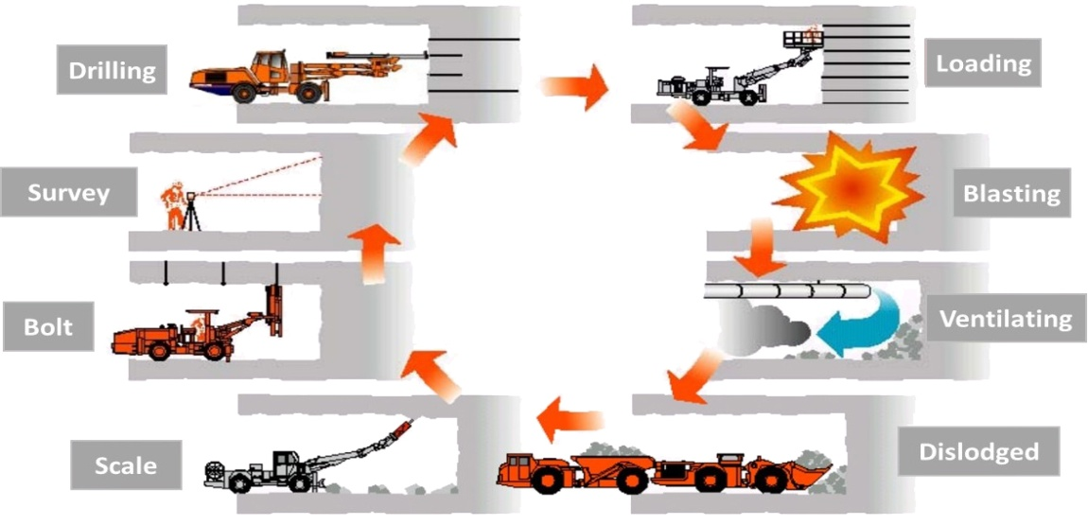
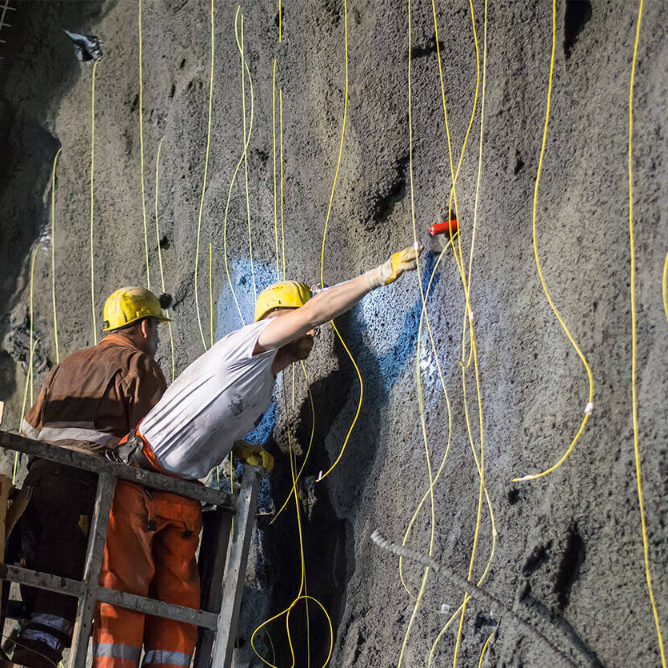
Drill and Blast method

Slide 12
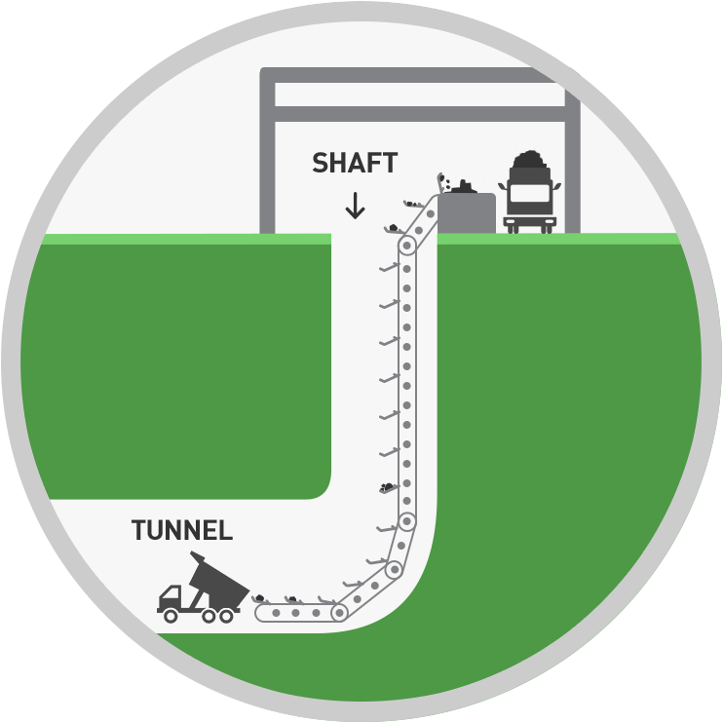
Shafts
Shaft in a tunnel is a temporary access which can be vertical or inclined and it go straight down until they reach the level at which the tunnel is going to be built.

Slide 13
Purposes of shafts
1
Used while the construction of a tunnel to move equipment.
2
For ventilation of a tunnel or underground structure.
3
For access to the tunnel or any underground structure, also as an escape route.

Slide 14
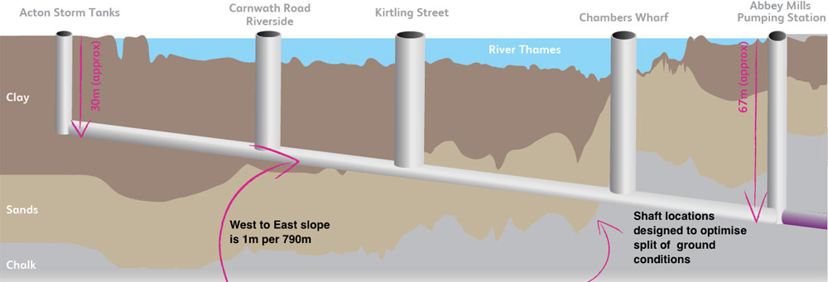
shaft

Slide 15
TUNNELS CHARACTERISTICS

Slide 16
Alignment and grading
Lighting
Design Speed for Tunnels
Drainage
Emergency exists
Ventilation systems

Slide 17
Design speed
For safety reasons, the maximum allowable speed in two-way tunnels throughout the world is between 60 and 80 km/h. In one-way tunnels, the speed limits are between 80 and 110 km/h.

Slide 18
Alignment and Grading
Grades in road tunnels should be limited to 3.5% in general, and for long two-lane tunnels with two-way traffic, a maximum grade of 3% is desirable to maintain reasonable truck speed.

Slide 19
Drainage
Drainage System characteristics
To help drain water, it may be desirable to make super elevation at a small longitudinal grade not less than 0.5%
Dispose of water to tanks via longitudinal grooves
The tank must have a pump to pump the collected water
the drainage system designed to be easily cleaned and maintained

Slide 20
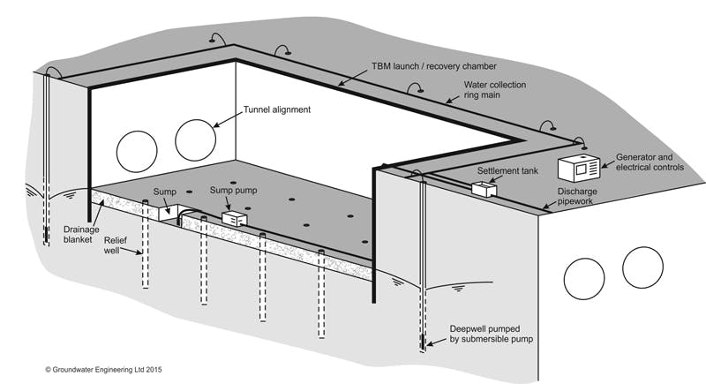
Drainage system

Slide 21
Emergency exit
Shelters
Safety corridors
Emergency staircase
Those Shelters must be directly connected to the ground surface via evacuation corridors in order to escape , and must contain fresh air , telephone , first aid .
They are constructed beside the traffic pipe or under the paved road where they lead to the ground surface.
It leads from emergency exit to the ground surface directly.

Slide 22
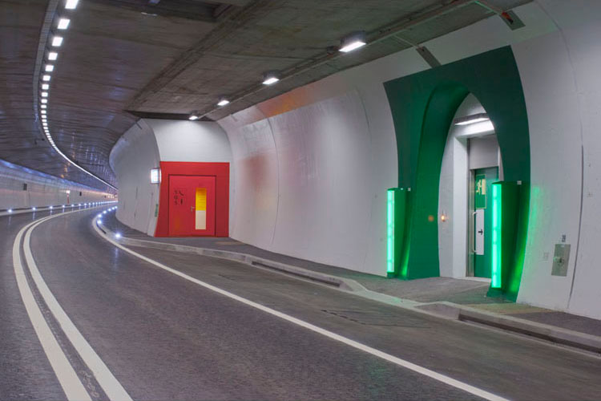
The doors of the emergency exits must be large, and with a distinct color, usually the green color, and there must be an emergency exit every (100-500) meters.

Slide 23
Ventilation Systems
Longitudinal Ventilation System
Natural Ventilation System
The system is placed at the beginning of the tunnel it moves the pollutant gases to the end of the tunnel.
Used when the tunnel length is short the natural ventilation is accrued.
Mechanical Ventilation System
It employs mechanical devices like electric fans, which removes the exhaust gasses within the tunnel.

Slide 24
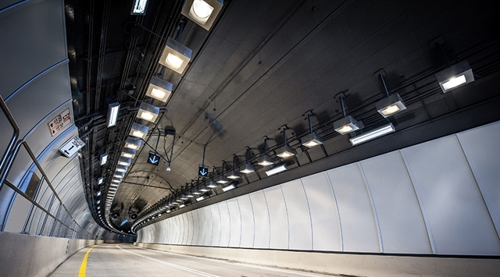
Tunnels Lighting
Natural lighting must be provided, day and night, so as not to affect the drivers vision.
Generators must be available in the event of a power outage.
The lighting at the emergency exits must be distinctive and strong.

Slide 25
TUNNEL PROFILE

Slide 26
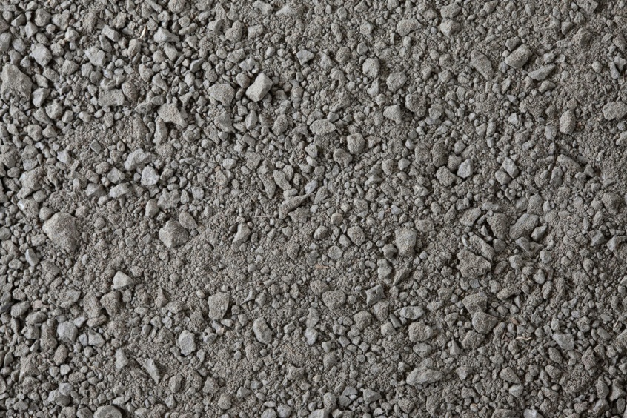
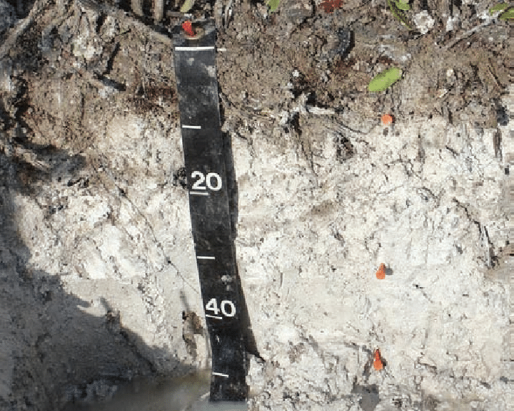
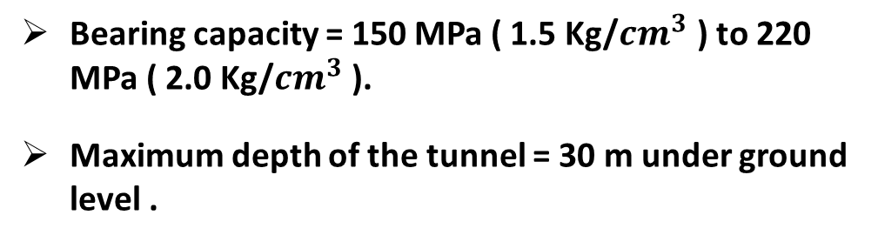
Soil Types among the tunnel axis
Dark brown, soft silty clay
Dark brown, soft silty clay
Soft and moist formation of creamy marl
Soft and moist formation of creamy marl
Bearing capacity = 150 MPa ( 1.5 Kg/${cm}^{3}$ ) to 220 MPa ( 2.0 Kg/${cm}^{3}$ ).
Maximum depth of the tunnel = 30 m under ground level .

Slide 27
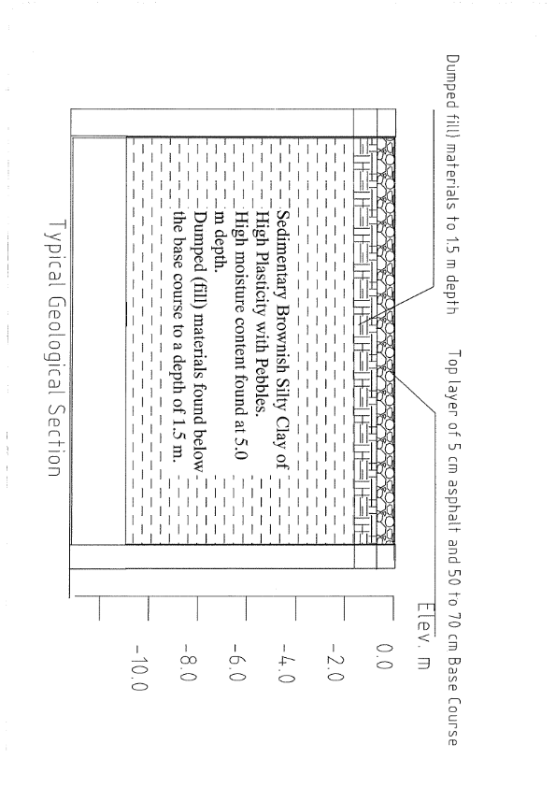
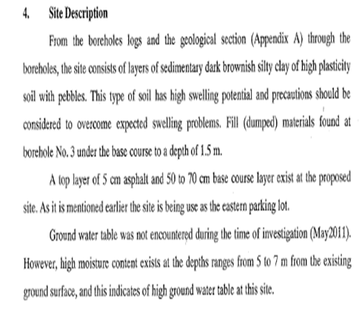

Slide 28
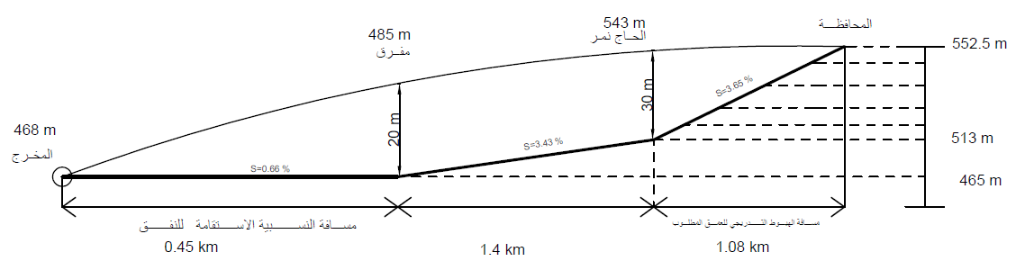
Maximum slope = 3. 5%
Maximum depth = 30 m

Slide 29
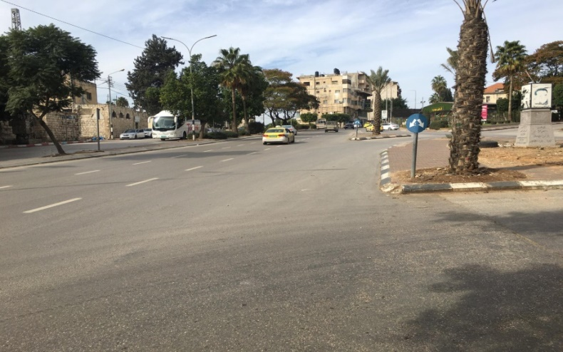
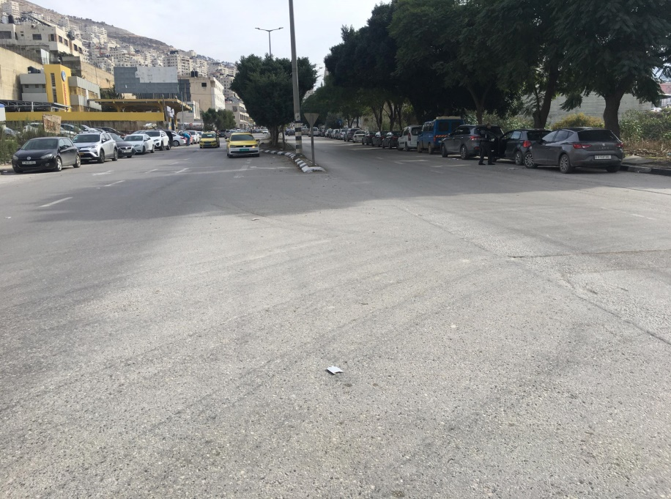
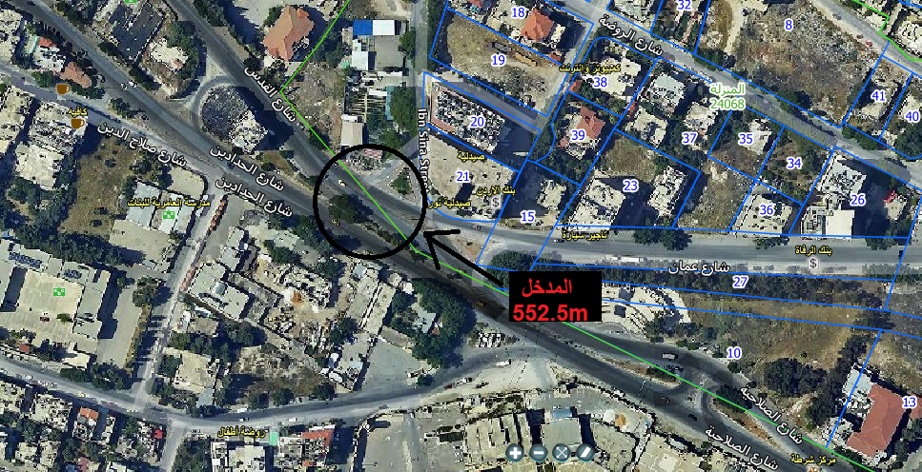
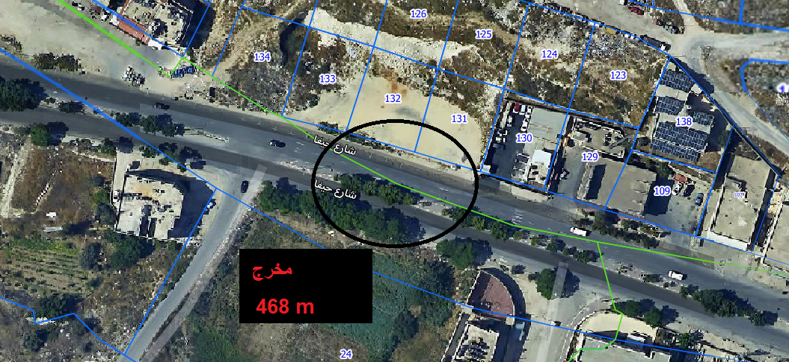
Entrance
Exit

Slide 30
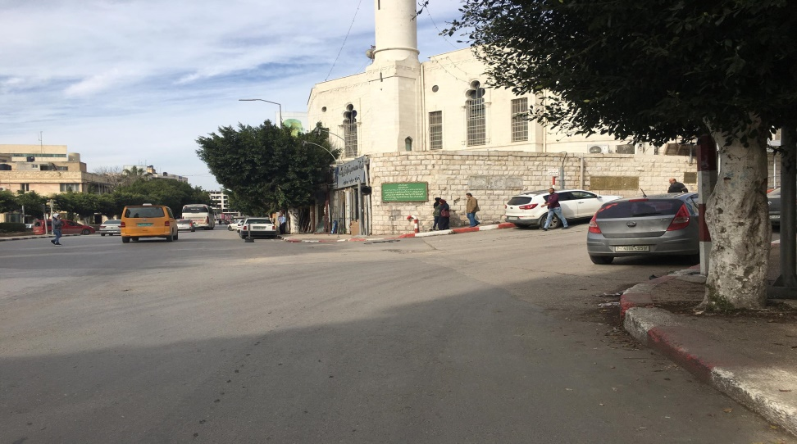
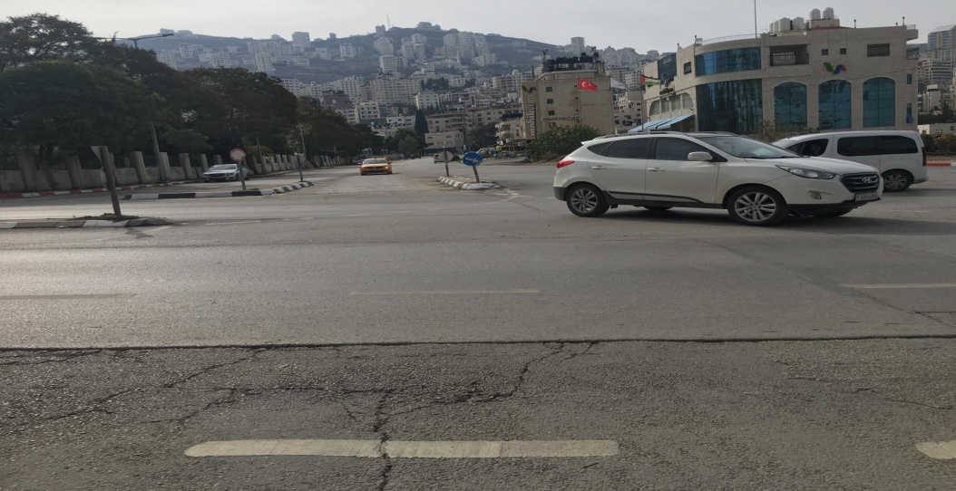
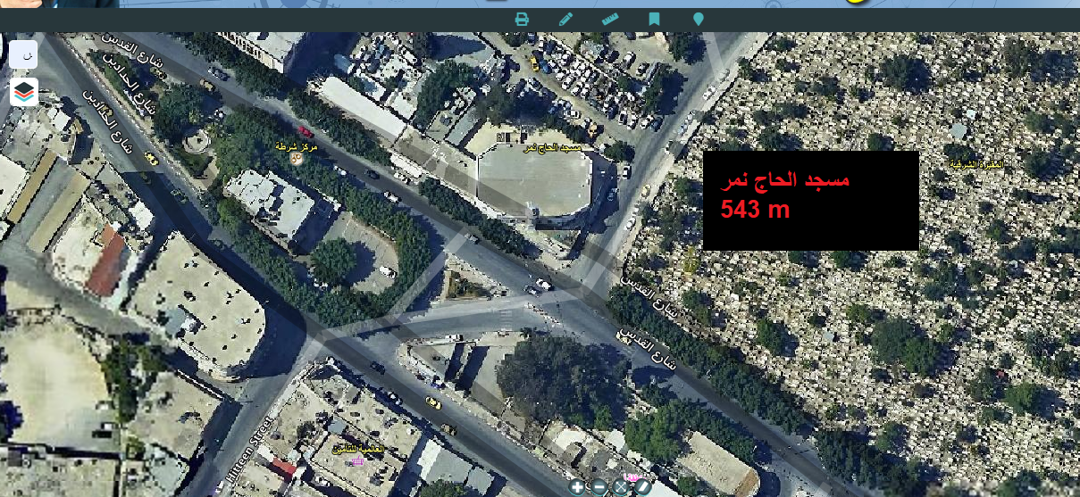
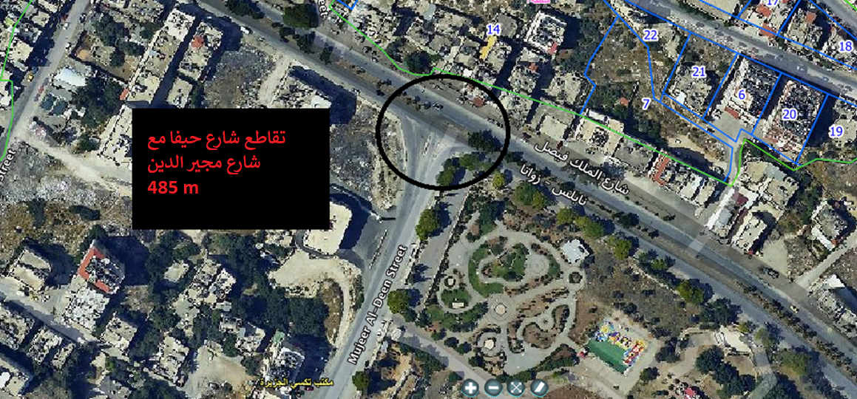
Al-Hajj Nemer Mosque
Intersection of Haifa St. and Mojeer
Al-Deen St.

Slide 31
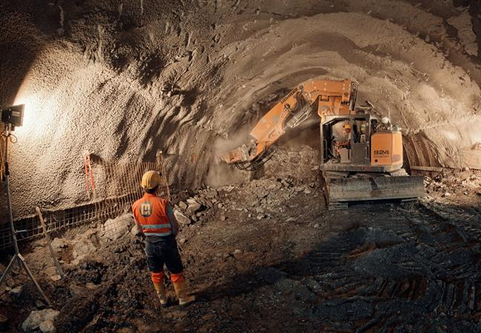
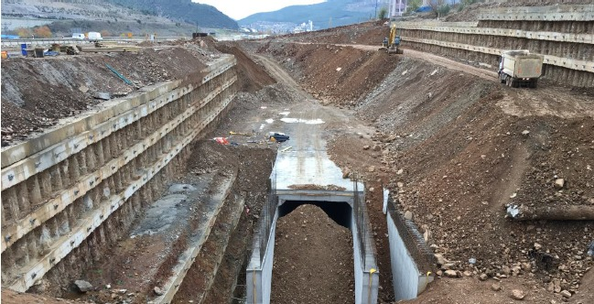
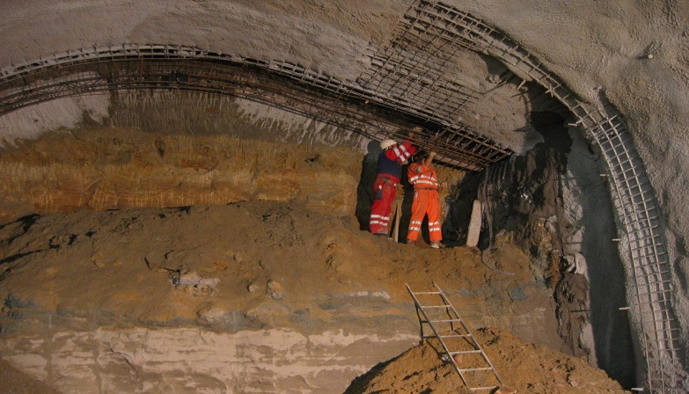
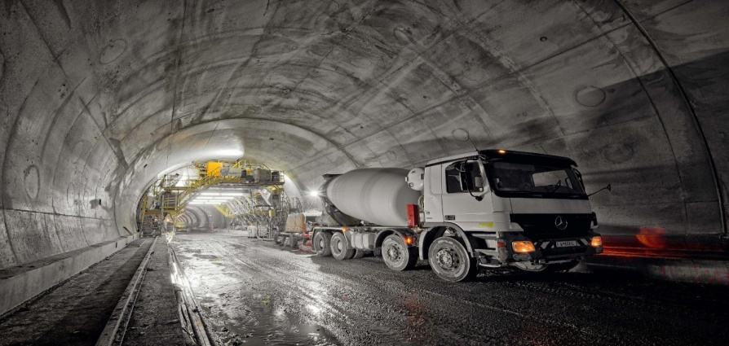
Implementation mechanism:
Excavating through the soft soil
Cut and cover for the entrance
Supporting work
After removing the soil

Slide 32
Conclusion
Next semester ..
Design a segment of the tunnel
Constructing the tunnel
Cross section modeling

Slide 33
THANK YOU
Prepared by :
Anas Tbaileh
Baha Al-Susa
Osama Abu Waar
Saif Tbaileh
Supervised by :
Dr. Mohammed Ghazzal

