Slide 1

Vector control of IM
Supervisor :Dr. Kamel Saleh
BY:
Eng. Waed Mohsen
Eng. Maha Bolus
Eng. Abeer Hasan

Slide 2
content:
Idea of the project.
Why do we prefer to use induction motor?
Methods to control induction motor.
What is Lab-Volt 9063 Software Development Kit (SDK)؟
5. Methodology of vector control of induction motor
5.1 Software design
5.2 results
6. Vector control of induction motor.
3.1 what is vector control?
3.2 types of vector control?
7. conclusion

Slide 3
1. Idea Of The Project
The idea of the project is to achieve a vector control of Induction Motor using the same hardware that is already used in lab to control IM using V/F control.
To achieve vector control of induction motor, it requires the followings
A- three currents sensors
B-speed measurements
D- inverter
C- software to implement the control

Slide 4
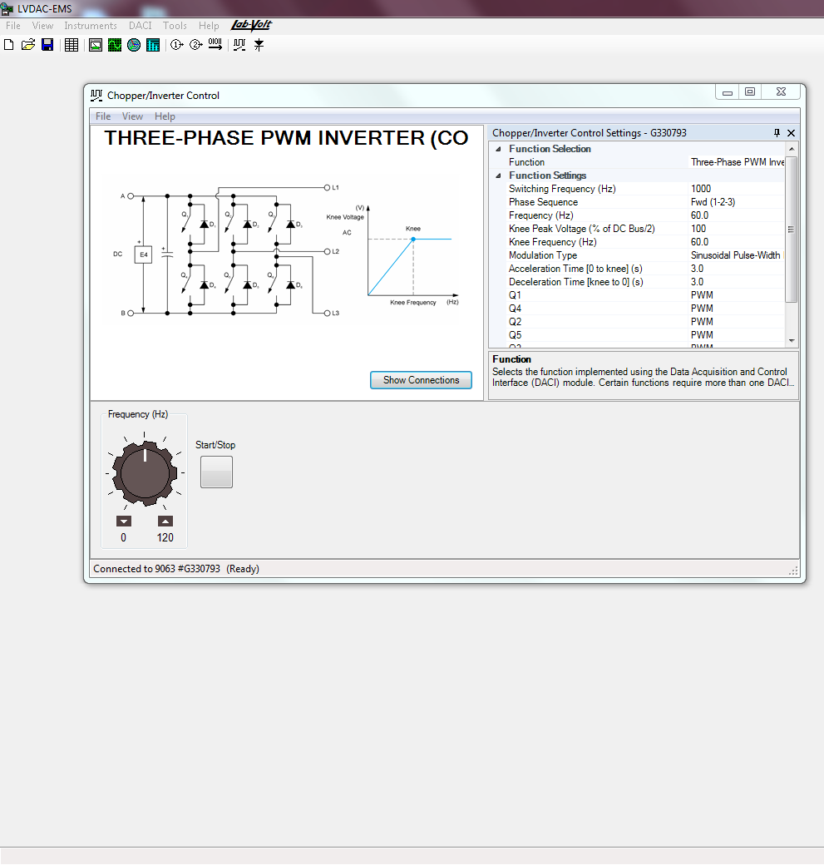
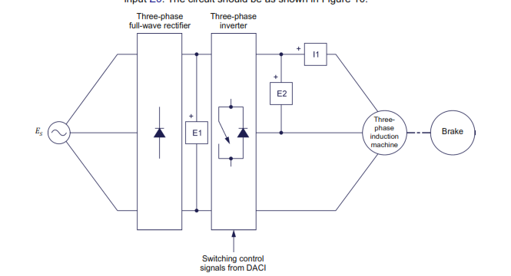
1. Idea Of The Project
The V/F experiment that exists in the lab including 3-phase invertor, Data Acquisition Unit, software associated with this experiment and run in PC to control the Data Acquisition Unit

Slide 5
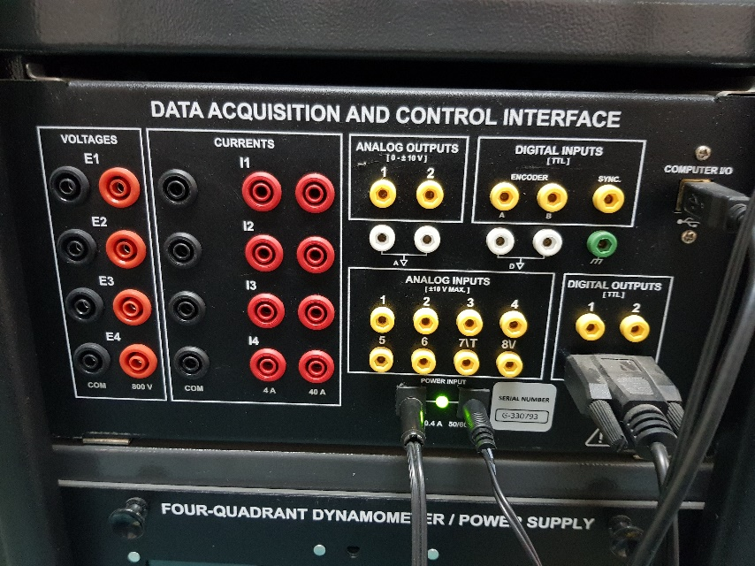
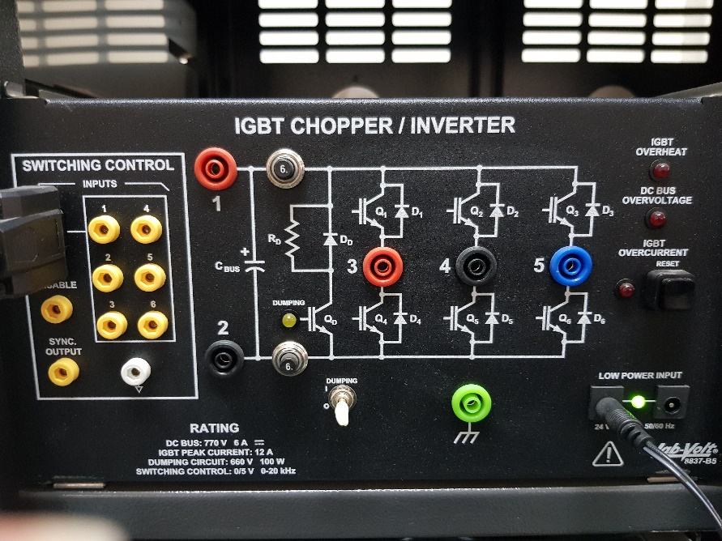
1. Idea Of The Project
In this project, it is wanted to control the Data Acquisition Unit by Matlab to do vector control using the preference that the Data Acquisition Unit have, which are:
4-voltage sensors
4-current sensors
Speed measurement
Torque measurement
Digital Outputs
In addition to 3-phase Invertor

Slide 6
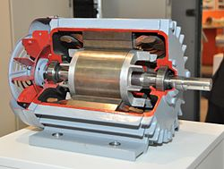
1.Why do we prefer to use induction motor?
  The 3-phase alternating current (AC) induction motors, which is the most widely used motor type in the industry has been favored because of its good self-starting capability, simple and rugged structure, low cost and reliability and capable of more torque and efficiency than single phase AC motors.

Slide 7
2.Methods to control induction motor:
VF Control (Scalar Vector)
Control of current/voltage/frequency magnitude based on steady-state equivalent circuit model
  ignores transient conditions
  for low performance drives
Vector Control
control of magnitude and phase of currents and voltages based on dynamic model
  Capable of observing steady state & transient motor behaviour
  for high performance drives

Slide 8
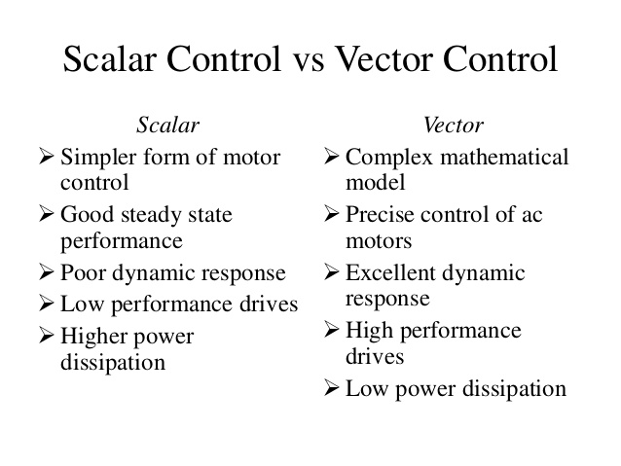

Slide 9
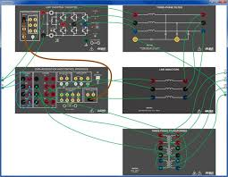
3. What is Lab-Volt 9063 Software Development Kit (SDK) ?
The 9063 SDK offers the possibility to control various inputs and outputs of the Data Acquisition and Control Interface, Model 9063. Using the functions in the SDK we can acquire data using voltage and current inputs. We can also acquire data using the Analog inputs and Encoder value. The SDK gives the access to control the Analog and Digital outputs of the Data Acquisition and Control Interface . The SDK contains DLL Files to communicate with the Data Acquisition and Control Interface

Slide 10
4. Methodology of vector control of induction motor
4.1 Software design
First step in our project was to communicate with the drive using Matlab. We wrote a code to read the voltage and current from the drive to check if the communication would occur, and it succeeded.
After we wrote a code to read the current and voltage, we tried to improve it in order to read the speed of the machine too.

Slide 11
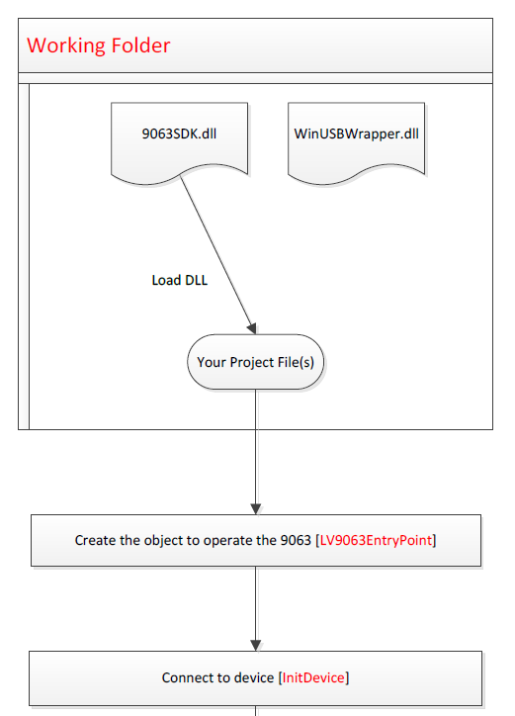
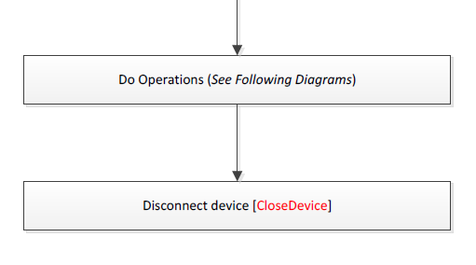
4.1 Software design
Operating the SDK:
First we had to initialize the SDK using the Matlab through USB. This is done by calling the dll files to communicate with DACI. After calling the dll files to code, the library of the SDK will be available, all we had to do was to load the library and start using functions. Then the device is initiated and the program will start reading and executing our operations.

Slide 12
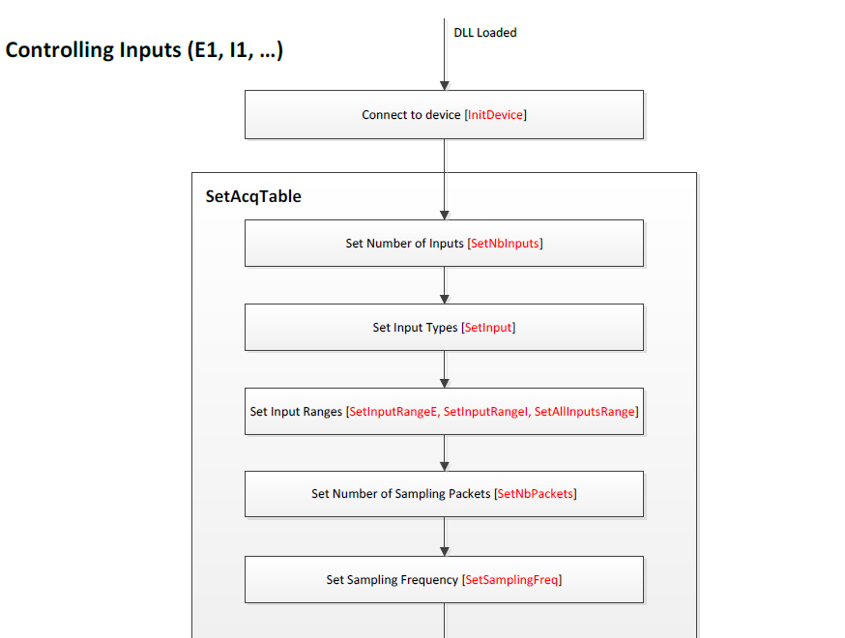
4.1 Software design
Controlling the inputs
Before executing the operations we had to set the desired properties of inputs. Such as, the input type (voltage or current), the input ranges, trigger settings and the sampling frequency.

Slide 13
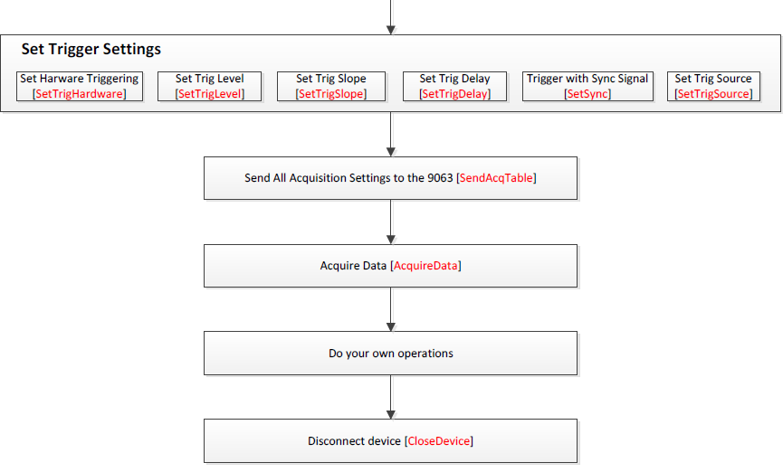
4.1 Software design

Slide 14
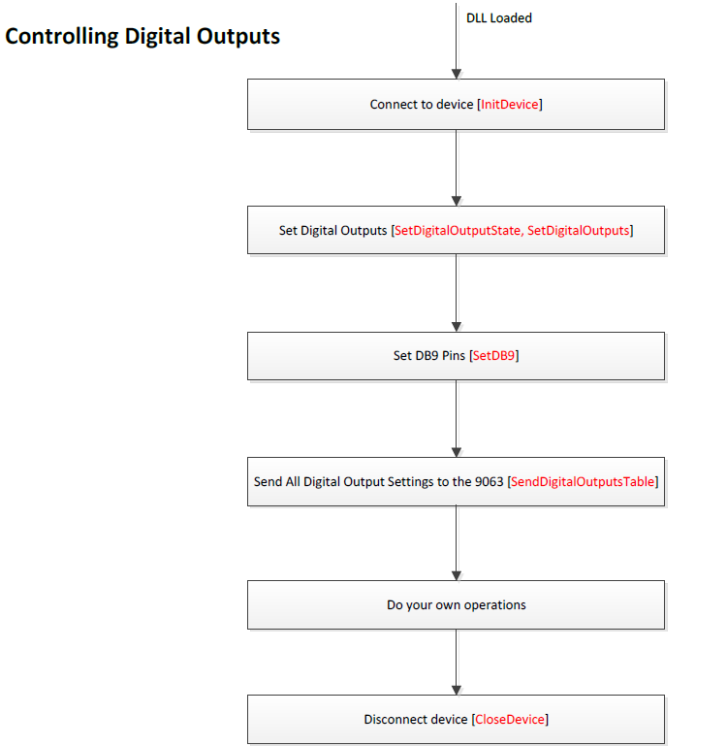
4.1 Software design
We can also get digital outputs, by setting the digital output states and after the control is done and the PWM is calculated, the digital signal is sent to the DACI Unit in order to control the invertor.

Slide 15
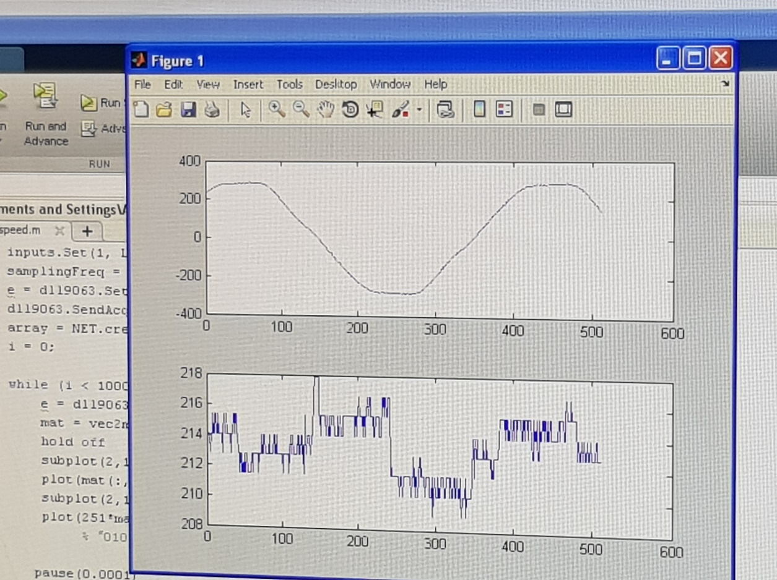
4 Methodology of vector control of induction motor
4.2 results :after we followed the previous steps we got the following results:
1. voltage and current:

Slide 16
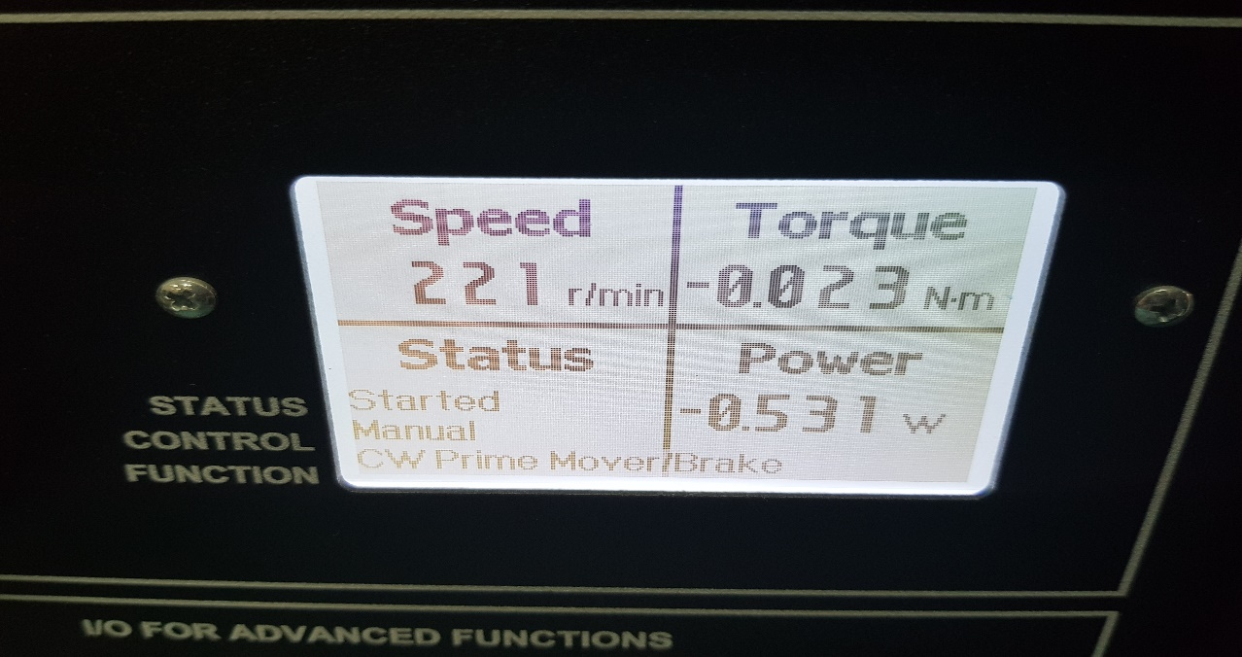
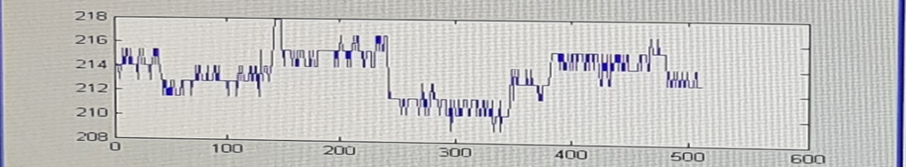
4 Methodology of vector control of induction motor
2. Speed
Using the original software
Using Matlab

Slide 17
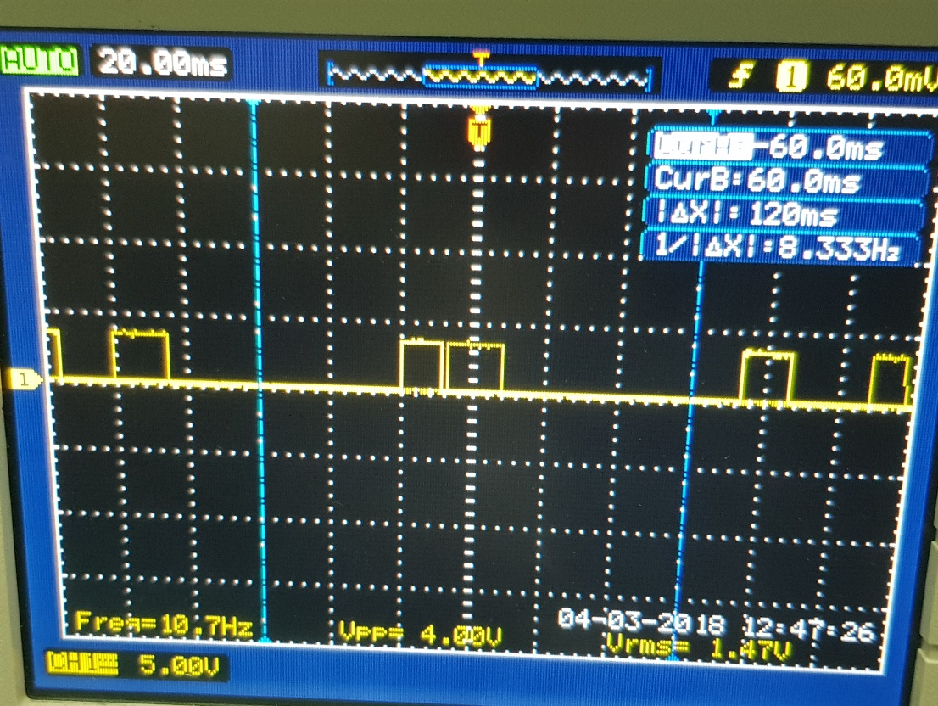
4 Methodology of vector control of induction motor
3. digital output

Slide 18
5.1 Vector control of IM
Vector control, also called field-oriented control (FOC), is a variable-frequency drive (VFD) control method in which the stator currents of a three-phase AC electric motor are identified as two orthogonal components that can be visualized with a vector (dq-frame) .

Slide 19
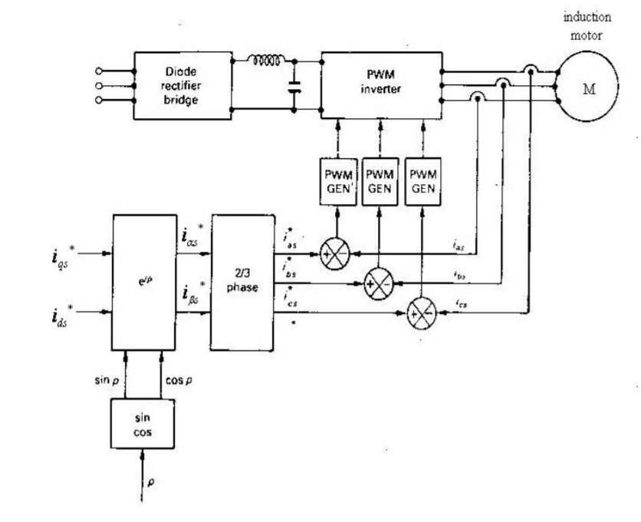
5.1 Vector control of IM
After we achieved this semester how to communicate with Matlab, we started to build Matlab simulation for vector control

Slide 20
5.2 types of vector control?
The vector control can be classified into:
(i) Direct vector control
In direct vector control method we have seen that it determines the magnitude and position of the rotor flux vector by direct flux measurement or by a computation based on terminal conditions

Slide 21
5.2 types of vector control?
(ii) Indirect vector control.
The indirect vector control method is essentially same as the direct vector control, except that the rotor angle θe is generated in an indirect manner (estimation) using the measured speed ωr and the slip speed ωsl .

Slide 22
Problems we will deal with next semester
Next semester, we will start simulating the vector control using Matlab. After we succeed with this step, we will apply the vector control simulation obtained with us to the IM in the device we have.

Slide 23
6. Conclusion:
Fast response of vector control make it better than other methods of speed control of induction motor, By using this method we attend maximum response in minimum time.

Slide 24
Thanks for listeninig

