Slide 1

Graduation Project
Analysis and design of a residential building (Monawer Building )
Supervised by : Dr. Samir Helou
Dr. Riyad Awad
Prepared by : Musab Budier
Riyad Arda
Mahdi Abu Hatab

Slide 2
Objective
Compiling of information which were studied in several years of studying and styling it in a study project.
Analysis and assessment of an existing building

Slide 3
Contents
Introduction
Analysis and design of slabs
Analysis and design of beams
Design of columns
Design of footings
Design of walls
Dynamic analysis of structure
Analysis and design of water tank

Slide 4
Project Description
Seven floors residential building consisted of :
Basement floor (377 m²)
Six typical floors each one has an area of (291.3m²)
Water tank has a volume of (192m³)

Slide 5
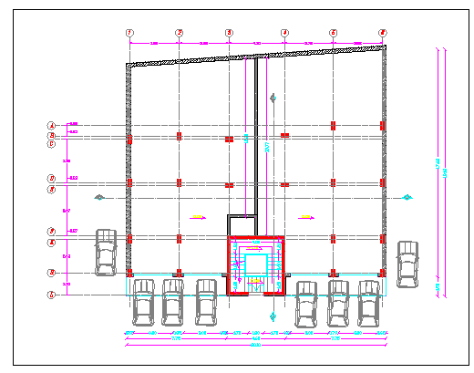
Basement Floor Plan

Slide 6
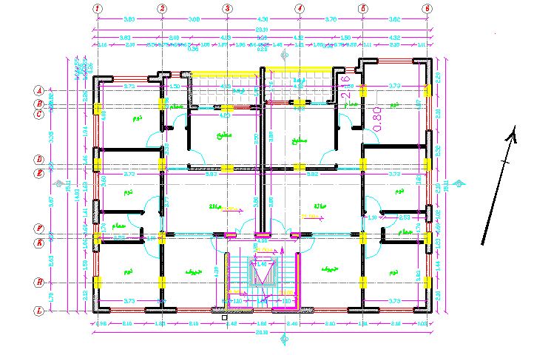
Typical Floors Plan

Slide 7
Design of Slabs
Design of slab of basement floor
Structural system : Two way solid slab
Slab thickness = 17 cm
Analysis method : 3D model by SAP program
.

Slide 8
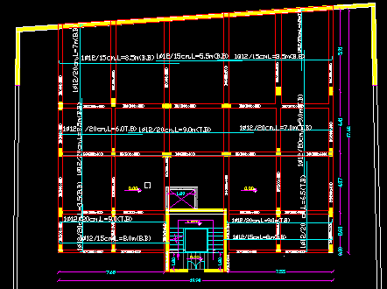
Basement Floor Details

Slide 9
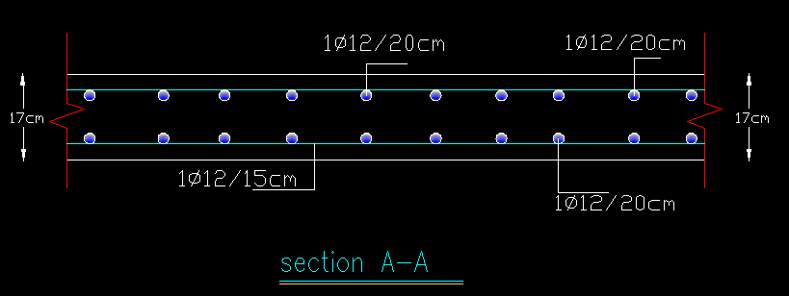
Cross section in slab

Slide 10
Design of Slabs
Design of ribbed slab
Structural system : One way ribbed slab
Slab thickness = 30 cm
Analysis method :1D and 3D model by SAP program
.

Slide 11
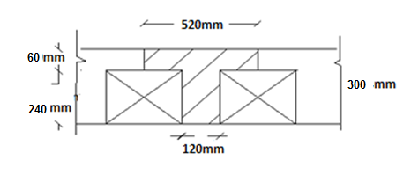
Typical cross section in ribbed slab

Slide 12
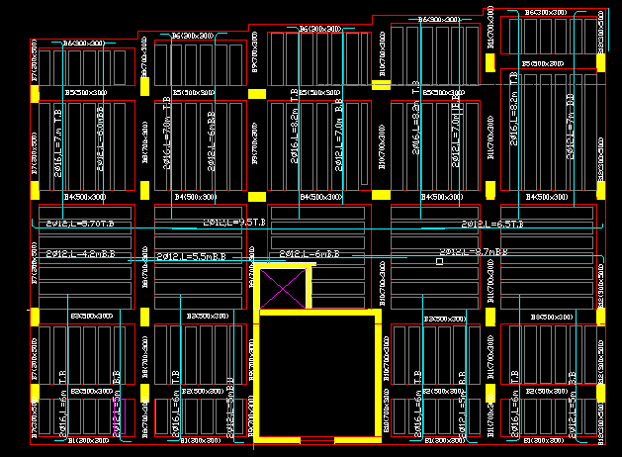
Slab Details

Slide 13
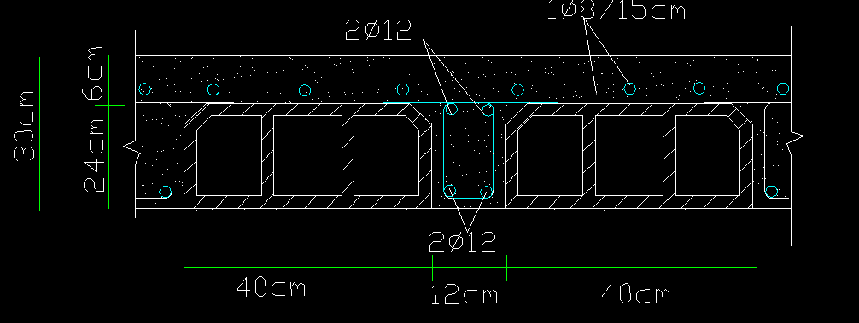
Cross section in ribbed slab

Slide 14
Design of Beams
Beams in basement floor
Beam number | Beam width(cm) | Beam depth(cm) | Bottom steel | Top steel | Stirrups
B1 | 40 | 50 | 6Ф16mm | 5Ф20mm | 1Ф10mm/100mm
B2 | 40 | 50 | 6Ф20 mm | 8Ф20mm | 1Ф10 mm / 100mm
B3 | 40 | 50 | 6Ф20 mm | 8Ф20mm | 1Ф10 mm / 100mm
B4 | 40 | 50 | 6Ф20 mm | 8Ф20mm | 1Ф10 mm / 100mm
B5 | 40 | 50 | 6Ф20 mm | 8Ф20mm | 1Ф10 mm / 200mm
B6 | 40 | 50 | 6Ф16mm | 5Ф20mm | 1Ф10mm/100mm
B7 | 30 | 40 | 3Ф16mm | 5Ф16 mm | 1Ф10 mm / 150mm
B8 | 30 | 40 | 3Ф16 mm | 5Ф16 mm | 1Ф10 mm / 150mm
B9 | 30 | 40 | 5Ф16 mm | 4Ф16 mm | 1Ф10 mm / 150mm
B10 | 30 | 40 | 5Ф16 mm | 4Ф16 mm | 1Ф10 mm / 150mm

Slide 15
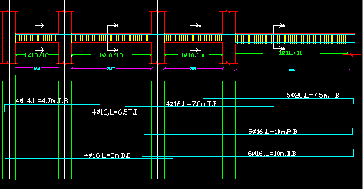
Reinforcement Details in Representative frame (B1 , B6)

Slide 16
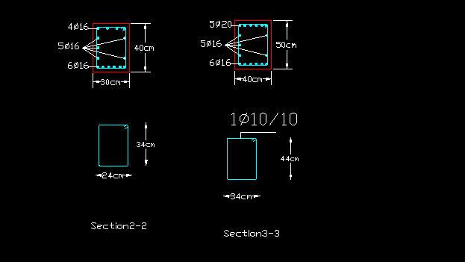
Cross sections in beams( B1,B6

Slide 17
Beams in Typical floors
Beam name | width(m) | depth(m) | Top steel | middle steel | bottom steel | stirrups
B1 | 0.3 | 0.3 | 4 Ф 12 |  | 4 Ф 12 | 1ф10/200mm
B2 | 0.5 | 0.3 | 5Ф 12 | 3 Ф 16 | 5 Ф 12 | 1ф10/200mm
B3 | 0.5 | 0.3 | 5 Ф 12 | 3 Ф 16 | 5 Ф 12 | 1ф10/200mm
B4 | 0.5 | 0.3 | 4 Ф 12 |  | 4 Ф 12 | 1ф10/200mm
B5 | 0.5 | 0.3 | 4 Ф 16 |  | 4Ф 14 | 1ф10/200mm
B6 | 0.3 | 0.3 | 4 Ф 12 |  | 4 Ф 12 | 1ф10/200mm
B7 | 0.3 | 0.5 | 3 Ф 20 | 2 Ф 16 | 4 Ф 16 | 1ф8/150mm
B8 | 0.7 | 0.3 | 5 Ф 20 |  | 6 Ф 16 | 1ф8/150mm
B9 | 0.7 | 0.3 | 5 Ф 16 |  | 6Ф 16 | 1ф8/150mm
B10 | 0.7 | 0.3 | 6 Ф 20 |  | 2 Ф 16 | 1ф10/100mm
B11 | 0.7 | 0.3 | 8 Ф 16 |  | 8 Ф 14 | 1ф8/150mm
B12 | 0.5 | 0.3 | 4Ф 20 | 2 Ф 16 | 4 Ф 16 | 1ф8/150mm

Slide 18
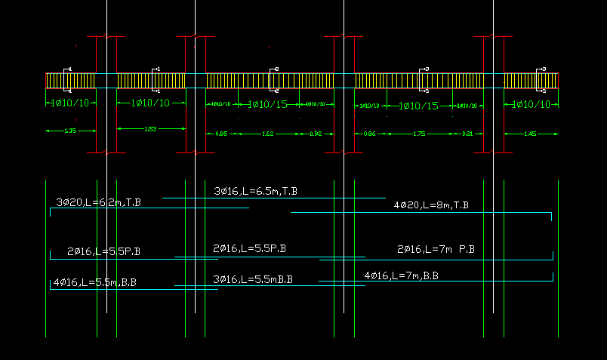
Reinforcement Details of representative frame in Typical floors frame B12

Slide 19
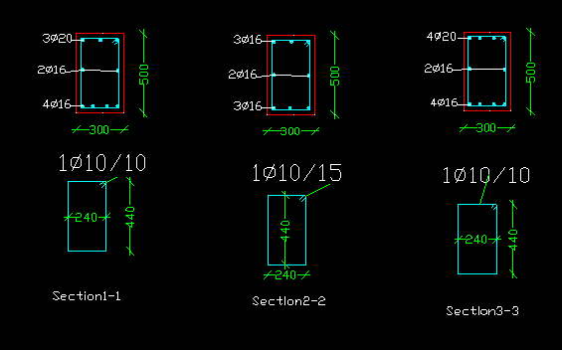
Cross sections in beam B12

Slide 20
Summary table of columns design
Design of columns
 | Group (1) | Group (2) | Group(3)
Dimensions (cm) | 30*60 | 40*70 | 20*50
Reinforcement | 10 Ø 16 mm | 14 Ø 16 mm | 8Ø 16 mm
stirrups reinforcement | 1 Ø 8 /200 mm | 1 Ø 8 /200 mm | 1 Ø 8 /200 mm
cover (cm) | 4 | 4 | 4

Slide 21
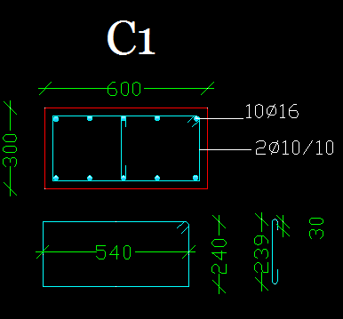
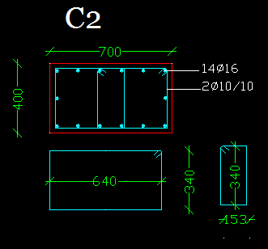
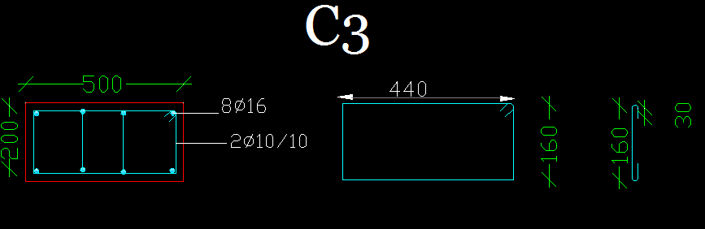
Cross sections in columns

Slide 22
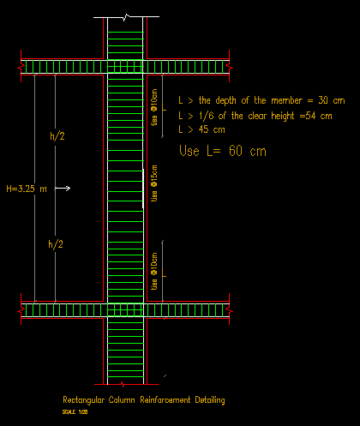
Longatianal section in column -C1

Slide 23
Footings
Types of footings are used :
Isolated footing
Combined footing
Mat footing
Wall footing
Bearing capacity of soil = 250 KN/m²

Slide 24
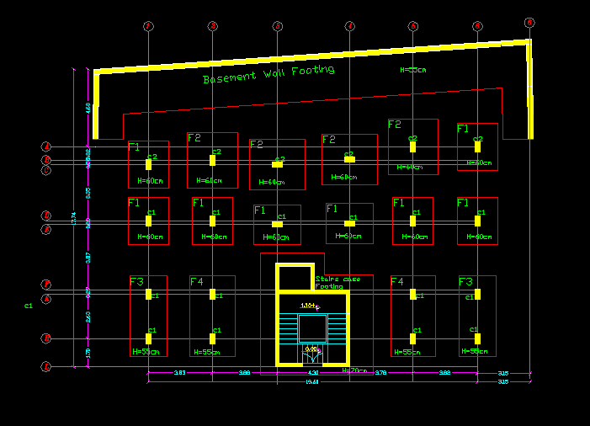
Footing types

Slide 25
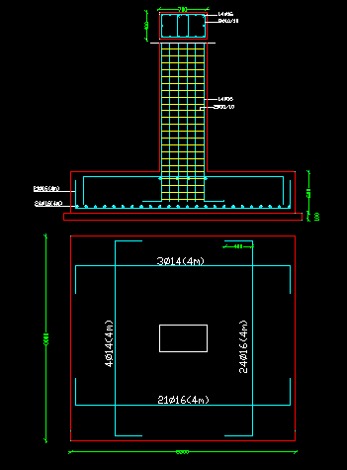
Isolated footing (F2)

Slide 26
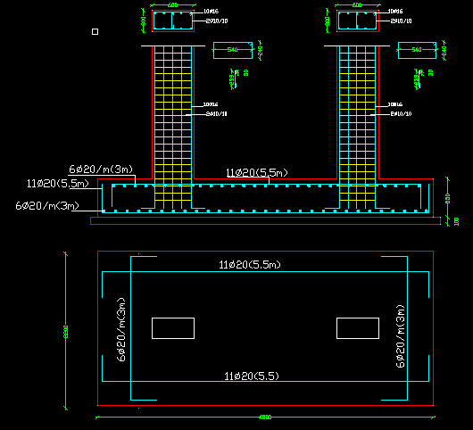
Combined footings (F3)

Slide 27
Shear wall design
Thickness of shear wall = 25 cm
Height (m) | Reinforcement(mm²)
0.0-3.25 | 1200 (6ф16m/layer)
3.25 -8.25 | 1200 (6ф16m/layer)
8.25-11.5 | 1000(5ф16m/layer)
11.5-14.75 | 1000(5ф16m/layer)
14.75-18 | 1000(5ф16m/layer)
18-21.25 | 800(5ф14m/layer)
21.25-24.5 | 800(5ф14m/layer)
24.5-27.5 | 800(5ф14m/layer)

Slide 28
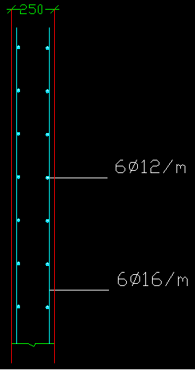
Section in shear wall

Slide 29
Basement wall design
Wall height = 3.25 m
Wall thickness = 30 cm
Unit weight of the soil is 18 KN/m³
Surcharge load = 20 KN/m²
Bearing capacity of the soil = 250 KN/m²

Slide 30
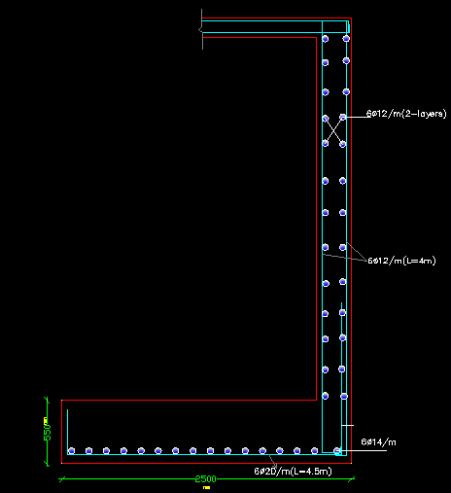
Cross section in basement wall

Slide 31
Stairs Design
Loads
Slab own weight of staircase = 5 KN/m²
Superimposed dead load = 5 KN/m²
Live load = 5 KN/m²
Slab Thickness =20cm

Slide 32
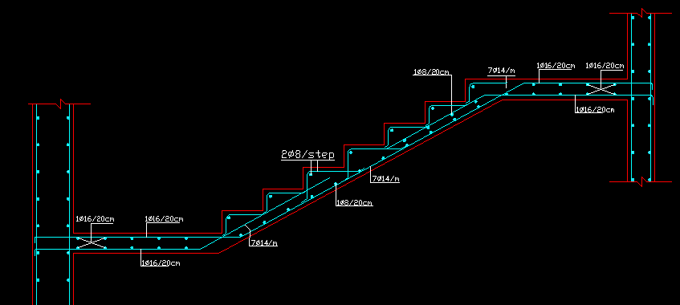
Cross section in Stairs

Slide 33
Dynamic Analysis
Period calculations of structure
Base shear calculations
Analysis of building subjected to time history earthquake

Slide 34

1.Fundamental Period of the structure
Period in X-direction
By Rayleigh’s method:

Slide 35
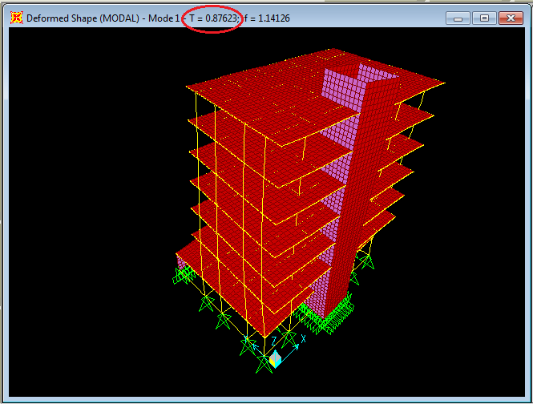
Tx by SAP modal
% of error =19%

Slide 36

Period in y-direction
By Rayleigh’s method :

Slide 37
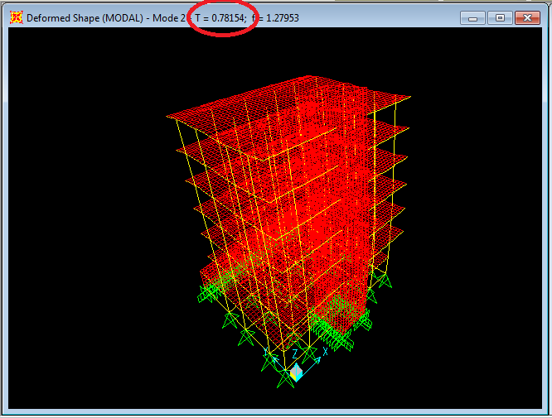
% of error =5%
Ty by SAP Modal

Slide 38
2.Base shear
Three methods :
Equivalent lateral force method (IBC 2003).
Response spectrum dynamic analysis method
Time history analysis method and structure is subjected to Elcentro earthquake.

Slide 39

Equivalent lateral force method
Base shear force (V):
V=C_{s} W
All parameters used for equivalent force method are:
Area: Nablus
Soil type: B
S1=0.2
Ss= 0.5
Fa = Fv = 1
SDs = 2/3(Ss*Fa) = 0.333
SD1 = 2/3(S1*Fv) = 0.1333
Cs=0.051
V_{X} =0.051*(2665*9.81) =1333.3 KN

Slide 40
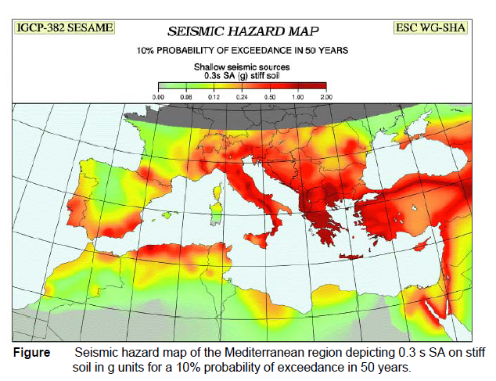
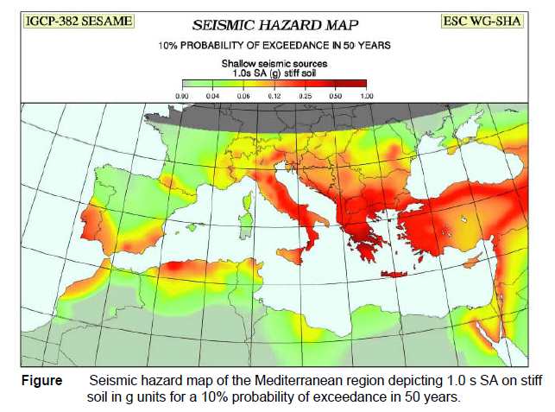
Ss
S1

Slide 41
Summary table
Base shear calculation
Method | base shear in X-direction(KN) | base shear in y-direction(KN)
Equivalent lateral force | 1368 | 1526
Response spectrum | 920.2 | 1164.8
Time history | 1139.8 | 1478.6

Slide 42
4.Analysis of structure subjected to earthquake (Elcentro EQ)
Checks of columns - Axial loads
column No. | Axial load (KN)-Gravity combination (Comb.1) | Axial load(KN) –EQ combination (comb.2) | govern combination
1 | 1689 | 1698 | comb.(2)
2 | 2120 | 2046 | comb.(1)
3 | 2087 | 2027 | comb.(1)
4 | 1693 | 1712 | comb.(2)
5 | 1699 | 1622 | comb.(1)
6 | 2050 | 1857 | comb.(1)
7 | 2022 | 1831 | comb.(1)
8 | 1700 | 1614 | comb.(1)
9 | 1760 | 1705 | comb.(1)
10 | 2171 | 1964 | comb.(1)
11 | 2086 | 1852 | comb.(1)
12 | 2144 | 1911 | comb.(1)
13 | 2382 | 2143 | comb.(1)
14 | 2001 | 1921 | comb.(1)
15 | 2224 | 2124 | comb.(1)
16 | 3109 | 2868 | comb.(1)
17 | 3291 | 3010 | comb.(1)
18 | 3286 | 3019 | comb.(1)
19 | 3123 | 2897 | comb.(1)
20 | 2243 | 2124 | comb.(1)

Slide 43
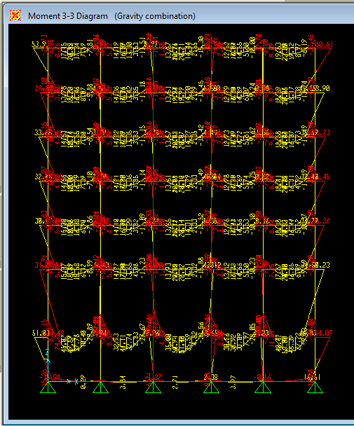
Bending moment diagram For interior frame
U=1.2 DL+1.6 LL

Slide 44
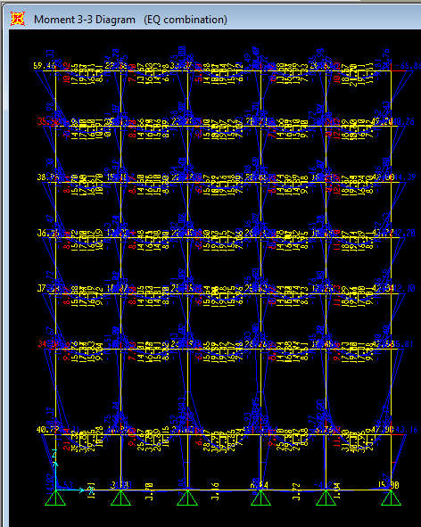
Bending moment diagram For interior frame
U=1.2 DL+1 LL +1.4 E

Slide 45
Volume : 192 m³
Water Tank
Dimensions :
Height = 5m
width= 5.5 m
Length = 7m
Wall thickness = 30 cm

Slide 46
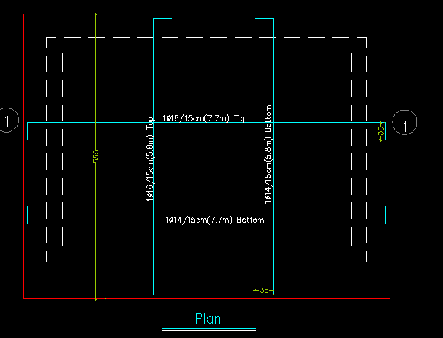
Reinforcement of footing

Slide 47
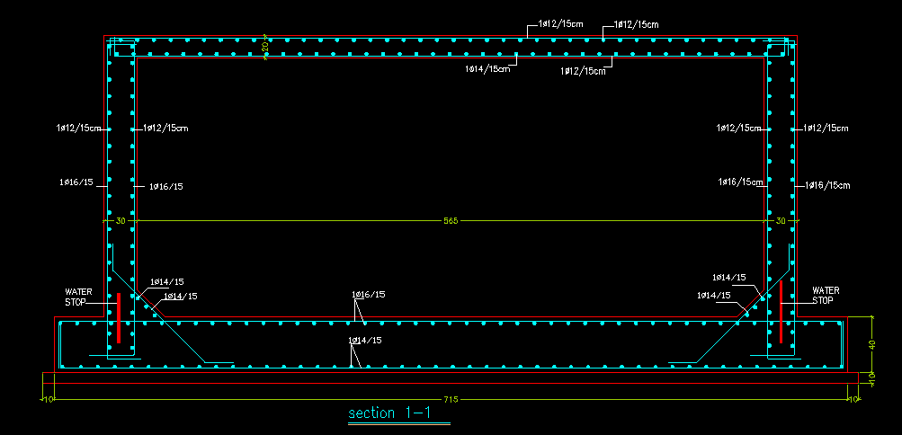
Cross section in water tank

Slide 48

The END
Thank you for your Attention
Any Questions ?

