Slide 1
Graduation Project
Bracing system for deep excavation.

Slide 2
The results of lab tests that carried out in the soil mechanics lab. The results include, liquid limit, plastic limit and unconfined compressive strength.
From this experiment, the liquid limit was found to be equal 46, plastic limit 23. Hence the plasticity index equals 23.
The unconfined compressive strength was found to be equal 84 kN/m2. Hence, the undrained cohesion equals 42kN/m2 with unit weight equals 17 kN/m2.
The soil is described as Medium Stiff Blackish silty clay of high plasticity and it is high expansive soil. The above geotechnical parameters will provide the necessary information for geotechnical design.

Slide 3
Chapter One
Introduction

Slide 4
This project is formed of six basic chapters:-
Chapter 1: Introduction, that describes the types of support systems, sheet piles, retaining walls, bigboulders .
Chapter 2:Review of bracing system.
Chapter 3: Design of sheet piles.
Chapter 4: Design of conventional retaining walls.
Chapter 5:Bigboulders.
Chapter 6: Conclusion and recommendation.

Slide 5
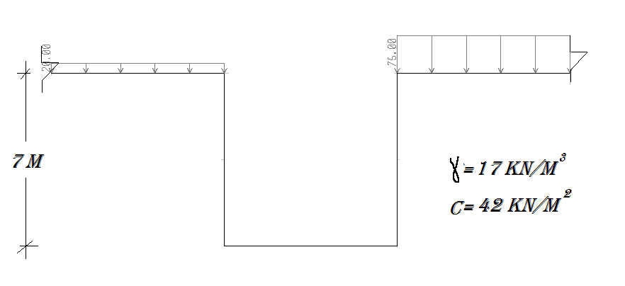
Vertical Section

Slide 6
Chapter Two
Review Of Bracing System

Slide 7
Soil Nailing: It is a technique in which soil slopes, excavations or retaining walls are reinforced by the insertion of relatively slender elements – normally steel reinforcing bars.
Sheet Pile Walls: Sheet pile walls are used to build continuous walls for waterfront structures and for temporary construction wall. They may have heights greater than 6 m if used with anchors. They can be made of steel, plastics, wood, pre-cast concrete,.

Slide 8
Ground Freezing: It is a process of making water-bearing strata temporarily
impermeable and to increase their compressive and shear strength by
transforming joint water into ice.
Retaining Walls: Are structure s used to retain soil, rock or other materials
in a vertical condition. Hence they provide a lateral support to vertical slopes
of soil that would otherwise collapse into a more natural shape

Slide 9
Chapter Three
Design Of Sheet Pile Walls

Slide 10
Depth Of Excavation
The excavation depth for the proposed building is 7 m below the foundation of nearby building, which consists of 7 stories.
Diameter Of Piles
Surcharge (KN/m² ( | Diameter (cm)
20 | 80
75 | 120

Slide 11
The Result
The diameter of pile = (80cm), surcharge (q) = (20 KN/m2). E=24*10^6 KN/m2
As shown in figure .

Slide 12

The Result
Pile length = 13.73m. say 14m.
I= 2513274.1 cm^4 / cm.
=2.5 * 10^6 cm^4 / cm.
Mmax from graph = 484 KN.m /m.
Pile 80 cm,
Mmax =901.5 KN.m / pile
Resistance:
R = 1127 KN.m /m.> Mmax = 484 → safe.
deflection=44.2mm →ok.

Slide 13
The diameter of pile = (120cm), surcharge (q) = (75 KN/m2). E=24*10^6 KN/m2

Slide 14

I= 8482300.2 cm^4 / cm.
=8.4 * 10^6 cm^4 / cm.
Mmax from graph = 1546 KN.m /m.
Pile 120 cm,
Mmax =3063.7 KN.m / pile
Resistance :
R = 2553.1 KN.m /m.> Mmax = 1546 → safe. deflection= 109.7mm →ok.
Pile length = 21.5 m.

Slide 15
CHAPTER FOUR
DESIGN OF CONVENTIONAL RETAINING WALLS

Slide 16
Introduction
A retaining wall is a structure that holds back earth. Retaining walls stabilize soil and rock from down slope movement or erosion and provide support for vertical or near-vertical grade changes. Retaining walls provide lateral support to vertical slopes of soil. They retain soil which would otherwise collapse into a more natural shape. The retained soil is sometimes referred to as backfill, as seen in Figure.

Slide 17
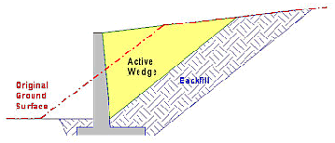
Retaining Wall Function.

Slide 18
Retaining walls
a-It is structure that holds back earth.
b-Stabilize soil and rock from down slope movement or erosion.
c-Provide support for vertical or near-vertical grade changes.
d-Provide lateral support to vertical slopes of soil.
e-Retain soil which would otherwise collapse into a more natural shape.

Slide 19
Design of Cantilever Retaining Wall
Height of retaining wall H = 7 m.
Surcharge load left side q = 20 kN/m²
Surcharge load right side q = 75 kN/m²
Soil parameters
Unit weight γ = 17 kN/m³
Cohesion c = 42 kN/m²
Angle of internal friction = 5 degrees
Allowable bearing capacity q_{all} = 84 kN/m²
The following shows the calculations for finding the dimensions:
For right side retaining wall (q = 75 kN/m²)
Fc = 28 Mpa
μ = 0.58
F_{y} = 420 Mpa

Slide 20
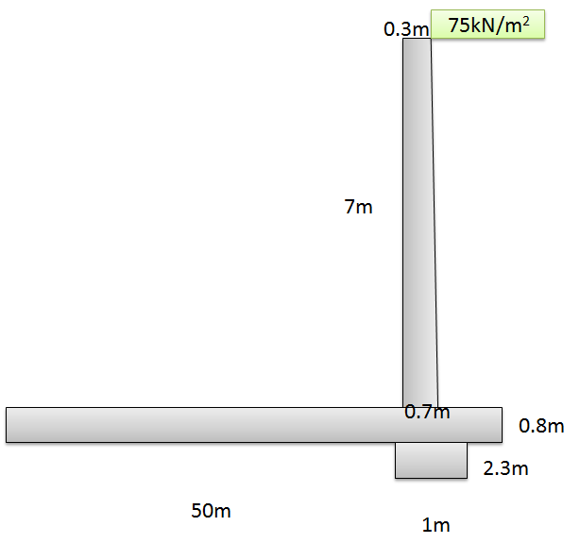
. Cantilever Retaining Wall for Surchage Load 75 kN/m²

Slide 21
Stability checks.
Overturning check.
Ka = 0.84
Kp = 1.2
Moment about C (5) | Moment are measured from C (4) | Weight/unit Length of wall (3) | Section (1)
2948.82 | 50.15 | 58.8 | 1
1976.856 | 50.43 | 39.2 | 2
1205.946 | 50.567 | 23.8 | 3
6092.8 | 51.2 | 119 | 4
29936.368 | 25.85 | 1158.08 | 5
3134.25 | 49.75 | 63 | 6
5344.5 | 50.9 | 105 | 7
14875 | 25 | 595 | 8
65514.54 |  | 2161.88 | ∑=

Slide 22
M₀ = 63 (7.8) (7.8)/2 + (174.38 – 63) (7.8/2) (7.8/3)
= 3043.85KN.m/m
F.s = M_{R}/M₀ = 63453.9/3043.85 = 21.52 > > 2.5
Sliding
F_{sliding} = 63 * 7..8 + (174.38 – 63) (7.8/2)
= 491.4 + 434.38 = 925.78 KN/m
F.s = ((1.2 *3.7 * 17)* 3.7/2 + 2161.88*.58 /925.78 )
= 1.51>1.5
Check For Bearing Capacity
e=6586.092/2161.88= 3.046m
L/6= 8.6167m > e = 3.46m
σ _{max} = 2161.88/51.7 (1+( 6*3.046/51.7)) = 56.6 KN/m²
σ _{min} = 2161.88/51.7 (1- 6*3.046)= 27.034 KN/m²

Slide 23
Chapter Five
bigboulder

Slide 24
Big boulder : a-It is engineered system of stacked angular rocks placed without mortar. b- It’s dimensions are generally greater than 450 mm (18 in) c-It’s weights generally greater than 90 kg (200 lb).

Slide 25
Design Of Big Boulders:
Left side bracing system
The following data are provided as follows:
Excavation depth = 7 m
Surcharge load q = 20 kN/m²
Soil properties:
Unit weight =17KN/m³
Cohesion=42 kN/m²
Big boulder properties
Unit weight = 27 kN/m³
Limestone of medium of high strength
The calculations will check overturning, sliding and bearing capacity, as follows:

Slide 26
check sliding :
F.S= 7*27*1*2/(140+122.5-84-34)
F.S= 2.7 ok
Check of overturning
Driving moment M₀= 20*7*3.5+122.5*(7/3) =775.8 kN.m/m
Resisting-moment. M_{R}=27*7*b((b+1.2)/2)+1*2*42+17*2*2*(2/3)
F.S=1
b=2m

Slide 27
Check of Bearing Capacity
The allowable bearing capacity of soil q_{all} = 84 kN/m²
The big boulder stress for 7 m height =7 x 27 =189 kN/m²
Since the stresses from big boulders is higher than allowable bearing capacity, problems is expected, such as high settlement or bearing failure of the soil. In other words this solution of bracing cut using big boulders may not be considered as the ideal solution.

Slide 28
CHAPTER SIX
CONCLUSIONS AND RECOMMENDATIONS

Slide 29
Conclusions
The selected type of supports (bracing system) for the proposed commercial center is bored cast – in – place sheet piles. This proposed method provides bracing for large and deep excavation, at the same time it needs very limited area for construction. In addition to that, this method can be constructed with the available tools in our country. It is believed to be safer than any other local method such as gravity or reinforced concrete retaining wall or big boulders.
Big boulders may be a solution to this project as a bracing system. However, external stability regarding bearing capacity may be a problem; it was found less than one. This would cause an acceptable settlement and failure in strength. Another disadvantage of this method is it will take large area from the site to be constructed; hence the actual site area will be reduced.

Slide 30
Conventional retaining walls would not be a good solution to the project as bracing systems, since the excavation is deep; it is more than 7 m. Of course gravity retaining walls and counterfort retaining walls cannot be constructed. Cantilever retaining wall was tried and found that it needs very large foundation width. This was due to the soft soil of the foundation project; it has very low bearing capacity.

Slide 31
Recommendations
The following recommendations may be derived from this project as follows:
The most suitable bracing system for deep excavation available locally is bored cast in-situ sheet piles. This system is the safest one and would cause fewer disturbances to the nearby structures. However, it may be considered as the cheapest.
New method of bracing system should be introduced to our country such as soil nailing which is well used worldwide and shown its excellent applications.

Slide 32
Detailed lab and field soil tests to provide a comprehensive geotechnical report.
The designer and the constructor must work together in both design and construction stages, with knowledge of condition within and adjacent to the site.
For more accurate analysis of a bracing system, finite element analysis has shown good results. This has been done in many projects and the results are compared to actual cases by using instrumentation. This may be done in our country providing an appropriate support.

Slide 33
Thank you

