Slide 1
Smart Irrigation System
Prepared by
Ahed arafat
Ahmad yasin
Mahmoud abd alraziq
Supervisor
DR.Falah Mohammed

Slide 2
Introduction
Renewable Energy Sources is the term used to describe sources of energy that are natural, continuous, largely available and environmentally benign. Renewable energy sources are constantly available and do not run out as they are being continually replenished by mother nature either at the same rate or faster than they are being consumed or used up. A good example of this would be the suns solar radiation which is so enormous that it can never be depleted giving us an abundant supply of solar energy every day. Other “Renewable Energy Sources” include the Wind, Rain, Tides, Biomass and Geothermal heat etc, or any other natural source of energy for that matter which is being constantly “renewed” or replenished by Mother Nature.

Slide 3
Objective
The main objective for this project include a solar power source to drive a water pump that can feed an irrigation system.

Slide 4
Component of system

Slide 5
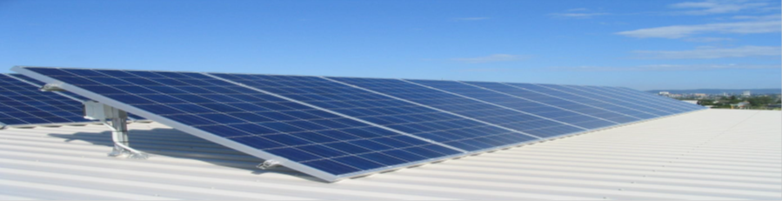
Solar panel
Is devices that allow for the input of sunlight, and convert this sunlight into electricity. The solar panel consists of solar cells which are semiconductor devices that change the sunlight into electricity or direct current

Slide 6
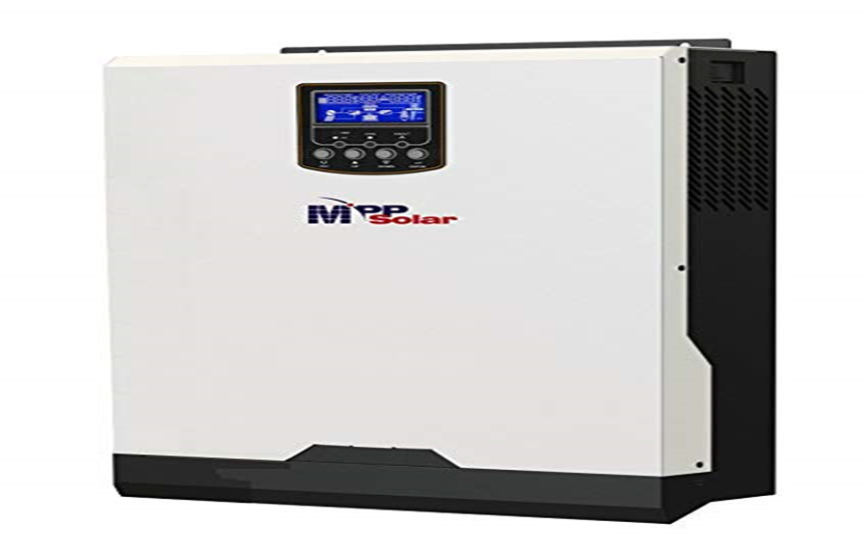
inverter
is a device capable of converting DC into AC electricity The input voltage, output voltage and frequency, and overall power handling depend on the design of the specific device or circuitry. The inverter does not produce any power; the power is provided by the DC source.

Slide 7
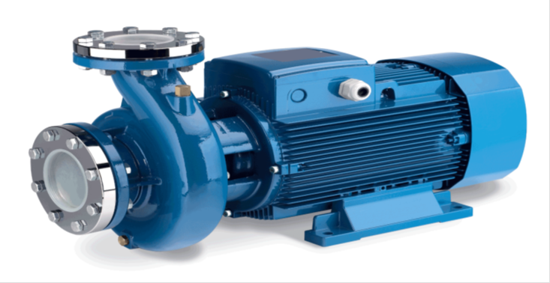
Water pump
Water pumps are machines that move water from their sources to other places and play an essential role in irrigation.

Slide 8
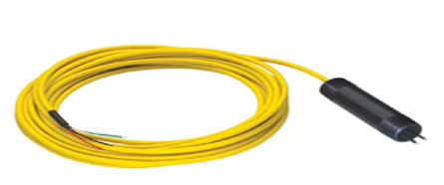
Water level tank sensor
A sensor used to determine the height of the water in the tank.

Slide 9
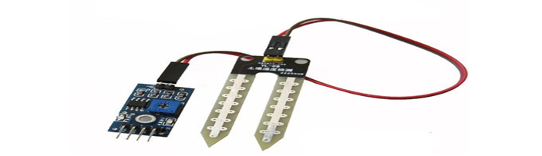
Soil moisture sensor
used to determine the percentage of water in the soil (soil moisture).
Notes:
used to determine the percentage of water in the soil (soil moisture)

Slide 10
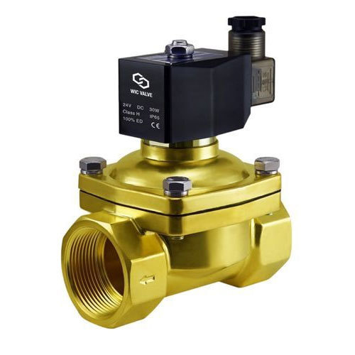
Solenoid valve
It is a valve that opens and closes automatically when an electric current passes through its magnetic coil.

Slide 11
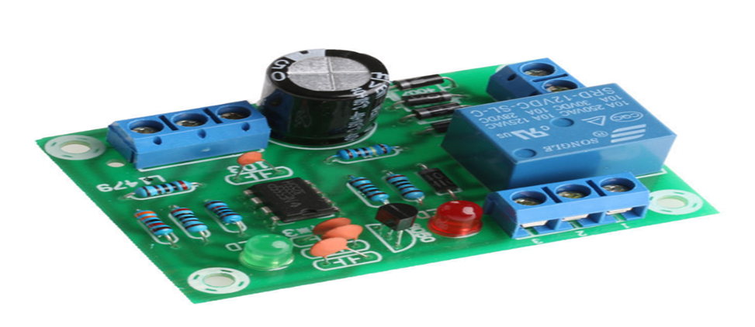
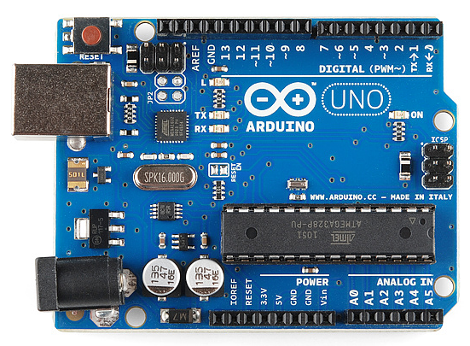
The control circuit contains
Liquid Level Controller for Pond Tank water
Arduino

Slide 12
Calculation

Slide 13
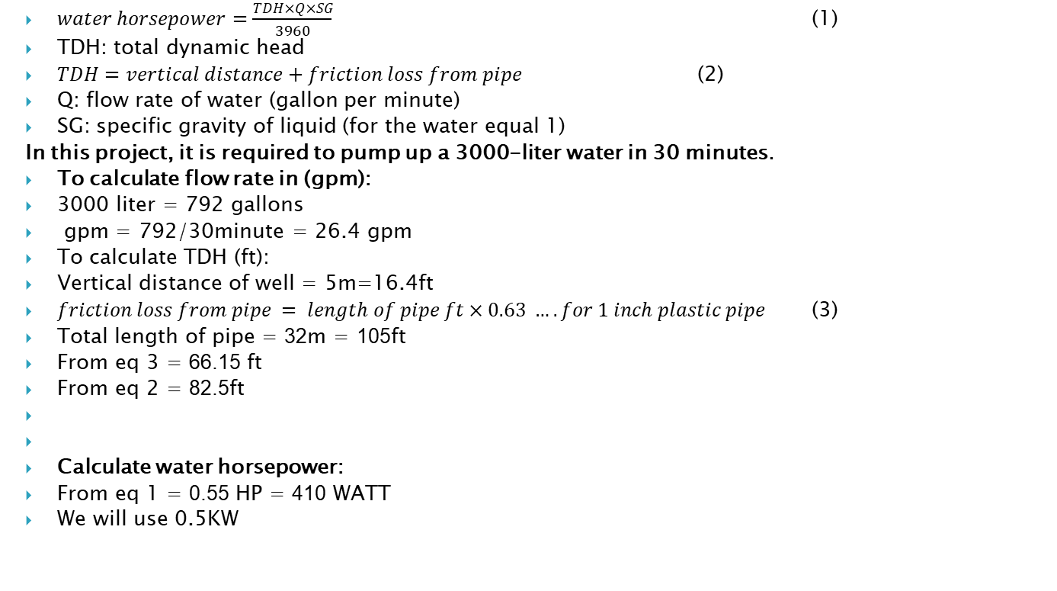
Calculation of horsepower for water pump
$water horsepower=\frac{TDH×Q×SG}{3960}$ (1)
TDH: total dynamic head
$TDH=vertical distance+friction loss from pipe$ (2)
Q: flow rate of water (gallon per minute)
SG: specific gravity of liquid (for the water equal 1)
In this project, it is required to pump up a 3000-liter water in 30 minutes.
To calculate flow rate in (gpm):
3000 liter = 792 gallons
gpm = 792/30minute = 26.4 gpm
To calculate TDH (ft):
Vertical distance of well = 5m=16.4ft
$friction loss from pipe = length of pipe ft×0.63 …. for 1 inch plastic pipe$ (3)
Total length of pipe = 32m = 105ft
From eq 3 = 66.15 ft
From eq 2 = 82.5ft
Calculate water horsepower:
From eq 1 = 0.55 HP = 410 WATT
We will use 0.5KW

Slide 14
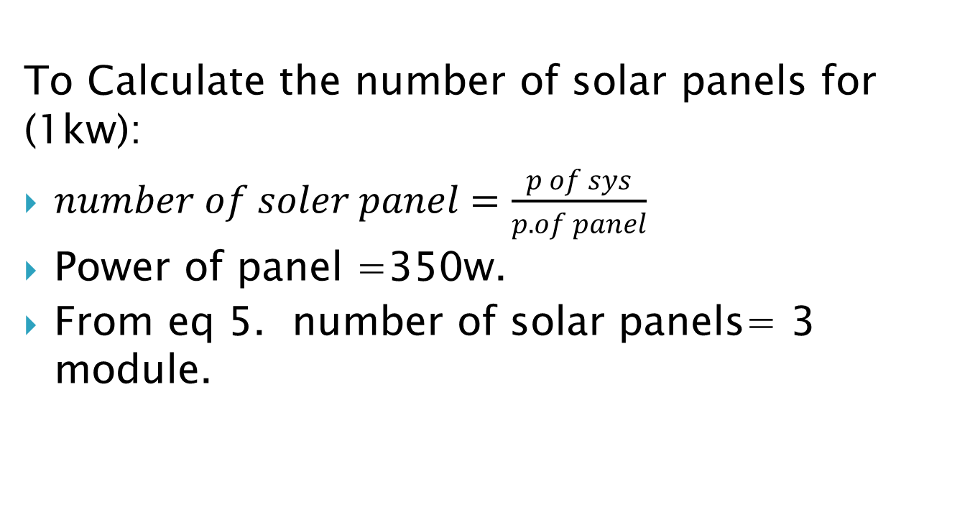
Calculating of the PV system
To Calculate the number of solar panels for (1kw):
$number of soler panel=\frac{p of sys}{p. of panel}$
Power of panel =350w.
From eq 5. number of solar panels= 3 module.

Slide 15
Procedure
The solar system generates 1 KW power and the output of solar panel form is DC voltage then use inverter to convert from DC voltage to AC voltage, after that the water pump machine its operation to pump water from the well to the overhead tank, we connect water level tank to control operation of the pump if the water in tank is low level the pump it’s on and higher level the pump it’s off, after that we do automatic irrigation crops by use soil monster sensor and solenoid valve we explain that by flowcharts.

Slide 16
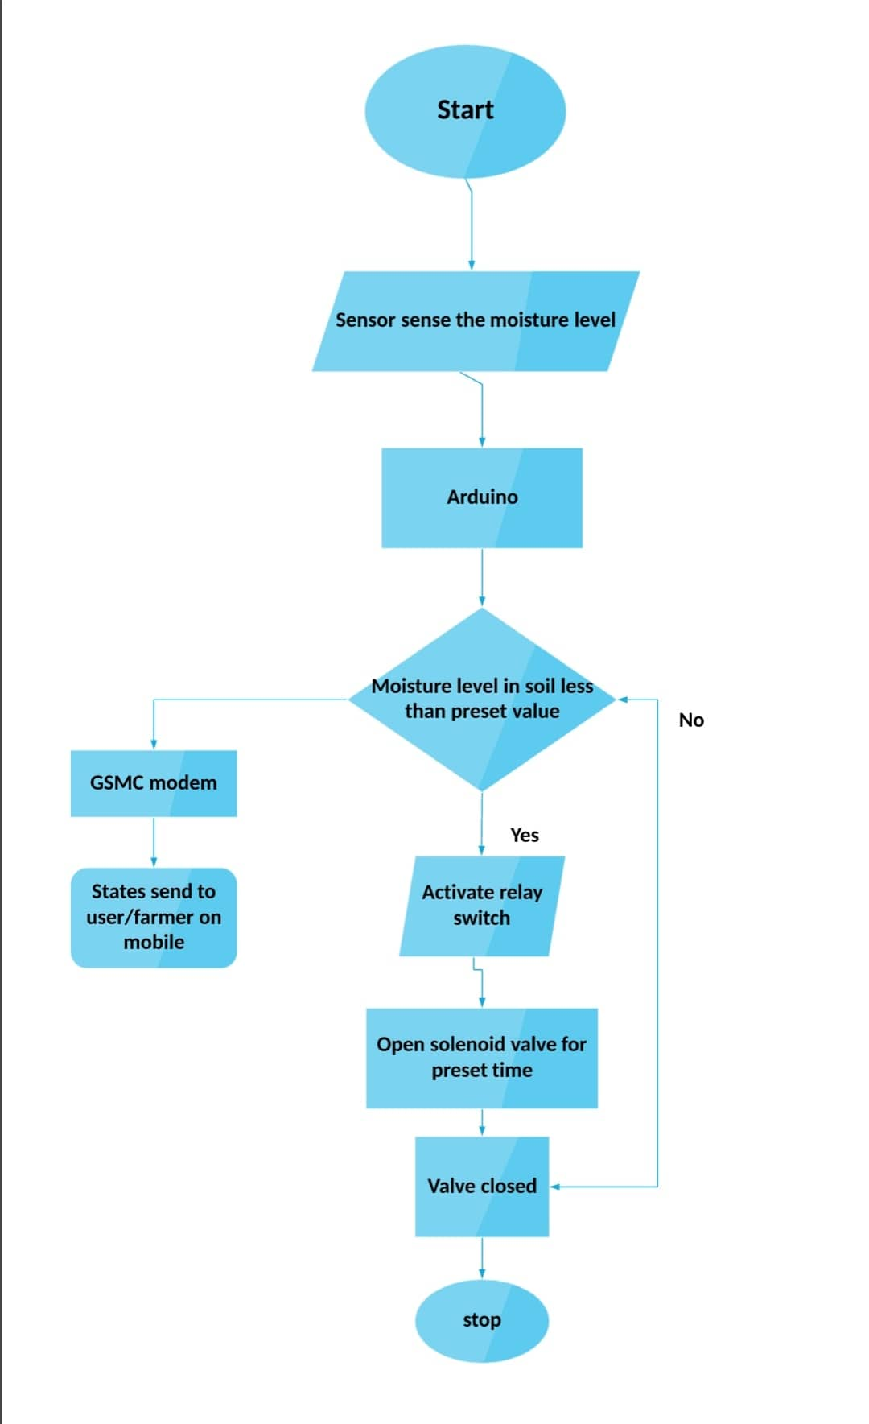
Flow chart for soil moisture sensor

Slide 17
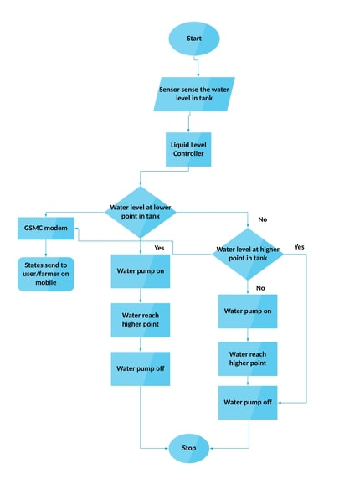
Flow chart for water level tank

Slide 18
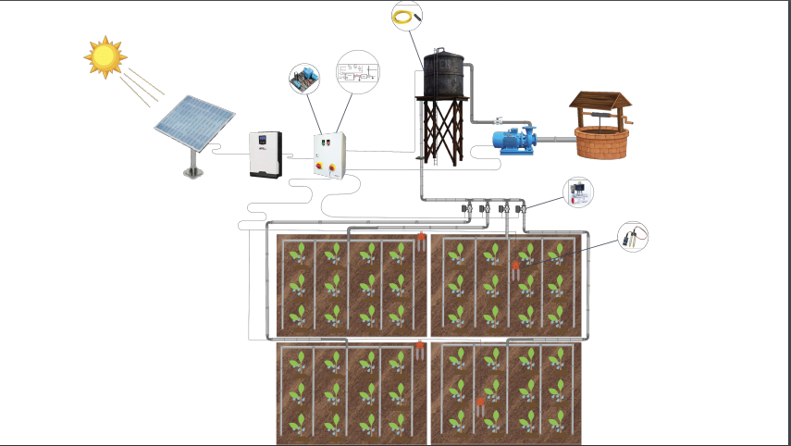
Final design

Slide 19
Cost of Material

Slide 20
conclusion
During this project we carried out a sufficient study on the project requirements and its components where we have good information on each component of the system; to supply agricultural lands with water using solar cells and surface irrigation pumps and control the system’s work automatically by using sensors to calculate soil moisture and sensors to find out the height water.

