Slide 1
Passive Villa
An-Najah National university
Faculty of engineering
Building engineering departmenet
Graduation project ||
Prepared By :
Dana Saeed
Kamal Salhab
Mohammad Saeeri
Supervisor :
Eng. Haitham Sawalha

Slide 2
Outline
Introduction.
Site analysis.
Architectural design.
Structural design.
Environmental design.
Mechanical design.
Electrical design.
Safety and fire system.
Quantity survey

Slide 3
Introduction
Project definition
Objective.
Passive villa
Palestinian requirements
Integrated design
Comfortable
Affordable
Energy efficient

Slide 4
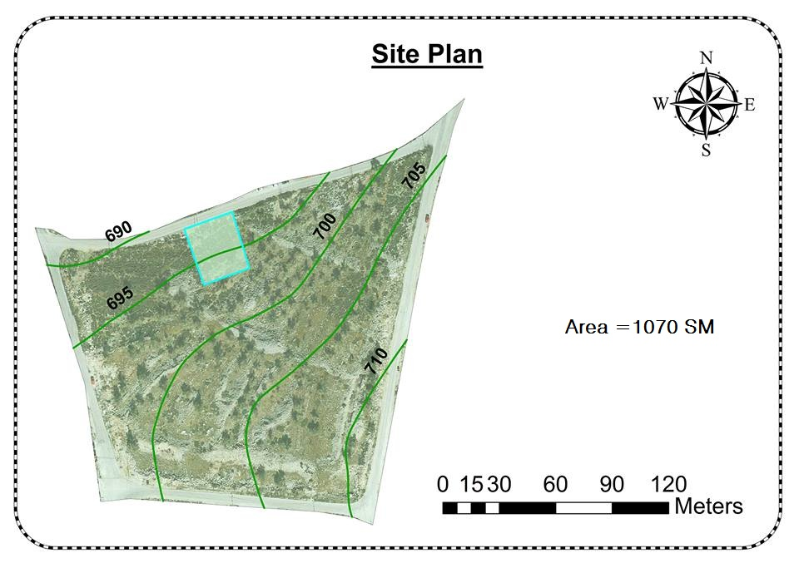
Site Analysis
Al-Ameria,
Nablus- Palestine
Total area of 1070 m²

Slide 5
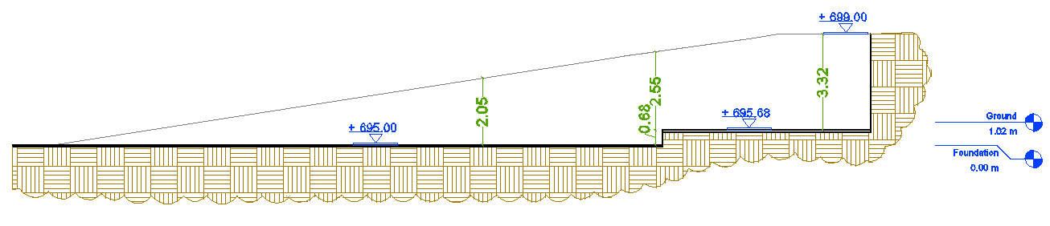
Site Analysis

Slide 6
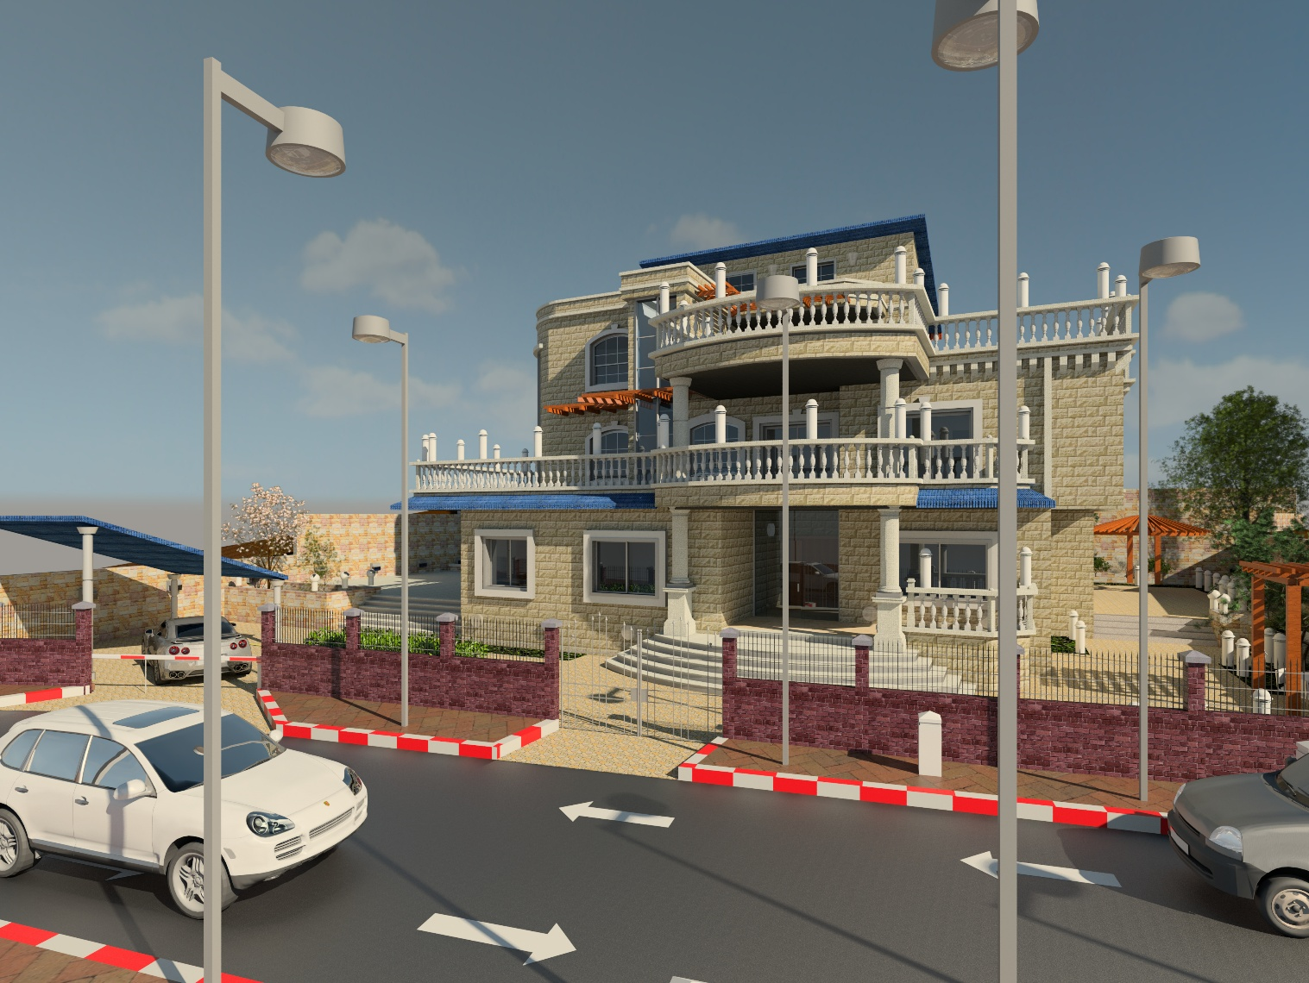
Architectural Design

Slide 7
Architectural Design
Floor | Space | Area (m²) | Floor | Space | Area (m²)
Ground floor | Entrance | 20.2 | First floor | Master bed room | 40
 | Guest room | 22.3 |  | Two bed rooms | 60
 | Guest room (bed) | 28 |  | Living area | 48
 | Living room | 30.4 |  | Study room | 12.5
 | Sitting area | 16.5 |  | Services | 20
 | Dirty kitchen | 8 |  | Terraces | 90
 | Kitchen | 23.2 | Second floor | Living area | 41
 | Storage | 4.2 |  | Laundry room | 12.5
 | Dinning | 31.85 |  | Services | 45
 | Services | 20 |  | Terraces | 150
 | Terraces | 25 | Roof | Maintenance area | 50
The total area of a passive villa equal 810 m² divided into three floors plus roof, the distributions and area of spaces in each floor are shown in the following table.

Slide 8
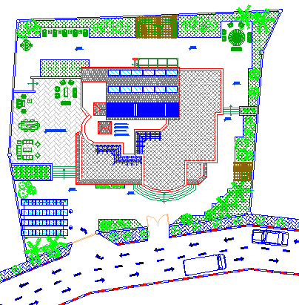
Architectural Design
Site plan

Slide 9
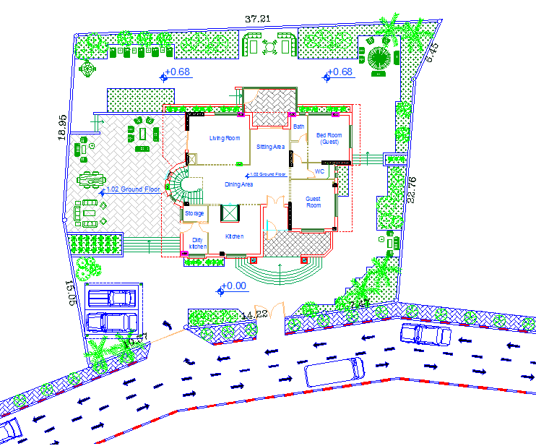
Architectural Design
Master plan

Slide 10
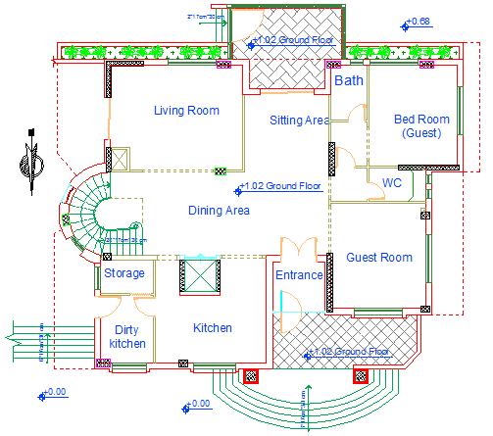
Architectural Design
Ground floor

Slide 11
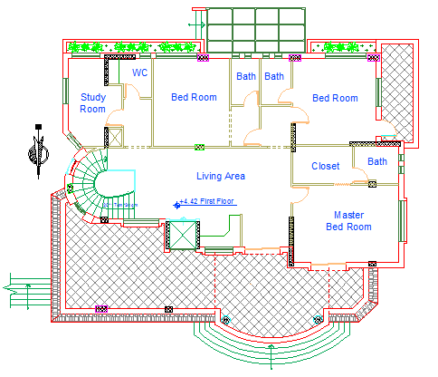
Architectural Design
First floor

Slide 12
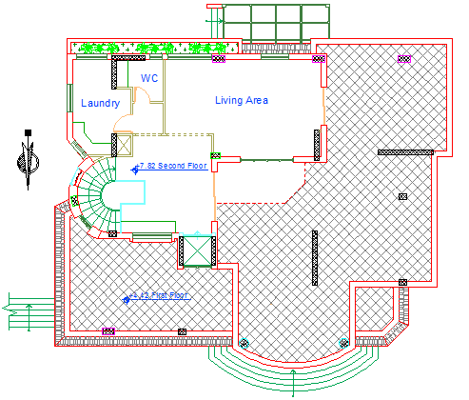
Architectural Design
Second floor

Slide 13
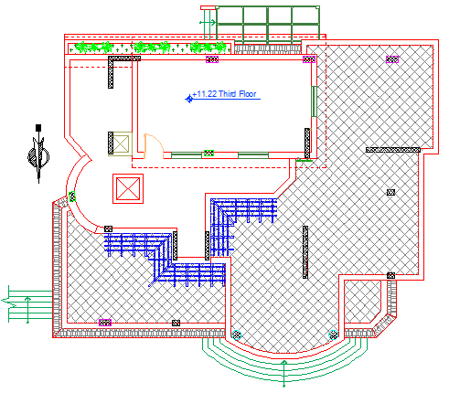
Architectural Design
Roof floor

Slide 14
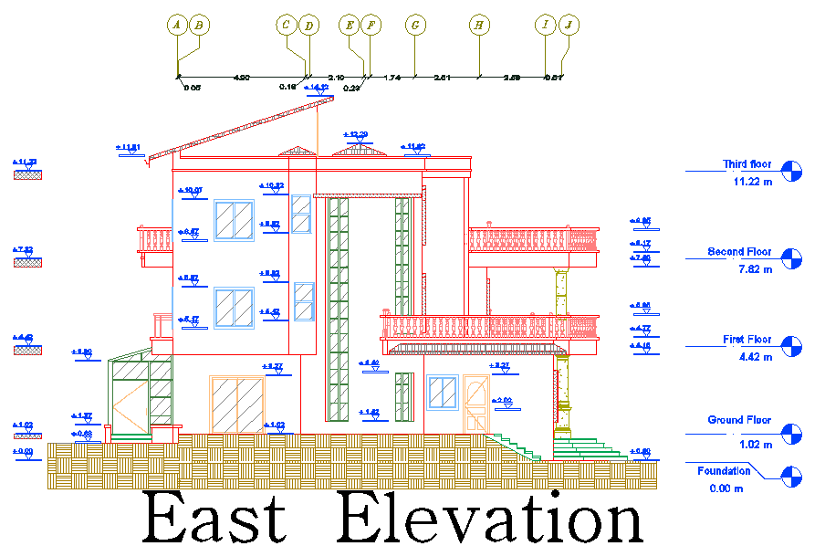
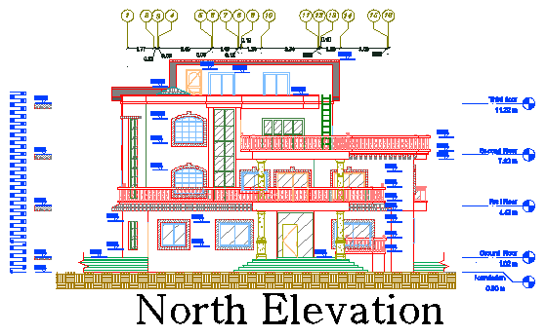
Architectural Design
North and East elevations

Slide 15
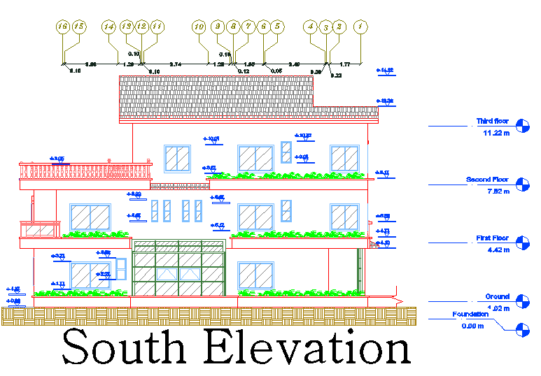
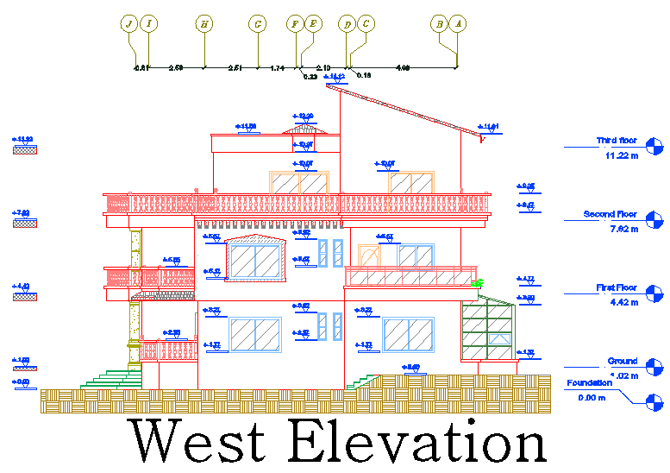
Architectural Design
South and West elevations

Slide 16
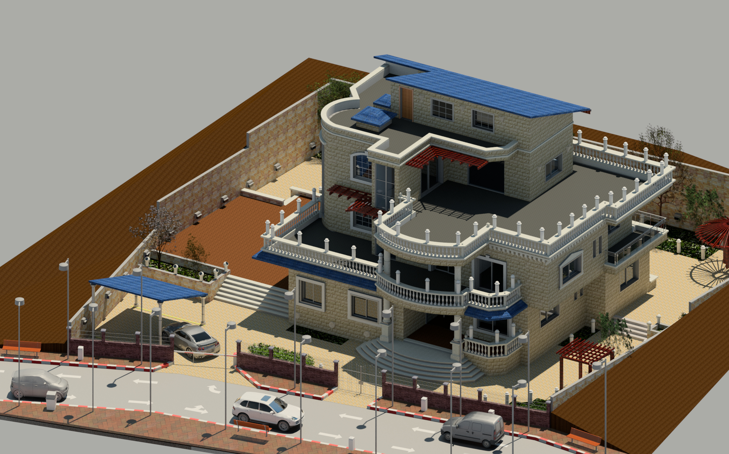
3DView

Slide 17
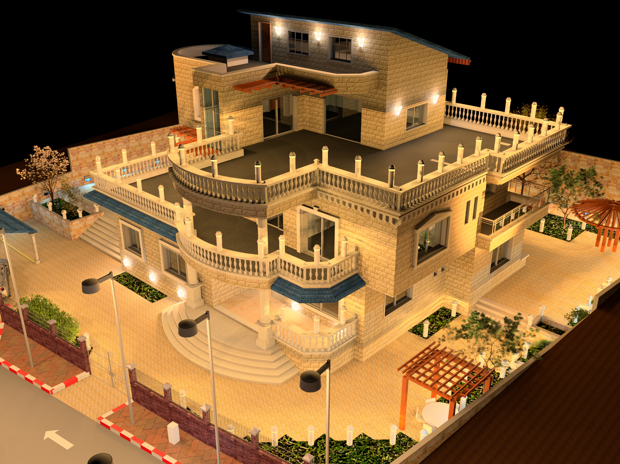
N.W View

Slide 18
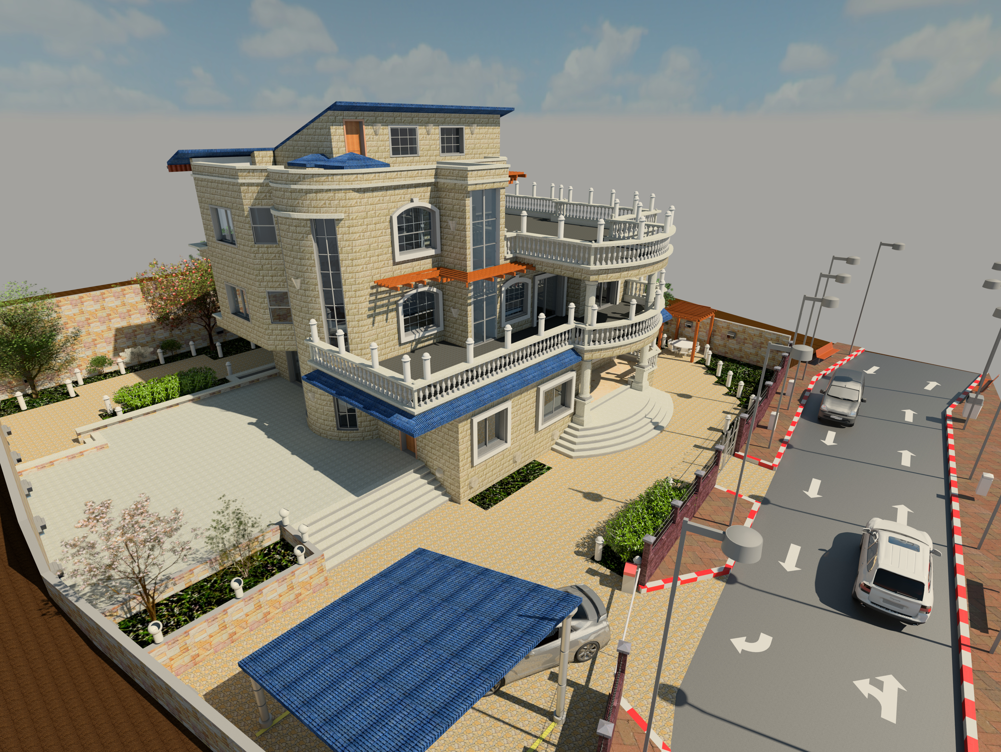
N.E View

Slide 19
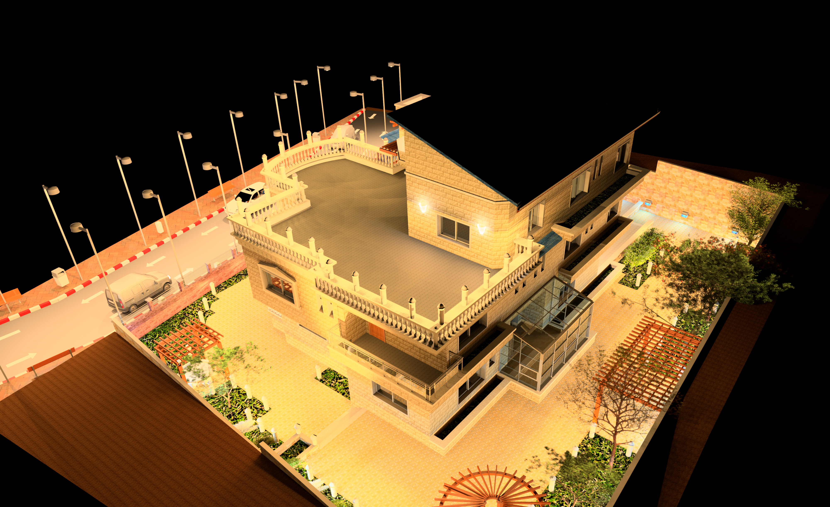
S.W View

Slide 20
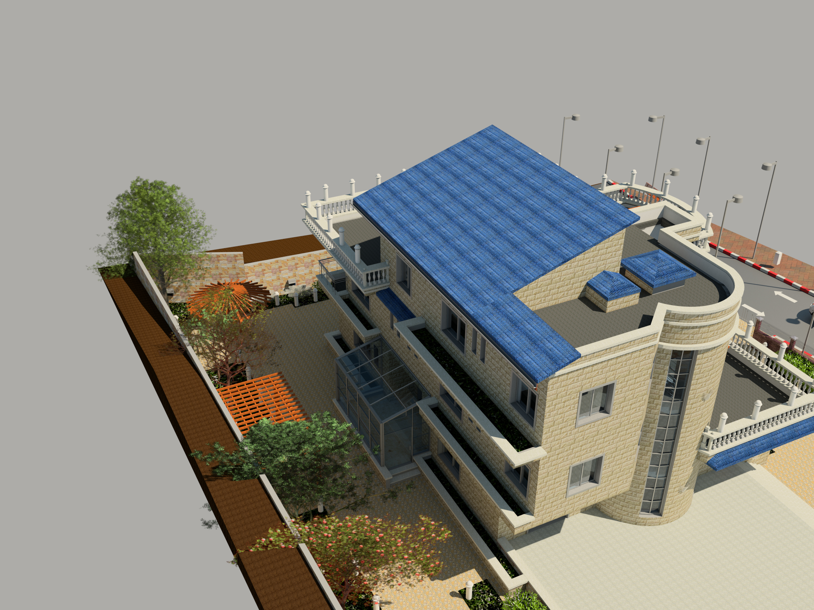
S.E View

Slide 21
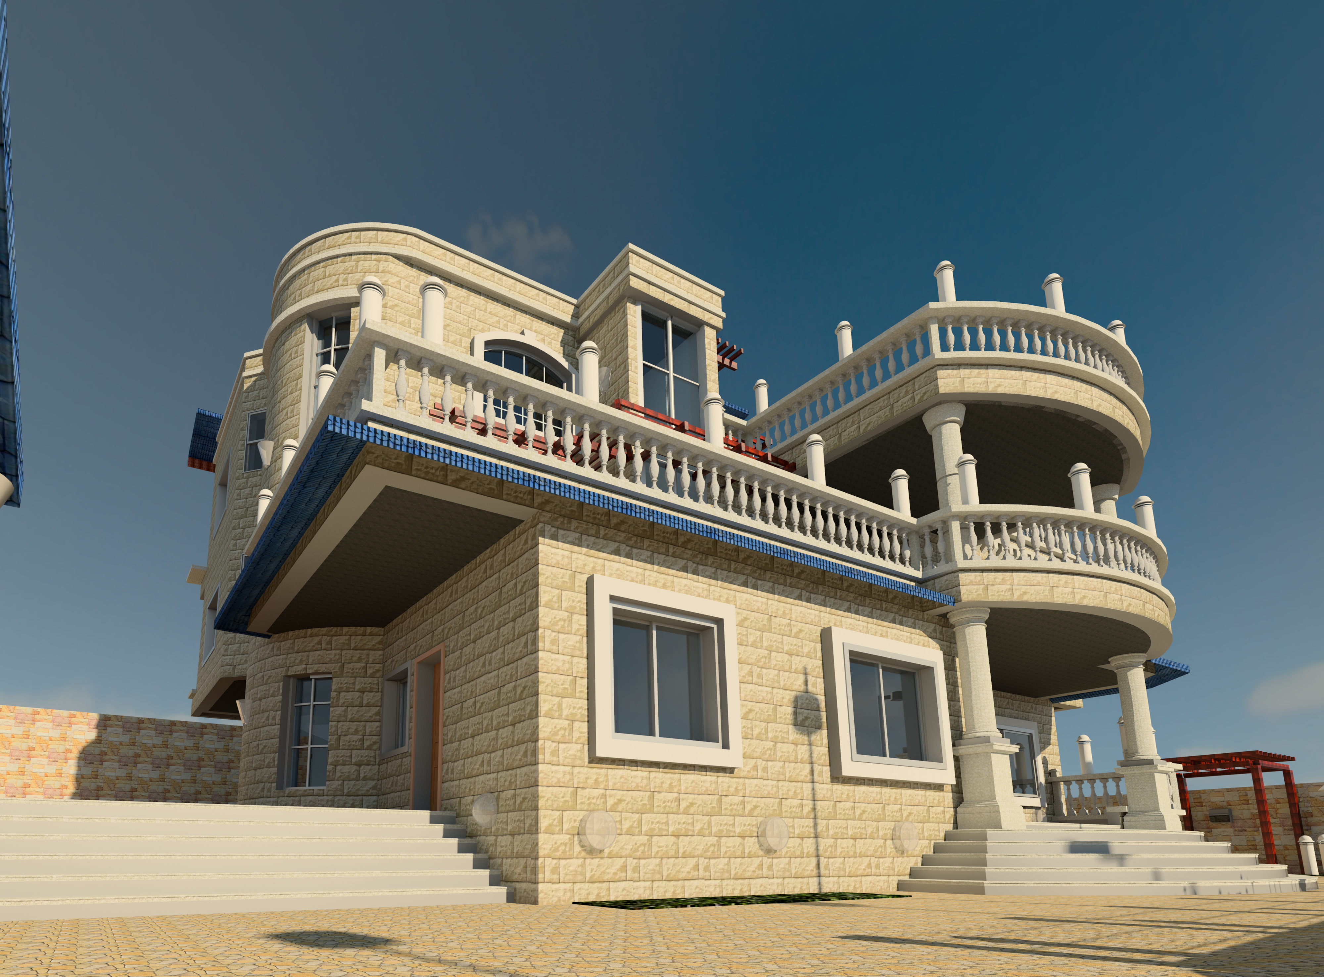
Structural Design

Slide 22
Structural Design
Codes and Standards:
ACI -318-11 for reinforced concrete structural design.
UBC -97 for earthquake design.
ASCE 7 2010 for load combinations

Slide 23
Structural Design
Design data:
Concrete strength for slabs and beams, f’_{c}=24 mpa.
Concrete strength for columns and shear walls ,f’_{c}=28 mpa.
Steel yield strength f_{y}=420 mpa.
Bearing capacity for soil = 350 kN/m²

Slide 24
Structural Design
Loads:
Load Type | Ribbed slab | Solid slab
Live | 2.5 (kN/m²) | 12 (kN/m²)
S.I.D | 4 (kN/m²) | 5 (kN/m²)

Slide 25
Structural Design
Lateral loads:
The city of structure is Nablus.
The seismic zone factor. Z=0.2.
The soil profile is type Sc.
The acceleration seismic coefficient Ca=0.24
The velocity seismic coefficient Cv=0.32.
The Seismic importance factor is 1.
The structural design type is intermediate, R=5.5

Slide 26
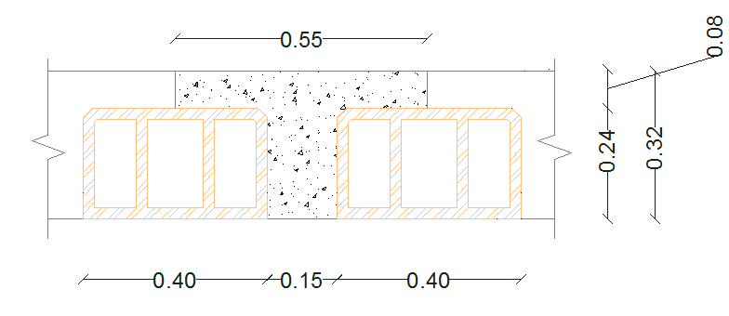
Slabs
Solid and ribbed slab with 32 cm thickness.

Slide 27
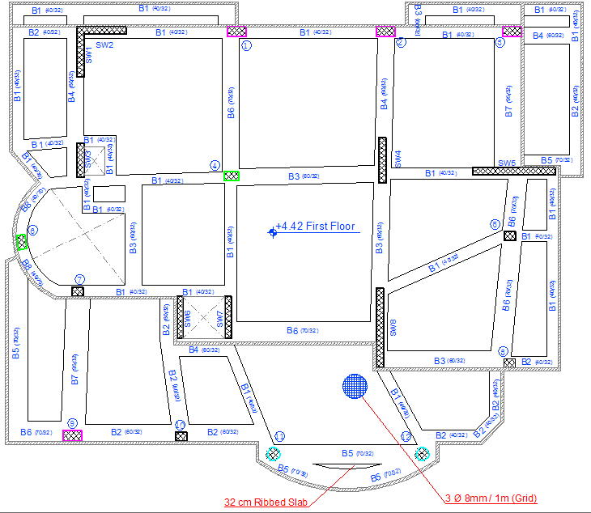
Beams

Slide 28
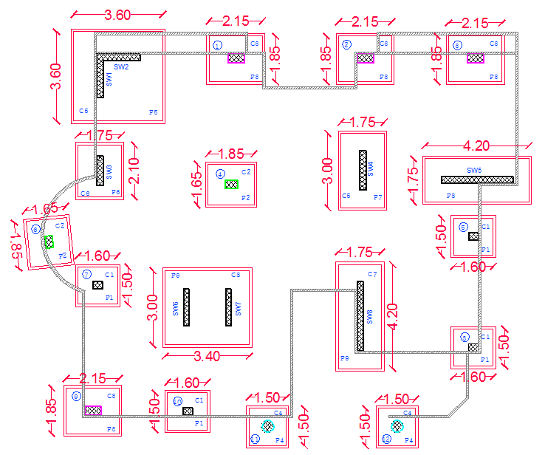
Columns and footings

Slide 29
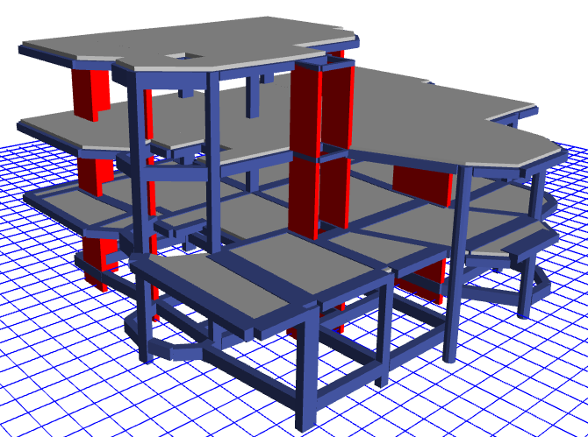
Modeling

Slide 30
Verification of model
Compatibility check
Equilibrium check
Internal force check
Deflection check
Drift check
Period check
Model participating mass ratio check

Slide 31
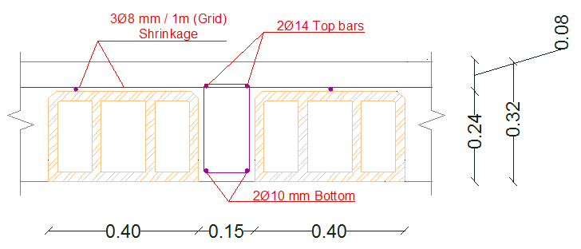
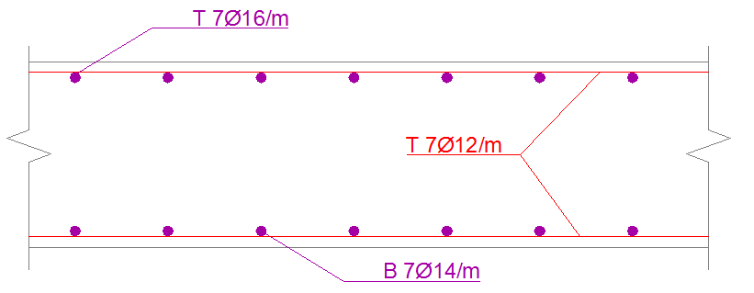
Slab Reinforcement

Slide 32
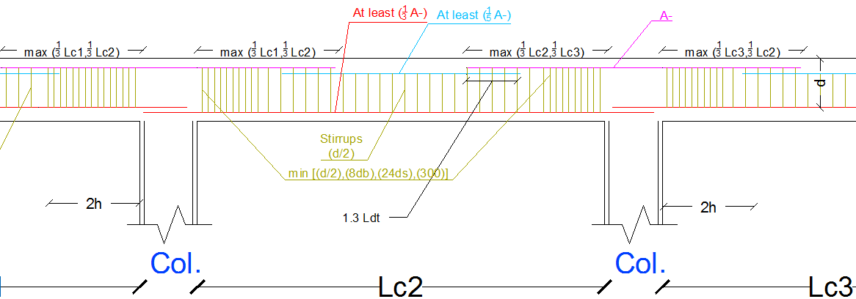
Beam Reinforcement

Slide 33
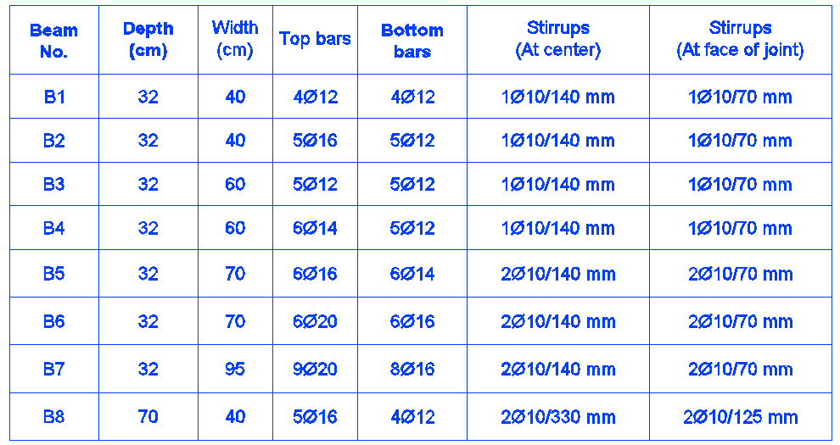
G.F Beam Reinforcement

Slide 34
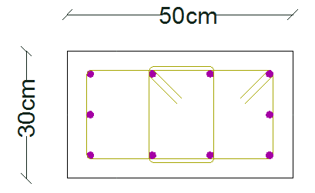
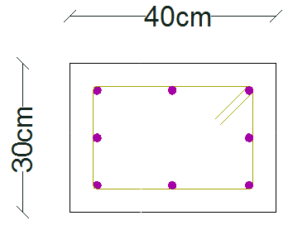
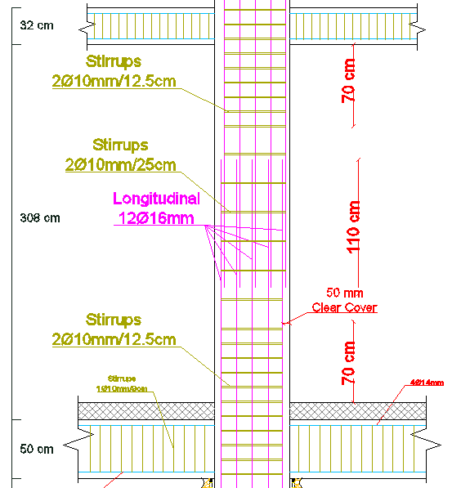
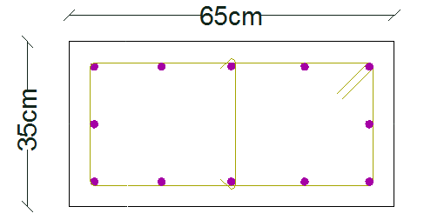
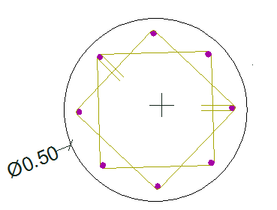
Columns Reinforcement

Slide 35
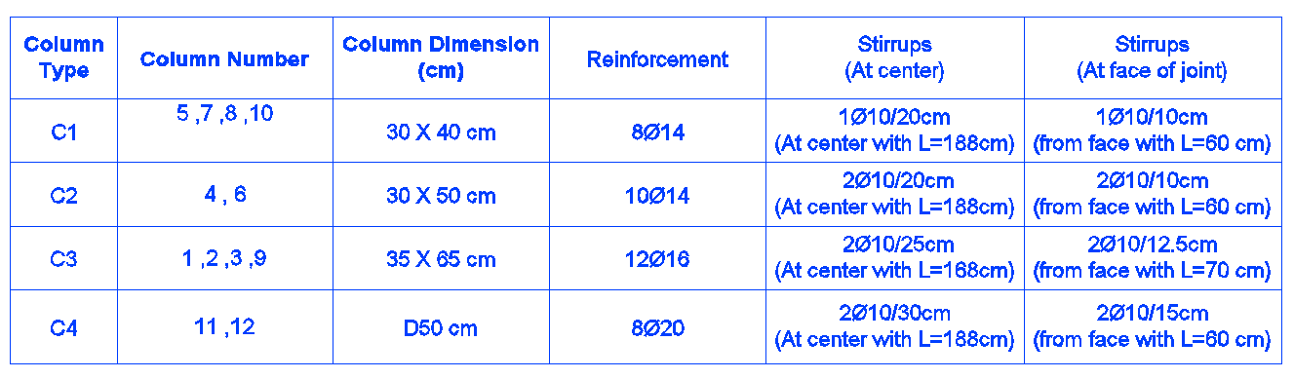
Columns Reinforcement

Slide 36
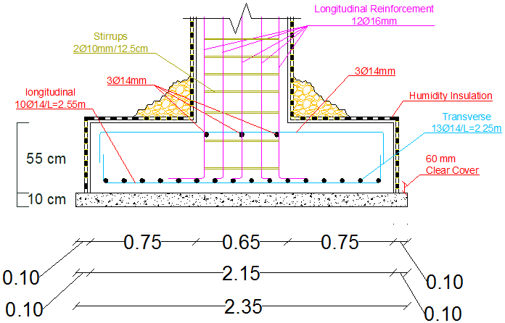
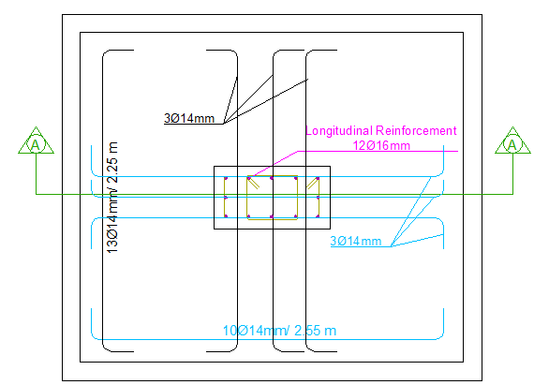
Footing Reinforcement

Slide 37
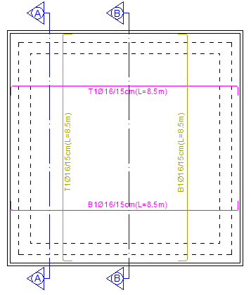
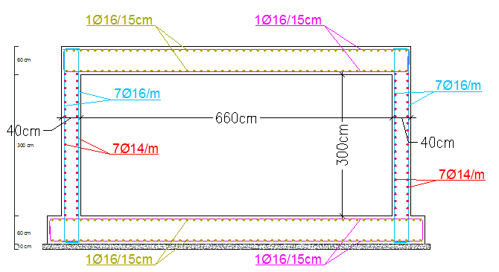
Water tanks Reinforcement

Slide 38
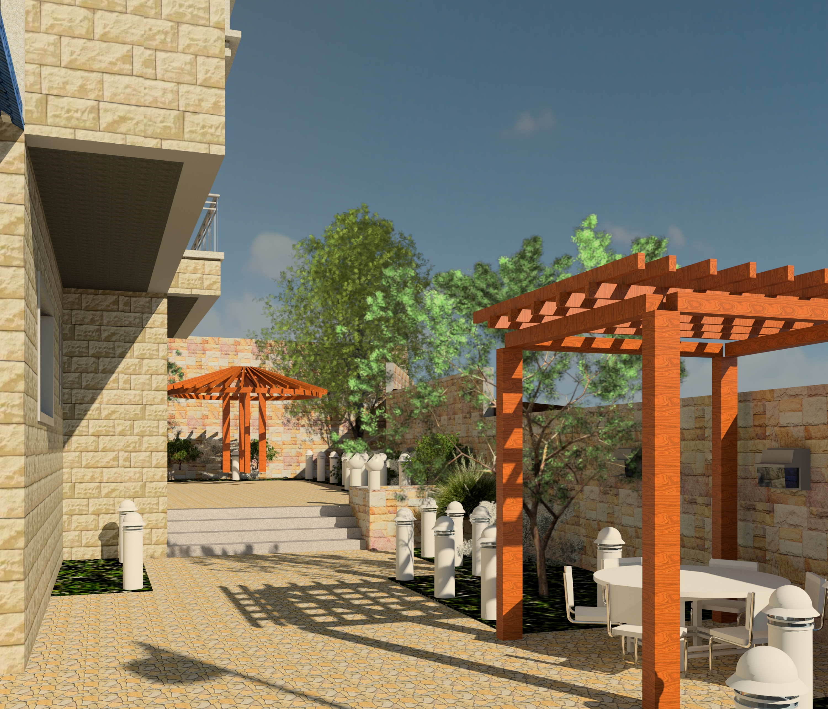
Environmental Design

Slide 39
Environmental Design
Palestinian requirements for green building
Number | The outer structural elements | Maximum U-Value w/m².k
1 | Outer wall | 0.5 w/m².k
2 | Outer Slab | 0.39 w/m².k
3 | Ground slab | 0.46 w/m².k
4 | Windows | 2.1 w/m².k
5 | Doors | 6 w/m².k

Slide 40
Environmental Design
Palestinian requirements for green building
 | Maximum U-Value w/m².k | Shading coefficient | Transmitting coefficient
The ratio of glass to wall less than 40% | 2.1 w/m².k | 0.4 max | 25% min
The ratio of glass to wall between (40-60) % | 1.9 w/m².k | 0.32 max | 10% min
The ratio of glass to wall greater than 60% | 1.9 w/m².k | 0.25 max | 10% min

Slide 41
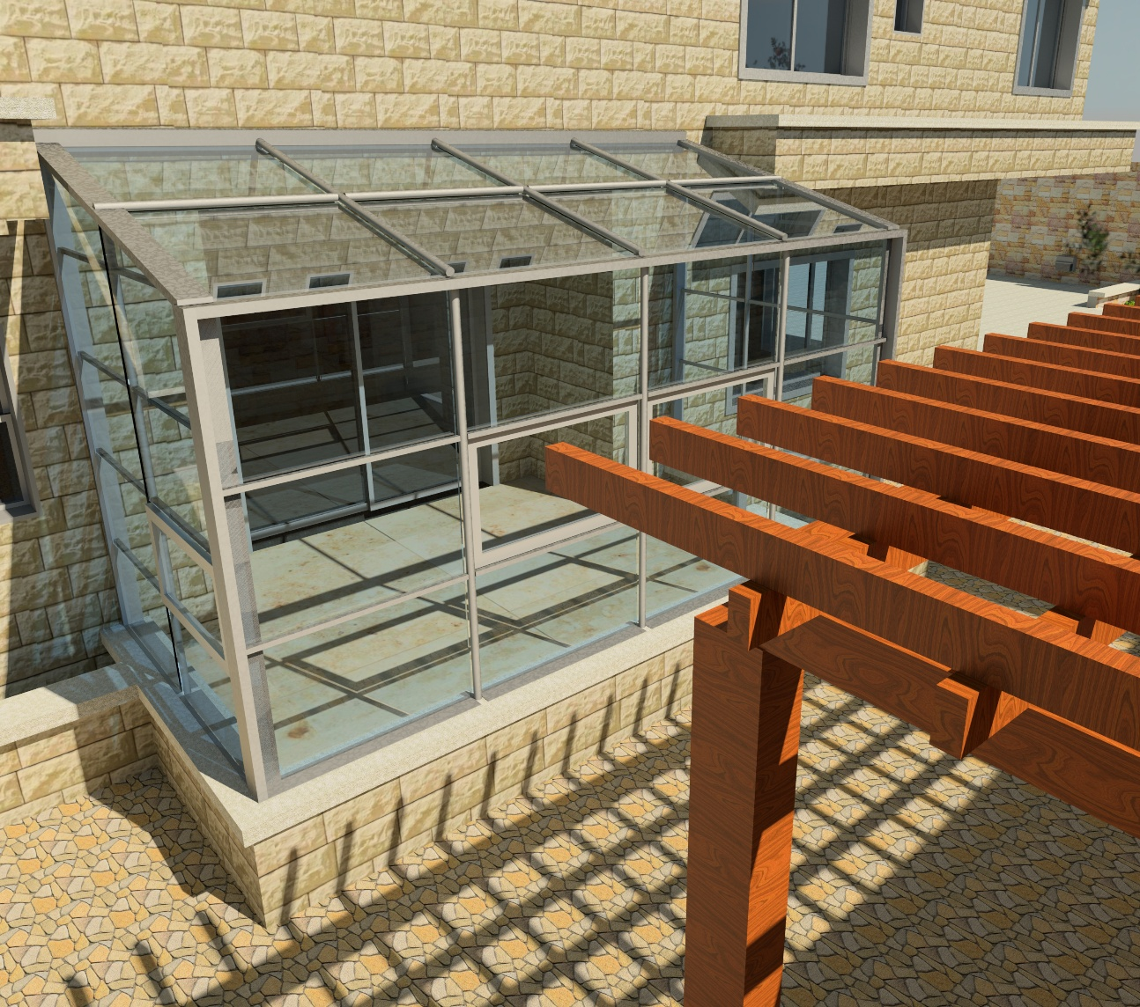
Techniques
Heating
Cooling

Slide 42
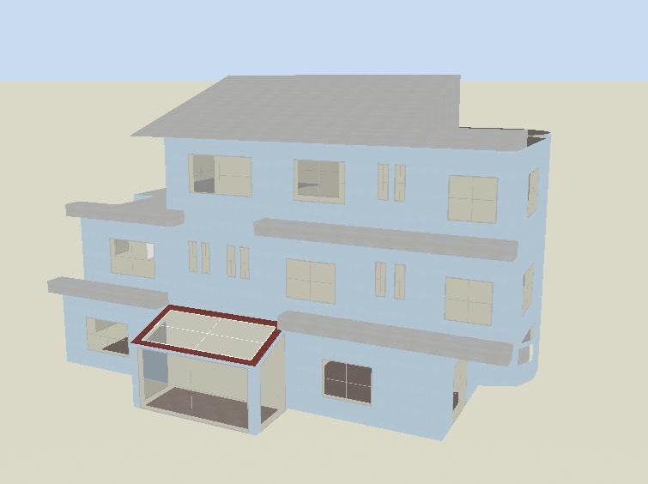
Modeling

Slide 43
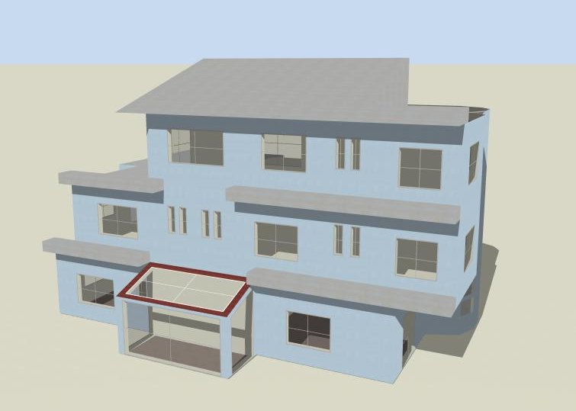
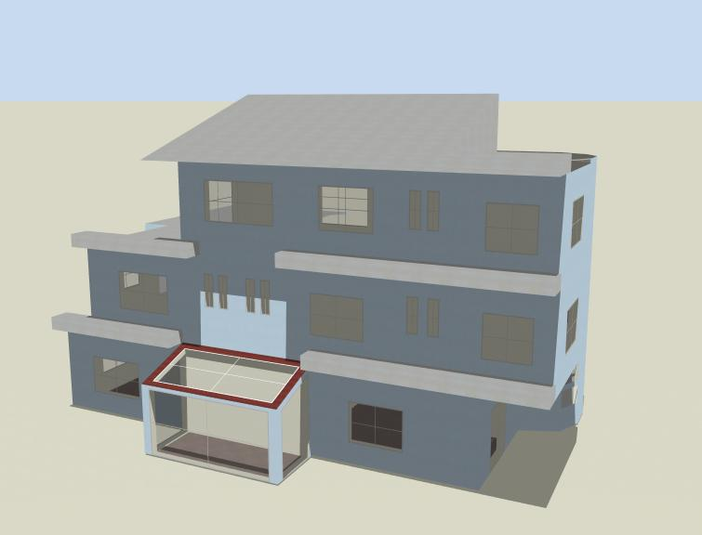
Shading
21th Jan
21th Jun

Slide 44
Environmental Design
Materials
Palestinian Requirements |  | Passive Villa
Element | Value | Value | Fit/Not
External walls | 0.5 w/m².k | 0.457 | Fit
External roof | 0.39 w/m².k | 0.367 | Fit
Ground slab | 0.46 w/m².k | 0.397 | Fit
Glass | 2.1 w/m².k | 1.752 | Fit
Shading coefficient | 0.4 max | 0.4 | Fit
transmitting | 25% min | 42 | Fit

Slide 45
Environmental Design

Slide 46
Thermal Analysis
Winter
Lighting kWh (kwh/m²) | Equipment kWh (kwh/m²) | Heating kWh (kwh/m²) | Total (kwh/m²)
2149.91 (5.74) | 586.95 (1.57) | 8136.12 (21.73) | 10873 (29.04)
Summer
Lighting kWh (kwh/m²) | Equipment kWh (kwh/m²) | Cooling kWh (kwh/m²) | Total (kwh/m²)
1536.86 (4.1) | 567.67 (1.52) | 8591.96 (22.95) | 10696.5 (28.57)

Slide 47
Thermal Analysis
Story | Zone | Heating Capacity (kW) | Cooling Capacity (kW)
Ground floor | Living | 1.3 | 0.83
 | Bed (guest) | 1.2 | 0.98
 | Dining | 1.3 | 0.75
 | Sitting | 0.87 | 0.55
 | Kitchen | 1.22 | 0.65
 | Guest | 1.16 | 0.87
 | Corridor | 0.1 | 0.09
 | Dirty kitchen | 0.69 | 0.59
First Floor | Bed room 1 | 1.25 | 1.08
 | Corridor (bed) | 0.12 | 0.16
 | Living F.1 | 2.11 | 1.88
 | Master room | 1.48 | 1.5
 | Bed room 2 | 0.76 | 0.54
 | Corridor (WC) | 0.09 | 0.14
 | Study room | 0.82 | 0.92
Second Floor | Kitchenette | 1.68 | 2.62
 | Living F.2 | 2.31 | 1.77
Total |  | 18.54 | 16.05

Slide 48
Daylight Factor
Story | Zone | Average Daylight factor (%)
Ground floor | Living | 1.7
 | Bed (guest) | 2.58
 | Sitting | 1.03
 | Kitchen | 1.15
 | Guest | 2.5
 | Dirty kitchen | 2.23
First Floor | Bed room 1 | 1.99
 | Living F.1 | 1.59
 | Master room | 2.64
 | Bed room 2 | 1.21
 | Study room | 3.21
Second Floor | Living F.2 | 2.93
Avg. |  | 2.06

Slide 49
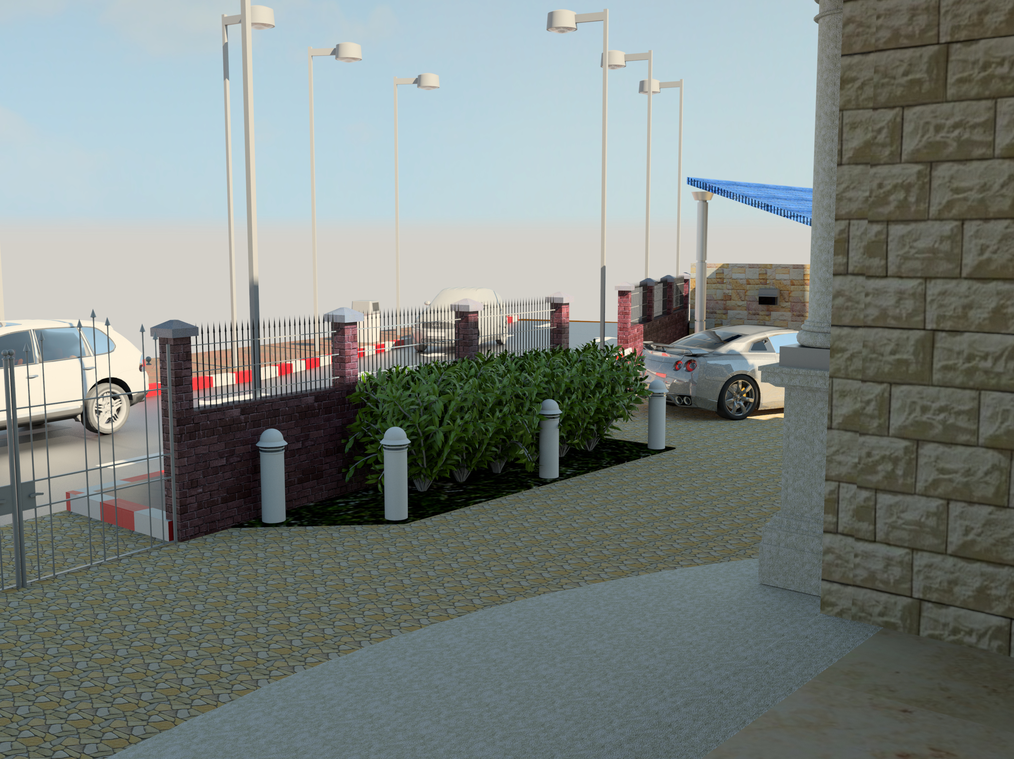
Mechanical Design

Slide 50
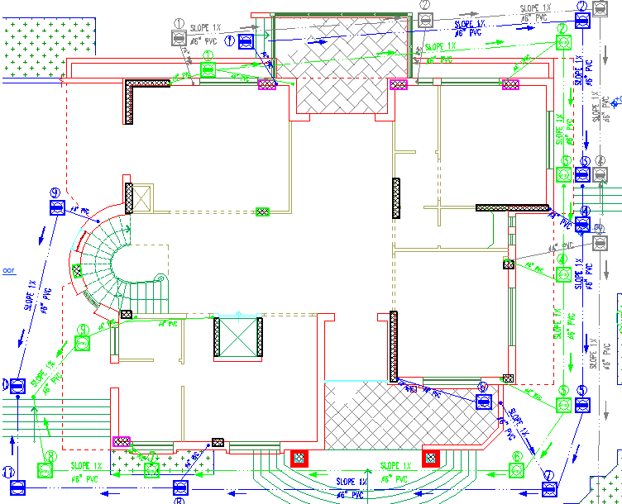
Drainage system

Slide 51
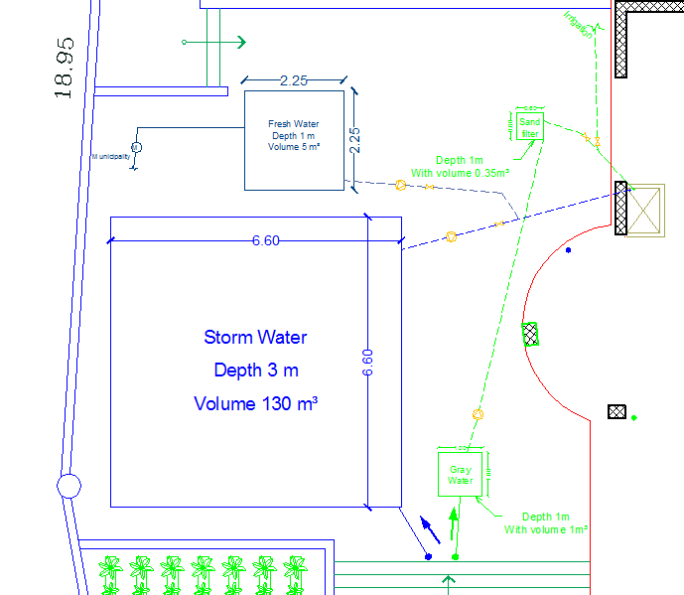
Layout of water tanks

Slide 52
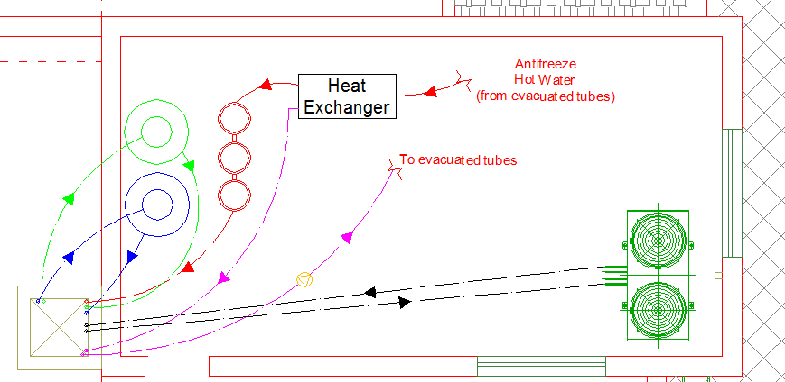
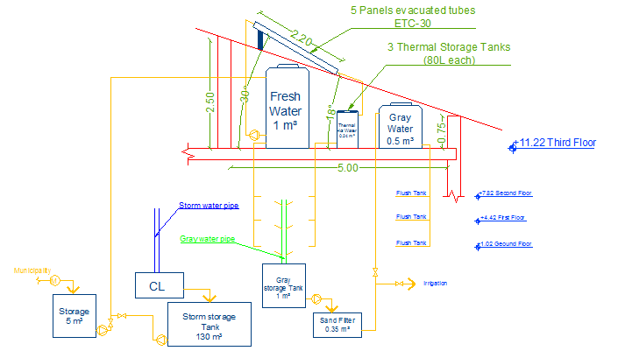
System of distribution of water

Slide 53
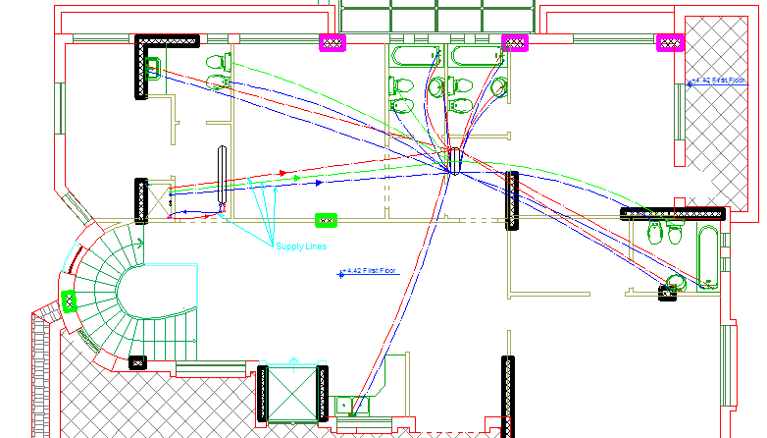
System of distribution of water

Slide 54
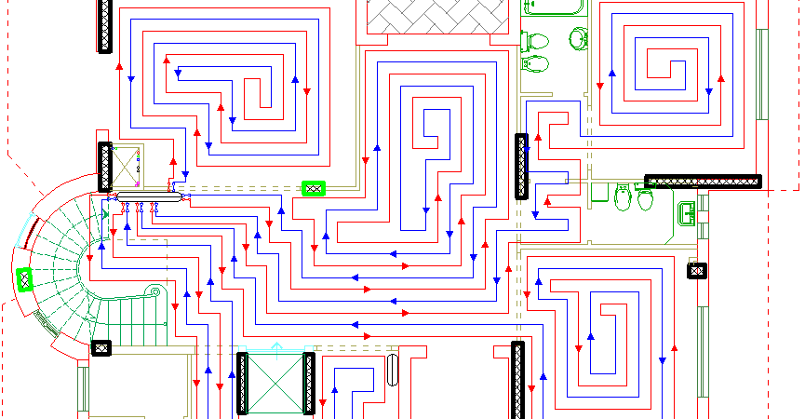
Under Floor Heating

Slide 55
VRF System
Story | Zone | Max Design Capacity (BTU/h) | Ton Refrigerator (TR) | Capacity of indoor unit (TR)
Ground floor | Living | 4436.9 | 0.37 | 0.5
 | Bed (guest) | 4095.6 | 0.34 | 0.5
 | Dining | 4436.9 | 0.37 | 0.5
 | Sitting | 2969.3 | 0.25 | 0.5
 | Kitchen | 4163.8 | 0.347 | 0.5
 | Guest | 3959.1 | 0.33 | 0.5
 | Dirty kitchen | 2354.9 | 0.197 | 0.5
First Floor | Bed room 1 | 4266.2 | 0.356 | 0.5
 | Living F.1 | 7201.4 | 0.60 | 1
 | Master room | 5119.5 | 0.427 | 0.5
 | Bed room 2 | 2593.9 | 0.216 | 0.5
 | Study room | 3139.9 | 0.262 | 0.5
Second Floor | Kitchenette | 8941.9 | 0.745 | 1
 | Living F.2 | 7883.9 | 0.66 | 1
Sum. |  |  |  | 8.5 (TR)

Slide 56
Acoustical Design
STC
Layers | Modifications | STC (dB)
Dense Hollow Block 10 cm |  | 38
 | Adding plaster on both sides | +4
 | Adding sand to cores of hollow block | +3
 | Adding two improvements | +2
Total |  | 47dB

Slide 57
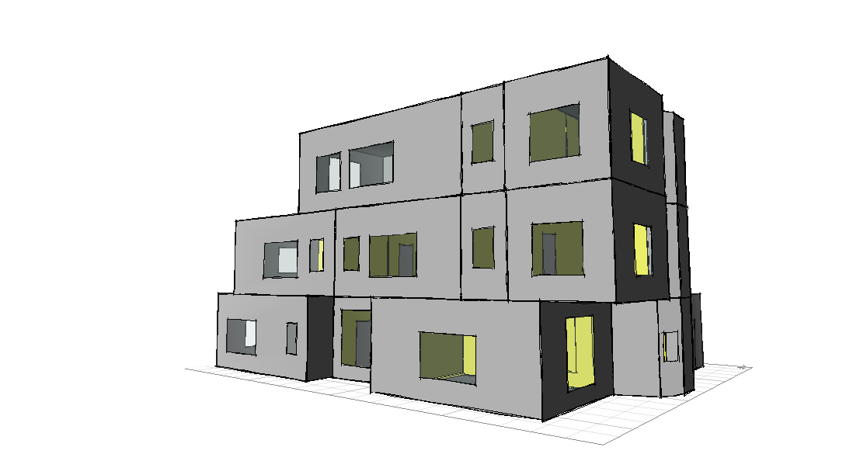
Modeling

Slide 58

Photovoltaic System

Slide 59
Photovoltaic System
 | E Grid (kWh)
Jan | 1212.92
Feb | 1124.65
Mar | 1503.13
Apr | 1579.5
May | 1724.74
Jun | 1765.17
Jul | 1824.74
Aug | 1808.11
Sep | 1795.8
Oct | 1775.21
Nov | 1442.08
Dec | 1205.99
Year (kWh) | 18762
21570 kWh total consumption energy
85% can be covered

Slide 60

Electrical Design

Slide 61
Artificial Lighting
Type of room | Level of illuminance needed ( lux)
Stairs | 150
Entrances, landings ,halls, balconies | 100-150
Kitchen | General 150-200
Bathroom | General 100-200
Laundry room | 300-400
Bedroom | General 100-200
Studies/library | General 100-400
Living room | General 100-200
Guest room | 100-200
Dining room | 100-200
Storage room | 150

Slide 62

Motion Sensors

Slide 63

Artificial Lighting

Slide 64
Sockets
Floor | Number of socket 2 Amp | Number of socket 10 Amp | Number of branches (3Ø2.5 mm²)
G.F | 22 | 2 | 7
F.1 | 19 | 2 | 6
F.3 | 5 | 3 | 3
Roof | -- | 4 | 2

Slide 65

Sockets

Slide 66

Branches

Slide 67




Fire and Alarm System

Slide 68

Fire and Alarm System

Slide 69
Quantity Survey
 | Total Cost ($) | Unit cost ($/m²)
Excavation works | 48198.3 | 59.5
Civil works | 129620.7 | 160
Architectural works | 295348.6 | 364.6
Mechanical works | 37675 | 46.5
Electrical works | 31225.2 | 38.55
Total Cost | $ 542067.73 | $ 609

Slide 70
THANK
YOU

